Slide 1
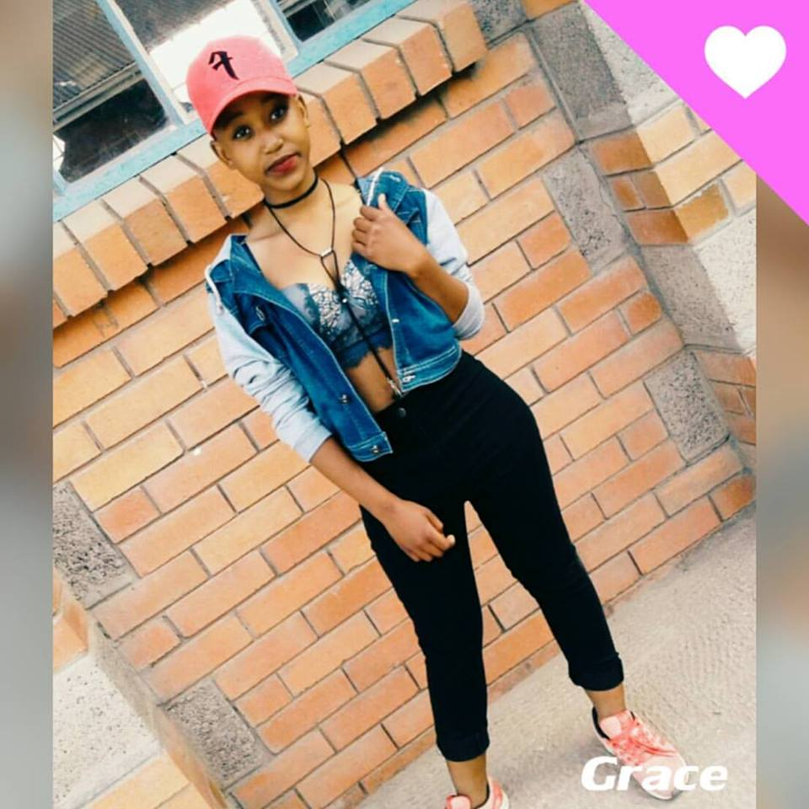


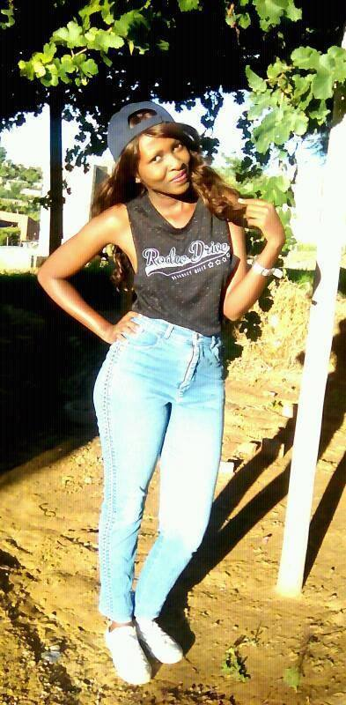
Girl motivation in INFORMATION
TECHNOLOGY

