Slide 1
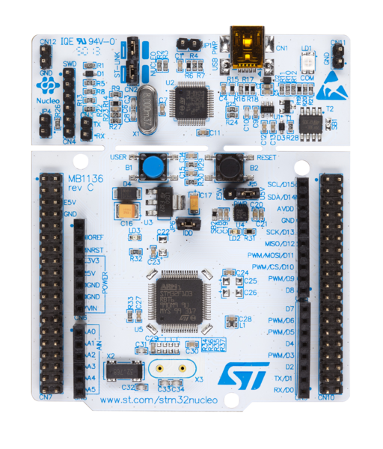
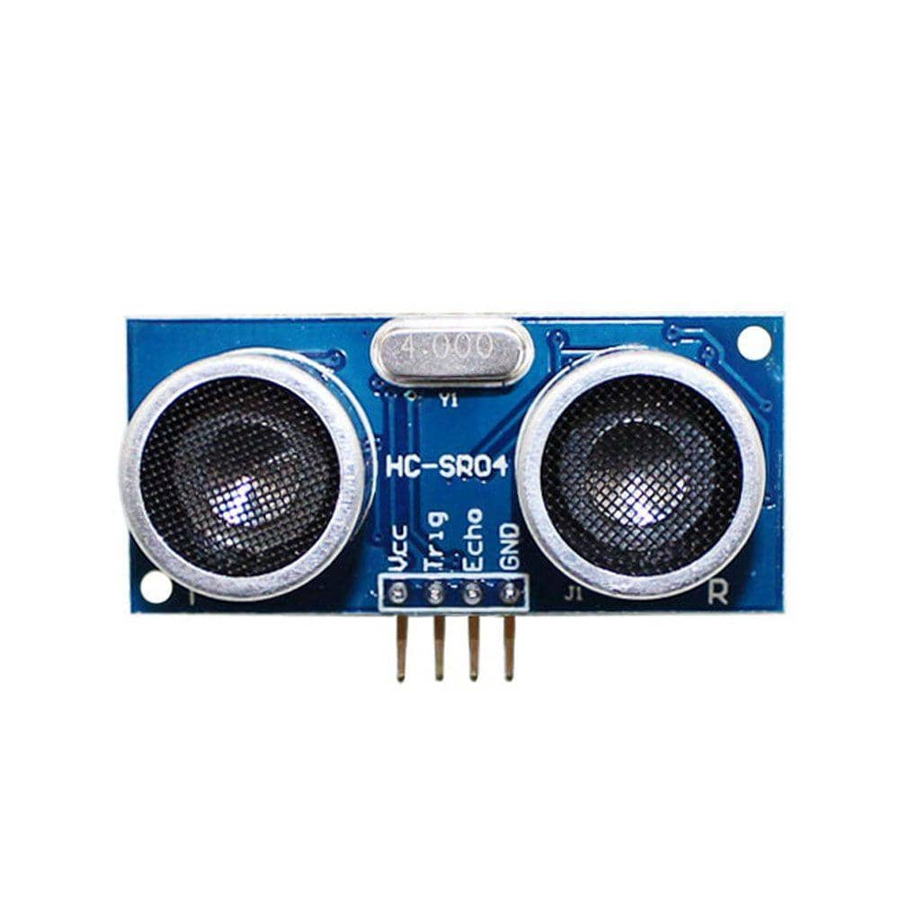
HC-SR04
PA6
VCC 5V
PB6
GND

Slide 2

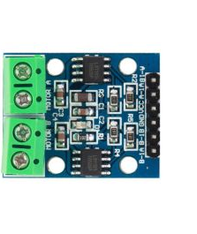
DC Motor
DC Motor Driver
VCC
GND
PA0
PC0

Slide 3
Phase | Port_Pin | Sequence
 |  | 1 | 2 | 3 | 4
A | PB_10 | H | L | L | H
B | PB_4 | H | H | L | L
A’ | PB_5 | L | H | H | L
B’ | PB_3 | L | L | H | H

Slide 4
Phase | Port_Pin | Sequence
 |  | 1 | 2 | 3 | 4 | 5 | 6 | 7 | 8
A | PB_10 | H | H | 0 | L | L | L | 0 | H
B | PB_4 | 0 | H | H | H | 0 | L | L | L
A’ | PB_5 | L | L | 0 | H | H | H | 0 | L
B’ | PB_3 | 0 | L | L | L | 0 | H | H | H

Slide 5
State | Next State |  | Output
 | DIR = 0 | DIR = 1 | (A B A’ B’)
S0 | S3 | S1 | HHLL
S1 | S0 | S2 | LHHL
S2 | S1 | S3 | LLHH
S3 | S2 | S0 | HLLH

Slide 6
State | Next State |  | Output
 | DIR = 0 | DIR = 1 | (A B A’ B’)
S0 | S7 | S1 | H0L0
S1 | S0 | S2 | HHLL
S2 | S1 | S3 | 0H0L
S3 | S2 | S4 | LHHL
S4 | S3 | S5 | L0H0
S5 | S4 | S6 | LLHH
S6 | S5 | S7 | 0L0H
S7 | S6 | S0 | HLLH

Slide 7
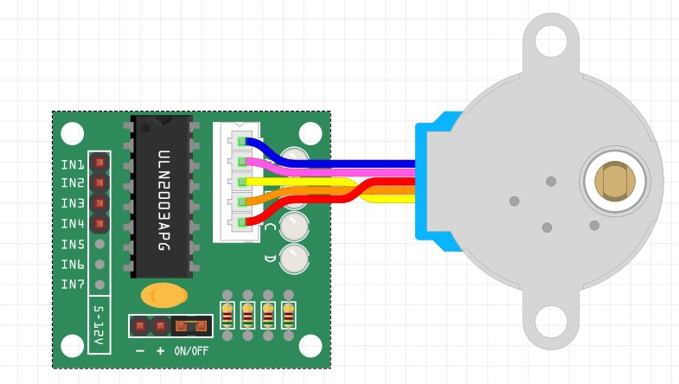
STM32 Board
VCC 5V
Stepper Motor
GND
PB10
PB4
PB5
PB3

Slide 8
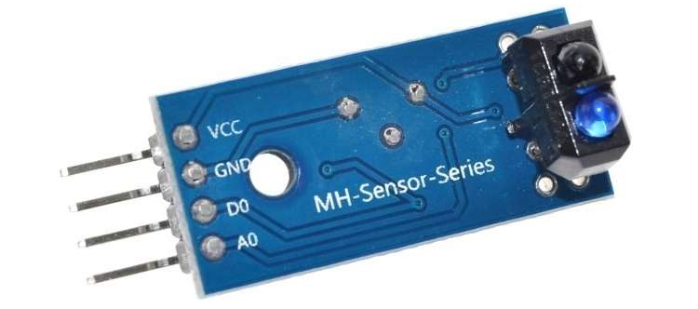
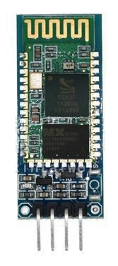
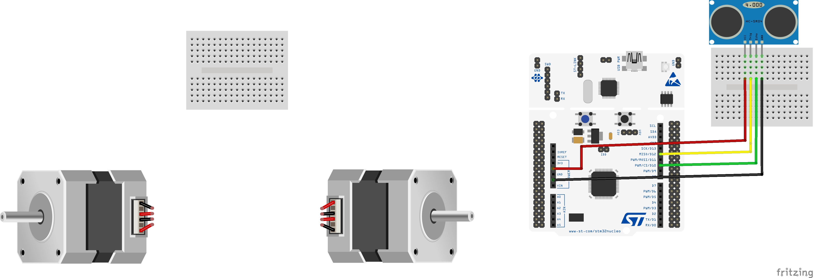
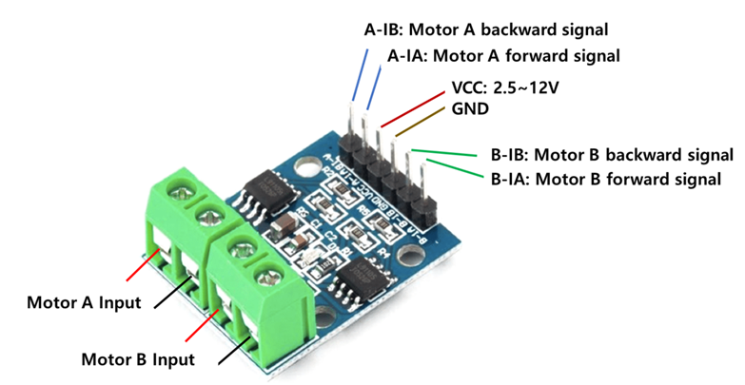
PB0
PB1
VCC
GND
PC2
VCC
PA1
PA0
PC3
PA9
VCC
PA10
PA6
PB6
GND
Connect to color

