Slide 1
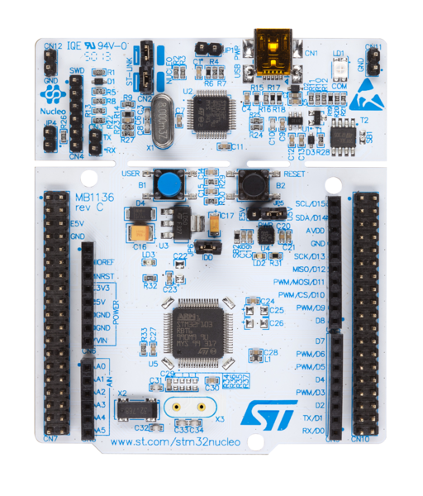
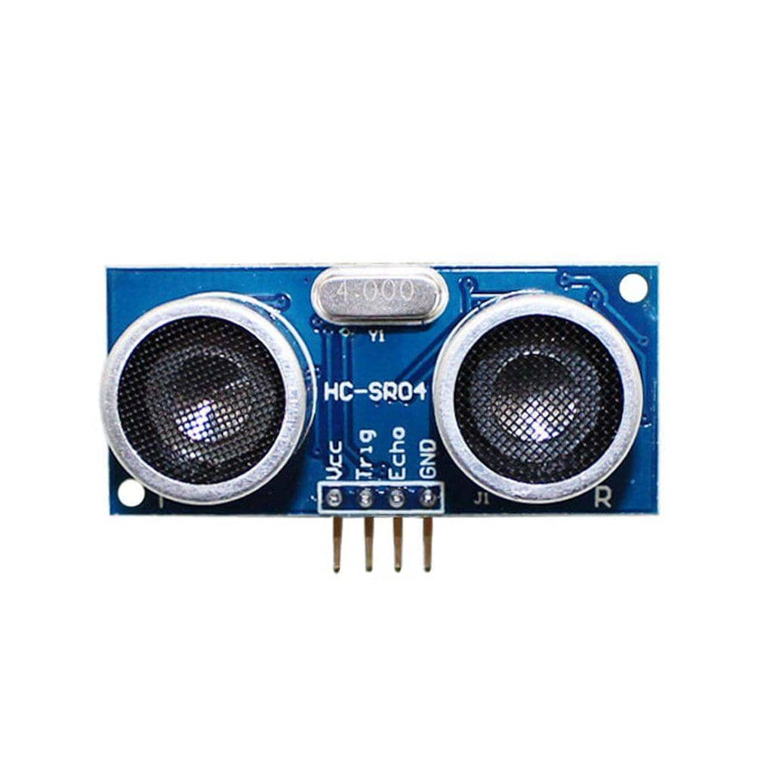
HC-SR04
PA6
VCC 5V
PB6
GND

Slide 2

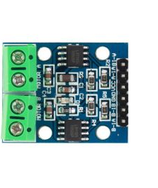
DC Motor
DC Motor Driver
VCC
GND
PA0
PC0

