Slide 1
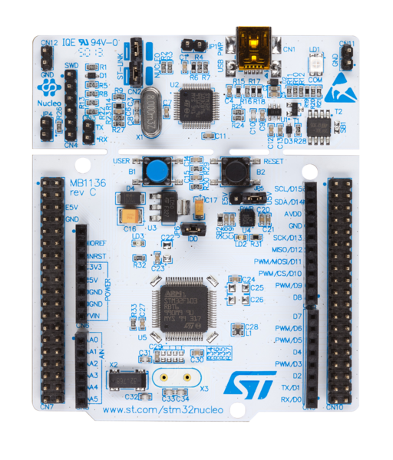
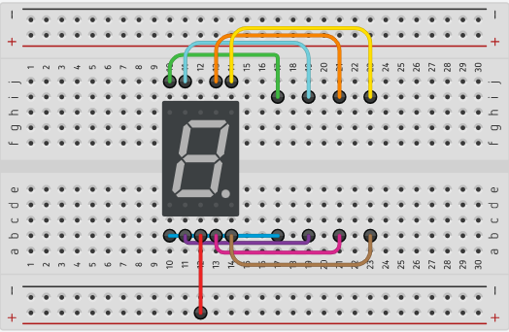
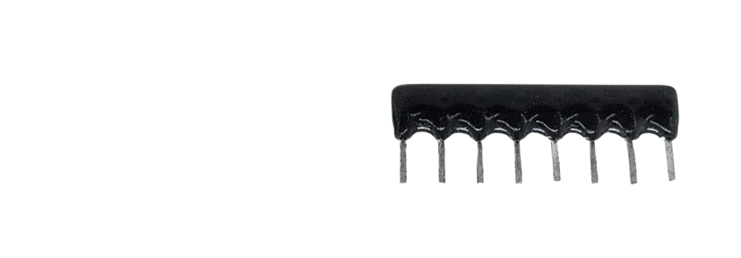
PC7
PA9
PA8
PB10
PA5
PA6
PA7
PB6
PC7
PA9
PA8
PB10
PA5
PA6
PA7
PB6
VCC +5V

Slide 2
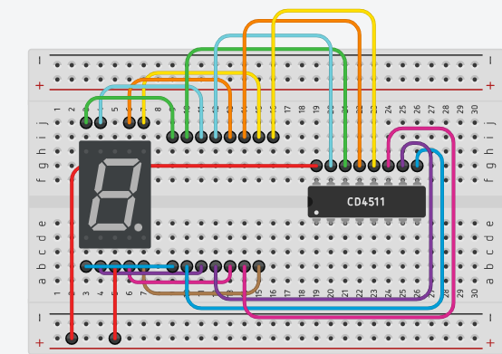
VCC +5V
PA7
PB6
PC7
PA9
GND

