Slide 1


LOAN PORTFOLIO PERFORMANCE AND CREDIT RISK ANALYSIS
PRESENTED BY: OLUNUMELU GRACE
TECHCRUSH DATA ANALYTICS BOOTCAMP
COHORT 7 CAPSTONE PROJECT
SECTOR: INSURANCE, BANKING AND FINANCE

Slide 2
Executive Summary
Project Overview
This project analyzed a financial loan dataset obtained from Kaggle covering loan records for 2021.
It Evaluated overall loan portfolio performance and explored customer characteristics, loan attributes, geographic credit risk, income verification effectiveness, and estimated financial losses resulting from defaults
Methodology
Cleaned and transformed data using Excel, SQL, Power Query, and DAX.
Built an interactive Power BI dashboard for analysis.
Business Impact
The findings provide data-driven recommendations that can support improved lending decisions, stronger credit risk management, and enhanced portfolio profitability.

Slide 3

Project Context
INTRODUCTION:
Project Objectives, Business questions, KPIs/key metrics
This project analyzes a 2021 financial loan dataset from Kaggle to evaluate portfolio performance, identify key default drivers, and support data-driven lending decisions.
Project Objectives
Evaluate the overall performance of the loan portfolio.
Identify customer characteristics associated with higher completed loan default rates.
Identify loan characteristics associated with increased default risk.
Assess geographic variations in completed loan default rates.
Evaluate the effectiveness of income verification in reducing loan default
Develop a profile of high-risk borrowers

Slide 4

Addressing Critical Business Questions
What is the overall performance of the bank's loan portfolio?
Which customer characteristics are associated with higher completed loan default rates?
Which loan characteristics are associated with higher completed loan default rates?
Which states present the highest credit risk?
Does income verification reduce the likelihood of loan default?
What characteristics define a high-risk borrower?

Slide 5

Key Performance Indicators (KPIs) for Loan Portfolio Analysis
Volume Metrics
Repayment Metrics
Total Loans
Total Amount Repaid
Total Loan Amount
Fully Paid Loans
Risk Metrics
Financial Impact
Charged-Off Loans
Estimated Financial Loss
Current Loans
Completed Loan Default Rate

Slide 6

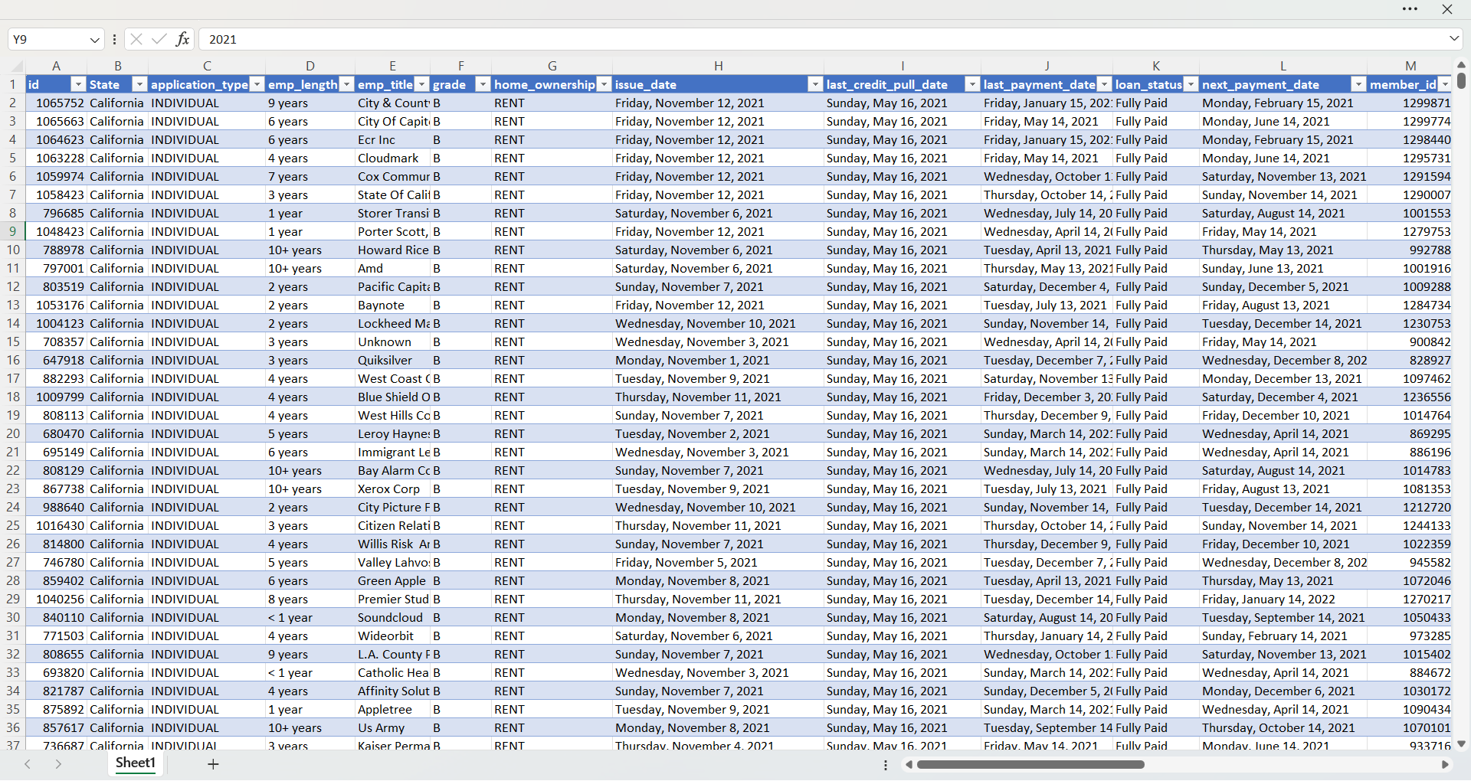
Dataset Overview: Foundation of Our Analysis
Source & Scope
Dataset Scale
Key Categories
Primary Source: Kaggle Financial Loan Dataset published by Tushar Nandanwar covering customers across all 50 US states.
Total Records: 38,576 unique loan entries
Customer: Annual Income, Employment length, Home Ownership
Fiscal Period: 2021 Financial Year
Variables: 24 original features
Loan: Amount, Rate, DTI, Grade, Purpose, Term
Context: Comprehensive loan records covering origination to performance status.
Data Formats: Mixed types including Text, Whole/Decimal numbers, and Date fields.
Performance: Status, Total Repayments
Geographic: Borrower State location

Slide 7

Data Preparation: Ensuring Quality & Readiness
ETL Process
Data Cleaning
Analytical Variables
Structured Extract, Transform, Load (ETL) workflow implemented via Power Query.
Resolved 1,433 missing values in Employment Title fields.
Created Annual Income and DTI Bands for risk segmentation.
Standardized inconsistent date formats across the 2021 financial year.
Expanded state abbreviations to full names for geographic clarity.
Segmented Loan Amounts and Interest Rates into logical bands.
Corrected data types for whole numbers, decimals, and percentages.
Grouped Employment Length to identify stability trends.
Analytical stack : Power Query | Power BI | SQL | DAX

Slide 8
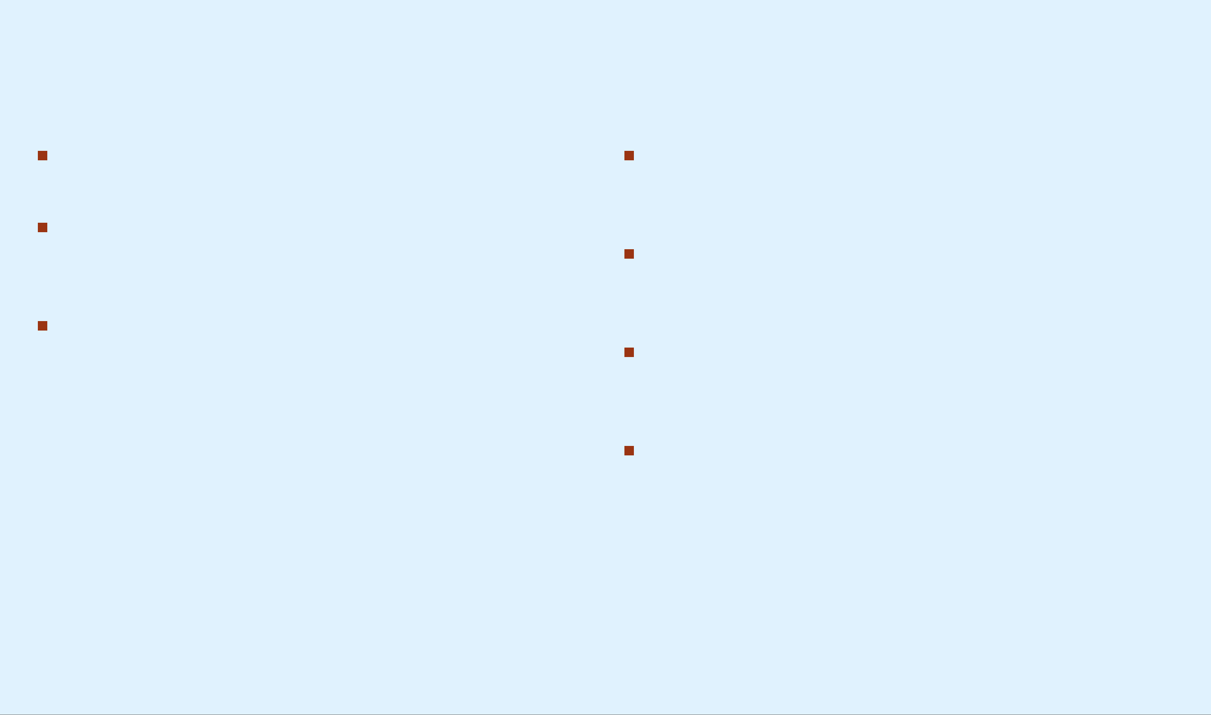
Data Analysis & Key Findings: Unveiling Portfolio Dynamics
Over all Health: The majority of loans were successfully repaid, indicating a generally healthy loan portfolio.
Loan Risk Factors: Lower credit grades, higher interest rates, larger loan amounts, and longer loan terms were associated with increased default risk.
Default Correlates: Borrowers with lower annual income and higher debt-to-income ratios exhibited higher completed loan default rates.
Purpose-Specific Risk: Certain loan purposes, particularly Small Business loans, recorded relatively higher completed default rates.
Geographic Disparities: Significant differences in completed loan default rates were observed across states, although loan volume varied considerably.
Verification Nuance: Income verification alone did not eliminate default risk, suggesting that multiple borrower and loan characteristics collectively influence loan performance.
Strategic Insight: These findings support more informed lending and credit risk management decisions through data-driven profiling.

Slide 9
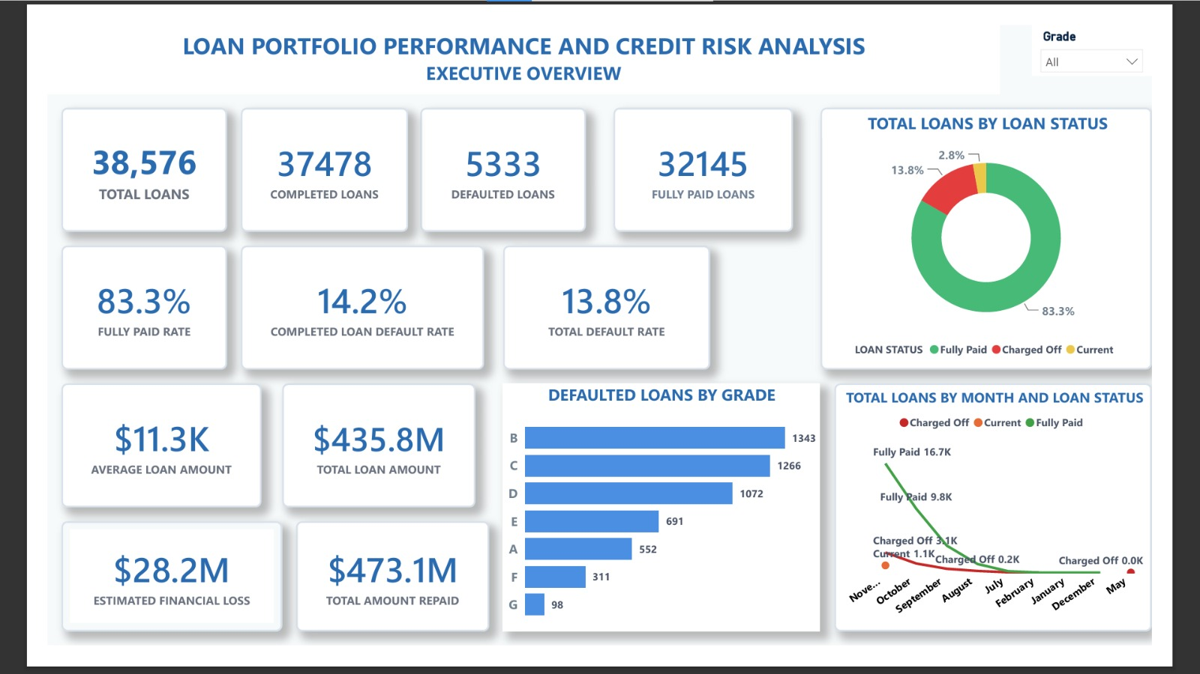
Fig 1: Showing executive overview of the bank loan portfolio performance and KPIs

Slide 10

Borrower Characteristics: Impact on Default Rates
Income & DTI Correlation: Borrowers with low annual income and very high debt-to-income ratios consistently show elevated completed loan default rates.
Predictive Capacity: Financial stability and current debt burden are the most critical predictors of a borrower's long-term repayment capacity.
Risk Segmentation: Data suggests that high-risk segments can be proactively identified by monitoring shifts in these core financial health indicators.

Slide 11
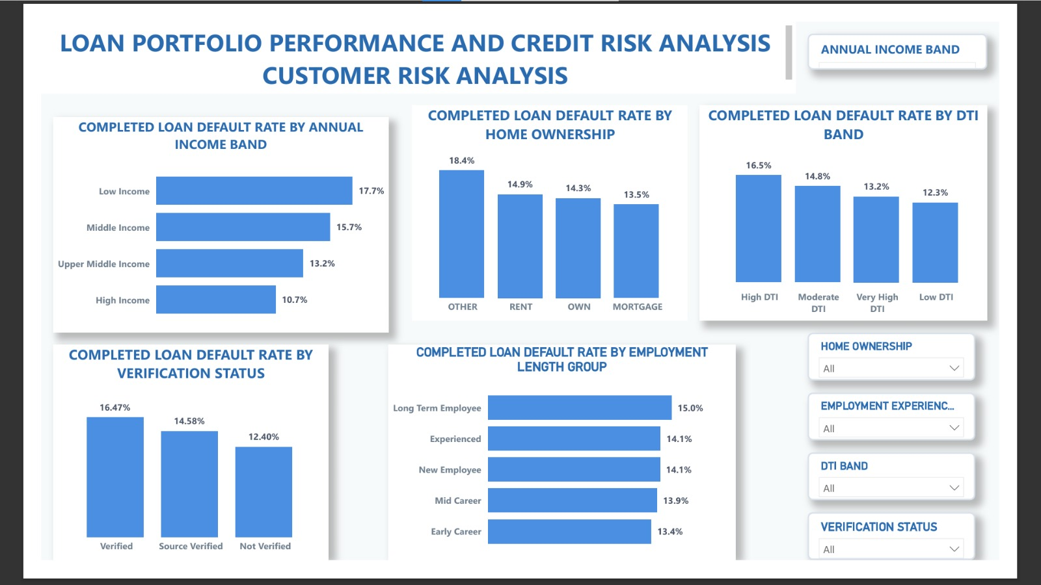
Fig 2: Showing customer risk analysis

Slide 12

Loan Characteristics: Identifying Inherent Risk Factors
Structural Risk Drivers
Terms & Purpose Impact
Credit Grade & Interest Rate: Grade G/F and very high interest rates are directly linked to increased default risk, reflecting origination-time risk assessment.
Loan Term: Longer repayment periods of 60months amplify risk exposure to default compared to that of 30months
Loan Purpose: Small Business loans exhibit relatively higher completed default rates compared to other purposes.
Loan Amount: very Large loan amounts correlate with higher default rates, as they represent a more significant financial burden on the borrower.

Slide 13
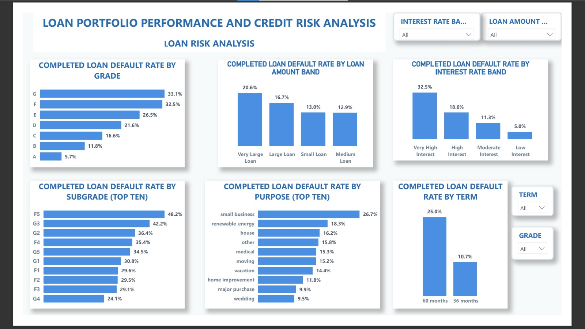
Fig 4: Showing loan risk analysis

Slide 14

Geographic Credit Risk: State-Level Variations
Regional Disparities: Significant differences in completed loan default rates are observed across various states with south Dakota having the highest default on the top ten ranking.
Volume vs. Rate: It is critical to analyze default rates in conjunction with loan volumes to avoid skewed risk perceptions in low-volume regions.
Economic Drivers: Variations may likely stem from local economic conditions, employment trends, and regional demographic profiles.

Slide 15
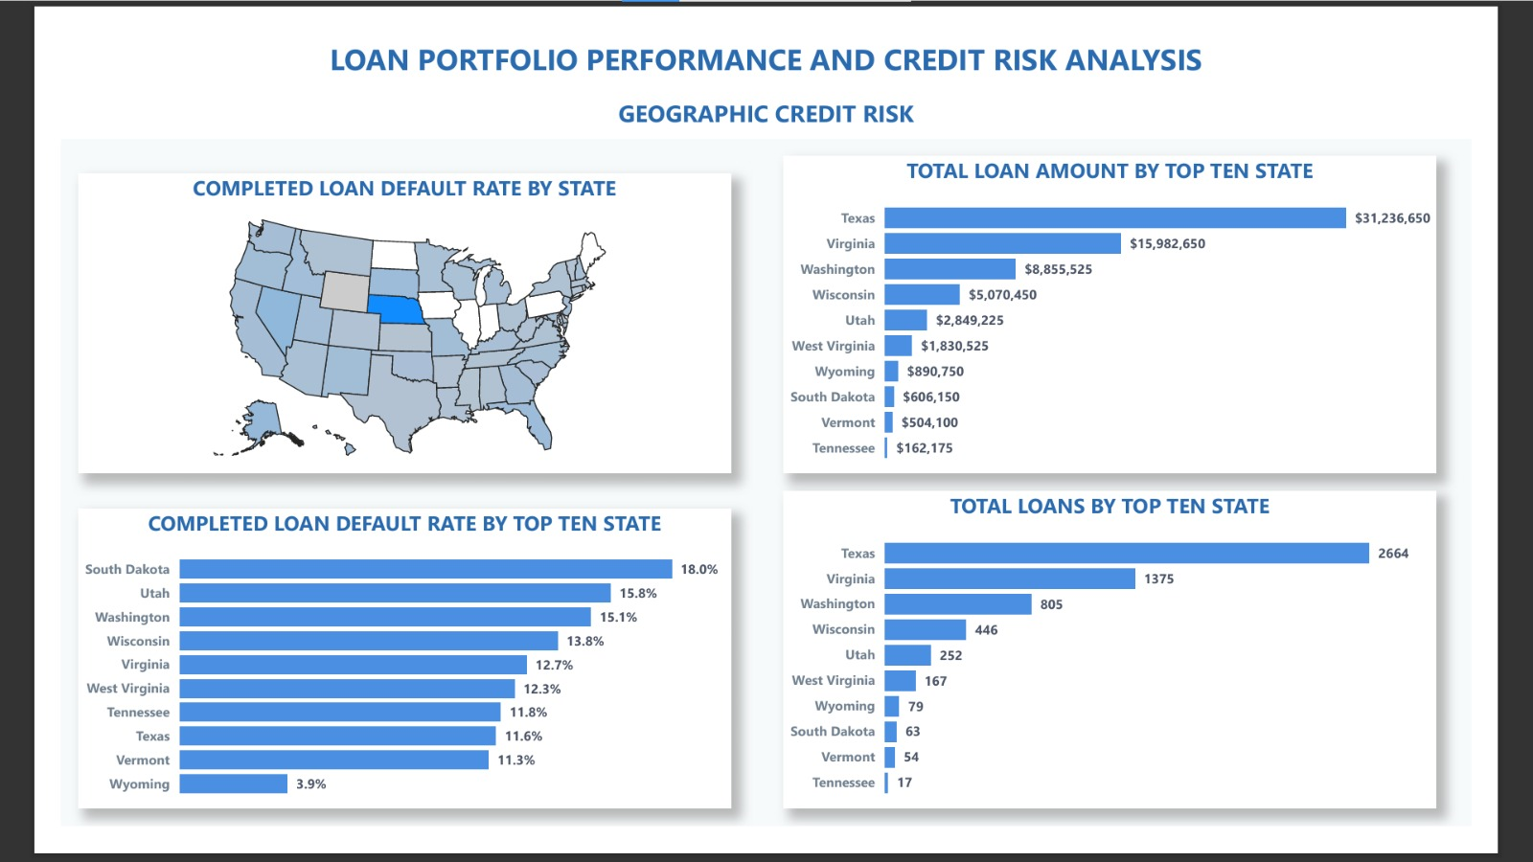
Fig 4 : Showing the Geographic risk analysis

Slide 16

Income Verification: A Component, Not a Panacea
Verification Effectiveness: While income verification contributes to risk assessment, it does not eliminate default risk. Verified borrowers recorded a higher default rate.
Holistic Assessment: Loan performance is influenced by a complex interplay of borrower and loan characteristics, requiring a multi-faceted evaluation.
Strategic Insight: Accurate risk prediction necessitates moving beyond single-factor verification to a comprehensive credit analysis framework.

Slide 17
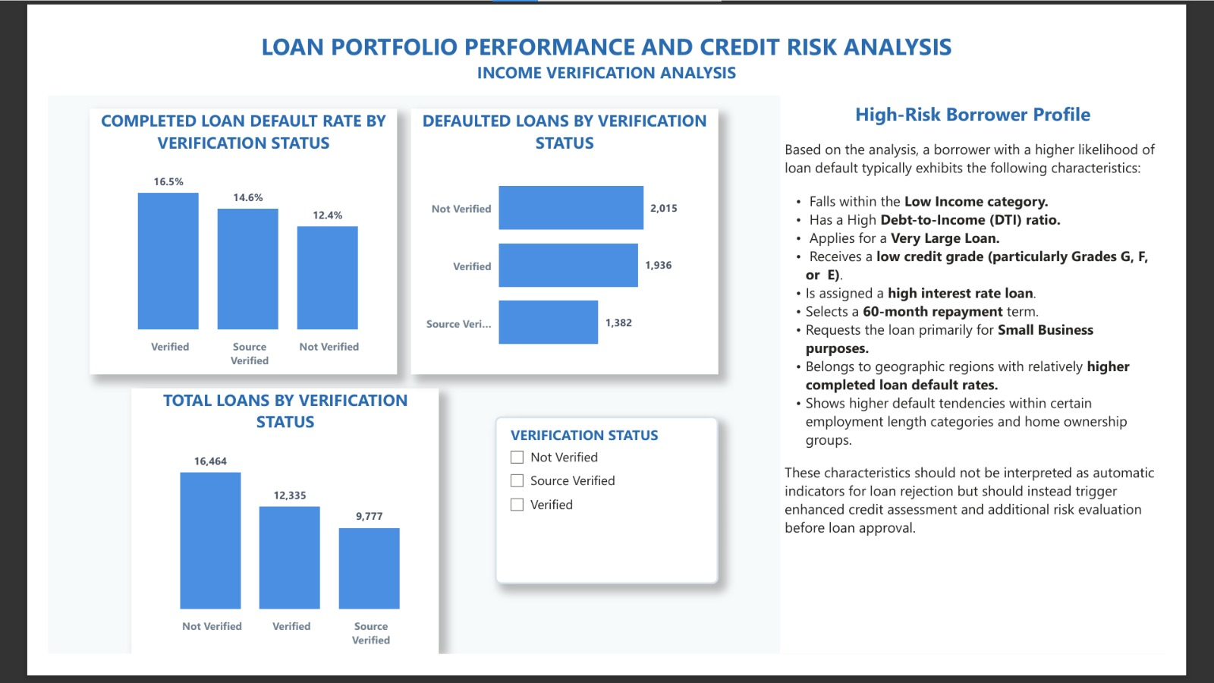
Fig 5: Showing Analysis for verification status and a high-risk borrower profile.

Slide 18

Power BI Dashboard Overview: Interactive Insights
Page 1: Executive Overview
High-level summary of portfolio performance using KPIs and loan status distribution.
Page 2: Customer Risk Analysis
Examines borrower characteristics (income, DTI, employment, home ownership, and verification) influencing default rates.
Page 3: Loan Risk Analysis
Analyzes relationship between loan attributes (grade, interest rate, amount, DTI, purpose and term) and default risk.
Page 4: Geographic Credit Risk
Identifies high-risk states and compares regional lending performance metrics.
Page 5: Income Verification Analysis
Evaluates the effectiveness of income verification in reducing loan default rates.

Slide 19

Strategic Recommendations Based on insights: Strengthening Lending Practices
Enhanced Credit Assessment
Targeted Product Monitoring
Implement more robust credit assessment and additional risk evaluation for borrowers with characteristics associated with higher default tendencies.
Increase scrutiny and monitoring frequency for high-risk loan products and emerging lending patterns.
Encourage Repayment Terms
Proactive Geographic Tracking
Encourage and structure appropriate, sustainable repayment terms to align with borrower cash flow capacity.
Improve continuous monitoring of geographic credit risk to identify regional economic shifts early.
Capacity Assesment
BI-Driven Insights
Continuously strengthen internal assessments of borrower affordability and long-term repayment capacity.
Leverage business intelligence dashboards for real-time portfolio monitoring and data-driven decision making.

Slide 20

Limitations of the Analysis
Temporal Scope: The analysis is restricted to the 2021 financial year dataset, which may not reflect long-term cyclical trends.
Volume Variance: Certain states recorded high default rates despite low loan volumes, potentially leading to statistical outliers.
Macroeconomic Exclusion: External factors such as inflation, unemployment rates, and policy changes were not integrated into the dataset.
Data Granularity: Critical variables, including borrower credit scores and comprehensive credit histories, were unavailable in the source data.
Analytical Depth: The study focused on descriptive and diagnostic analytics; predictive modeling was outside the current project scope.

Slide 21
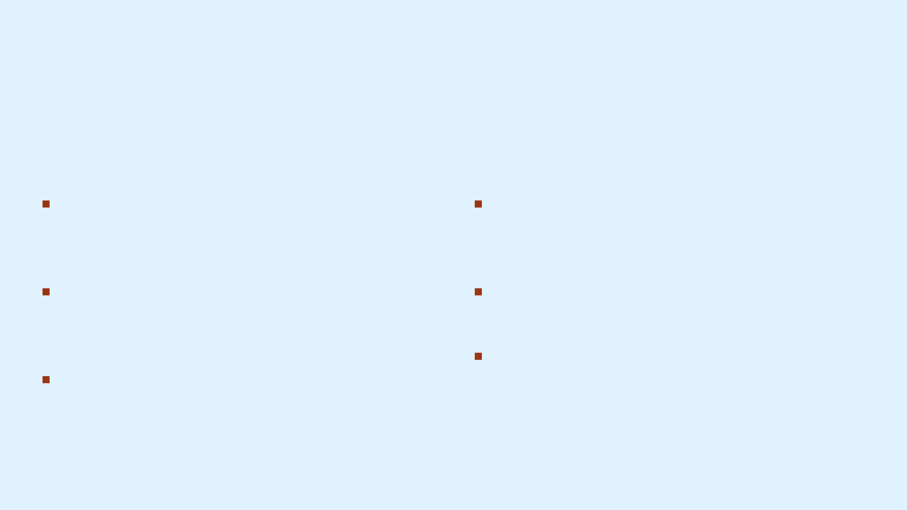
Future Work: Expanding Analytical Capabilities
Data & Scope Expansion
Advanced Analytics & Automation
Multi-Year Analysis: Expand the dataset to cover multiple years for robust long-term trend identification.
Predictive Modeling: Develop machine learning models to proactively predict loan default probabilities.
Enriched Variables: Incorporate borrower credit scores and comprehensive credit history for deeper risk profiling.
Real-Time Monitoring: Build automated dashboards for continuous, real-time portfolio management.
Economic Cycle Resilience: Compare performance across economic cycles to identify long-term portfolio stability.
Macroeconomic Integration: Integrate external indicators like inflation and unemployment rates into the risk model.

Slide 22

Thank You
We appreciate your time and attention. We are now open for any questions or further discussion regarding the Loan Portfolio and credit risk Analysis.

