Slide 2
Russel 2000 Index

Slide 3
Small Cap Index
The Russell 2000 Index is a small-cap stock market index
It indexes the bottom 2,000 stocks in the Russell 3000 Index

Slide 4
As George sees it

Slide 5
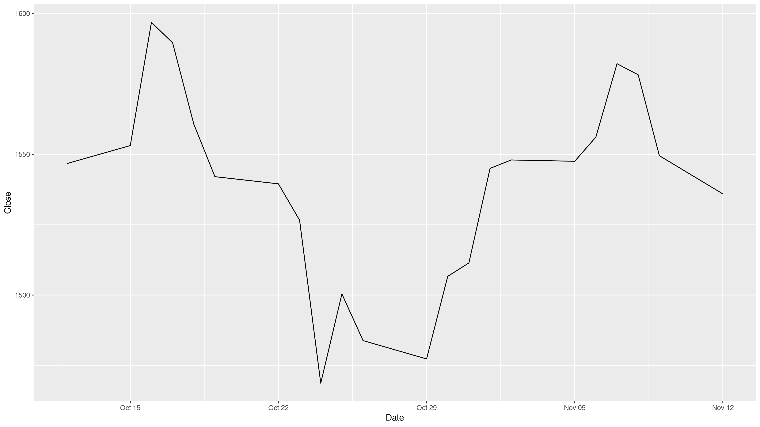
Russel 2000 plot

