Slide 1
Creating and formatting PowerPoint documents from R
using officeR package

Slide 2
Overview
OfficeR became available in mid-2017, currently on version 0.3.1
Previous option: ReporteRs, same author. Important drawback - Java requirement
Important functionalities:
Automates reporting, allows using MS templates
Lets the user format any complex table
Incorporates editable vector graphics

Slide 3
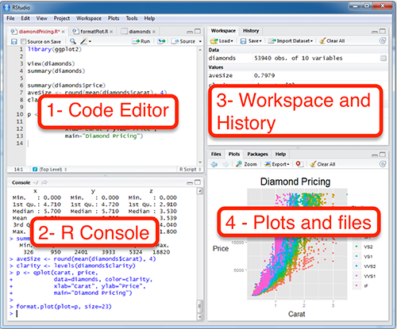
Getting Started
- Install R
- [Install R Studio]
- Install and load the package:
install.packages('officer') library(officer) # Package `magrittr` makes # officer usage easier library(magrittr)

Slide 4
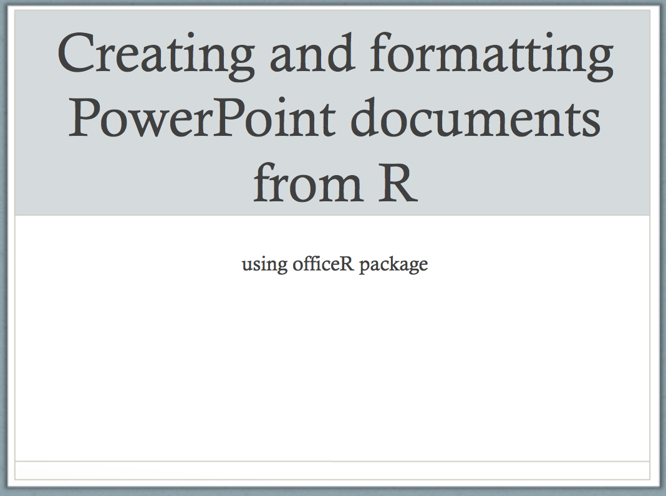
Generating Title Slide
officeR_example <- read_pptx("blank.pptx")
## Title slide officeR_example <- add_slide(officeR_example, layout='Title Slide', master='Capital') officeR_example <- ph_with_text(officeR_example, type = 'ctrTitle', str = 'Creating and formatting PowerPoint documents from R') officeR_example <- ph_with_text(officeR_example, type = 'subTitle', str = 'using officeR package')

Slide 5
Title Slide Using Piping
library(magrittr)
officeR_example <- officeR_example %>% add_slide(layout='Title Slide', master='Capital') %>% ph_with_text(type = 'ctrTitle', str = 'Creating and formatting PowerPoint documents from R') %>% ph_with_text(type = 'subTitle', str = 'using officeR package')

Slide 6
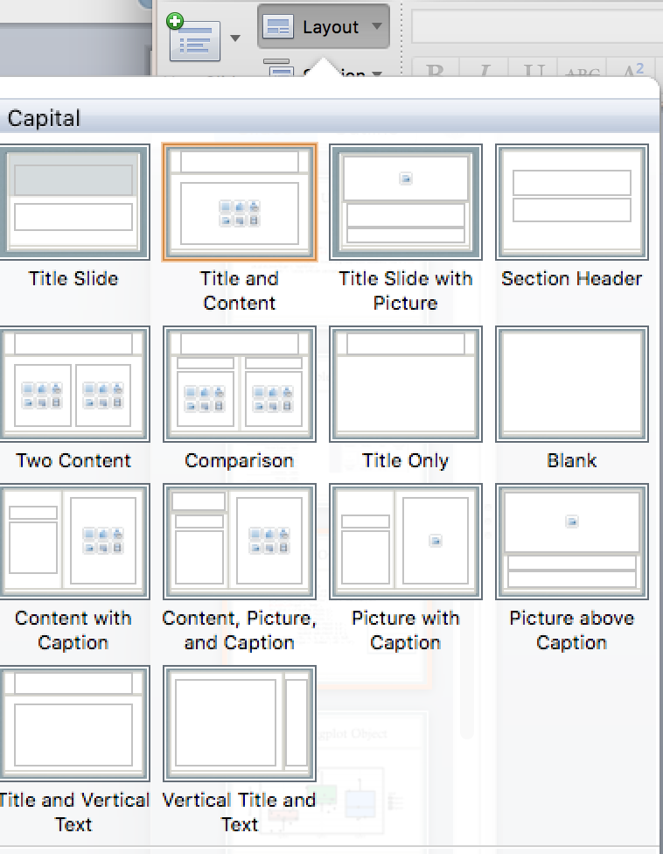
Available layouts
layout | master
Title Slide | Capital
Content, Picture, and Caption | Capital
Picture with Caption | Capital
Picture above Caption | Capital
Title and Vertical Text | Capital
Vertical Title and Text | Capital
Title and Content | Capital
Title Slide with Picture | Capital
Section Header | Capital
Two Content | Capital
Comparison | Capital
Title Only | Capital
Blank | Capital
Content with Caption | Capital

Slide 7
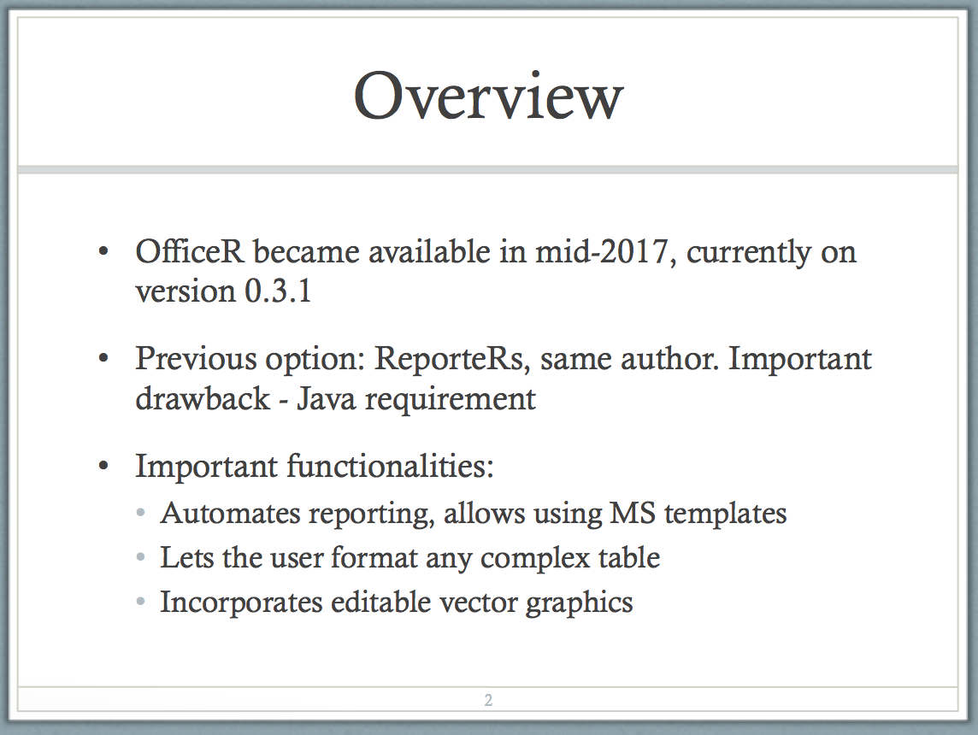
Generating Overview Slide
officeR_example <- officeR_example %>% add_slide(layout='Title and Content', master='Capital') %>% ph_with_text(type = 'title', str = 'Overview') %>% ph_with_ul(type = 'body', str_list = c('Bullet Point 1', 'Bullet Point 2', 'Bullet Point 3', 'Bullet Sub-Point 3.1', 'Bullet Sub-Point 3.2', 'Bullet Sub-Point 3.3'), level_list = c(1, 1, 1, 2, 2, 2)) %>% ph_with_text(type = 'sldNum', str = '2')

Slide 8
Adding ggplot Object
Mileage by Gear Number
35
30
25
gear
Miles per Gallon
3gears
4gears
20
5gears
15
10
3gears
4gears
5gears

Slide 9
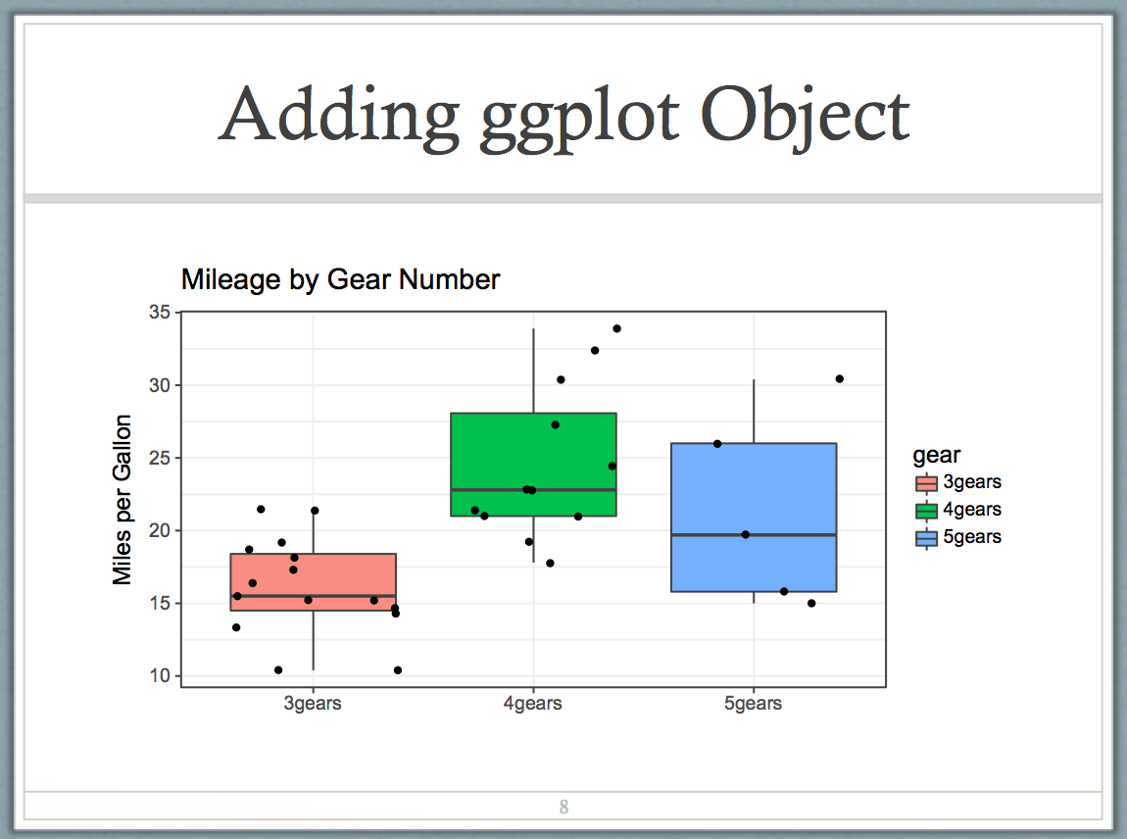
Code for Adding ggplot Object
# Create a my_gg_plot object first using my_gg_plot = ggplot([...]) officeR_example <- officeR_example %>% add_slide(layout='Title and Content', master='Capital') %>% ph_with_text(type = 'title',
str = 'Adding ggplot Object') %>% ph_with_vg(code = print(my_gg_plot), type = 'body')

Slide 10
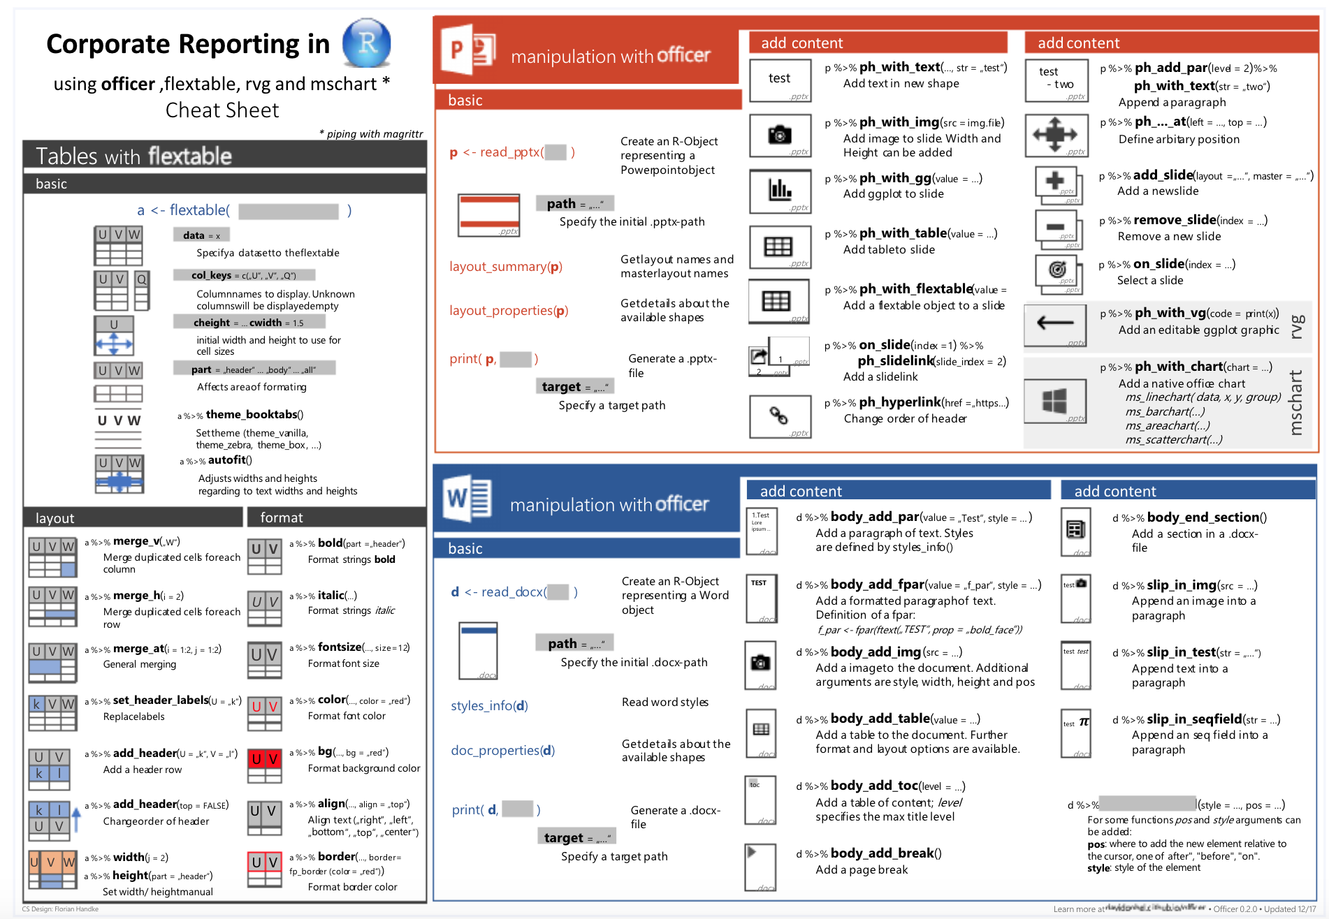
officeR Cheat Sheet

