Slide 2
Advantages of a Bear Market
Yes there is a positive side to a Bear Market!

Slide 3
Investing in Stocks
1. Represents ownership in a firm
2. Earn a return in two ways
Price of the stock rises over time
Dividends are paid to the stockholder
3. Stockholders have claim on all assets
4. Right to vote for directors and on certain issues
5. Two types
Common stock
Right to vote
Receive dividends
Preferred stock
Receive a fixed dividend
Do not usually vote

Slide 4
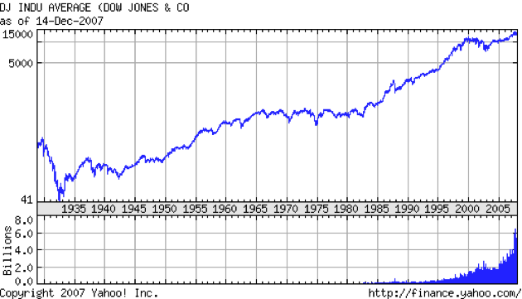
As George sees it

Slide 5
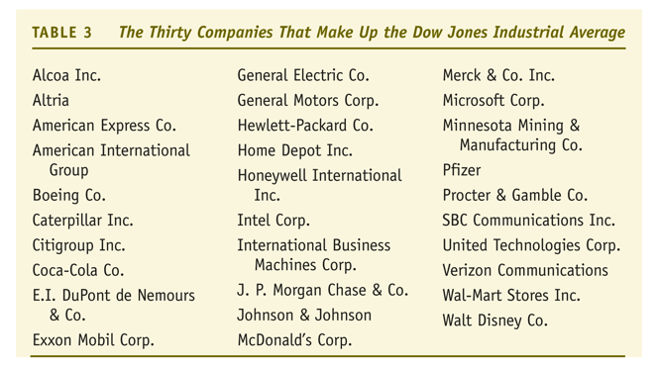
As George sees it

Slide 6
What is a Bear Market?

Slide 7
Stock Market Indexes: the Dow Jones Industrial Average

