Slide 2
Russel 2000 Index

Slide 3
Russel 2000 Index

Slide 4
As George sees it

Slide 5
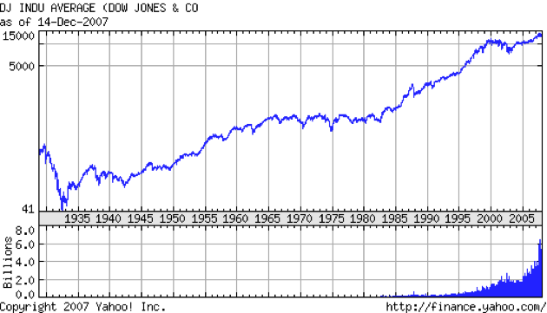
As George sees it

Slide 6
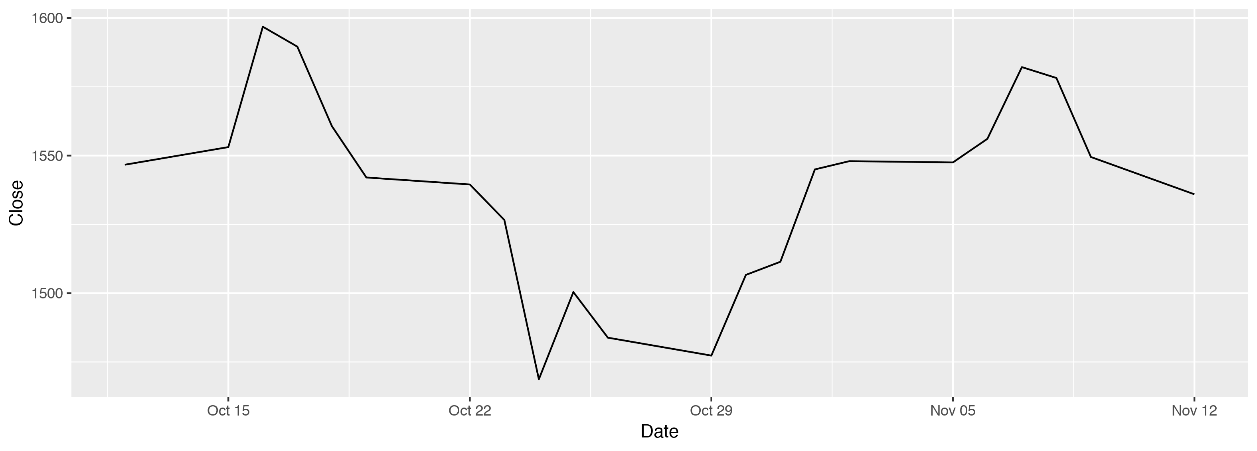
Russel 2000 plot

