Slide 1

Project 1: Asset Analysis
2023-2024 ASU FinTech Bootcamp
Grace Mwangi
&
Tyler Johnson

Slide 2

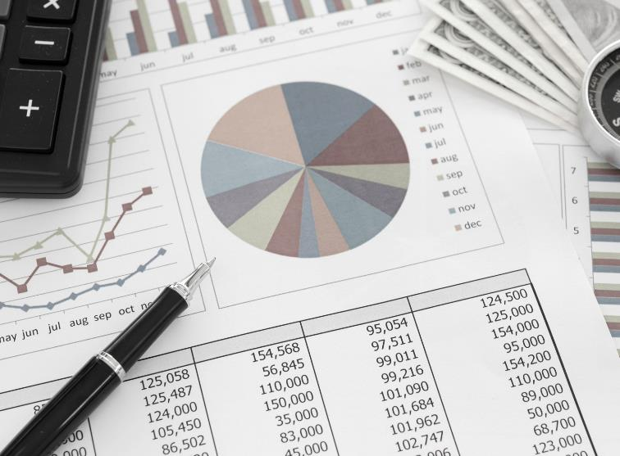
Summary/Overview
The goal of our project was to analyze data for various assets over the past 15 years and calculate the historical risk and returns of these assets. We analyzed 10 assets within 5 different asset classes; we acquired the data, analyzed it, and created visualizations to help us compare the risk and returns. This analysis will allow us to better advise clients on how to invest their money based on their age, risk tolerance, and investment goals.

Slide 3
Assets We Chose To Analyze
Equities:
1. S&P 500 (Large cap companies) – SPX
2. S&P 400 MidCap Index (Mid cap companies) – MID
3. S&P SmallCap 600 (Small cap companies) – SML
4. Nasdaq Composite (Technology sector) – COMP
Bonds:
5. 10 Year Treasury Rate
6. iShares High Yield Corporate Bond ETF – HYG
Commodities:
7. Gold
8. Silver
Real Estate:
9. S&P 500 Real Estate Sector Index
Cryptocurrency:
10. Bitcoin

Slide 4
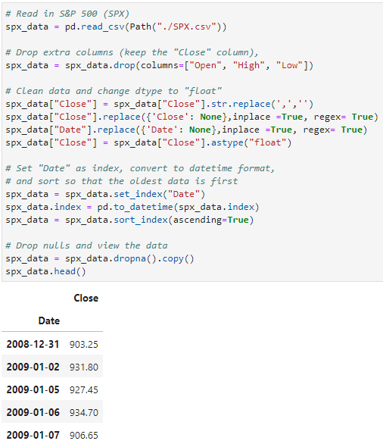
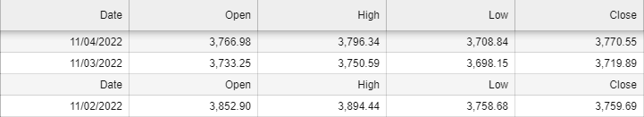
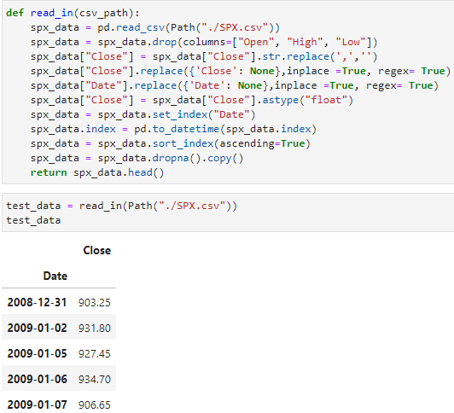
Data Collection and Cleanup
Step 1: Find the data (https://www.marketwatch.com/)
Function We Attempted To Use:
Step 2: Concat the CSV files for each asset (cat *.csv > combined.csv)
Step 3: Read in the CSV files
Step 4: Clean/reformat the data
Step 5: Create a function to limit code and use DRY (don’t repeat yourself) principles

Slide 5
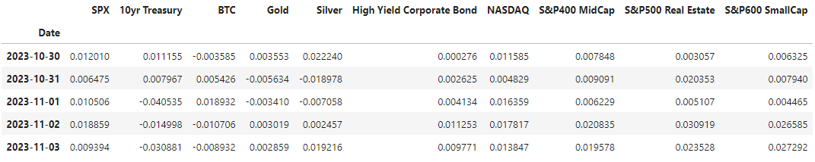
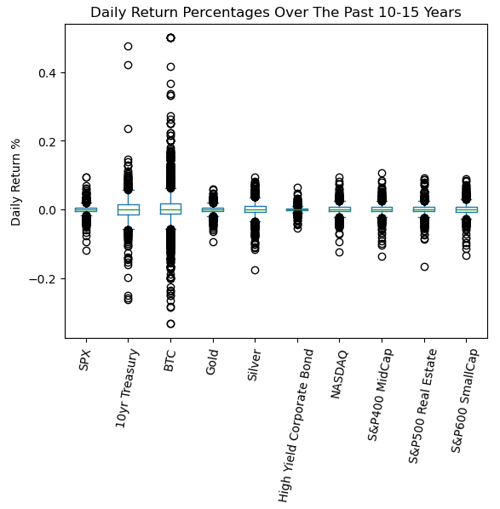
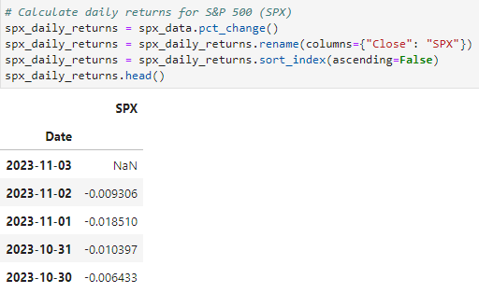
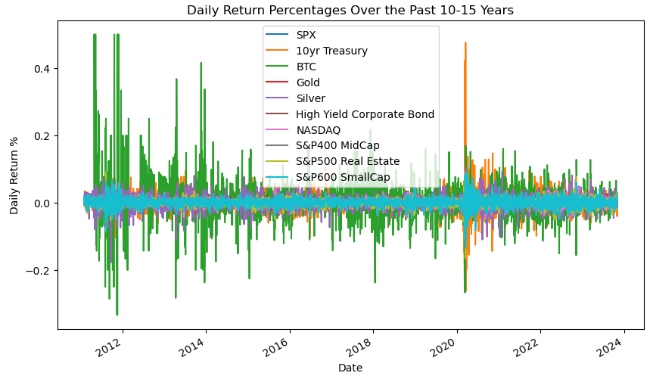
Daily Returns

Slide 6
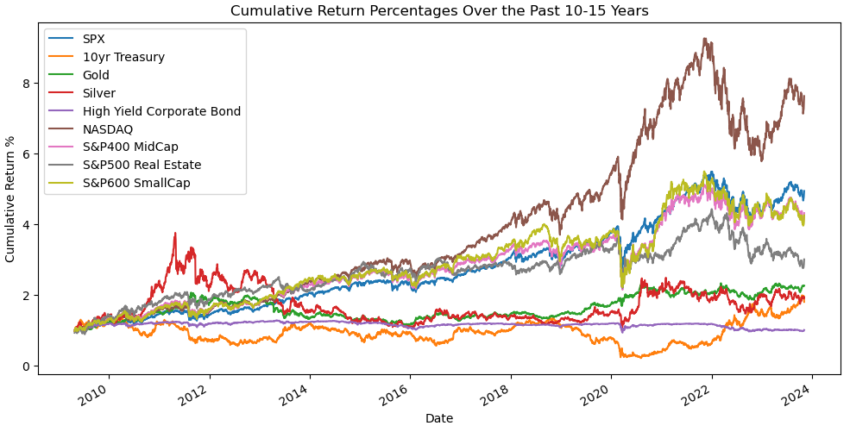
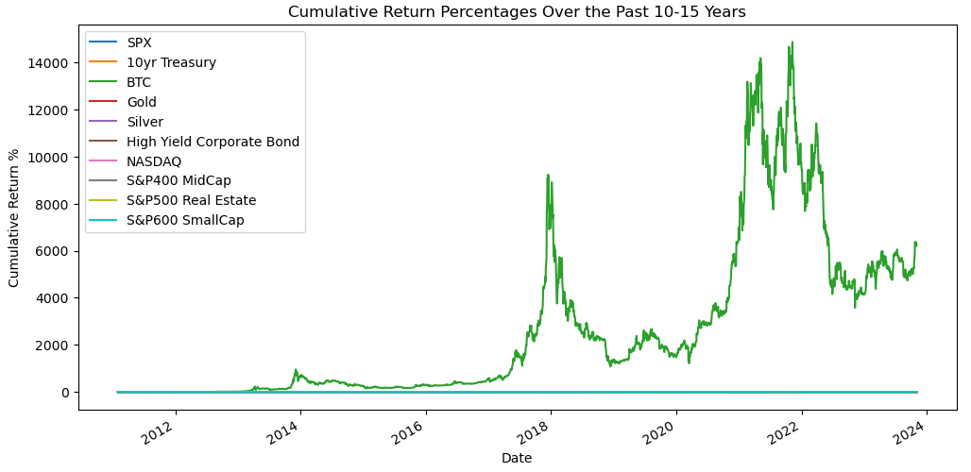
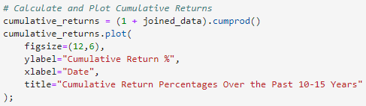
Cumulative Returns
Without Bitcoin:
With Bitcoin:
Code for Cumulative Return:

Slide 7
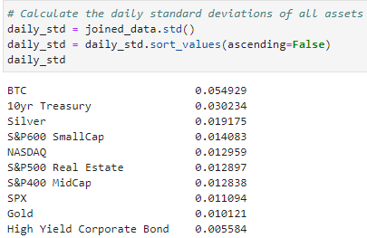
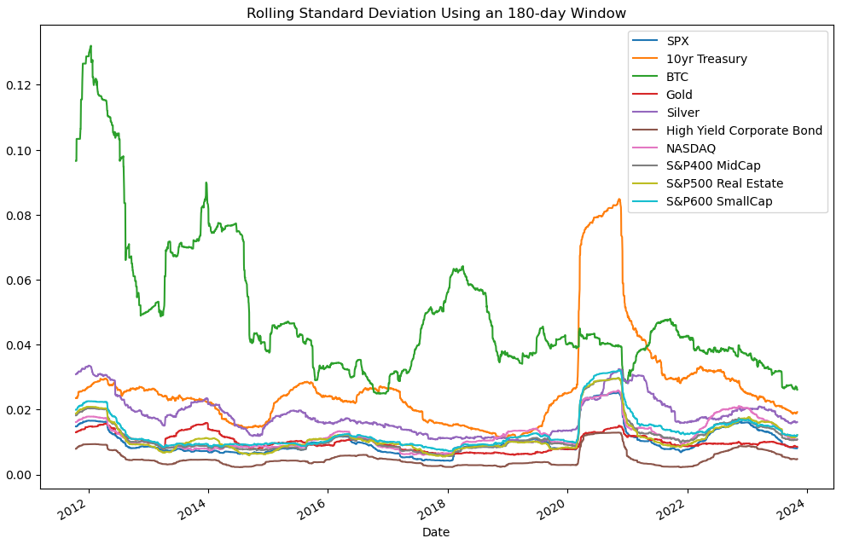
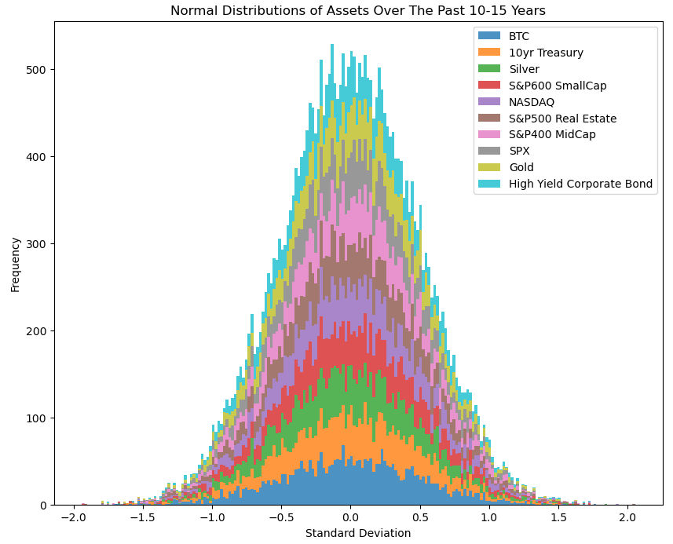
Risk Analysis
Daily Standard Deviations:
180-day Rolling STD:
Normal Distribution:

Slide 8
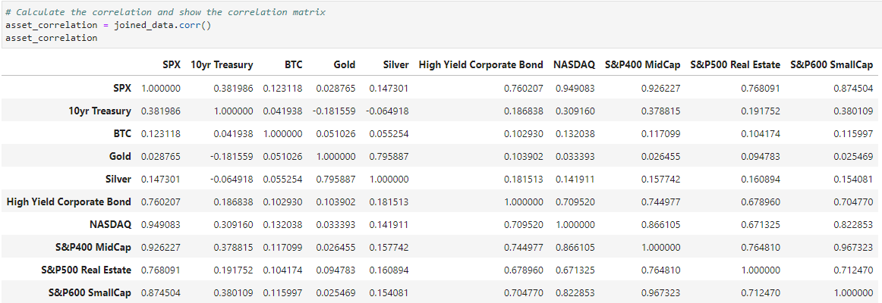
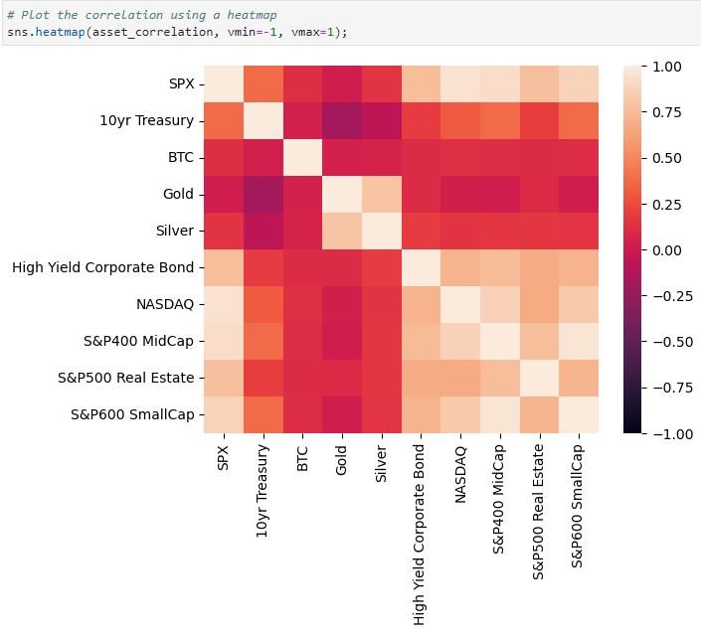




Correlation

Slide 9
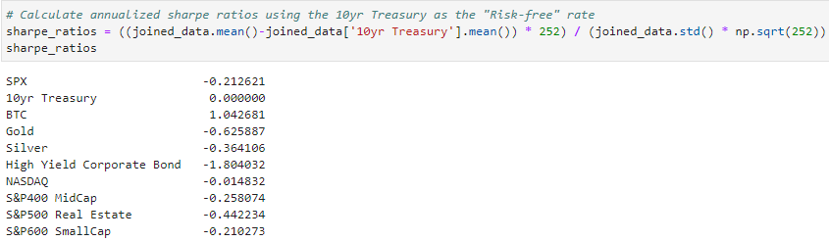
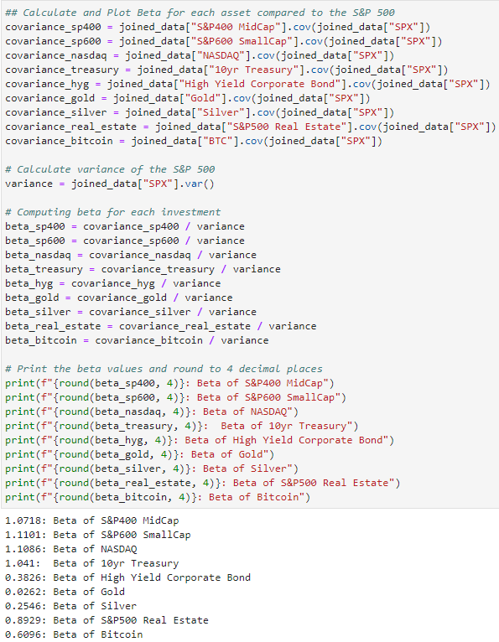
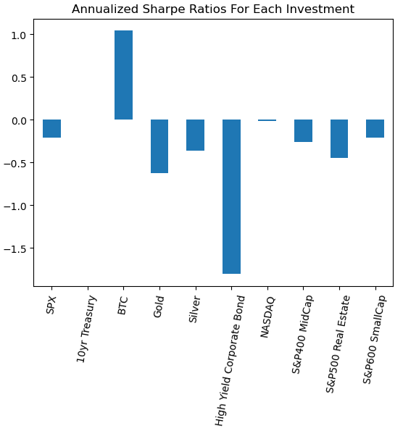
Beta
Sharpe Ratios

Slide 10

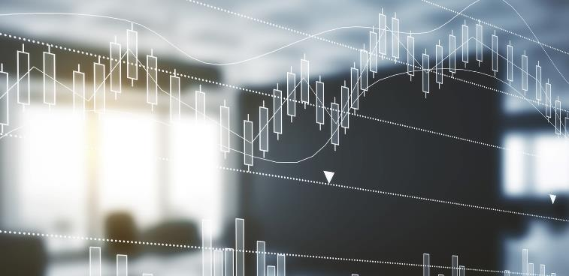

Results and Future Development
Bitcoin’s cumulative returns are over 6000% during the period analyzed, and the next highest is the NASDAQ around 8%.
Bitcoin clearly has the highest standard deviation, but it was surprising that the 10yr Treasury (“risk-free rate”) had the next highest standard deviation.
The only assets that had a negative correlation were the 10yr Treasury and Gold and the 10yr Treasury and Silver.
Bitcoin is the only asset analyzed that has a positive Sharpe Ratio (risk-adjusted return).
We will use this data to perform Monte Carlo simulations in the future, weighting portfolios based on different risk tolerances.

Slide 11


THANK YOU
Any Questions?

