Slide 1

Project 2: Machine Learning
2023-2024 ASU FinTech Bootcamp
Grace Mwangi
&
Tyler Johnson

Slide 2


Summary/Overview
In this project, we will develop models that predict the probability of credit card default. We will use a dataset that consists of information for 30,000 customers, including whether they ended up defaulting the next month. We will perform exploratory data analysis to derive any important insights from the data that should improve the effectiveness of the models. After the models are developed, we’ll compare their performances and determine which has the most sufficient predictive power.

Slide 3
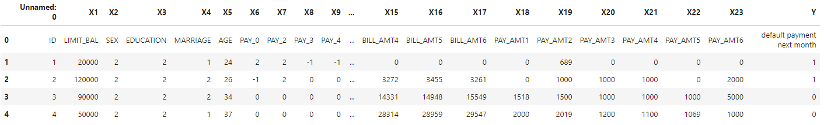

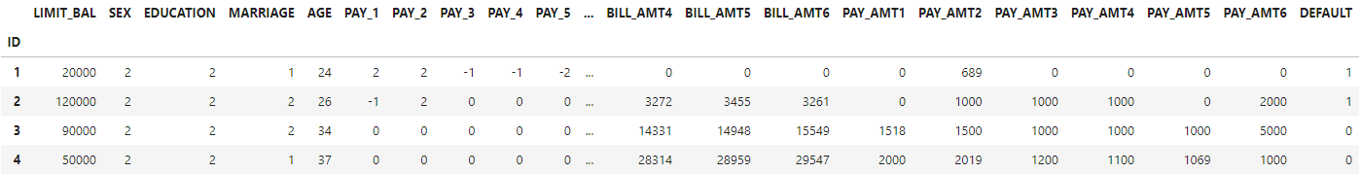
Data Cleaning
Original Dataset:
Reading In & Cleaning the Data:
Data Source:
Yeh,I-Cheng. (2016). default of credit card clients. UCI Machine Learning Repository. https://doi.org/10.24432/C55S3H.
Notes:
First, we set the index as the “ID” column. Next, we didn’t think we needed the first row of the original dataset with the X variables so we decided to skip that row when reading in the data. We also decided to rename a couple of the columns to clean it up a little bit; we changed “PAY_0” to “PAY_1” to make it more orderly, and then we shortened “default payment next month’ to “DEFAULT”. Lastly, we checked for null values within the data but there were none.

Slide 4
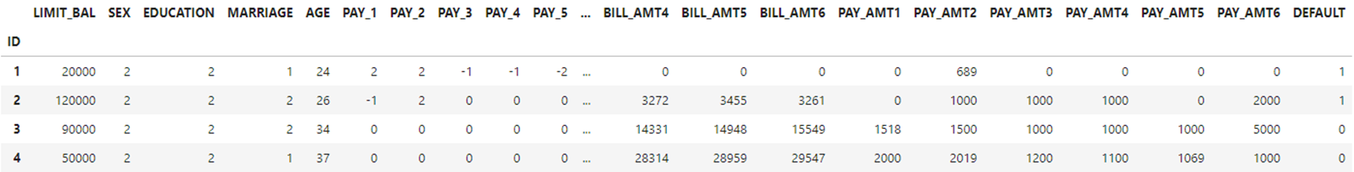

Understanding The Dataset
Dependent Variable (Target): DEFAULT: Did the individual default on the following month’s payment? (Yes = 1; No = 0)
Independent Variables (Features):
LIMIT_BAL: Dollar amount of the given credit
AGE: (year)
SEX: (1 = male; 2 = female)
PAY_1 - PAY_6: History of past payment (-1 = pay duly;
1 = payment delay for one month; 2 = payment delay for two months; . . .; 9 = payment delay for nine months and above)
EDUCATION: (1 = graduate school; 2 = university; 3 = high school; 4 = others)
BILL_AMT1 - BILL_AMT6: Dollar amount of bill statement
MARRIAGE: Marital status (1 = married; 2 = single; 3 = others)
PAY_AMT1 - PAY_AMT6: Dollar amount of previous payment
*All dollar amounts are in New Taiwan dollar
Notes:
This dataset used a binary variable, "DEFAULT", as the target variable, which designates whether the individual defaulted on the following month’s payment (Yes = 1; No = 0). The dataset we chose to use tracked the past monthly payment records (from April to September 2005) of 30,000 individuals and used 23 variables as independent variables. The documentation we were given with the dataset gave descriptions for each variable, which was important since the categorical variables had already been encoded.

Slide 5
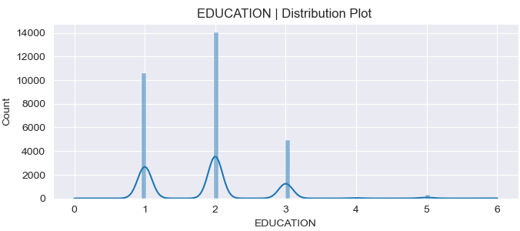
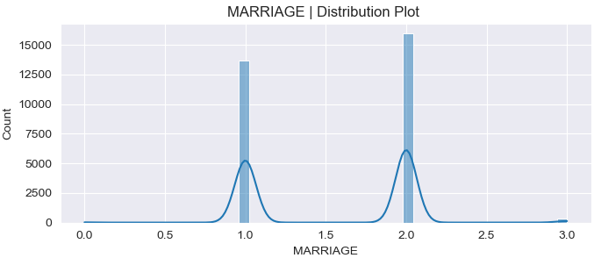
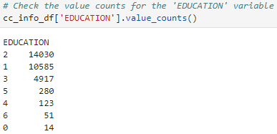
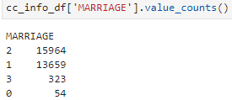
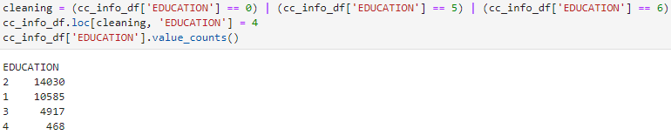
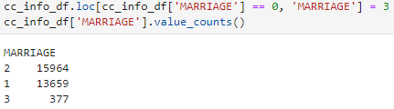
Exploratory Data Analysis (Part 1)
MARRIAGE: Marital status
(1 = married; 2 = single; 3 = others)
EDUCATION: (1 = graduate school; 2 = university; 3 = high school;
4 = others)
Notes:
Exploratory data analysis involves studying, exploring, and visualizing the data to derive important insights. The first thing we did during the exploratory step was create distribution plots for each of the variable. Doing this gave rise to a couple oddities within two of the independent variables. The first was ‘MARRIAGE’ variable. As we mentioned in the previous slide, the documentation we were given for this variable stated that there should be only 3 classes: married, single, and others. However, we noticed in the distribution plot that there appeared to possibly be some 0’s as well.. So we checked the value counts and sure enough there were. We safely decided that we could reclassify all of the 0’s as 3’s since they would likely fit in the “others” class. A similar situation was noticed in the ‘EDUCATION’ variable. The documentation stated that there were only 4 classes for this variable, but the distribution plot appeared to have classes 0-6. And this was confirmed using the value_counts function again. Once again, we figured we could safely reclassify all of the 0’s, 5’s, and 6’s to be in the “others” class.

Slide 6

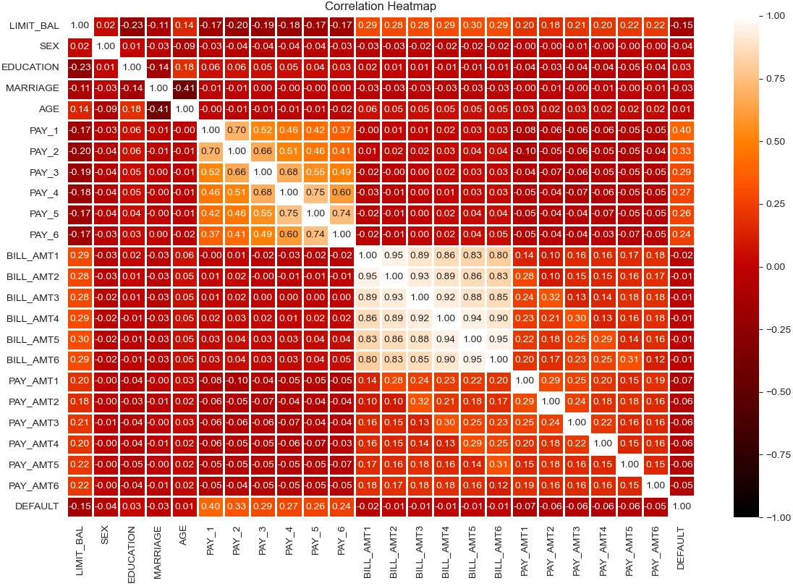
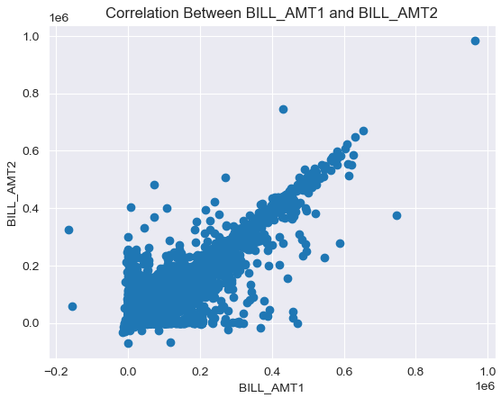
Exploratory Data Analysis (Part 2)
Multivariate Analysis
Bivariate Analysis
Notes:
The next thing we did within the exploratory process was multivariate analysis, which looks at multiple variables at once to determine if there’s any relationships amongst them. We did this by generating a correlation matrix using a heatmap. The main area that stood out to us was the tan area with correlations of 0.80 and higher. This told us there was a strong positive correlation between the 6 ‘BILL_AMT’ variables. We also did a bivariate analysis of the two variables with the highest correlation to visualize the relationship a little better.

Slide 7
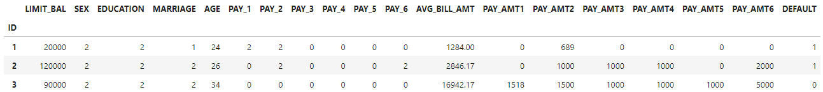
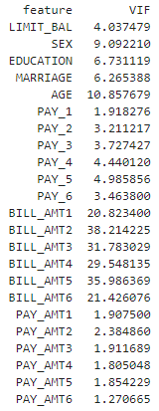
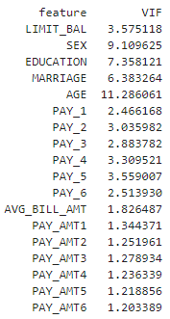
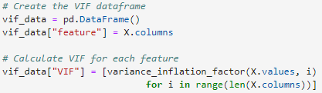
Pre-Processing
Original VIF Data:
Updated VIF Data:
Multicollinearity:
“Multicollinearity is a statistical concept where several independent variables in a model are correlated. Multicollinearity among independent variables will result in less reliable statistical inferences.” https://www.investopedia.com/
Variance Inflation Factor (VIF):
Notes:
In this pre-processing section, we prepared the data for our models. This included choosing the columns to be our independent variables. Since we determined that there was some strong correlation between the 6 ‘BILL_AMT’ variables in the data, we decided it would be best to dive deeper into this before starting to model. According to Investopedia, “Multicollinearity is a statistical concept where several independent variables in a model are correlated. Multicollinearity among independent variables will result in less reliable statistical inferences.” This can create a problem in the model because the inputs are influencing each other and aren’t truly independent. We used the variance inflation factor (VIF) in order to provide us with a measure of multicollinearity for the independent variables. Any value above 10 indicates strong multicollinearity, so the VIF confirms that the ‘BILL_AMT’ variables are collinear. Consequently, we decided to calculate the average of these ‘BILL_AMT’ columns and replace the six columns with a single 'AVG_BILL_AMT' column. Once we did this, we ran the VIF again and as you can see the multicollinearity decreased significantly.

Slide 8

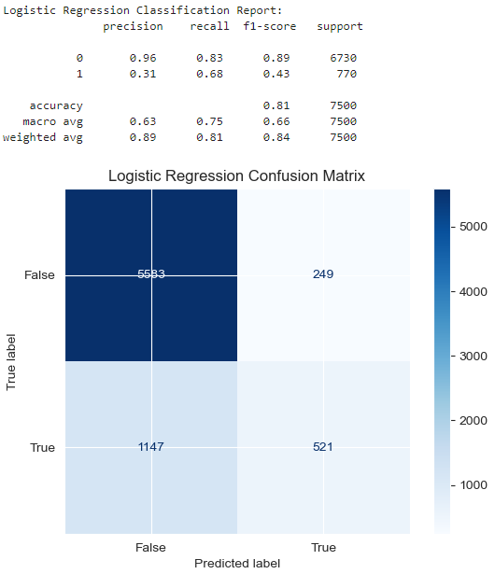
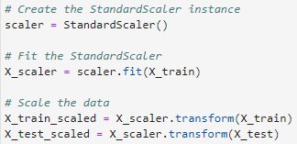
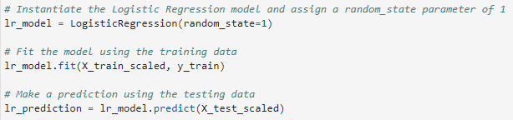
Model 1: Logistic Regression
Results:
Step 1: Split the DataFrame into training and testing sets
Step 2: Standardize the independent variables (features)
Step 3: Model, Fit, Predict
8

Slide 9
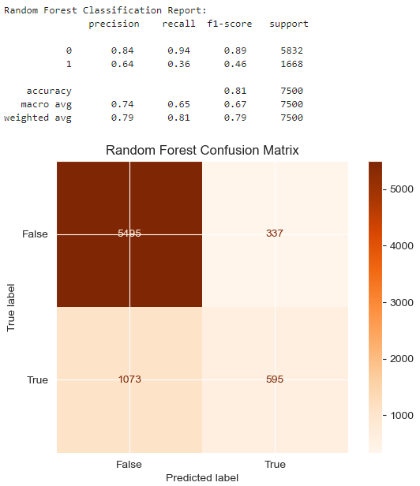
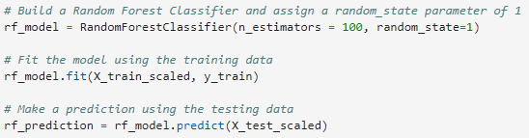

Model 2: Random Forest
Results:
Model, Fit, Predict:
Code Used for the Balanced Accuracy Scores:
9
Notes:
n_estimators is the number of trees in the forest of the model. Since Random Forest is an ensemble method with multiple decision trees, this parameter is used to control the number of trees to be used in the process. We kept this as the default value, which is 100.

Slide 10
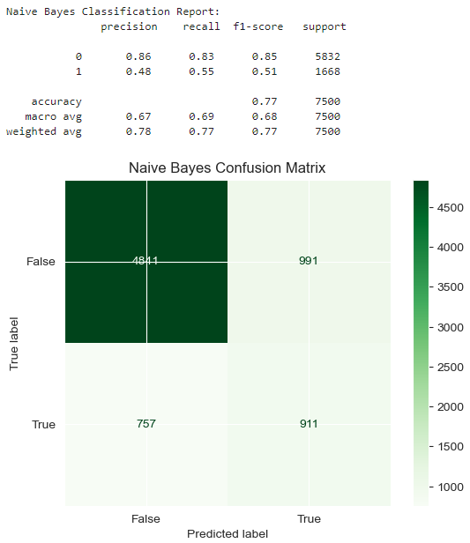
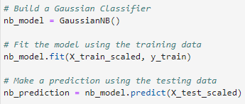
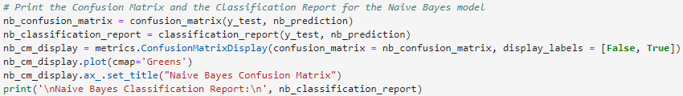
Model 3: Naïve Bayes
Results:
Model, Fit, Predict:
Code Used for Creating the Confusion Matrixes and Classification Reports:
10
Notes:
The classifier assumes that the features used to describe an observation are conditionally independent.

Slide 11
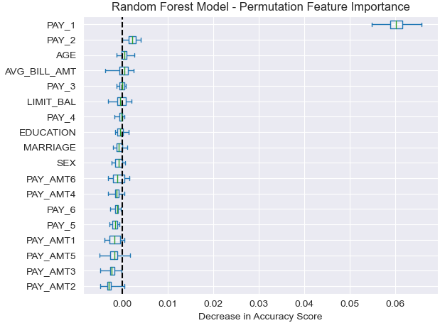
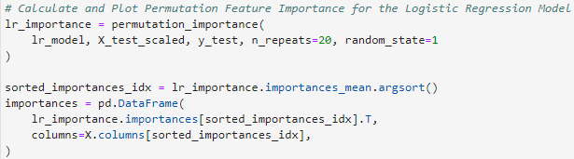
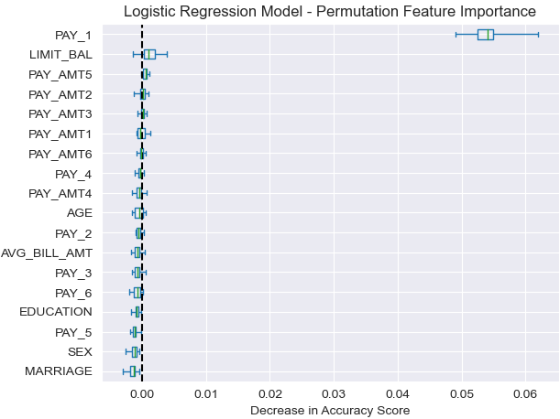
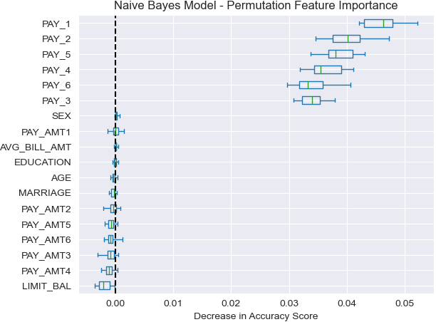
Permutation Feature Importance
11
Notes:
Feature importance in general refers to assigning scores to the input features that indicate the relative importance of each feature when making a prediction. Permutation feature importance involves randomly shuffling the values of a single feature and seeing how that impacts the model’s accuracy. A feature is considered “important” if shuffling its values results in a higher decrease in accuracy score, because in this case the model relied on the feature for the prediction. And as for the opposite, a feature is “unimportant” if shuffling its values results in less of a decrease in accuracy score (or unchanged), because in this case the model didn’t put much weight on the feature for the prediction.

Slide 12
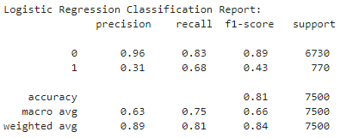
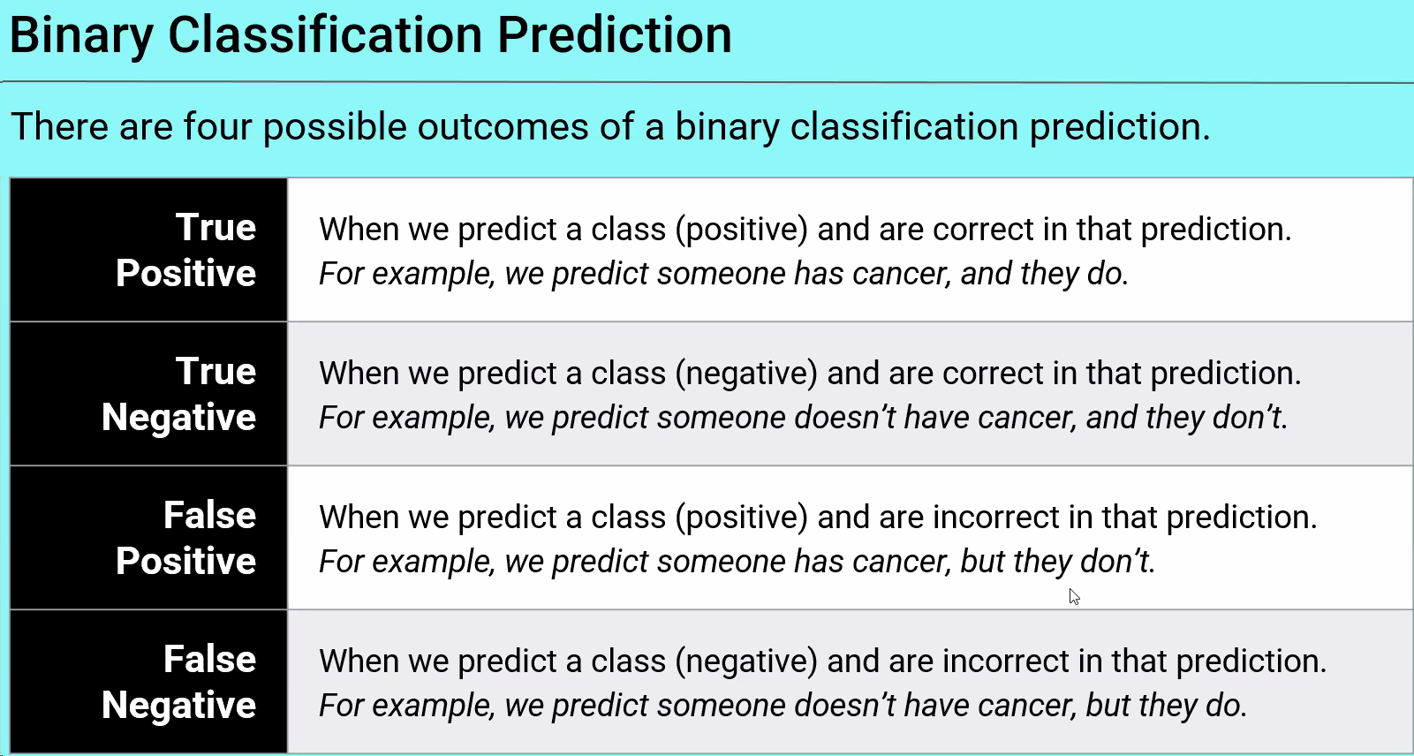
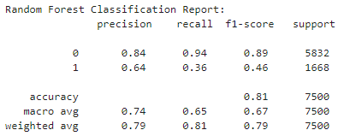
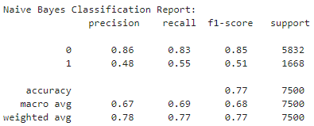
Analyzing The Results
We predict someone will default, and they do.
We predict someone will not default, and they don’t.
We predict someone will default, and they don’t.
We predict someone will not default, and they do.
If False Positives are very undesirable, you want a model with high precision.
If False Negatives are very undesirable, you want a model with high recall.
Notes:
At first glance, we can see that both the logistic regression and random forest models had an accuracy score of 0.81 while the Naïve Bayes model was lower at 0.77. This, along with the balanced accuracy scores that account for any possible imbalances in the classes, are both useful metrics when looking at the overall predictive power of the models. However, we decided that in this situation the False Negatives are the most undesirable outcome. We would be willing to accept more false positives, in return for reducing the number of false negatives. Therefore, a model with high recall is the most important to us. And if we look at the classification reports for each model, we can see that the logistic regression model seems to have the highest recall of the three.

Slide 13



Possible Future Development
Use different sampling strategies to see if that boosts the models’ predictive accuracy.
We could mess around more with feature engineering. For instance, create bins for the ‘AGE’ variable, or combine the ‘SEX’ and ‘MARRIAGE’ variables to create a variable with classes: married man, single man, married woman, single woman, etc.
Using the feature importance data, we could attempt to remove certain, “unimportant” features to see if this increases the models’ accuracy.

Slide 14


THANK YOU
Any Questions?

