Slide 1
MODULE 5 · STAKEHOLDER COMMUNICATION
Diabetic Readmission Risk Tool
Business Insights for Discharge Planning Decision-Making
Objective: translate the Module 4 model's results, explainability, and fairness findings into a clear, honest picture for non-technical hospital stakeholders — what it does, what it doesn't, and what was found along the way.
Grace Sitienei | MSc Data Analytics, Nexford University | Capstone Module 5

Slide 2
THE PROBLEM
Why This Tool Exists
Hospital discharge planning teams have no reliable way to tell, at the moment a patient leaves, which diabetic patients are most likely to be readmitted within 30 days. Limited follow-up capacity is currently allocated by clinical judgment alone, under time pressure, with no consistent signal to work from.
FOCUS POPULATION
High-utilization diabetic patients
2+
Who this affects
• Discharge planning nurses & case managers — deciding who gets a follow-up call
prior-year inpatient or emergency visits — the group most likely to benefit from prioritized follow-up
• Hospital administrators — tracking readmission-related costs and penalties
• Ethics & compliance reviewers — overseeing fair, responsible use of the tool
30 days
the readmission window this tool predicts
02

Slide 3
THE MODEL
What It Does, in Plain Language
The model looks at a patient's hospital record — how many times they've been admitted recently, how long their current stay is, how many medications they're on, and similar details — and produces a single risk score between 0 and 100%. Patients with the highest scores are placed on a prioritized follow-up list, sized to match the discharge team's actual weekly capacity.
Input
Output
Role
Hospital record details already collected at discharge
A risk score from 0–100%, ranked into a follow-up shortlist
Decision support only — a clinician reviews every case
03

Slide 4
KEY RESULTS
How Much Better Than Guessing?
56%
more effective than random selection at finding truly high-risk patients within the same-size follow-up list
17,983
patient records used to build and test this model
04

Slide 5
KEY RESULTS — IN FULL
An Honest Look at the Gap
This tool was originally targeted to catch 75% of true readmissions within its shortlist. It currently reaches 31%. This gap is discussed openly here, and in full in the Limitations section — not adjusted or hidden.
05

Slide 6
EXPLAINABILITY
What Drives a High-Risk Prediction?
Technical explainability tools (SHAP and LIME) were used to determine which patient details most influence the model's risk score. Translated into plain language, the top drivers are:
06

Slide 7
IN PRACTICE
Two Patients, Two Risk Levels
Patient A
Lower risk
Patient C
Higher risk
7% predicted risk
38% predicted risk
• No hospital stays in the past year
• 5 hospital stays in the past year
• Short current stay (2 days)
• Longer current stay (9 days)
• Fewer medications (8)
• More medications (19), including a recent insulin dose increase
This patient's hospital history shows no recent pattern of frequent admissions — the strongest factor pushing their risk score down.
A pattern of frequent recent admissions, combined with a longer, more complex current stay, is what pushes this patient's risk score up.
07

Slide 8
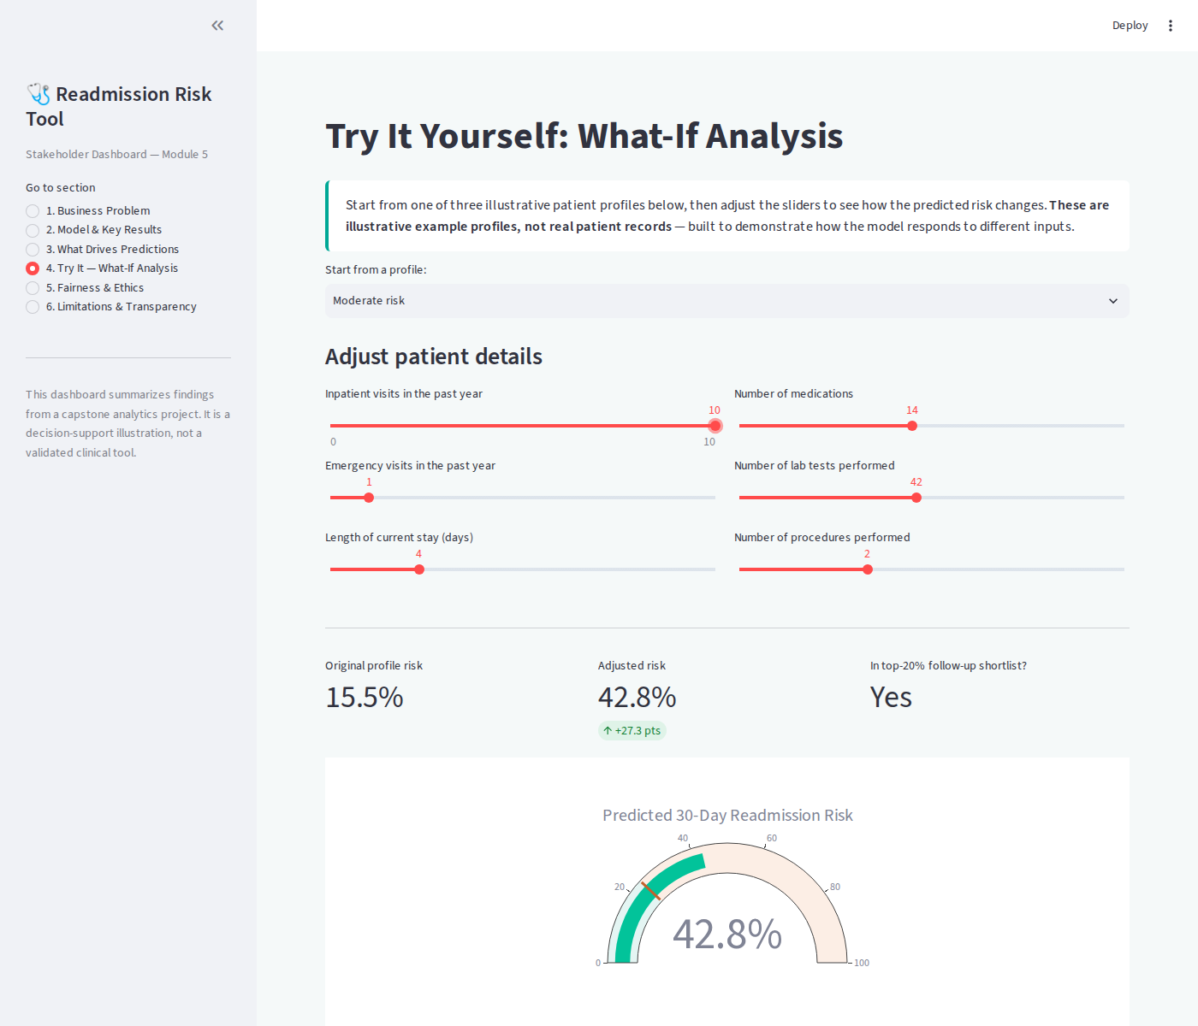
INTERACTIVE TOOL
Try It Yourself: What-If Analysis
The live dashboard lets a stakeholder adjust a patient's details and immediately see how the predicted risk changes — shown here for an illustrative example, not a real patient record.
08

Slide 9
ETHICS & COMPLIANCE
Fairness Summary
A fairness audit checked whether the model's follow-up shortlist treats patients differently based on race, gender, or age, in ways it shouldn't — building directly on this project's Ethical AI Charter and Privacy Plan.
✓
Gender
No meaningful disparity found
!
Race
Disparity found — flagged for review
!
Age Group
Disparity found — flagged for review
09

Slide 10
ETHICS & COMPLIANCE
What Was Found & How It Was Addressed
A gap was found: some race and age groups are selected for follow-up at noticeably different rates than others. Two technical corrections were tested to close this gap automatically — both were tried honestly and both failed: one badly hurt the tool's ability to catch true high-risk patients; the other reduced the tool to flagging almost no one at all. This gap is not yet resolved, and is flagged here as a required fix before any real deployment.
10

Slide 11
HONEST ASSESSMENT
Model Limitations
What this model CAN do
Rank discharged diabetic patients by estimated 30-day readmission risk, meaningfully better than random selection, using information already in the hospital record.
What this model CANNOT do
• Reliably catch the majority of true readmissions — it currently reaches about 31% of them within its shortlist, short of the original 75% goal
• Guarantee equal treatment across race and age groups — a fairness gap was found and remains unresolved
• Replace clinical judgment — every prediction is a decision-support signal only, never an automated action
• Reflect current clinical practice — it was trained on hospital data from 1999–2008
11

Slide 12
COMMITMENT
Transparency Statement
This tool is a decision-support illustration built for an academic capstone project. It is not validated for real clinical deployment. Every prediction requires human clinical review before any action is taken — the model does not, and should not, make decisions on its own.
Known limitations, including the fairness gap and the gap between target and actual performance, are disclosed here rather than omitted, consistent with this project's Explainability Over Black-Box Accuracy and Human-in-the-Loop principles.
Explainability Over Black-Box Accuracy · Equity of Access Over Aggregate Performance · Human-in-the-Loop, Not Human-Replaced
12

Slide 13
SO WHAT?
Business Implications
A working signal now exists
The fairness gap carries real weight
Current data may be the ceiling
56% better than random selection — where no consistent prioritization signal existed before.
If deployed as-is, the tool would direct follow-up resources unevenly across race and age groups — an ethical and regulatory concern.
The gap between target and actual recall suggests today's administrative/coded hospital data may not be enough on its own to reach the original goal.
13

Slide 14
LOOKING AHEAD
Next Steps
1
Resolve the fairness gap using a different technical approach than the two already tested
2
Explore whether richer data sources could close the recall gap
3
Continue human-in-the-loop review as a permanent design requirement, not a temporary safeguard
Per this assignment's scope, no formal recommendation is made here — see the Final Project deliverable.
Grace Sitienei | MSc Data Analytics, Nexford University | Q&A Backup Deck follows in Appendix
14

Slide 15
SOURCES
References
Centers for Medicare & Medicaid Services. (2023). Hospital Readmissions Reduction Program (HRRP). U.S. Department of Health and Human Services. https://www.cms.gov/medicare/payment/prospective-payment-systems/acute-inpatient-pps/hospital-readmissions-reduction-program-hrrp
Strack, B., DeShazo, J. P., Gennings, C., Olmo, J. L., Ventura, S., Cios, K. J., & Clore, J. N. (2014). Impact of HbA1c measurement on hospital readmission rates: Analysis of 70,000 clinical database patient records. BioMed Research International, 2014, Article 781670. https://doi.org/10.1155/2014/781670
Additional data and methodology detail: Module 1–4 project documentation (Vision Document, Project Overview Report, Data Pipeline artifacts, Model Validation Report).
15

