Slide 1
Q&A BACKUP DECK
Technical Appendix
Detail for technical questions from the stakeholder presentation — model specification, full metrics, fairness methodology, and mitigation attempts.

Slide 2
A1 — MODEL DETAIL
Algorithm & Hyperparameters
Model | Key Hyperparameters | Selection Basis
Logistic Regression | C=0.01, class_weight=None | Grid search, 5-fold CV, scored on ROC-AUC
Random Forest | max_depth=10, n_estimators=400 | Grid search, 5-fold CV, scored on ROC-AUC
XGBoost (selected) | max_depth=4, n_estimators=200, learning_rate=0.05, scale_pos_weight=1 | Best ROC-AUC (0.596) and recall@20% (31.2%) of the three
All three algorithms, and every grid point evaluated, are logged in MLflow (experiment: diabetic_readmission_risk) with full parameter and metric history.
02

Slide 3
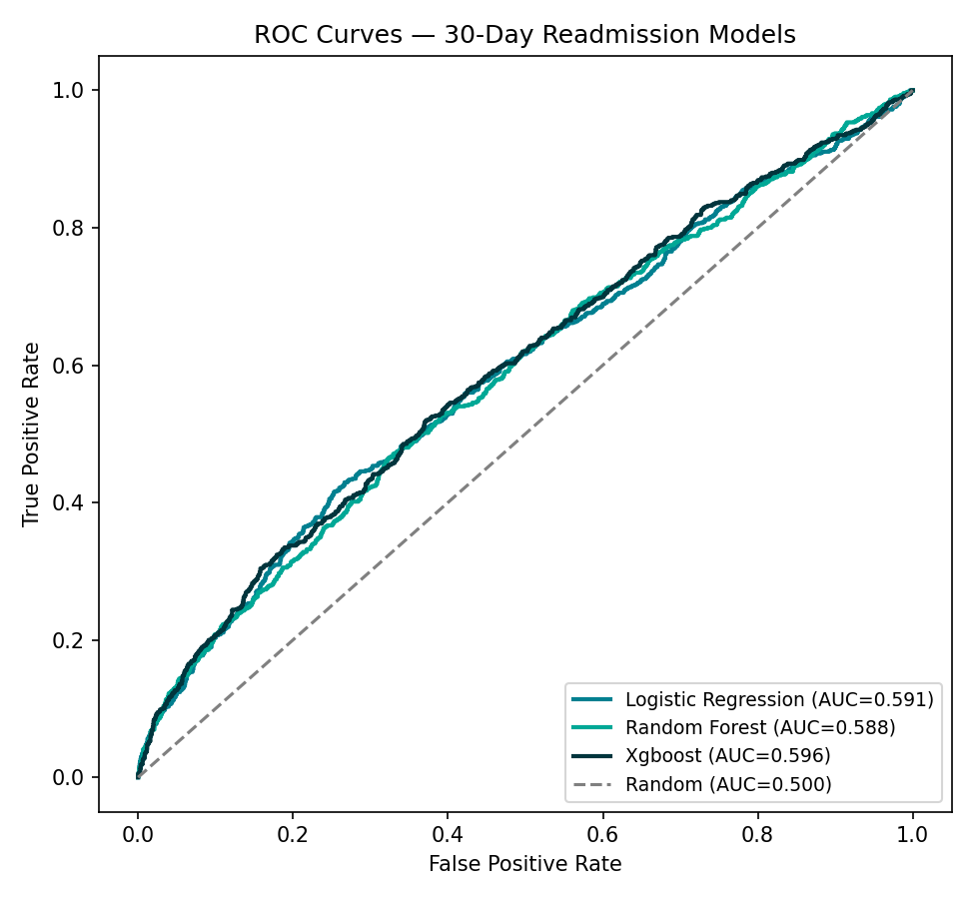
A2 — MODEL DETAIL
Full Performance Metrics
Model | Accuracy | Precision | Recall | F1 | ROC-AUC | Recall@20% | Lift@20%
Baseline | 0.795 | 0.000 | 0.000 | 0.000 | 0.500 | — | —
Logistic Regression | 0.796 | 0.560 | 0.037 | 0.070 | 0.591 | 0.307 | 1.53
Random Forest | 0.795 | 0.000 | 0.000 | 0.000 | 0.588 | 0.288 | 1.44
XGBoost (selected) | 0.795 | 0.519 | 0.019 | 0.036 | 0.596 | 0.312 | 1.56
Why 0.5-threshold recall looks so low: with a ~20% positive rate, all three models rarely cross 0.5 predicted probability. recall@20% (a ranking-based metric matching the deployed shortlist) is the metric that actually reflects how the tool is used.
03

Slide 4
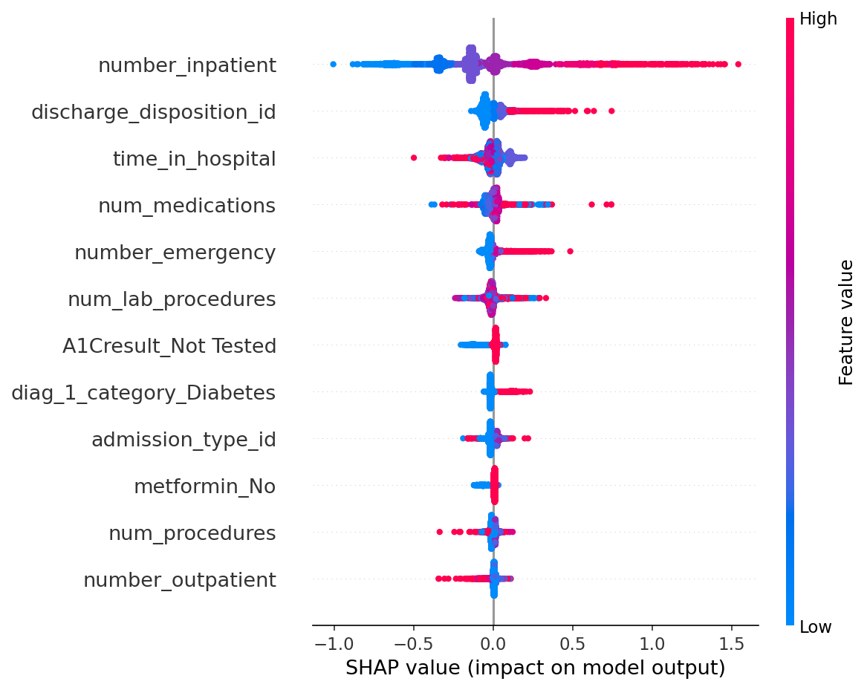
A3 — EXPLAINABILITY DETAIL
SHAP Global Feature Importance
04

Slide 5
A4 — FAIRNESS DETAIL
Fairness Metrics & Methodology
Attribute | Demographic Parity Diff. | Equalized Odds Diff. | Min. Disparate Impact Ratio | Flagged (<0.8)
race | 0.320 | 0.556 | 0.000 | Yes
gender | 0.009 | 0.049 | 0.958 | No
age | 0.388 | 0.556 | 0.369 | Yes
Methodology note: audited on the deployed decision rule (top-20% risk-ranked shortlist), not a raw 0.5 probability threshold — the latter is close to vacuous here since most subgroups show a selection rate of exactly zero at 0.5, an artifact of class imbalance rather than a meaningful fairness signal. k=5 anonymity suppression applied to all subgroup breakdowns per the Data Privacy Plan.
05

Slide 6
A5 — FAIRNESS DETAIL
Bias Mitigation: What Was Tried
Constraint Tested | Result | Outcome
demographic_parity | DP difference: 0.32 → 0.02 | Overall recall collapsed: 32.3% → 5.1% — rejected
equalized_odds | DP & EO differences both → 0 | Collapsed to trivial all-negative solution (0% selection for every group) — rejected
Both failures are instructive, not just negative results: equalized_odds collapsing to the trivial solution happened because per-group calibration samples were small (Asian n=8, Unknown n=18 in the calibration split), making the degenerate zero-selection point the easiest feasible solution. Recommended next step: coarser race grouping, or an in-processing technique (Fairlearn ExponentiatedGradient) rather than post-hoc threshold adjustment.
06

Slide 7
A6 — DATA DETAIL
Dataset & Pipeline Summary
Source
Diabetes 130-US Hospitals (Strack et al., 2014); 130 U.S. hospitals, 1999–2008
Raw records
101,766 inpatient encounters
After cleaning & cohort filter
17,983 encounters (2+ prior-year inpatient/ED visits, deceased/hospice excluded)
Feature matrix
142 engineered features (one-hot encoded, scaled); protected attributes excluded from modeling
Train/test split
80/20, patient-grouped, stratified; zero patient overlap verified
Validation
10/10 Great Expectations checks passed; 13/13 unit tests passed
07

Slide 8
A7 — ACCESS
Live Dashboard, Repository & API
Live Dashboard
diabetic-readmit-xai-jlfoaphnrgsetvppdwxhsf.streamlit.app
GitHub Repository
github.com/Graciaanah/diabetic-readmit-xai
SHAP Notebook
notebooks/shap_analysis.ipynb
Model Card
docs/model-card.md
API demo script
api/api_demo.py (run against uvicorn api.main:app)
08

