Slide 1
Team Availability Analysis
August 2022
Analysis of staffing requirements and recommendations

Slide 2
Service Line Requirements
Minimum Staffing Requirements:
• Service Line 1: 2.5 agents
• Service Line 2: 4.0 agents
• Service Line 3: 18.0 agents
Total Required: 24.5 agents

Slide 3
Key Statistics
• Total Agents: 30
• Working Days: 23 weekdays (Monday-Friday only)
• Average Daily Available Agents: 25.08
• Maximum Available: 29.00 agents
• Minimum Available: 21.00 agents
• Days Meeting Requirements: 16 days (≥24.5 agents)
• Days Below Requirements: 7 days (<24.5 agents)

Slide 4
Staffing Analysis
Coverage Rate:
• 69.6% of weekdays met minimum requirement
• 30.4% of weekdays fell below requirement
Staffing Buffer:
• Average surplus: 0.58 agents
• Maximum surplus: 4.5 agents
• Maximum deficit: 3.5 agents

Slide 5
Critical Issues
Staffing Gaps:
• Highest gaps in third week of August
• Friday staffing levels show shortages
• 7 days (30.4%) below requirements
Resource Management:
• Uneven distribution of leave days
• Limited buffer for unexpected absences
• Peak vacation period impacts

Slide 6
Recommendations
Leave Management:
• Implement structured approval process
• Stagger vacation schedules
• Set concurrent leave limits
Staffing Adjustments:
• Add 1-2 additional agents
• Develop flexible staffing model
• Cross-train across service lines
Monitoring System:
• Implement daily tracking
• Set up shortage alerts
• Regular pattern analysis

Slide 7
Action Plan
Immediate (1-2 weeks):
• Review and optimize staff distribution
• Implement leave request coordination
Short-term (1-3 months):
• Begin recruitment for additional staff
• Develop cross-training program
Long-term (3-6 months):
• Implement workforce management system
• Establish monitoring process

Slide 8
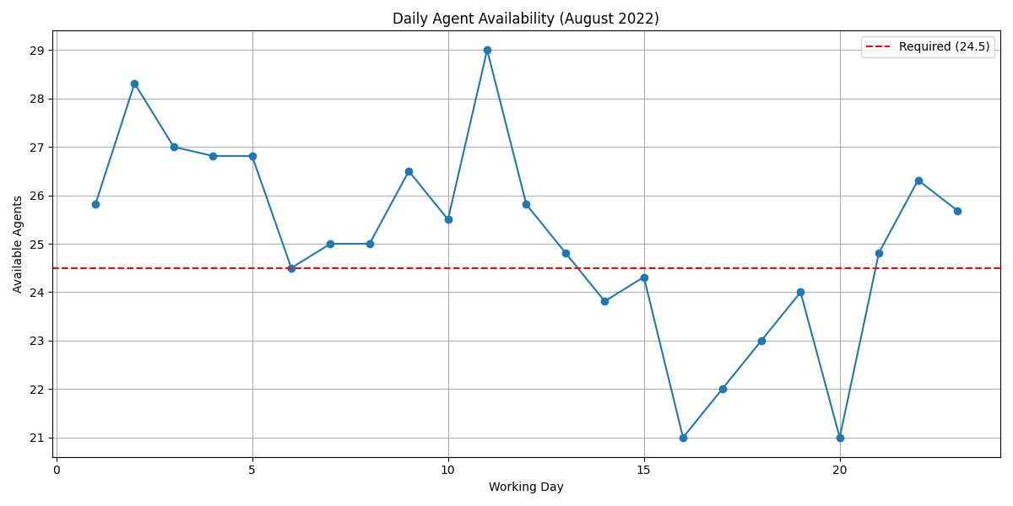
Availability Analysis

