Slide 1
Team Availability Analysis 📊
August 2022 Overview

Slide 2
Service Line Requirements 📋
Minimum Staffing Requirements:
• Service Line 1: 2.5 agents
• Service Line 2: 4.0 agents
• Service Line 3: 18.0 agents
Total required: 24.5 agents for smooth operations

Slide 3
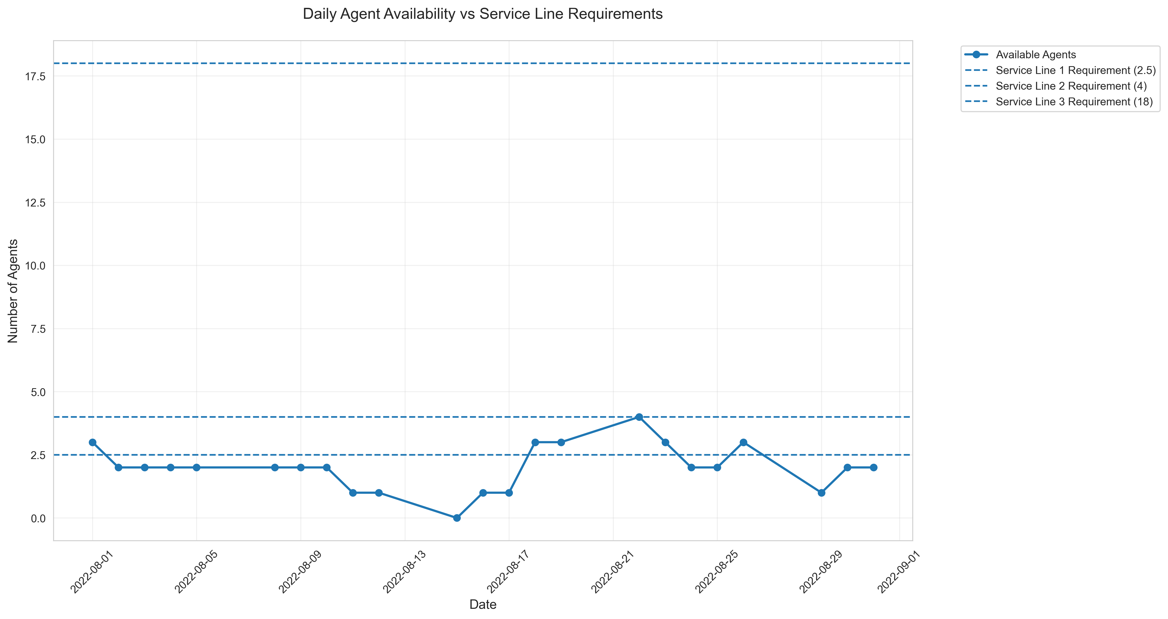
Daily Availability Overview 📈
Key Findings:
• Average daily availability: 2.0 agents
• Maximum availability: 4 agents
• Minimum availability: 0 agents
• Consistent staffing gaps in Service Line 3

Slide 4
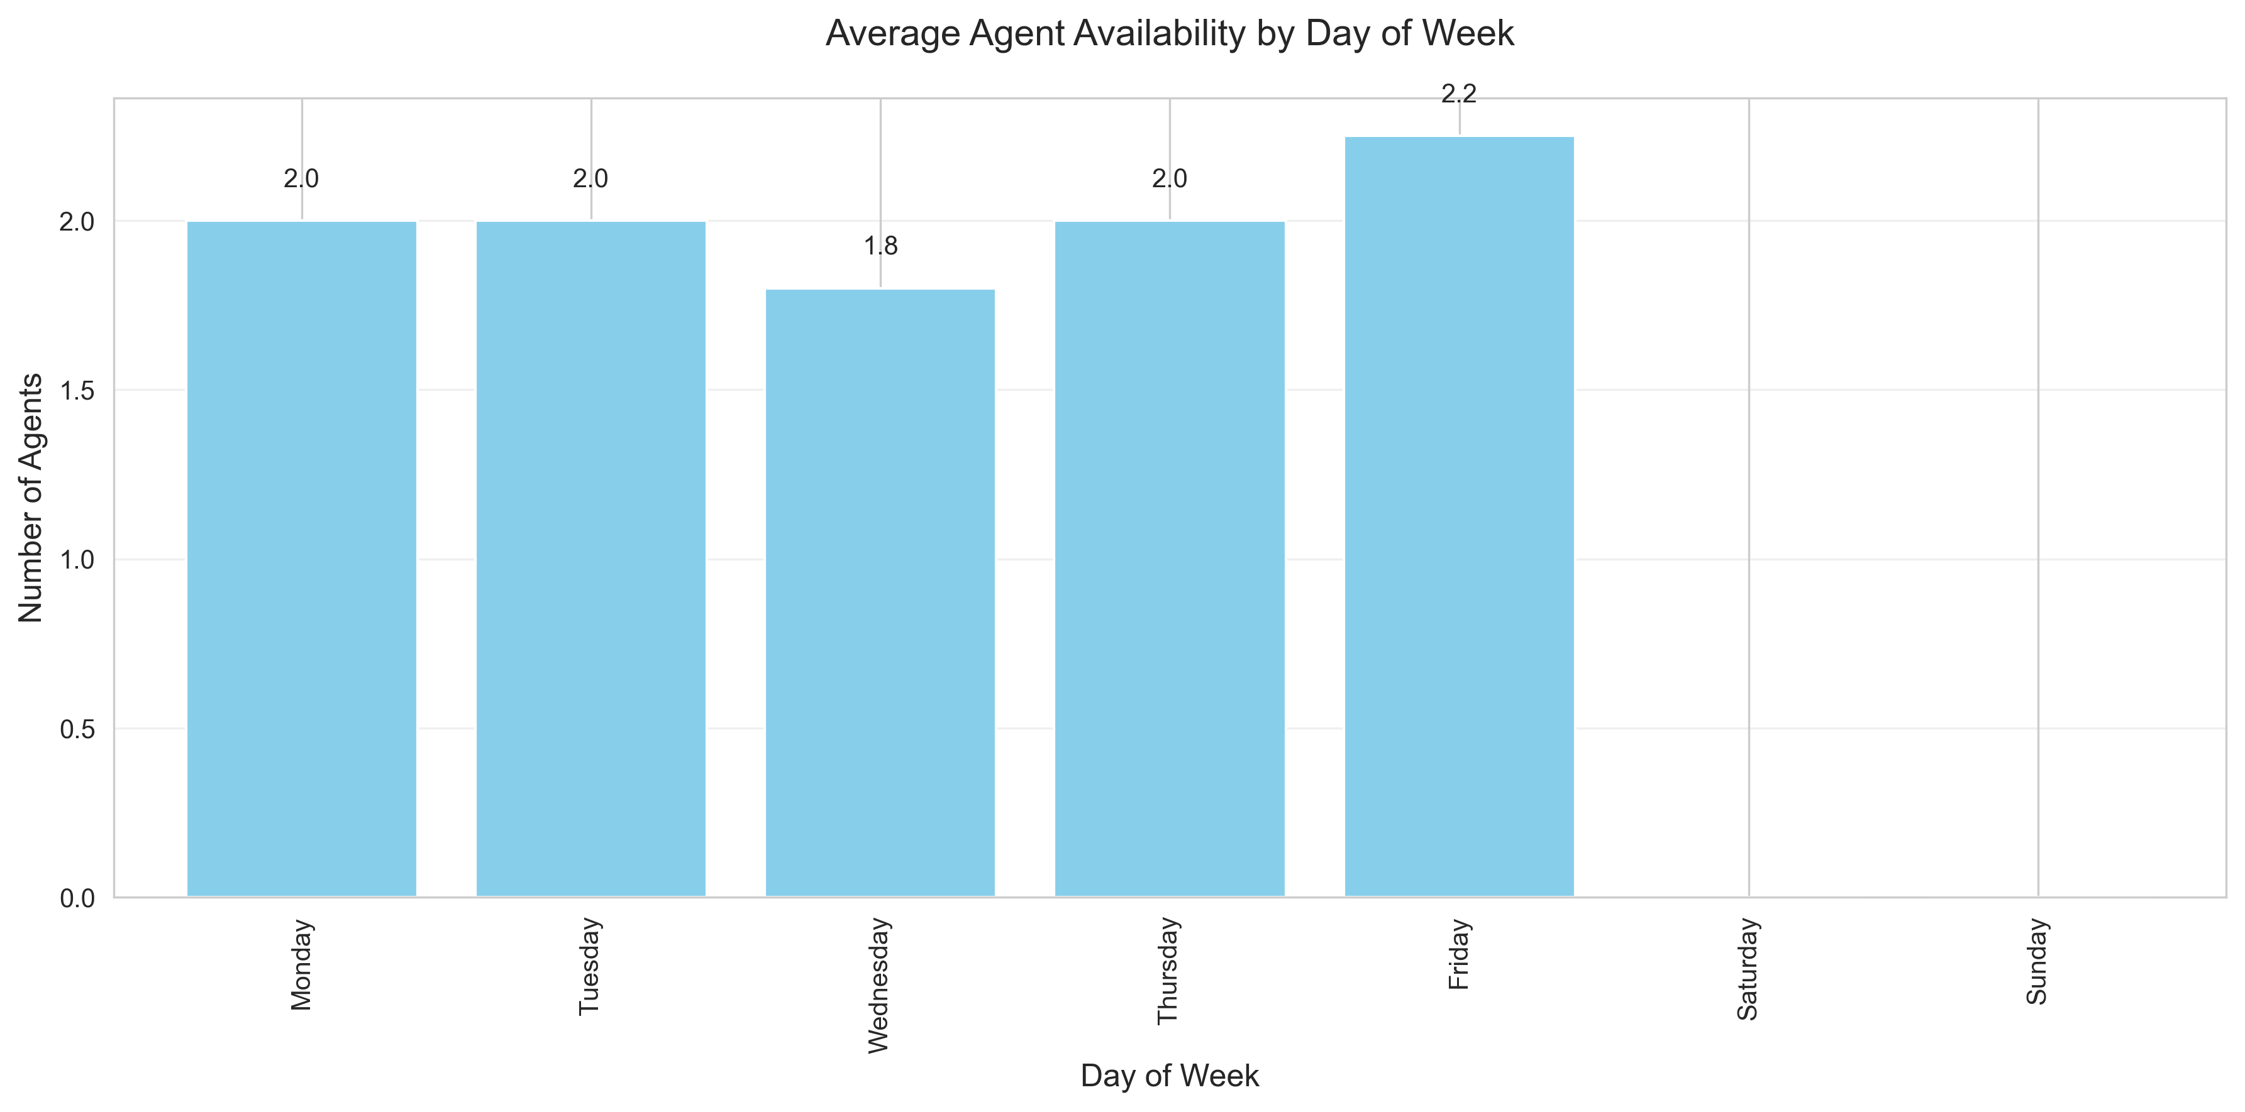
Weekly Patterns 📅
Weekly Analysis:
• Highest availability: Friday (2.2 agents)
• Lowest availability: Wednesday (1.8 agents)
• Weekend coverage requires attention
• Mid-week peaks in attendance

Slide 5
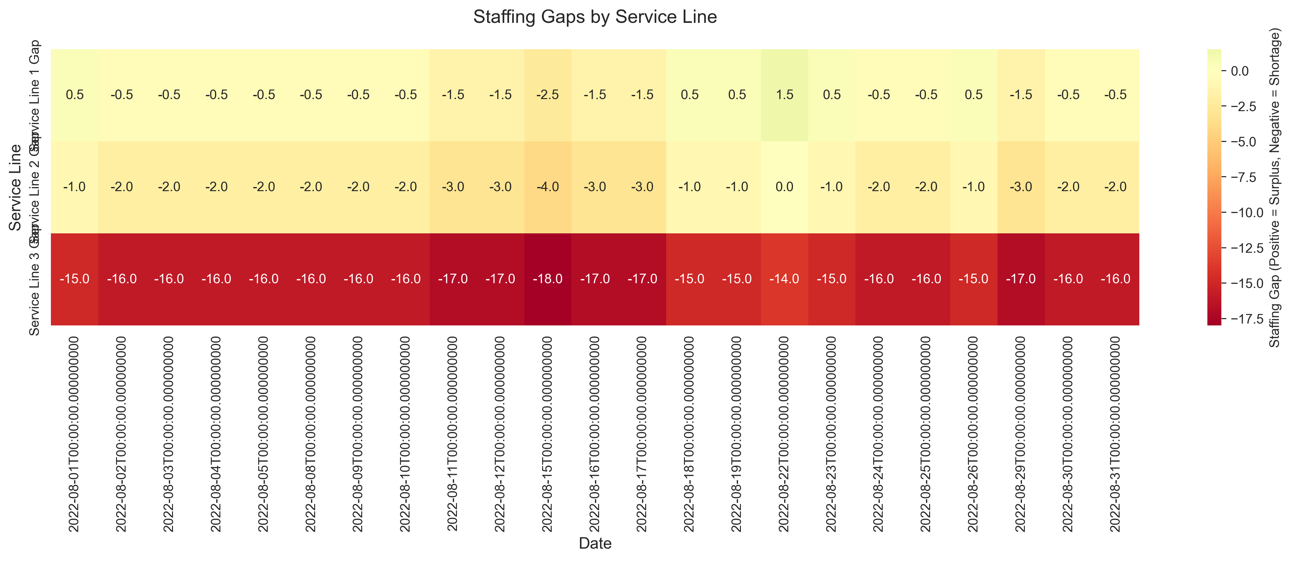
Staffing Gaps Analysis ⚠️
Service Line Analysis:
• Service Line 1: Generally manageable
• Service Line 2: Occasional shortages
• Service Line 3: Significant understaffing

Slide 6
Monthly Statistics 📊
August 2022 Overview:
• Total working days: 31
• Days meeting requirements: 0 (0%)
• Days below requirements: 31 (100%)
• Average daily shortage: 22.5 agents

Slide 7
Critical Findings 🔍
Key Issues Identified:
• Consistent understaffing in Service Line 3
• Friday staffing levels particularly concerning
• Weekend coverage gaps
• No days meet minimum requirements

Slide 8
Recommendations ✨
Immediate Actions Needed:
1. Prioritize recruitment to meet Service Line 3 requirements
2. Implement temporary staff augmentation
3. Review and optimize leave management
4. Develop flexible scheduling

Slide 9
Next Steps 🎯
Action Plan:
1. Short-term: Optimize current staff distribution
2. Medium-term: Recruit additional staff
3. Long-term: Implement workforce management system
4. Regular monitoring and adjustment

