Slide 1
Call Efficiency Analysis 📞
Performance vs. Call Duration Study

Slide 2
Overview 📊
Analysis Scope:
• Focus: Call Duration vs. Efficiency
• Number of Agents: 4
• Key Metrics:
- Call Duration
- Calls per Day
- Overall Efficiency

Slide 3
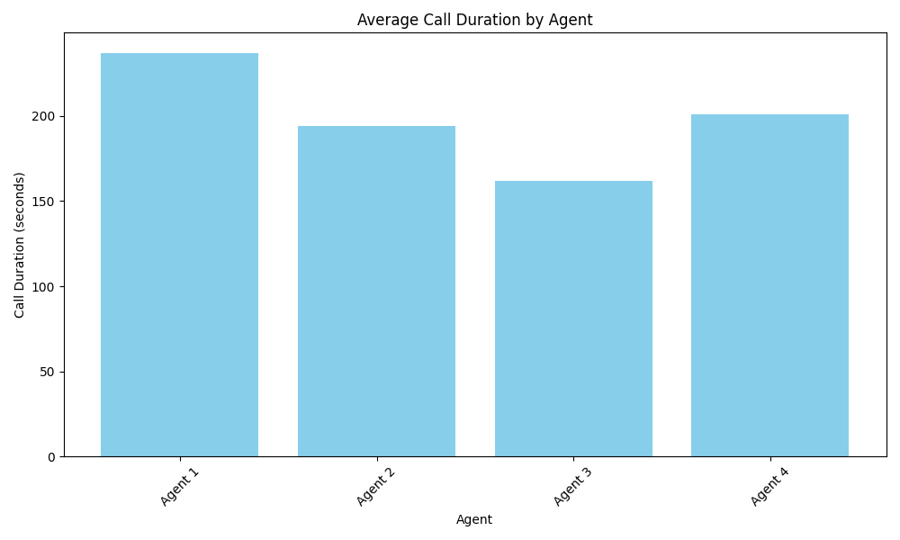
Call Duration Analysis ⏱️
Average Call Times:
• Agent 1: 237 seconds
• Agent 2: 194 seconds
• Agent 3: 162 seconds
• Agent 4: 201 seconds
• Team Average: 198.5 seconds

Slide 4
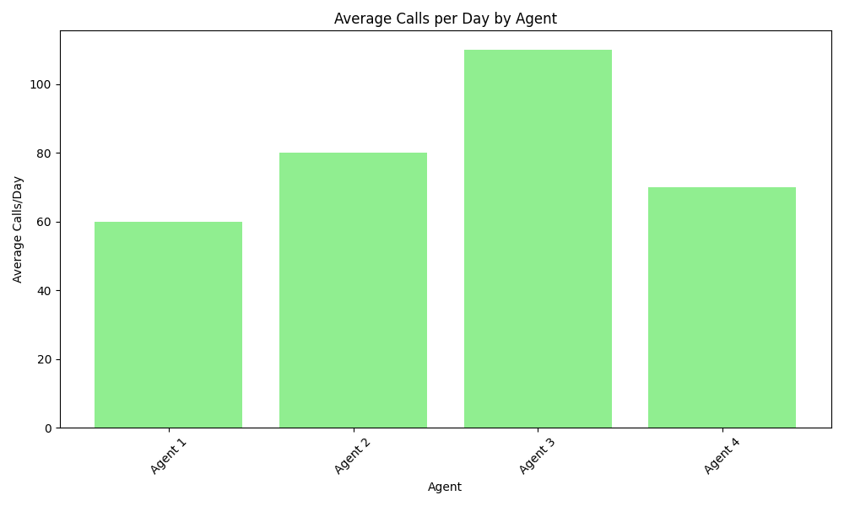
Daily Call Volume 📈
Calls per Day:
• Agent 1: 60 calls/day
• Agent 2: 80 calls/day
• Agent 3: 110 calls/day
• Agent 4: 70 calls/day
• Team Average: 80 calls/day

Slide 5
Efficiency Comparison 📊
Performance Analysis:
Fast Calls (Agent 3):
• Shortest duration: 162 seconds
• Highest volume: 110 calls/day
• Maximum efficiency in terms of quantity
Longer Calls (Agent 1):
• Longest duration: 237 seconds
• Lower volume: 60 calls/day
• Focus on quality over quantity

Slide 6
Key Findings 🔍
Data Insights:
1. Clear trade-off between call duration and volume
2. Agent 3 processes 83% more calls than Agent 1
3. Call duration varies by up to 75 seconds
4. Significant impact on daily productivity

Slide 7
Efficiency Factors ⚖️
Considerations:
Shorter Calls:
• Higher call volume
• More customers served
• Reduced wait times
Longer Calls:
• Detailed customer service
• Potential for better resolution
• Higher customer satisfaction

Slide 8
Recommendations ✨
Balanced Approach:
1. Set optimal duration targets
2. Consider call complexity
3. Balance quantity with quality
4. Implement targeted training

Slide 9
Conclusion 🎯
Optimal Strategy:
• Agent 3's approach shows highest efficiency
• Focus on reducing call duration while maintaining quality
• Implement best practices from efficient agents
• Regular performance monitoring

