Slide 1
Team Availability Analysis
August 2022 Overview

Slide 2
Service Line Requirements
Service Line Requirements:
• Service Line 1: 2.5 agents
• Service Line 2: 4 agents
• Service Line 3: 18 agents
Total required: 24.5 agents for smooth operations

Slide 3
Daily Availability Overview
Key Statistics:
• Total number of agents: 29
• Average daily available agents: 24.03
• Maximum available agents: 29.00
• Days meeting requirements: 16 days
• Days below requirements: 8 days

Slide 4
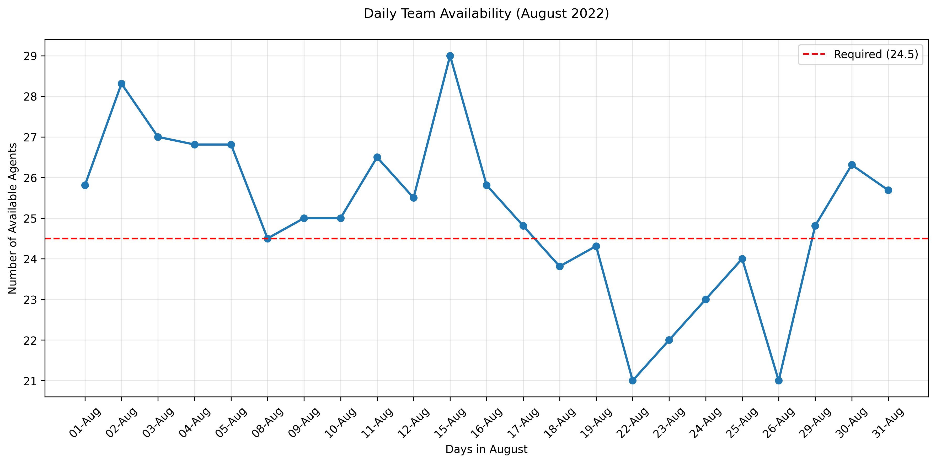
Daily Team Availability
Daily availability trend showing actual vs required staffing levels

Slide 5
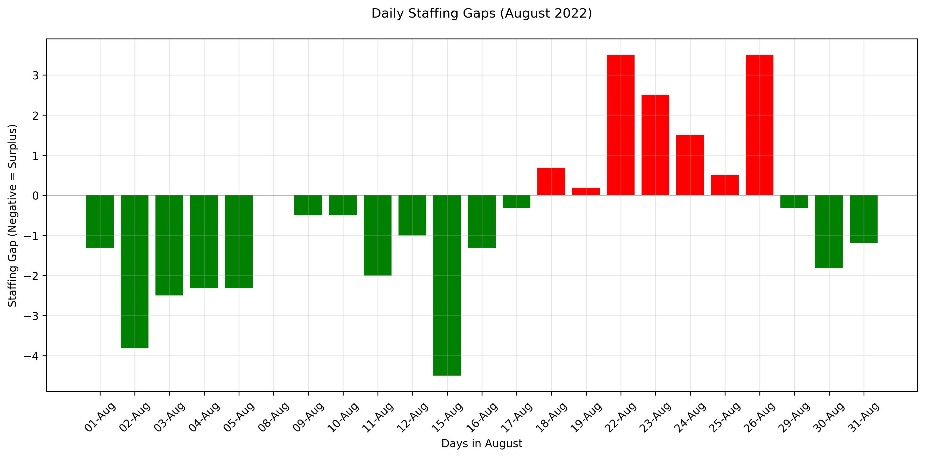
Staffing Gaps Analysis
Red bars indicate understaffing, green bars indicate surplus staffing

Slide 6
Recommendations
Action Items:
• Implement better leave management to prevent understaffing
• Consider additional backup staff for high-absence days
• Review partial availability patterns to optimize scheduling
• Develop contingency plans for days with known staffing gaps

