Slide 1
Team Availability Analysis
August 2022
Staffing Analysis & Recommendations

Slide 2
Service Line Requirements
Minimum Staffing Requirements:
• Service Line 1: 2.5 agents
• Service Line 2: 4.0 agents
• Service Line 3: 18.0 agents
Total Required: 24.5 agents

Slide 3
Key Statistics
• Total Agents: 30
• Working Days: 23 weekdays (Monday-Friday only)
• Average Daily Available Agents: 25.08
• Maximum Available: 29.00 agents
• Minimum Available: 21.00 agents
• Days Meeting Requirements: 16 days (≥24.5 agents)
• Days Below Requirements: 7 days (<24.5 agents)

Slide 4
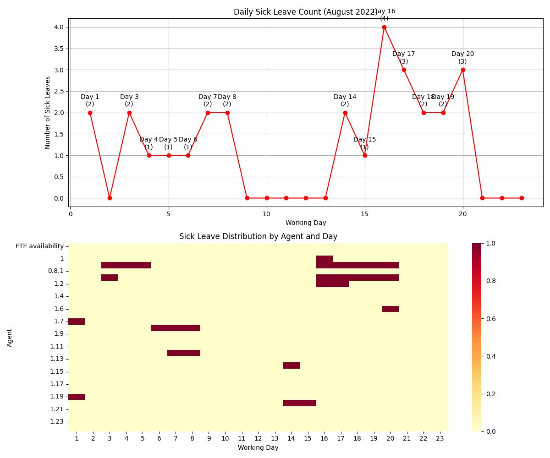
Sick Leave Analysis
• Total sick leave instances: 28
• Maximum sick leaves in one day: 4
• Average sick leaves per day: 1.22
• Days with sick leave: 14 (60.9%)

Slide 5
Recommendations
Leave Management:
• Structured approval process
• Stagger vacation schedules
• Monitor sick leave patterns
Staffing Adjustments:
• Add 1-2 additional agents
• Cross-train across service lines
• Implement wellness programs
Monitoring:
• Daily tracking system
• Early warning alerts
• Regular pattern analysis

Slide 6
Action Plan
Now (1-2 weeks):
• Optimize staff distribution
• Review sick leave patterns
Soon (1-3 months):
• Start recruitment
• Launch wellness program
Later (3-6 months):
• Implement new systems
• Review effectiveness

Slide 7
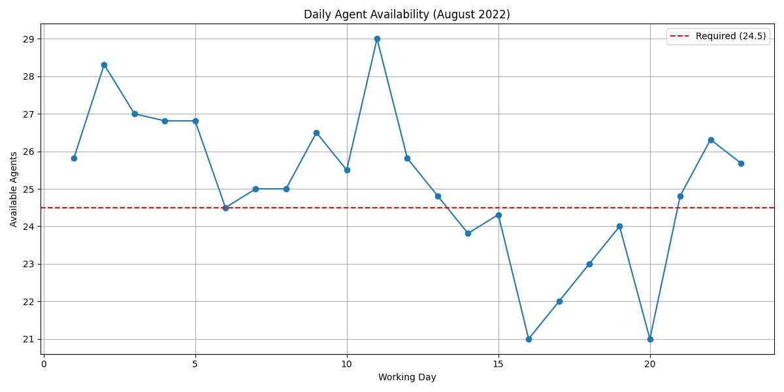
Daily Availability

Slide 8
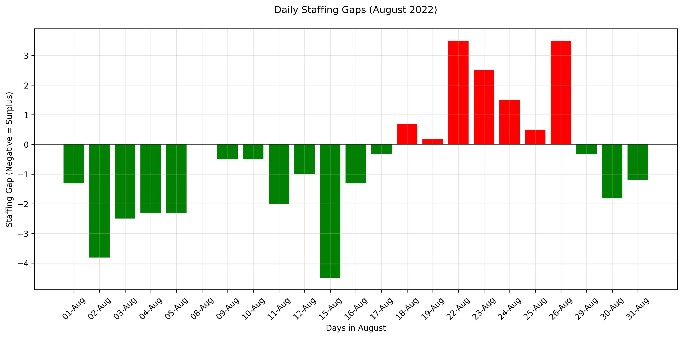
Staffing Gaps

