Slide 1
Power System fault detection and classification
CAPSTONE PROJECT
Presented By:
Gracy Ananthika D
VIT Chennai
MTech Integrated Software Engineering

Slide 2
OUTLINE
Problem Statement
Proposed System/Solution
System Development Approach
Algorithm & Deployment
Result
Conclusion
Future Scope

Slide 3
Problem Statement
Design a machine learning model to detect and classify different types of faults in a power distribution system. Using electrical measurement data (e.g., voltage and current phasors), the model should be able to distinguish between normal operating conditions and various fault conditions (such as line-to-ground, line-to-line, or three-phase faults). The objective is to enable rapid and accurate fault identification, which is crucial for maintaining power grid stability and reliability.

Slide 4
Proposed Solution
Data Collection:
Gather ‘Power System Fault Dataset’ from Kaggle
Upload into IBM cloud as a csv file.
Data Preprocessing:
Auto AI automatically cleans the data
Normalization is done to the numerical values and performs Hyperparameter optimization
Machine Learning Algorithm:
After data preprocessing Watson.ai studio tries different models such as Random Forest, Gradient Boosting etc.
Then ranks the models by the performance
Deployment:
Select the best pipeline using Watson Machine Learning

Slide 5
System Approach
System Requirements
Operating System: Windows 10/11 or Ubuntu/Linux
Processor: Intel i5 or higher
RAM: Minimum 8 GB
Storage: At least 2 GB free disk space
Internet: Required for IBM Cloud access and dataset upload
IBM Cloud Services:
IBM Cloud Object Storage
IBM Watson Studio
IBM Watson Machine Learning

Slide 6
Algorithm & Deployment
Algorithm Selection:
For detecting and classifying faults in a power distribution system, IBM AutoAI is used. AutoAI is a tool within IBM Watson Studio that automates the end-to-end machine learning process — from data preparation to model selection, training, and hyperparameter optimization. It evaluates multiple algorithms like Logistic Regression, Random Forest, Gradient Boosting, and XGBoost, then selects and ranks the best-performing pipeline based on accuracy and other metrics. AutoAI is ideal for this problem due to its ability to handle structured data (phasor measurements) and produce high-accuracy models without manual tuning.

Slide 7
Data Input
Fault ID
Fault Type (target variable for classification)
Fault Location (Latitude, Longitude)
Voltage (V)
Current (A)
Power Load (MW)
Temperature (°C)
Wind Speed (km/h)
Weather Condition
Maintenance Status
Component Health
Duration of Fault (hrs)
Down Time (hrs)

Slide 8
Training Process:
Once the dataset is uploaded to IBM Cloud Object Storage, it is connected to an AutoAI experiment in IBM Watson Studio. AutoAI:
Splits the dataset into training and test sets.
Performs data cleaning, transformation, and normalization.
Generates multiple pipelines with different algorithm combinations.
Uses cross-validation to evaluate each model.
Automatically tunes hyperparameters for the best-performing pipelines.
Prediction Process:
The trained AutoAI model predicts the type of fault based on real-time or historical phasor inputs. When new electrical measurements are provided, the model classifies the condition as either normal or one of the defined fault types, enabling quick fault detection and system protection.

Slide 9
Deployment:
The selected pipeline is deployed as a REST API using IBM Watson Machine Learning :
A deployment space is created in Watson Studio.
The model is published and deployed, generating a scoring endpoint.
Applications or dashboards can send JSON-formatted phasor data to the endpoint.
The API responds with the predicted fault type.

Slide 10
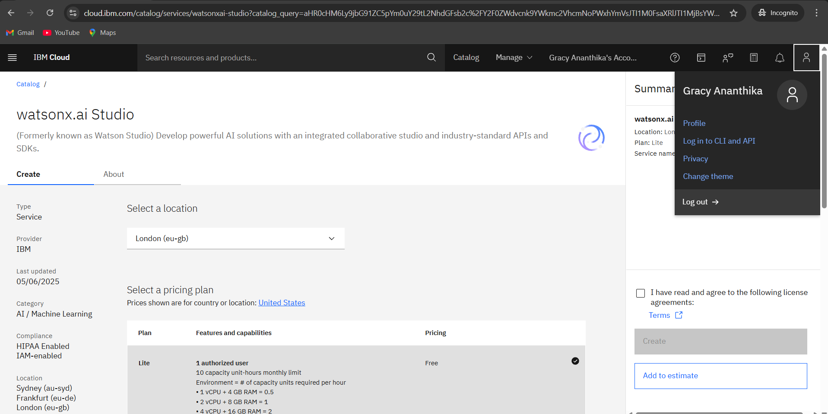
Result

Slide 11
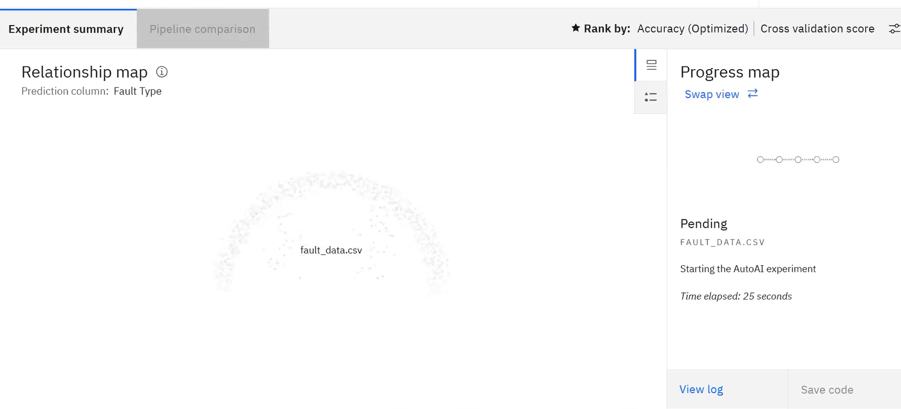

Slide 12
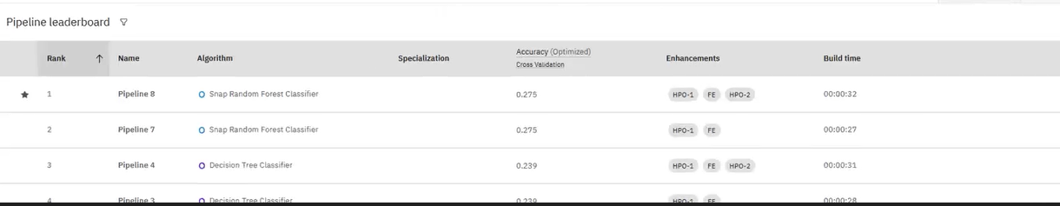

Slide 13
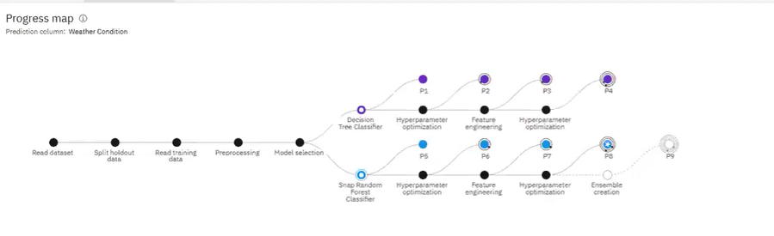

Slide 14
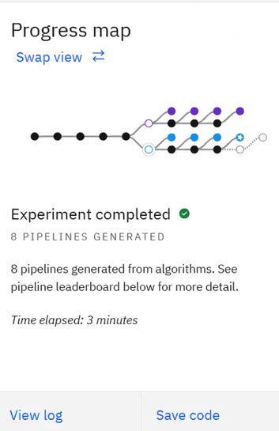
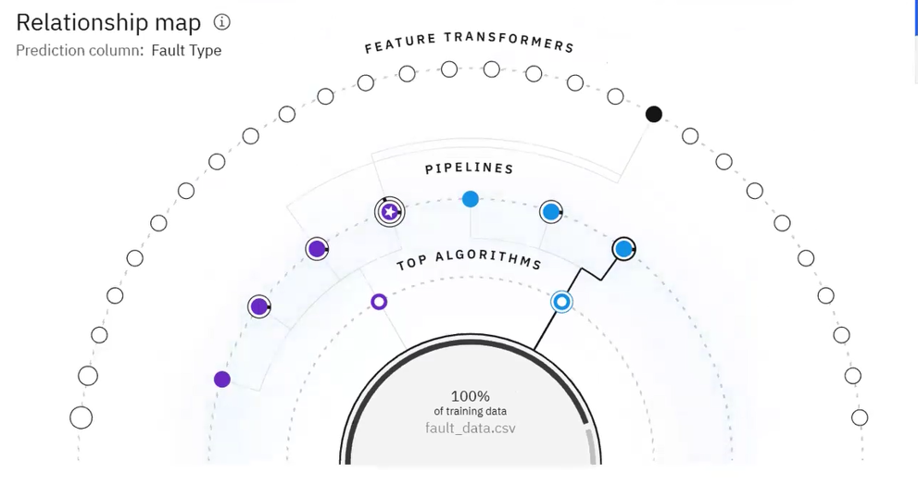

Slide 15
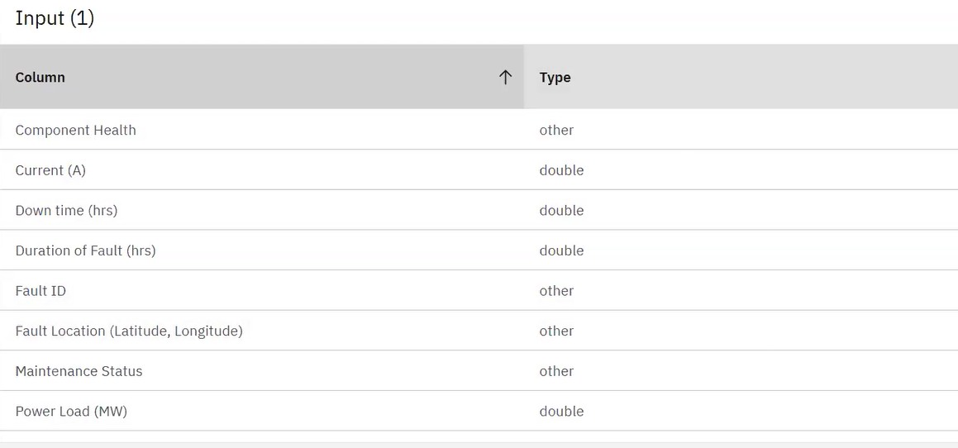

Slide 16
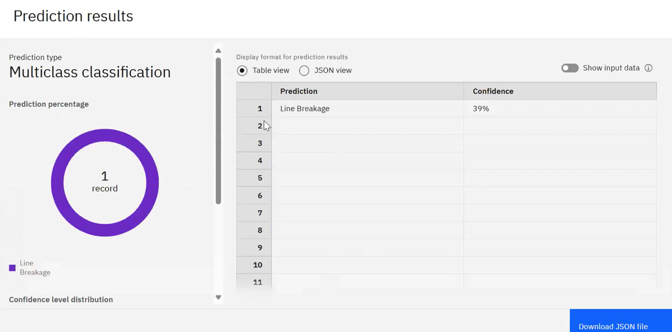

Slide 17
Conclusion
The implementation of a machine learning model using IBM AutoAI for power system fault detection and classification has demonstrated an efficient, accurate, and scalable approach to maintaining grid stability. By leveraging voltage and current phasor data, the model successfully distinguishes between normal conditions and various types of faults such as line-to-ground, line-to-line, and three-phase faults. The use of IBM AutoAI streamlined the entire pipeline from data preprocessing to model training and deployment enabling rapid development without requiring in-depth manual tuning. The final deployed model, accessible through a REST API on IBM Watson Machine Learning, offers a reliable solution for real-time monitoring and quick decision-making, ultimately supporting a more resilient and responsive power distribution system.

Slide 18
Future scope
In the future, the model can be enhanced by integrating real-time IoT sensor data for live fault detection
and prediction. Additionally, incorporating advanced deep learning models could improve accuracy in
complex fault scenarios.

Slide 19
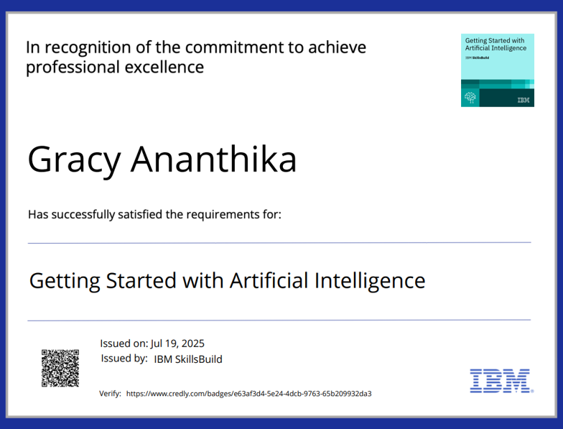
IBM Certifications

Slide 20
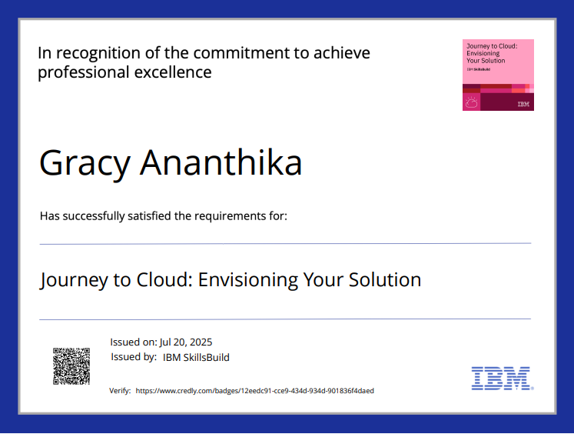
IBM Certifications

Slide 21
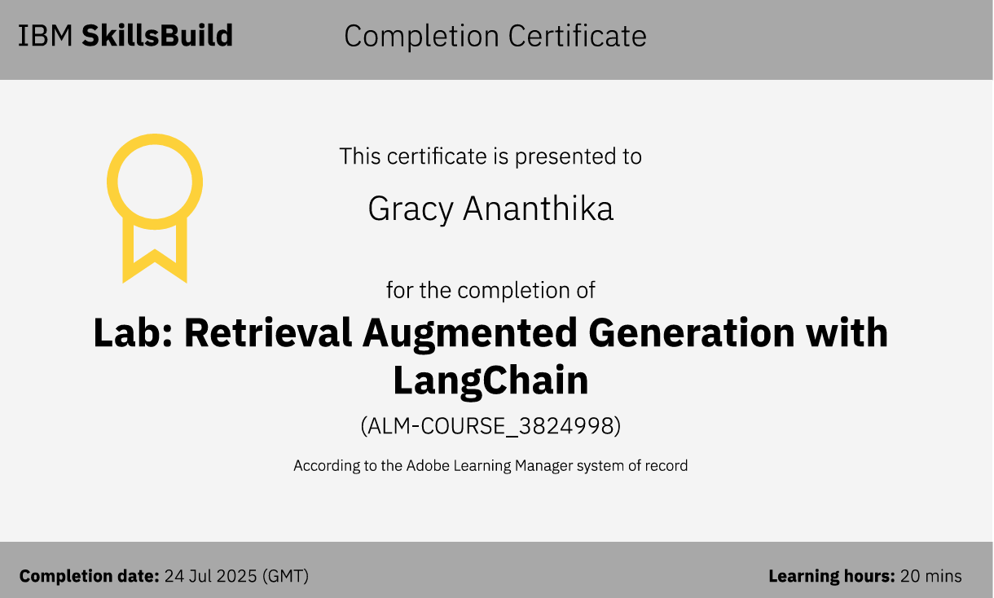
IBM Certifications

Slide 22
THANK YOU

