Slide 1
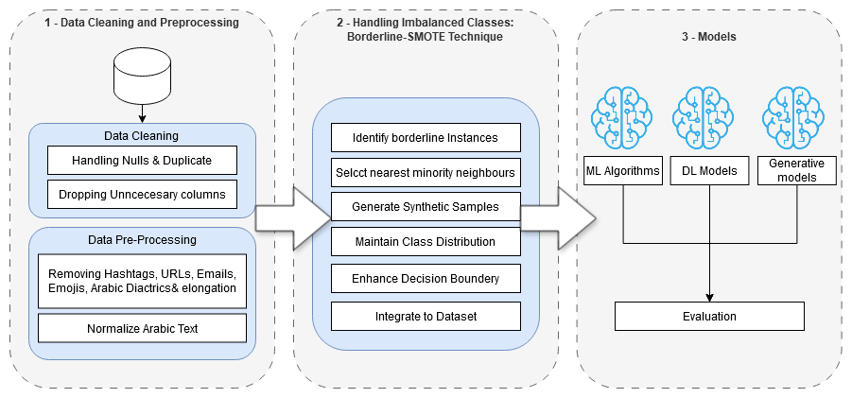
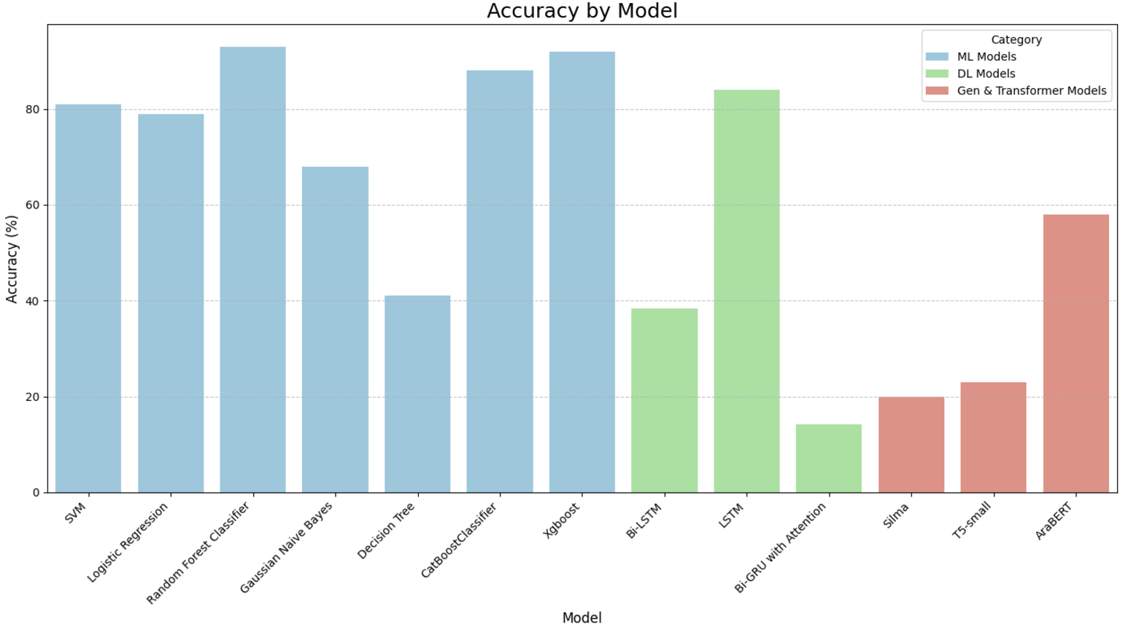
The results demonstrate that traditional machine learning models, such as Random Forest and XGBoost, outperformed deep learning and transformer-based models, achieving accuracies of 93% and 92%, respectively. In contrast, generative models like Silma and T5-small exhibited lower performance, highlighting the effectiveness of traditional approaches for this specific task.
AIS411-1
Detecting bias in news coverage: Israel vs Gaza conflict
Team: Marryam Yahya, Mariam Nabil, Esraa Ismail, Yomna Ashraf, Nada Radwan
Abstract
Material & Methods
Bias in news reporting shapes public perception, especially in polarized contexts like the Israel-Gaza conflict. Detecting such bias is challenging due to the political and cultural complexities involved. To address this, we propose an NLP-based framework leveraging Nakba narratives for bias detection. Using a multilingual Arabic-focused corpus, we apply advanced preprocessing and methods to address class imbalance. Our study evaluates ML, DL, Transformer-based architectures, and generative models, showing promising advancements in automating bias detection and improving fairness in politically sensitive reporting.
Our methodology involves a three-phase model pipeline: data preprocessing, class imbalance handling, and applying diverse models. We used a multilingual dataset of 12,000 annotated Facebook posts from the BiasFignews corpus. After cleaning and normalizing text data, Borderline-SMOTE was applied to address class imbalance. For embeddings, we utilized the Multilingual E5 model to capture semantic relationships. Classification was performed using advanced models, including transformer-based approaches like Silma LLM, T5, and AraBERT, as well as deep learning models like Bi-LSTM and machine learning algorithms such as SVM and XGBoost, ensuring robust bias detection across languages.
Introduction
Bias in news reporting significantly influences public opinion and political polarization, especially in sensitive topics like the Israel-Gaza conflict. Traditional bias detection methods often overlook the complexities of language shaped by historical, cultural, and political contexts. To address this, our study develops a specialized NLP framework for detecting biased coverage, leveraging the multilingual "BiasFignews" corpus of 12,000 annotated Facebook posts in Arabic, Hebrew, English, French, and Hindi. By employing advanced NLP techniques, such as transformer models (T5) and machine learning algorithms (SVM, Random Forest, XGBoost), we aim to tackle challenges like class imbalance and improve model performance. Our work contributes to promoting ethical journalism and ensuring balanced media coverage in conflict reporting.
Conclusion
Results & Discussion
This study addresses the critical task of detecting bias in news reporting on the Israel-Gaza conflict using an Arabic corpus and advanced machine learning techniques. Ensemble methods like Random Forest and XGBoost demonstrated superior performance, overcoming challenges such as data imbalance and subtle bias indicators. By combining strategies like Borderline-SMOTE with state-of-the-art models, the framework offers a scalable solution for analyzing media coverage in sensitive geopolitical contexts, contributing to the pursuit of ethical journalism.
References
[1] SinaLab, "BiasFignews: A Multilingual Corpus of Facebook Posts Annotated for Bias and Propaganda," GitHub, 2024. [Online]. Available: https://github.com/SinaLab/BiasFignews
[2] L. Duaibes, A. Jaber, M. Jarrar, A. Qadi, and M. Qandeel, "Sina at FigNews 2024: Multilingual Datasets Annotated with Bias and Propaganda," arXiv, 2024. [Online]. Available: https://arxiv.org/abs/2407.09327
The results demonstrate that traditional machine learning models, such as Random Forest and XGBoost, outperformed deep learning and transformer-based models, achieving accuracies of 93% and 92%, respectively. In contrast, generative models like Silma and T5-small exhibited lower performance, highlighting the effectiveness of traditional approaches for this specific task.
Acknowledgement
We would like to thank Dr. Ensaf and Eng Zeyad for their great help in this project.

