Slide 1
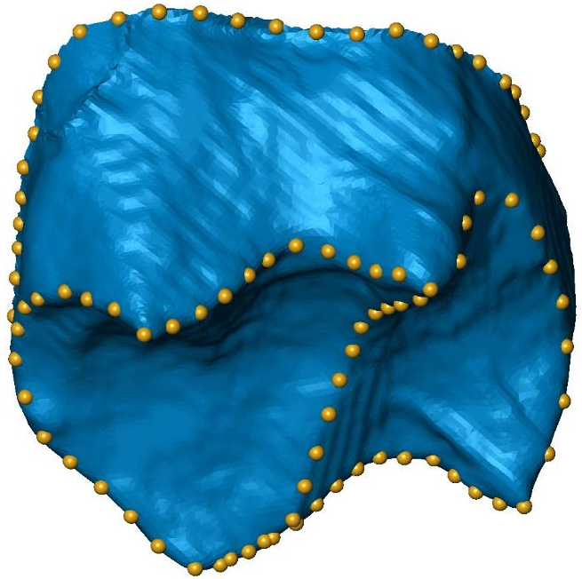
3D Geometric morphometrics in practice
Clément Zanolli & Laura Maréchal
Day 4 (28/06/2022)

Slide 2
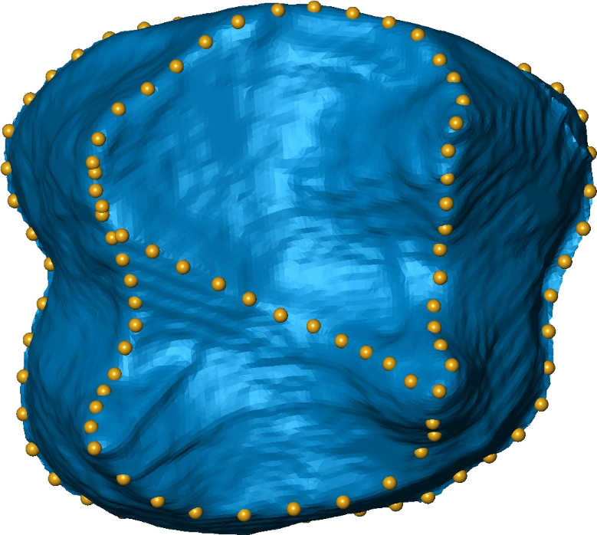
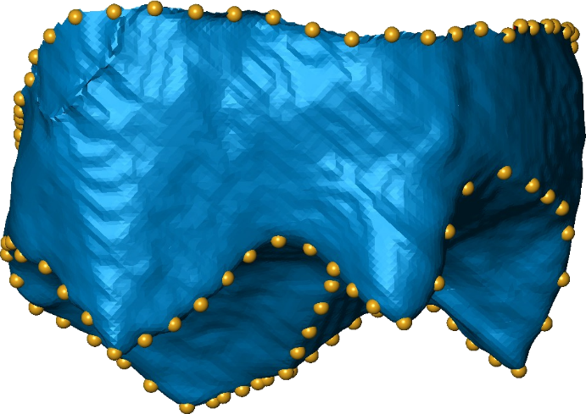
4 type I landmarks and 110 semilandmarks

Slide 3
Loading packages for GM analyses
#load libraries
library(scatterplot3d)
library(shapes)
library(ade4)
library(Morpho)
library(rgl)
library(MASS)
library(pairwiseAdonis)
library(vegan)

Slide 4
Loading data (landmark coordinates)
#load data set (semilandmarks.csv)
data<-read.table("Semilandmarks.csv",header=FALSE,sep=";")
Before running the line below, let's look at the organization of the data
edit(data)
How are data organized? (hint: how many lines and columns are there and what do they represent?)

Slide 5
Let’s define some parameters
#number of dimensions
dimensions=3
#a group with genera names
name=as.factor(data[,1])
#number of individuals
nbIndividu=nrow(data)
#number of landmarks
nbLandmark=(ncol(data)-1)/3

Slide 6
Selecting only data and formatting them as an array
#selecting only semilandmark data (i.e., removing the first column that include genera names)
data2=as.matrix(data[,-1])
#reorganizing the data as an array
data2<-aperm(array(t(data2),dim=c(dimensions,nbLandmark,nbIndividu)),c(2,1,3))

Slide 7
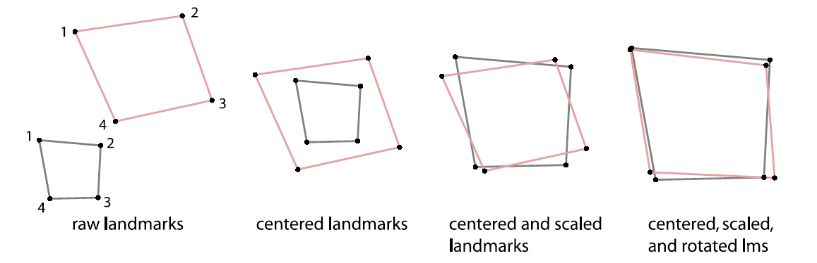
Procrustes superimposition
####running the Procrustes superimposition
gp1<-procGPA(data2,scale=TRUE)
Mitteroecker and Gunz, 2009, Evol. Biol.

Slide 8
PCA plots: PC1 and PC2
#isolating percentage of variance
x=round(gp1$percent, digits=2)
x1=as.factor(paste("PC1 (",x[1],"%)"))
x2=as.factor(paste("PC2 (",x[2],"%)"))
#PC1 and PC2 plot
plot(gp1$scores[,c(1,2)],xlab=x1,ylab=x2,asp=1,pch=as.numeric(name),col=as.numeric(name))
#vertical and horizontal dotted lines passing by zero
abline(v=0,h=0,lwd=.5,lty=3)
#adding labels
text(gp1$scores[,c(1,2)],labels=name,pos=1,offset=0.1,cex=0.5)
#creating convex hulls for groups
s.chull (gp1$scores[,c(1,2)],fac=name,xax=1,optchull=1,clabel=0,add.plot=TRUE)

Slide 9
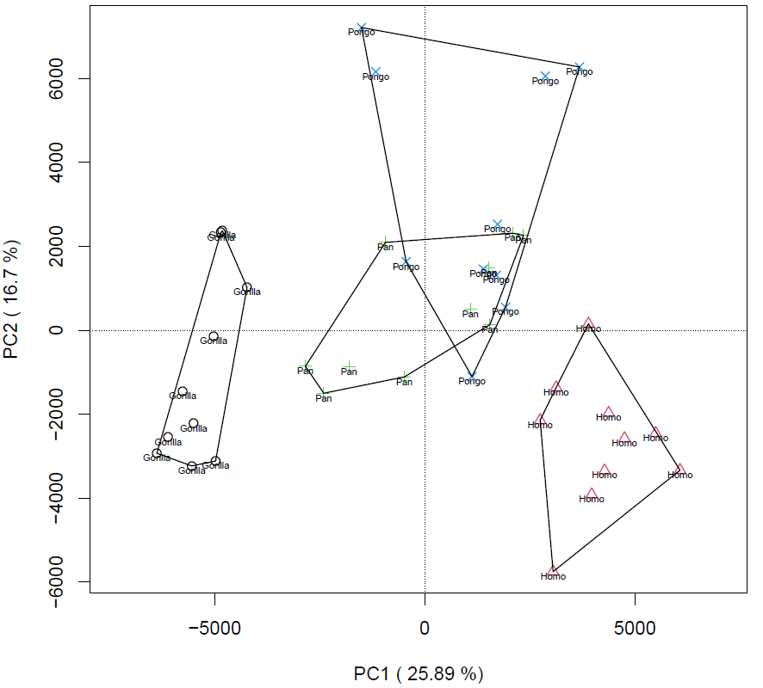
PC1 and PC2 plot

Slide 10
PC2 and PC3
#now, let's look at PC2 vs. PC3
x3=as.factor(paste("PC3 (",x[3],"%)"))
plot(gp1$scores[,c(2,3)],xlab=x2,ylab=x3,asp=1,pch=as.numeric(name),col=as.numeric(name))
abline(v=0,h=0,lwd=.5,lty=3)
text(gp1$scores[,c(2,3)],labels=name,pos=1,offset=0.1,cex=0.5)
s.chull (gp1$scores[,c(2,3)],fac=name,xax=1,optchull=1,clabel=0,add.plot=TRUE)

Slide 11
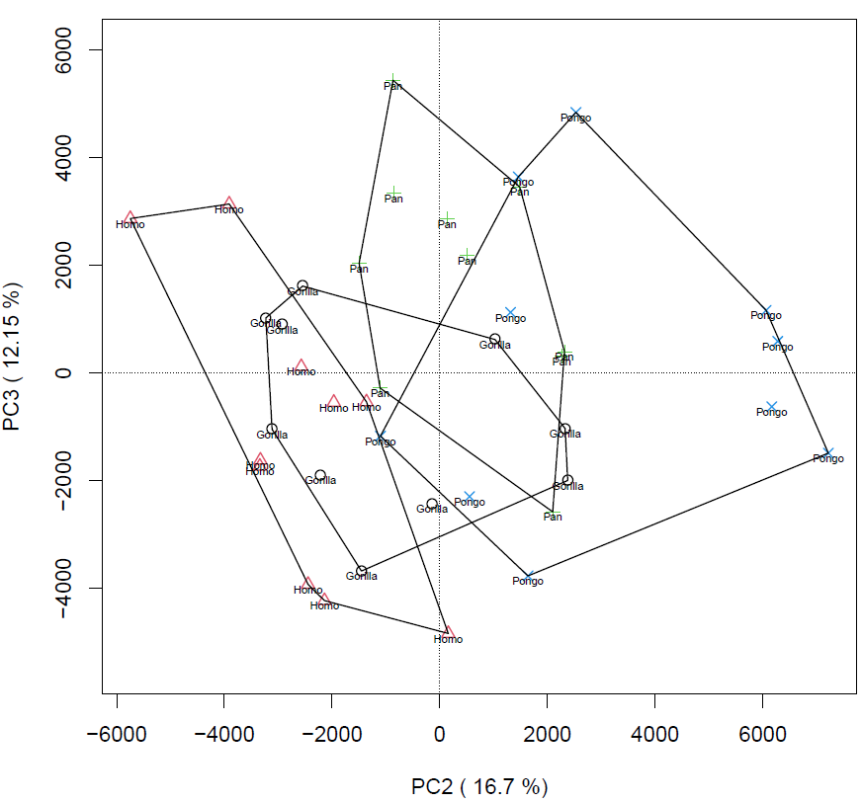
PC2 and PC3

Slide 12
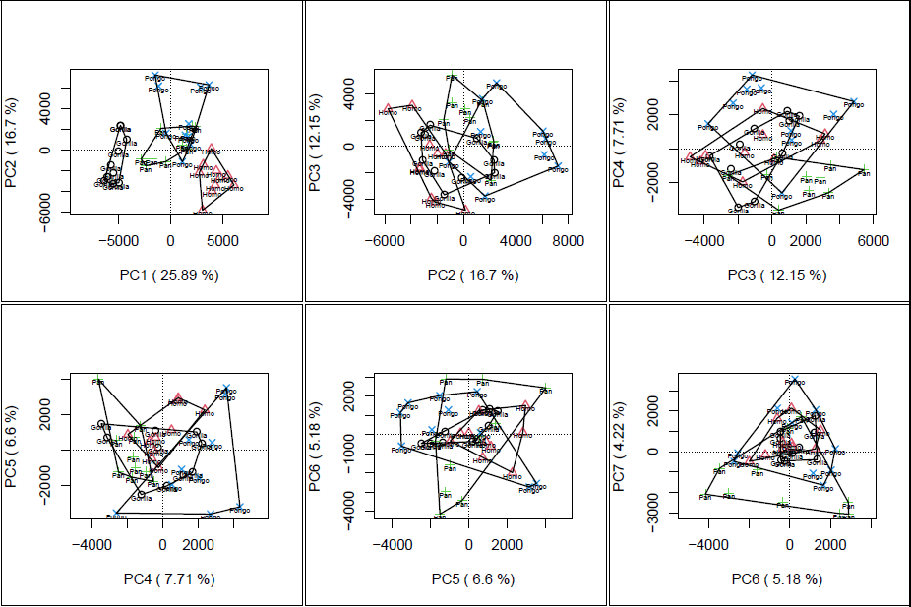
PCA plots
#you can also try to explore other PC combinations and further PCs

Slide 13
Extreme shapes visualization
####extreme shapes PC1
source(file.choose()) # open functions.R
#creating an object with rotated data for visualization
procrustes<-array2mat(gp1$rotated)
#computing extreme shapes along PC1
#minimum shape
minPC1<-extshapes(procrustes,"pca",gp1,1,"min")
array_minPC1<- aperm(array(minPC1,c(3,length(minPC1)/3)),perm=c(2,1))
#visualize in 3D the minimum shape
points3d(array_minPC1,size=5,col="blue")

Slide 14
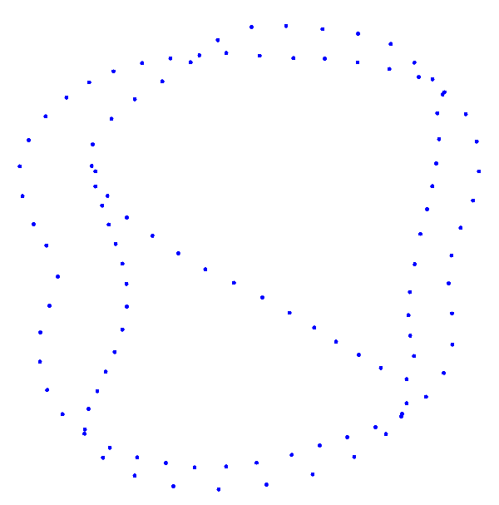
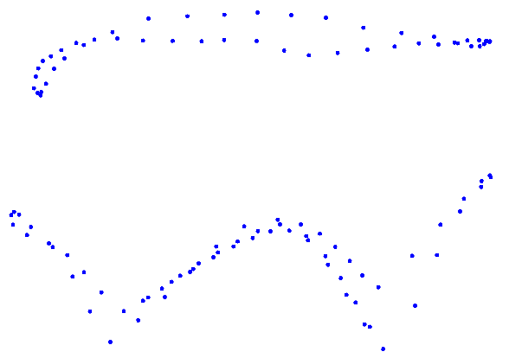
Minimun shape of PC1
Occlusal view
buccal view

Slide 15
#maximal shape
maxPC1<-extshapes(procrustes,"pca",gp1,1,"max")
array_maxPC1<- aperm(array(maxPC1,c(3,length(maxPC1)/3)),perm=c(2,1))
#visualize in 3D the maximum shape
points3d(array_maxPC1,size=5,col="red")
#change to ortogonal view (by default it is in perspective view)
par3d(FOV=0)
#save pdf with extreme shape points (as visible on screen)
#rgl.postscript("PC1_min-max.pdf","pdf")
#close the rgl window
rgl.close()

Slide 16
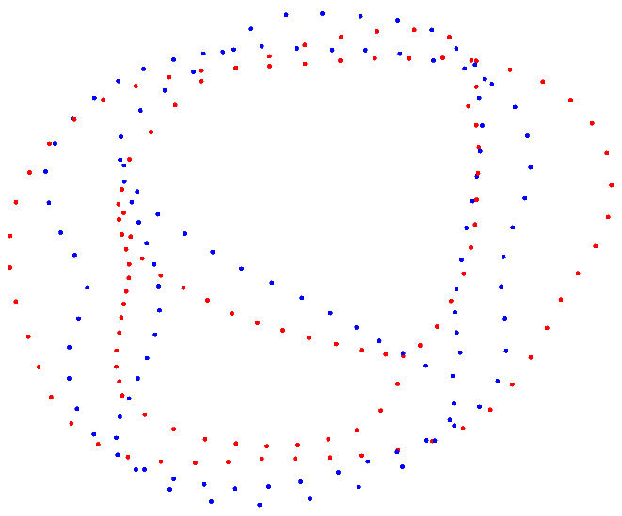
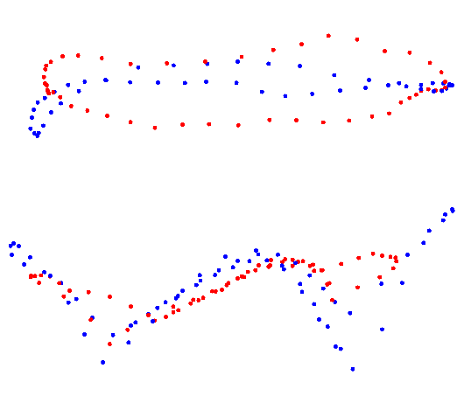
Minimun shape of PC1 compared with maximum shape (red)
Occlusal view
buccal view

Slide 17
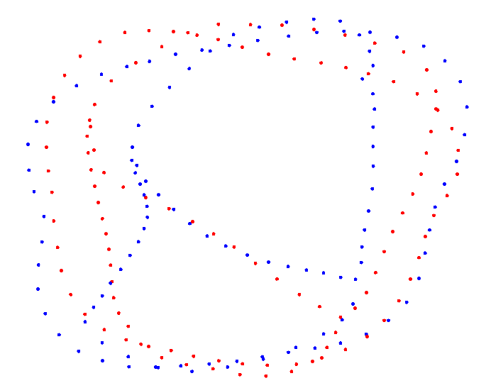
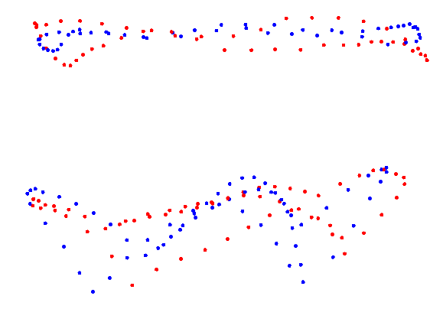
Now try to visualize minimum and maximum shapes of PC2
Occlusal view
buccal view

Slide 18
PC2 min-max shapes
#min
minPC2<-extshapes(procrustes,"pca",gp1,2,"min")
array_minPC2<- aperm(array(minPC2,c(3,length(minPC2)/3)),perm=c(2,1))
points3d(array_minPC2,size=5,col="blue")
#max
maxPC2<-extshapes(procrustes,"pca",gp1,2,"max")
array_maxPC2<- aperm(array(maxPC2,c(3,length(maxPC2)/3)),perm=c(2,1))
points3d(array_maxPC2,size=5,col="red")
par3d(FOV=0)
rgl.postscript("PC2_min-max2.pdf","pdf")

Slide 19
Between-group PCA
####between group PCA
#computing again Procrustes superimposition (with Morpho function procSym)
gp2=procSym(data2)
group=name
#computing the between-group PCA
bgPCA=groupPCA(dataarray=gp2$orpdata,groups=group,rounds=1000,cv=T,weighting=T)

Slide 20
Between-group PCA plot
#calculating the percentage of variance along bgPC1 and bgPC2
X1=as.factor(paste("bgPC1 (",round(bgPCA$Variance$exVar[1]*100,digits=2),"%)",sep=""))
X2=as.factor(paste("bgPC2 (",round(bgPCA$Variance$exVar[2]*100,digits=2),"%)",sep=""))
#normal bgPC1 and bgPC2 plot
plot(bgPCA$Scores[,1:2],xlab=X1,ylab=X2,pch=as.numeric(group),col=as.numeric(group),asp=1)
#vertical and horizontal dotted lines passing by zero
abline(v=0,h=0,lwd=.5,lty=3)
#adding labels
text(bgPCA$Scores[,1:2],labels=name,pos=1,offset=0.1,cex=0.5)
#creating convex hulls for groups
s.chull (bgPCA$Scores[,1:2],fac=group,xax=1,optchull=1,clabel=0,add.plot=TRUE)

Slide 21
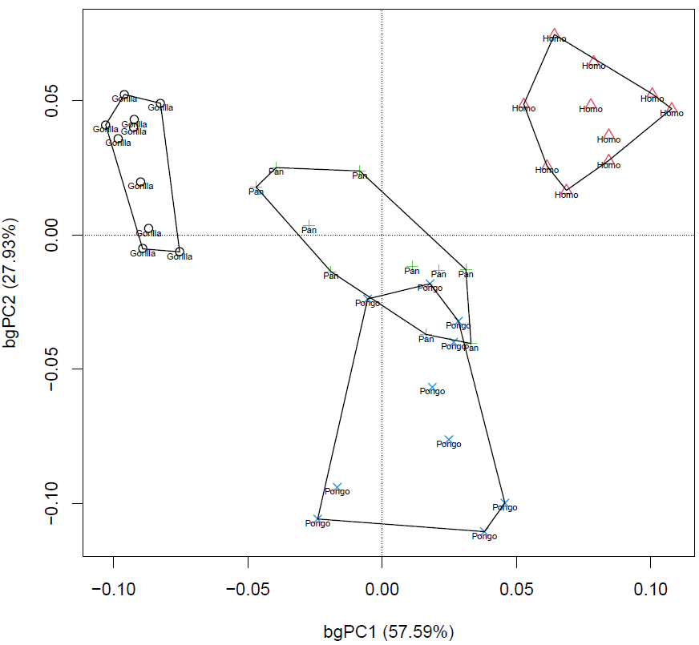
bgPC1 and bgPC2 plot

Slide 22
Cross-validated bgPCA
#cross-validated bgPCA plot
plot(bgPCA$CV[,1:2],xlab="cv-bgPC1",ylab="cv-bgPC2",pch=as.numeric(group),col=as.numeric(group),asp=1)
abline(v=0,h=0,lwd=.5,lty=3)
text(bgPCA$CV[,1:2],labels=name,pos=1,offset=0.1,cex=0.5)
s.chull (bgPCA$CV[,1:2],fac=group,xax=1,optchull=1,clabel=0,add.plot=TRUE)

Slide 23
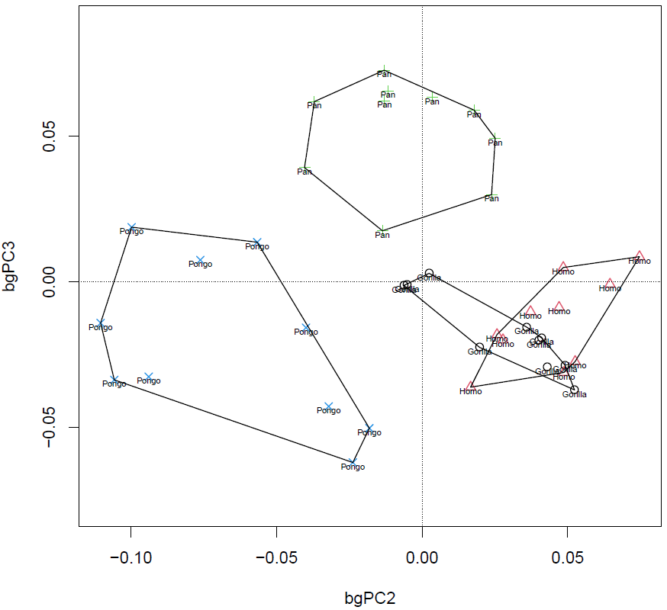
bgPC2 and bgPC3 plot
#now try to plot bgPC2 and bgPC3

Slide 24
#Plot bgPC2 and bgPC3
plot(bgPCA$Scores[,c(2,3)],xlab="bgPC2",ylab="bgPC3",pch=as.numeric(group),col=as.numeric(group),asp=1)
abline(v=0,h=0,lwd=.5,lty=3)
text(bgPCA$Scores[,c(2,3)],labels=name,pos=1,offset=0.1,cex=0.5)
s.chull (bgPCA$Scores[,c(2,3)],fac=group,xax=1,optchull=1,clabel=0,add.plot=TRUE)

Slide 25
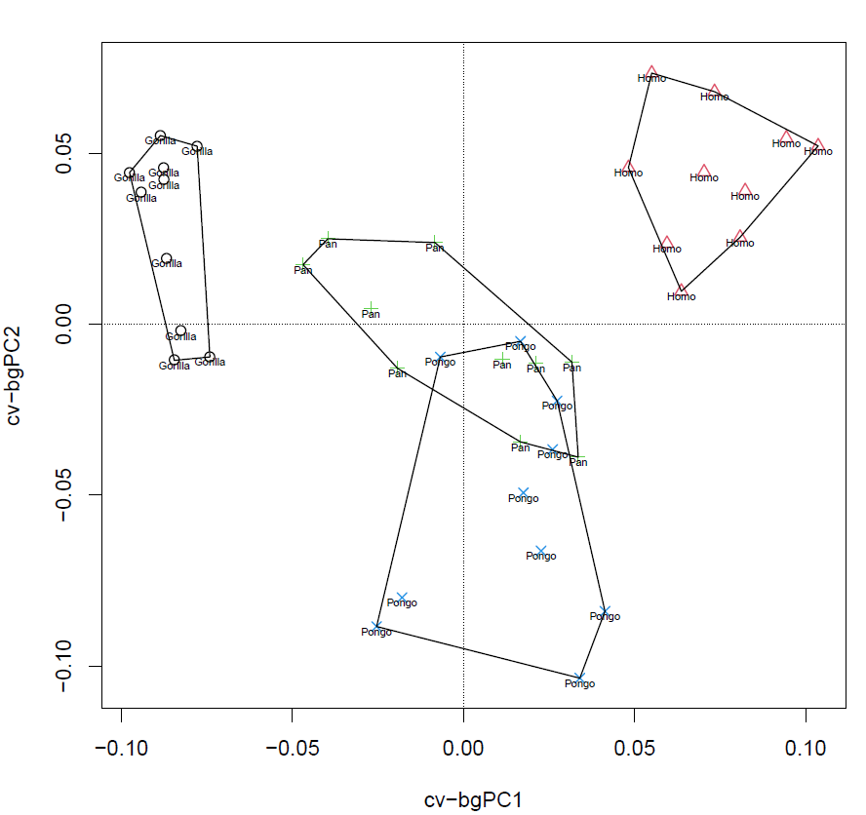
Cross-validated bgPCA plot (bgPC1 and bgPC2)

Slide 26
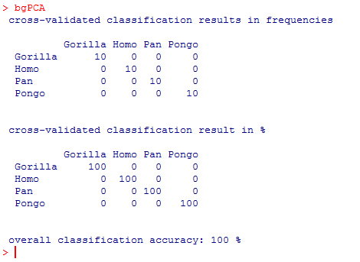
#checking the degree of correct classification
bgPCA

Slide 27
Extreme shapes of bgPCs
####extreme shapes bgPC1
#min bgPC1
minbgPC1<-extshapes(procrustes,"bgpca",bgPCA,1,"min")
array_minbgPC1<- aperm(array(minbgPC1,c(3,length(minbgPC1)/3)),perm=c(2,1))
#visualize in 3D the minimum shape
points3d(array_minbgPC1,size=5,col="blue")

Slide 28
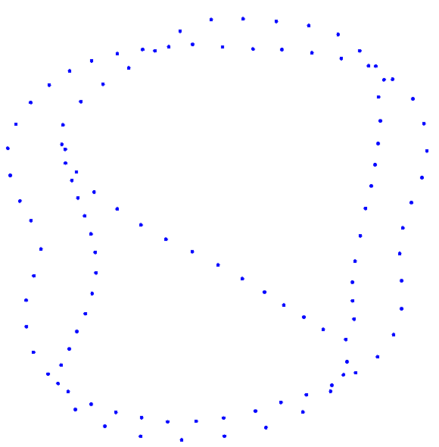
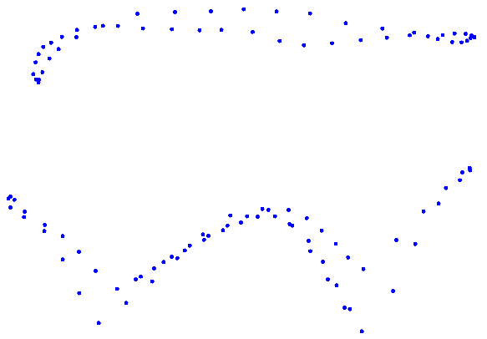
Minimun shape of bgPC1
Occlusal view
buccal view

Slide 29
Maximum shape of bgPC1
#max bgPC1
maxbgPC1<-extshapes(procrustes,"bgpca",bgPCA,1,"max")
array_maxbgPC1<- aperm(array(maxbgPC1,c(3,length(maxbgPC1)/3)),perm=c(2,1))
#visualize in 3D the maximum shape
points3d(array_maxbgPC1,size=5,col="red")
#change to ortogonal view (by default it is in perspective view)
par3d(FOV=0)
#save pdf with extreme shape points (as visible on screen)
rgl.postscript("bgPC1_min-max.pdf","pdf")
#close the rgl window
rgl.close()

Slide 30
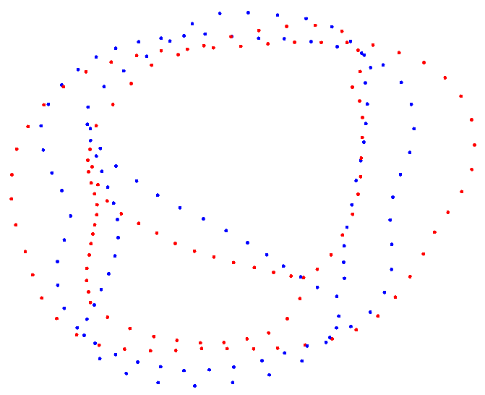
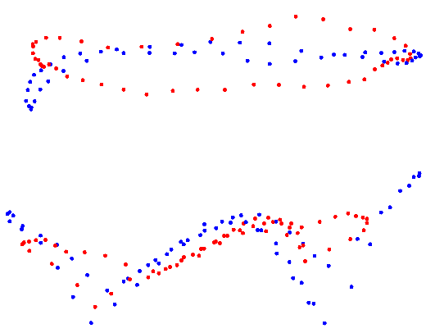
Minimun shape of bgPC1 compared with maximum shape (red)
Occlusal view
buccal view

Slide 31
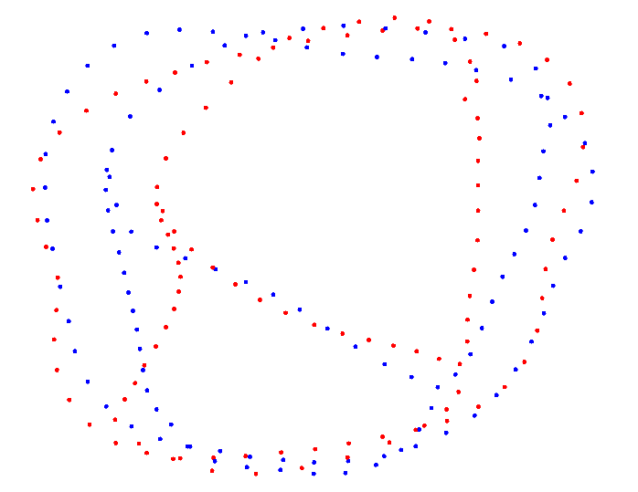
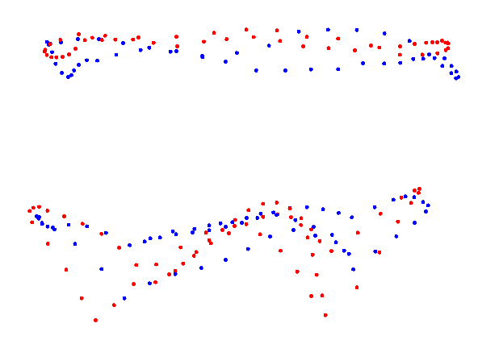
Now try to visualize the extreme shapes of bgPC2
Occlusal view
buccal view

Slide 32
Extreme shapes of bgPC2
#min bgPC2
minbgPC2<-extshapes(procrustes,"bgpca",bgPCA,2,"min")
array_minbgPC2<- aperm(array(minbgPC2,c(3,length(minbgPC2)/3)),perm=c(2,1))
points3d(array_minbgPC2,size=5,col="blue")
#max bgPC2
maxbgPC2<-extshapes(procrustes,"bgpca",bgPCA,2,"max")
array_maxbgPC2<- aperm(array(maxbgPC2,c(3,length(maxbgPC2)/3)),perm=c(2,1))
points3d(array_maxbgPC2,size=5,col="red")
par3d(FOV=0)

Slide 33
Preliminary steps before computing a canonical variate analysis
# input data
ncomp=40
dat <- as.data.frame(cbind(Group = group, gp1$scores, 1:ncomp))
# plot the highest cross-classification accuracy
accuracies <- rep(NA, ncomp - 1)
names(accuracies) <- paste(2:ncomp, "axes")
for (k in 3:ncol(dat)) {
mod <- lda(dat$Group ~ ., data = dat[, 1:k],
prior = rep(1/4, 4),
CV = TRUE)
accuracies[k - 2] <- sum(mod$class == dat$Group) / nrow(dat)
}
plot(x = 2:ncomp, y = accuracies,
type = "b", pch = 16,
xlab = "Number of PCA axes in LDA model",
ylab = "X-val classification accuracy")
grid()

Slide 34
#display the cumulative percentage of variation along PC scores
cumsum(gp1$percent[1:40])

Slide 35
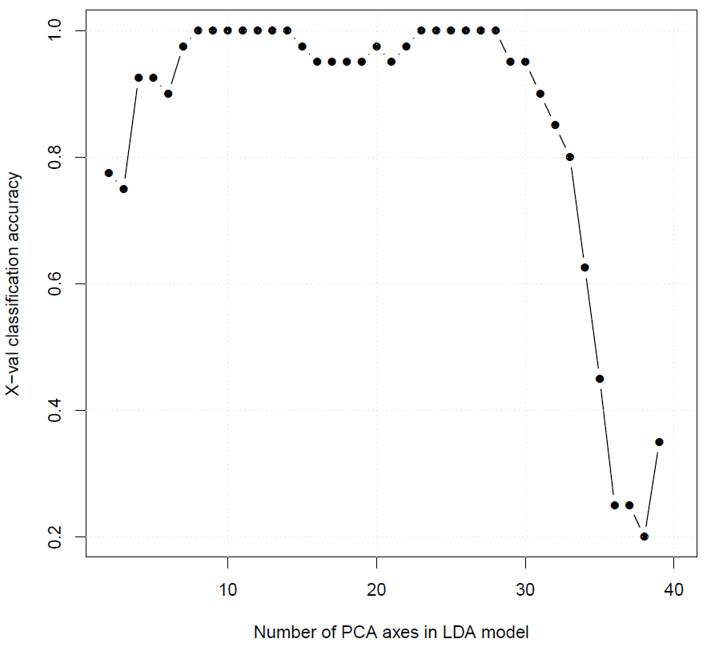
Cross-validated classification accuracy

Slide 36
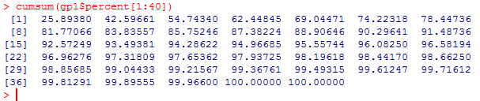
Based on the previous plot, 8 components are enough to reach 100% correct classification.
Now what do 8 PCs represent in term of percentage of variance?

Slide 37
Run the CVA
#create data objects based on the number of PC scores relevant for CVA
resDonnees2=gp1$scores[,1:8]
#run CVA
cva=CVA(resDonnees2, group, cv=TRUE, prior=rep(1/4,4), weighting=TRUE)

Slide 38
Plot of CV1 and CV2
#isolating percentage of variance for CV1 and CV2
percx=round(cva$Var[1,2],digits=2)
percy=round(cva$Var[2,2],digits=2)
#plot CV1 and CV2
plot(cva$CVscores,xlab=paste("CV1 (",percx,"%)"),ylab=paste("CV2 (",percy,"%)"),asp=1,cex=1,col=as.numeric(group),pch=as.numeric(group))
#vertical and horizontal dotted lines passing by zero
abline(v=0,h=0,lwd=1,lty=3)
#adding labels
text(cva$CVscores[,c(1,2)],labels=name,pos=1,offset=0.1,cex=0.5)
#creating convex hulls for groups
s.chull(cva$CVscores,fac=group,xax=1,optchull=1,clabel=0,add.plot=TRUE)

Slide 39
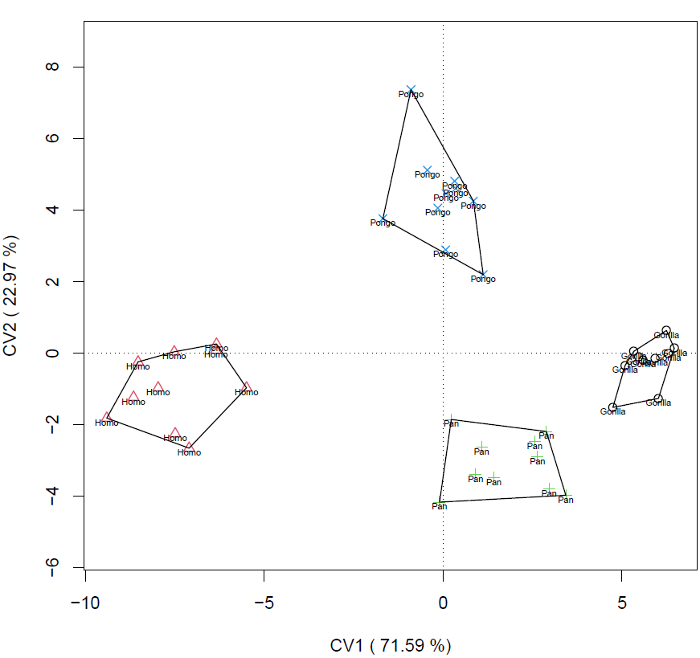
CV1 and CV2 plot

Slide 40
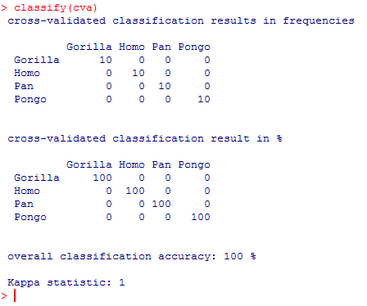
#check classification accuracy
classify(cva)

Slide 41
CV1 extreme shapes shape
#min CV1
minCV1<-extshapes(procrustes,"lda",cva,1,"min")
array_minCV1<- aperm(array(minCV1,c(3,length(minCV1)/3)),perm=c(2,1))
#visualize in 3D the minimum shape
points3d(array_minCV1,size=5,col="blue")

Slide 42
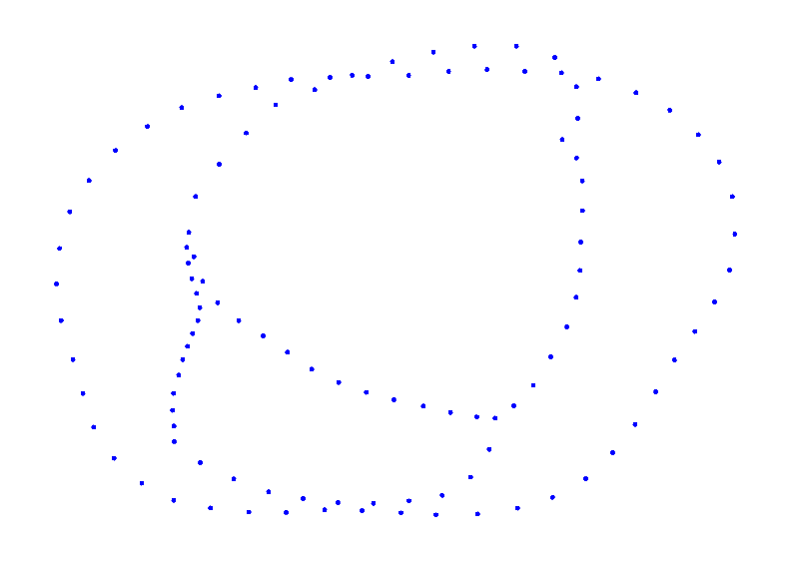
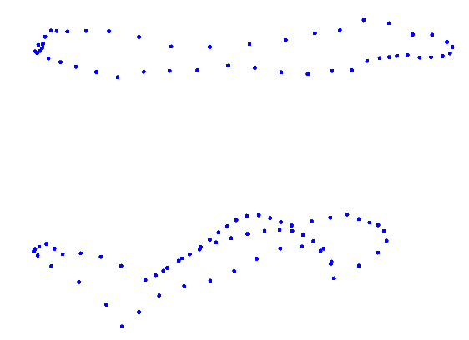
CV1 extreme shapes
Occlusal view
buccal view

Slide 43
#max CV1
maxCV1<-extshapes(procrustes,"lda",cva,1,"max")
array_maxCV1<- aperm(array(maxCV1,c(3,length(maxCV1)/3)),perm=c(2,1))
#visualize in 3D the maximum shape
points3d(array_maxCV1,size=5,col="red")
#change to ortogonal view (by default it is in perspective view)
par3d(FOV=0)
#save pdf with extreme shape points (as visible on screen)
rgl.postscript("CV1_min-max.pdf","pdf")

Slide 44
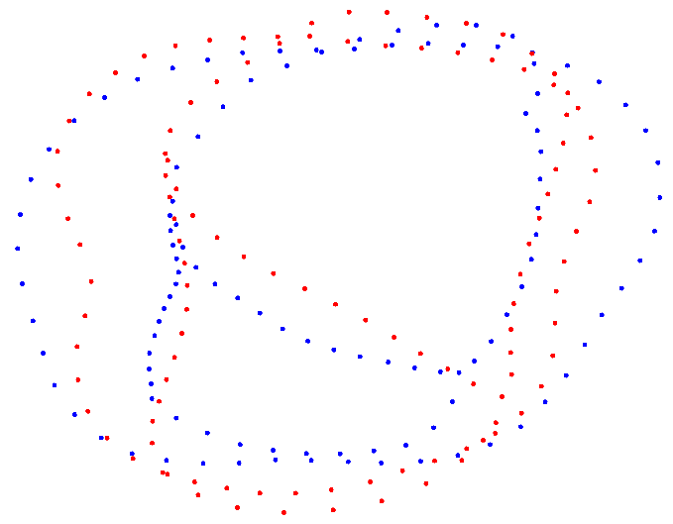
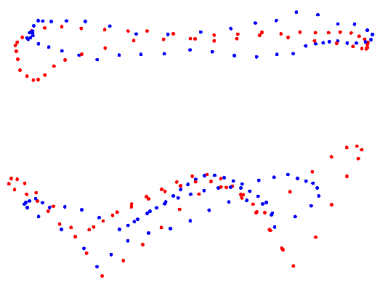
Occlusal view
buccal view

Slide 45
CV2 min-max shapes
Now try to visualize minimum and maximum shapes of CV2

Slide 46
CV2 min-max shapes
#min CV2
minCV2<-extshapes(procrustes,"lda",cva,1,"min")
array_minCV2<- aperm(array(minCV2,c(3,length(minCV2)/3)),perm=c(2,1))
#visualize in 3D the minimum shape
points3d(array_minCV2,size=5,col="blue")
#max CV2
maxCV2<-extshapes(procrustes,"lda",cva,1,"max")
array_maxCV2<- aperm(array(maxCV2,c(3,length(maxCV2)/3)),perm=c(2,1))
#visualize in 3D the minimum shape
points3d(array_maxCV2,size=5,col="red")
#change to ortogonal view (by default it is in perspective view)
par3d(FOV=0)

Slide 47
Testing for allometry
#define object for centroid size
centroid.size=gp1$size
#plot PC1 and centroid size
plot(gp1$scores[,1],centroid.size,col=as.numeric(group))
abline(coef(lm(centroid.size~gp1$scores[,1])),lwd=2,col="red")
text(gp1$scores[,1],centroid.size,labels=name,pos=1,offset=0.1,cex=0.5)

Slide 48
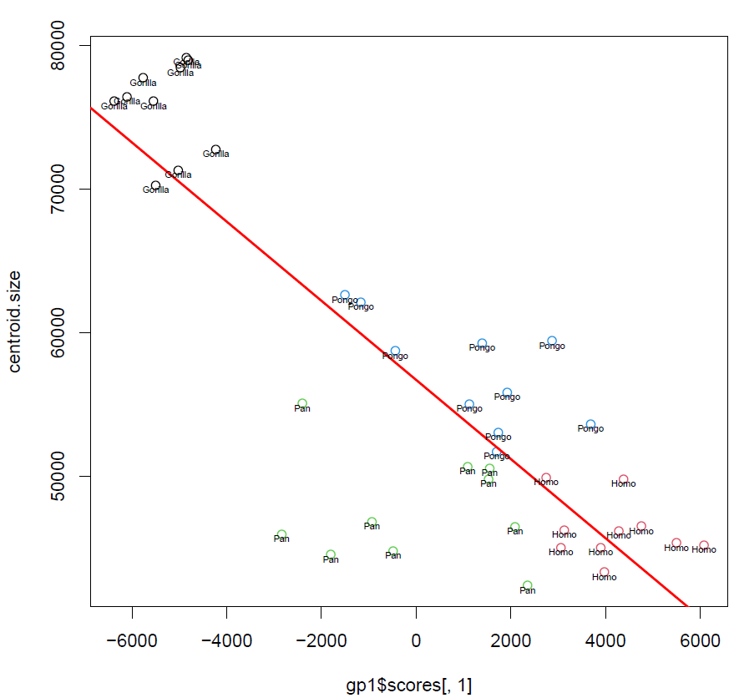
Plot of PC1 and centroid size

Slide 49
Plotting centroid size against scores
Try to investigate other PC scores, as well as bgPCs and CVs

Slide 50
ANOVA with pairwise comparisons
#statistically testing for allometry
perm1=adonis(formula=gp1$scores~centroid.size*group,permutations=9999,method="euc")
perm1

Slide 51
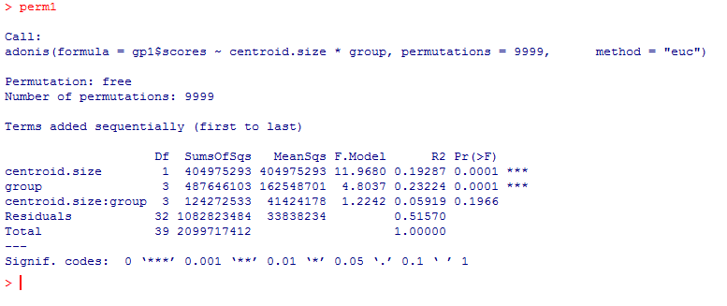
Results

