Slide 1
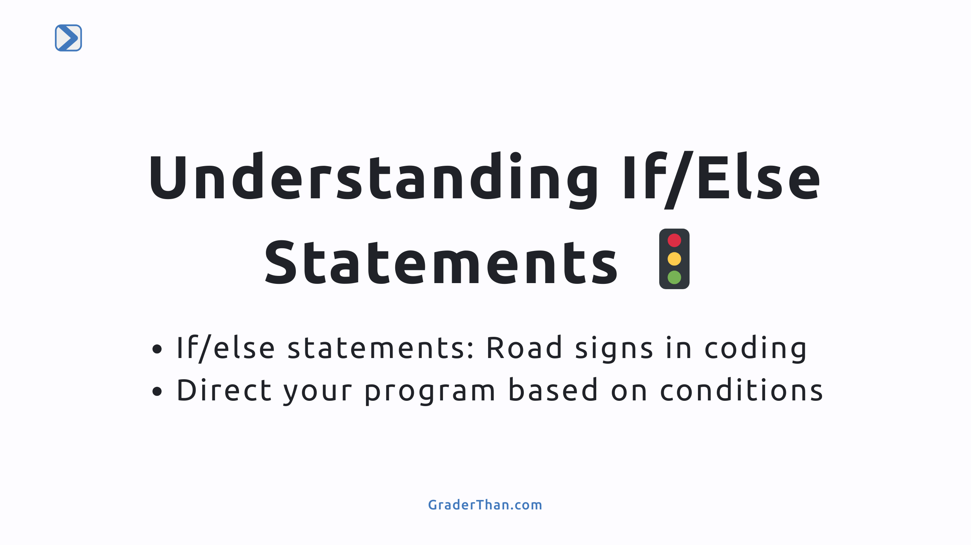
Notes:
- This slide introduces if/else statements as fundamental decision-making tools in programming. - Explain that these statements guide the flow of the program, much like road signs guide traffic.

Slide 2
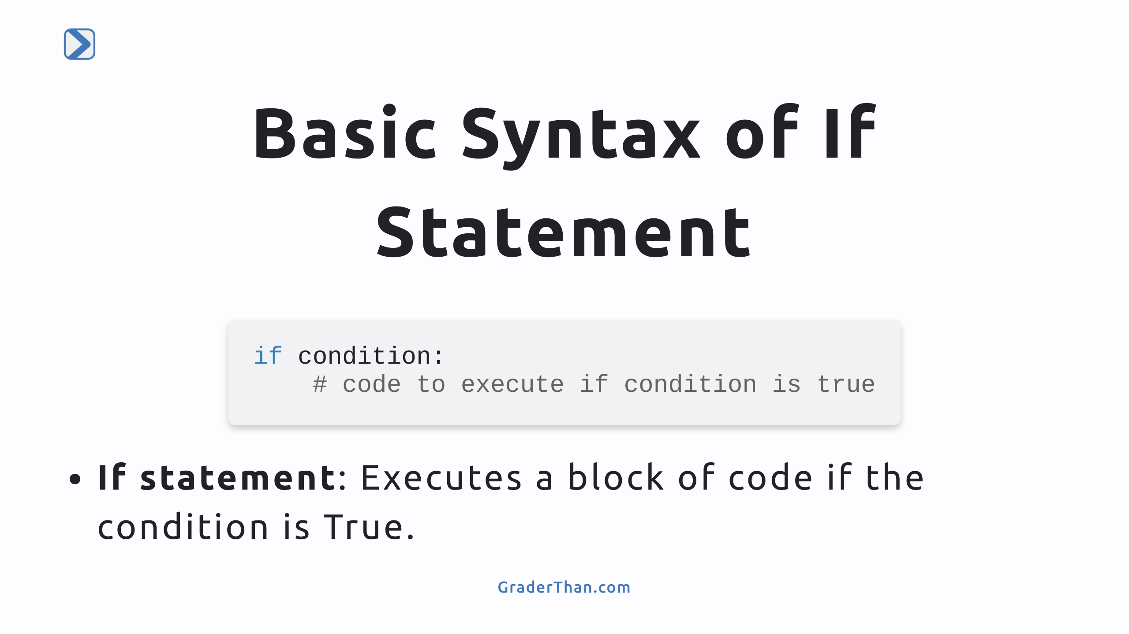
Notes:
Speaker notes: Discuss the syntax of an if statement. Highlight the importance of the condition being True for the code block to execute. This is the starting point for understanding conditional logic in programming.

Slide 3
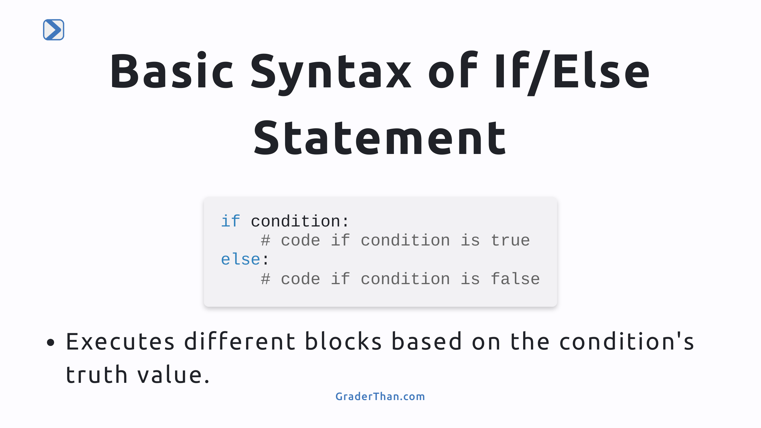
Notes:
Speaker notes: Explain the addition of the else statement for handling cases where the condition is False. This expands on the decision-making capabilities of programs, allowing for two possible paths of execution.

Slide 4
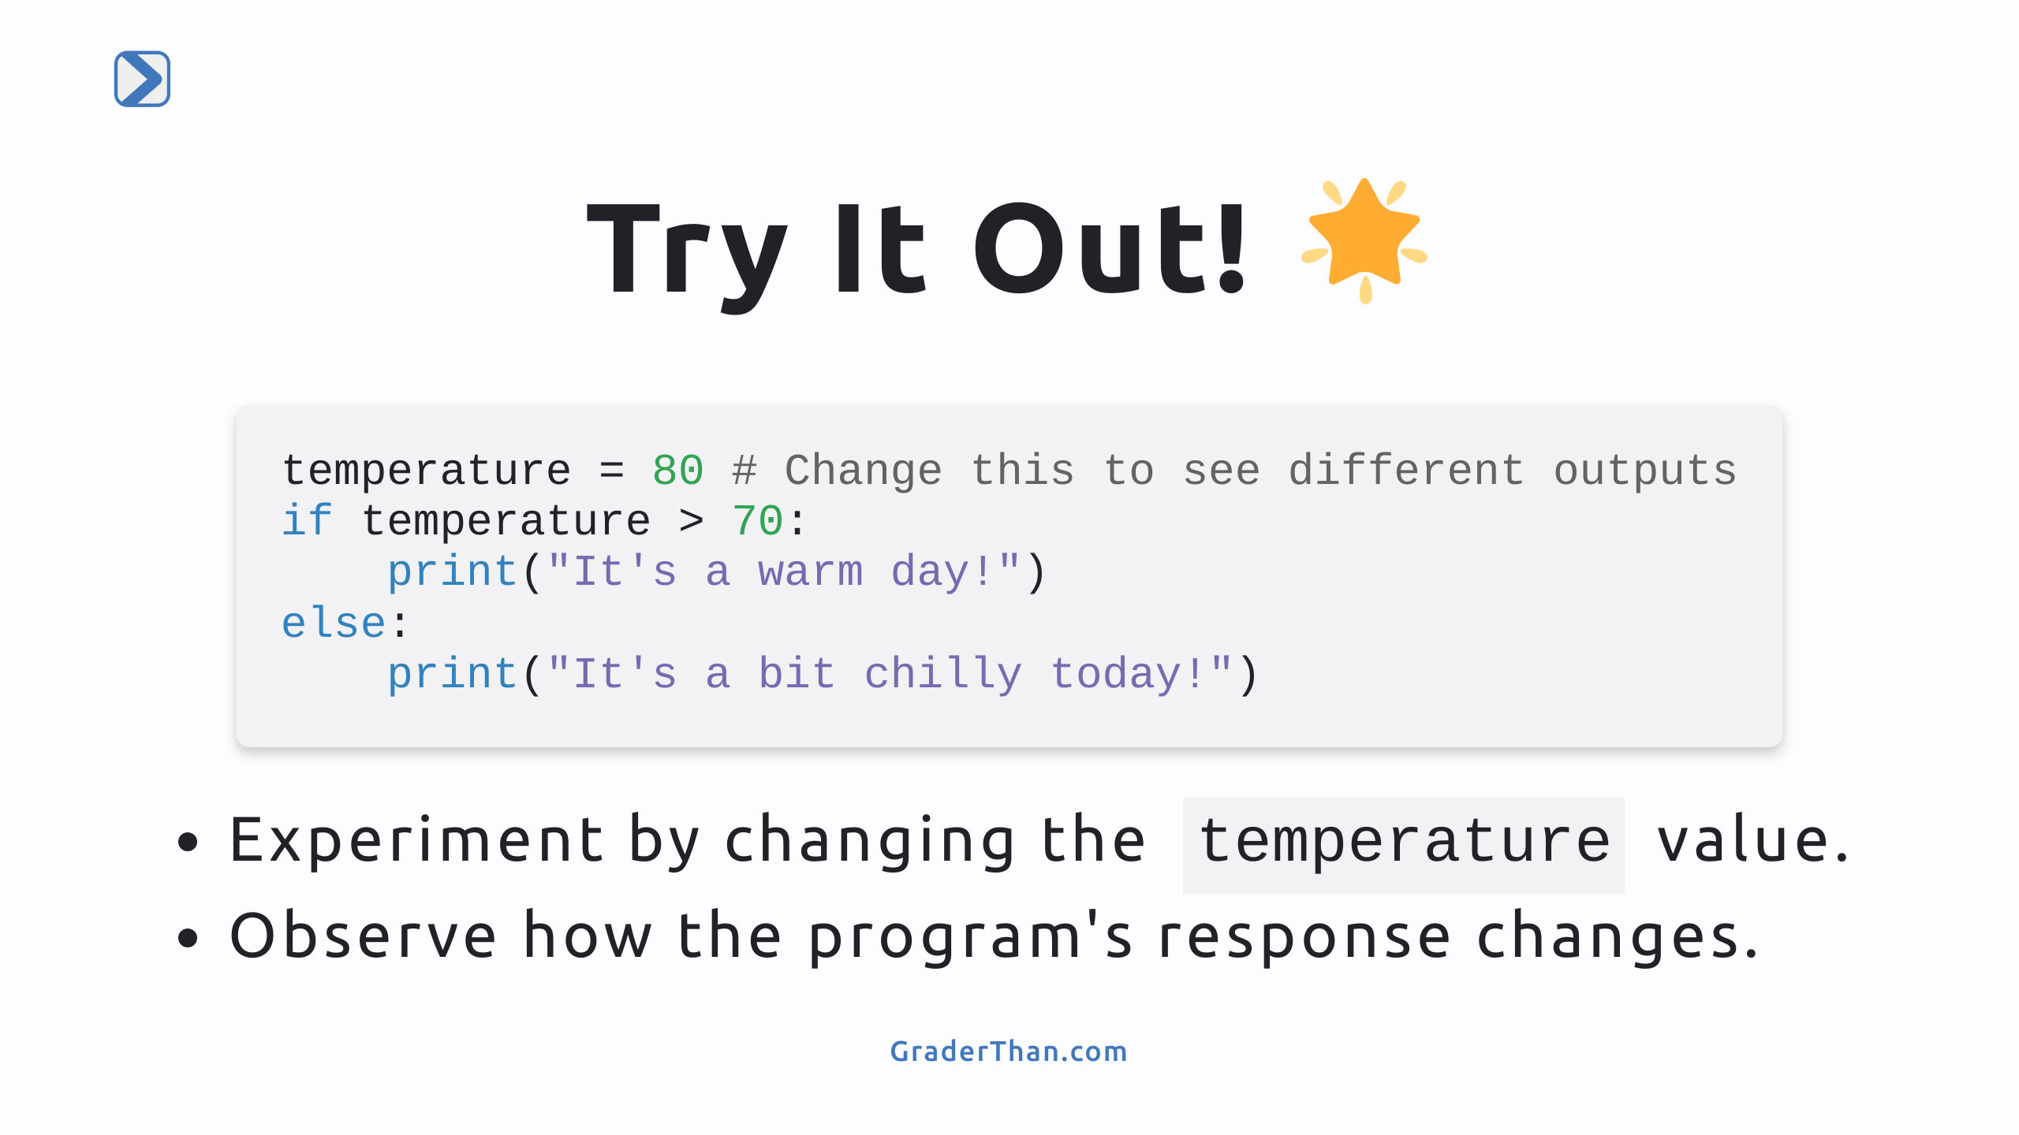
Notes:
Speaker notes: Encourage students to actively modify the temperature variable to see how the conditional logic in the program responds. This hands-on activity helps solidify their understanding of if/else statements through direct experimentation.

Slide 5
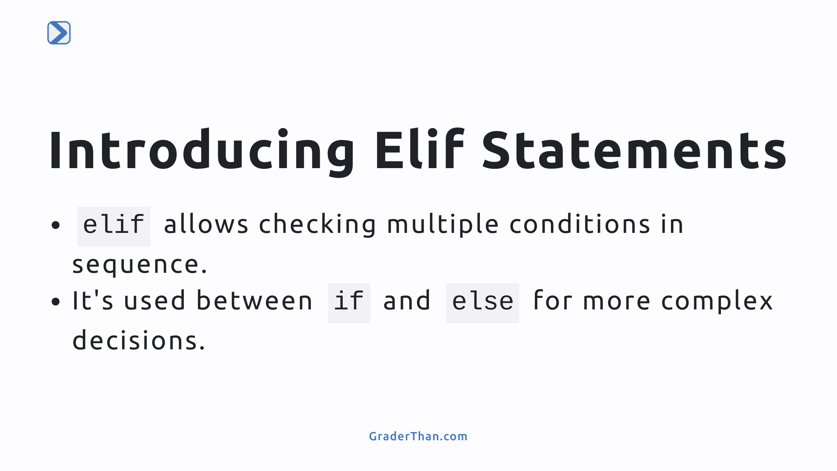
Notes:
Speaker notes: Introduce `elif` as a way to extend the basic if/else logic to handle multiple conditions. Explain that `elif` stands for "else if," providing a means to check several "if" conditions in one coherent structure.

Slide 6
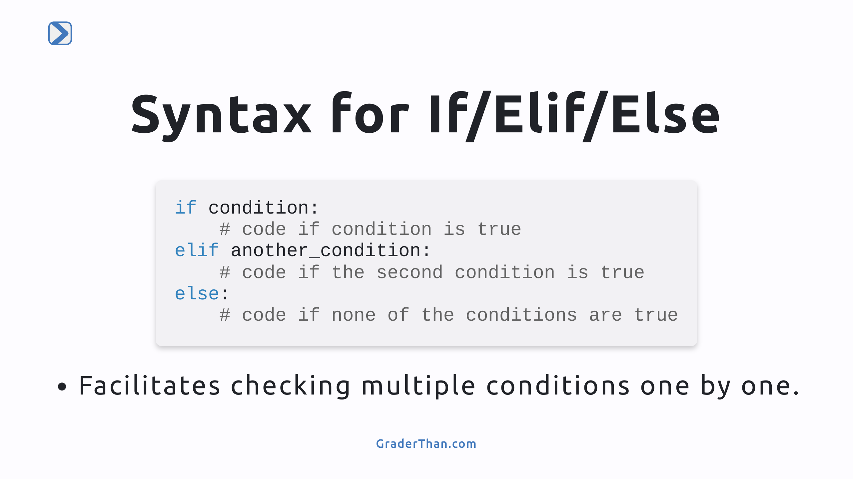
Notes:
Speaker notes: Dive deeper into the syntax of using if/elif/else statements together. Highlight how this structure allows programmers to construct more nuanced decision-making paths in their code.

Slide 7
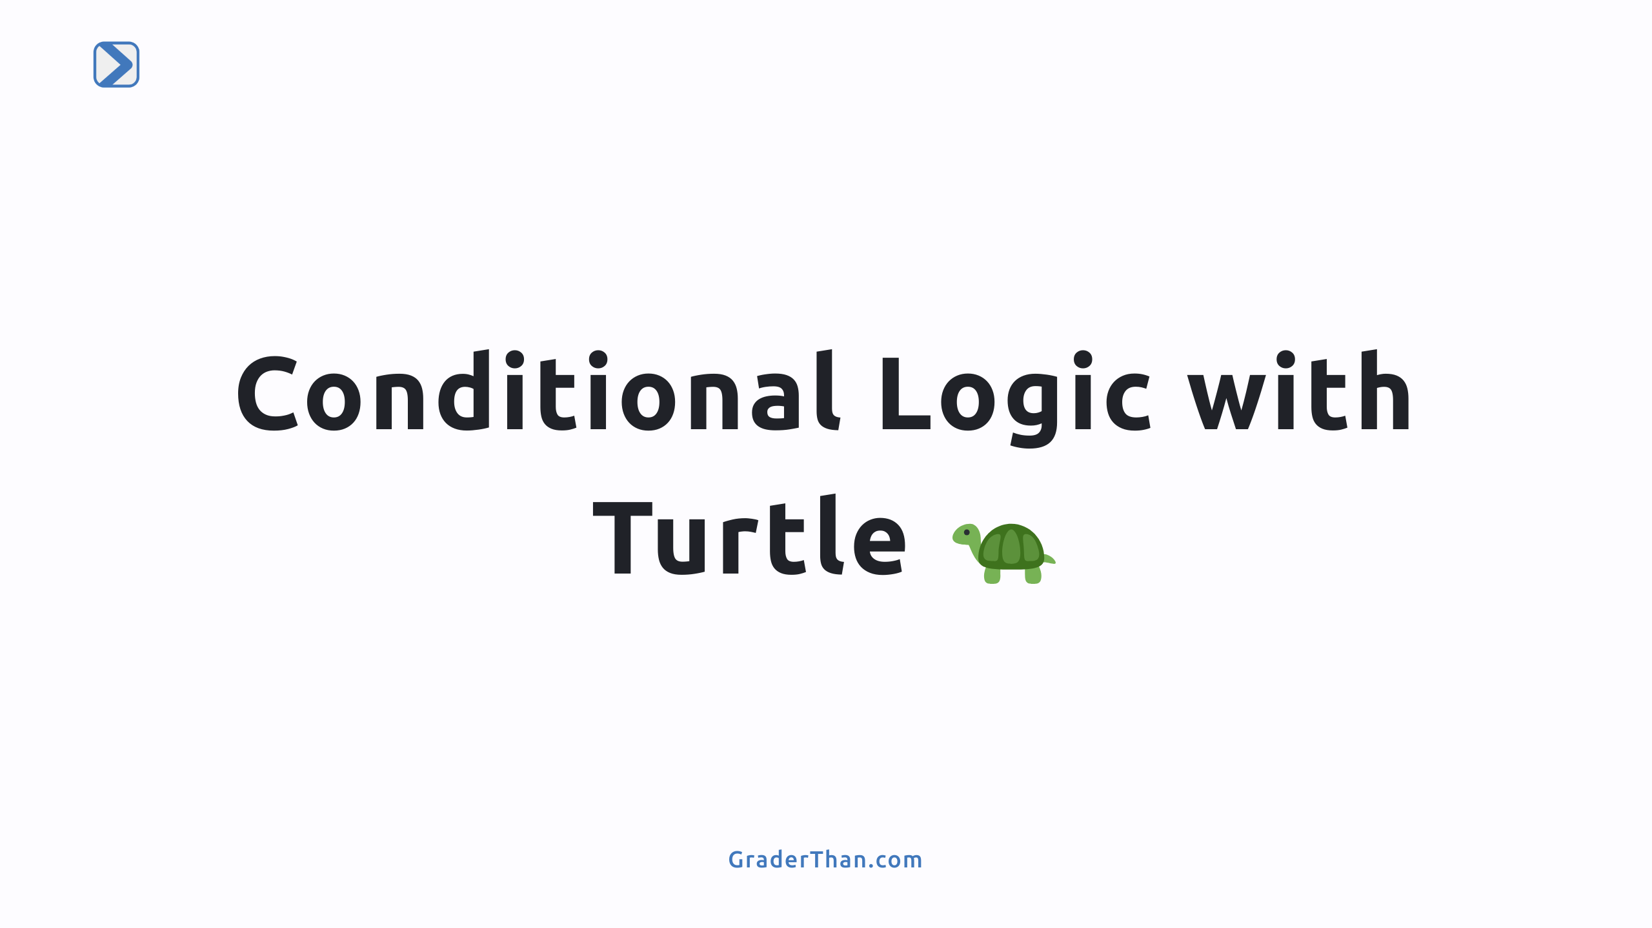

Slide 8
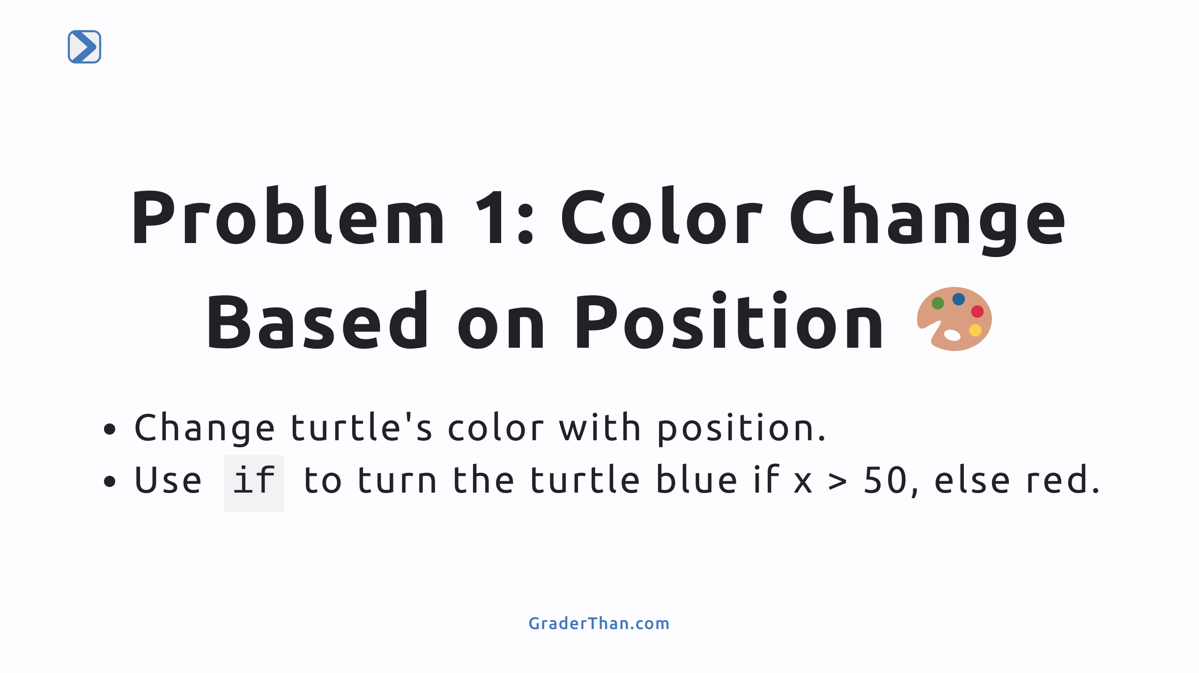
Notes:
This problem introduces a practical application of if/else statements, using the turtle's position to determine its color. It's a visually engaging way to understand conditional logic.

Slide 9
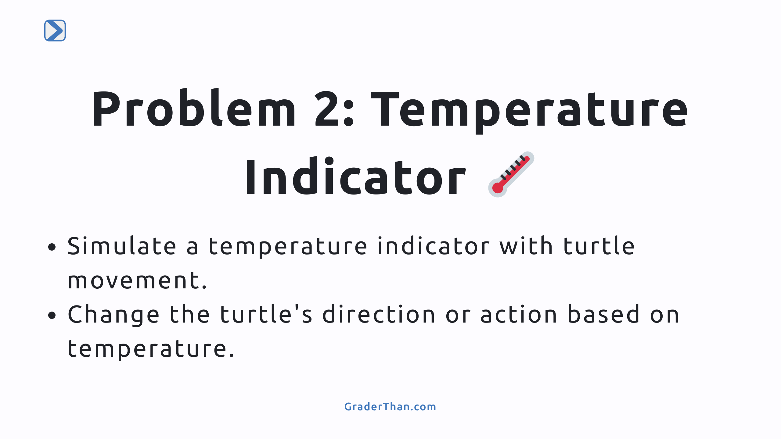
Notes:
The temperature indicator problem uses conditional logic to visually represent data (temperature) through turtle movement, showcasing a creative application of if/elif/else statements in programming.

