Slide 1
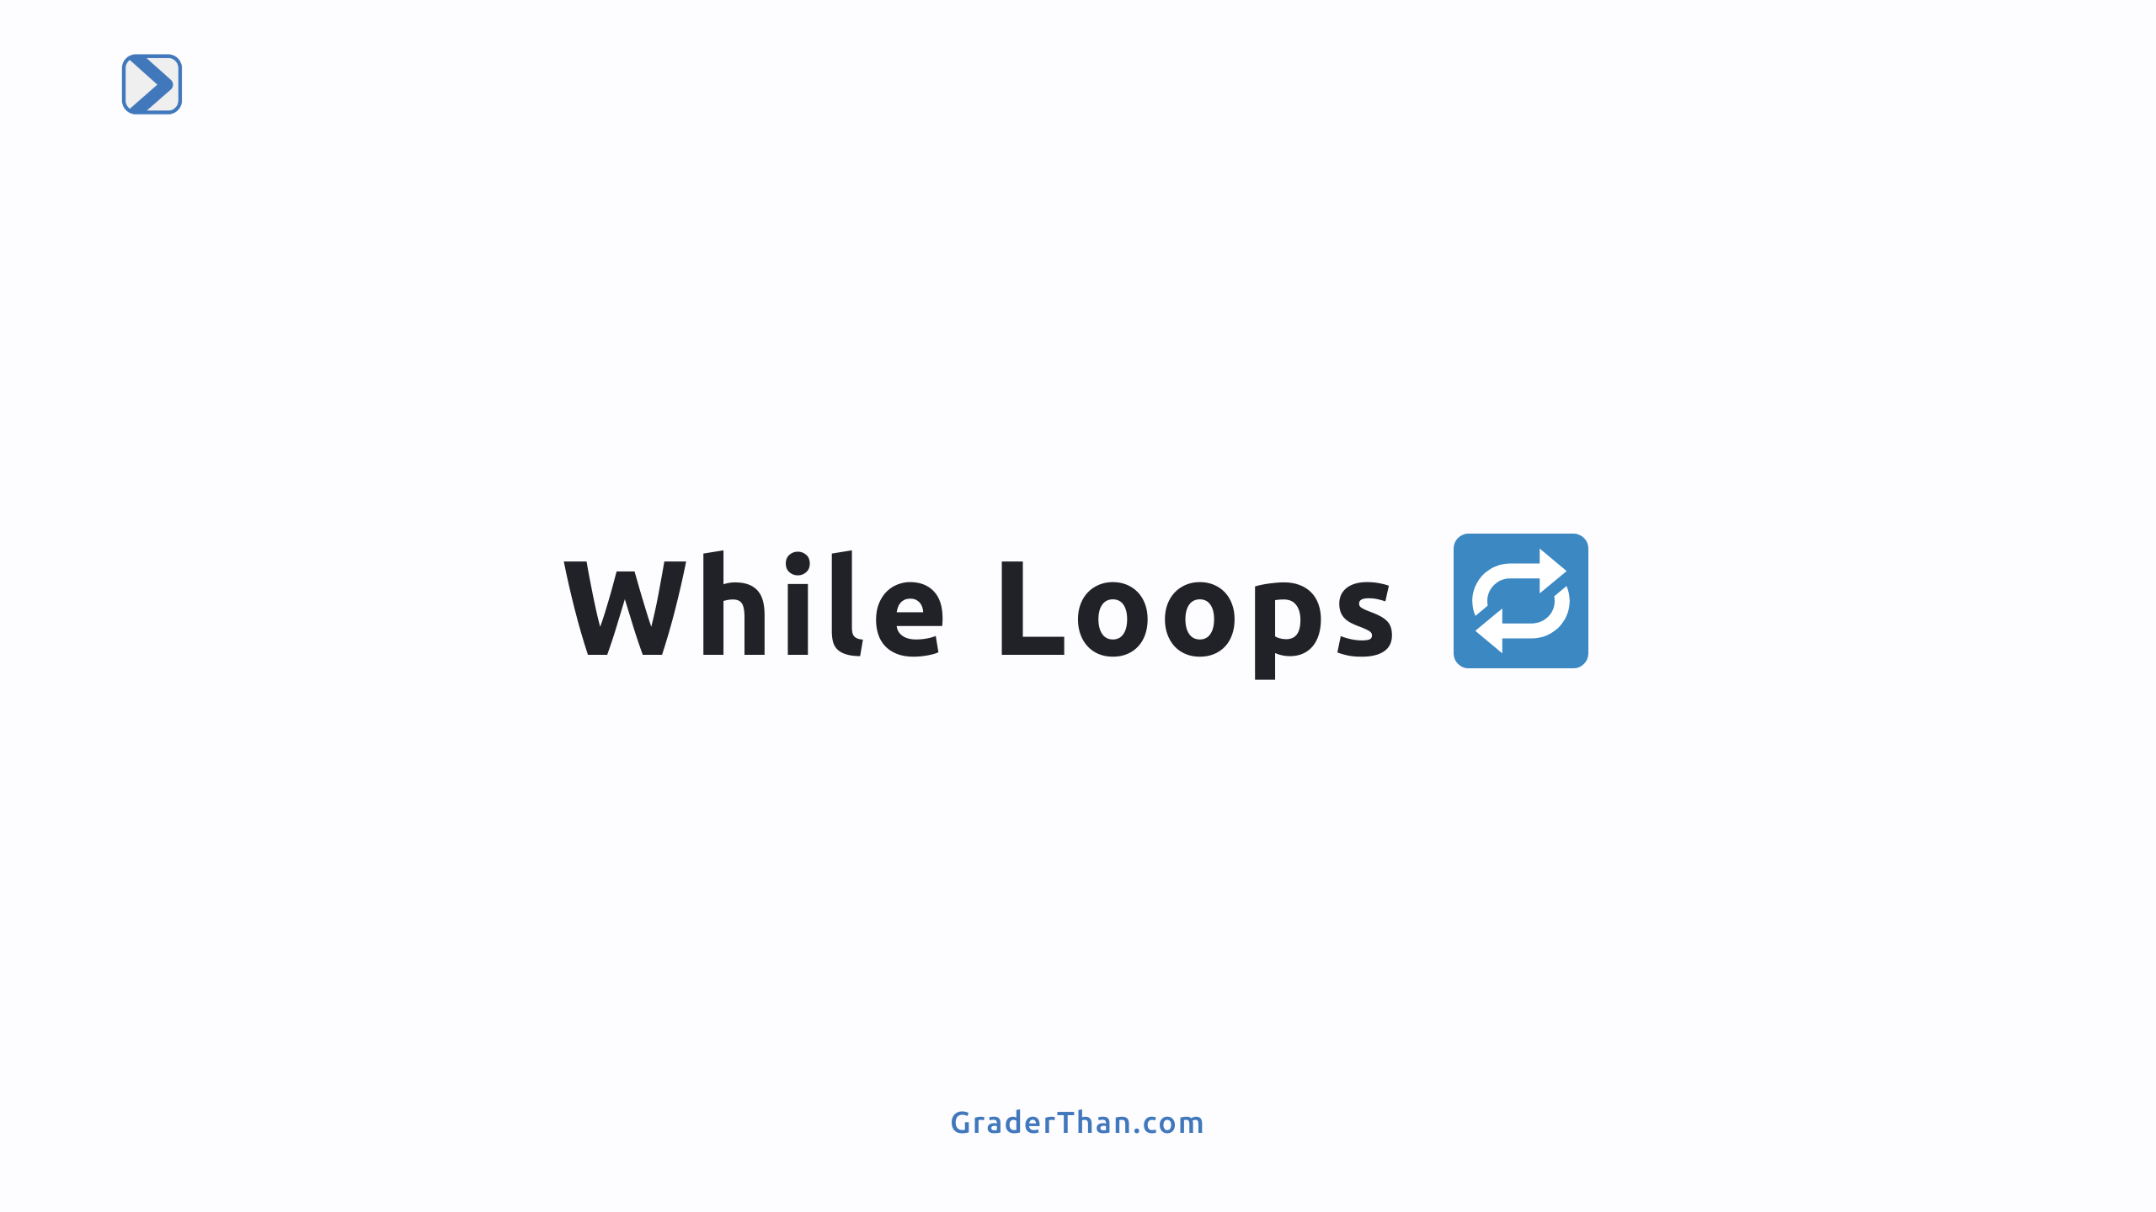

Slide 2
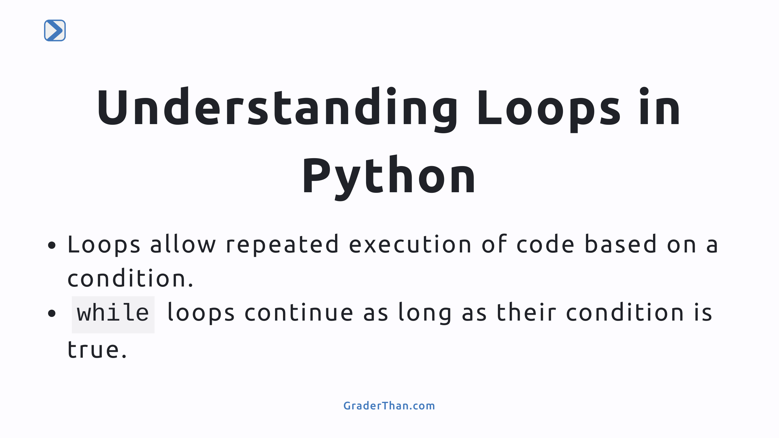
Notes:
- This slide introduces the concept of loops in Python, focusing on how they enable repetitive tasks through a conditional framework. - Discuss the importance of loops in automating tasks and handling repetitive actions efficiently in programming.

Slide 3
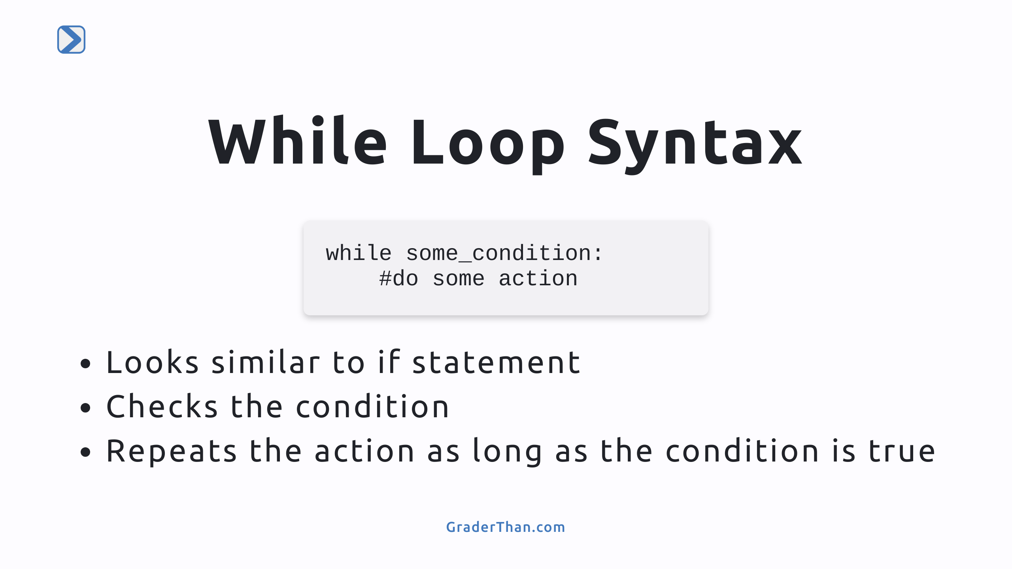

Slide 4
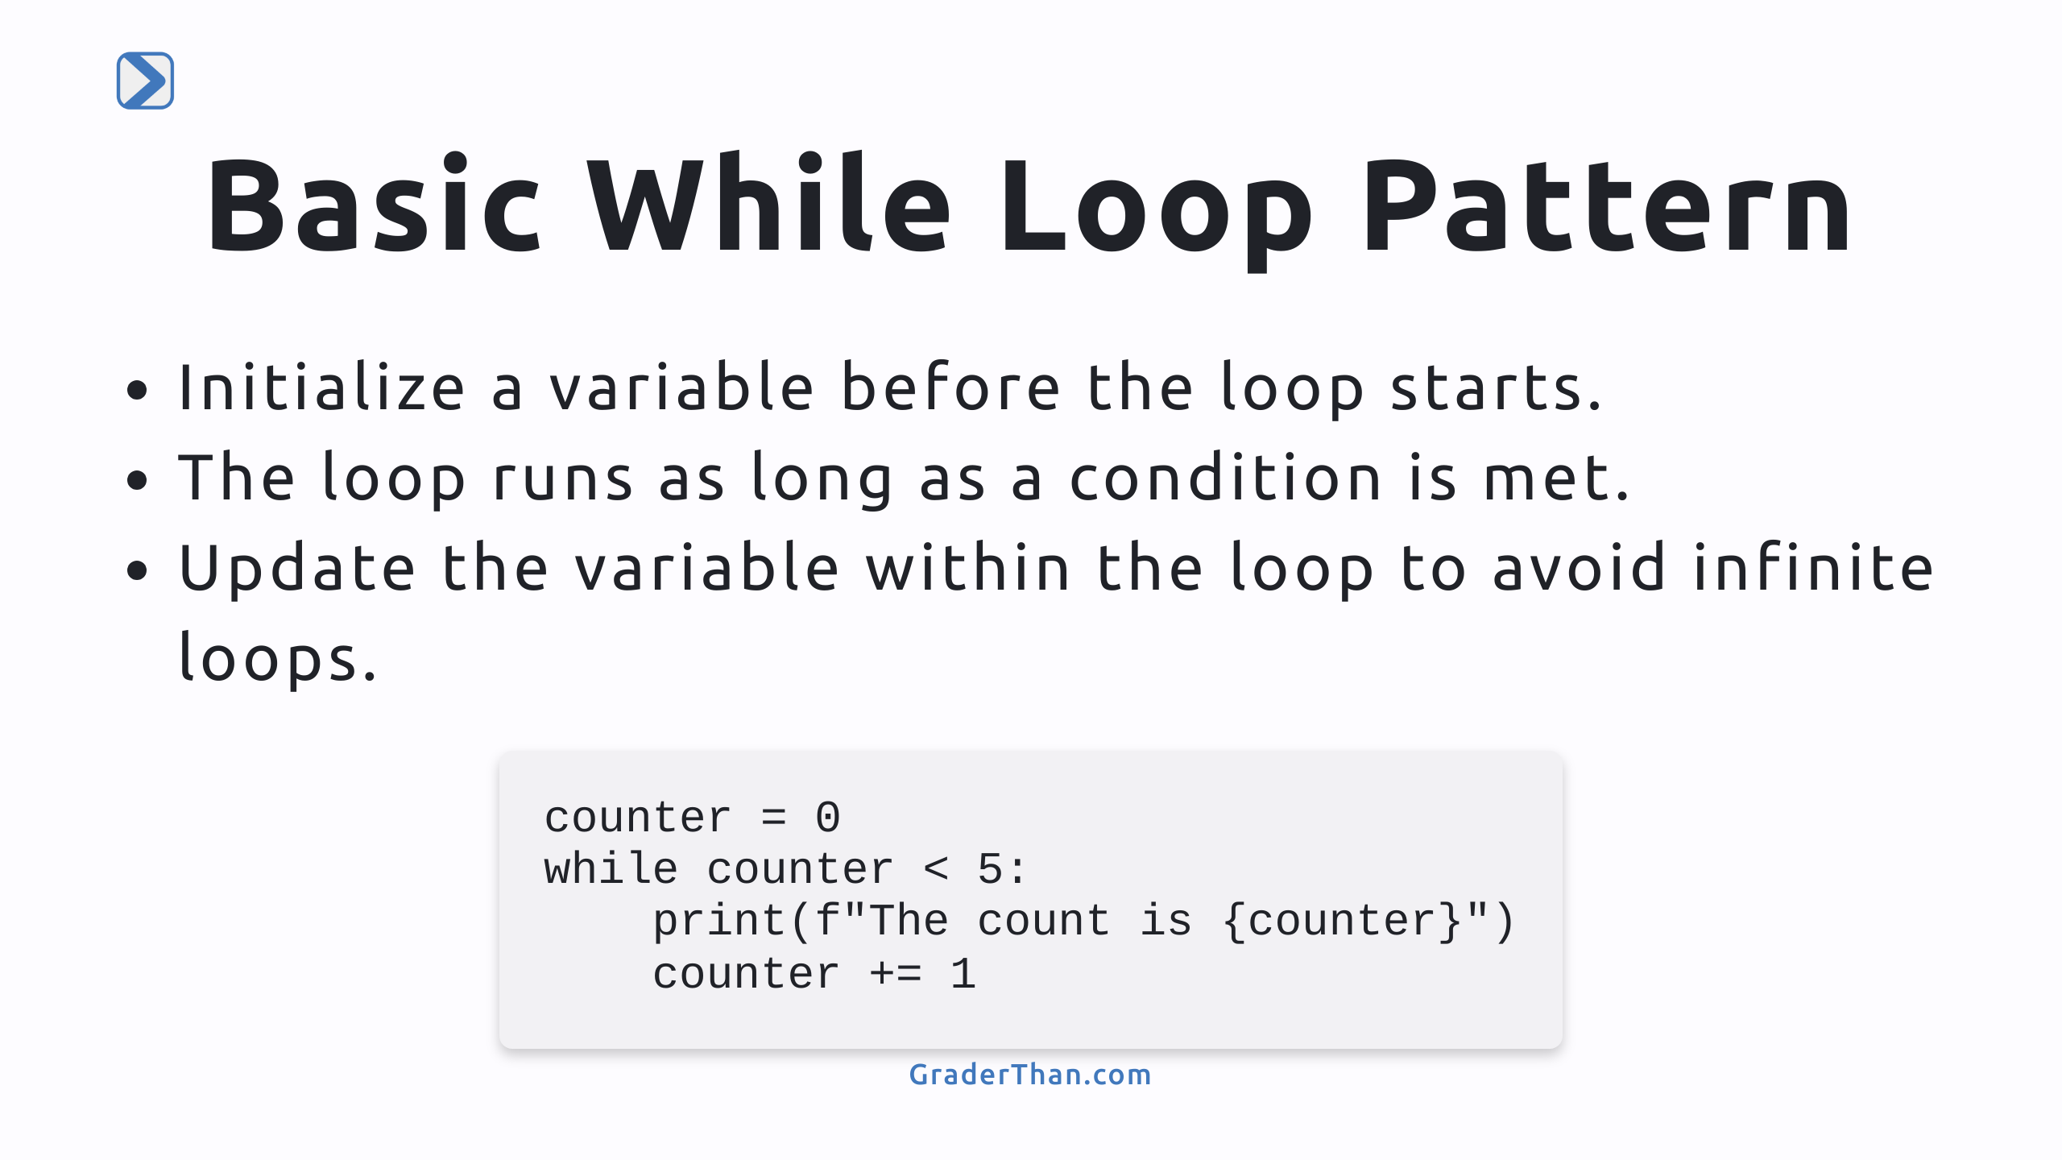
Notes:
- Explain the structure of a while loop, emphasizing initialization, condition checking, and updating the variable. - Highlight the risk of infinite loops if the condition never becomes false and how updating the variable within the loop prevents this.

Slide 5
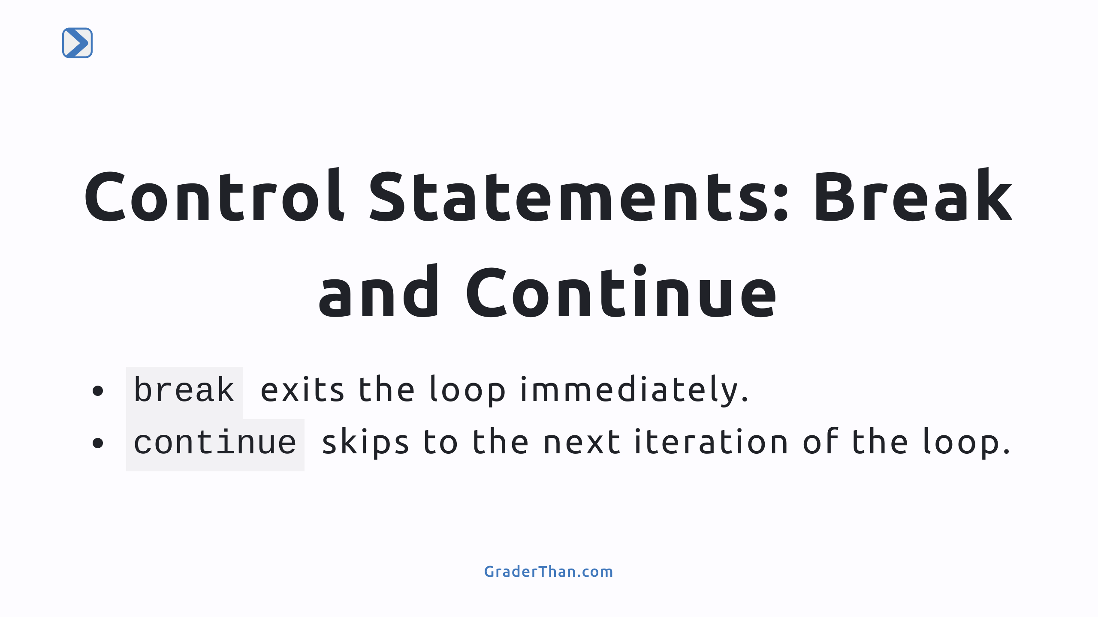

Slide 6
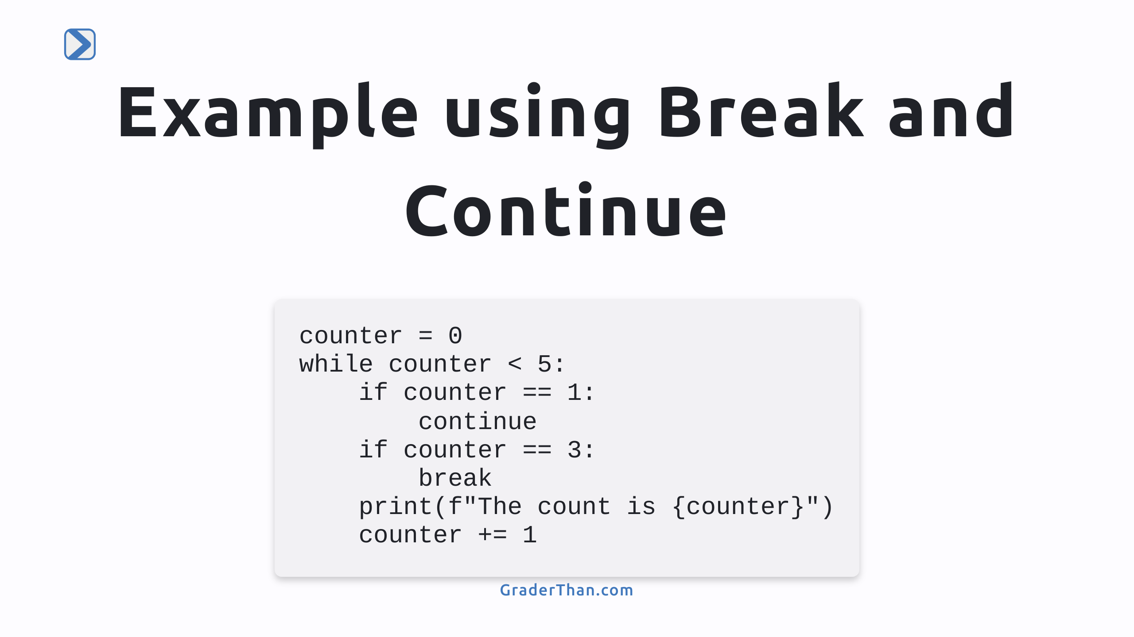
Notes:
- See if students can determine the output (0 and 2) - Discuss how `break` and `continue` control the flow within loops. - break exits the loop immediately - continue skips to the next iteration - Provide examples or scenarios where using `break` and `continue` can be useful in managing loop execution effectively such as if you encounter an error, or want to skip over something (odd nums, even nums, etc.)

Slide 7
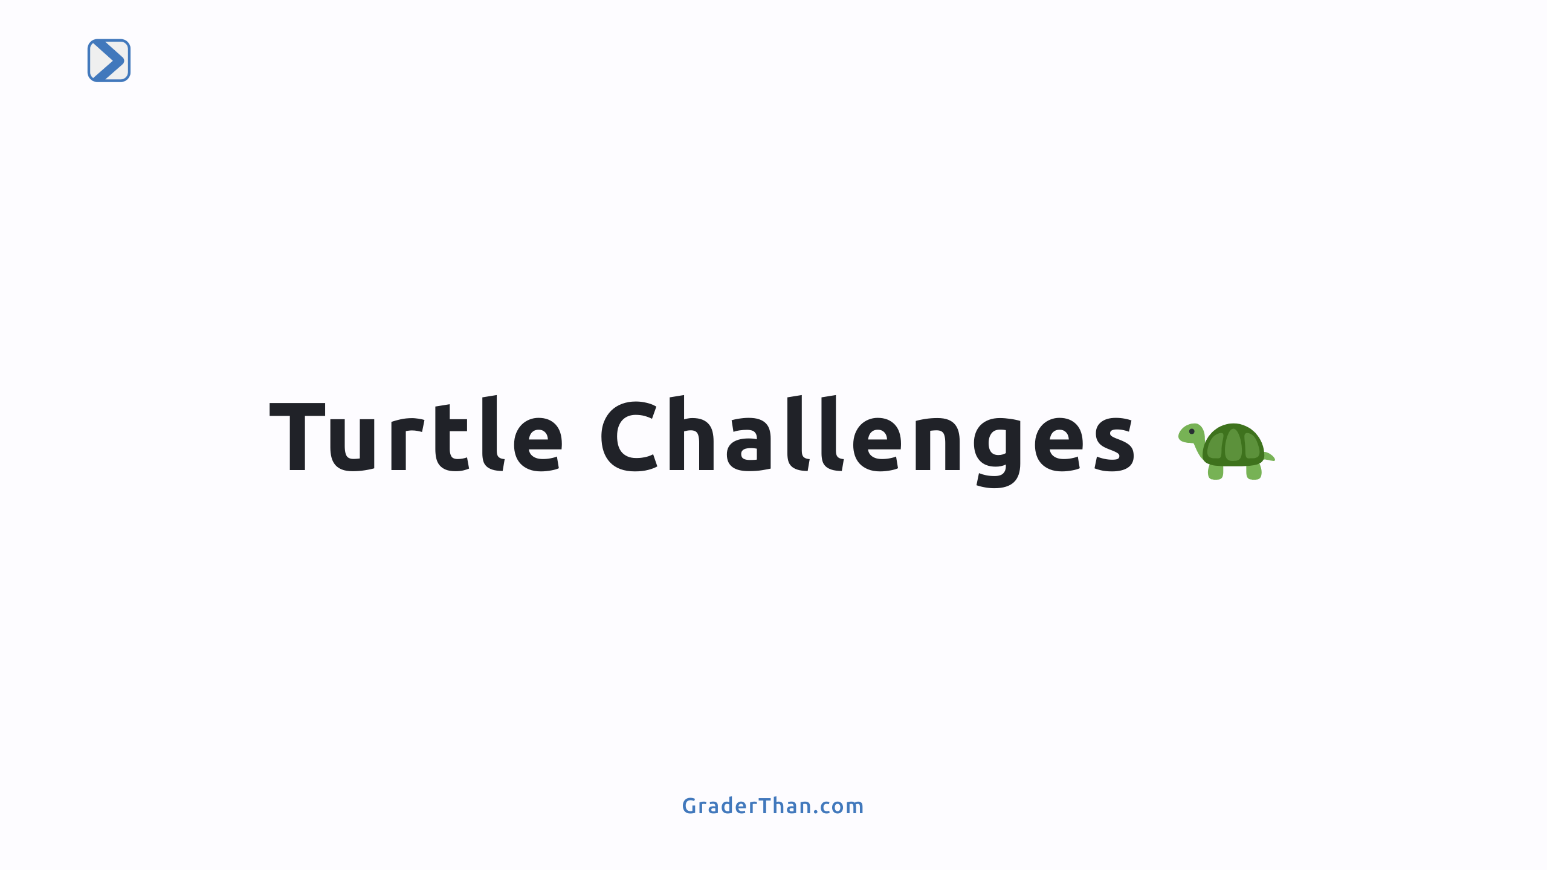

Slide 8
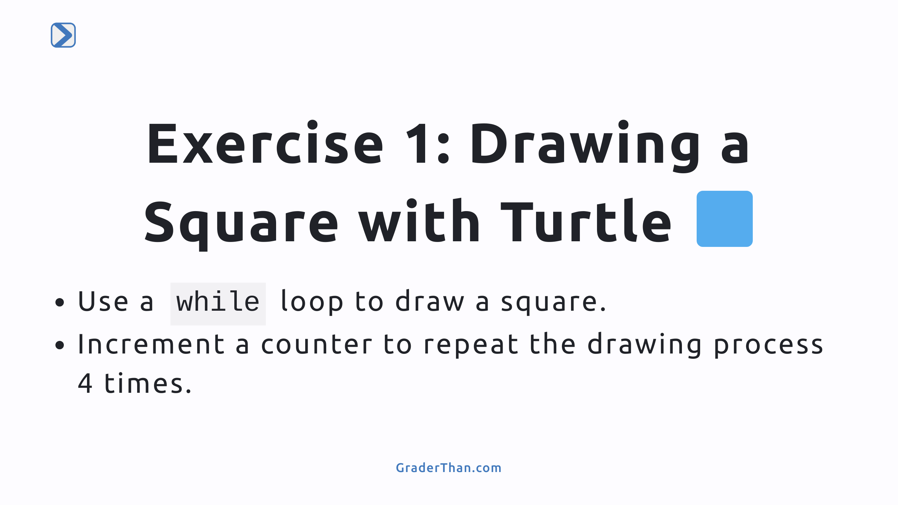
Notes:
- Introduce the turtle graphics library as a fun way to learn about loops. - Explain how each iteration of the loop draws one side of the square and how the loop facilitates drawing a complete square.

Slide 9
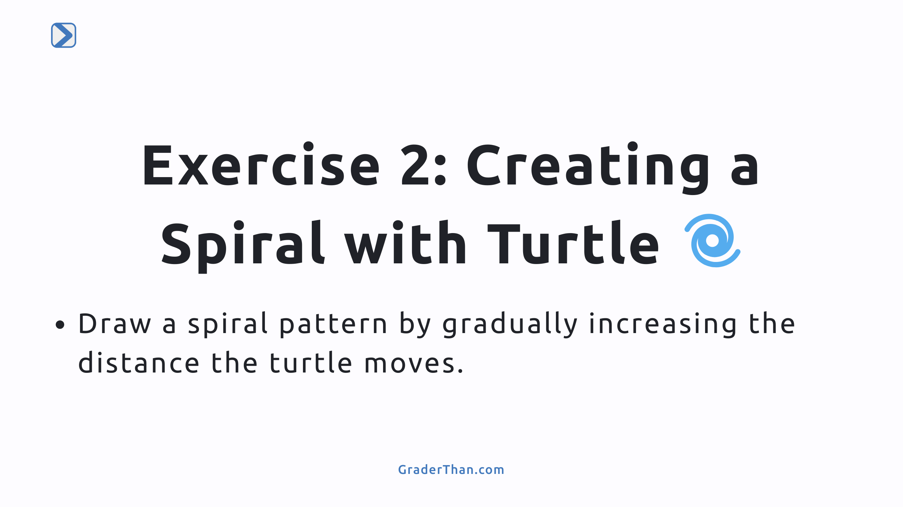
Notes:
- Encourage experimenting with different distances and angles to see how it affects the spiral's appearance.

