Slide 1
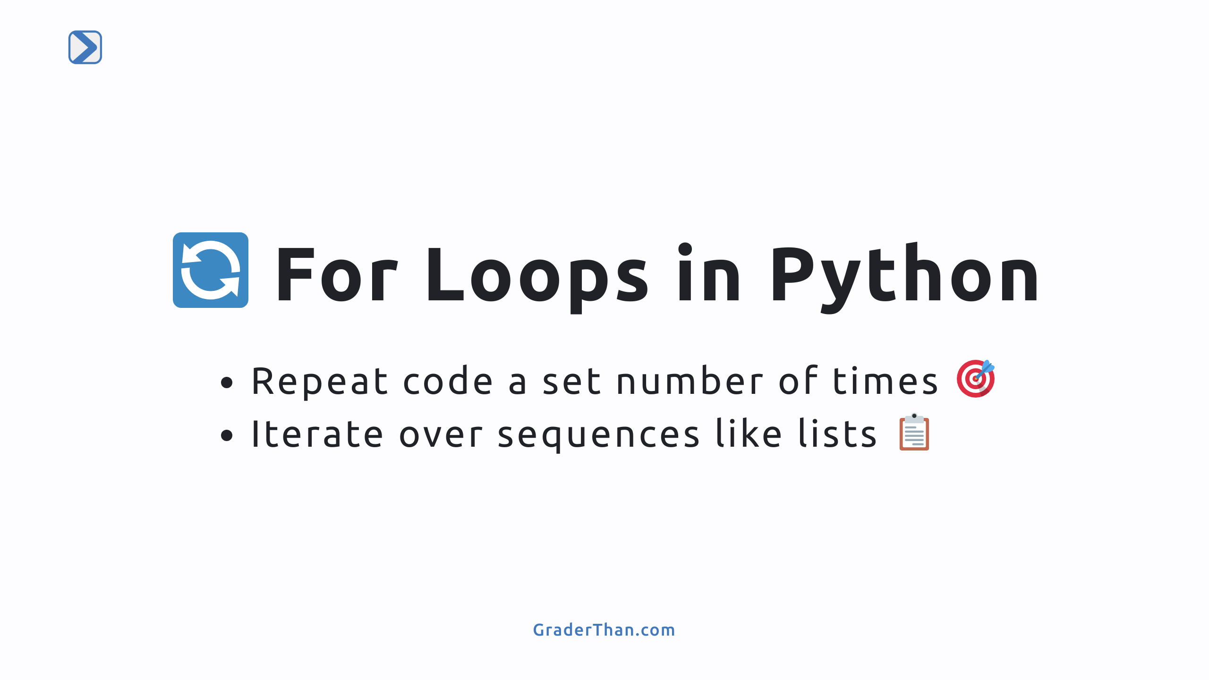
Notes:
- Introduce for loops as a powerful tool for repeating tasks. - Highlight the simplicity and efficiency of automating repetitive actions.

Slide 2
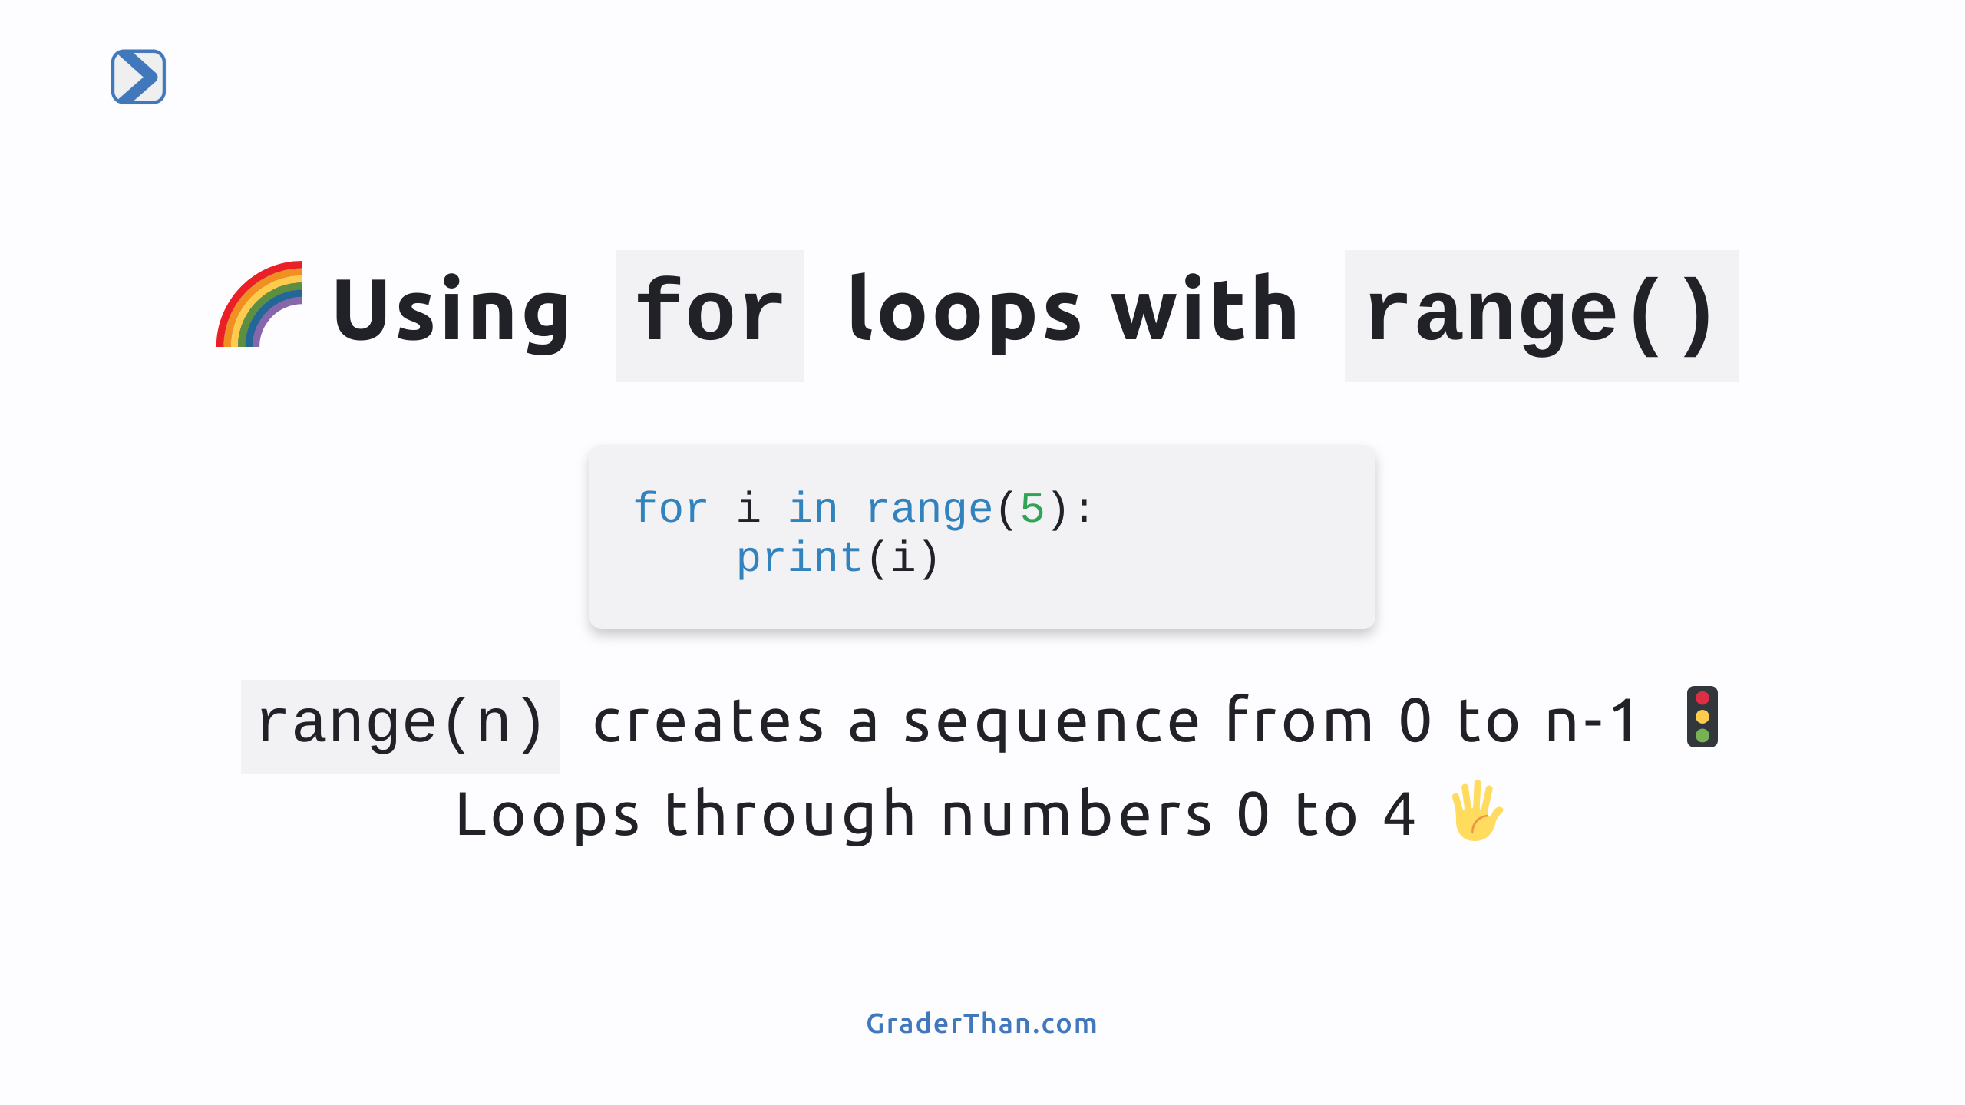
Notes:
- Demonstrate how to use range() in a for loop. - Explain that range(n) generates numbers from 0 up to, but not including, n.

Slide 3
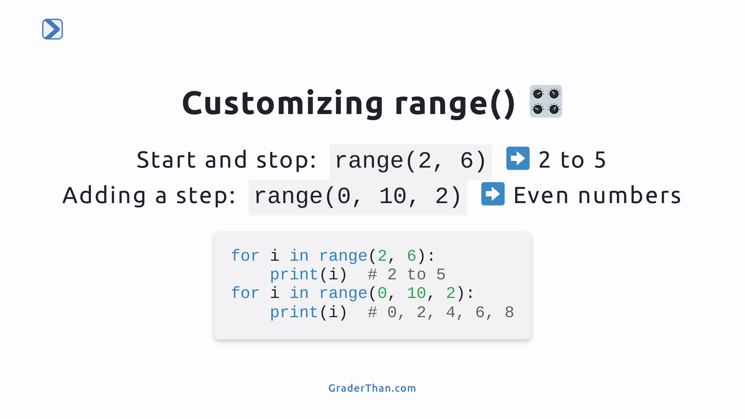
Notes:
- Explain how range() can be customized with start, stop, and step parameters. - Provide code examples to illustrate the flexibility of range() in controlling loop iterations.

Slide 4
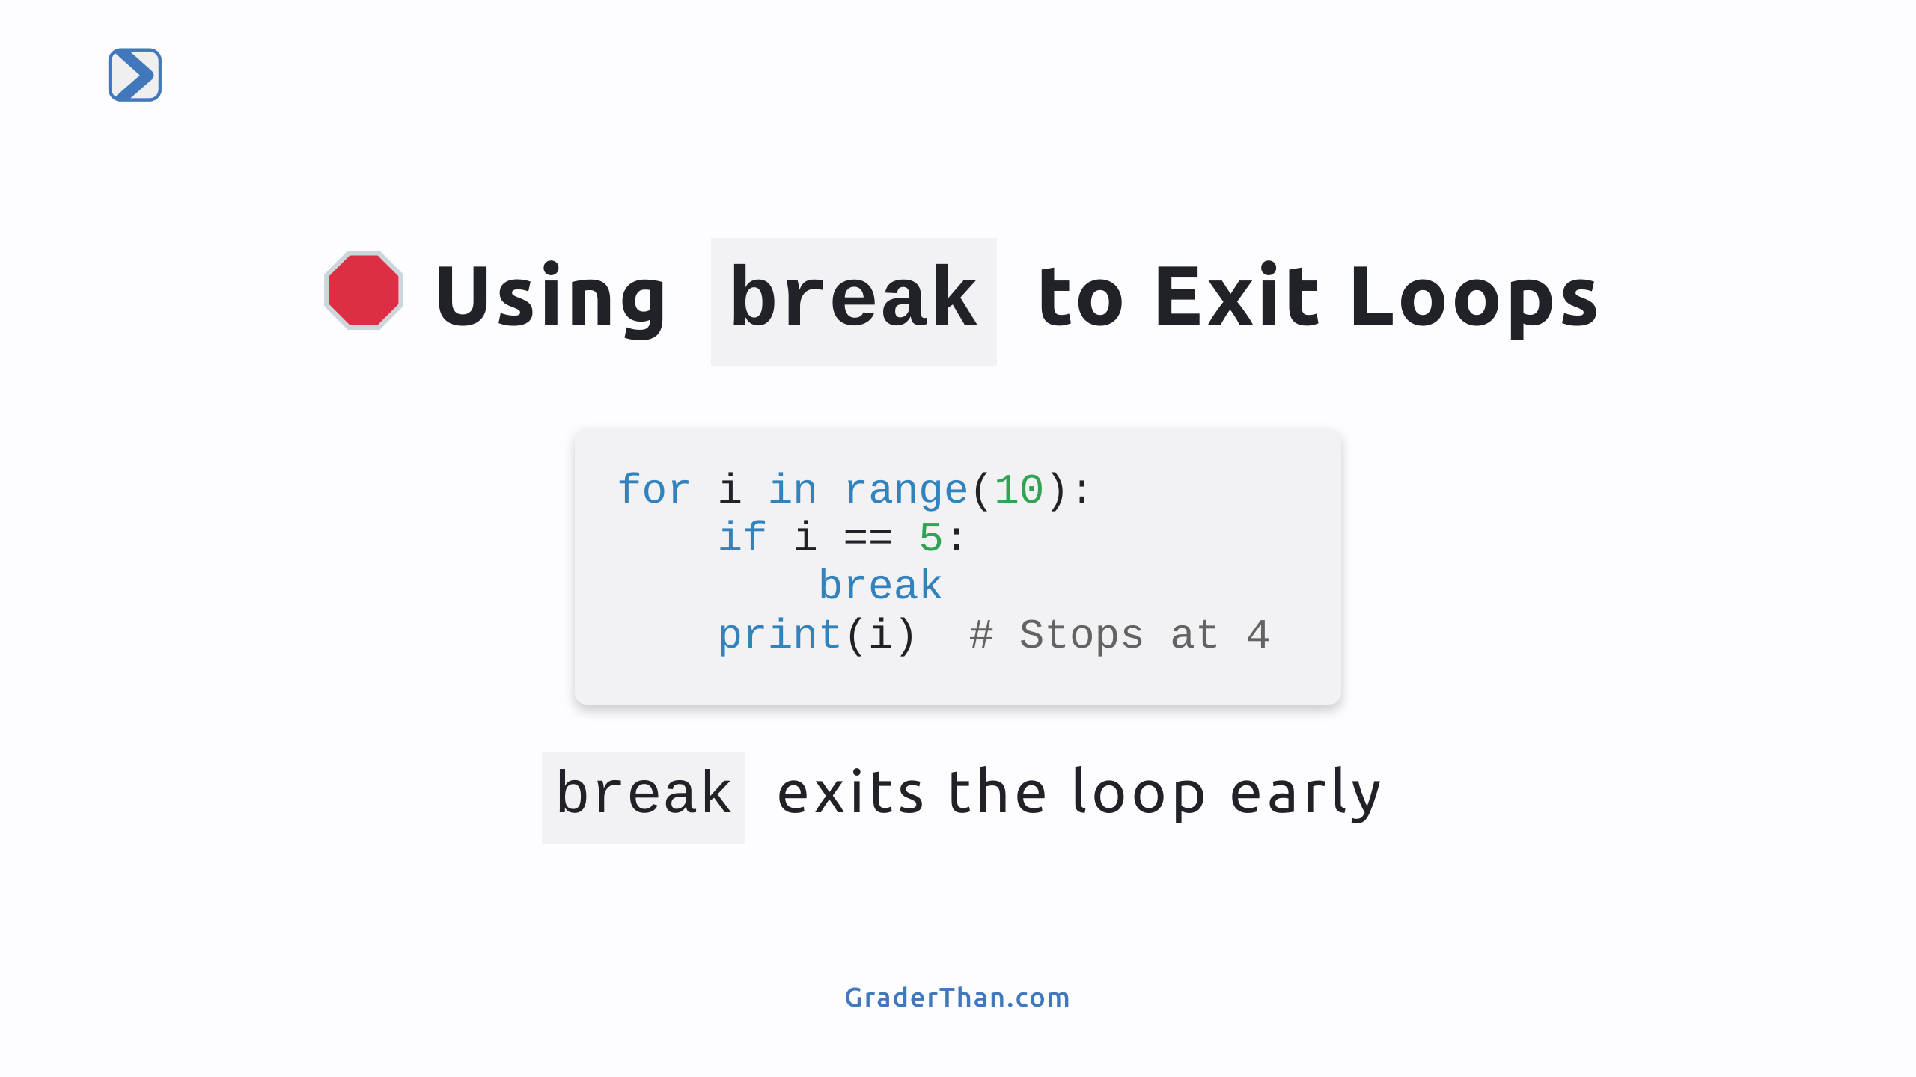
Notes:
- The break statement exits the loop early, stopping at 4 in this example. - Great for stopping a loop when a specific condition is met.

Slide 5
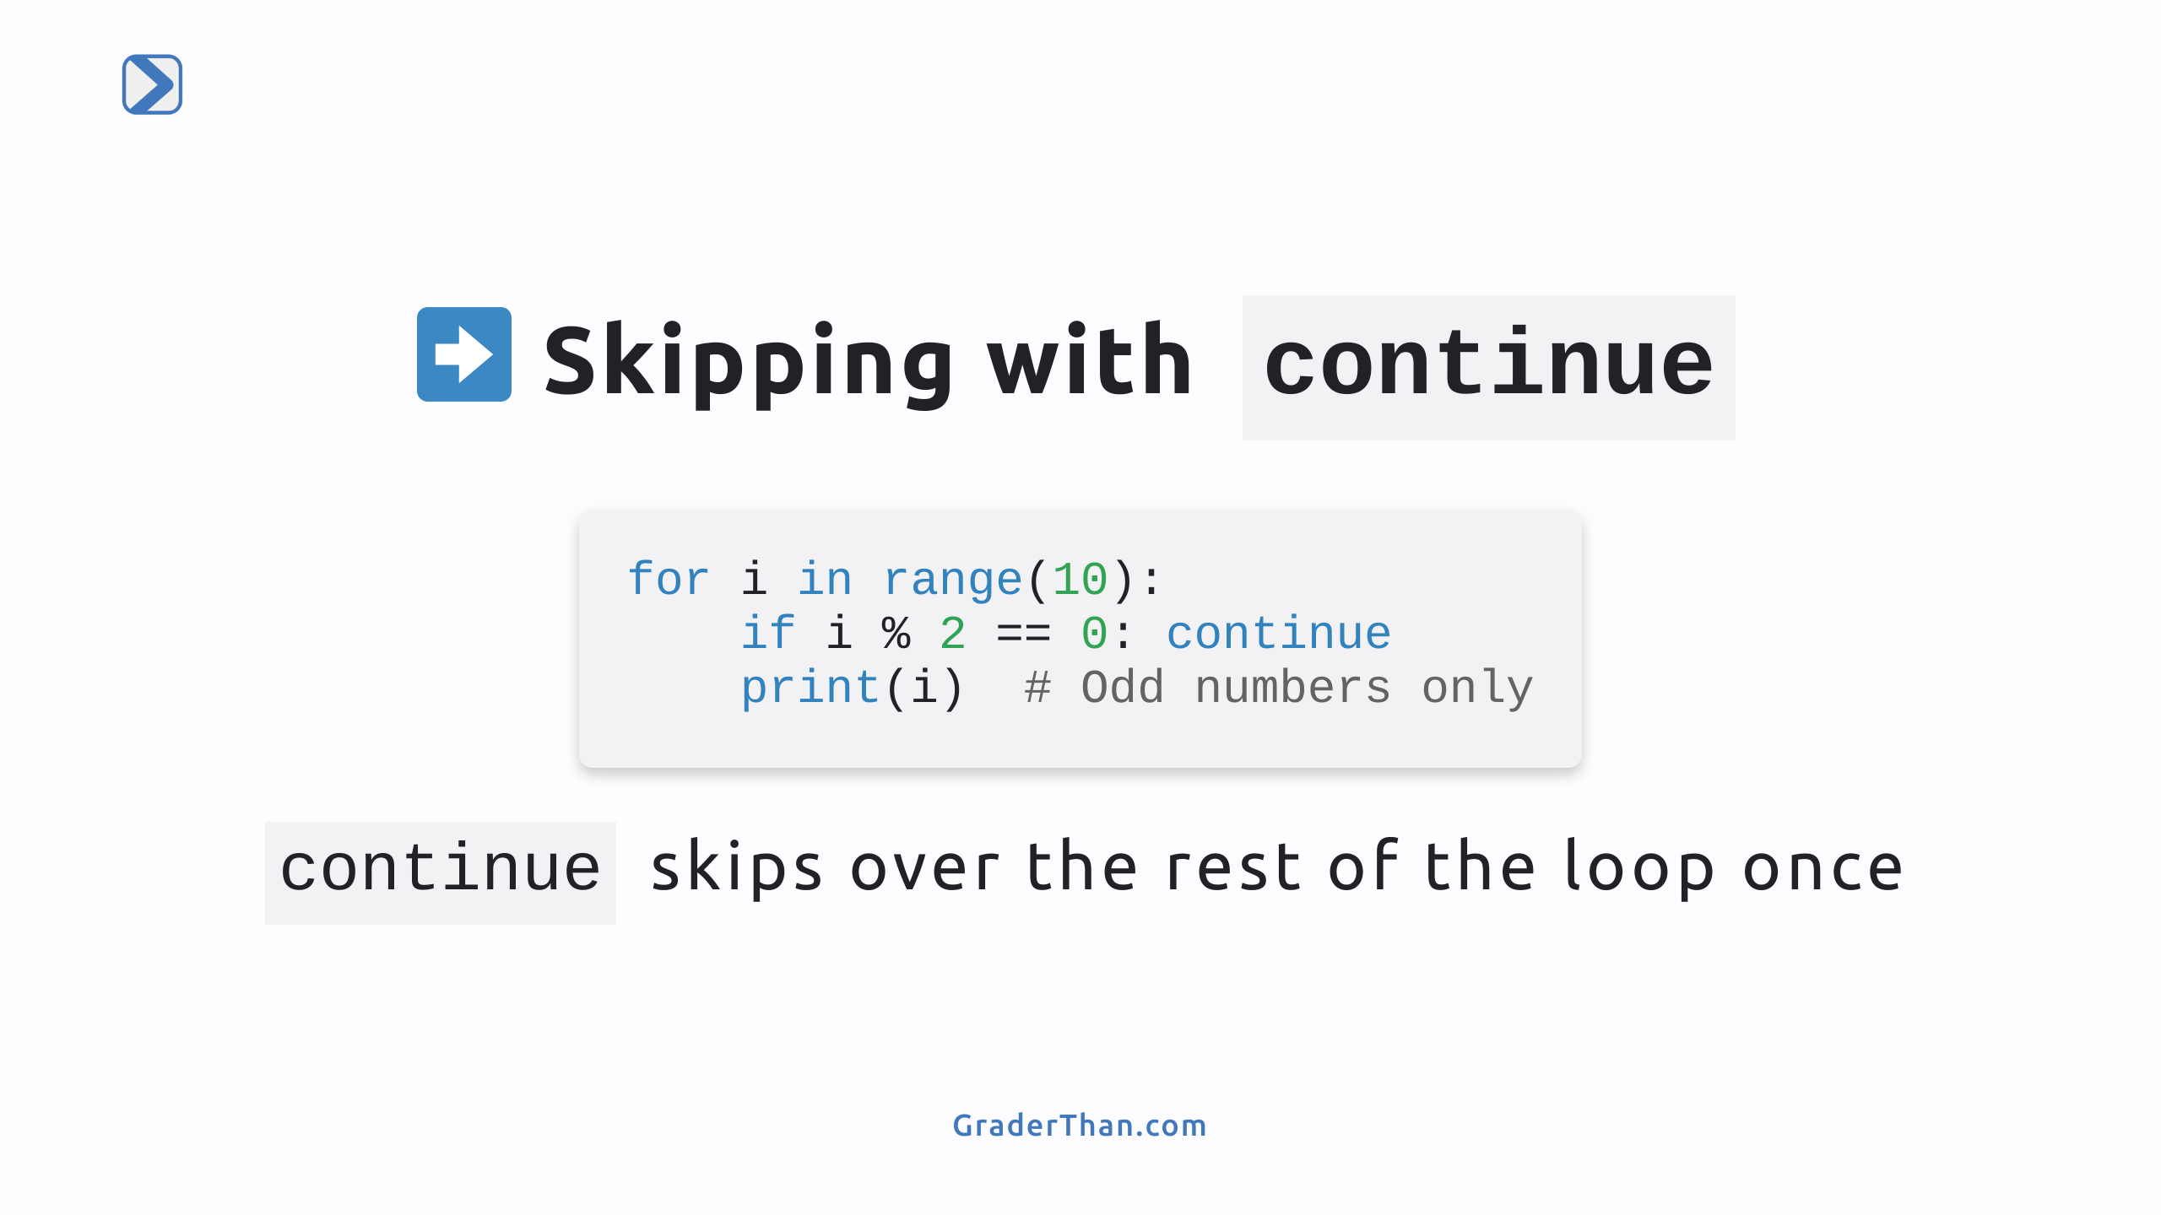
Notes:
- Continue skips the rest of the loop's body and continues with the next iteration. - Useful for skipping certain conditions, like even numbers here.

Slide 6
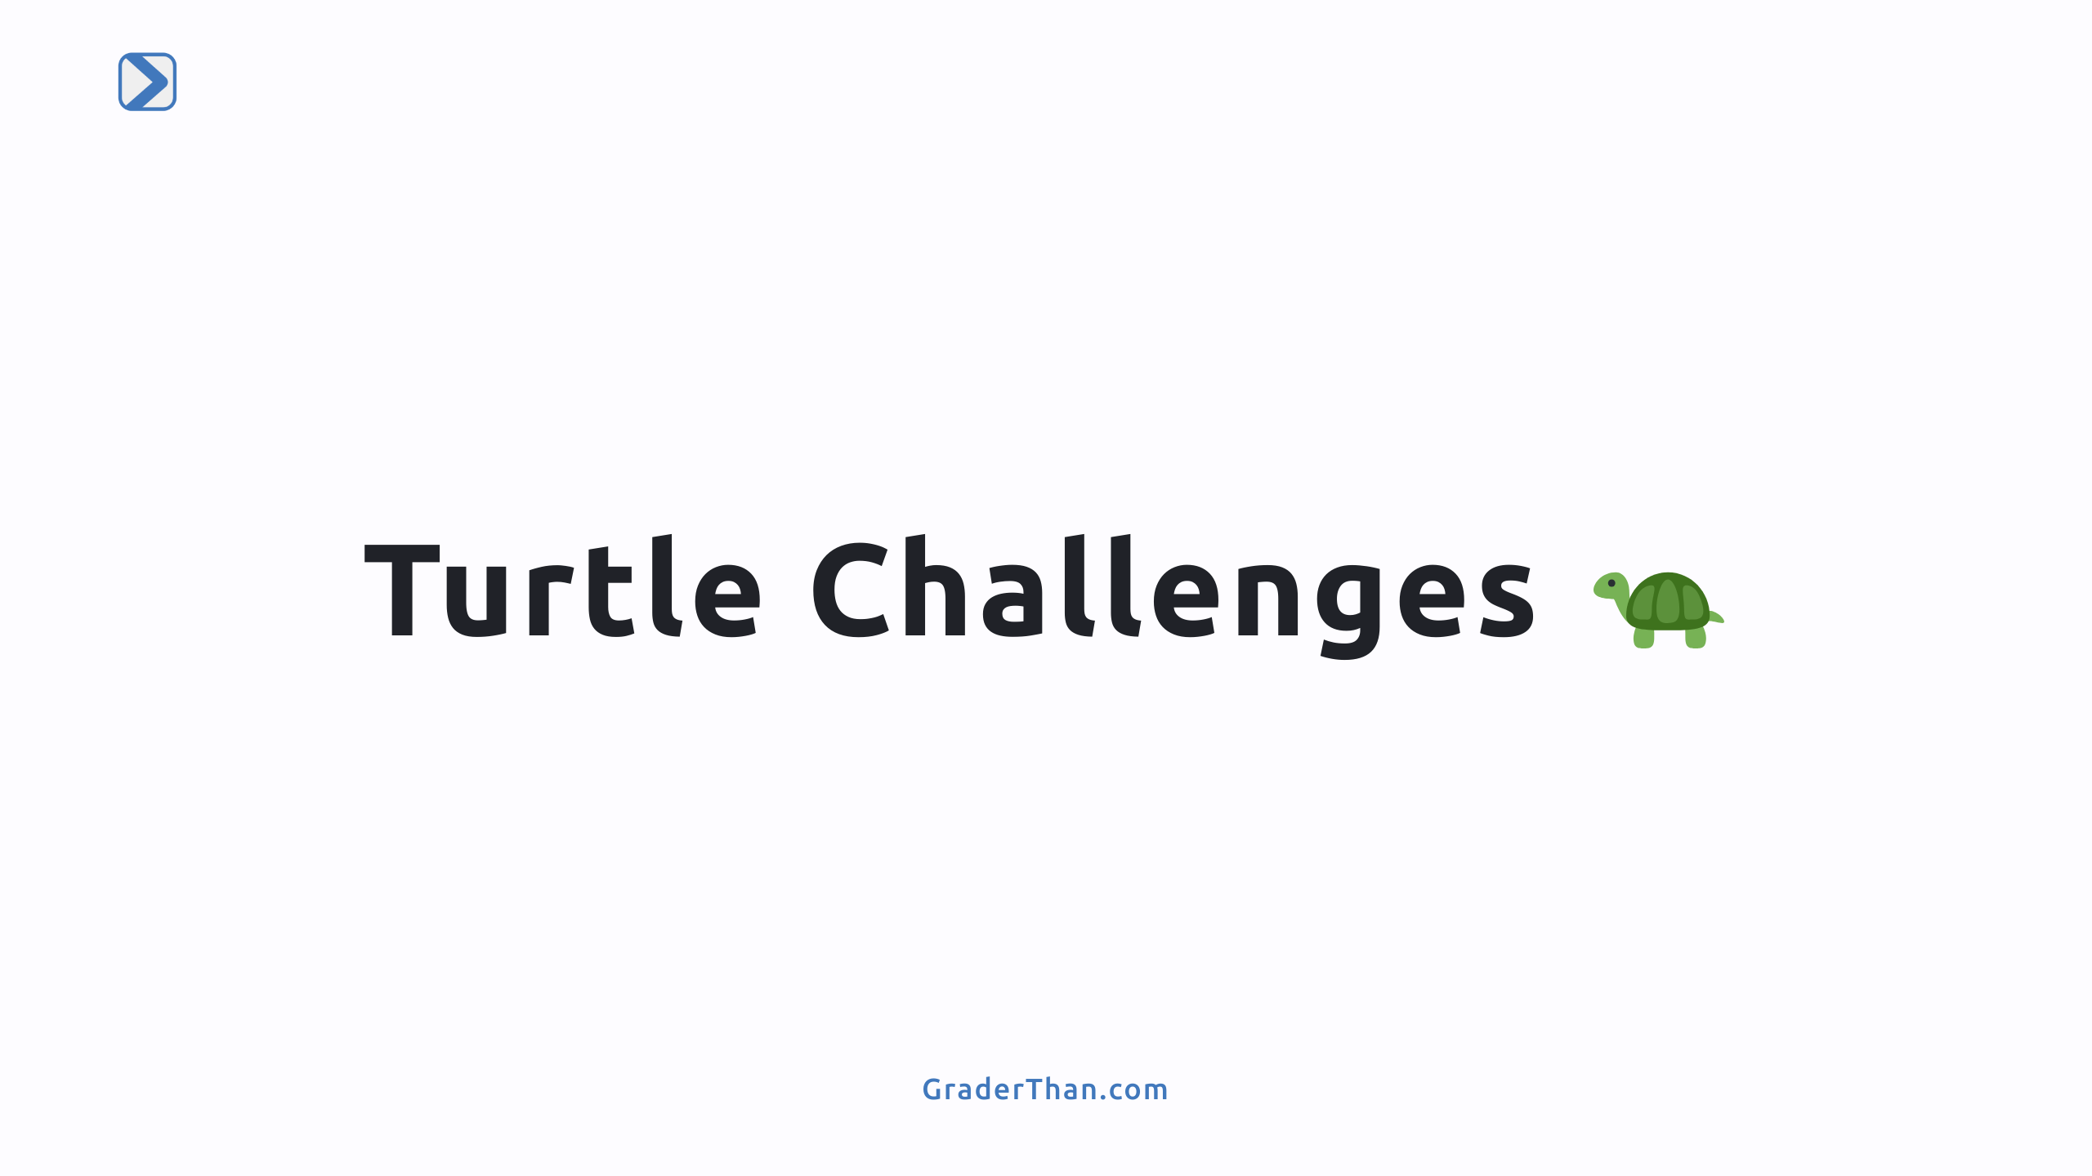

Slide 7
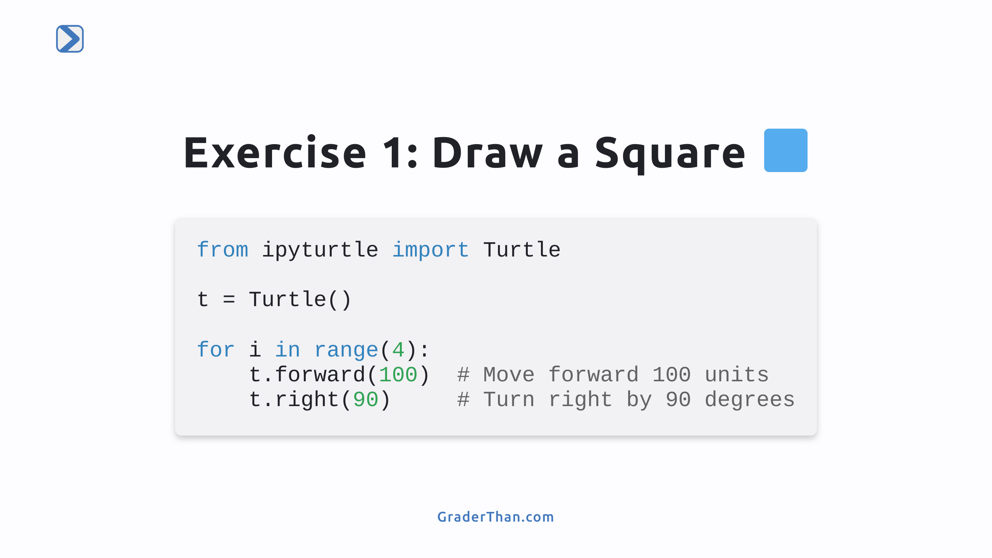
Notes:
- Use the loop to repeat the logic of constructing a side 4 times

Slide 8
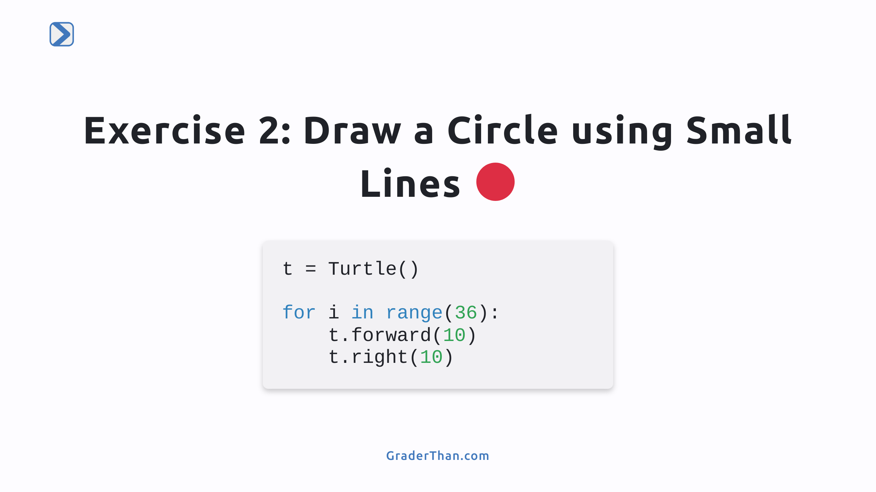
Notes:
- A circle can be drawn by turning the turtle slightly and moving a small distance multiple times in a loop.

Slide 9
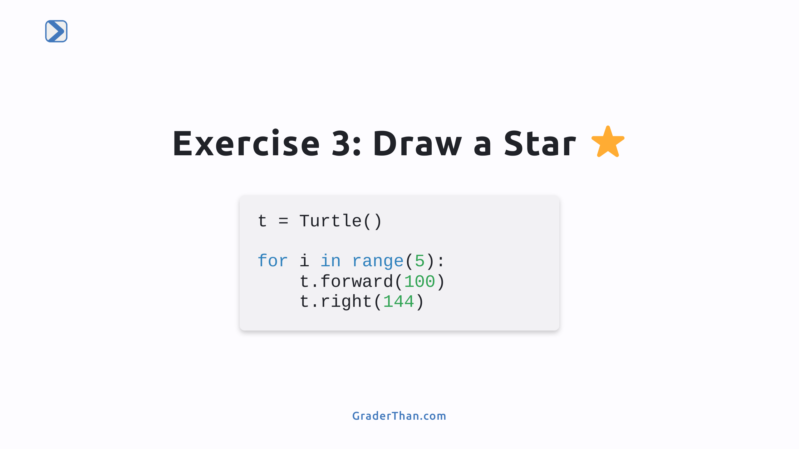
Notes:
Think of how to construct one side of the star and set up for the next side, then repeat it 5 times

