Slide 1
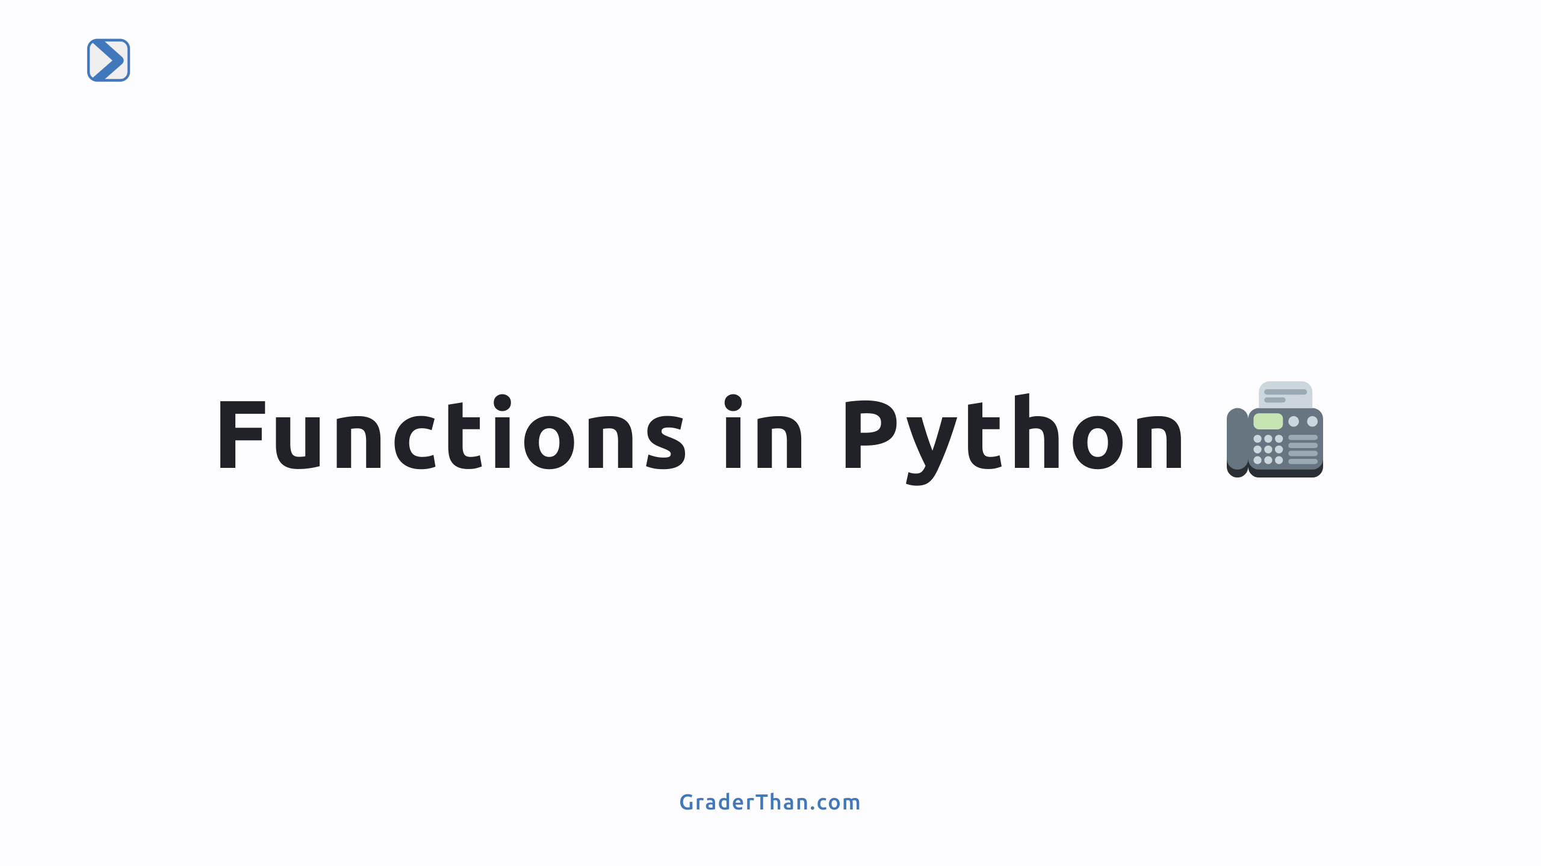

Slide 2
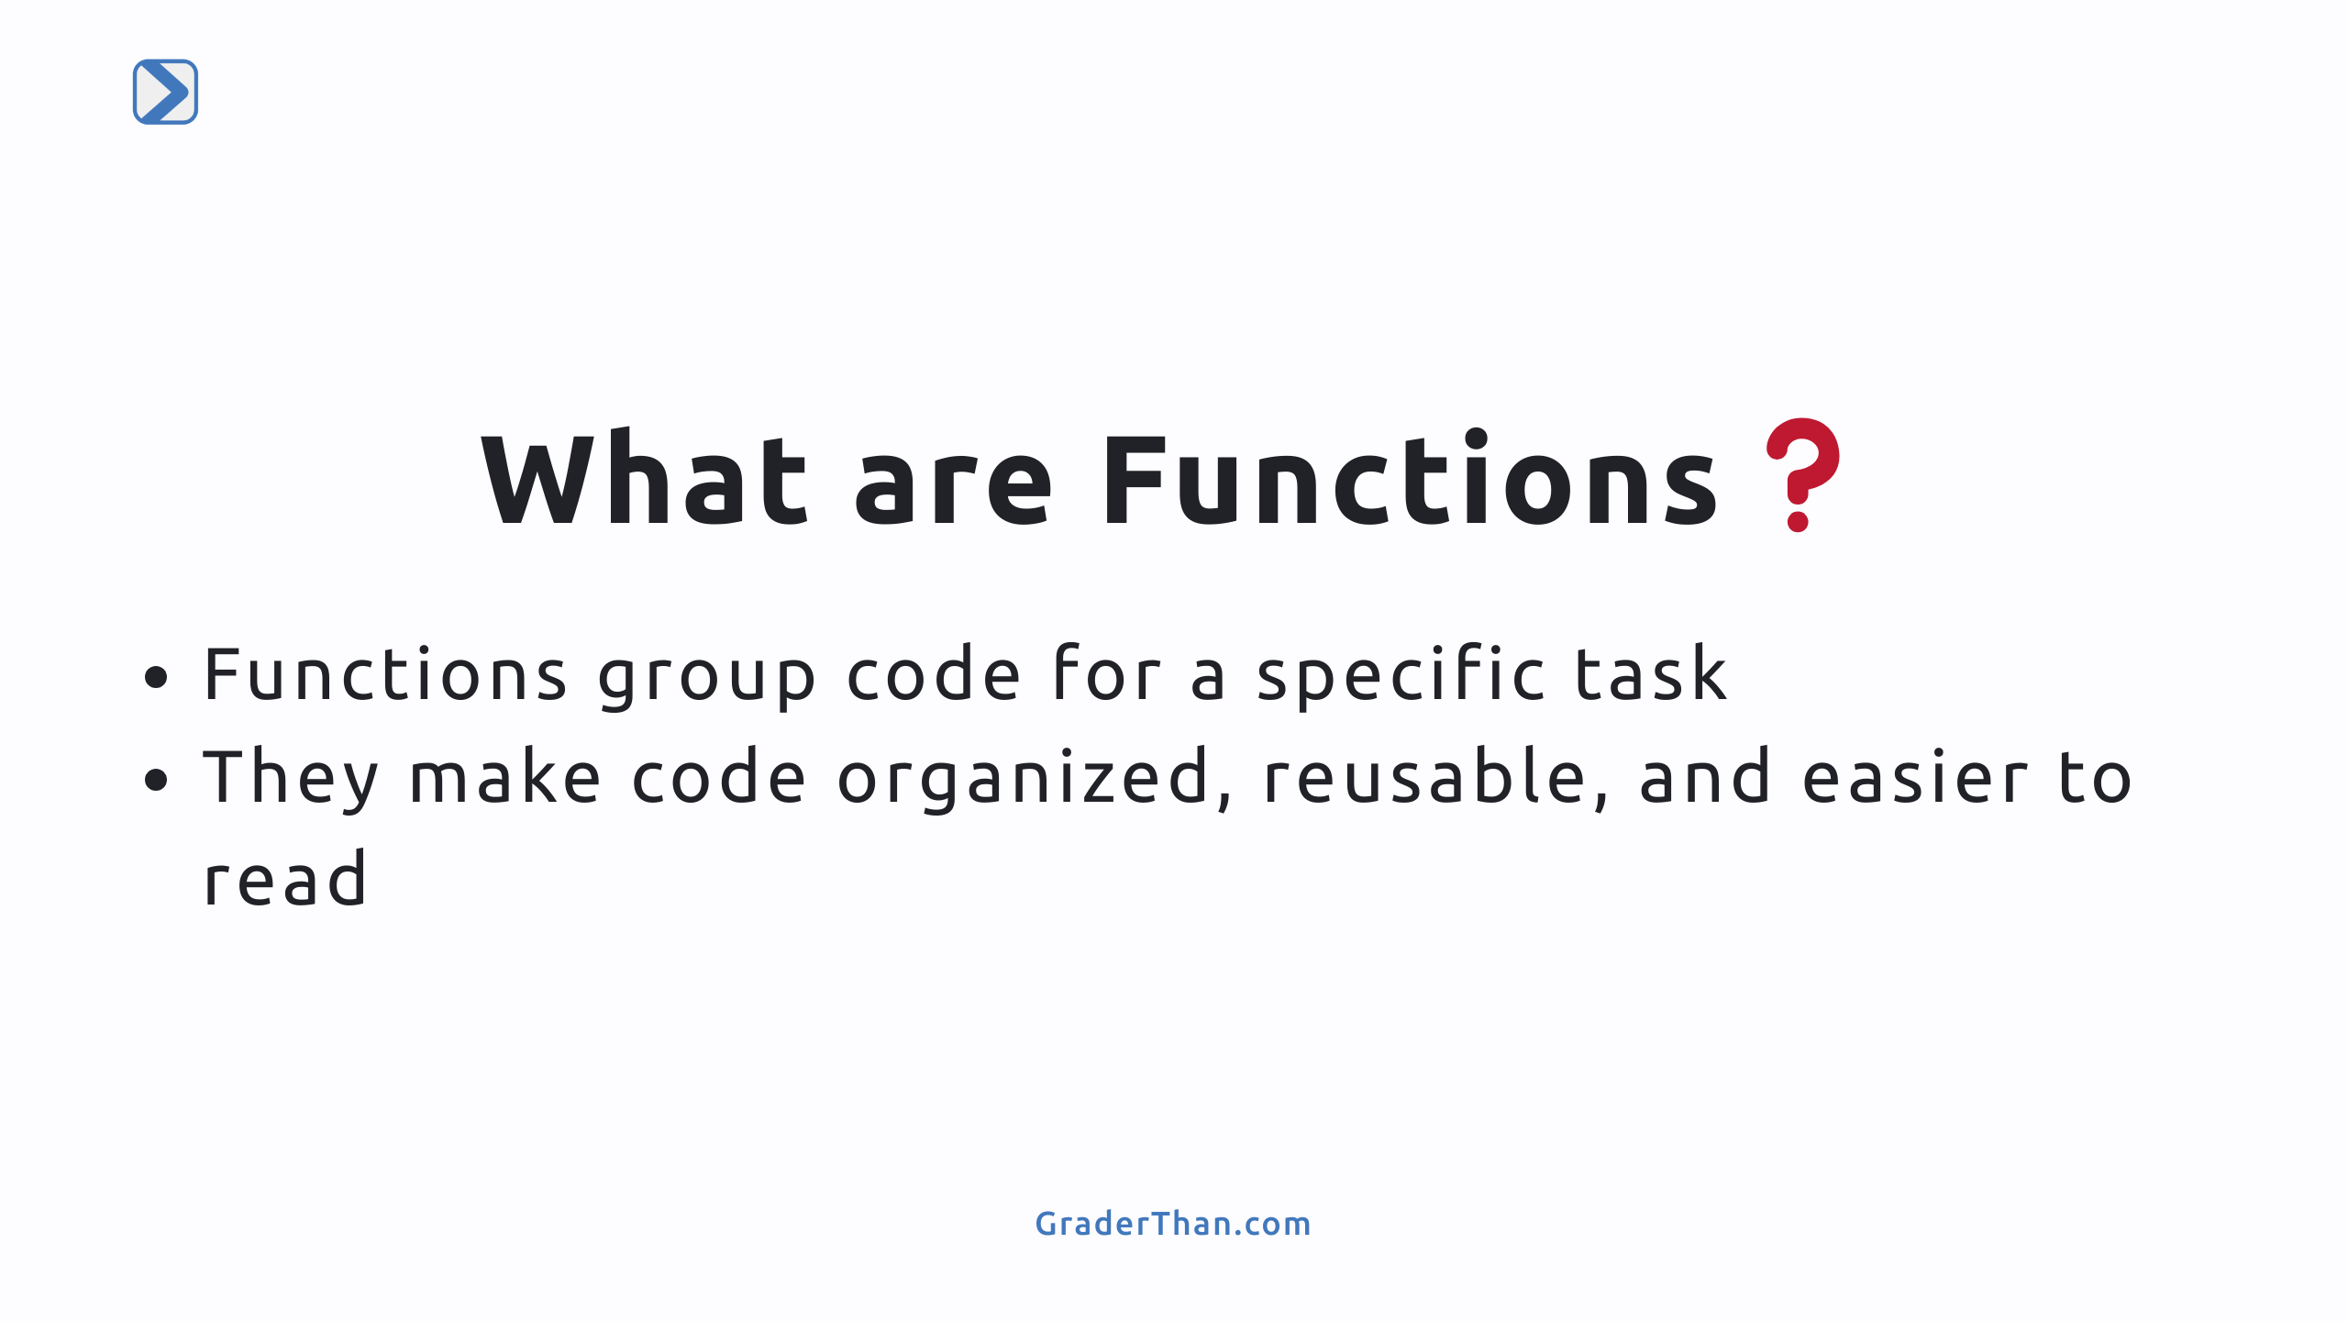
Notes:
- Speaker Note: Emphasize that functions are fundamental in programming for code organization and reuse. - Speaker Note: Highlight that we'll learn how to create and use functions in Python.

Slide 3
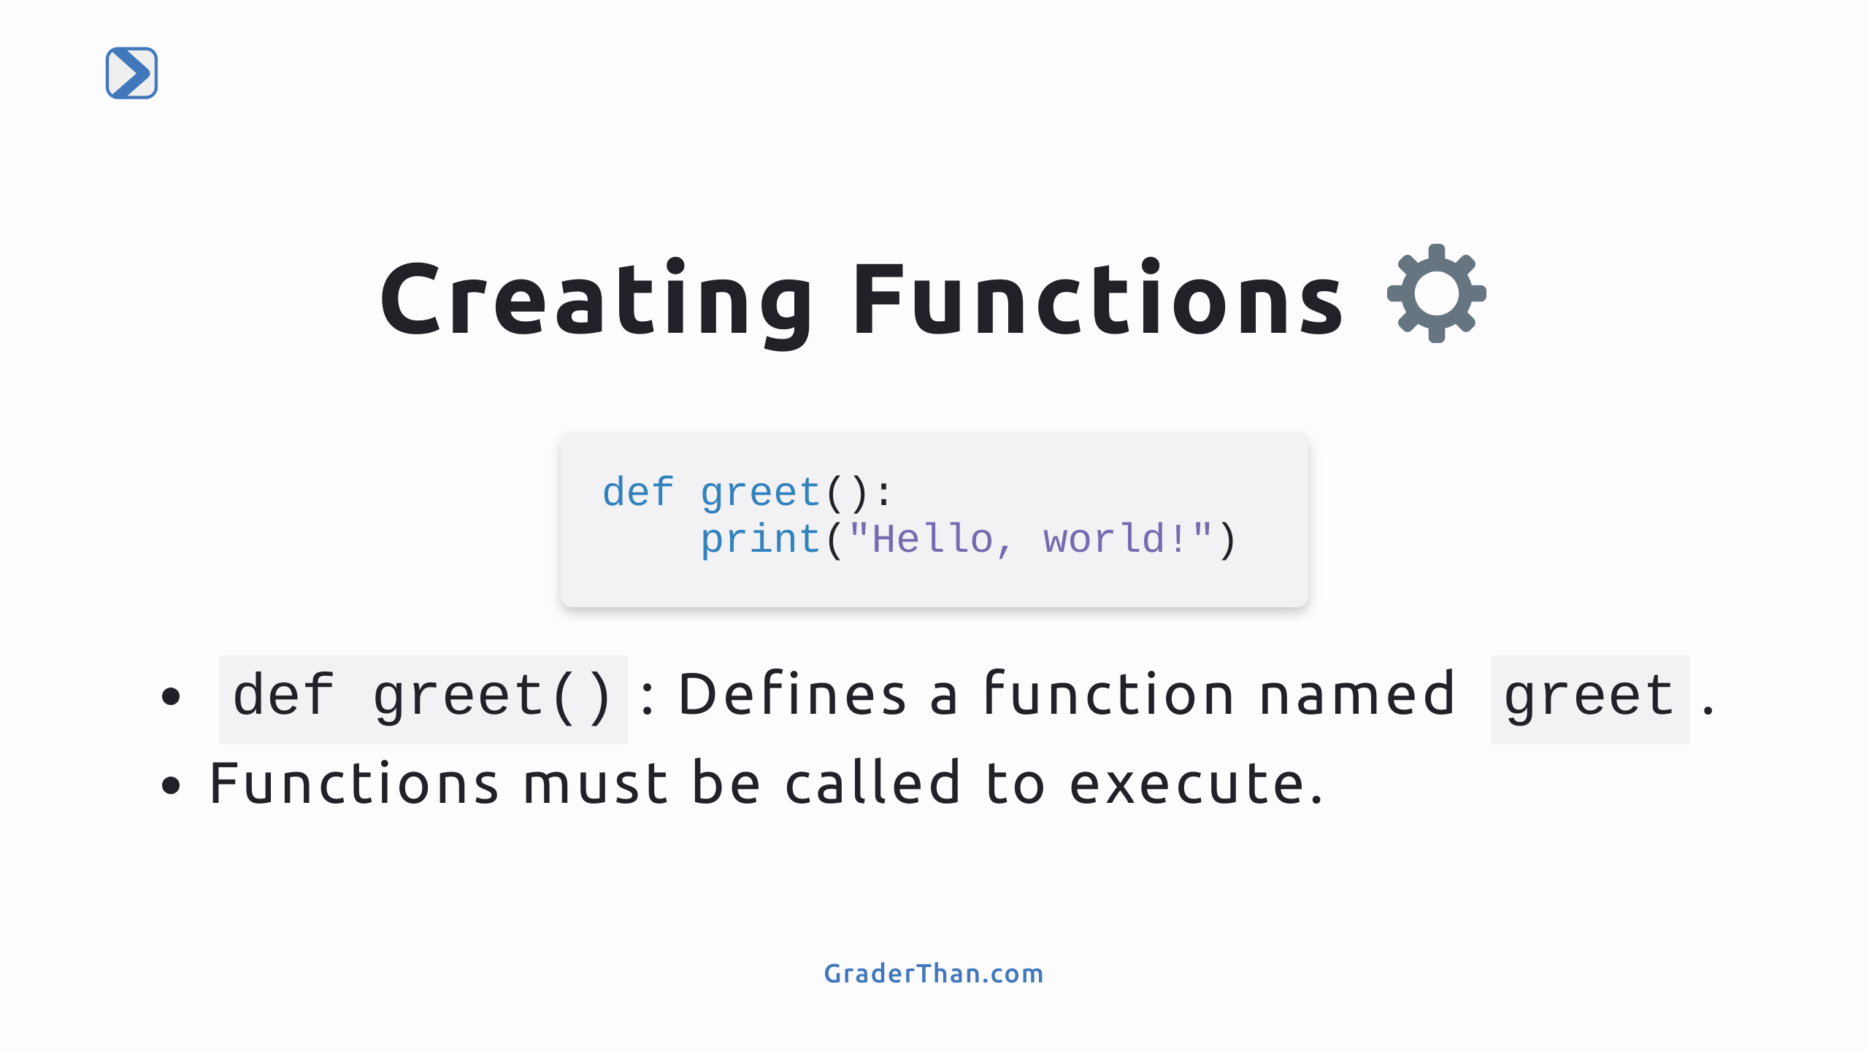
Notes:
- Speaker Note: Explain `def` keyword, function name, parentheses, and colon. - Speaker Note: Stress the importance of indentation in Python, as it defines the function's body. - Speaker Note: Mention that defining a function doesn't execute it; calling it does.

Slide 4
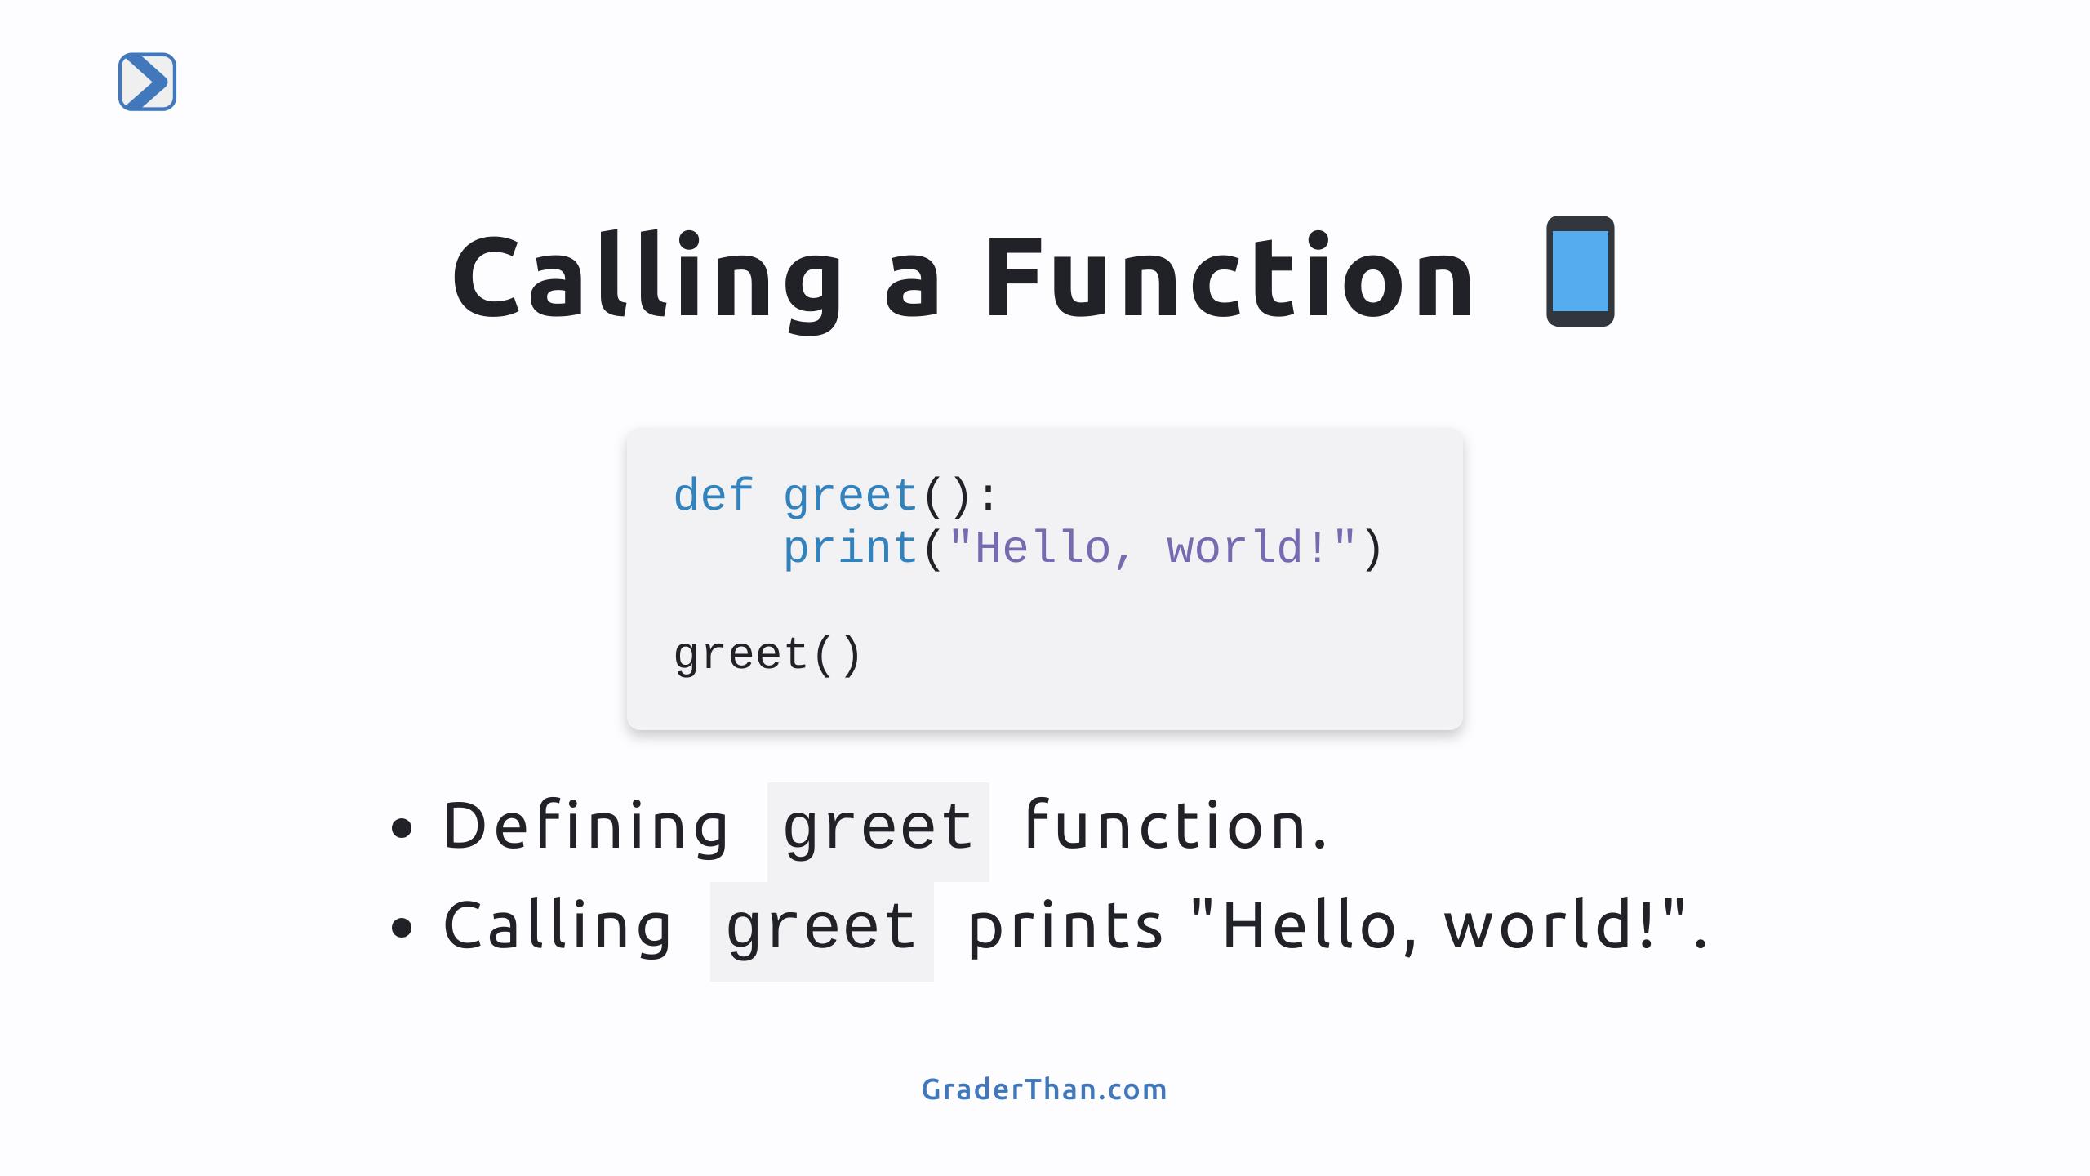
Notes:
- Speaker Note: Show the actual code to define and then call the `greet` function. - Speaker Note: Explain that after defining a function, calling it by its name followed by parentheses executes all the code within its body.

Slide 5
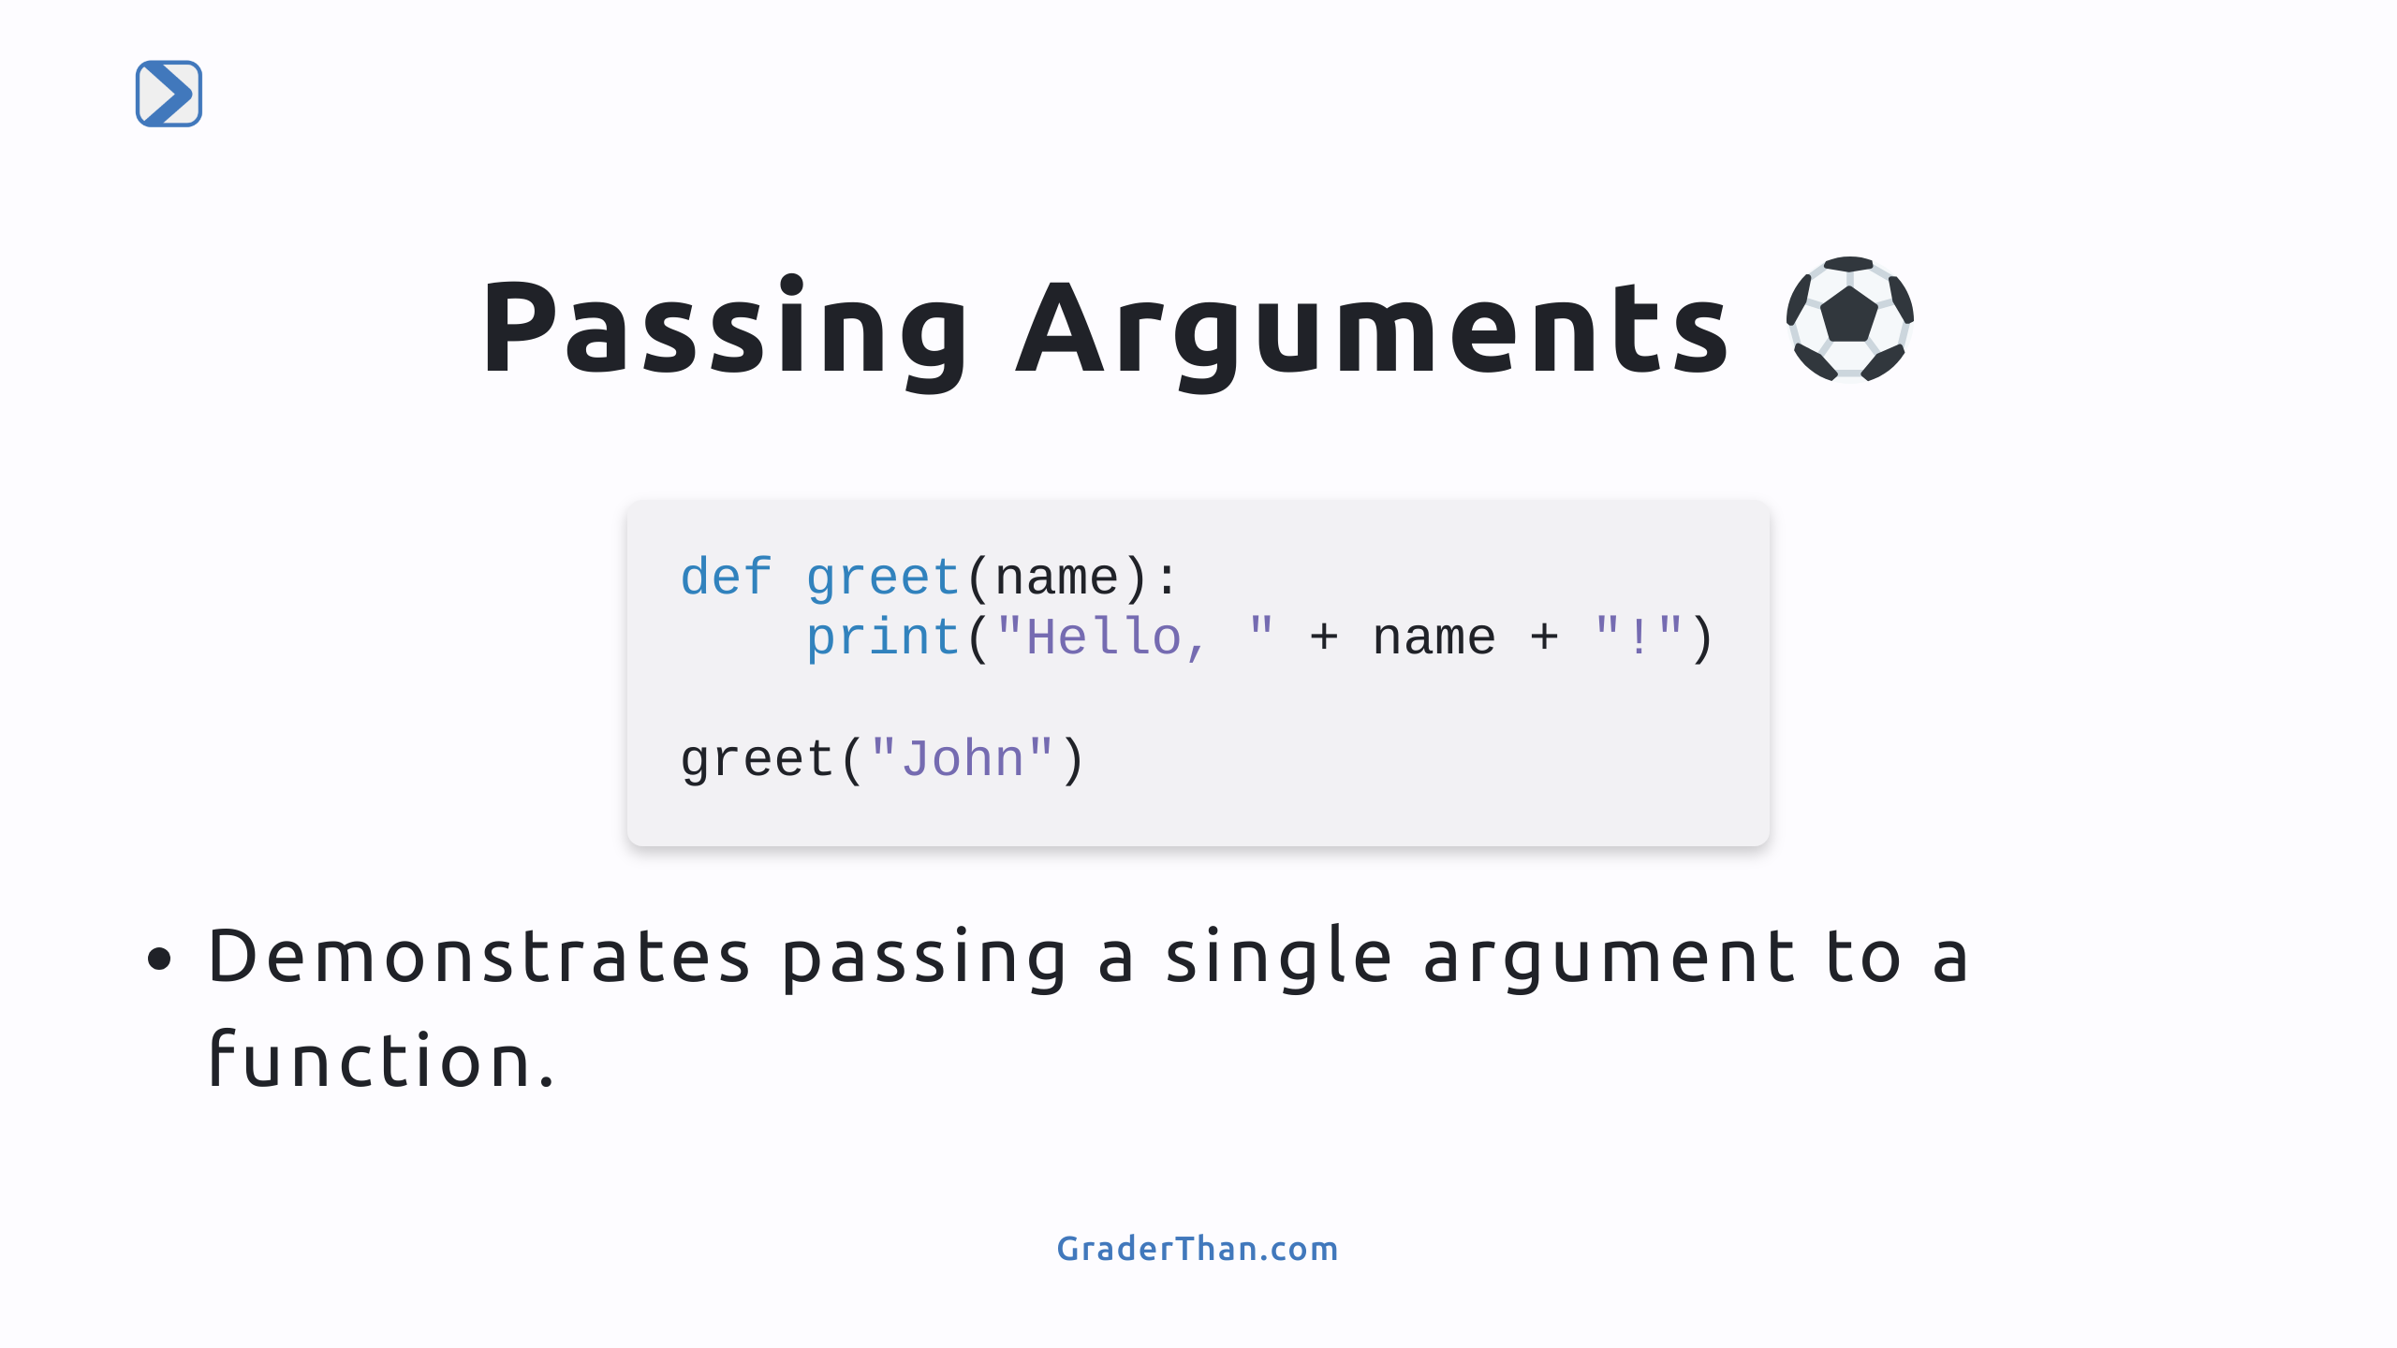
Notes:
- Speaker Note: Explain how arguments allow functions to perform tasks with different inputs. - Speaker Note: Show how to define a function that accepts arguments and how to call it. - The example `greet("John")` prints out "Hello, John!"

Slide 6
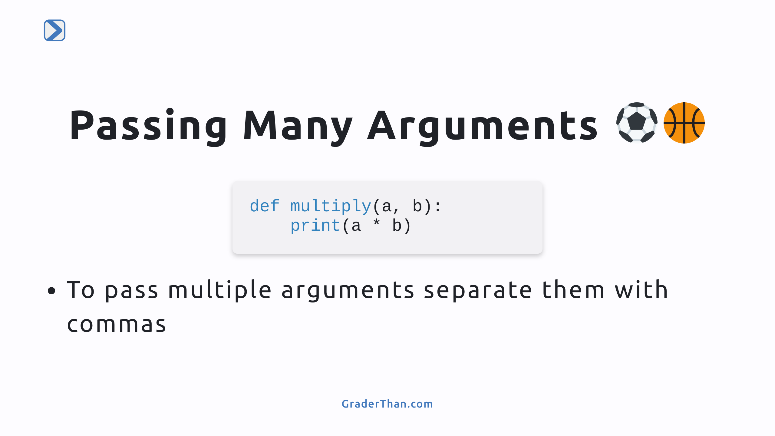

Slide 7
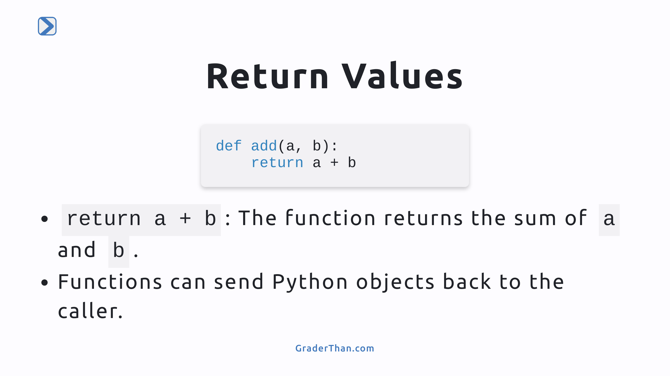
Notes:
- Speaker Note: Highlight the use of `return` to send back a result from a function. - Speaker Note: Mention that not all functions need to return something explicitly; without `return`, Python automatically returns `None`.

Slide 8
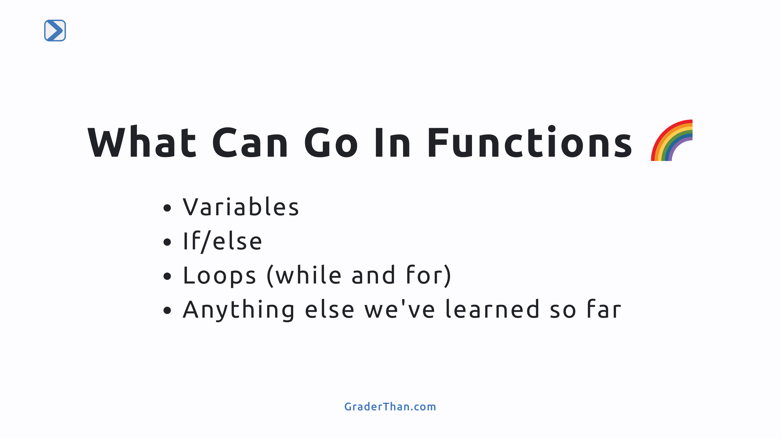

Slide 9
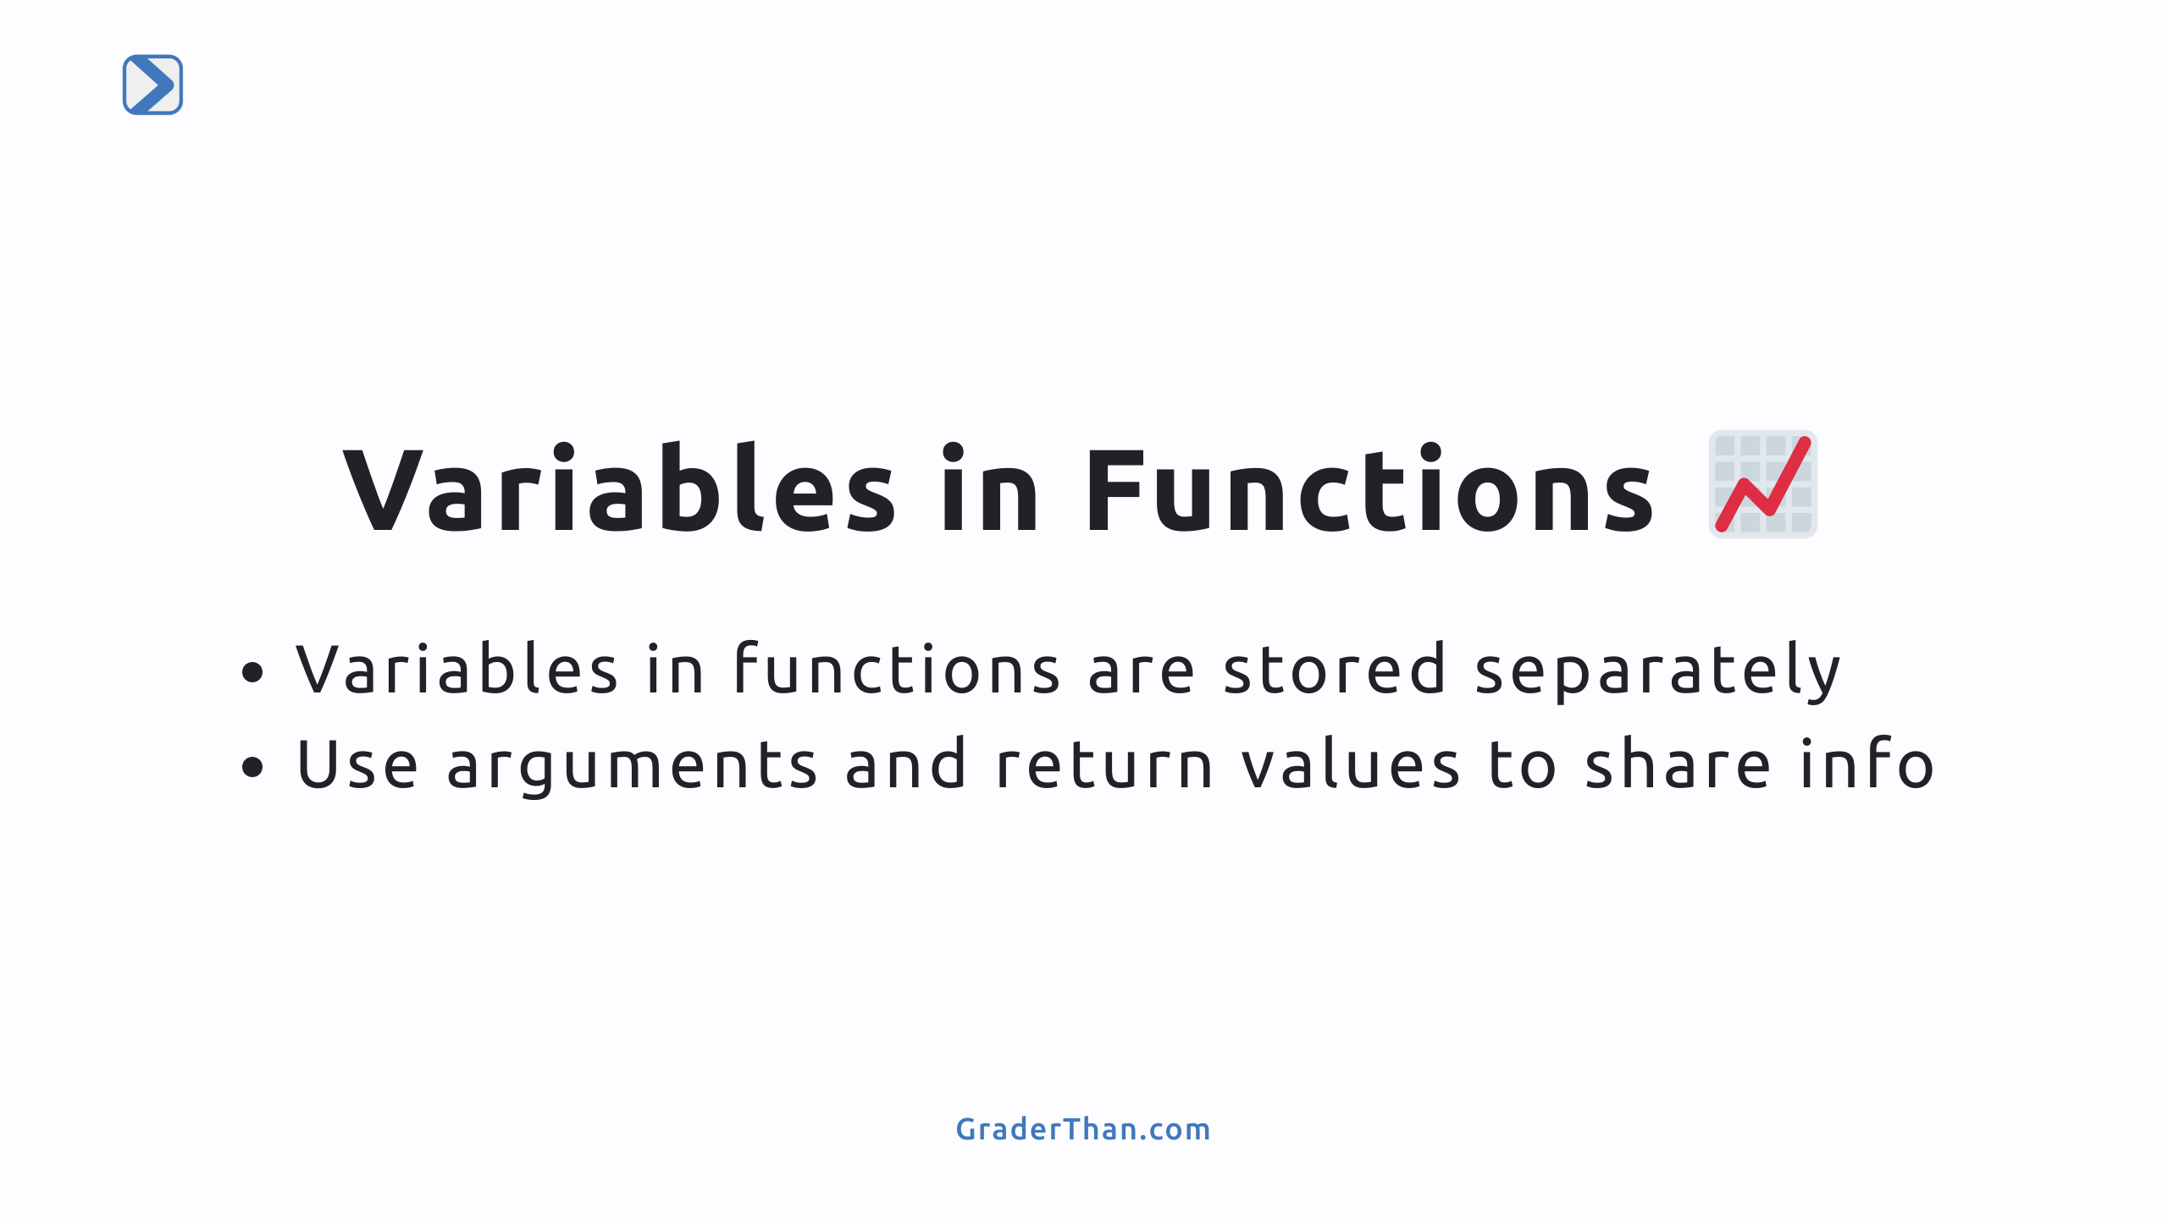
Notes:
Explain how you can have the same variable name in multiple functions and they can all have different values Each function is like its own bubble. To get info from one bubble to another, we use return values and arguments

Slide 10
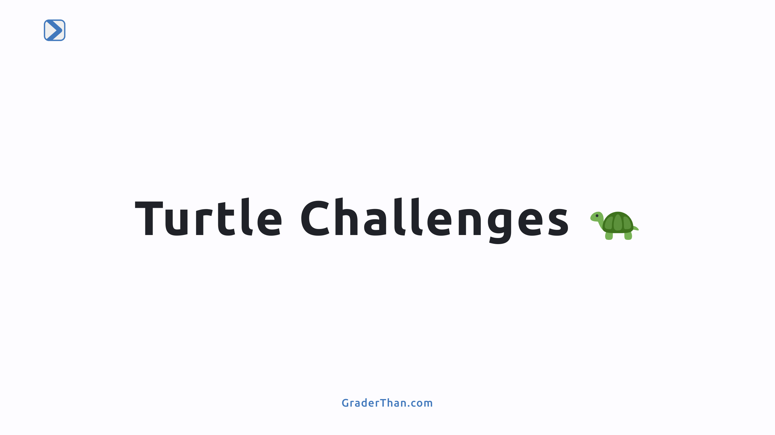

Slide 11
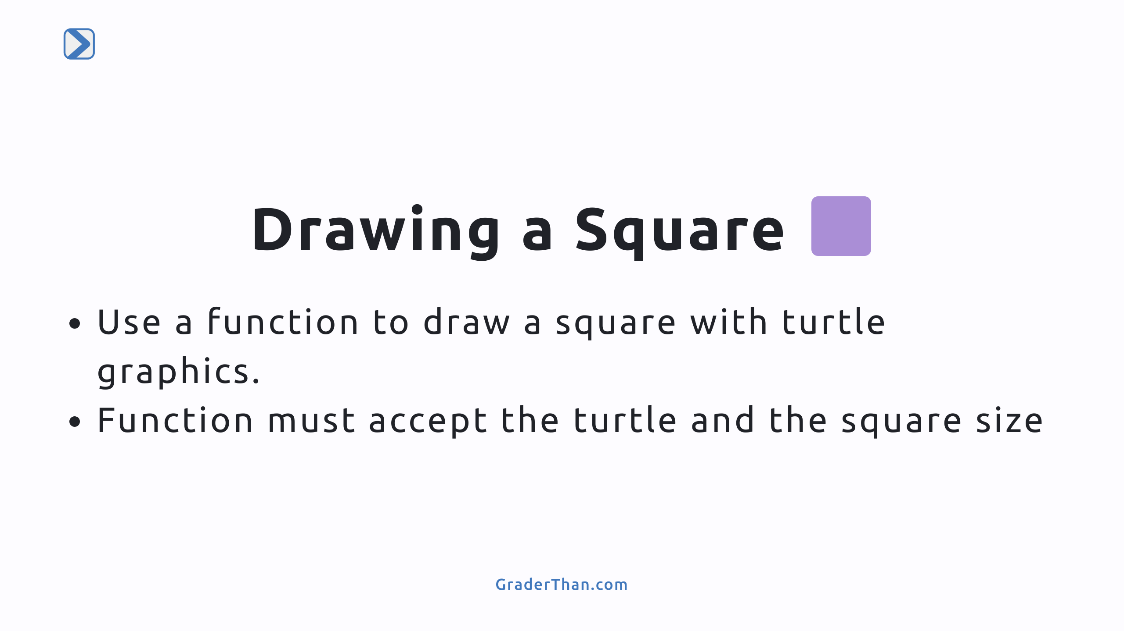
Notes:
- Point out how we have already drawn a square using turtle, we just need to put that logic into a function and call it

Slide 12
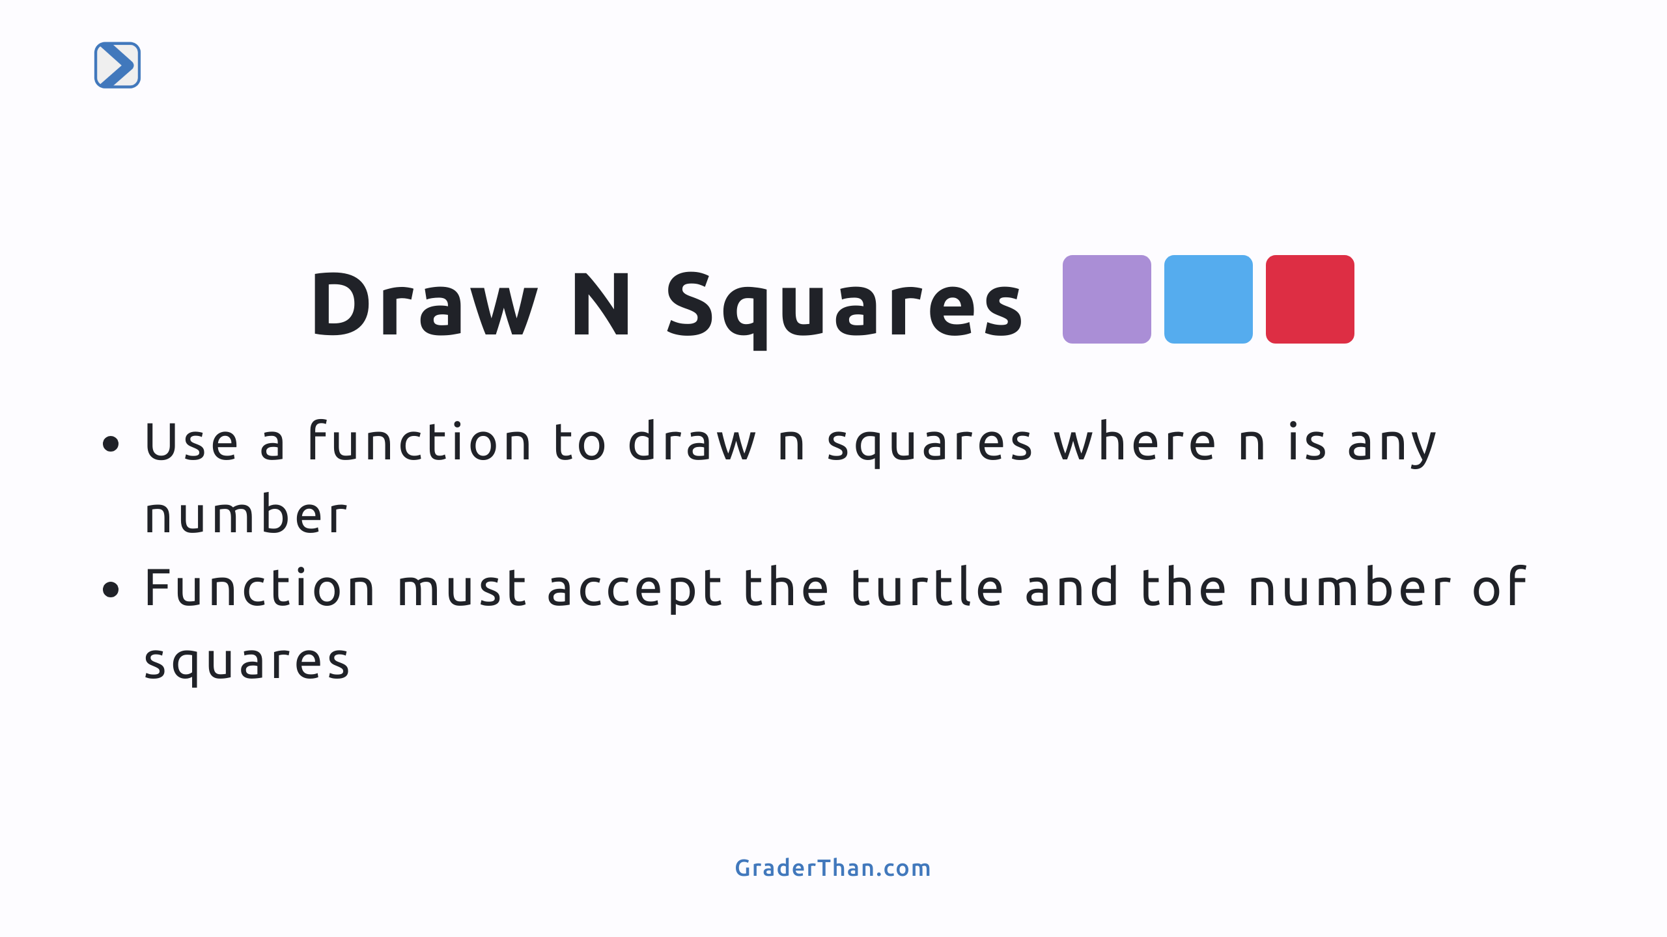
Notes:
- Speaker Note: Students will need to use for loops to accomplish this, where the size of each square is some multiple of i -

