Slide 1
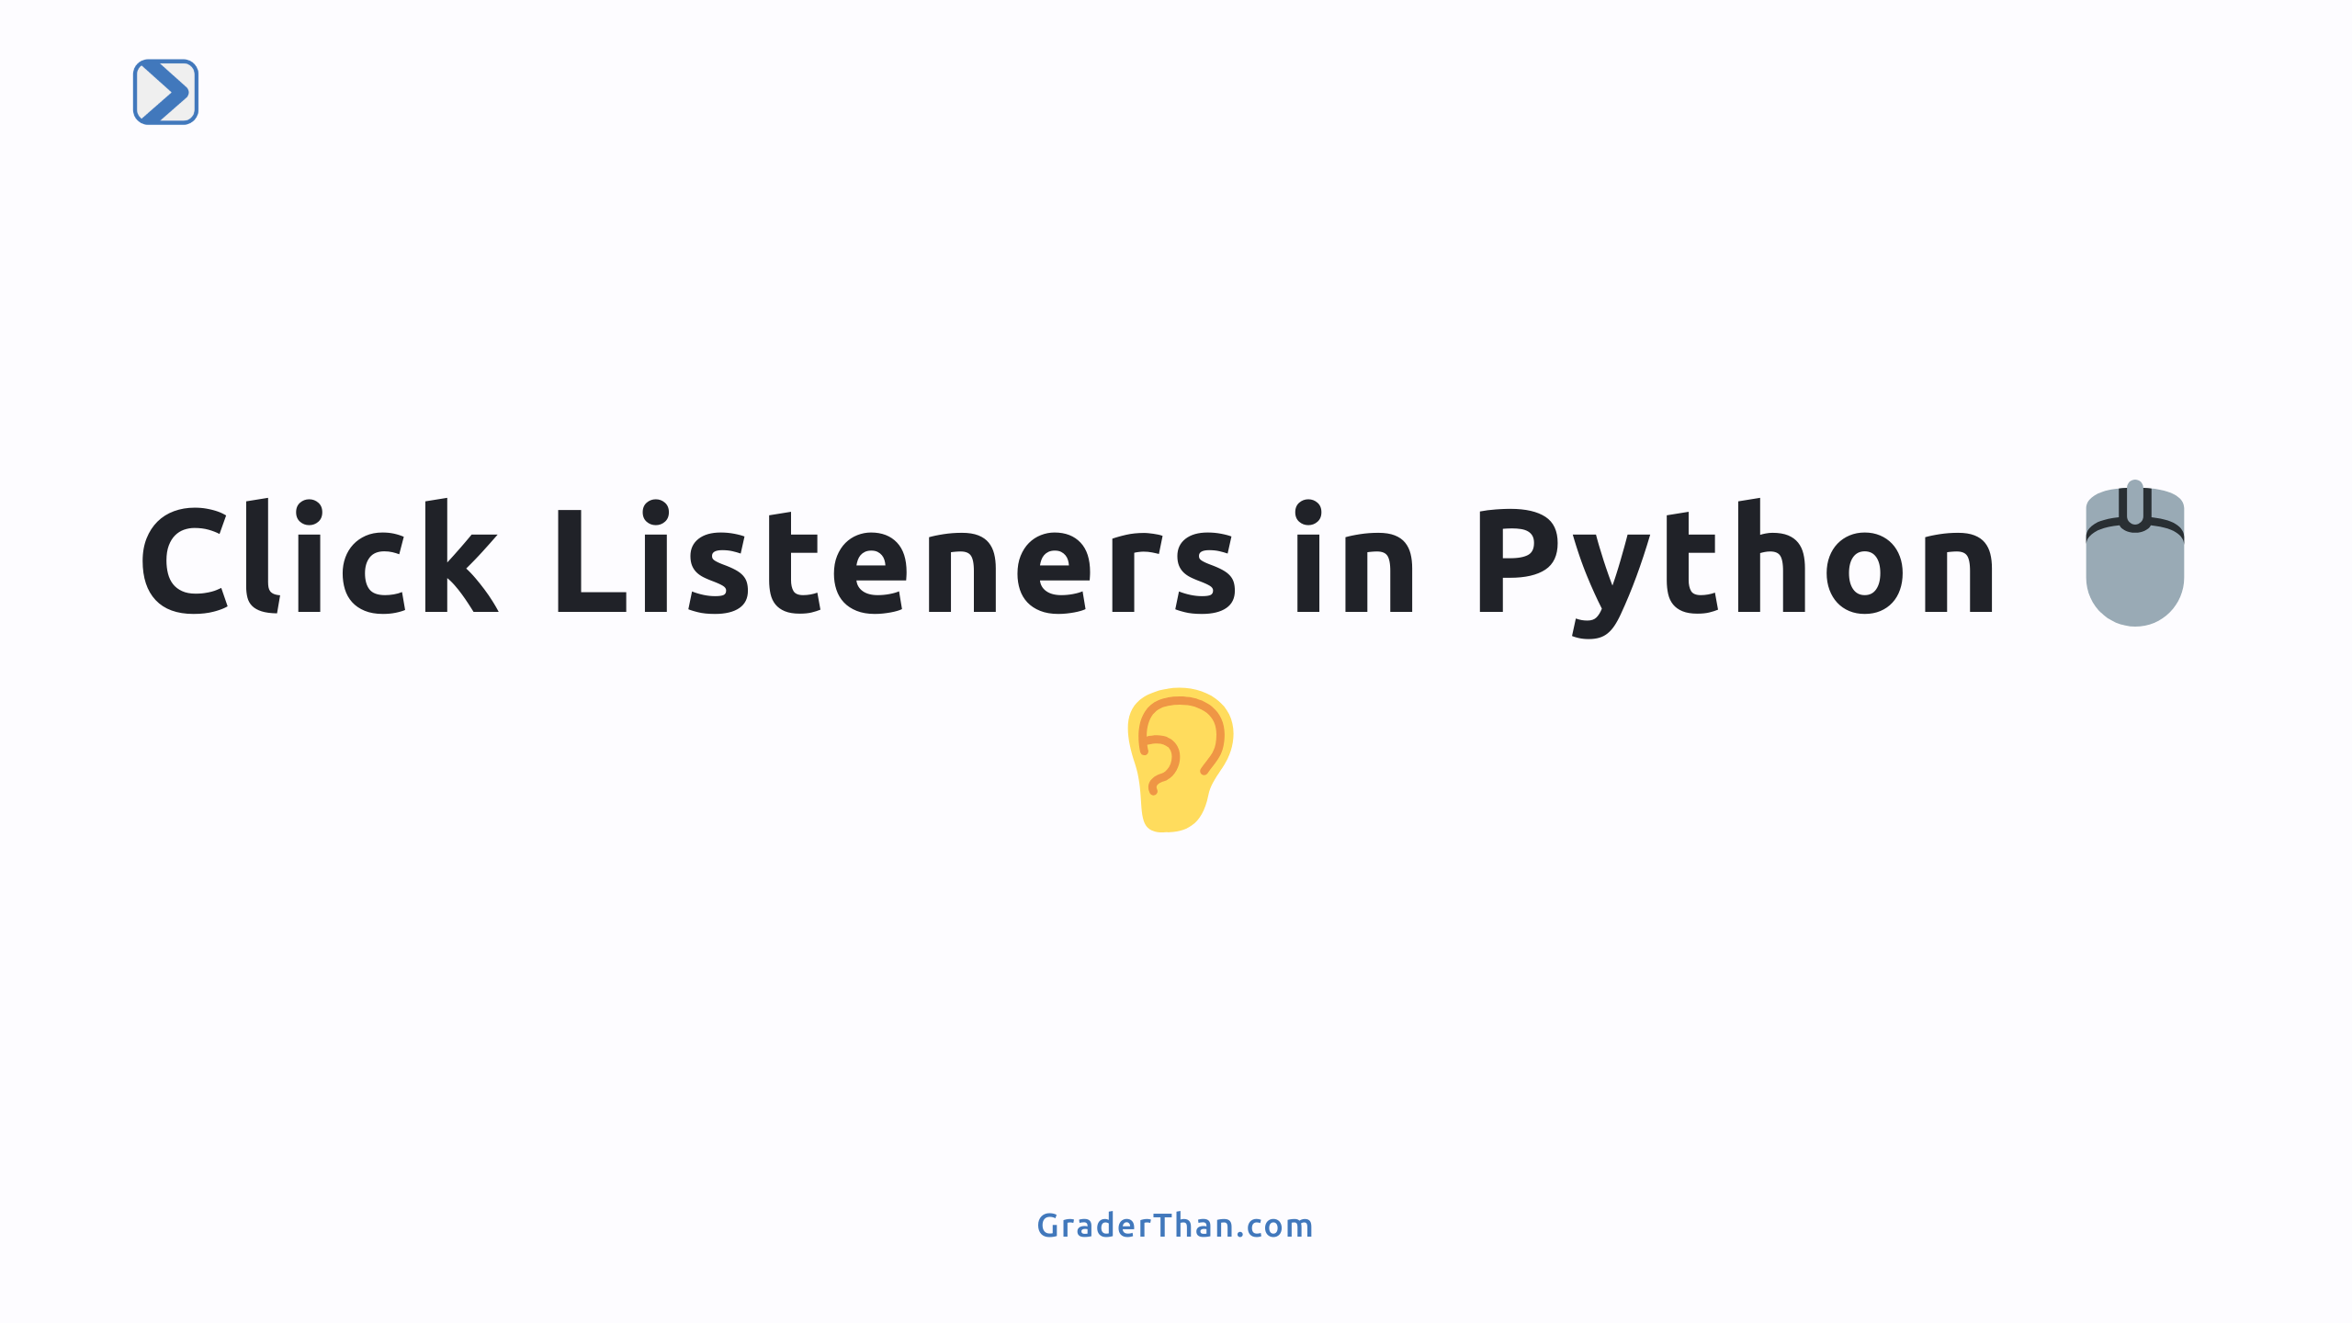

Slide 2
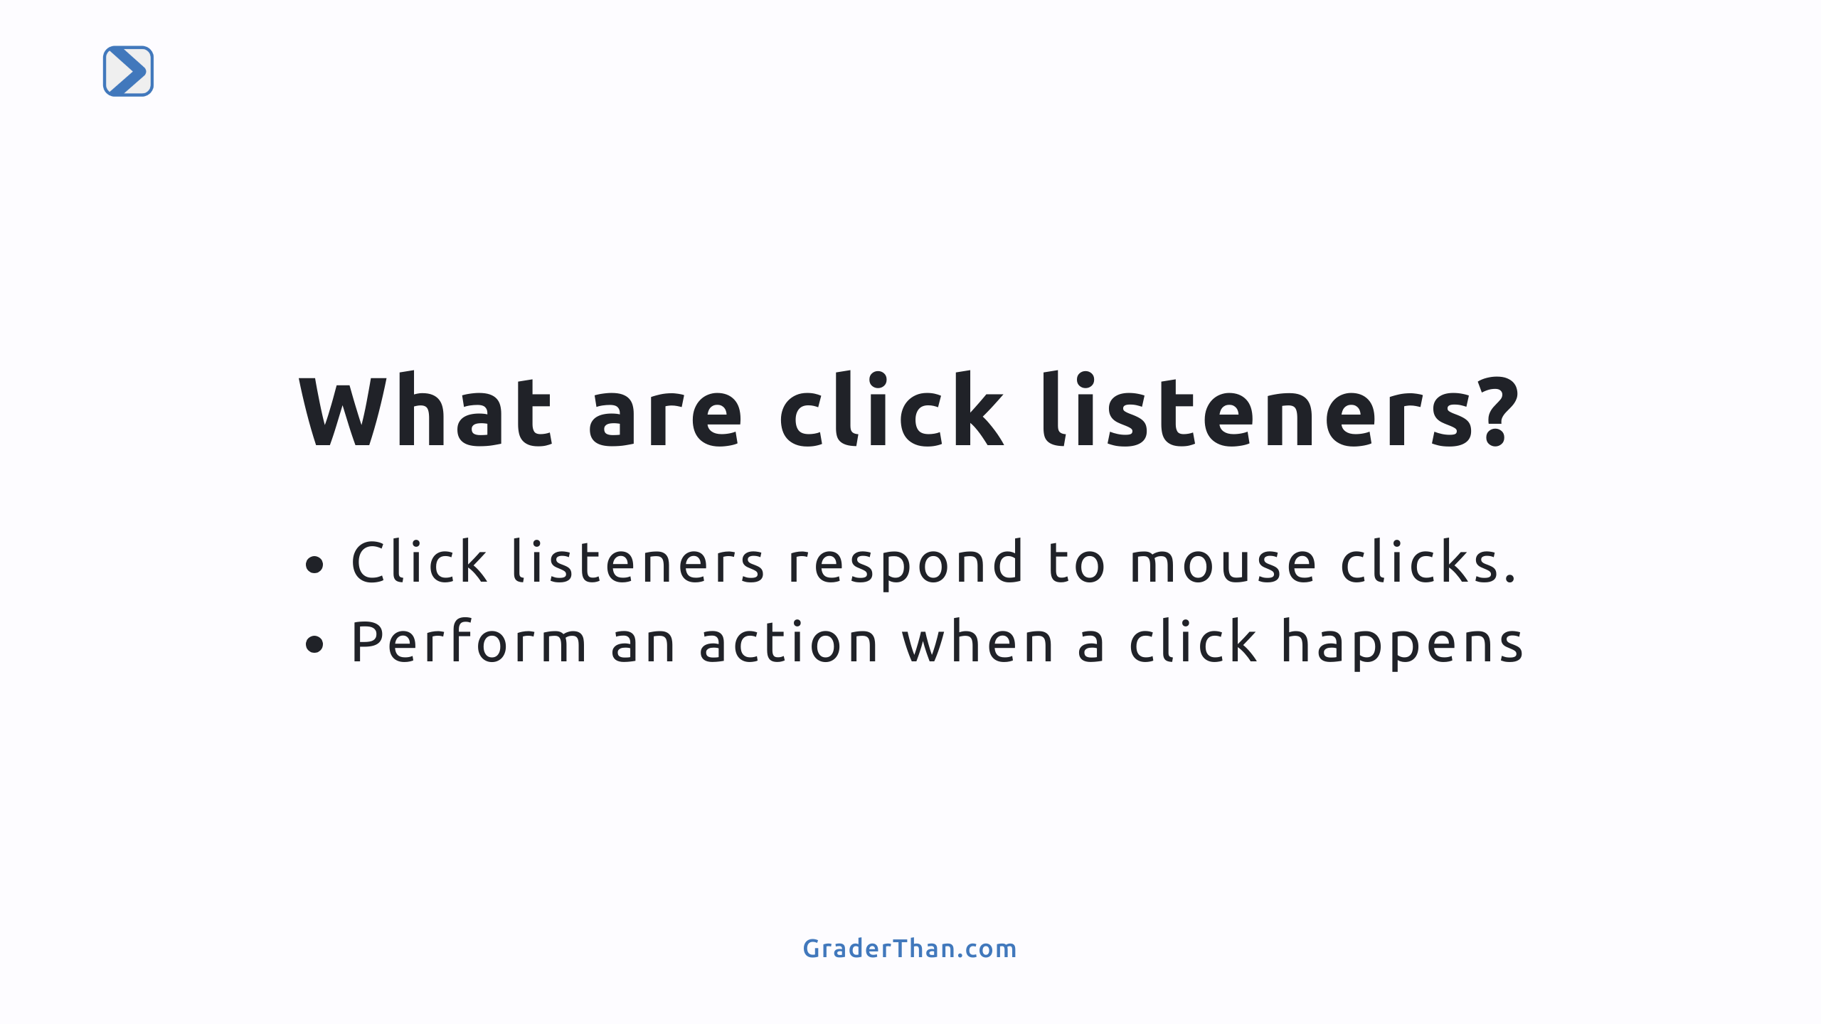
Notes:
- This slide introduces the concept of click listeners. - Emphasizes their importance in creating interactive applications in Python.

Slide 3
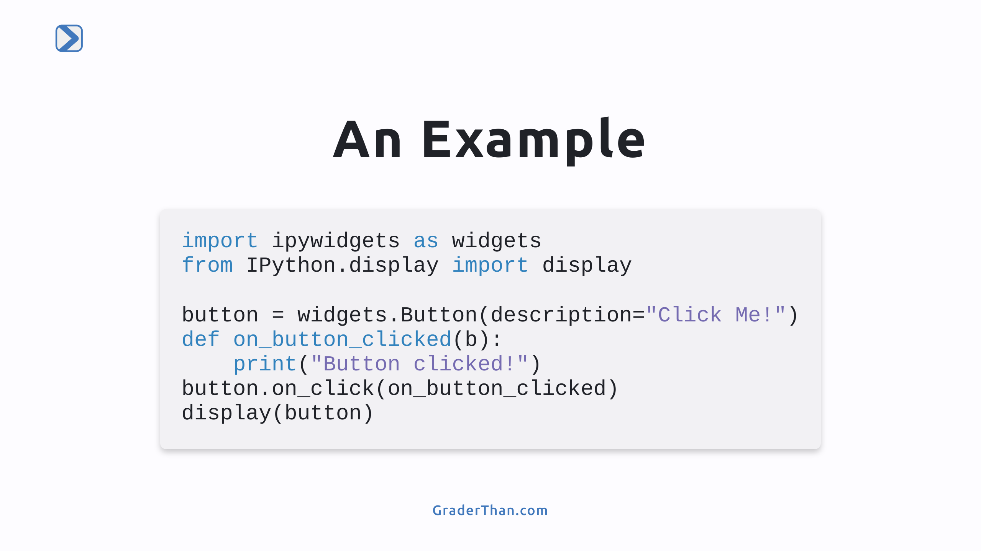
Notes:
- Demonstrates how to import necessary libraries and create a button widget. - Shows defining a function that executes when the button is clicked. - Illustrates attaching the click event handler to the button and displaying it.

Slide 4
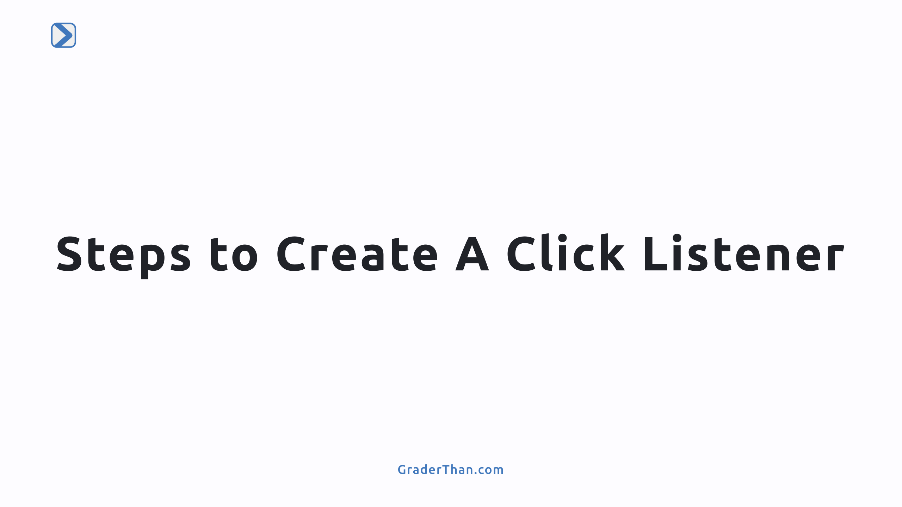

Slide 5
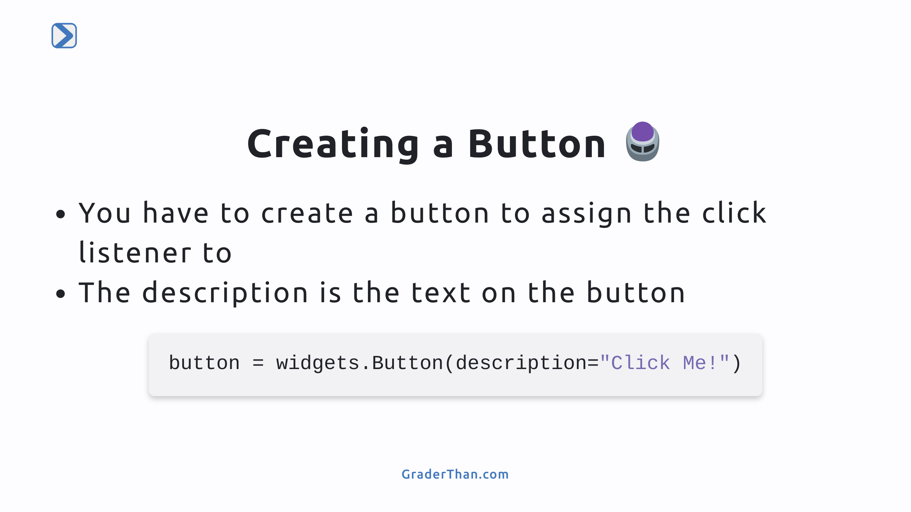

Slide 6
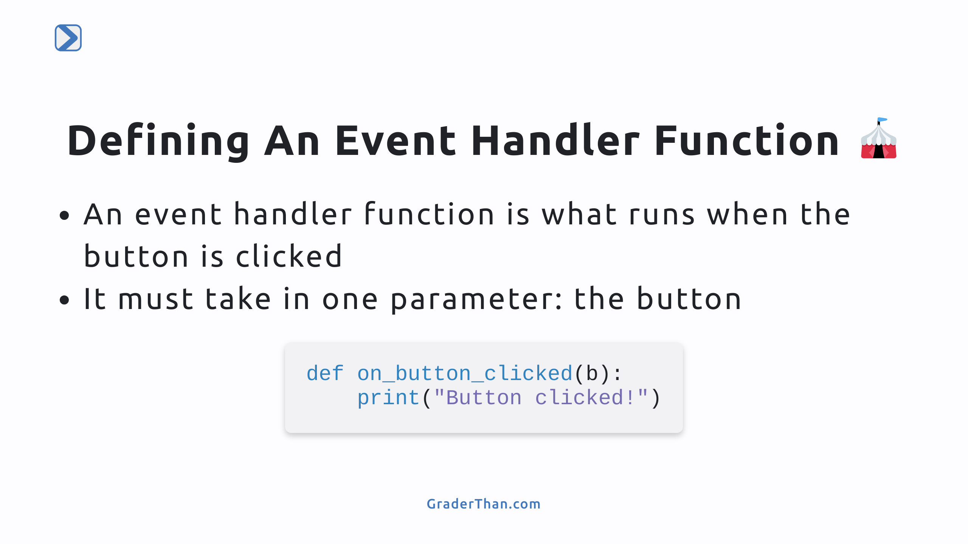
Notes:
- Talk about how clicking is the "event", the function is run to "handle" the event - The b argument is the button itself. You don't have to use in the function

Slide 7
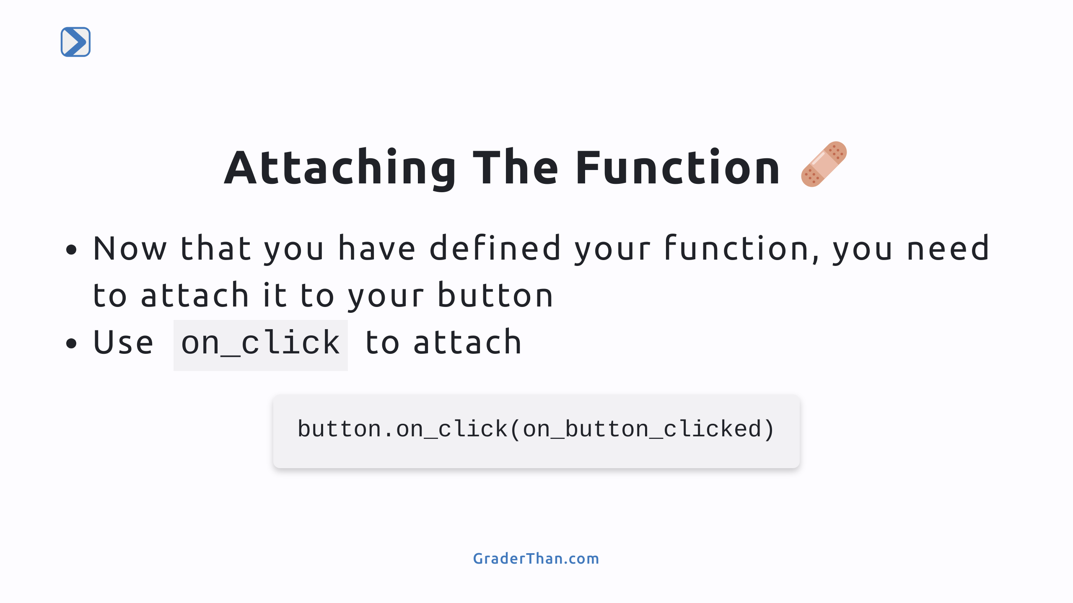
Notes:
- This is how the code knows what function to run when the button is clicked

Slide 8
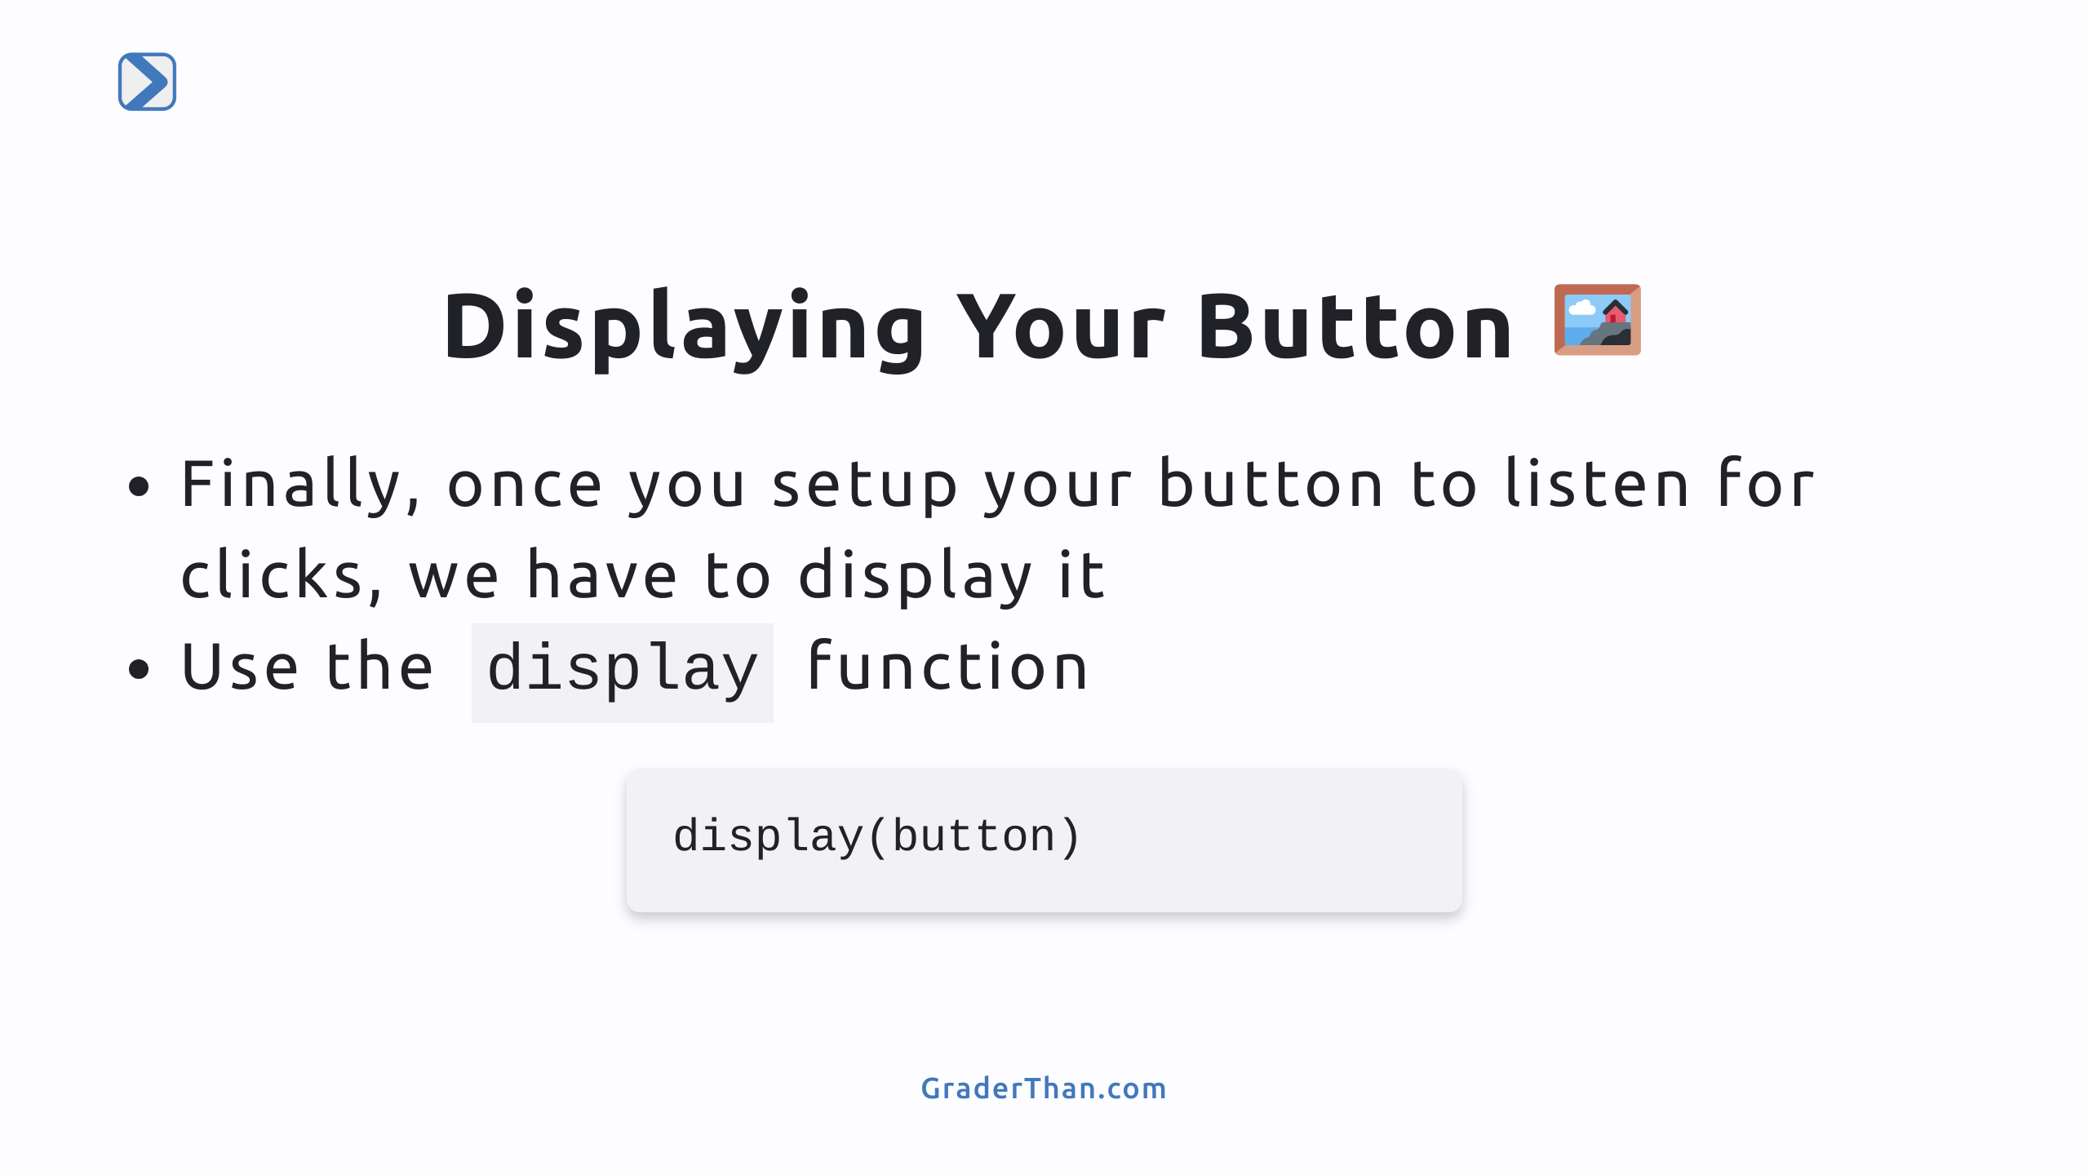
Notes:
- Make sure students understand that creating the button and displaying it are separate steps - Like creating a string variable vs printing it out

Slide 9
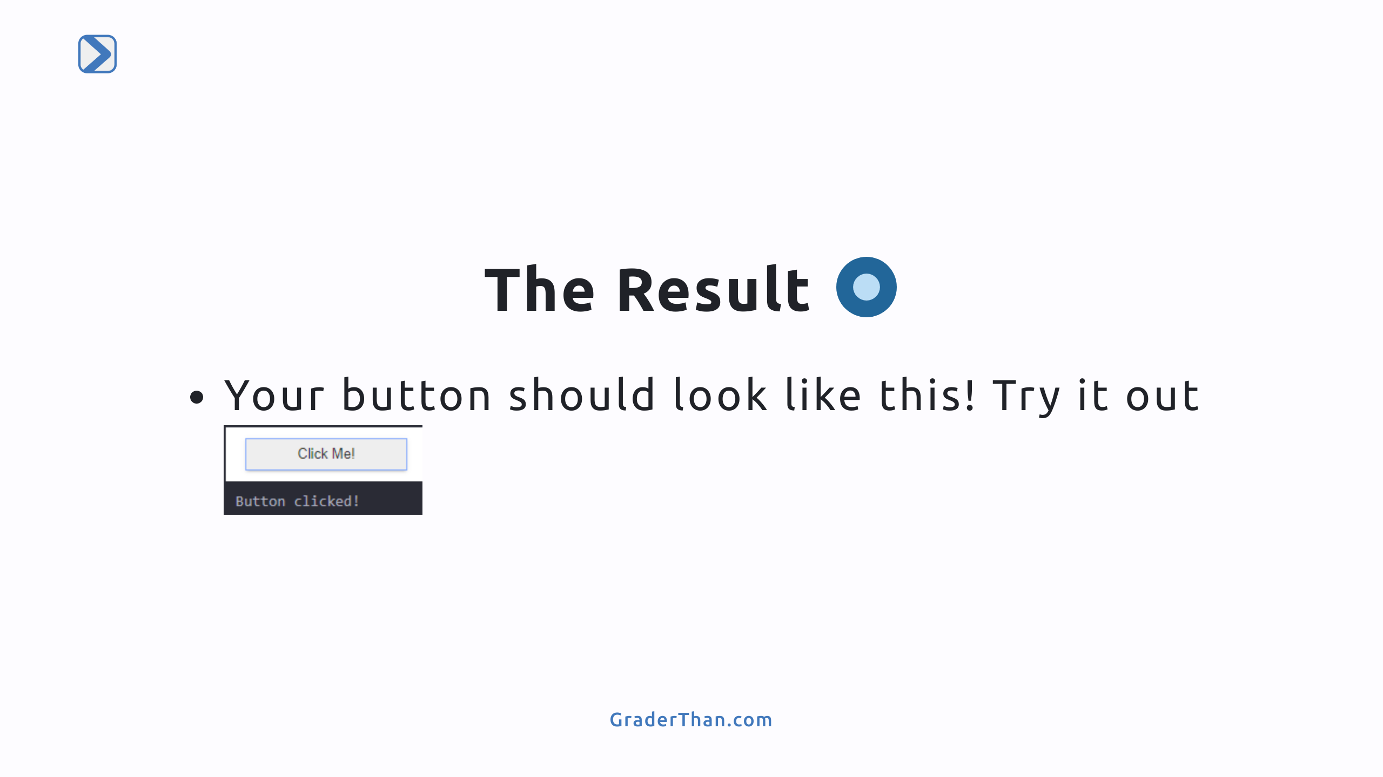

Slide 10
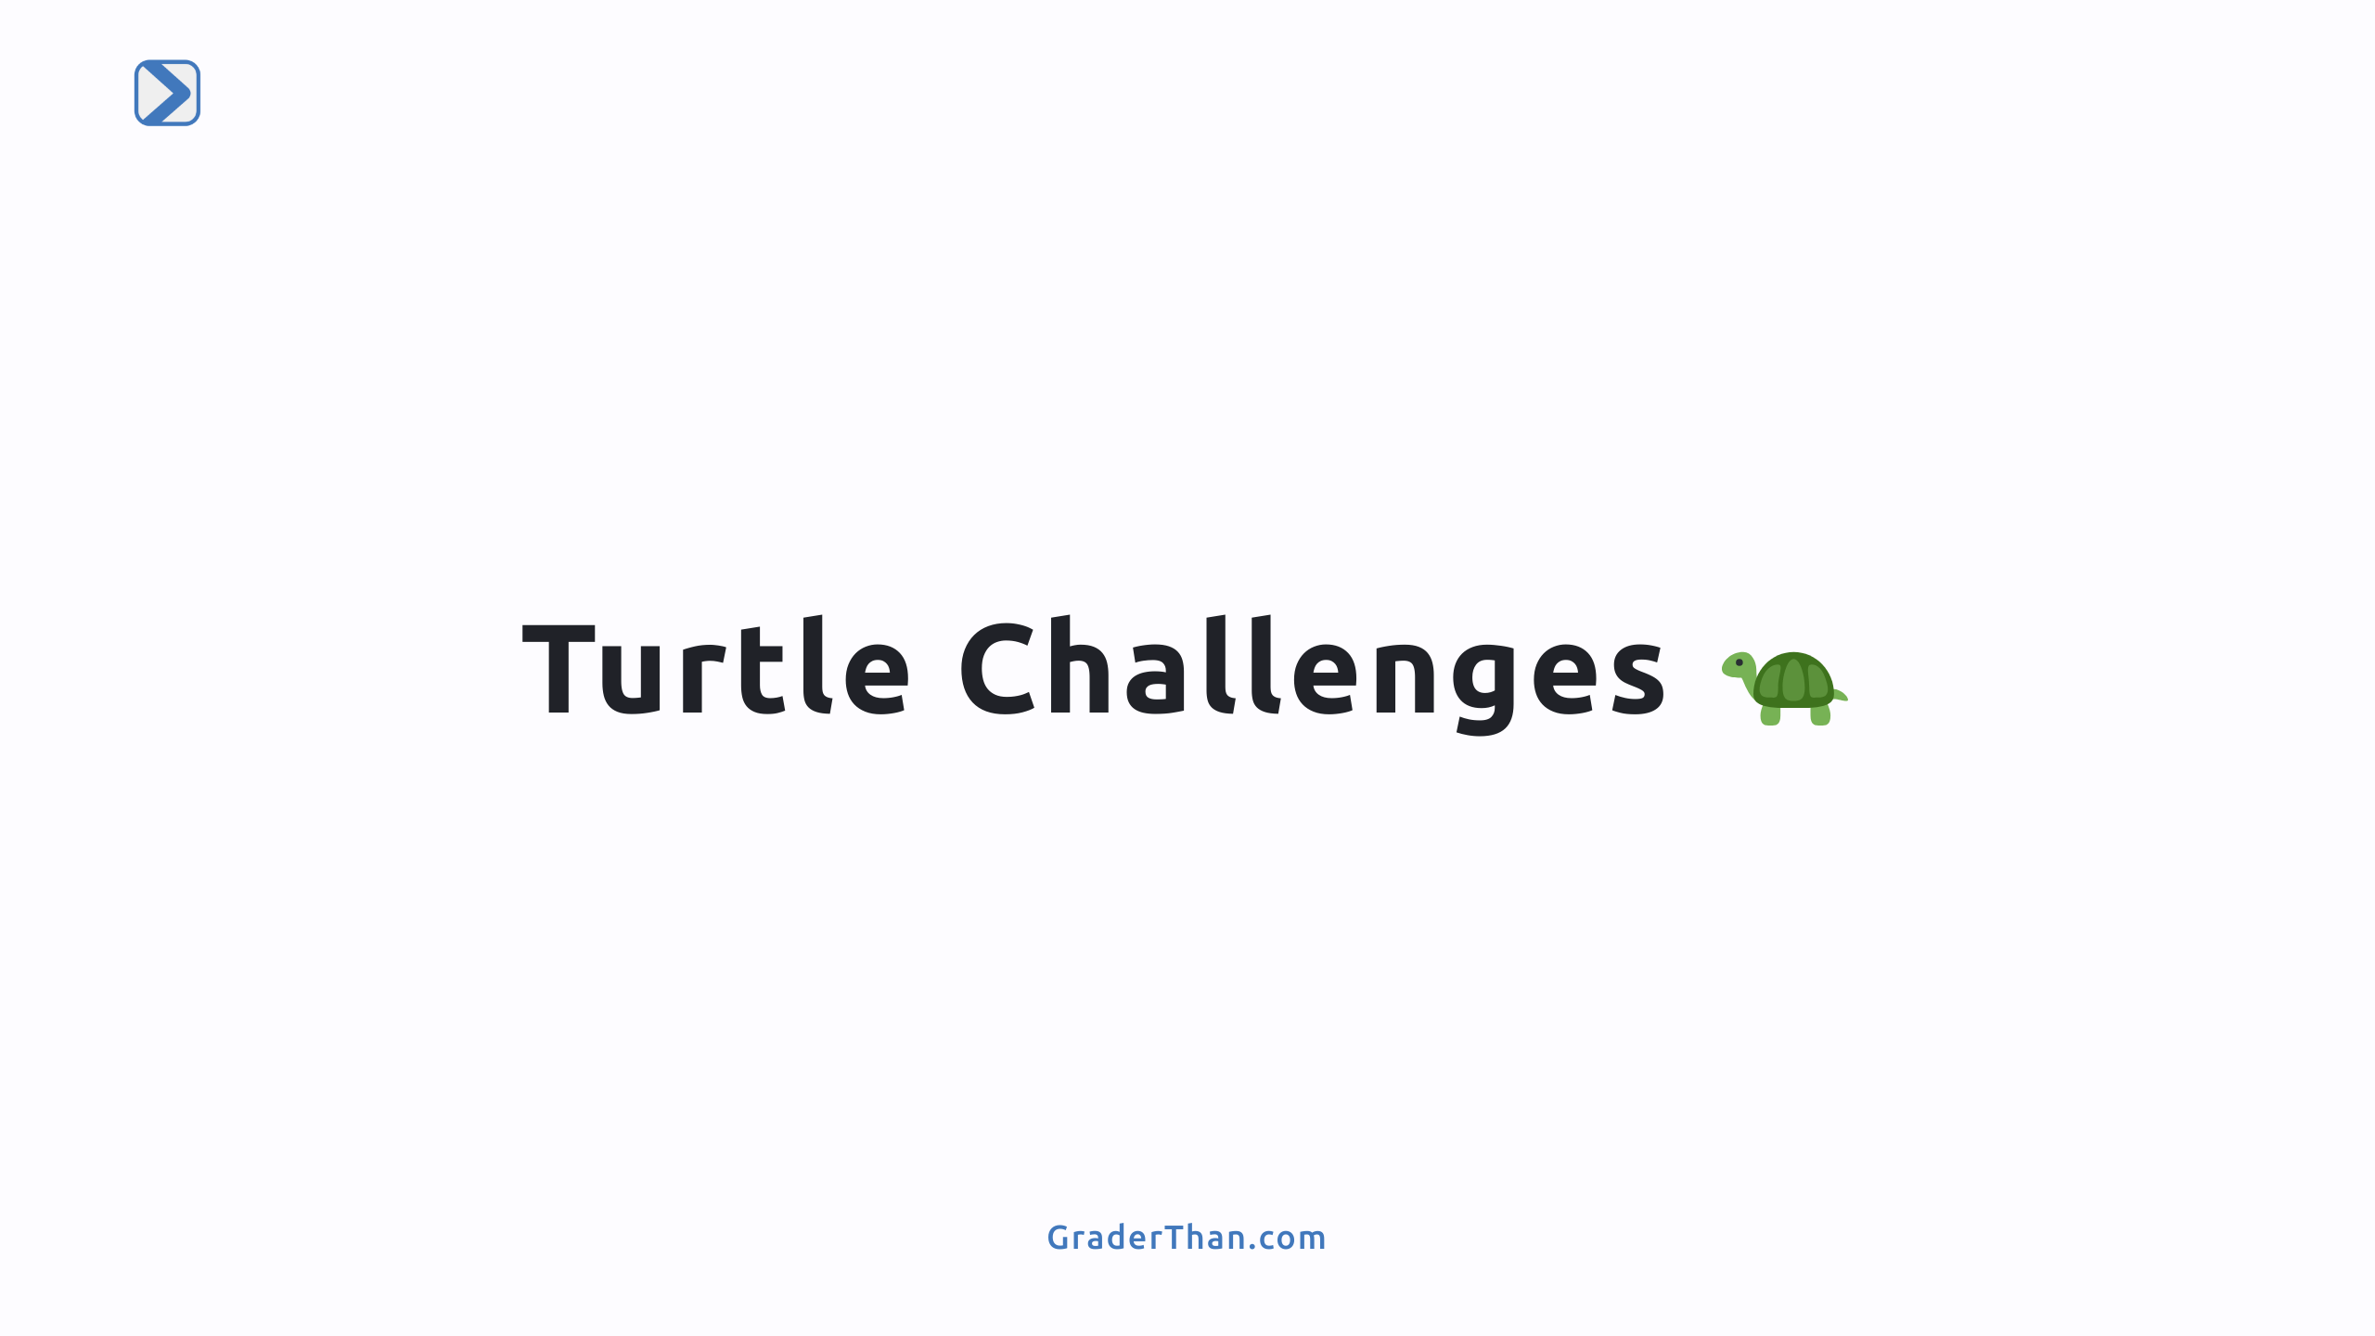

Slide 11
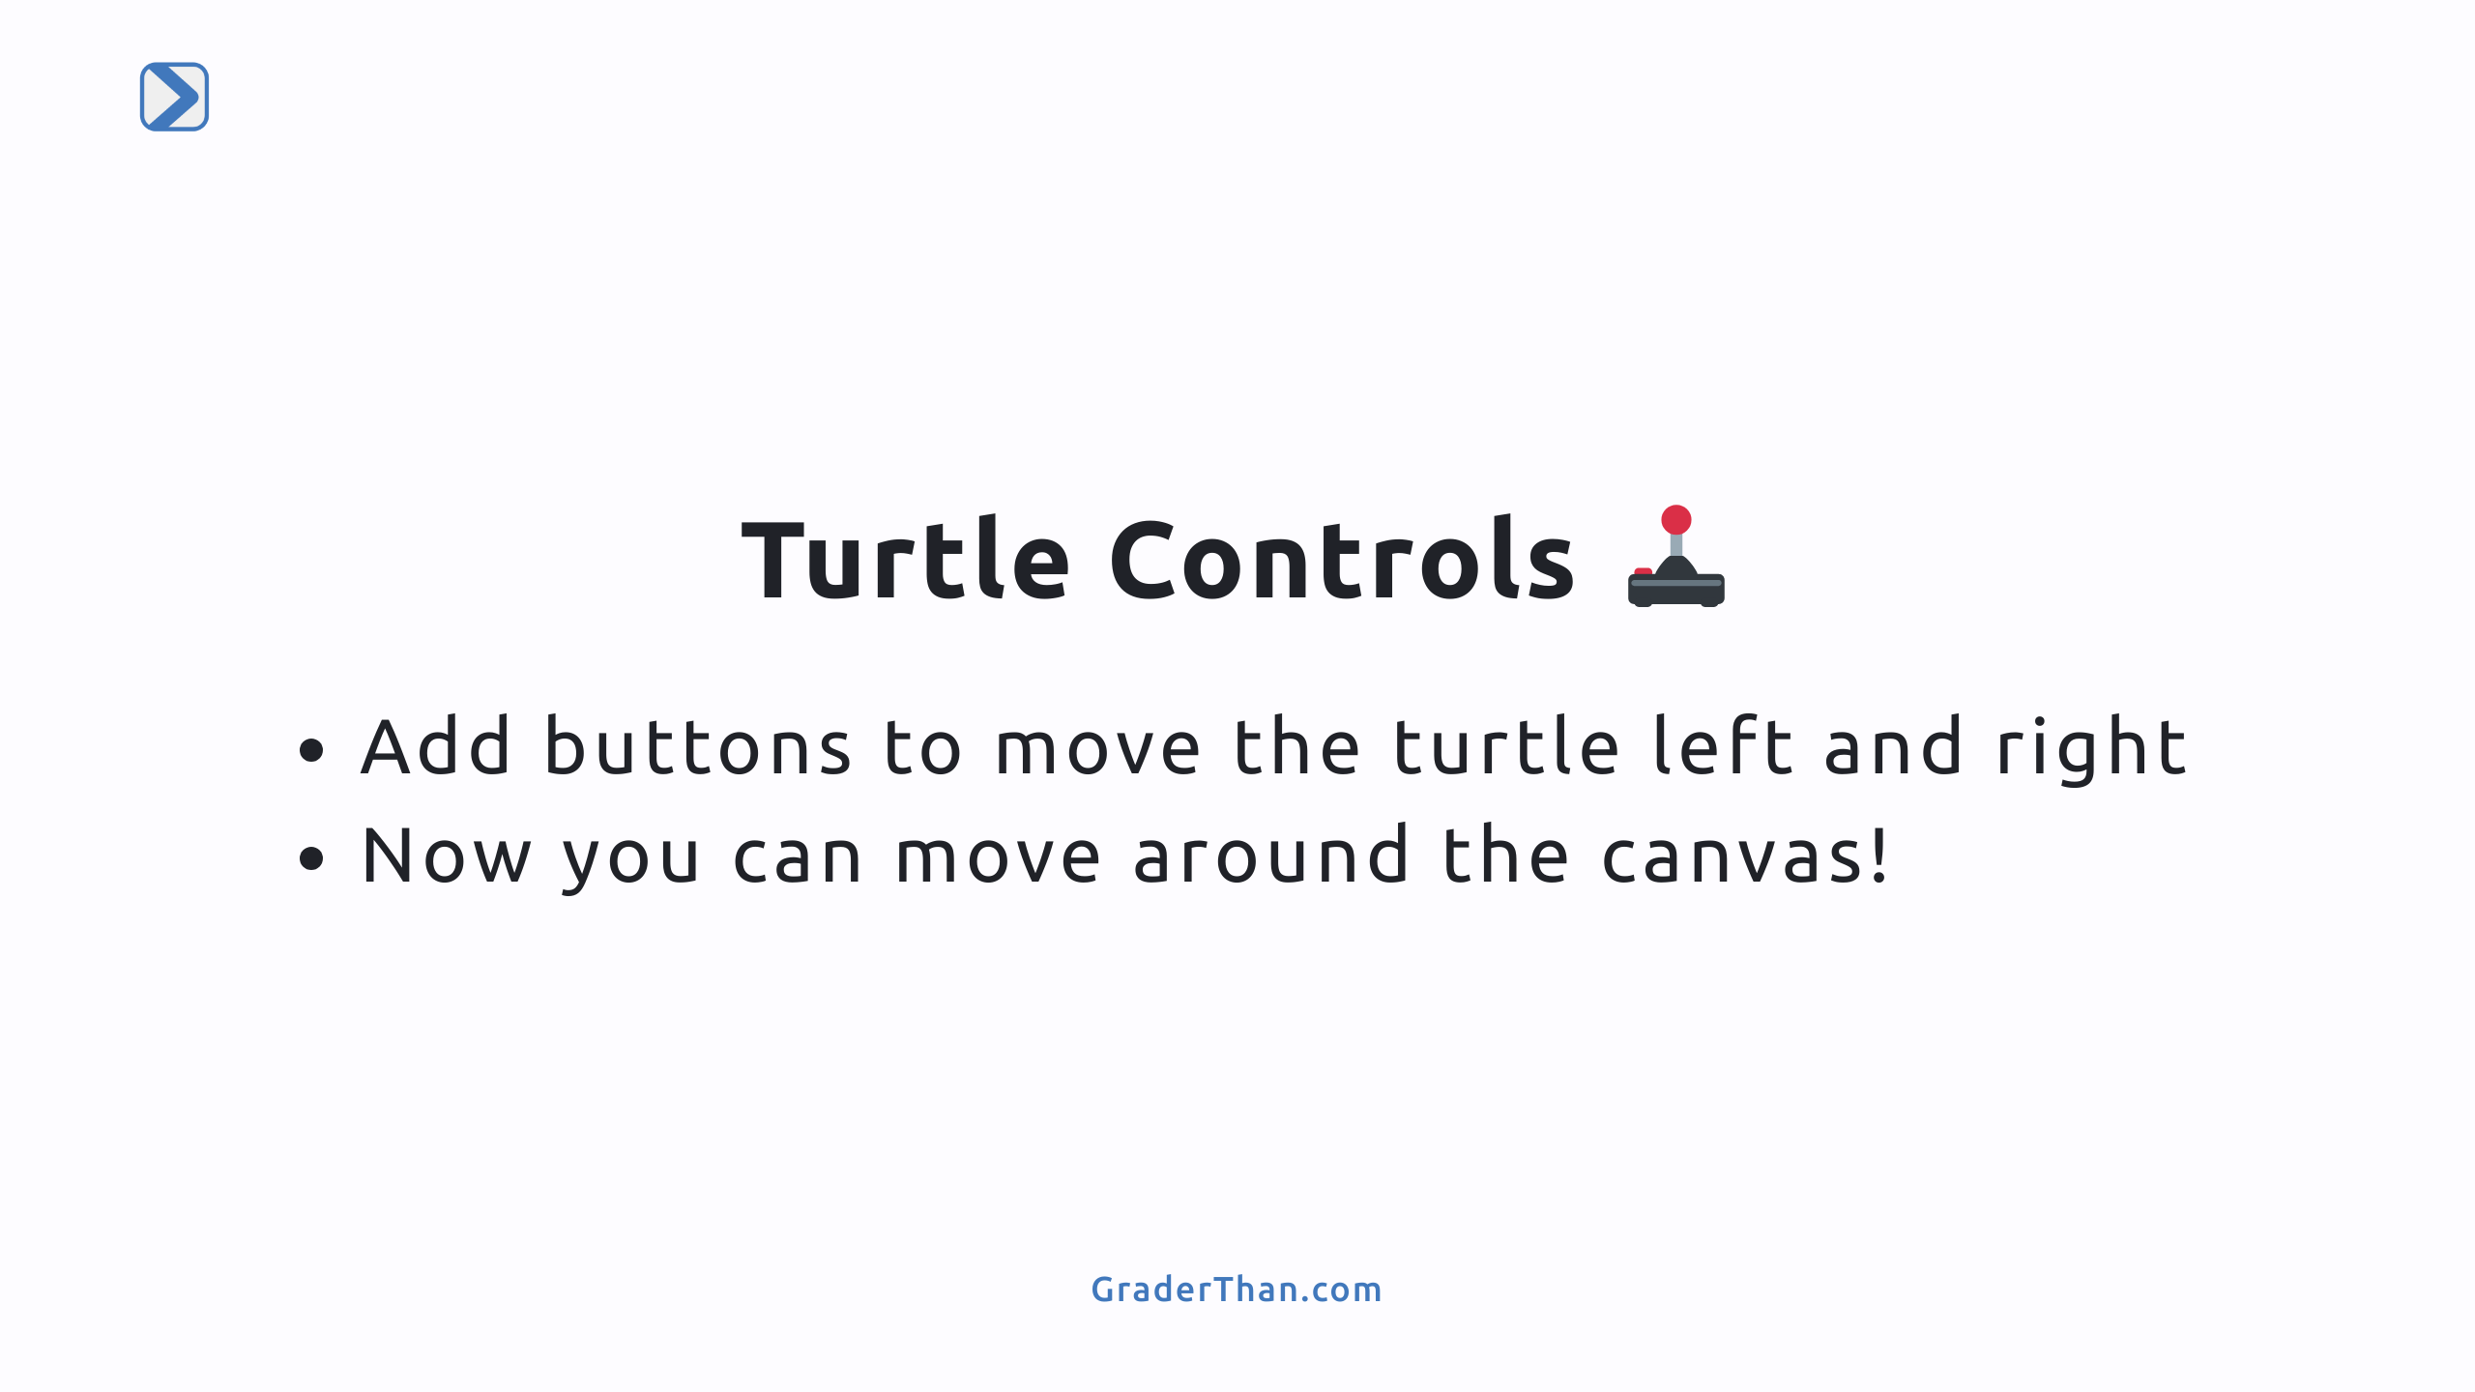

Slide 12
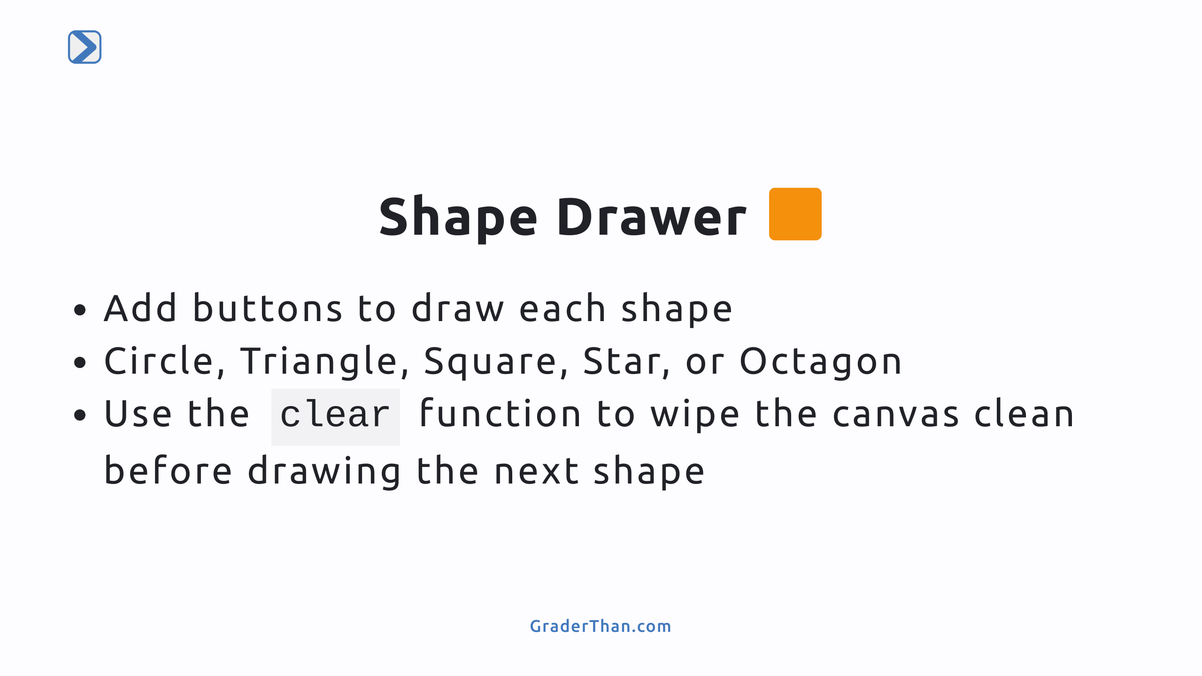
Notes:
- The clear function is used by calling turtle.clear() where turtle is their turtle - It removes all previous drawings from the screen

Slide 13
