Slide 1


Slide 2
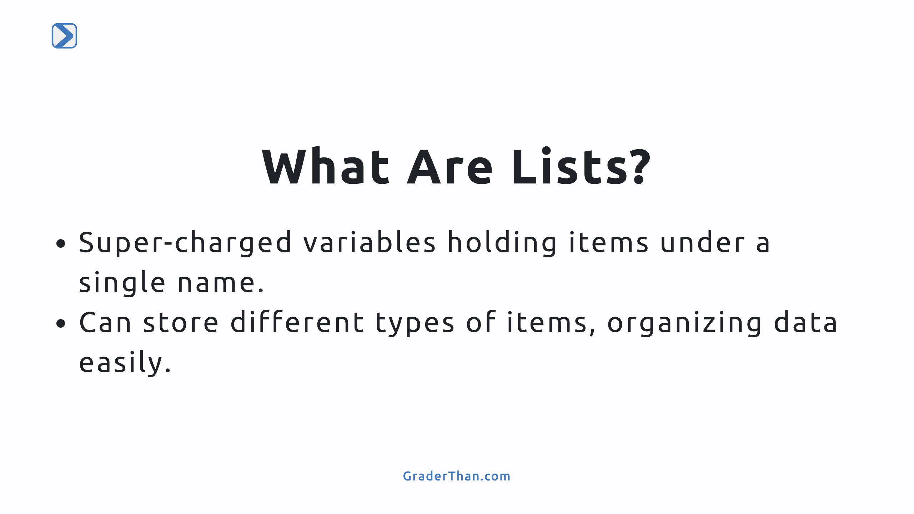
Notes:
- this is a speaker note: Introduce Python lists as powerful tools for grouping multiple items under one name, making data organization simpler. - this is another speaker note: Emphasize their ability to hold different types of data, which is useful for various programming tasks.

Slide 3
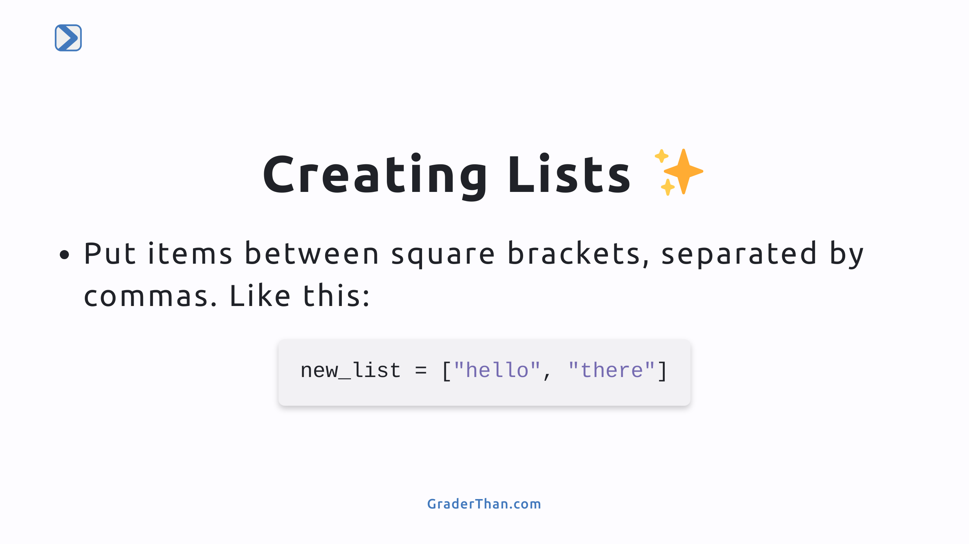
Notes:
- Explain how to create a list with a simple syntax. - Highlight that lists can include multiple data types and maintain the order of items.

Slide 4
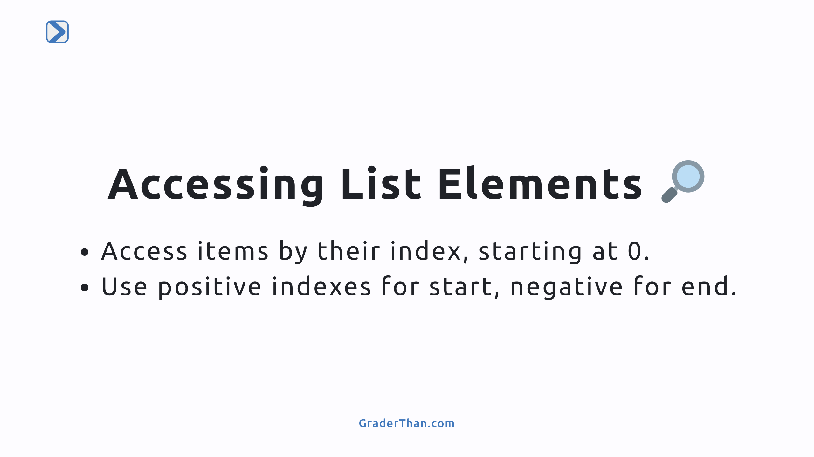
Notes:
- Detail how to access list elements using indexes. - Syntax looks like list_name[index] - Mention the use of positive indexes for the beginning and negative indexes for accessing items from the end.

Slide 5
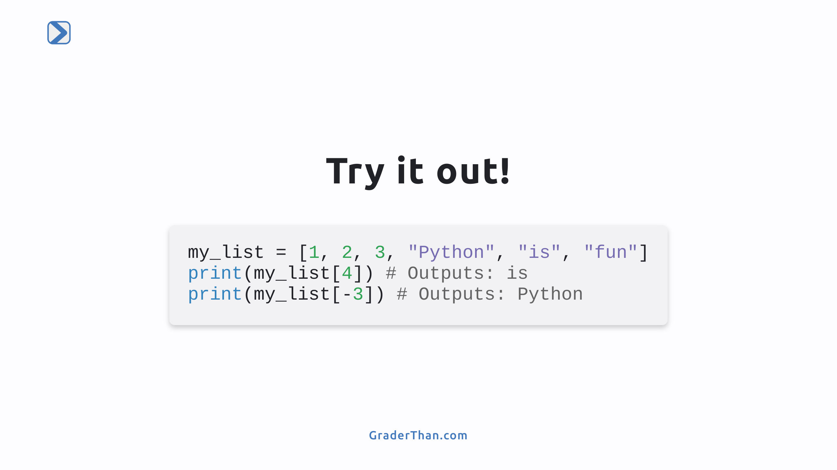
Notes:
- Encourage students to access list elements using both positive and negative indexes. - Provide a code example demonstrating how to access specific elements in a list.

Slide 6
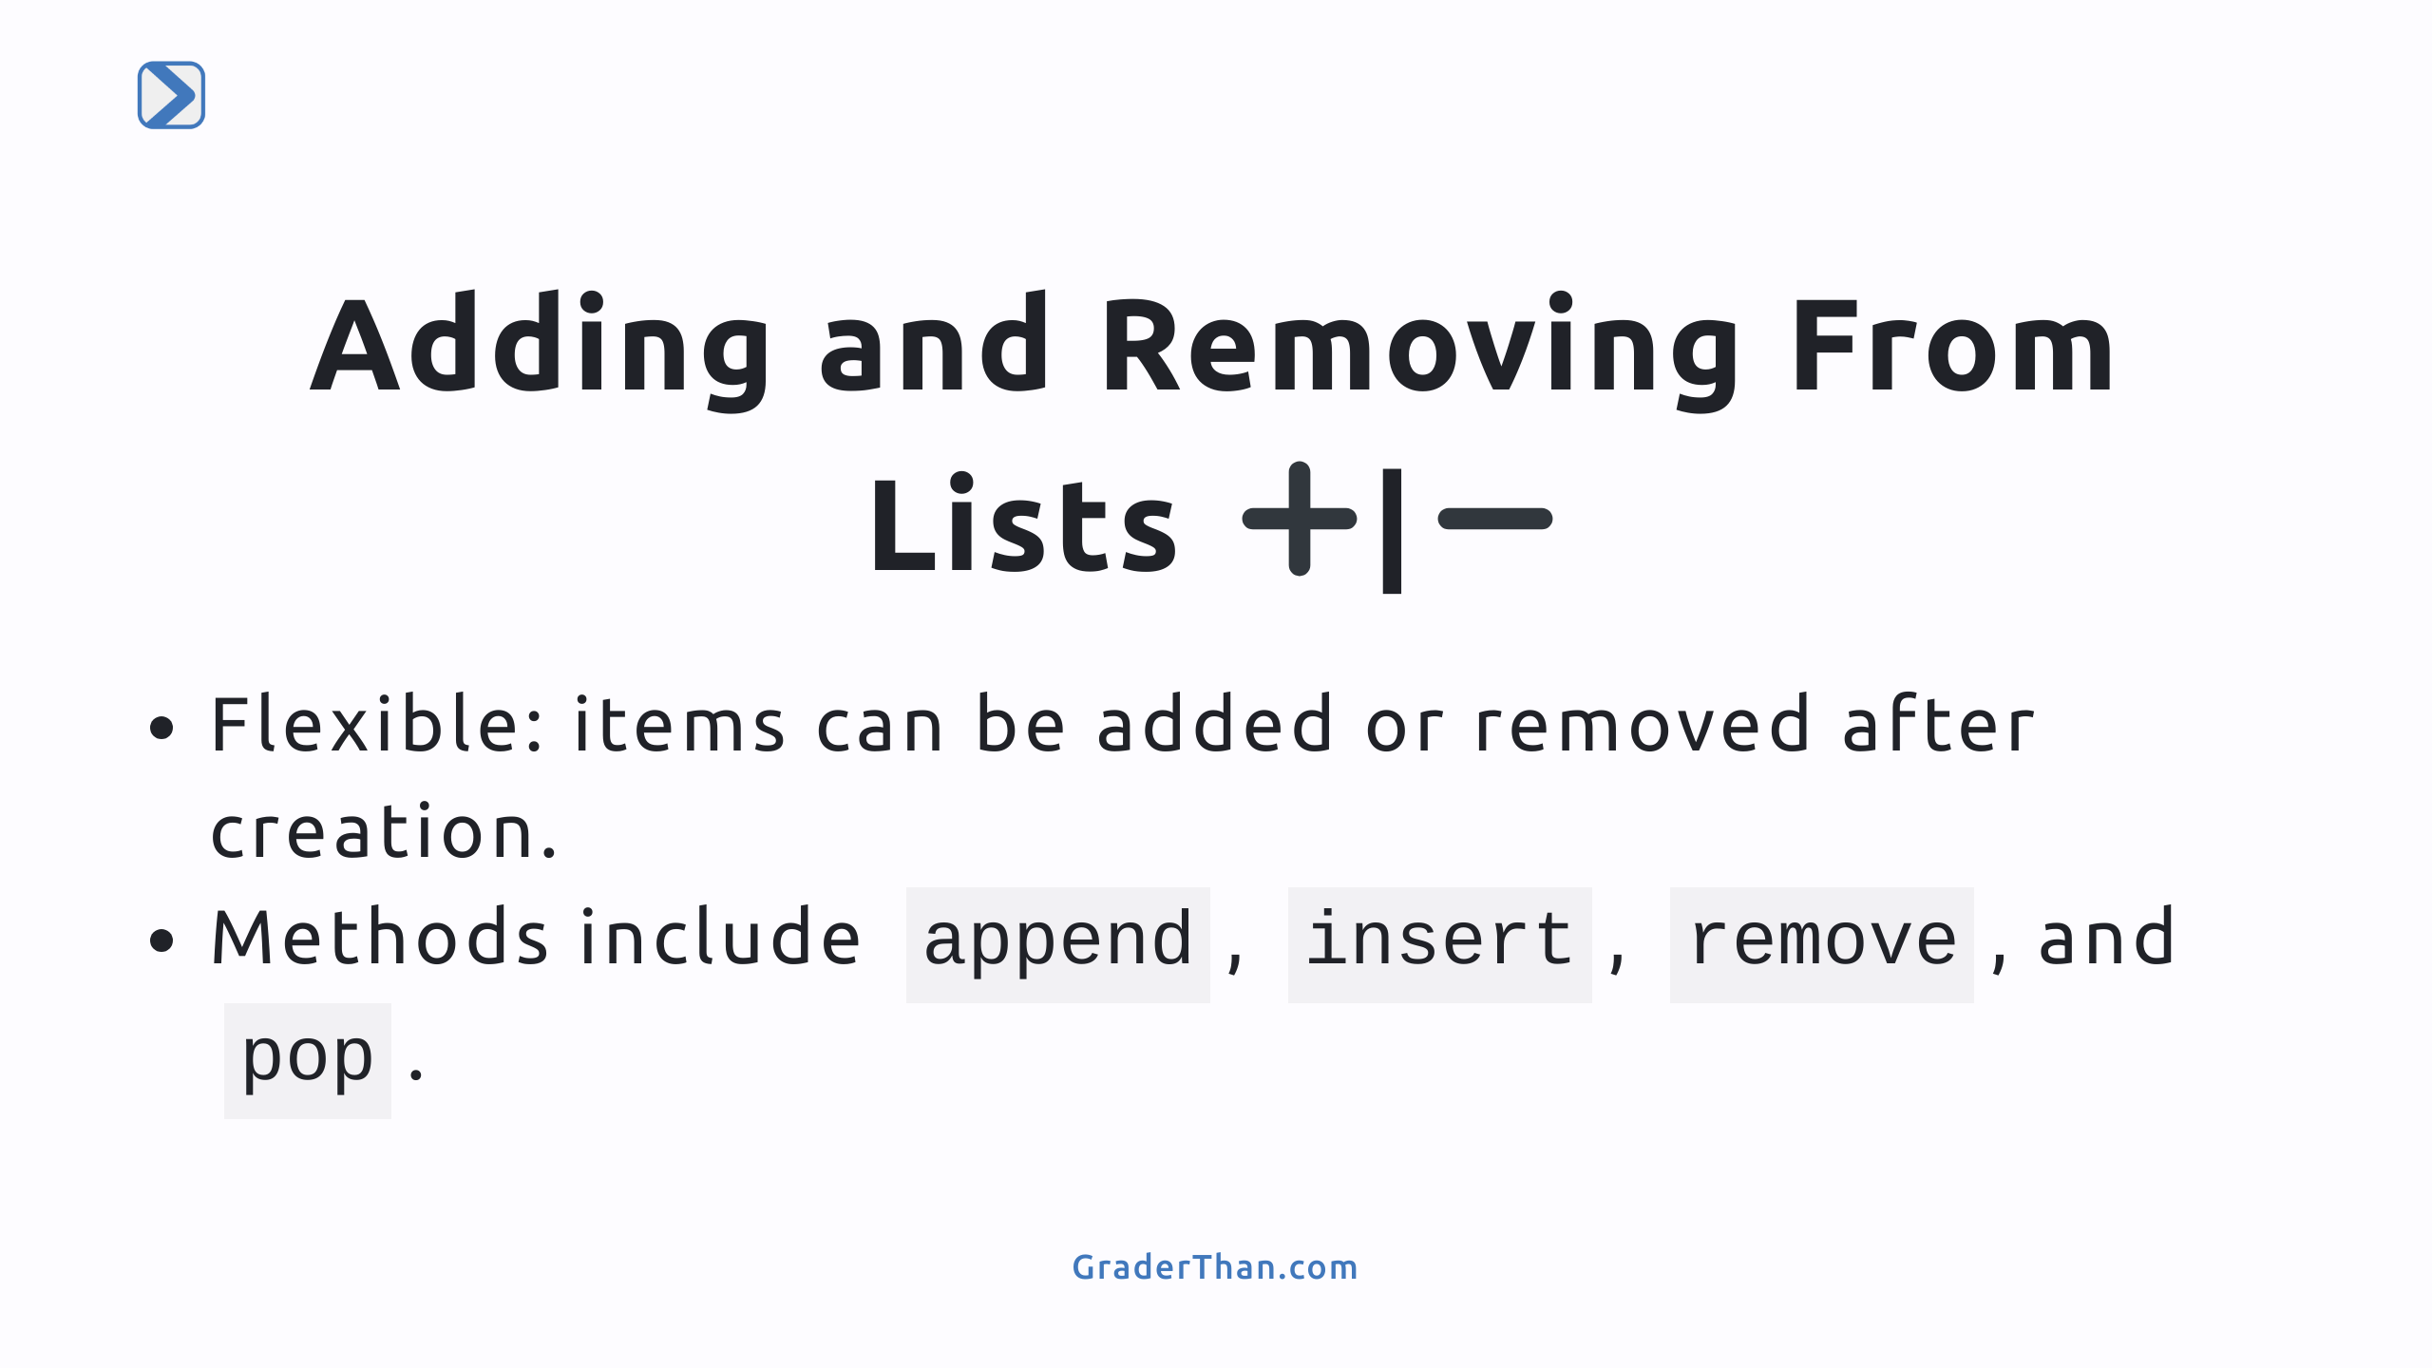
Notes:
- Explain the flexibility of lists in Python, allowing items to be added or removed. - Introduce methods for adding (`append`, `insert`) and removing (`remove`, `pop`) items.

Slide 7
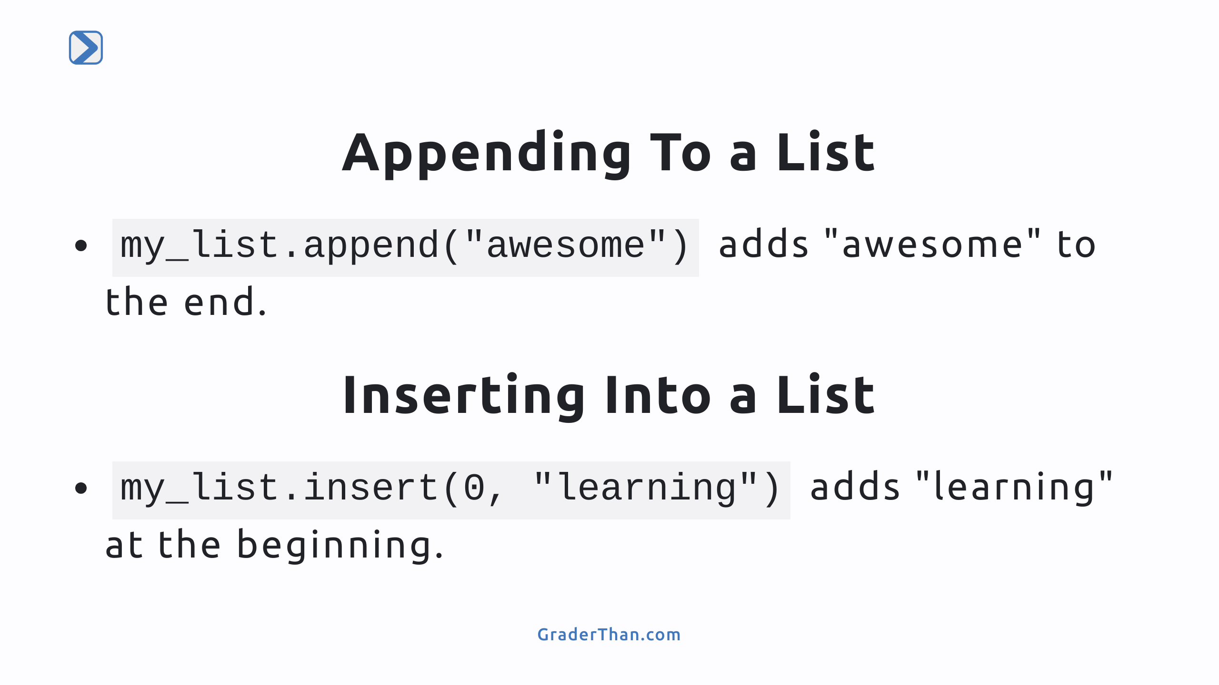
Notes:
- Show how to use `append` to add items to the end of a list. - Demonstrate `insert` to add items at a specific position within a list.

Slide 8
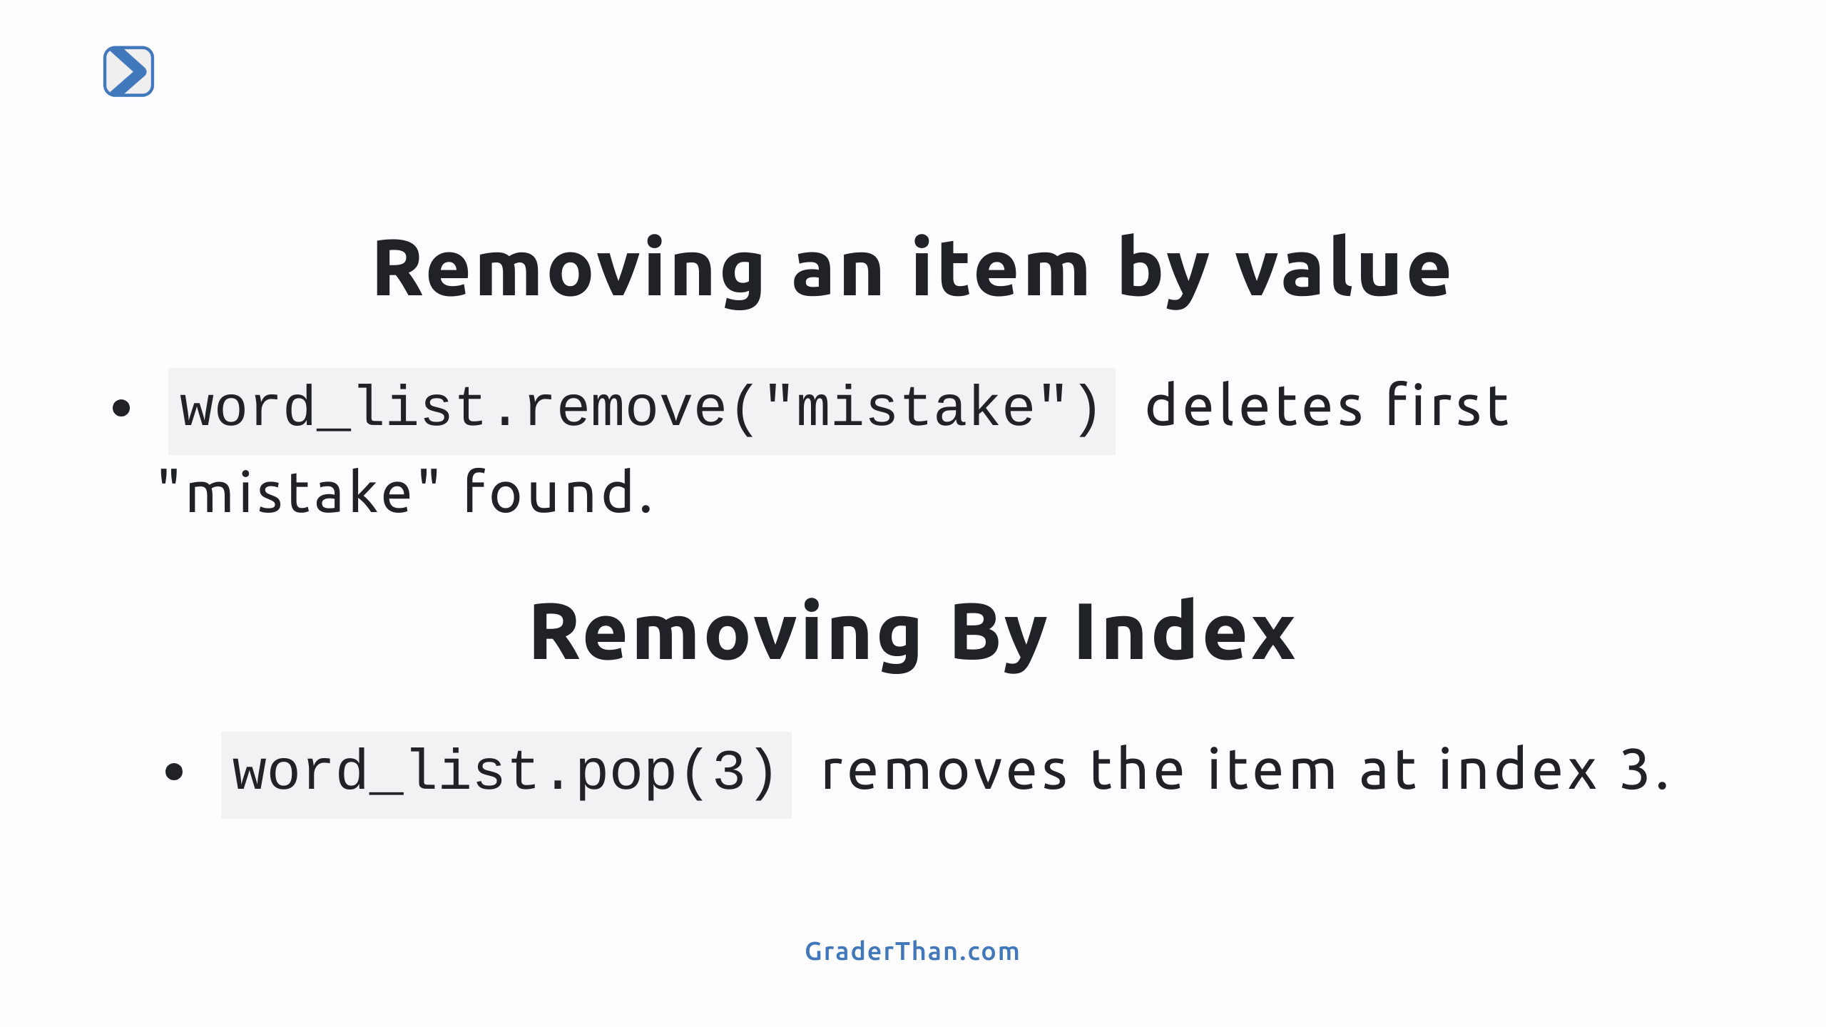
Notes:
- Illustrate removing items by value with `remove`. - Explain removing items by index using `pop` and its effect on the list.

Slide 9
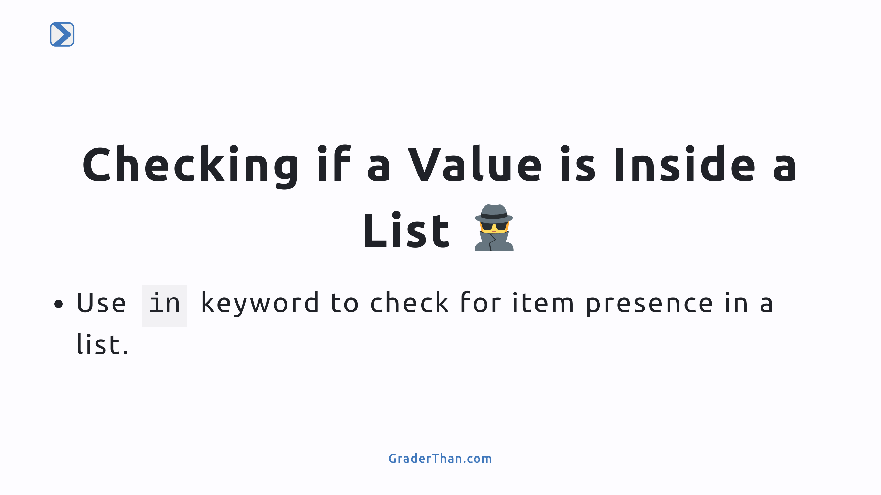
Notes:
- Teach how to use the `in` keyword to check if a specific item exists within a list. - Emphasize the simplicity and usefulness of this operation for conditionals and loops.

Slide 10
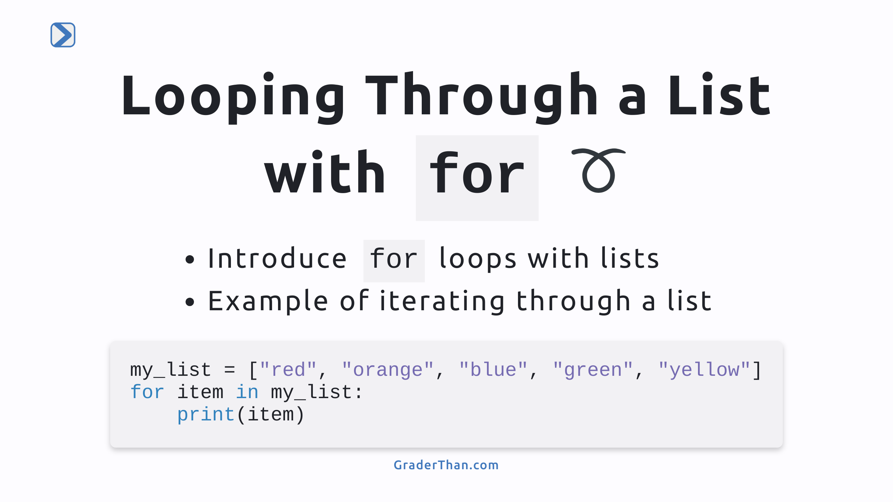
Notes:
- This slide introduces how to use `for` loops to iterate through lists in Python. - We show a simple example where we loop through `my_list` and print each color.

Slide 11
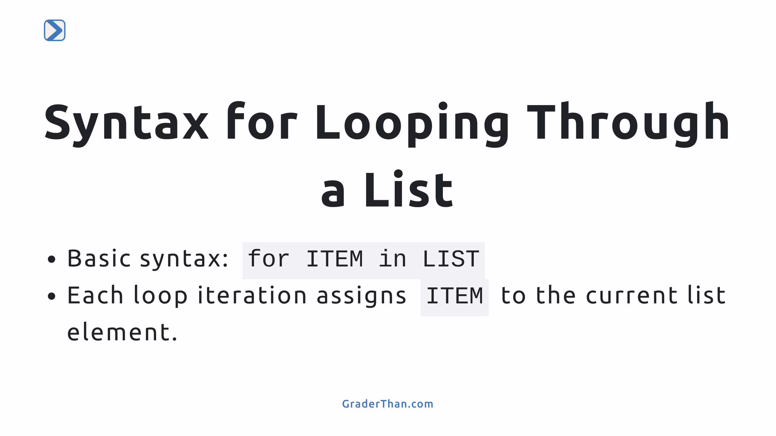
Notes:
- Here we explain the syntax for looping through a list with a `for` loop. - We highlight that with each iteration, the variable `ITEM` gets assigned the value of the current element in the list.

Slide 12


Slide 13
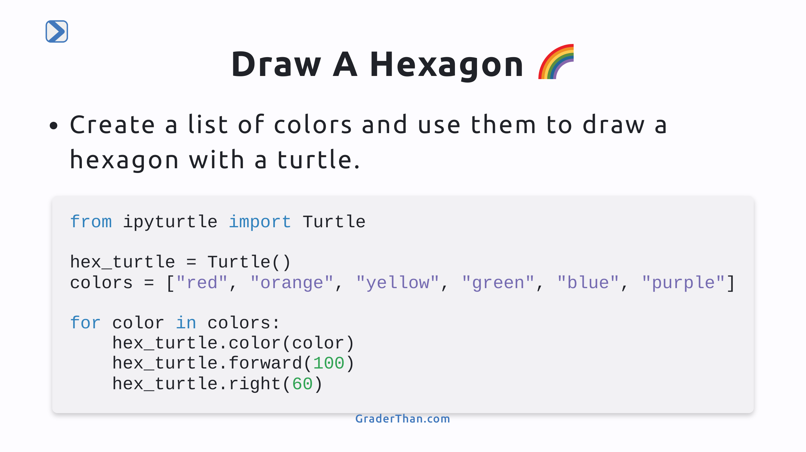
Notes:
- Introduce a practical exercise using turtle graphics to apply list concepts. - Explain the loop structure to cycle through a list of colors and draw a hexagon.

Slide 14
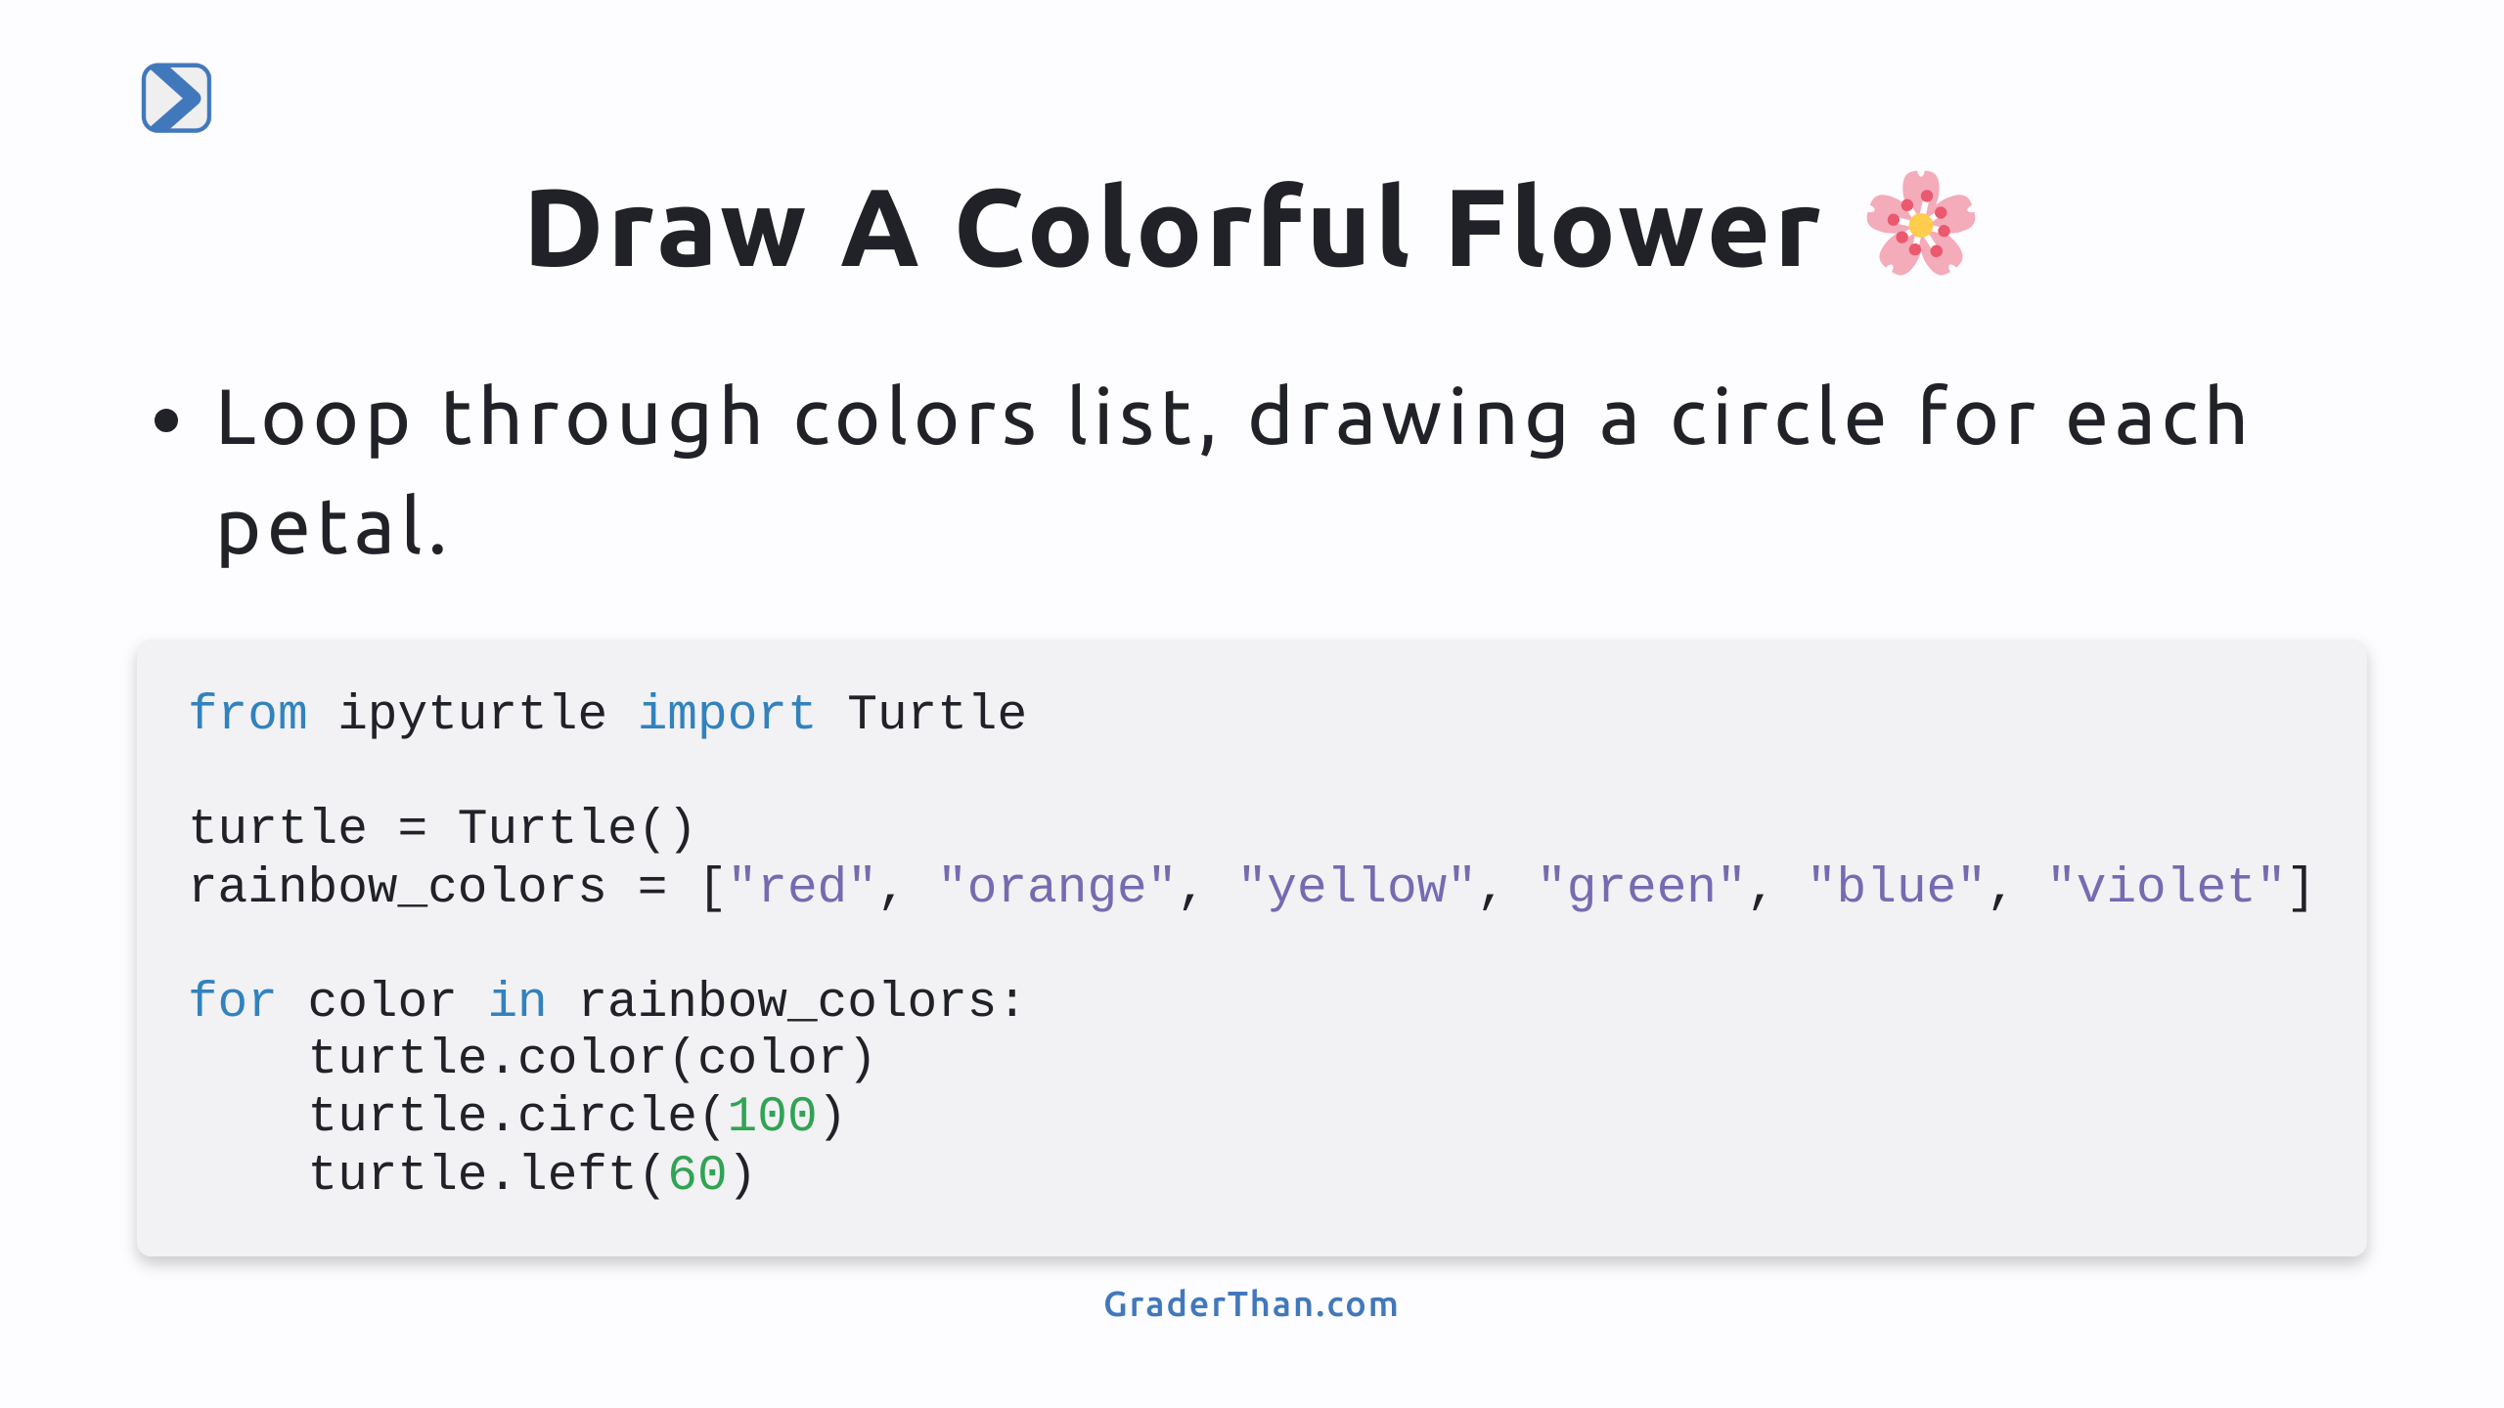
Notes:
- Encourage creativity in using lists with turtle graphics to draw a colorful flower. - Highlight the use of loops and the `circle` method for drawing petals of different colors.

