Slide 1
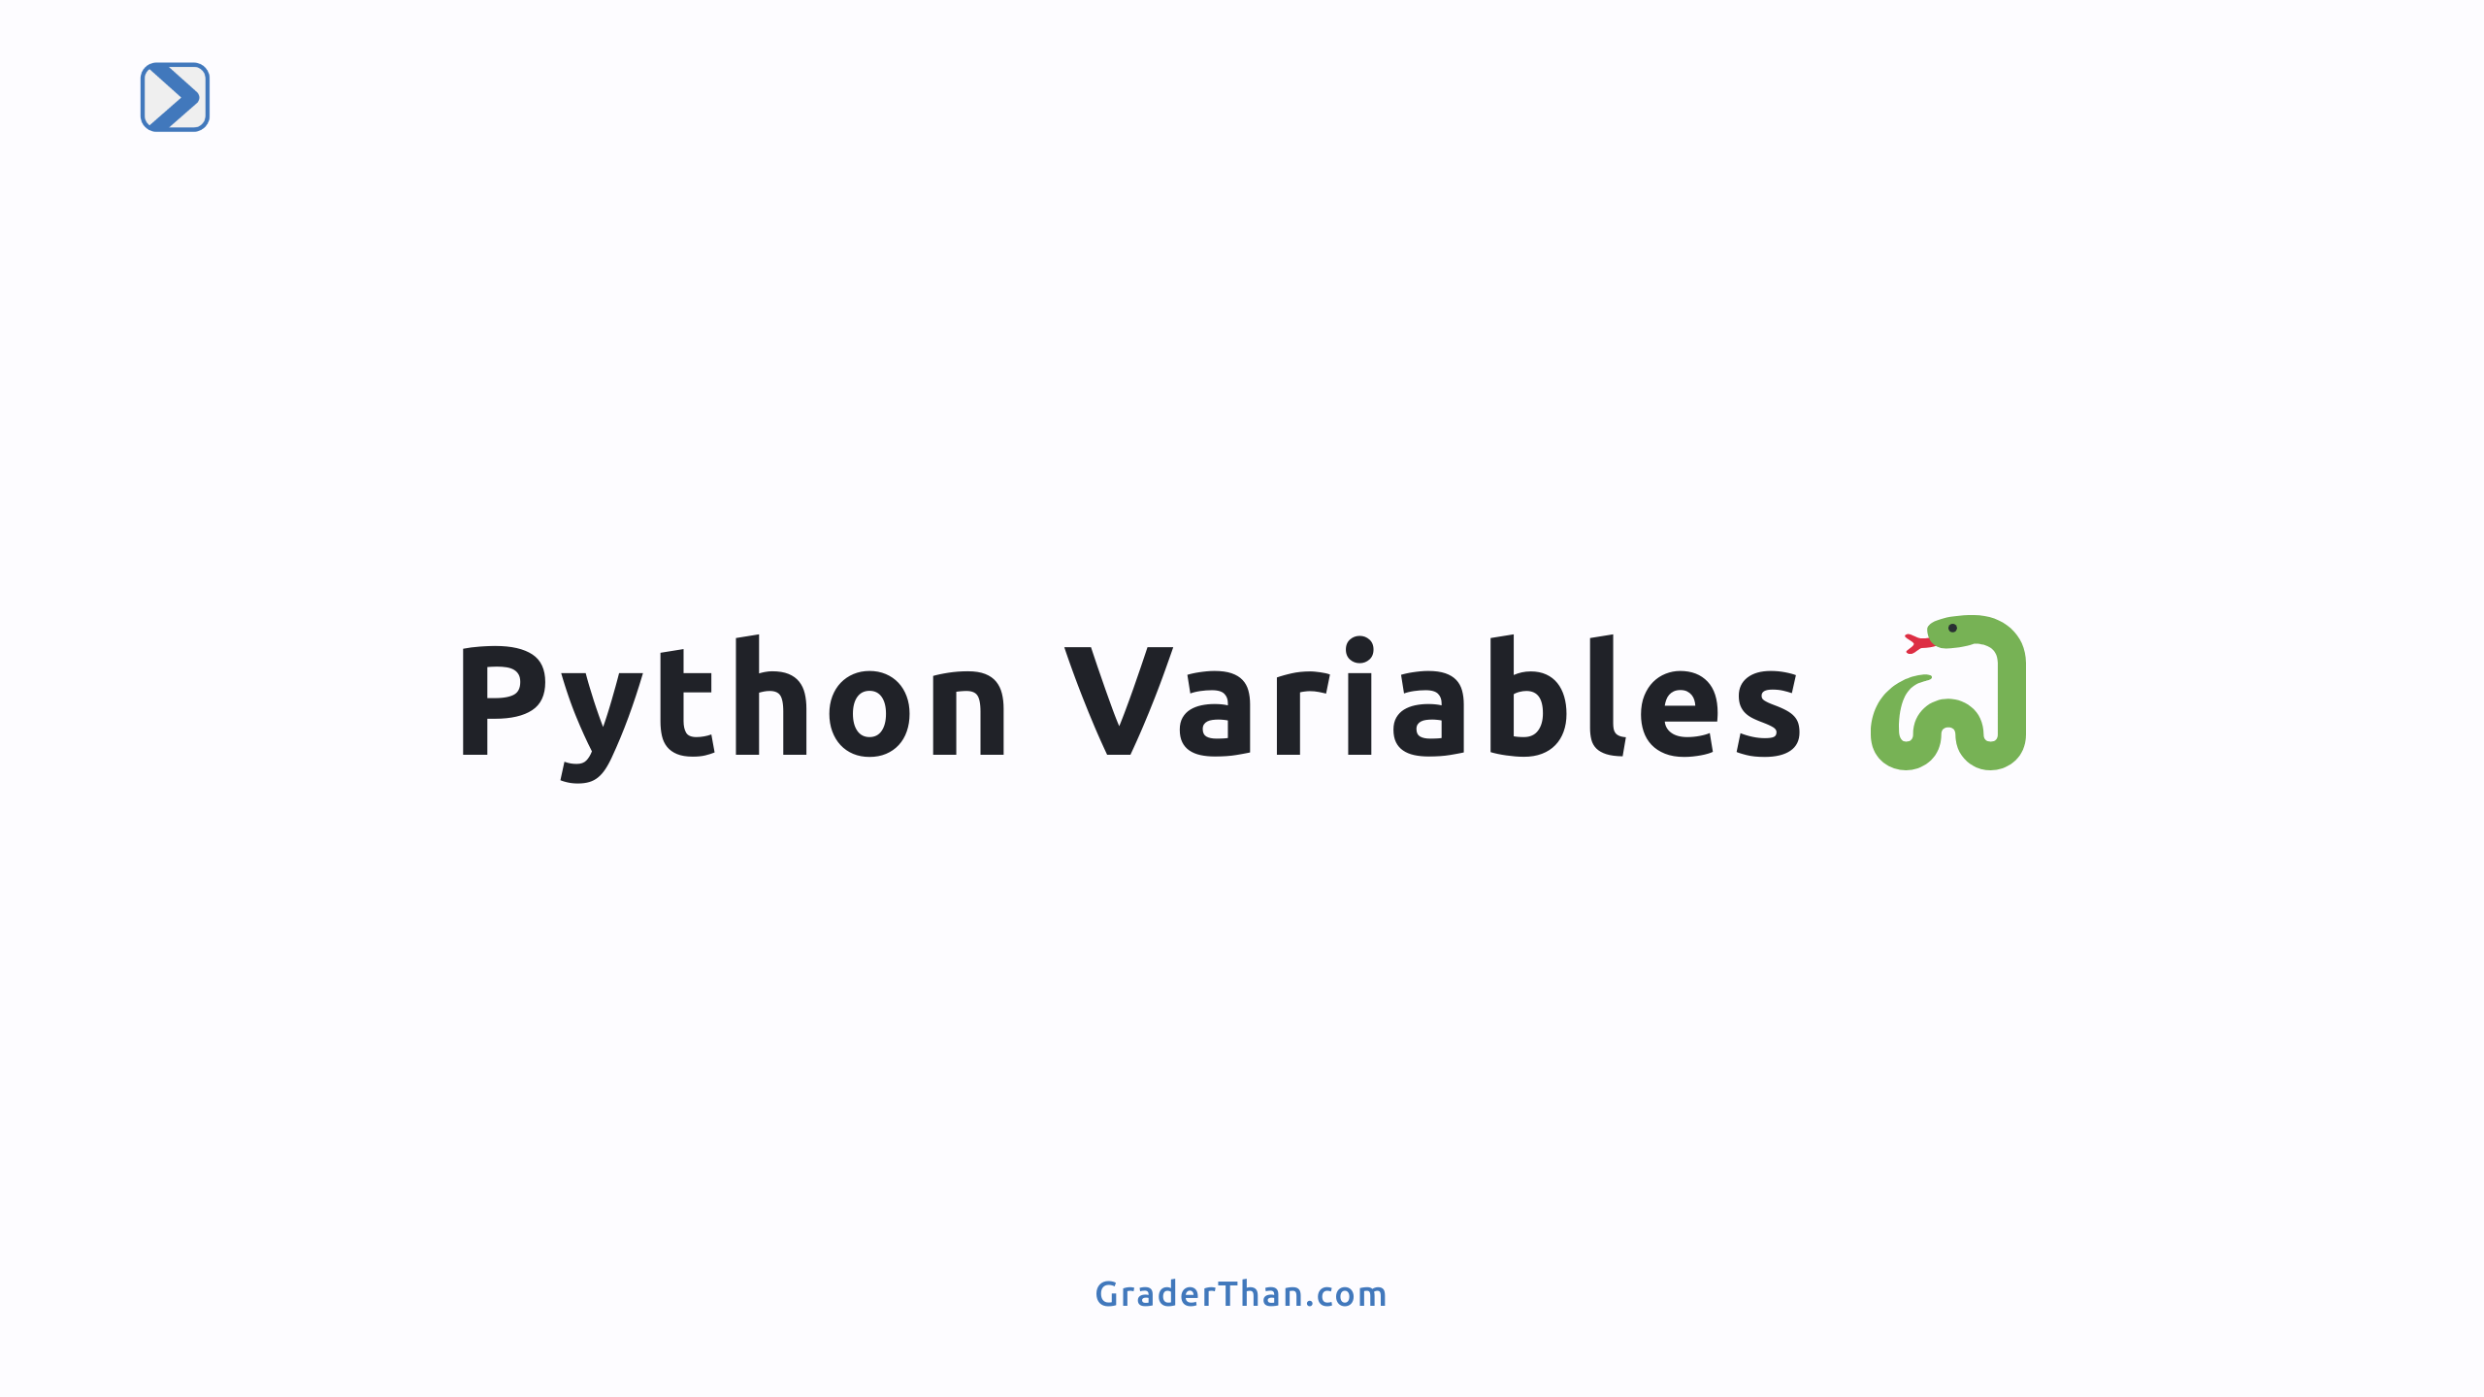

Slide 2
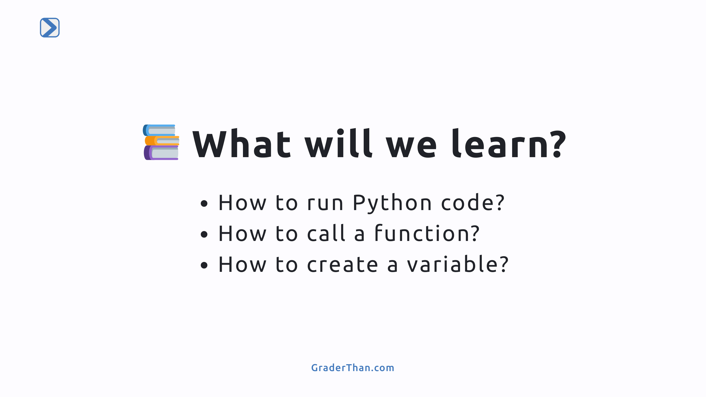

Slide 3
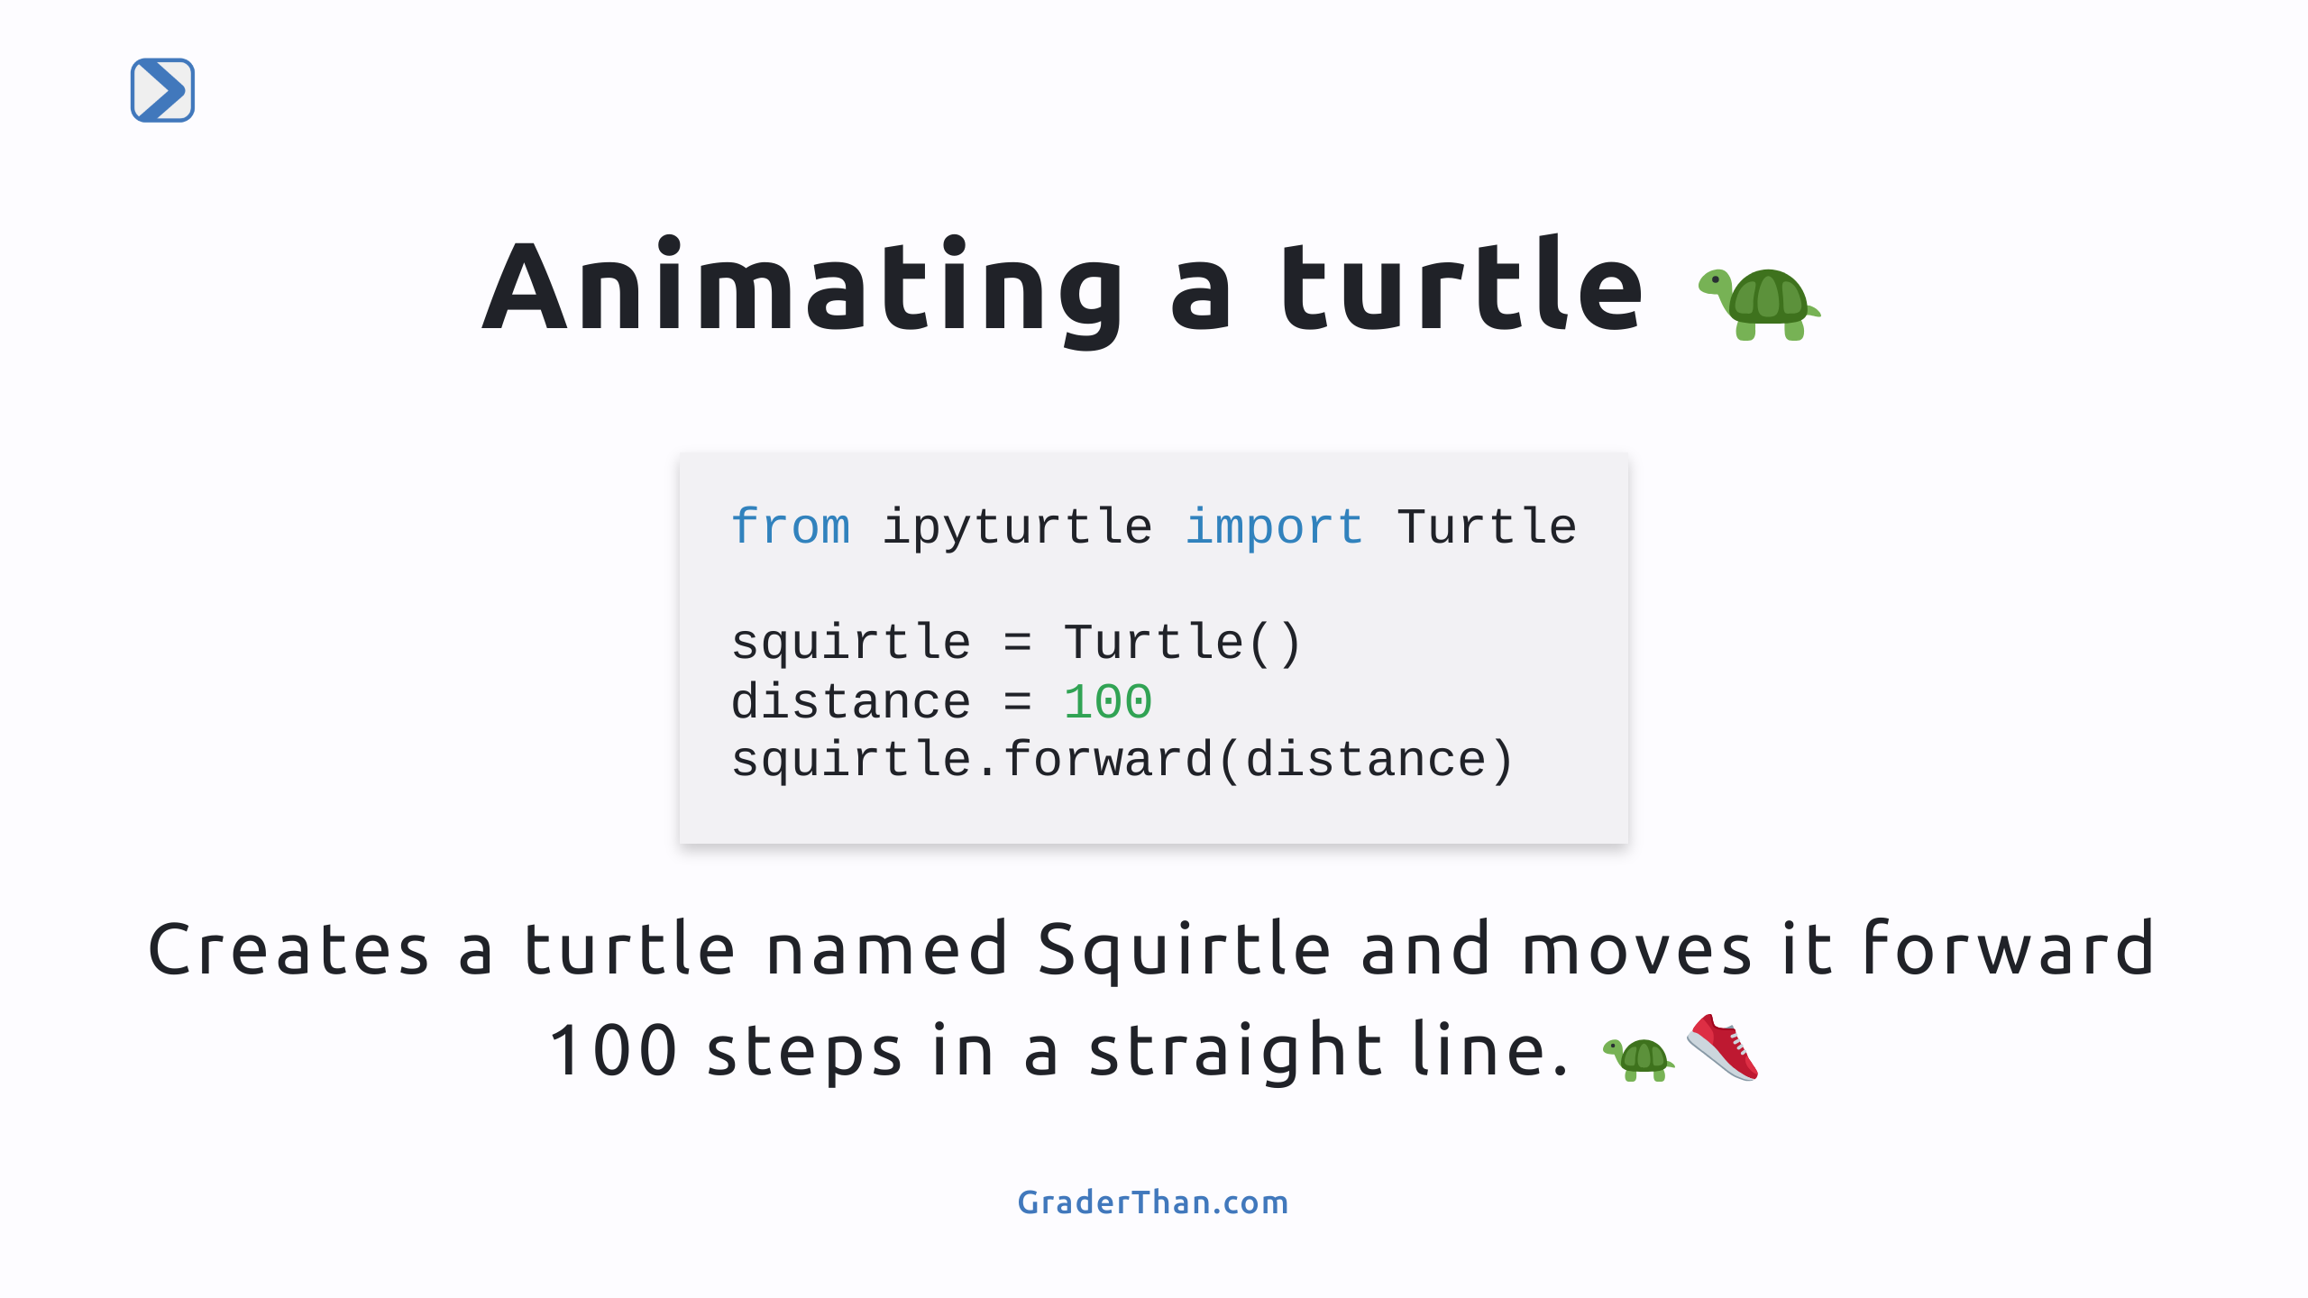
Notes:
Code Breakdown - `squirtle = Turtle()`: This line creates a new turtle named Squirtle in our code. - `distance = 100`: We set a variable named `distance` to 100, which is the number of steps Squirtle will move. - `squirtle.forward(distance)`: This makes Squirtle move forward 100 steps, the value we set for `distance`.

Slide 4
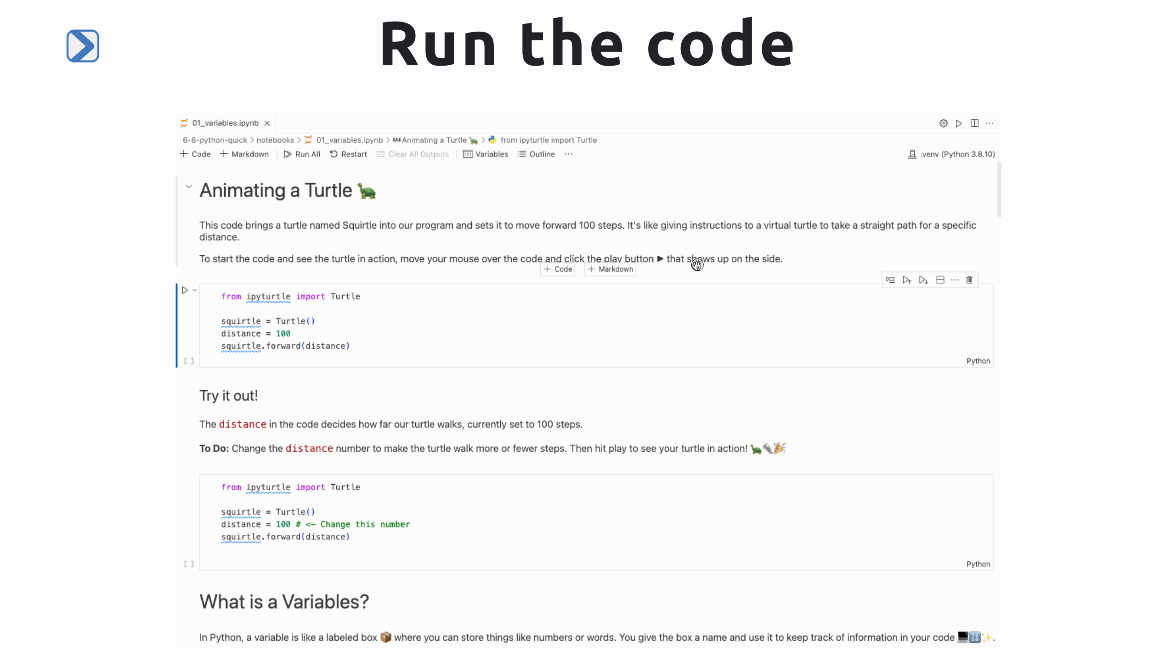
Notes:
1) In the upper right corner of select the kernel "python 3.8" 2) Hover your mouse over the code cell and press the play button that appears to the right Note: you only need to select the kernel the first time. Just press the play button for all future runs

Slide 5
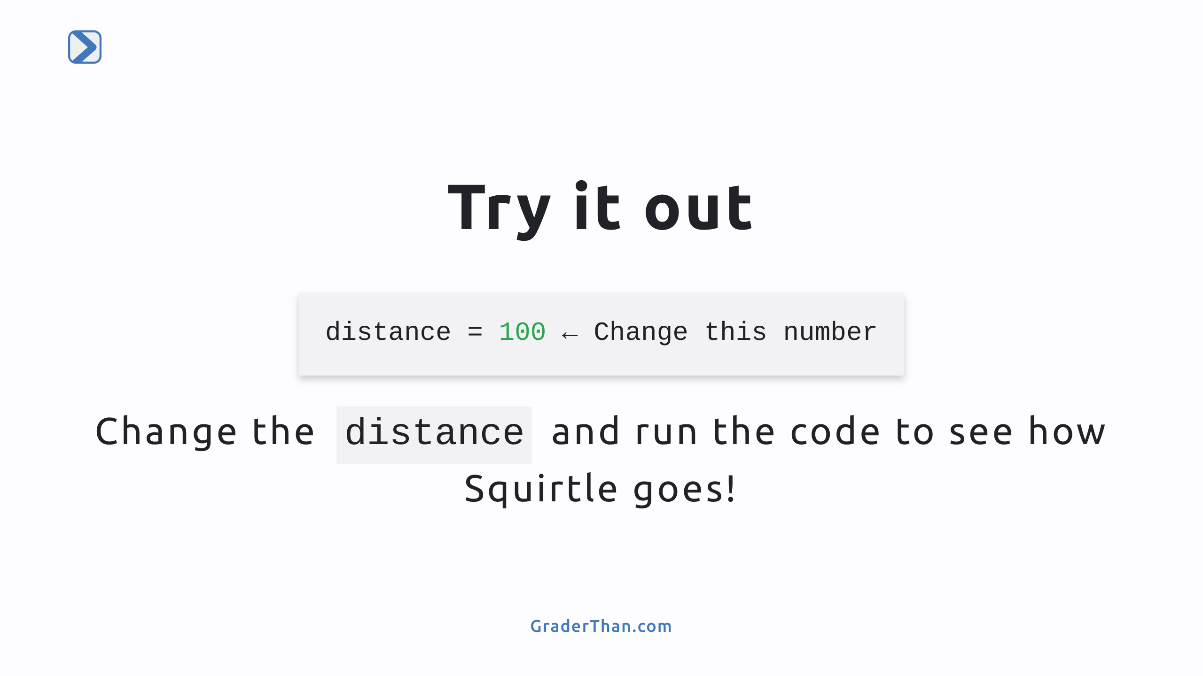
Notes:
Stop here and have the students complete the interactive "try it out" code cell in there notebook They are asked to change the `distance`` to another number and checkout the results.

Slide 6
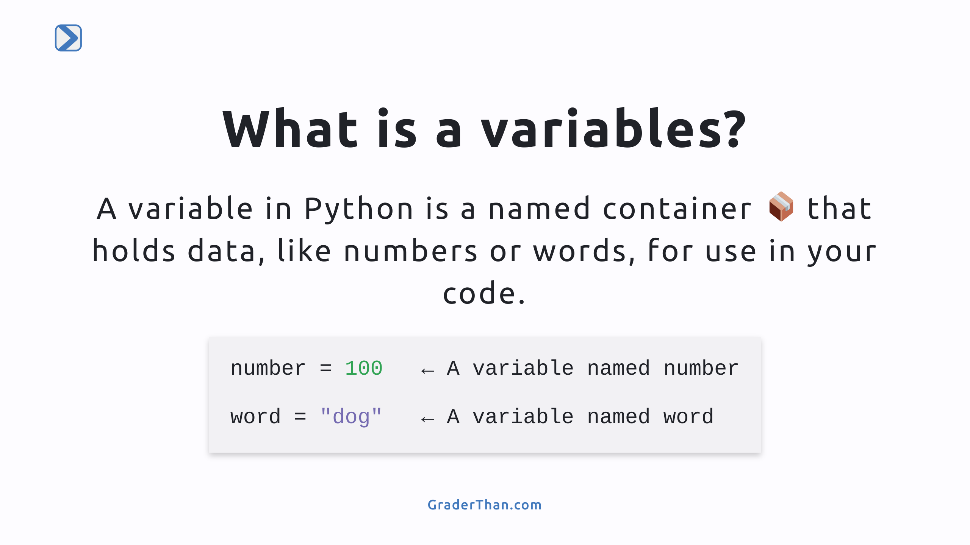
Notes:
Explain variables as named containers for data. - Use `number = 100` as an example of storing a numbers. - We use `=` to tell python the variable number holds the number 100 - Use `word = "dog"` to show storing a string, they can have spaces. - Don't forget the quotes! - Single or double quotes it does not matter - Emphasize variables' role in organizing and using data in code.

Slide 7
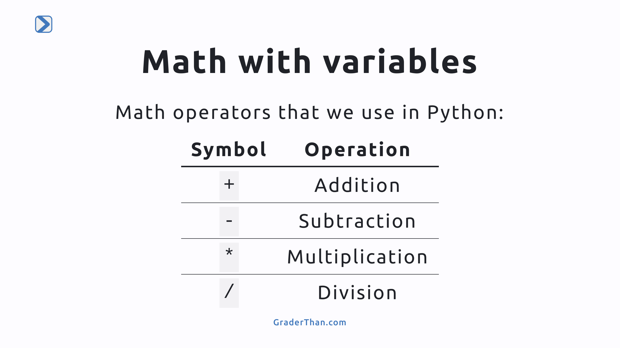
Notes:
A list of basic math operations in python. Students may be unfamiliar with using * for multiplication. Remind them that is we were to use `x` then would think it was a variable.

Slide 8
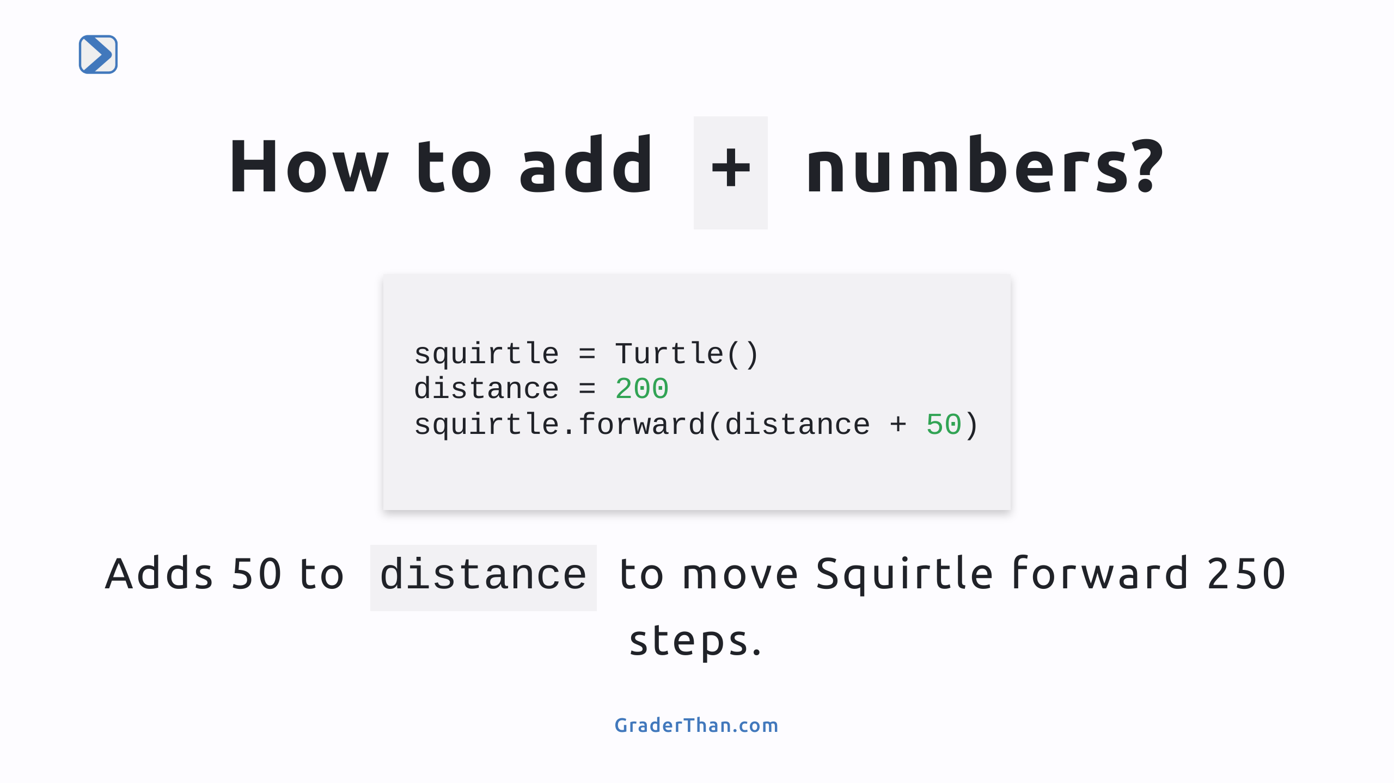
Notes:
Code Breakdown - `squirtle = Turtle()`: Creates a new turtle, Squirtle. - `distance = 200`: Sets `distance` to 200 steps. - `squirtle.forward(distance + 50)`: Squirtle moves forward 250 steps (200 + 50).

Slide 9
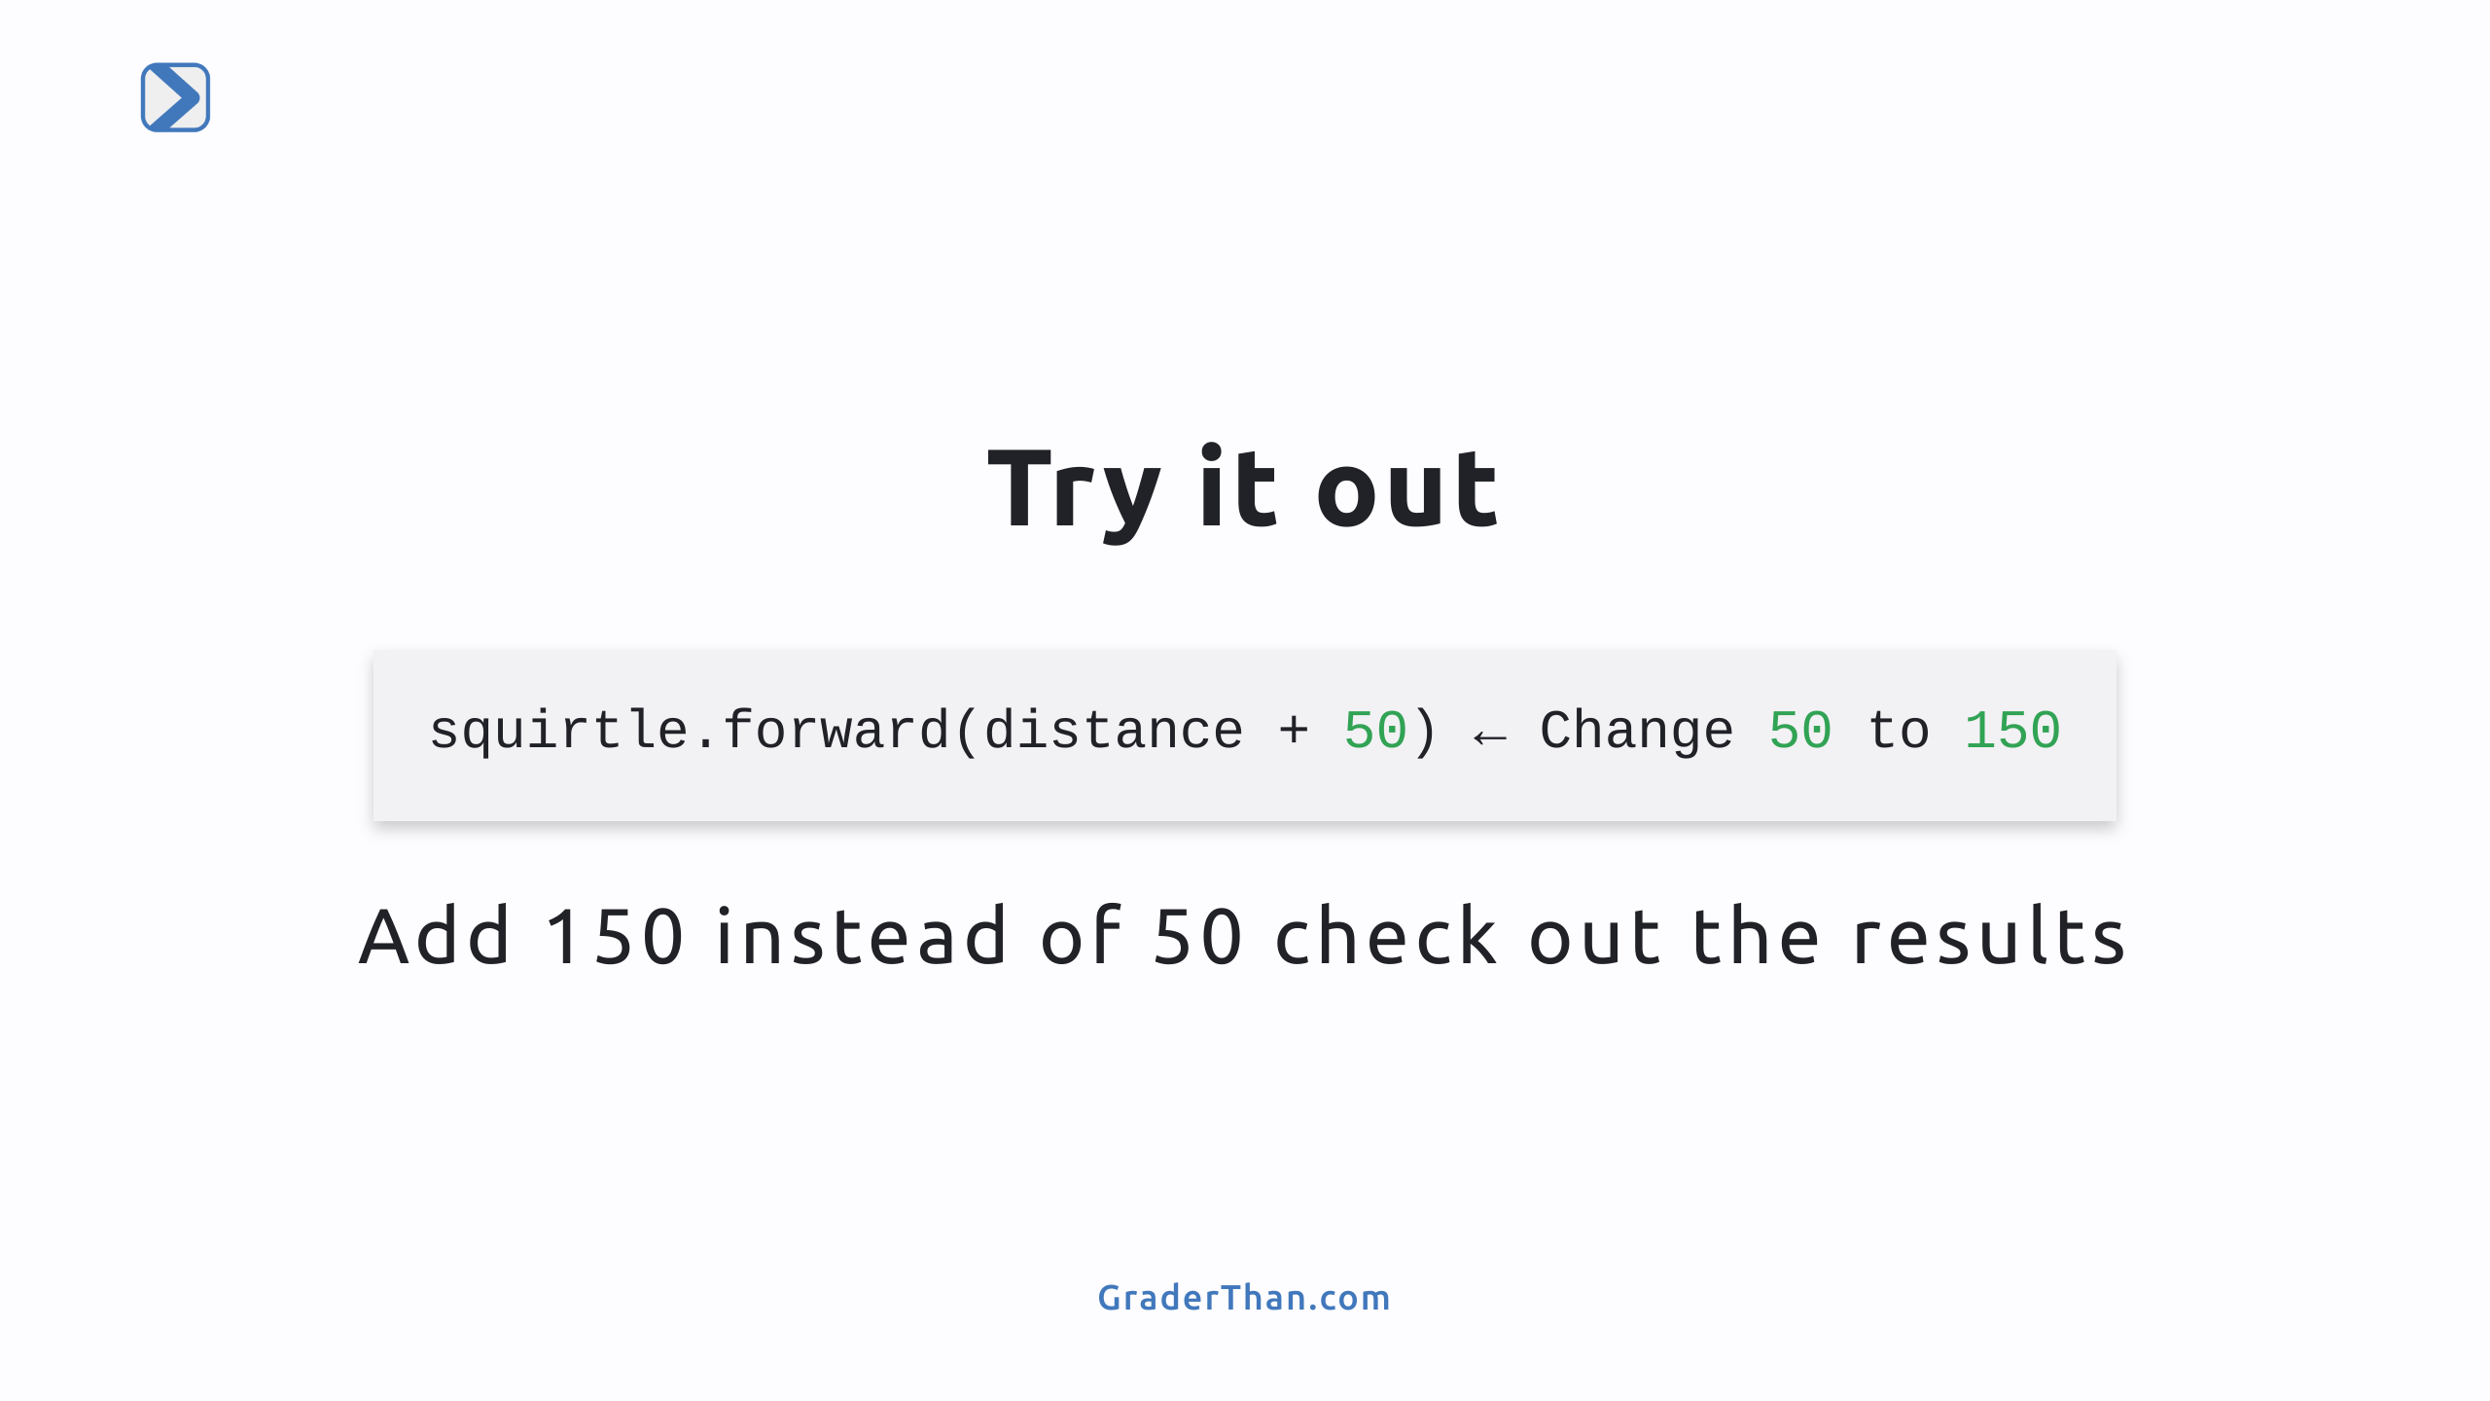
Notes:
Result: the turtle will walk further

Slide 10
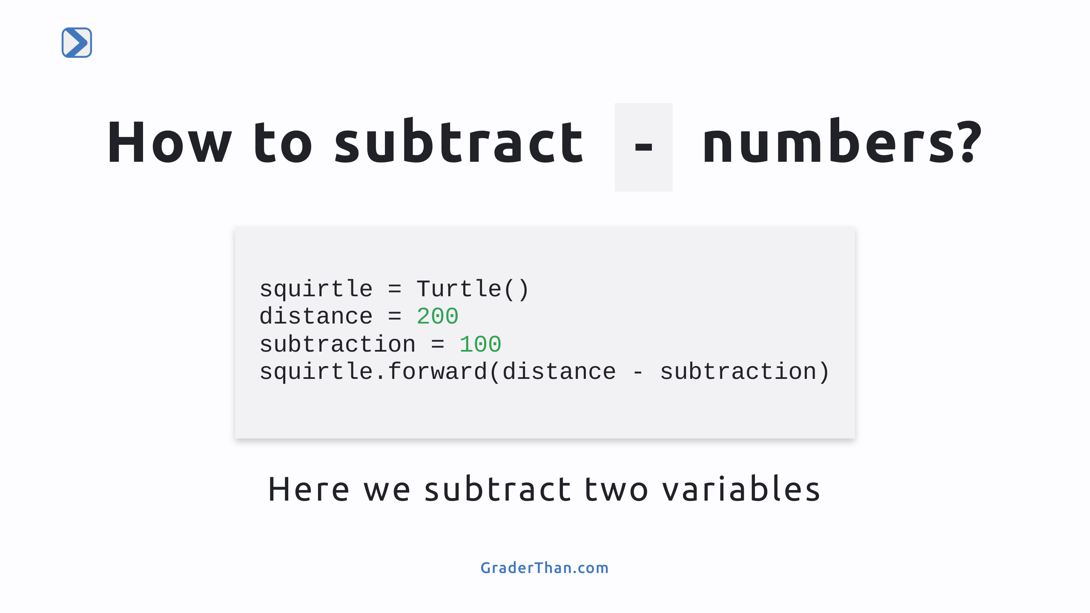
Notes:
Here we learn how to: - define a new variable - preform calculations using just variables We create 2 variables then calculate the difference using just the variables instead of raw numbers Student should think of the variables as named placeholders for the value they contain

Slide 11
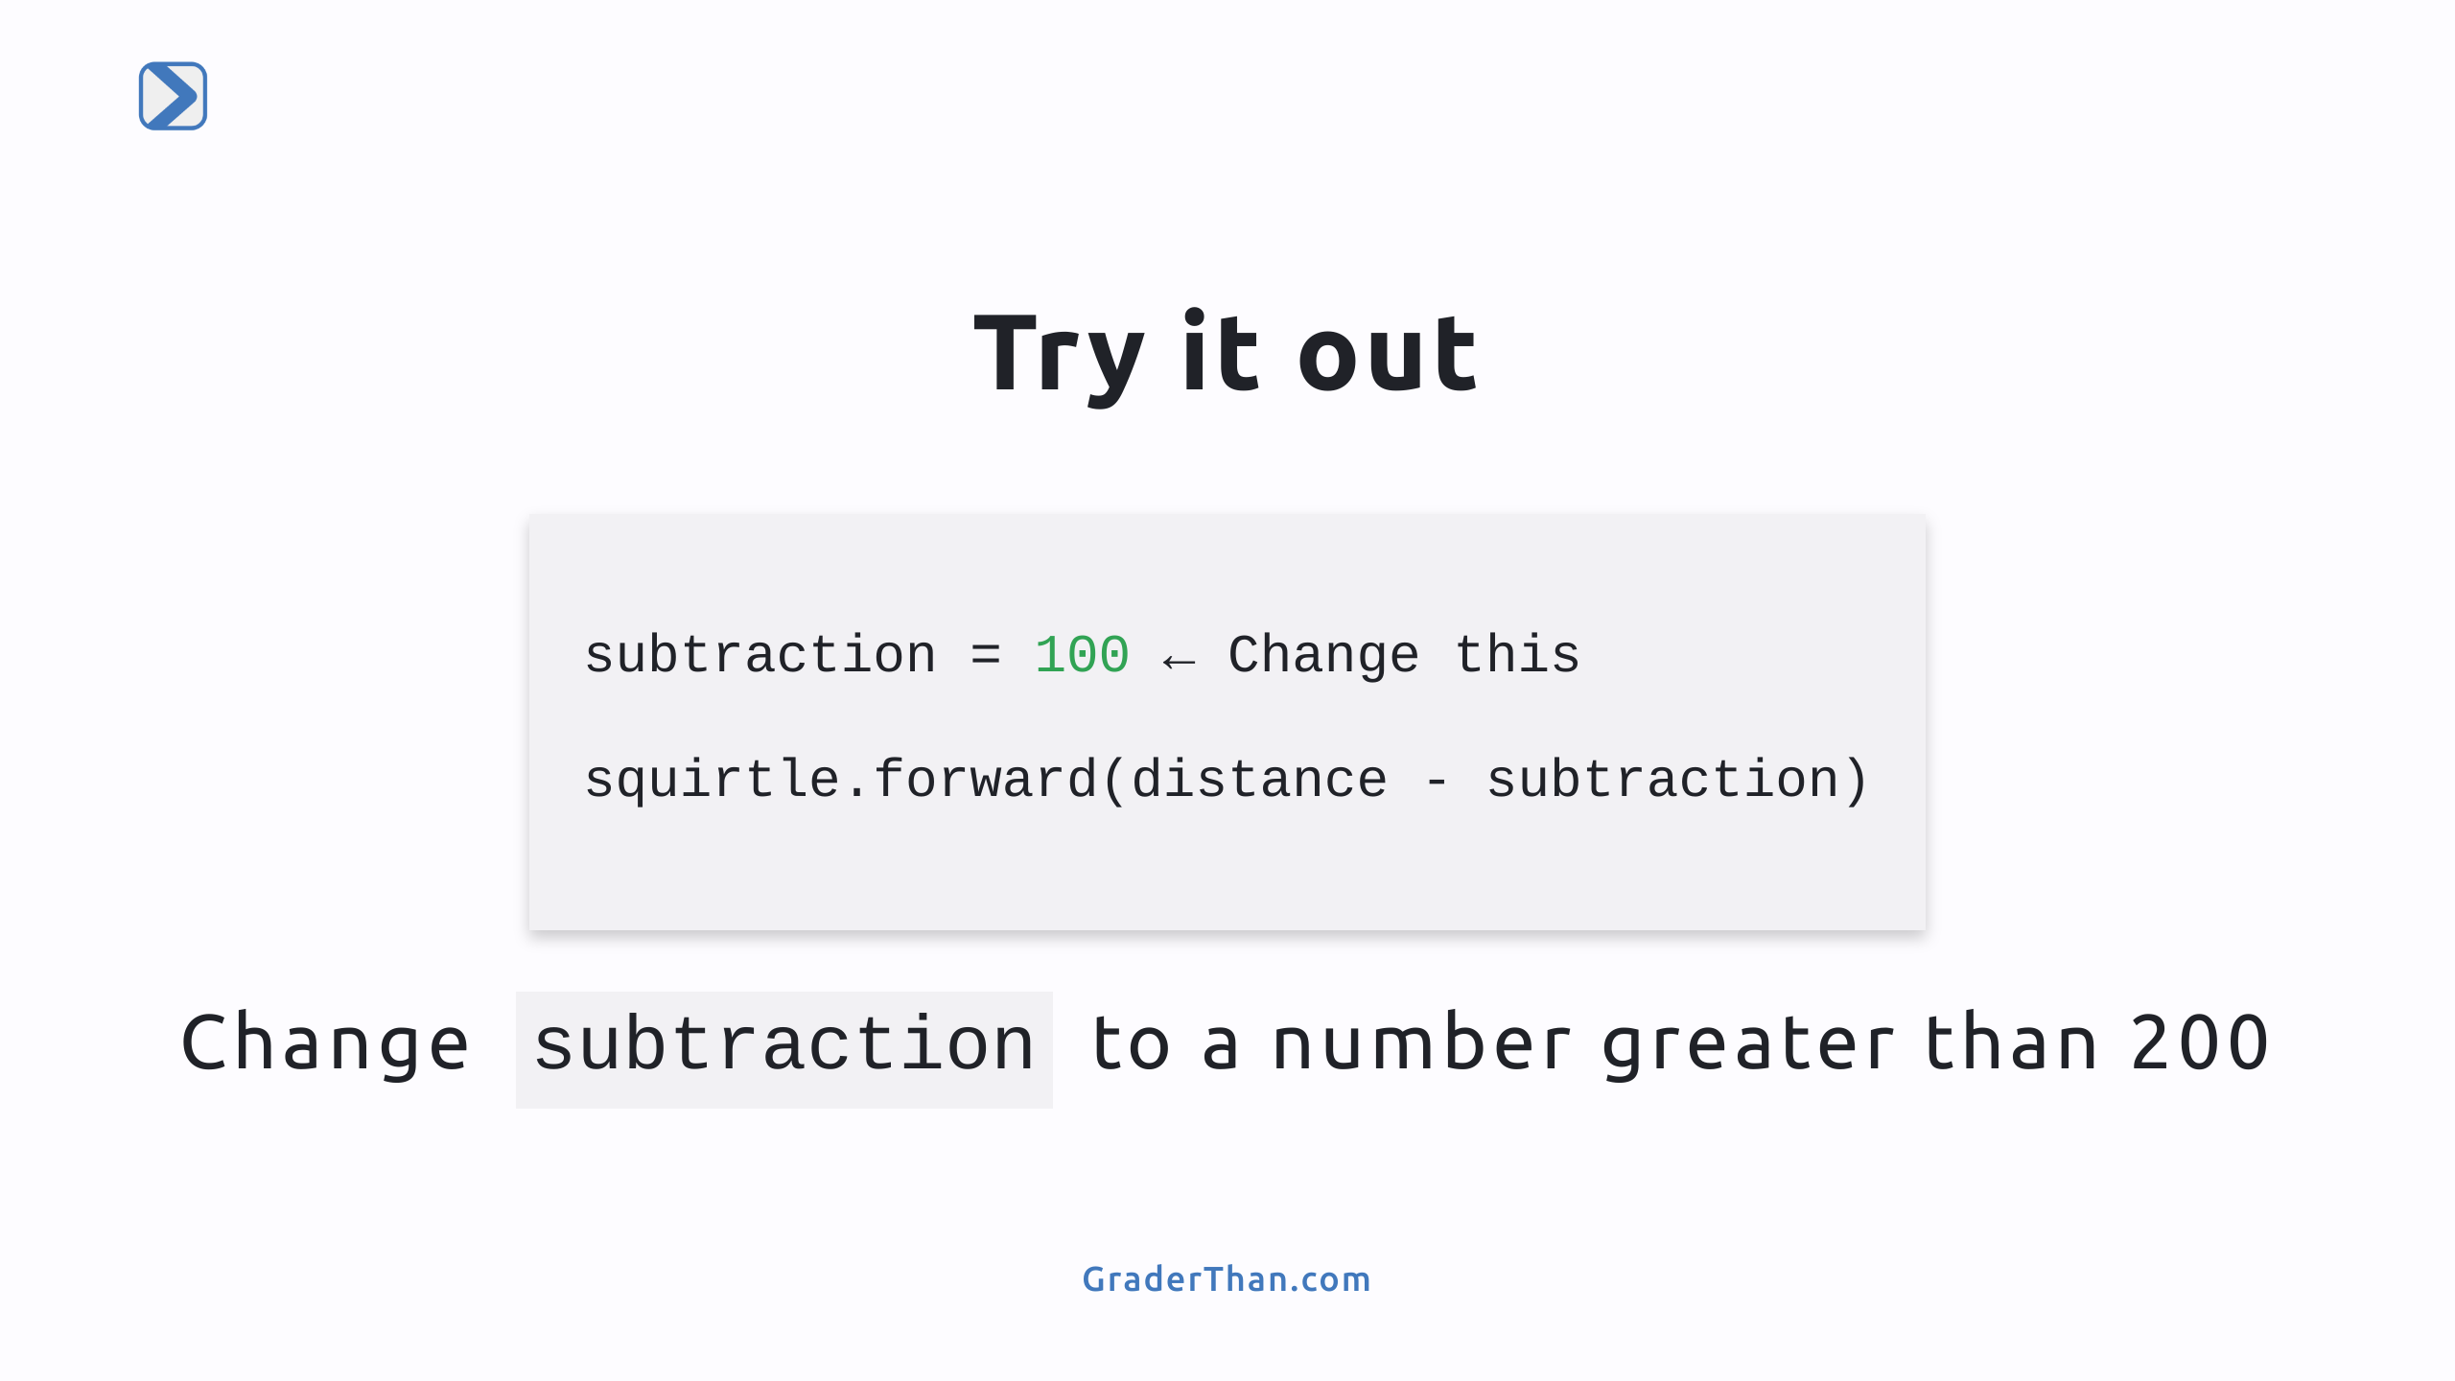
Notes:
Result: the turtle will move backwards

Slide 12
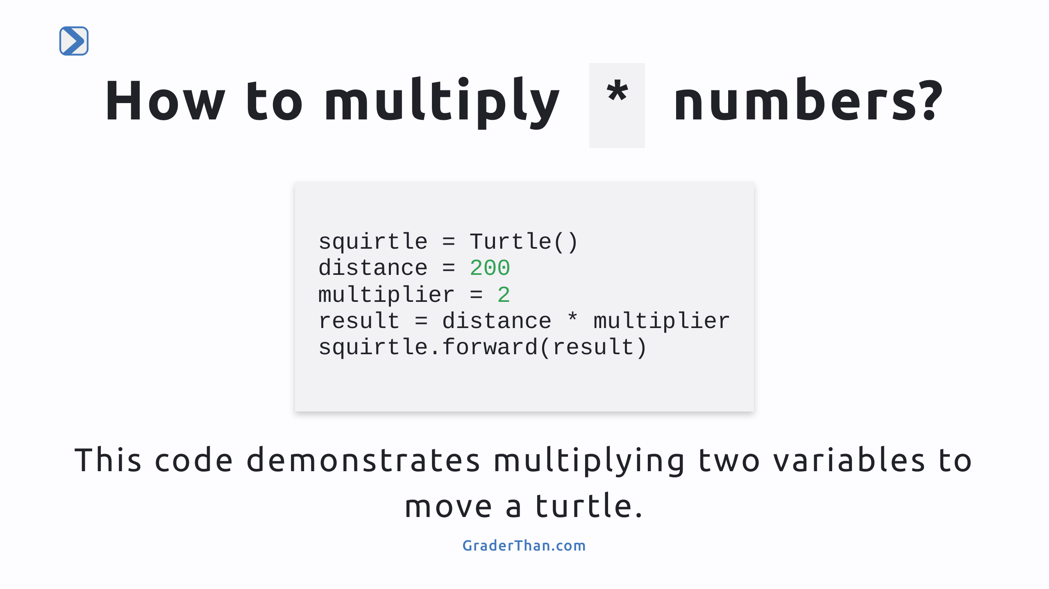
Notes:
Here we learn how to: - Perform multiplication using variables. - Variables can be used to store the output of calculations 1) We create two variables, 'distance' and 'multiplier' 2) Then use them to calculate a value and store it in 'result' 3) 'result' is used to move the turtle. Students should understand that variables act as containers for values

Slide 13
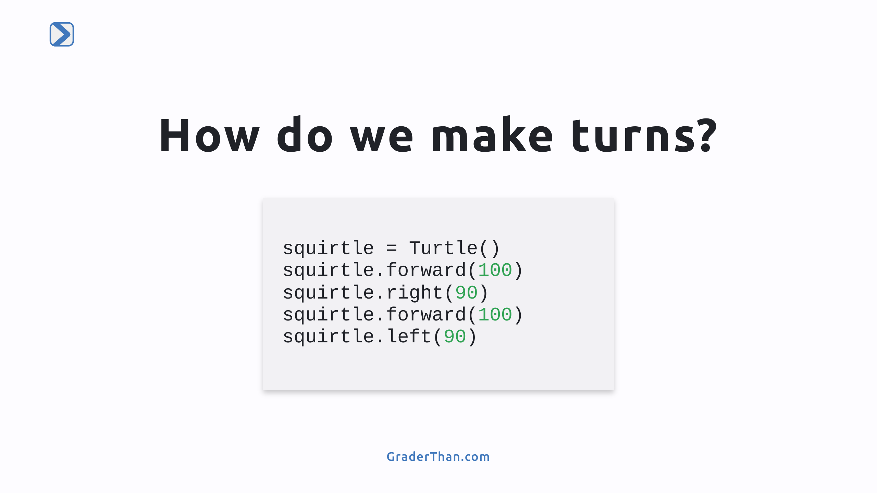
Notes:
- `squirtle.forward(100)` tells Squirtle to move straight ahead by 100 steps. It's like taking a long walk in a straight line. - `squirtle.right(90)` tells Squirtle to turn to its right by 90 degrees. Imagine Squirtle facing right at a corner. - After moving another 100 steps forward, `squirtle.left(90)` makes Squirtle turn left by 90 degrees, like taking another turn on its path.

Slide 14
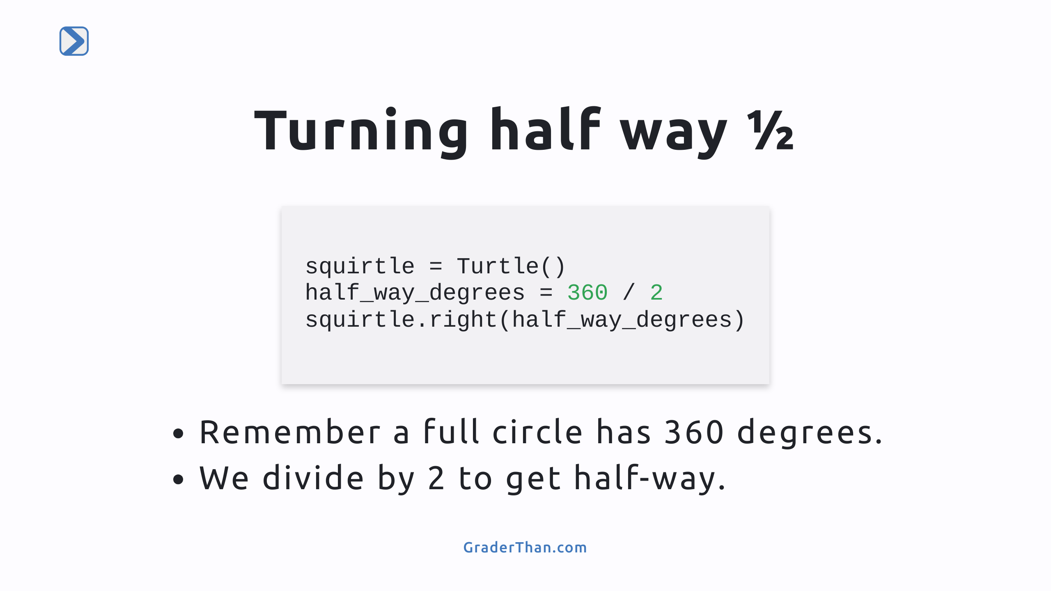
Notes:
`half_way_degrees = 360 / 2` This calculates half of a circle. A full circle has 360 degrees, so dividing by 2 gives us 180 degrees for a half-circle. `squirtle.right(half_way_degrees)` Here, we tell Squirtle to turn right by the number of degrees in `half_way_degrees`, making a half-circle turn.

Slide 15
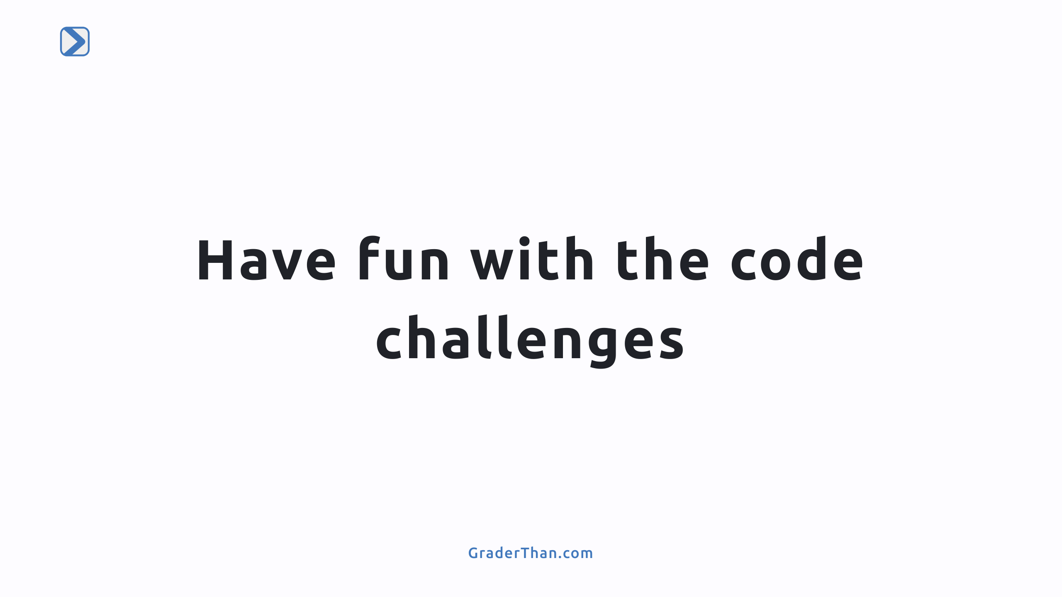
Notes:
There are a series of 6 different code challenges at the bottom of the notebook for the students to complete.

