Slide 1
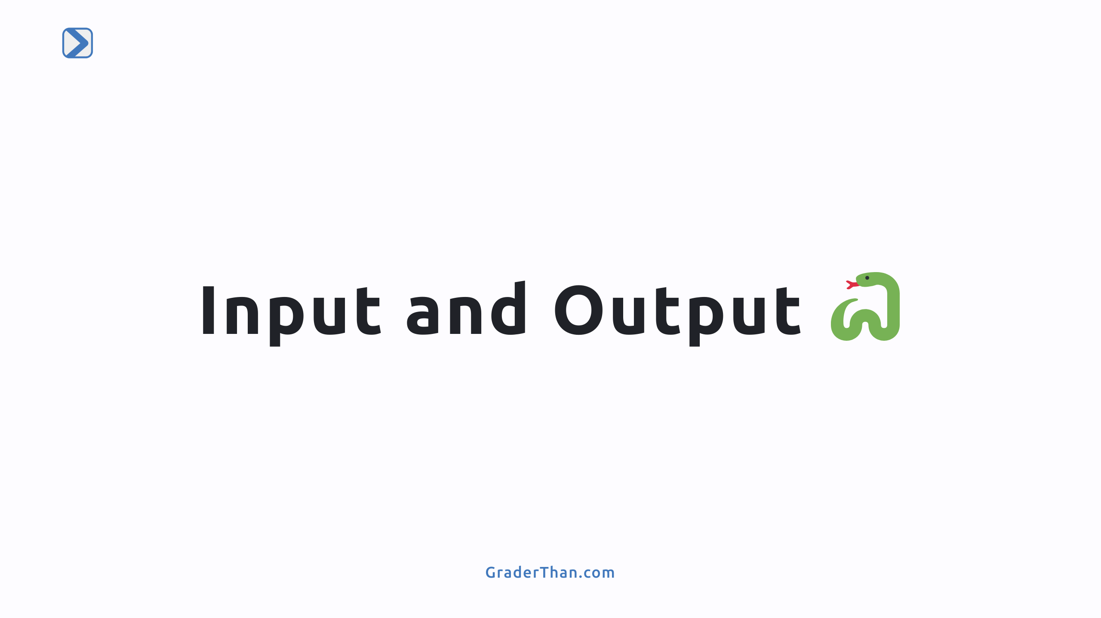

Slide 2
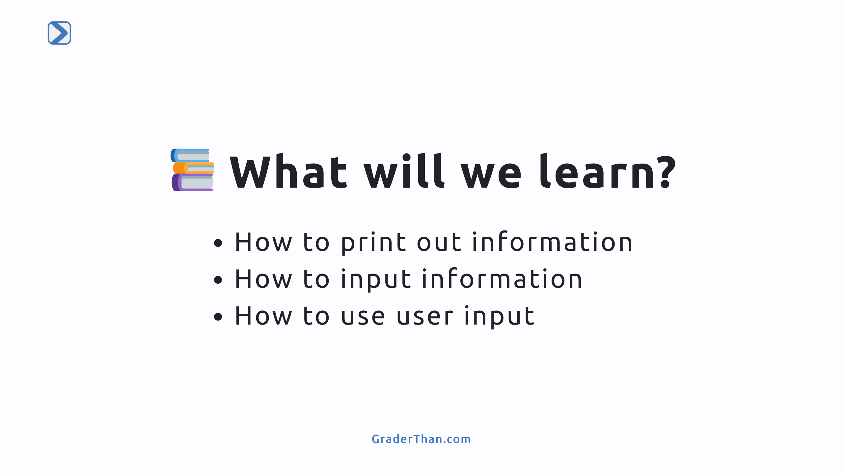

Slide 3
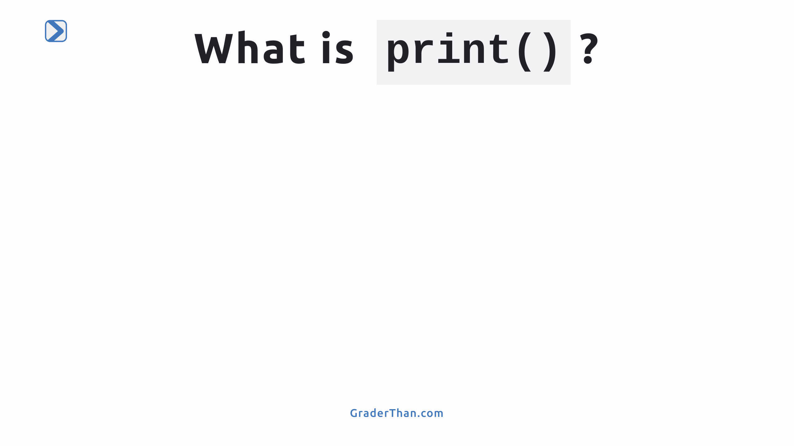

Slide 4
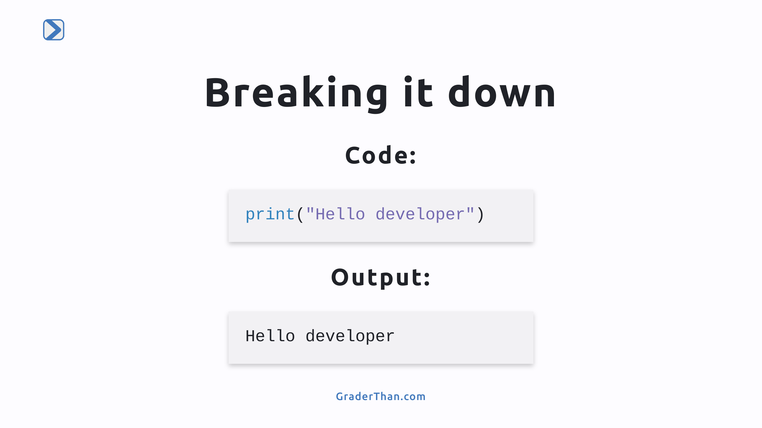
Notes:
Breaking Down the Syntax - `print()`: A function in Python for displaying text on the screen. It's a command that tells the computer to show something. - Parentheses `()`: Essential for functions like `print` to specify what to display. Without them, the computer won't know what to do. - Double Quotes `" "`: Enclose the message inside `print()`. They indicate that the content is text.

Slide 5
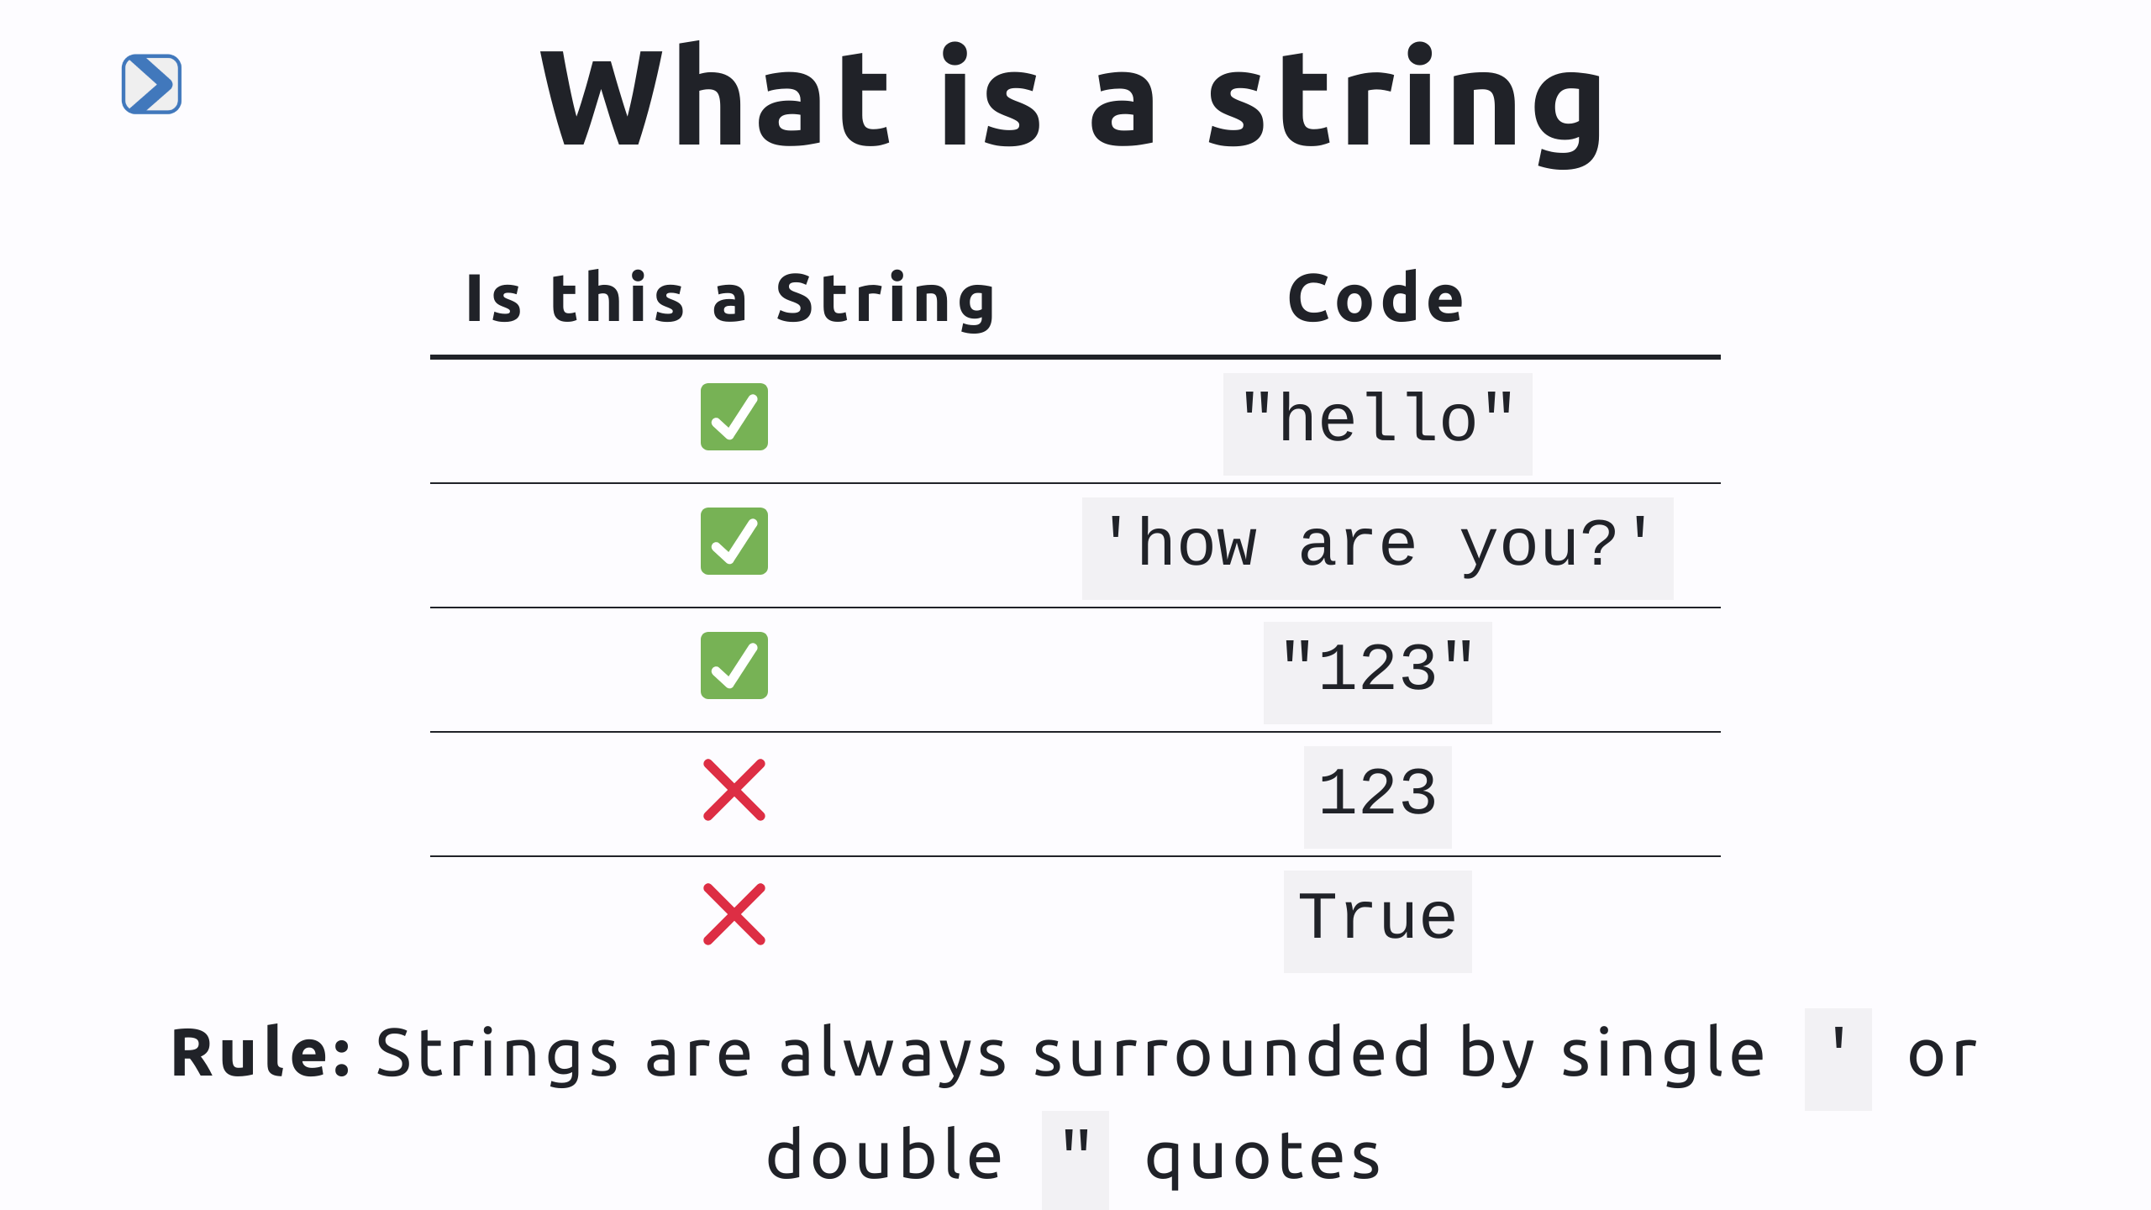
Notes:
- Strings are text wrapped in single quotes - Strings are always surrounded by single `'` or double `"` quotes - Numbers can be in strings - But strings that are numbers don't work the same way as regular numbers!

Slide 6
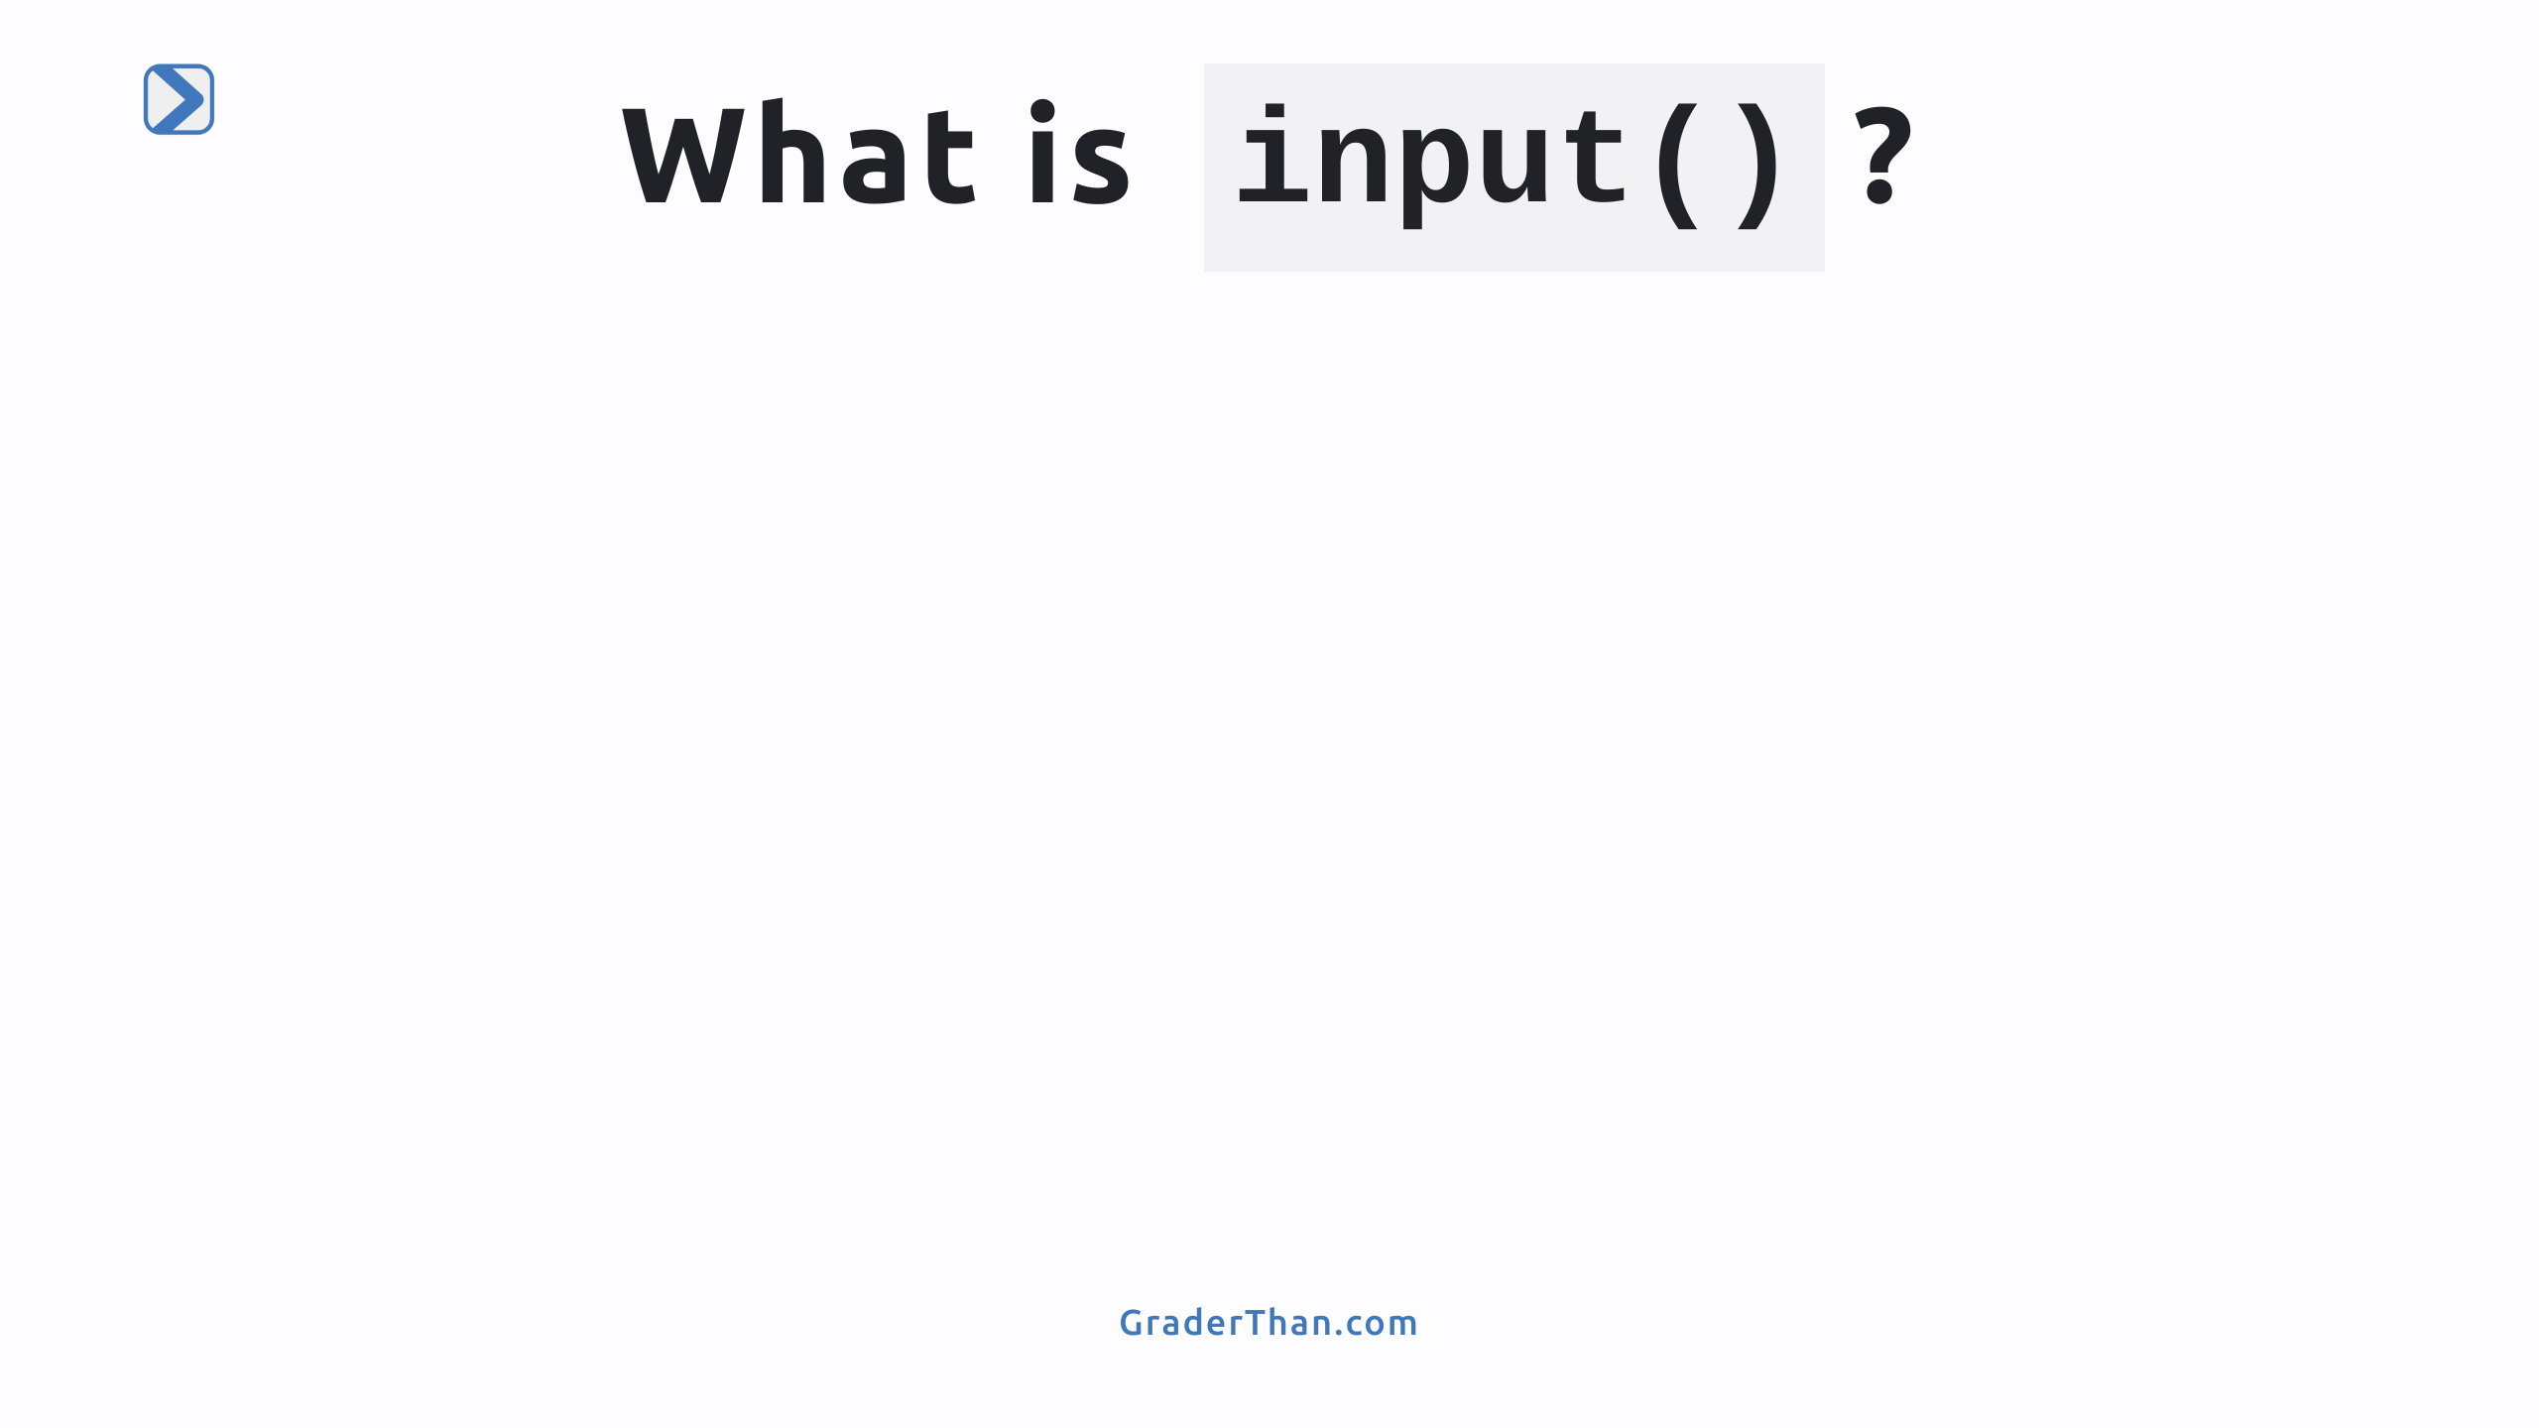

Slide 7
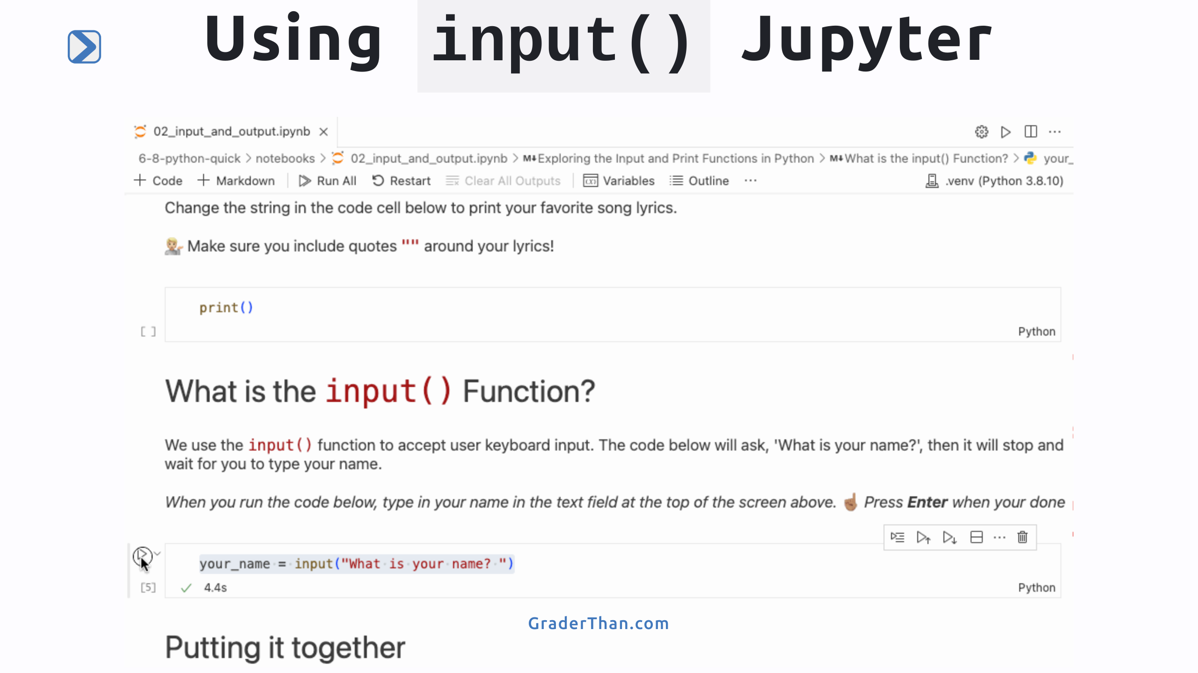
Notes:
When students run code with the input() function in jupyter a keyboard input prompt will appear at the top of the screen.

Slide 8
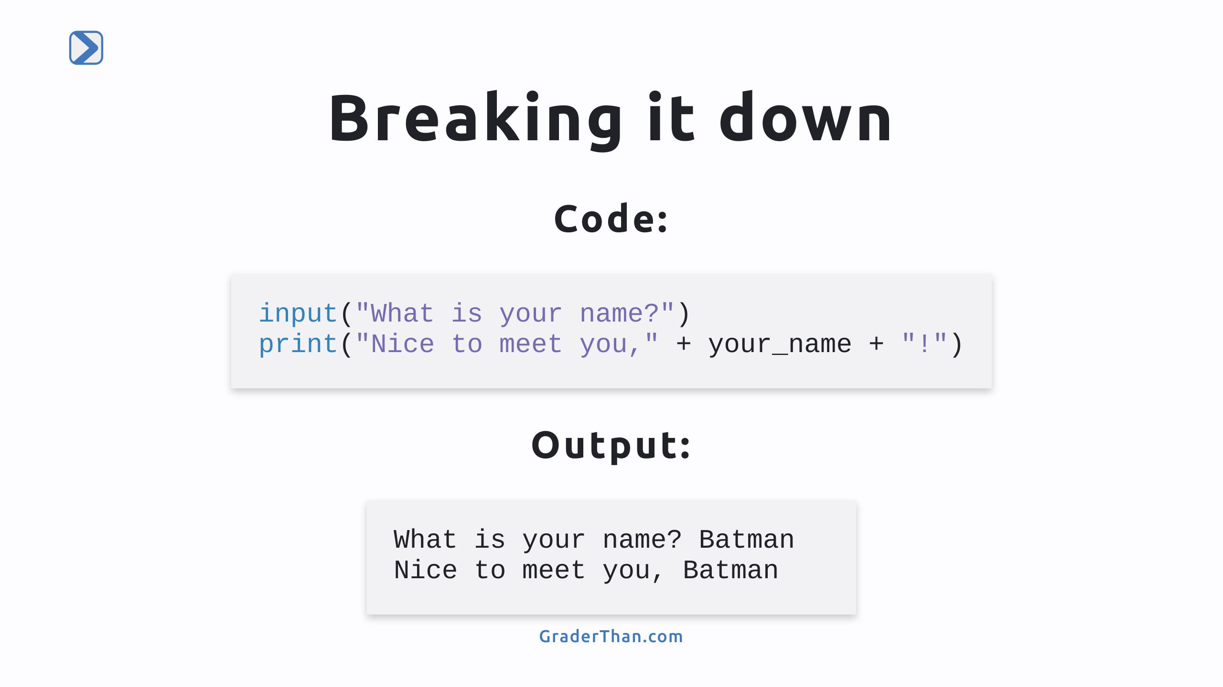
Notes:
Breaking Down the Syntax - `input()` Function: A command in Python that waits for you to type something and hit Enter. - Parentheses and String: Uses parentheses `()` with a string inside, like `"What is your name?"`, to display a question and wait for an answer. - Saving Your Answer: `input()` captures your typed response when you press Enter. - Variable `your_name`: Creates a 'variable', a storage box labeled `your_name`, where Python saves what you typed. - The code is split into two cell in the students notebooks. Students may wonder why their name is not displayed in the first code cell. This is because we did not print `your_name`. In the next code cell we print it out.

Slide 9
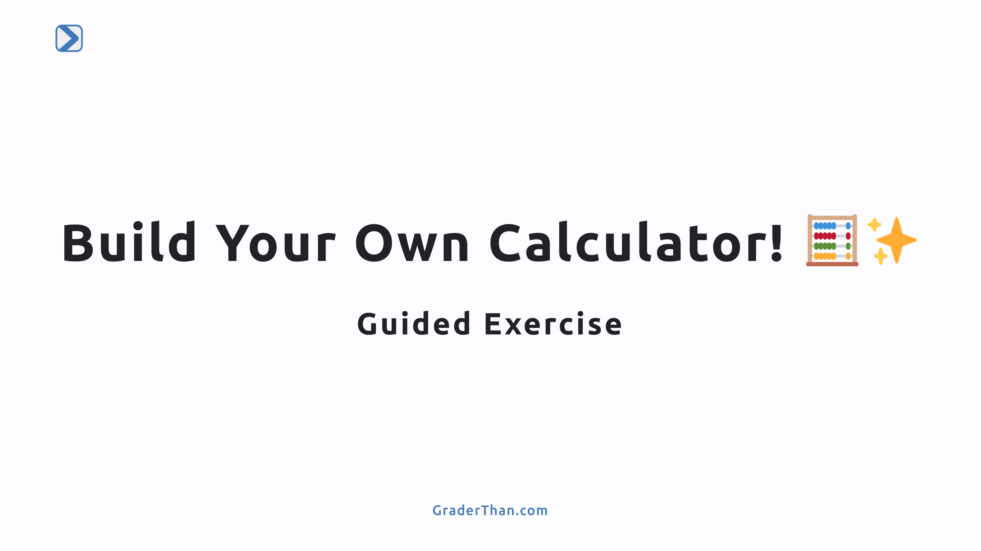
Notes:
This is a 3 step guided exercise where the students will create their own calculator to add numbers - They will use input(), print(), and float() Step 1) Ask for user input `input()`` Step 2) Convert the user input to numbers using `float()` Step 3) Print the result

Slide 10
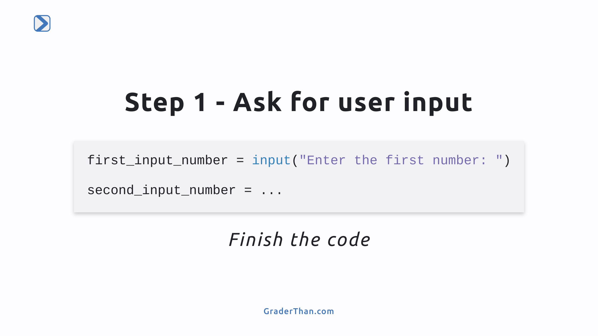
Notes:
Ask the class to complete the unfinished code in their notebooks Solution: `input("Enter the second number: ")`

Slide 11
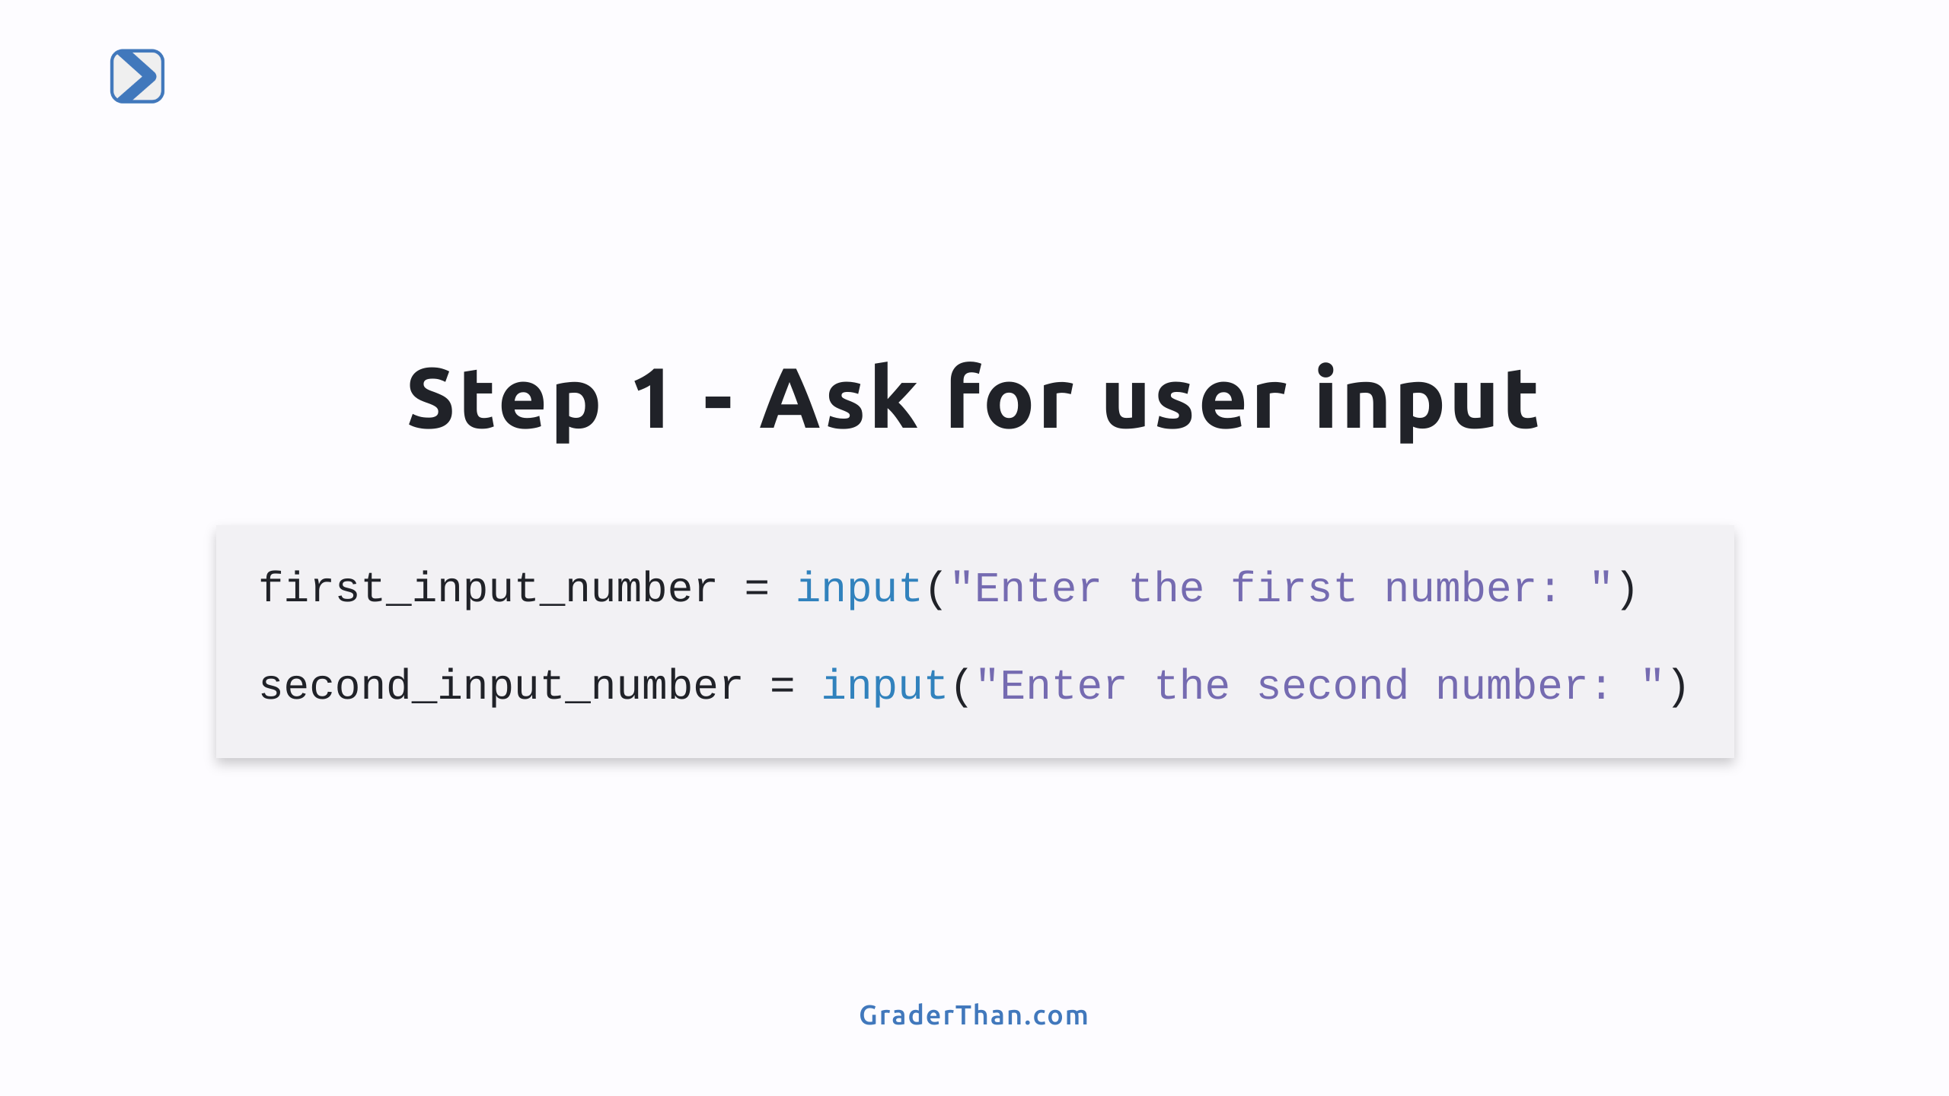

Slide 12
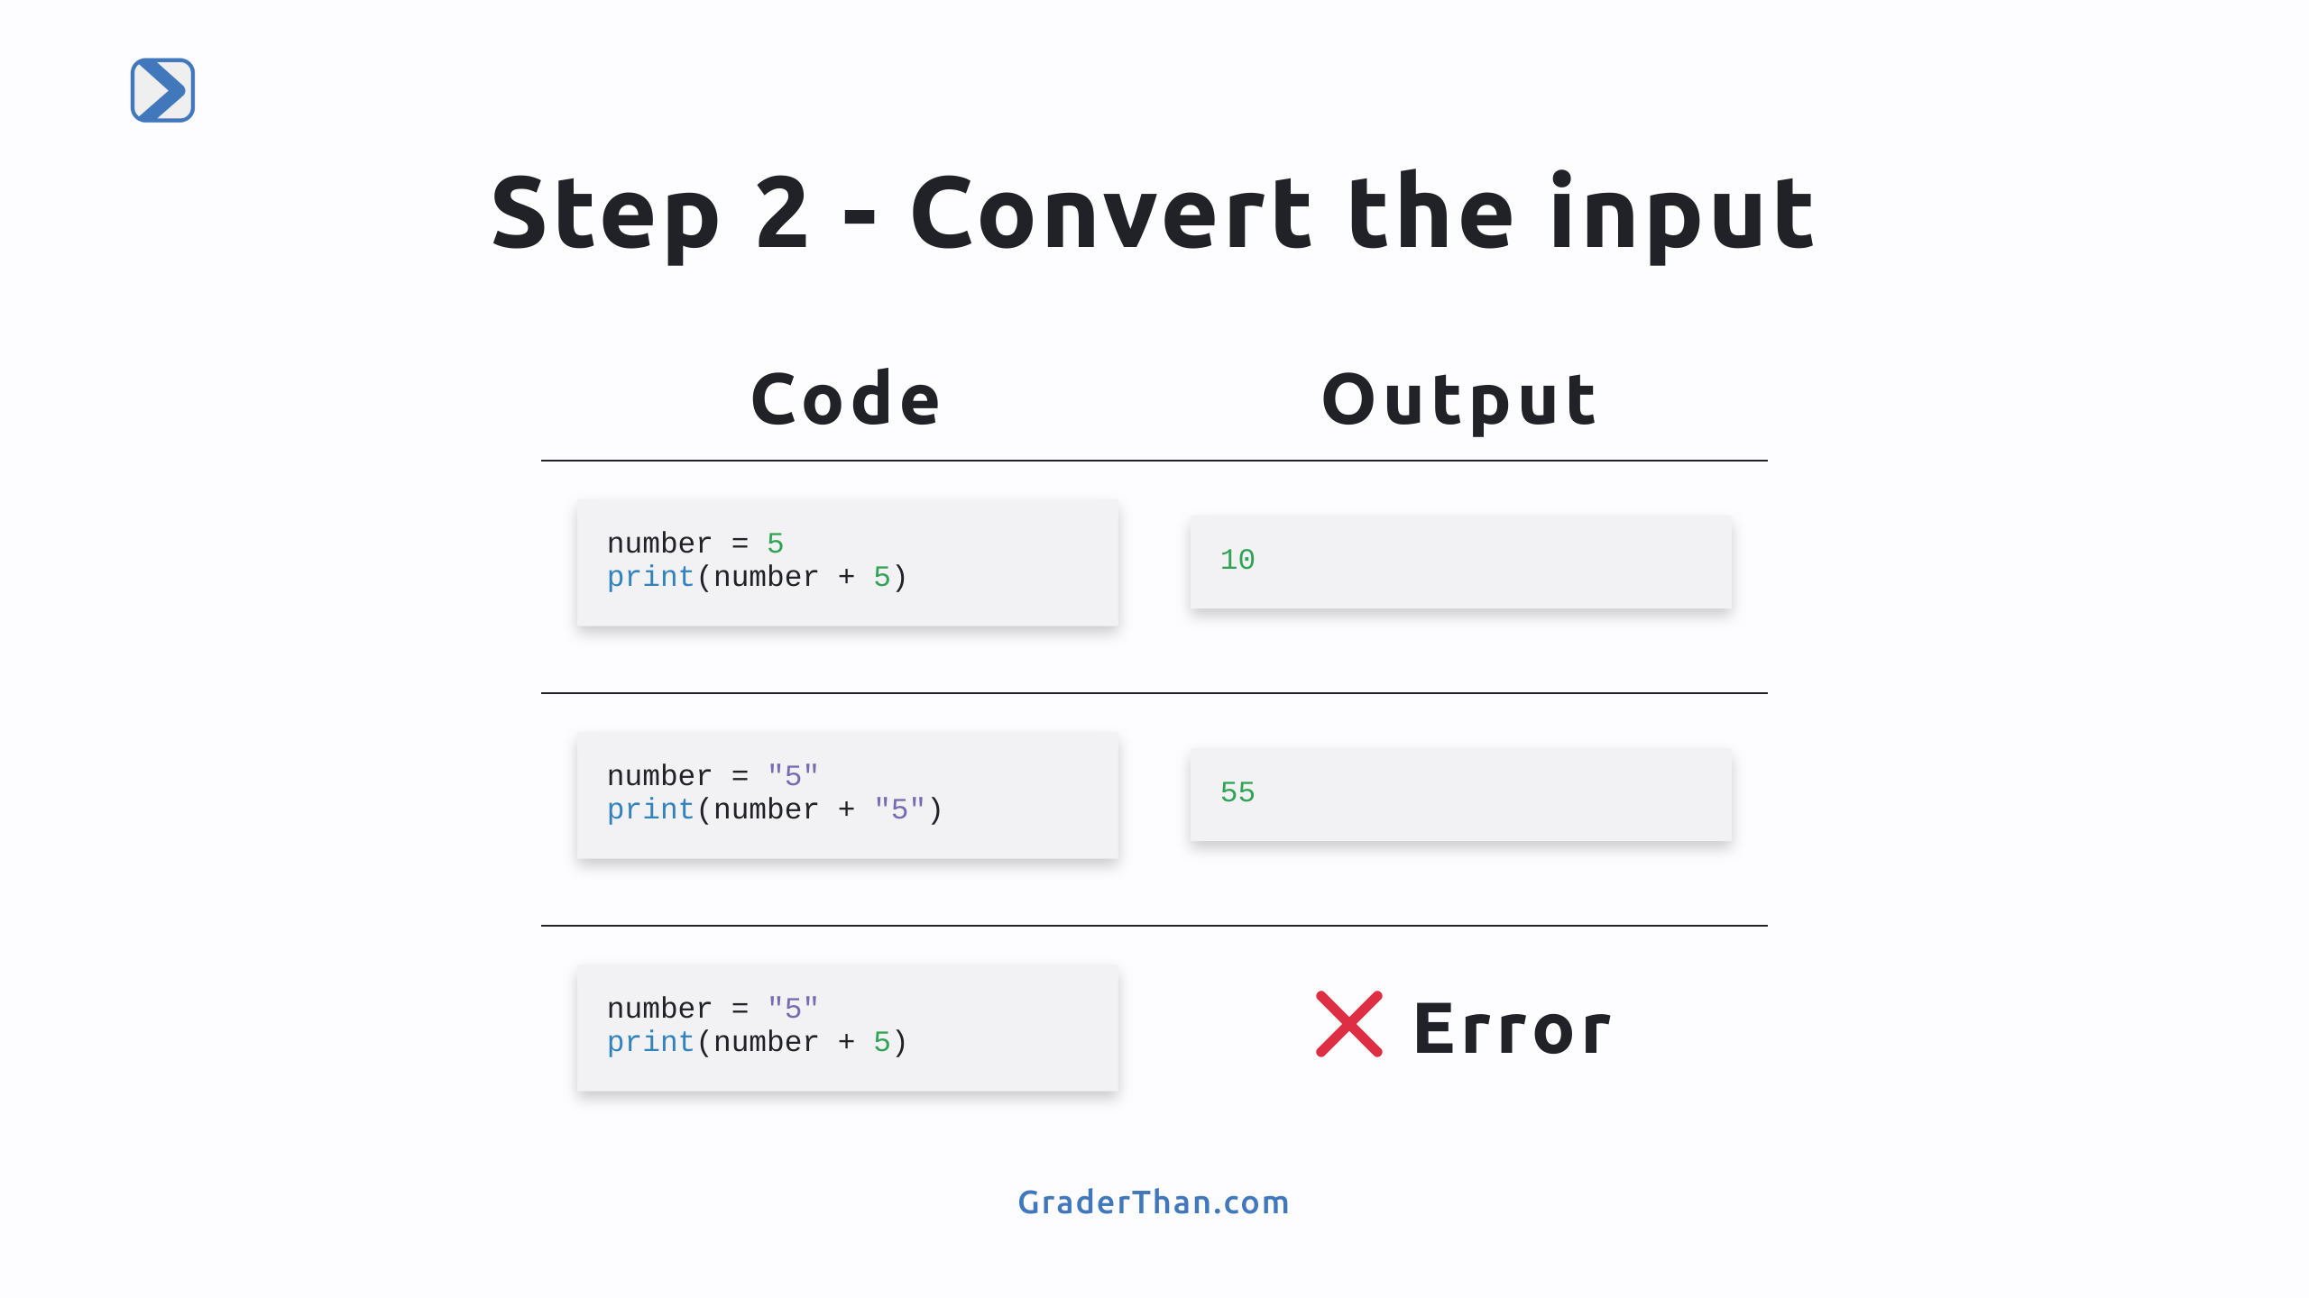
Notes:
This slide explains why we need to convert strings to numbers. The Input() always returns a string Row 1 - Both numbers so its simple arithmetic Row 2 - Both strings so python put the string together side-by-side this is known as "string concatenation" Row 3 - One is a number and the other is a string, we can not add numbers and sting together. They are different data types

Slide 13
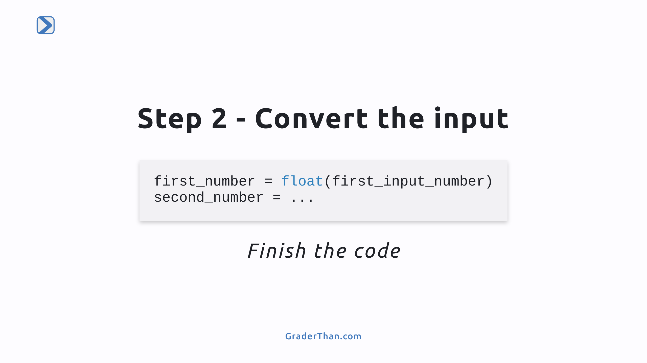
Notes:
Note: they must run the prior code cell for this to work! We use the float() function to convert a string that contains a number into a number. - we can user int() too but it does not handle decimal numbers. Ask the class to complete the unfinished code in their notebooks Solution: `float(second_input_number)`

Slide 14
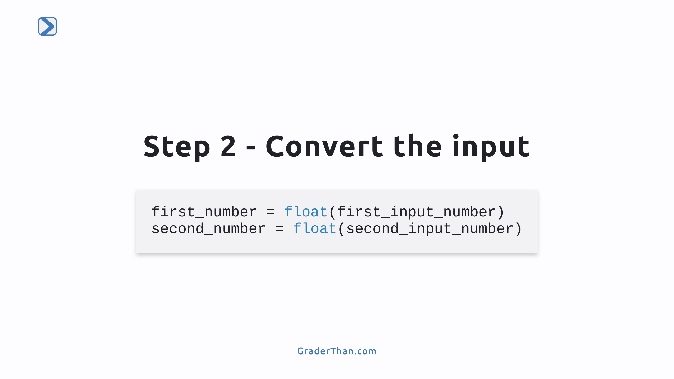

Slide 15
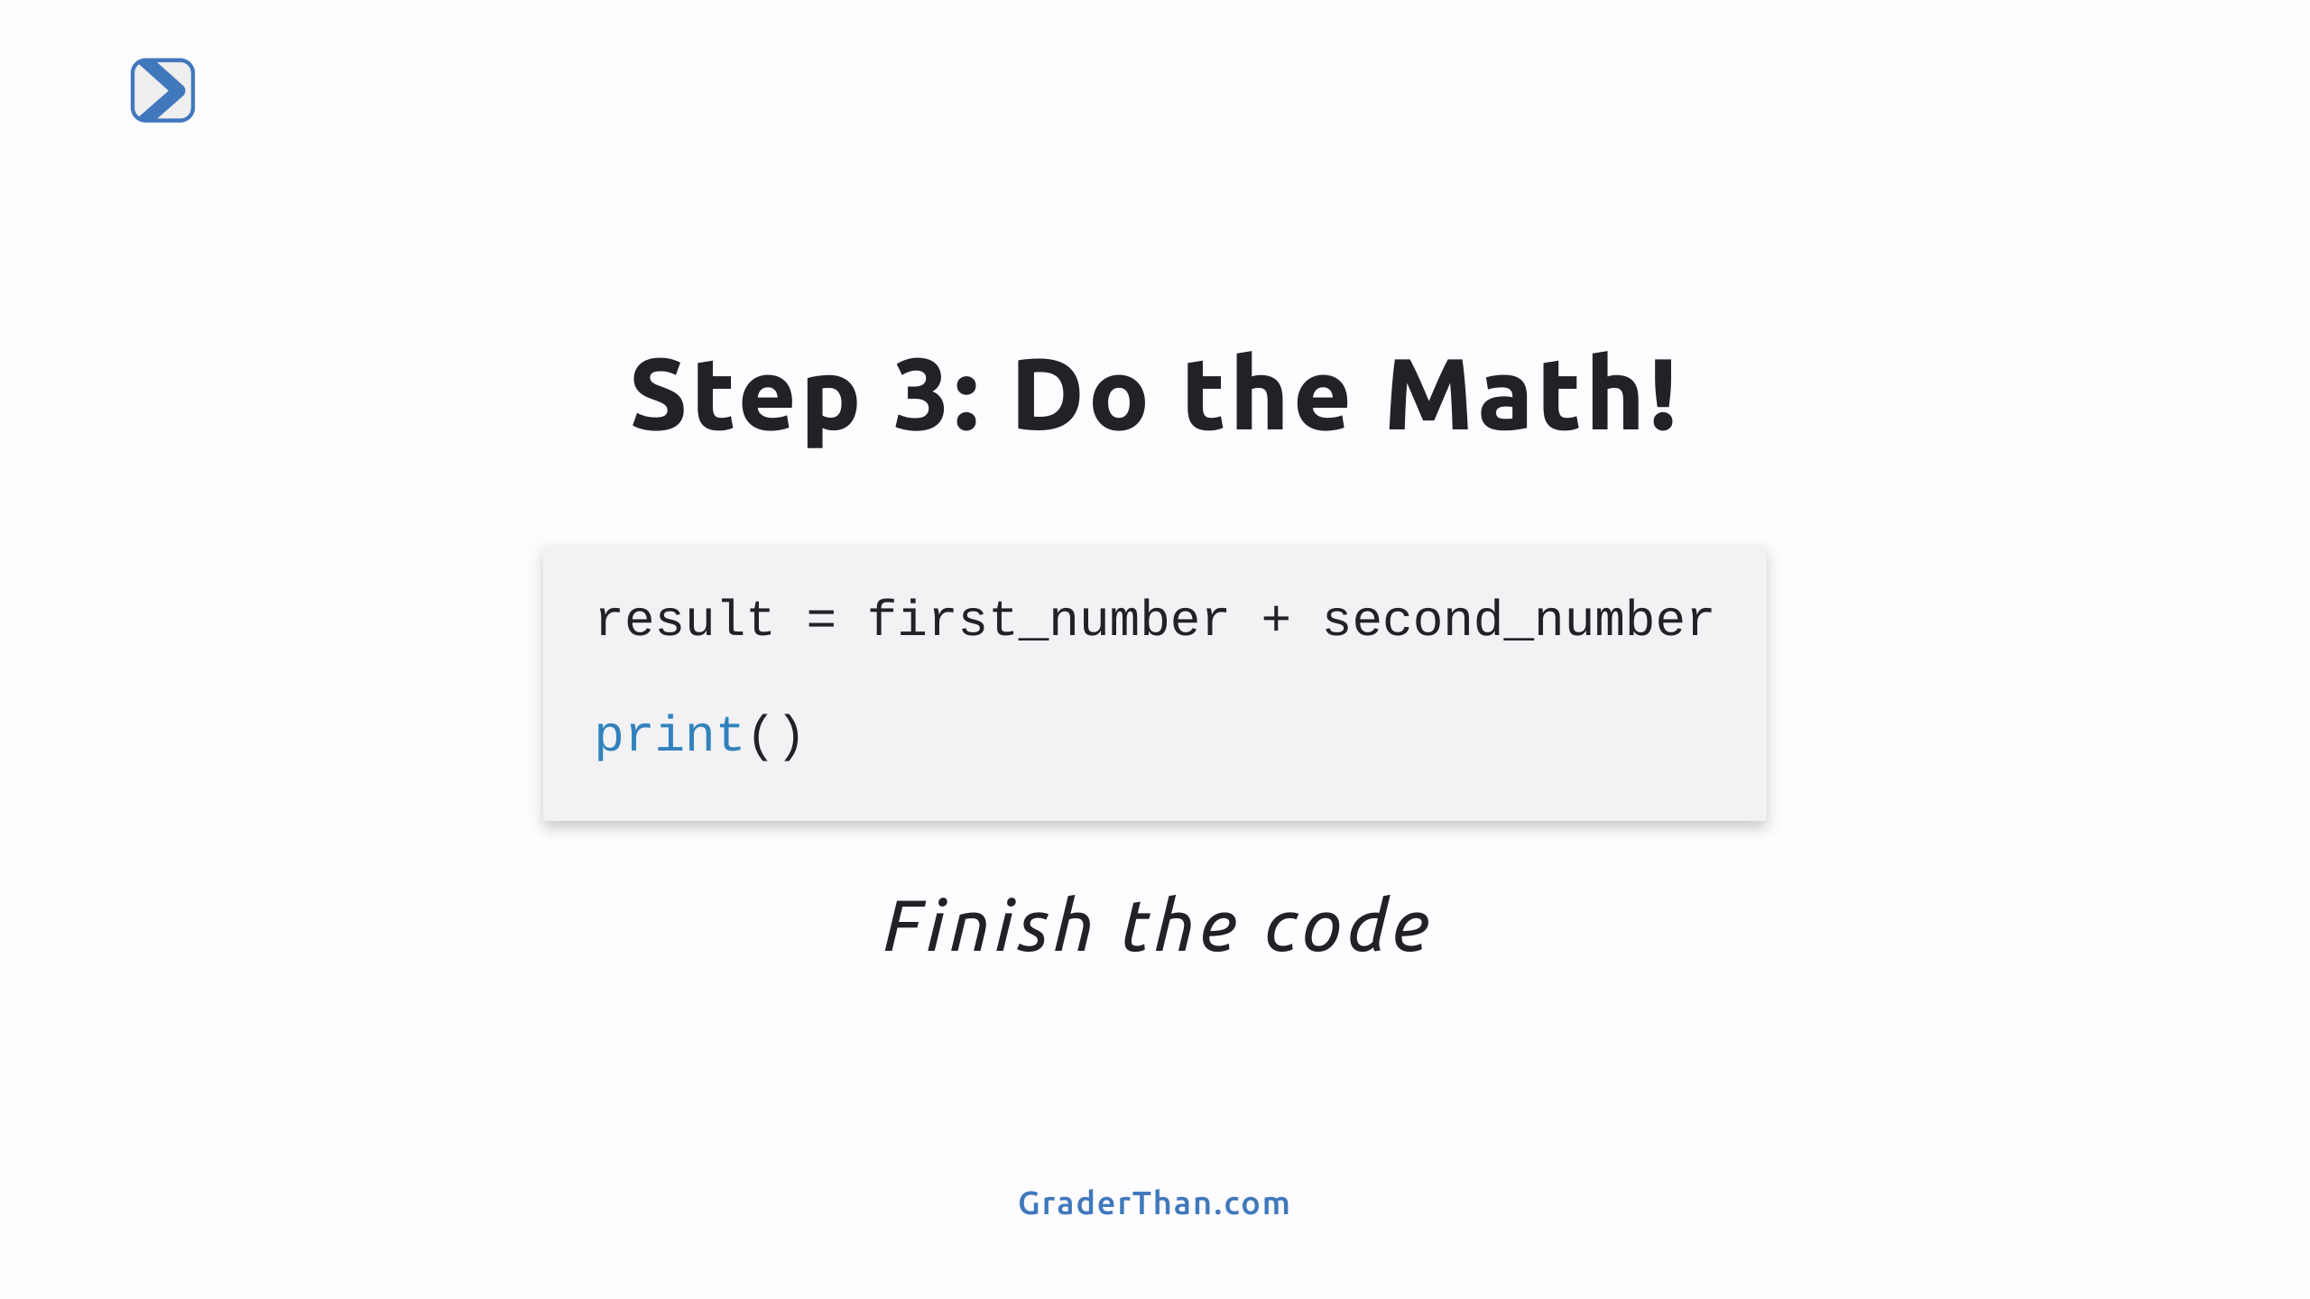
Notes:
They need to `print(result)` Tip: make sure they don't add quotes around the `result` variable name because that will make it a string.

Slide 16
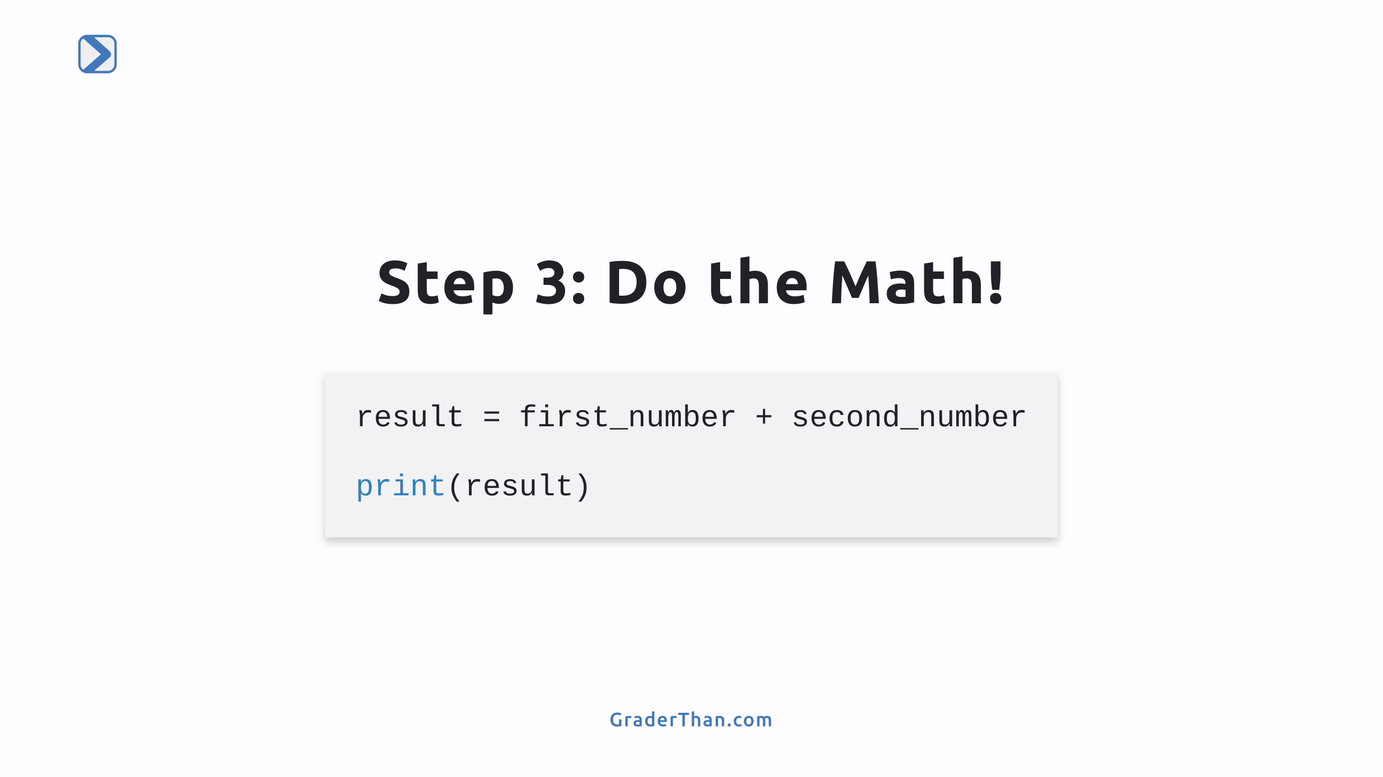

Slide 17
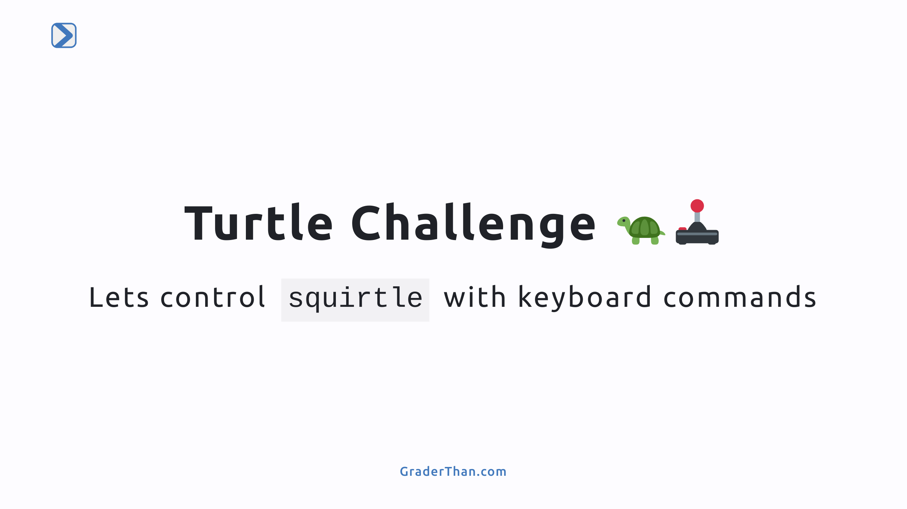

Slide 18
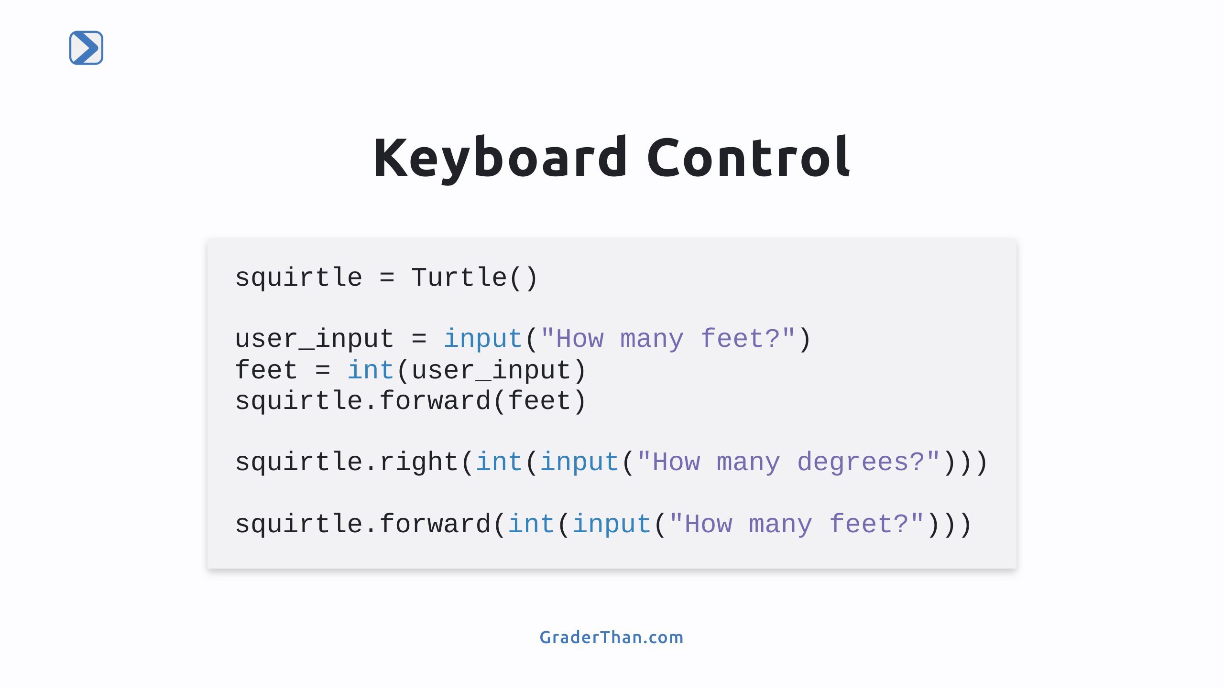
Notes:
1. First Input for Feet: - Use `input()` to ask for feet distance. - Save input as a string in `user_input`, then convert to an integer in `feet`. - `squirtle.forward(feet)` moves Squirtle forward by the entered feet value. 2. Turning Squirtle - Directly input and convert degrees with `squirtle.right(int(input("...")))`. - The response is first taken by `input()`, converted by `int()`, and used to turn Squirtle. 3. Moving Squirtle Again: - Ask for feet distance again, process the input with `input()` and `int()`, then move Squirtle with `squirtle.forward()`.

Slide 19
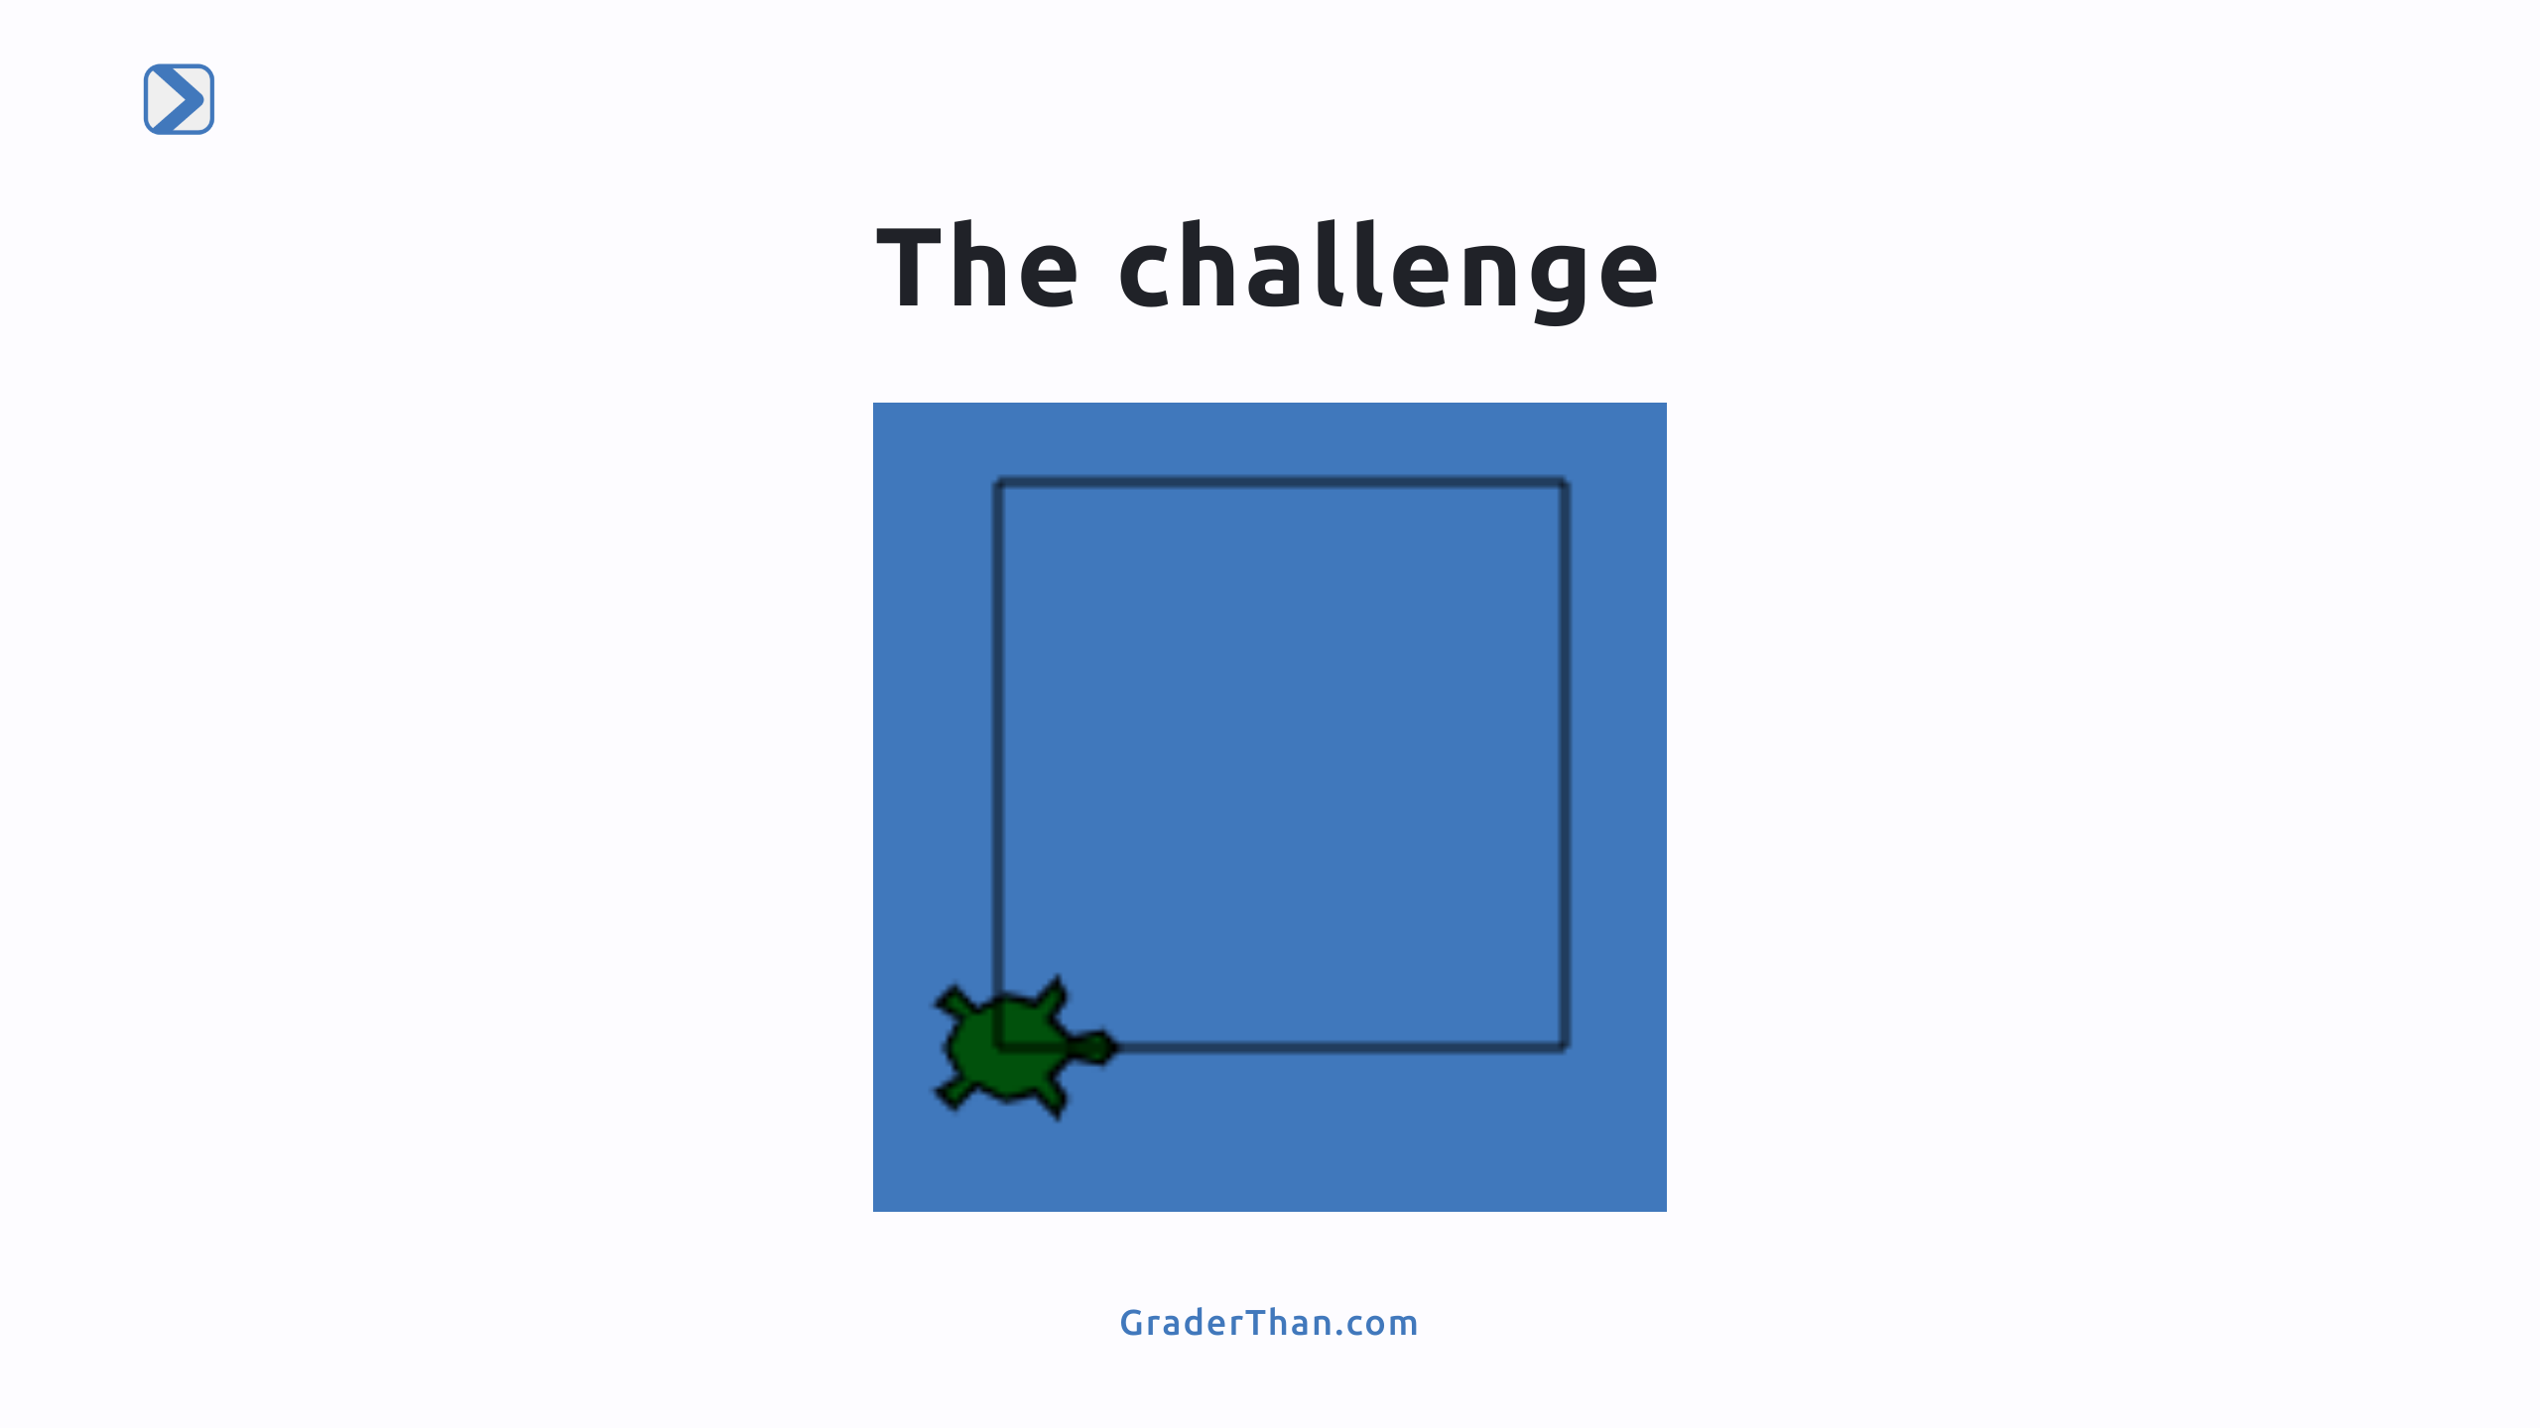
Notes:
- Start with the given code, then add lines to let the user guide the turtle using `int(input())` for movements. Hints: - Experiment with the code: Enter `100`, `90`, `100` to make one corner of a square. - Think about the number of sides and corners in a square, and how many times Squirtle needs to move forward and turn right to complete it.

