Slide 1
WASHINGTON STATE
Wildfire Preparedness Dashboard
Turning decades of DNR fire data into actionable statewide preparedness planning.
21,927 real fire records · 2008–2026 · 40 counties · 3,808,422 acres
For Washington State emergency-management & wildfire-planning officials

Slide 2
WHO & WHY
Our user and the problem
TARGET USER
Washington State emergency-management and wildfire-planning officials
deciding where and when to focus limited preparedness resources.
21,927
Real fires analyzed
3,808,422
Acres burned
The problem
• Longer, more intense wildfire seasons strain state resources.
• Decades of DNR records exist, but are hard to turn into decisions.
• Raw data mixes false alarms and blank fields, hiding real patterns.
• Officials lack a clear, trustworthy view of where activity concentrates.
8,594
False alarms removed
40
Counties covered
Every figure is computed directly from the real DNR records — false alarms excluded, blanks shown as 'Unknown', nothing invented.
Washington State Wildfire Preparedness Dashboard · Source: WA DNR Fire Statistics 2008–Present · Historical patterns, not a prediction
2

Slide 3
OUR SOLUTION
One dashboard, four decision views
Statewide fire map
Every real fire located and clustered, with cause, acres and year.
Historical trends
Incidents and acres burned by year and month.
Fire cause analysis
Dominant causes across counties and regions.
Preparedness priorities
Top counties to assess, with specific recommendations.
Live filters
County, region, year and cause update every view together.
Transparent limits
Sources, cleaning rules and caveats stated plainly.
Washington State Wildfire Preparedness Dashboard · Source: WA DNR Fire Statistics 2008–Present · Historical patterns, not a prediction
3

Slide 4
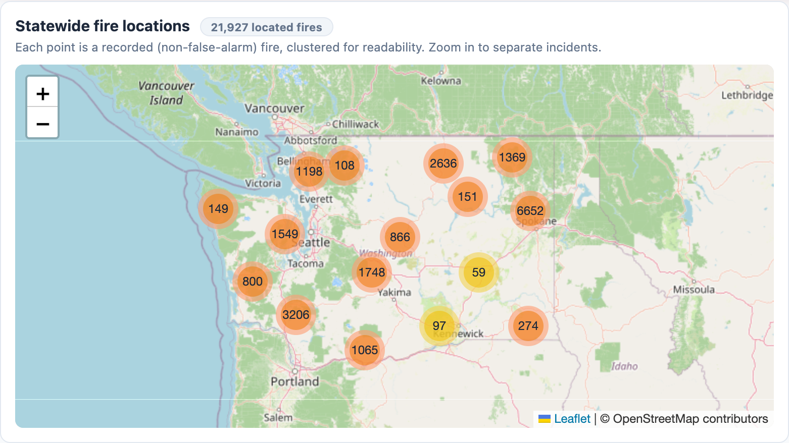
LIVE DASHBOARD
Statewide fire map
What it shows
• 21,927 real (non-false-alarm) fires, clustered for readability.
• Clusters reveal where activity concentrates — the dry eastern counties.
• Click any cluster to drill into county, cause, acres and year.
Planning value: an at-a-glance map of the state's historical fire footprint.
Washington State Wildfire Preparedness Dashboard · Source: WA DNR Fire Statistics 2008–Present · Historical patterns, not a prediction
4

Slide 5
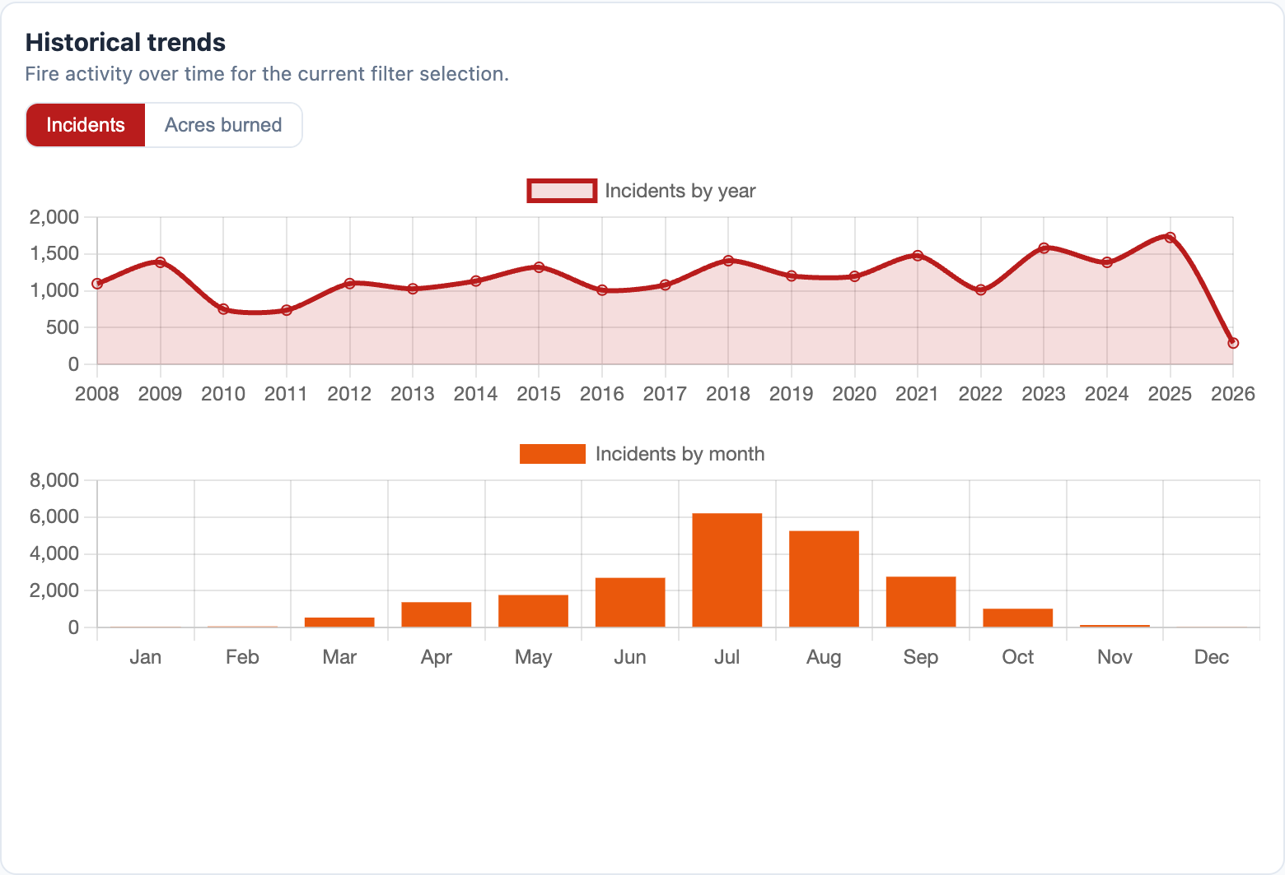
LIVE DASHBOARD
Historical trends
What it shows
• Incidents & acres by year (2008–2026) and by month.
• Clear summer peak: Jul, Aug and Sep drive ~65% of incidents.
• Toggle between incident counts and acres burned.
Planning value: shows when to stage crews, equipment and burn bans.
Washington State Wildfire Preparedness Dashboard · Source: WA DNR Fire Statistics 2008–Present · Historical patterns, not a prediction
5

Slide 6
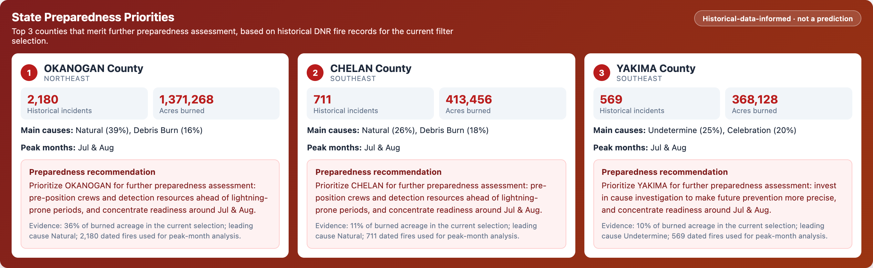
FROM DATA TO DECISIONS
State Preparedness Priorities
Top counties by historical burned acreage — Okanogan (~36% of all acreage), Chelan, Yakima. Each card pairs the evidence (incidents, acres, causes, peak months) with a specific, data-backed recommendation — explicitly labeled historical, not a prediction.
Washington State Wildfire Preparedness Dashboard · Source: WA DNR Fire Statistics 2008–Present · Historical patterns, not a prediction
6

Slide 7
SUPPORTING PREPAREDNESS
How it helps Washington State plan
Target high-burden counties
The top 5 counties hold ~70% of burned acreage — focus mitigation, mutual-aid and pre-positioning there.
Stage resources before peak season
~65% of incidents occur Jul–Sep; align staffing, readiness and burn bans ahead of summer.
Match prevention to local causes
Leading causes differ by county (Debris Burn, Undetermine, Natural); tailor permits and outreach to each area's drivers.
Keep decisions evidence-based
Only ~4% of causes are Unknown; every recommendation cites its supporting data and stays historical, not predictive.
Washington State Wildfire Preparedness Dashboard · Source: WA DNR Fire Statistics 2008–Present · Historical patterns, not a prediction
7

Slide 8
Data-driven wildfire preparedness
A clean, transparent, filter-driven view of Washington's wildfire history — built to help the state prepare, not to predict.
21,927 fires · 3,808,422 acres · 40 counties · 2008–2026
Limitations: historical patterns only; acreage skewed by a few large fires; some records lack a full year or cause.

