Slide 1
Java
Graphical User Interfaces

Slide 2
Objectives
Be able to use Java Foundation Class (JFC) Swing components JFrame, JButton, JTextField, and JLabel
Be able to choose and use an appropriate layout manager
Be able to use JPanel to create structured layouts
Be able to implement interaction using events and listeners
Be able to encapsulate a processing program within a Java GUI.

Slide 3
Java GUI Programming and Design
Graphical user interfaces (GUIs) are a standard application for object-oriented programming.
If the user can’t figure the interface out, it doesn’t matter how good the program is.
An interface must be usable:
Include the information users need; leave out the information they don’t need.
Be consistent from one window to another.
Use commonly known interface patterns.
Give feedback.
Put the user in control.
Notes:
GUI design is a “classic” application for OOP
Scheiderman’s 8 golden rules of interface design:
1. Strive for Consistency.
2. Enable Frequent Users to Use Shortcuts.
3. Offer Informative Feedback.
4. Design Dialogs to Yield Closure.
5. Offer Error Prevention and Simple Error Handling.
6. Permit Easy Reversal of Actions.
7. Support Internal Locus of Control.
8. Reduce Short-Term Memory Load.

Slide 4

Java Foundation Classes
The Java Foundation Classes (JFC) Swing library provides a library of classes for GUI implementation.
The most useful for us will be those for:
JFrame
JButton
JLabel
JTextField
JPanel
Notes:
http://java.sun.com/products/jfc/

Slide 5
Inheritance (Foreshadowing Ch 13)
A means of adding functionality to a class
Avoids repetitive programming
Shows relationships between classes
Implemented using the extends keyword
<child class> extends <parent class>
When using inheritance, the child class “gets” the data and methods of the parent
Notes:
Show JavaDoc for JFrame so students can see available methods

Slide 6
Building a GUI Controller
All Java GUIs are built using “frames”.
To build a GUI:
import the JFrame class from javax.swing
inherit from the JFrame class using extends
include a main() method
The main method implements the following algorithm:
Construct the frame object;
Set the frame as visible.
Notes:
A frame is kinda like a tack board: it has the outline, and certain abilities (hardware to hang it on the wall, ability to stick stuff on there), but starts out with nothing interesting
Step 2 is where stuff gets stuck on the board. 3 is where it is hung on the wall.
JFrames hold GUI components

Slide 7
A basic GUI window
import javax.swing.JFrame;
public class FrameExample extends JFrame {
public static void main(String[] args) {
FrameExample frame = new FrameExample();
frame.setTitle(“MyFrame”);
frame.setSize(400, 300);
frame.setDefaultCloseOperation(EXIT_ON_CLOSE);
frame.setVisible(true); // display the frame
}
}
Notes:
What file is this saved in?
Explain each statement in turn. Show variations.
frame.setLocationRelativeTo(null); // center a frame
Default constructor being created automatically

Slide 8
A basic GUI window
import javax.swing.JFrame;
public class FrameExample extends JFrame {
public FrameExample(){
setTitle(“MyFrame”);
setSize(400, 300);
setDefaultCloseOperation(EXIT_ON_CLOSE);
}
public static void main(String[] args) {
FrameExample frame = new FrameExample();
frame.setVisible(true); // display the frame
}
}
Notes:
frame.setLocationRelativeTo(null); // center a frame
We are making a thing we are modeling into an executable program. (Constructor and main).

Slide 9
Adding Components
Use appropriate constructor:
JButton okButton = new JButton(“Ok”);
JTextField nameField = new JTextField(“Type your name”);
JLabel message = new JLabel(“Welcome to my program!”);
Add new component to the frame (within constructor):
Default location to place an added component is the center of the screen!
add(okButton);
add(nameField);
add(message);
Notes:
Do these in eclipse
Remember to import relevant class, or import javax.swing.*
Demo placement on top of eachother.

Slide 10
Layout Managers
Java provides a variety of layout managers that pack components in a GUI frame.
BorderLayout() – components added at compass positions (north, south, east, west, center);
FlowLayout() – components are added left-to-right, top-to-bottom;
BoxLayout() – components added in horizontal or vertical box;
GridLayout(m,n) – components are added on a grid of m×n equal sized cells (m rows, n columns);
GridBagLayout – The most flexible (and complicated) layout manager.
Notes:
BorderLayout is the default.

Slide 11
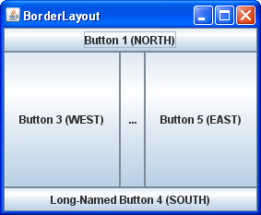
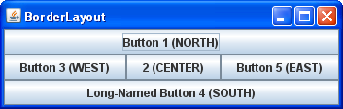
import java.awt.BorderLayout;
import javax.swing.*;
public class BorderWindow extends JFrame {
public BorderWindow(){
setTitle("BorderLayout");
setDefaultCloseOperation(EXIT_ON_CLOSE);
// setLayout(new BorderLayout()); This is actually the default.
add(new JButton("Button 1 (NORTH)"), BorderLayout.NORTH);
add(new JButton("2 (CENTER)"), BorderLayout.CENTER);
add(new JButton("Button 3 (WEST)"), BorderLayout.WEST);
add(new JButton("Long-Named Button 4 (SOUTH)"), BorderLayout.SOUTH);
add(new JButton("Button 5 (EAST)"), BorderLayout.EAST);
}
public static void main(String args[]) {
BorderWindow bw = new BorderWindow();
bw.pack();
bw.setVisible(true);
}
}
Notes:
BorderLayout gives you vertical and horizontal control.
Talk through the code noting:
Jbuttons are unnamed objects
Use of static constants
pack() as opposed to setting window size.

Slide 12
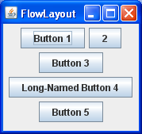

import java.awt.FlowLayout;
import javax.swing.JButton;
import javax.swing.JFrame;
public class FlowWindow extend JFrame {
public FlowWindow(){
setTitle("FlowLayout");
setDefaultCloseOperation(EXIT_ON_CLOSE);
setLayout(new FlowLayout());
add(new JButton("Button 1"));
add(new JButton("2"));
add(new JButton("Button 3"));
add(new JButton("Long-Named Button 4"));
add(new JButton("Button 5"));
}
public static void main(String args[]) {
FlowWindow fw = new FlowWindow();
fw.pack();
fw.setVisible(true);
}
}
Notes:
FlowLayout provides rather simple adjacency formatting.

Slide 13
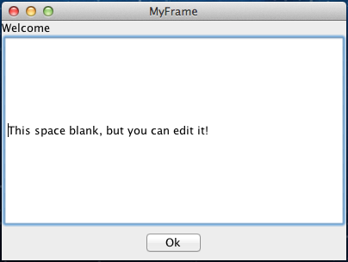

Slide 14
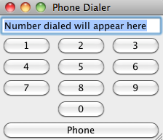
What about more structure?
Notes:
Phone dialer display
What kinds of things are there?

Slide 15
Grouping Components: JPanel
A JPanel can group user-interface components
Each JPanel can have its own layout
JPanels can have JButtons, JTextFields etc.
Must be added to the frame!
Notes:
JPanel is framed art hung on our big tack board.

Slide 16
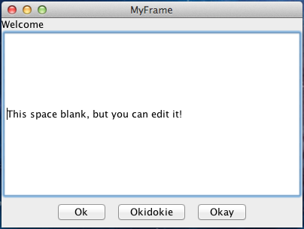
Using JPanel
// Message and textfield as before …
//Create panel and buttons
JPanel buttonPanel = new JPanel(new FlowLayout());
JButton okButton1 = new JButton("Ok");
JButton okButton2 = new JButton("Okidokie");
JButton okButton3 = new JButton("Okay");
//Put buttons onto JPanel
buttonPanel.add(okButton1);
buttonPanel.add(okButton2);
buttonPanel.add(okButton3);
//add group of buttons to frame
add(buttonPanel, BorderLayout.SOUTH);

Slide 17
import javax.swing.*;
import java.awt.BorderLayout;
import java.awt.GridLayout;
public class PhoneDialer extends JFrame {
public PhoneDialer (){
setTitle(“Phone Dialer”);
setDefaultCloseOperation(EXIT_ON_CLOSE);
add(new JTextField("Number dialed will appear here"), BorderLayout.NORTH);
//keypad holds the additional structure of the number buttons
JPanel keypad = new JPanel();
keypad.setLayout(new GridLayout(4,3));
for (int i = 1; i<10; i++){
keypad.add(new JButton("" + i));
}
keypad.add(new JLabel(""));
keypad.add(new JButton("0"));
add(keypad, BorderLayout.CENTER); //must add keypad to the frame
add(new JButton("Phone"), BorderLayout.SOUTH);
}
public static void main(String[] args) {
PhoneDialer dialer = new PhoneDialer();
dialer.pack();
dialer.setVisible(true);
}
}
Notes:
Phone dialer code.

Slide 18
Events and Listeners
An event is a signal to the program that something has happened
GUI components can trigger events (e.g. JButtons, JTextFields, JSlider, JCheckBox, etc.)
When triggered, an appropriate event object is created
JButton and JTextFields generate events of type ActionEvent
A listener is an object interested in an event
Must be an instance of a listener interface
An interface specifies a set of methods that an implementing class must implement.
Must be registered with a source component (i.e. registered with an object that generates events e.g. JButton)
Notes:
An interface is a classlike construct, but focuses on desired behaviours. An interface is a protocol or promissory note.

Slide 19
Action Listeners
Listener objects are defined as classes that:
Implement the ActionListener interface;
Override the actionPerformed() method.
GUI objects that generate events must register an action listener.
guiObject.addActionListener(actListObject)
Notes:
A Java interface is a class that declares a set of methods that an implementing class must define.
implementing ActionListener *requires* that we define the actionPerformed method.

Slide 20
Using ActionListener
Define a class to act as the listener:
class ButtonListener implements ActionListener{
public void actionPerformed(ActionEvent e) {
//do whatever should happen when button pushed
}
}
Construct an instance of the class and add it as the listener for an object that will generate an event:
JButton myButton = new JButton(“Click me!”);
myButton.addActionListener(new ButtonListener());

Slide 21
Handling Multiple Actions
Most GUIs have multiple widgets that might cause action events to be generated
Construct and register a different listener for each event using an inner class
A class defined inside of another class
Usually very short – our inner classes will only define the actionPerformed method
Example on next slide

Slide 22
... // import statements for Swing components and actions
public class WhichButton extends JFrame {
public WhichButton() {
... // code as before
myLeft = new JButton("Left");
myLeft.addActionListener(new LeftButtonListener());
add(myLeft);
myRight = new JButton("Right");
myRight.addActionListener(new RightButtonListener());
add(myRight);
}
class LeftButtonListener implements ActionListener{
public void actionPerformed(ActionEvent e) {
myIndication.setText("Left");
}
}
class RightButtonListener implements ActionListener{
public void actionPerformed(ActionEvent e){
myIndication.setText("Right");
}
}
//other code including main method
}

Slide 23
One Action Listener Object
If only one listener is required we can use the controller object:
public class Example extends Jframe implements ActionListener{
Then, we add an action listener using “this”:
public ClickButton(){
... // setting up the frame
myButton = new JButton(“Button”);
myButton.addActionListener(this);
add(myButton);
...
}
Must define an actionPerformed method:
public void actionPerformed(ActionEvent e) {
myMessage.setText(”Button was pressed");
myButton.setEnabled(false);
}

Slide 24
More JFC
The Swing GUI classes provide a variety of other GUI components.
The GUI slider component, for example is implemented using ChangeListener and the stateChanged() method.
Java provides good reference and tutorial materials for JFC and Swing, e.g.:
http://java.sun.com/docs/books/tutorial/ui/features/components.html
Notes:
http://java.sun.com/products/jfc/

Slide 25
Integrating Processing & Java
You can integrate a Processing sketch into a Java GUI as follows:
Encapsulate the Processing sketch as an object that inherits from PApplet;
Construct that object and add it to the GUI controller frame
Notes:
We implement the GUIController and SketchPanel, and inherit all the members of JFrame and PApplet (which, by the way, is a child of Applet and grandchild of JPanel). It’s the PApplet features that support the Processing animation and the JPanel features that allow us to include the sketch in the Java frame.

Slide 26
Encapsulating a Sketch
Processing sketches are implemented as classes that inherit from PApplet.
You can encapsulate sketches as follows:
Create a new class that extends PApplet and contains the Processing sketch code;
Mark the pre-defined Processing methods (e.g., setup() and draw() ) as public;
Treat the sketch variables as instance data and add constructors, accessors and mutators as needed.
Notes:
Demo this one step at a time. Add a default constructor and an explicit-value constructor that receives the frame rate.
Change the variable names to private my* instance variables to match our convention from chapter 9.

Slide 27
package c08java.shaker;
import processing.core.PApplet;
/**
* ShakerPanel1 is a simple Java encapsulation of a shaker animation from Processing.
* It draws a shaking circle and allows the user to reposition the circle using a mouse click.
*
* @author kvlinden
* @version Fall, 2009
*/
public class ShakerPanel extends PApplet {
private static final int SIZE = 300;
private int myShift;
public ShakerPanel(int shift) {
myX = myY = SIZE / 2;
myShift = shift;
}
public void setup() {
size(SIZE, SIZE);
smooth();
}
public void draw() {
background(255);
strokeWeight(2);
ellipse(myX + random(-myShift / 2, myShift / 2), myY + random(-myShift / 2, myShift / 2),
50, 50);
}
public void mousePressed() {
myX = mouseX;
myY = mouseY;
}
}
Notes:
Build this code by hand using the process specified above.

Slide 28
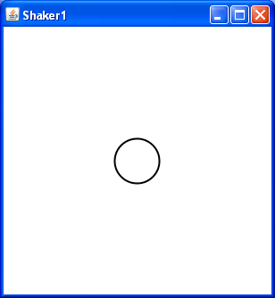
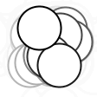
package c08java.shaker;
import javax.swing.JFrame;
/**
* ShakerController1 is a simple version of a Java controller for the Processing shaking circle
* application. It provides a simple Jframe in which to run the original application as it runs
* in Processing.
*
* @author kvlinden
* @version Fall, 2009
*/
public class ShakerController extends JFrame {
private ShakerPanel myShakerPanel;
public ShakerController() {
setTitle("Shaker1");
setDefaultCloseOperation(EXIT_ON_CLOSE);
myShakerPanel = new ShakerPanel(5);
myShakerPanel.init();
add(myShakerPanel);
}
public static void main(String[] args) {
ShakerController controller = new ShakerController();
controller.pack();
controller.setVisible(true);
}
}
Notes:
Be careful to note the use the Controller class and the Panel class. They must be used consistently and properly.
Note that the controller must init() the panel object. The panel inherits the init() method from Applet.

Slide 29
Interacting with an encapsulated Processing sketch
The controller object (which extends JFrame) has an object (i.e. an instantiation) of the PApplet class
Use accessors, mutators and utility methods of the PApplet object to make changes happen from the controller

Slide 30
public class ShakerController extends JFrame {
private ShakerPanel myShakerPanel;
private JTextField myShiftField;
private JButton myStartButton, myPauseButton;
public ShakerController() {
setTitle("Shaker");
setDefaultCloseOperation(EXIT_ON_CLOSE);
setLayout(new BorderLayout());
myShakerPanel = new ShakerPanel();
myShakerPanel.init();
add(myShakerPanel, BorderLayout.NORTH);
// a control panel
JPanel controlPanel = new JPanel(new FlowLayout());
myStartButton = new JButton("Start");
myStartButton.setEnabled(false);
myStartButton.addActionListener(new StartButtonListener());
controlPanel.add(myStartButton);
myPauseButton = new JButton("Pause");
myPauseButton.setEnabled(true);
myPauseButton.addActionListener(new PauseButtonListener());
controlPanel.add(myPauseButton);
controlPanel.add(new JLabel("Shift factor:"));
myShiftField = new JTextField(3);
myShiftField.setText(String.format("%d", myShakerPanel.getShift()));
controlPanel.add(myShiftField);
myShiftField.addActionListener(new ShiftFieldListener());
add(controlPanel, BorderLayout.CENTER);
}
// continued on next slide
Notes:
%d base 10 integer

Slide 31
// continued from previous slide
class StartButtonListener implements ActionListener {
@Override
public void actionPerformed(ActionEvent ae) {
myShakerPanel.setRunning(true);
myStartButton.setEnabled(false);
myPauseButton.setEnabled(true);
}
}
class PauseButtonListener implements ActionListener {
@Override
public void actionPerformed(ActionEvent ae) {
myShakerPanel.setRunning(false);
myStartButton.setEnabled(true);
myPauseButton.setEnabled(false);
}
}
class ShiftFieldListener implements ActionListener {
@Override
public void actionPerformed(ActionEvent ae) {
try {
myShakerPanel.setShift(Integer.parseInt(myShiftField.getText()));
} catch (Exception e) {
myShiftField.setText(“Invalid shift value. Please try again.”);
}
}
}
public static void main(String[] args) {
ShakerController controller = new ShakerController();
controller.pack();
controller.setVisible(true);
}
} // closes ShakerController class declaration

Slide 32
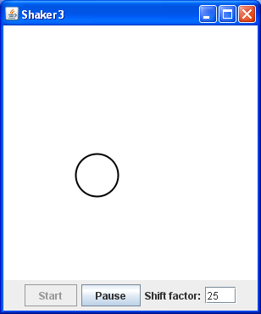
public class ShakerPanel extends PApplet {
private static final int SIZE = 300;
private int myX, myY, myShift;
private boolean myRunningStatus;
//constructor
public ShakerPanel() {
myX = myY = SIZE / 2;
myShift = 10;
myRunningStatus = true;
}
public void setup() {
size(SIZE, SIZE);
smooth();
background(255);
}
public void draw() {
if (myRunningStatus) {
background(255);
strokeWeight(2);
ellipse(myX + random(-myShift / 2, myShift / 2),
myY + random(-myShift / 2, myShift / 2), 50, 50);
}
}
public void mousePressed() {
myX = mouseX;
myY = mouseY;
}
public int getShift() {
return myShift;
}
public void setShift(int shift) throws Exception {
if (shift < 0) {
throw new Exception("invalid shift value: " + shift);
}
myShift = shift;
}
public void setRunning(boolean status) {
myRunningStatus = status;
}
}
Notes:
Bring up in eclipse so students can see correct orientation.

Slide 33
Review
To encapsulate a Processing sketch in a Java GUI:
Move Processing sketch to a new Java class that extends PApplet
Make animation methods public
Turn animation variables into instance variables
Write a constructor method that initializes any instance variables
In the controller class (that extends JFrame):
Create an instance of the new sketch class by calling the constructor
Call the init() method on the instance
Add the instance to the frame

Slide 34
Using Additional Classes
Only one class should handle the Processing animation
There should only ever be one class that extends PApplet!!!
Classes are best way to model additional features
So:
Support class extends Object (only); (this is implicit)
Pass a reference to the PApplet object to the render() method.
+render()
Notes:
Note that you could view Processing classes as being drawn inside the sketchPanel class – for scalability, Java moves them out.
In addition, you may have to modify the code in the following ways:
Use Math and System library methods/variables rather than protected PApplet methods/variables;
Java defaults to double rather than float.
Treat color as an integer and move all use of the color() method to display() (or render()).
Show code for variation 5.

Slide 35
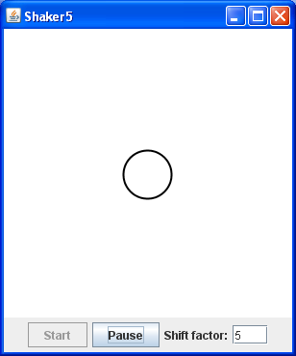
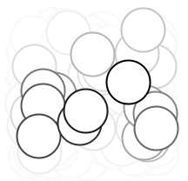
public class ShakerPanel extends PApplet {
private int mySize, myX, myY, myShift;
private boolean myRunningStatus;
private Figure myFigure;
public ShakerPanel(int size, int shift) {
mySize = size;
myShift = shift;
myRunningStatus = true;
myFigure = new Figure(mySize / 2, mySize / 2, 50, 5);
}
// ... repeated code removed for space ...
public void setup() {
size(mySize, mySize);
smooth();
}
public void draw() {
if (myRunningStatus) {
background(255);
myFigure.render(this);
}
}
}
Notes:
The controller is the same as before.

Slide 36
import processing.core.PApplet;
public class Figure {
private int myX, myY, myDiameter, myShift;
public Figure(int x, int y, int diameter, int shift) {
myX = x;
myY = y;
myDiameter = diameter;
myShift = shift;
}
public void render(PApplet p) {
p.strokeWeight(2);
p.ellipse(myX + p.random(-myShift / 2, myShift / 2),
myY + p.random(-myShift / 2, myShift / 2),
myDiameter, myDiameter);
}
}
Notes:
Basic changes:
Sequestered all the color and drawing calls to display();
Passed a reference to the PApplet object to display();
Replaced references to Math methods/data with Math library calls (re-implementing computeDistance())

Slide 37
Exercise
Expanding figure controller
Notes:
Change into a Java class

Slide 38

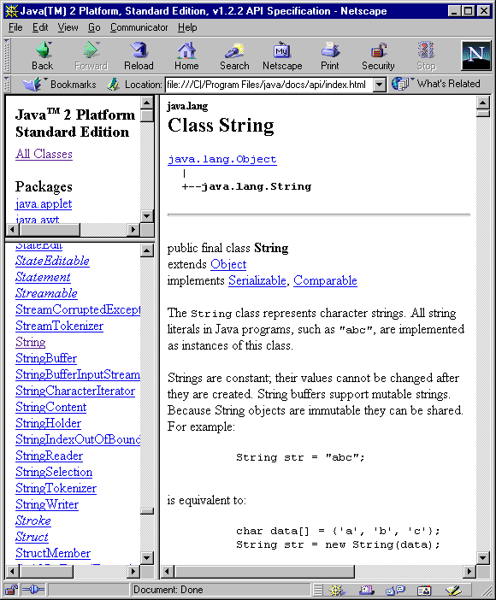
JavaDoc
What’s the
Big Idea
Application Programmers Interface (API) documentation is one critical aid in using a common abstraction.
JavaDoc is a Java tool designed to automate the construction of API documentation.
Notes:
Java has over 1600 classes for you to use - you’ll never remember them all. E.g., many languages have a string library, and they are all similar but not identical. Here’s the javadoc string manual: http://java.sun.com/j2se/1.5.0/docs/api/index.html
This is a key part of the quest to build ever more useful/powerful abstractions. The Java String API is anything but vague.

Slide 39
JavaDoc: Comments
JavaDoc supports comments for classes, methods, instance variables.
JavaDoc comments include:
A general description of the component written in HTML;
Additional tagged information for:
@author
@version
@param
@return
Notes:
Go through these, noting the following about tagged values:
They are all optional
They can take most any HTML-formatted text
They can be repeated, e.g., there is a separate @param for every parameter, each of which includes the name and a short description.

Slide 40
JavaDoc: Example
package c08java.text_examples;
import java.util.Scanner;
/**
* TemperatureConverter converts Celsius temperatures to Fahrenheit. This
* routine assumes that the user enters a valid temperature.
*
* @author kvlinden
* @version 23august2009
*/
public class TemperatureConverter {
/**
* This string prompt illustrates a static data member.
*/
public static final String PROMPT = "Please enter the temperature in Celsius:";
/**
* The main method implements the temperature conversion using console-base input and output.
*
* @param args these command line arguments are ignored
*/
public static void main(String[] args) {
System.out.print(PROMPT);
Scanner keyboard = new Scanner(System.in);
double celsius = keyboard.nextDouble();
double fahrenheit = ((9.0 / 5.0) * celsius) + 32;
System.out.print(celsius + " degrees Celsius is " + fahrenheit + " degrees Fahrenheit.\n");
}
}
Notes:
To demo, From Project – Generate JavaDoc.

Slide 41
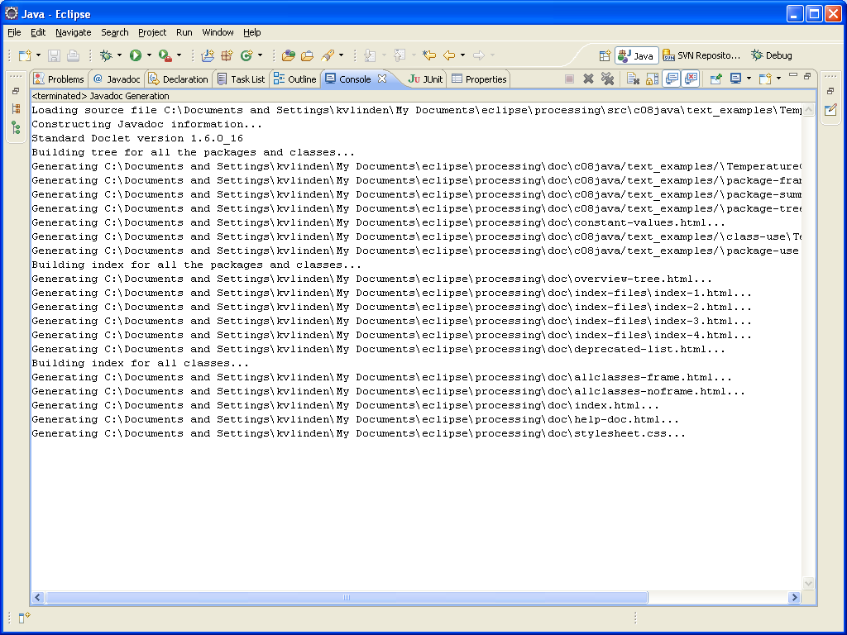
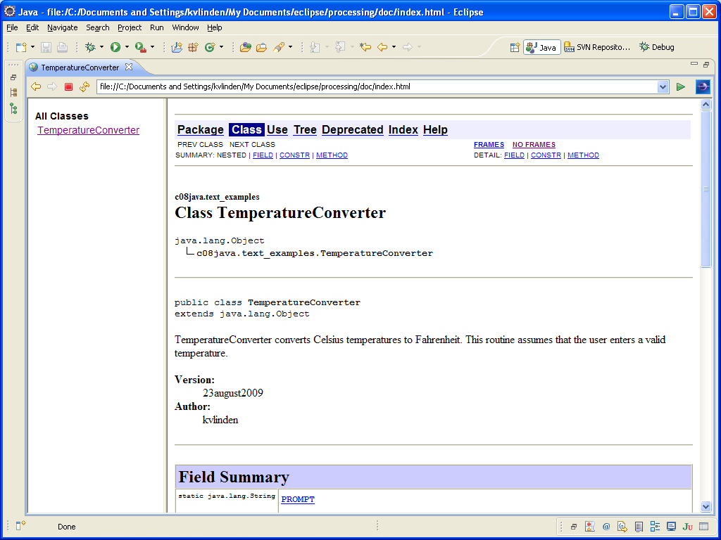
JavaDoc: Generation
Notes:
Choose “Project”-”Generate JavaDoc”.

