Slide 1


Project 2: Attrition Case Study
Presented by:
Kevin Boyd and Shikha Pandey

Slide 2
Objective and Approach
Approach
Utilize R to study employee dataset.
Objective
Conduct an analysis for Frito Lay on its existing employee data to predict employee turnover to help gain a competitive edge over its competition.

Slide 3
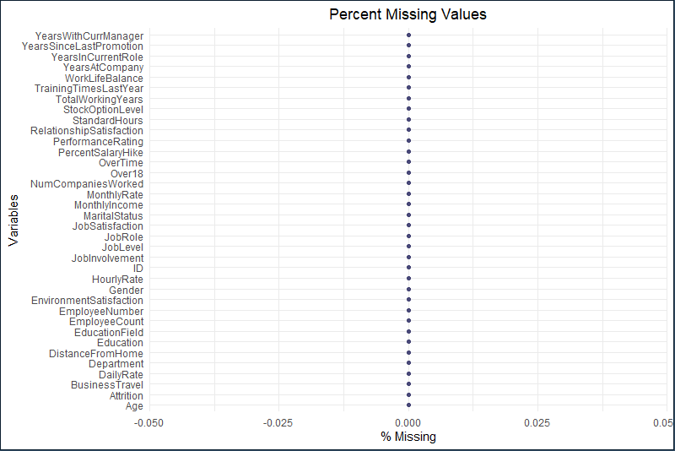
Investigate Missing Values

Slide 4
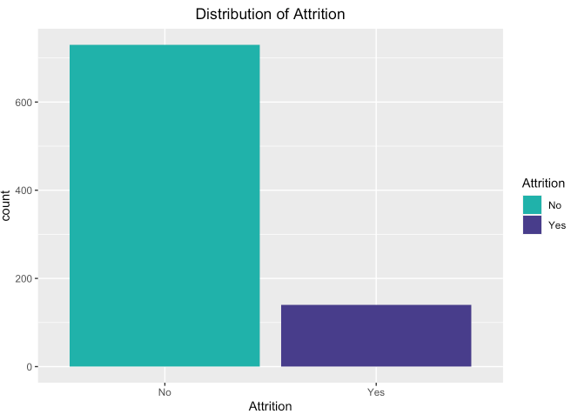
Distribution for Attrition

Slide 5
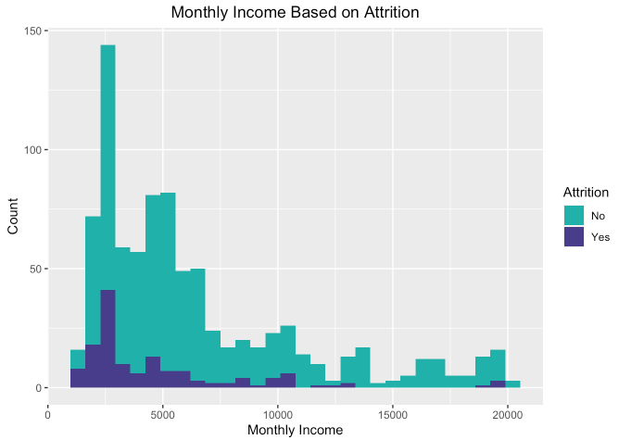
Monthly Income based on Attrition

Slide 6
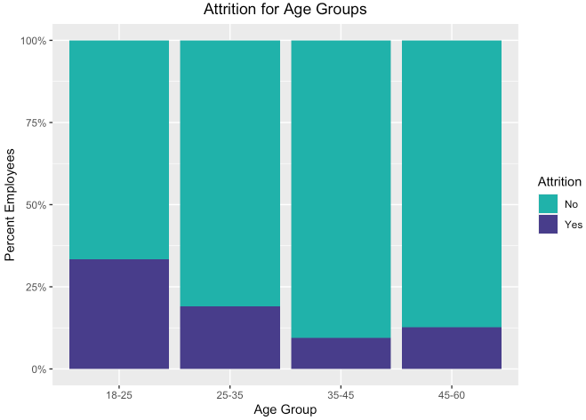
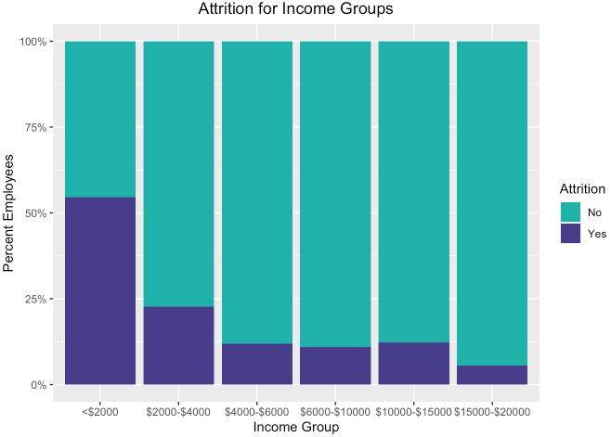
Attrition based on Age & Income Groups

Slide 7
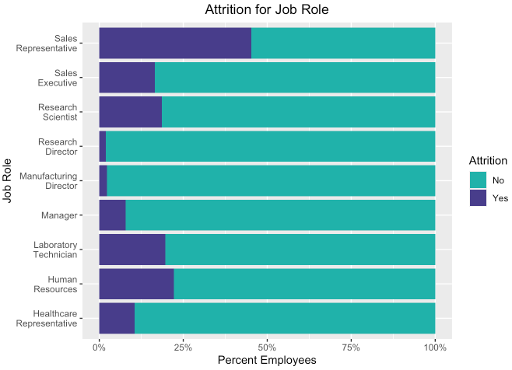
Attrition based on Job Role

Slide 8
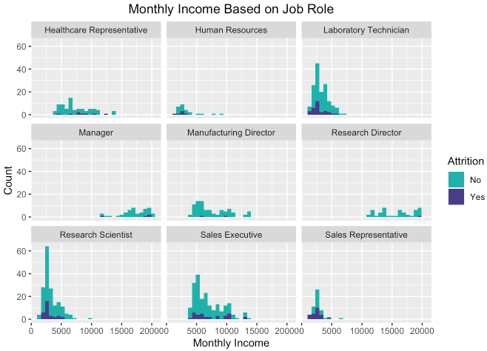


Monthly Income based on Job Role

Slide 9
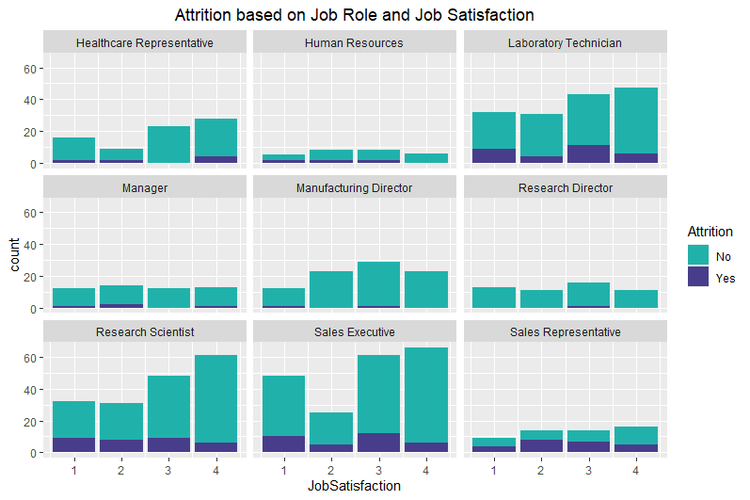
Attrition based on Job Role and Job Satisfaction

Slide 10
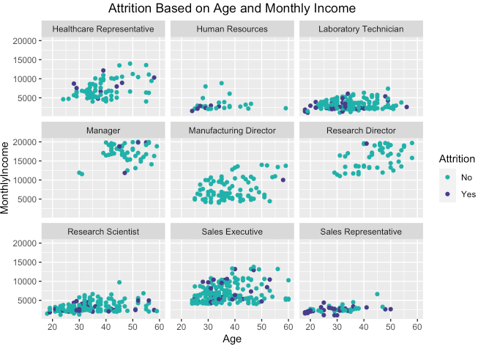
Attrition based on Age and Monthly Income

Slide 11
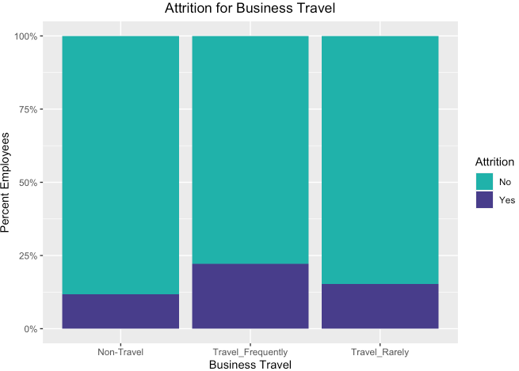
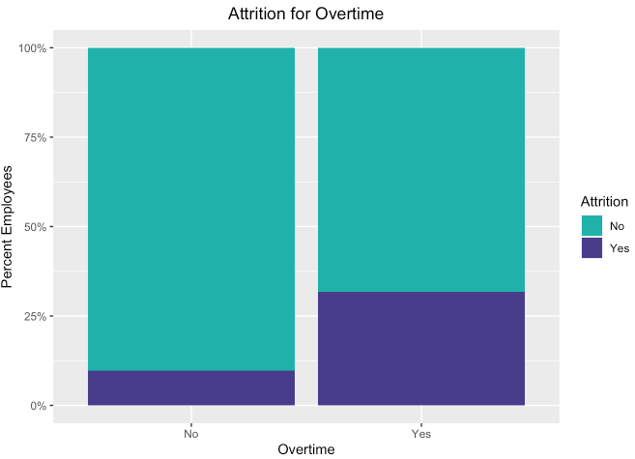
Attrition based on Overtime & Business Travel

Slide 12
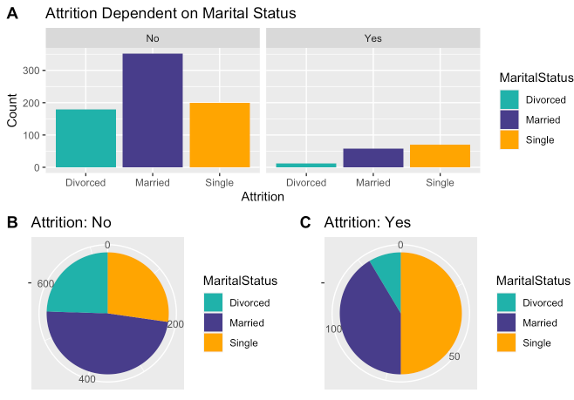
Attrition based on Marital Status

Slide 13
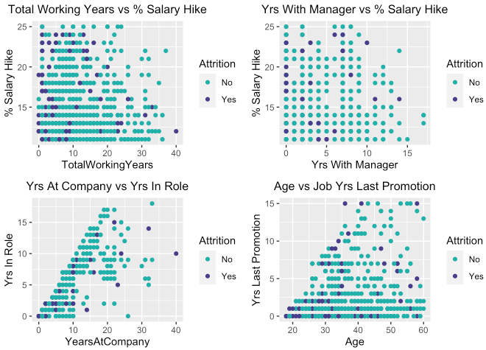
Attrition based on Continuous Variables

Slide 14
Predict Attrition: Naïve Bayes Model
Confusion Matrix
Naïve Bayes | No | Yes
No | 96 | 6
Yes | 10 | 18
Test Metrics
Accuracy | 0.8769
Sensitivity | 0.9057
Specificity | 0.7500
No Information Rate | 0.8154
P-Value | 0.0401

Slide 15
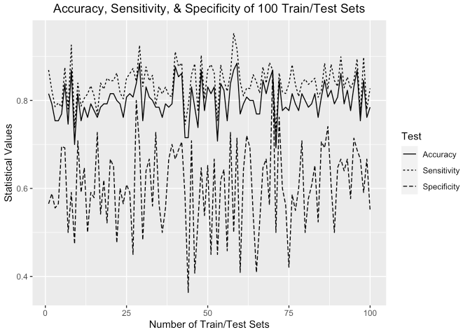
Statistical Values for Multiple Train/Test Sets
Metrics | Mean | Max
Accuracy | 80 | 88
Sensitivity | 84 | 95
Specificity | 60 | 87

Slide 16
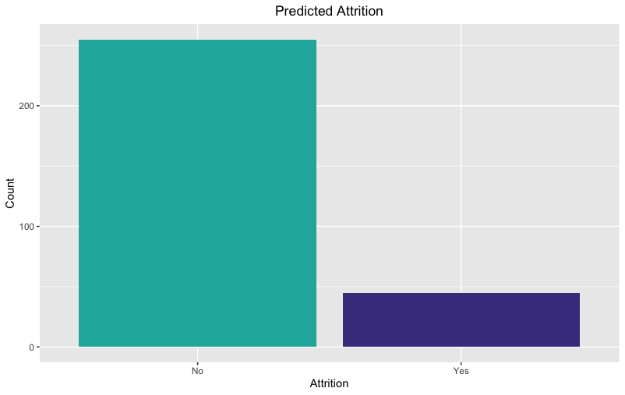
Predicted Attrition
255
45

Slide 17
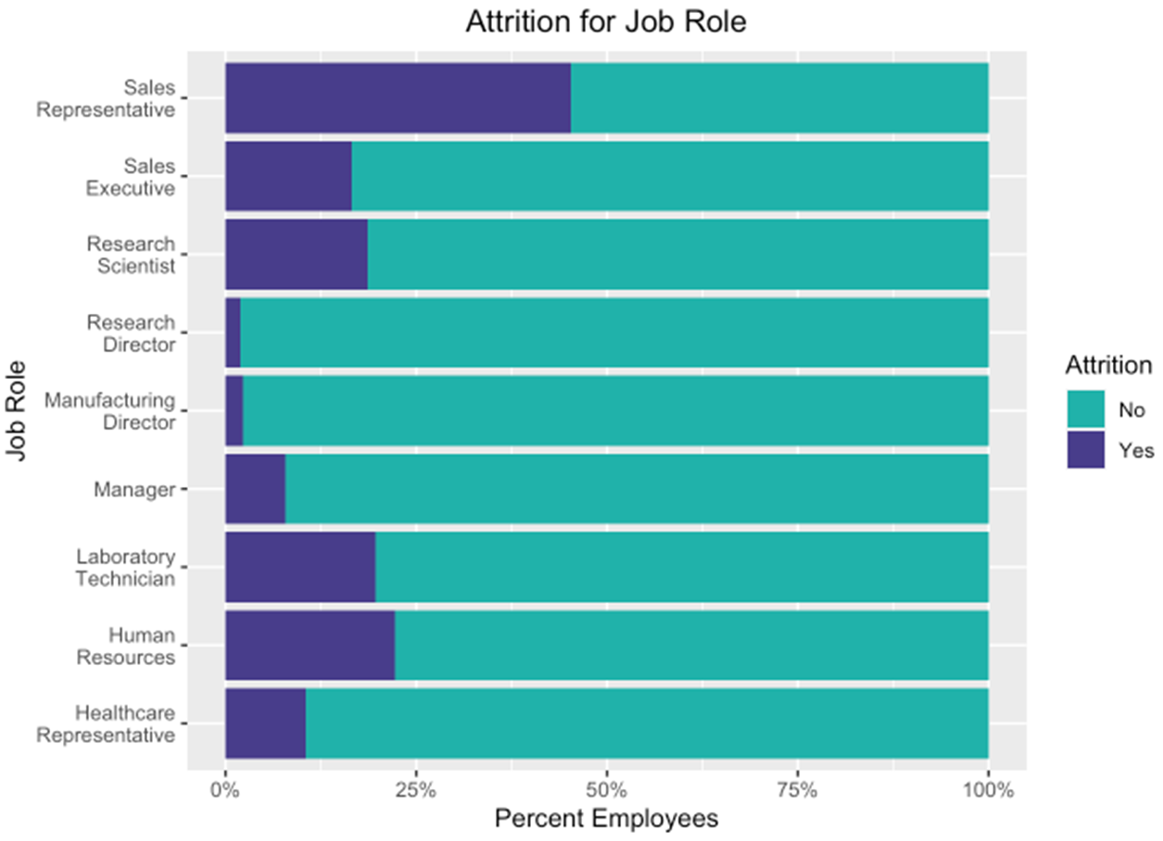
Top 3 Factors for Turnover

Slide 18
Predict Salary: Linear Regression Model
Coefficients | Pr(>|t|)
(Intercept) | 0.02367*
Age | 0.00386**
Job Level | < 2e-16***
Job Role: Human Resources | 0.20459
Job Role: Laboratory Technician | 0.00219**
Job Role: Manager | < 2e-16***
Job Role: Manufacturing Director | 0.61294
Job Role: Research Director | < 2e-16***
Job Role: Research Scientist | 0.14668
Job Role: Sales Executive | 0.38167
Job Role: Sales Representative | 0.06077
RMSE | 1080
P-Value | < 2.2e-16

Slide 19
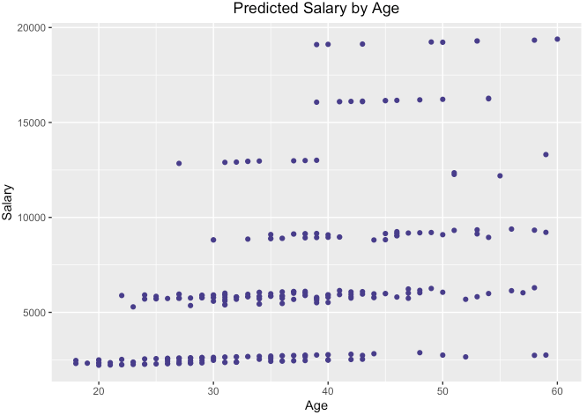
Predicted Salary by Age

Slide 20
Summary
Top 3 factors that contribute to employee turnover are Age, Monthly Income, and Job Role.
Sales Representative have the highest turnover.
Manufacturing Director, Research Director and Managers are the oldest, have highest income and have the least amount of turnover.
We used a Naïve Bayes model to predict attrition with 87% Accuracy.
We used a Linear Regression model to predict salary with RMSE of 1080 and extremely low P-Value (< 2.2e-16).

Slide 21
Thank you!!
Name: Kevin Boyd
Email: kevinboyd@smu.edu
Name: Shikha Pandey
Email: pandeys@smu.edu

