Slide 1

Project 2: Attrition Case Study
Presented by:
Kevin Boyd and Shikha Pandey

Slide 2
Objective and Approach
Approach
Utilize R to study employee dataset.
Objective
Conduct an analysis for DDSAnalytics on its existing employee data to predict employee turnover to help gain a competitive edge over its competition.

Slide 3
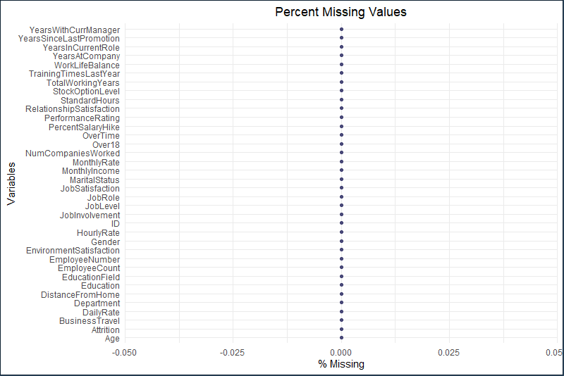
Investigate Missing Values

Slide 4
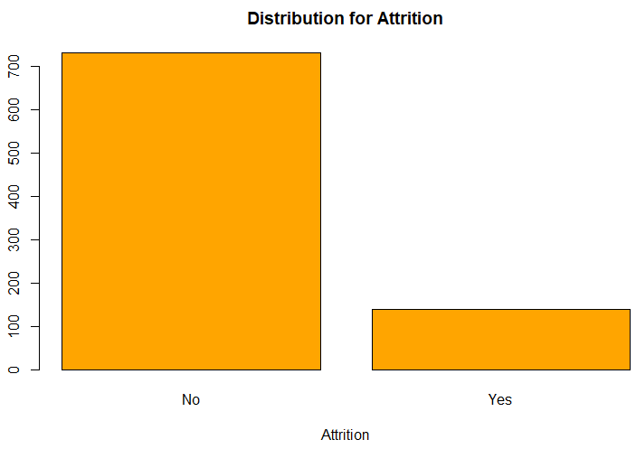
Distribution for Attrition

Slide 5
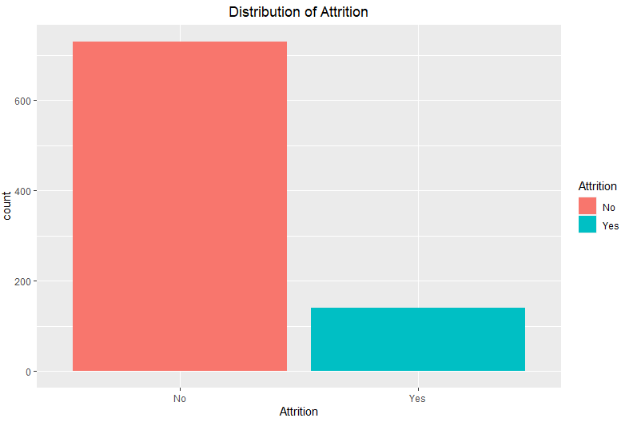
Distribution for Attrition

Slide 6
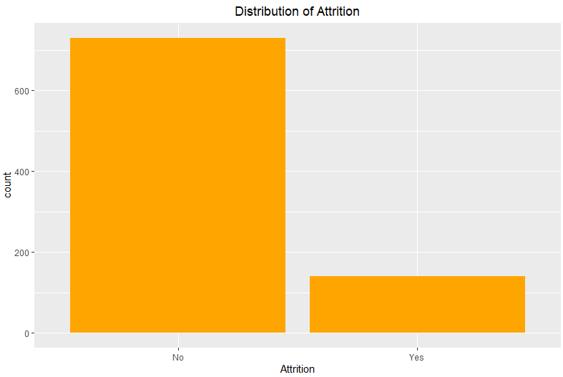
Distribution for Attrition

Slide 7
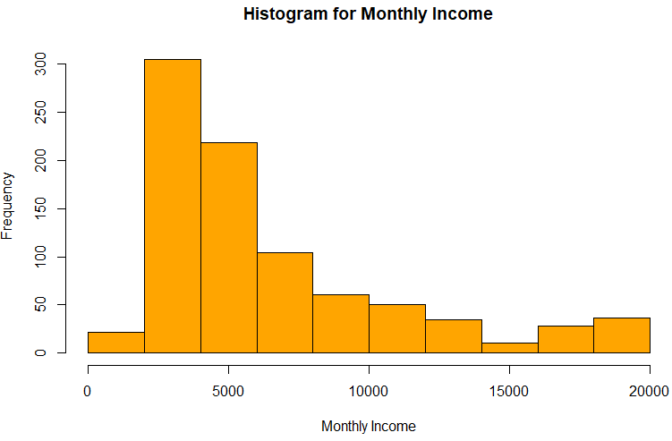
Attrition based on Monthly Income

Slide 8
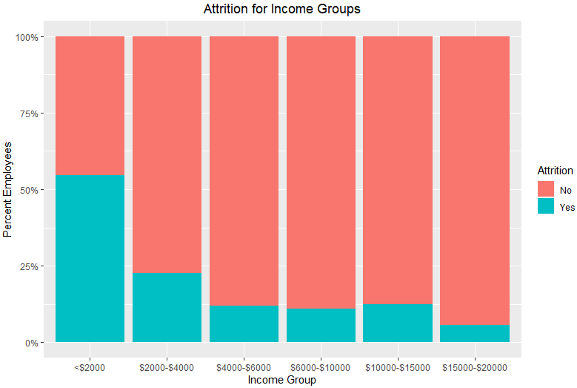
Attrition for Income Groups

Slide 9
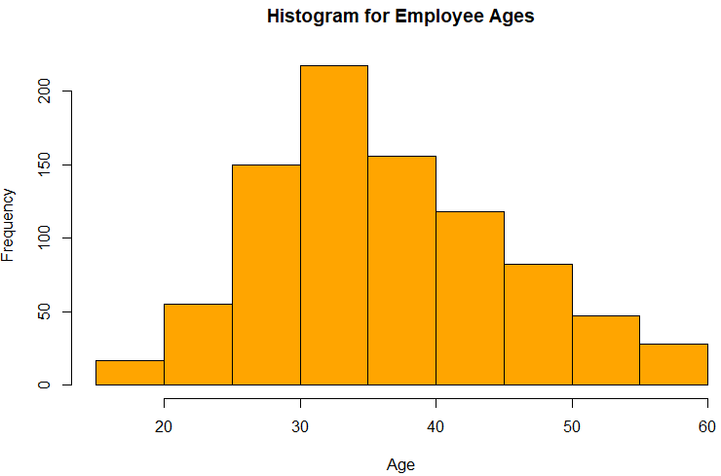
Distribution for Age

Slide 10
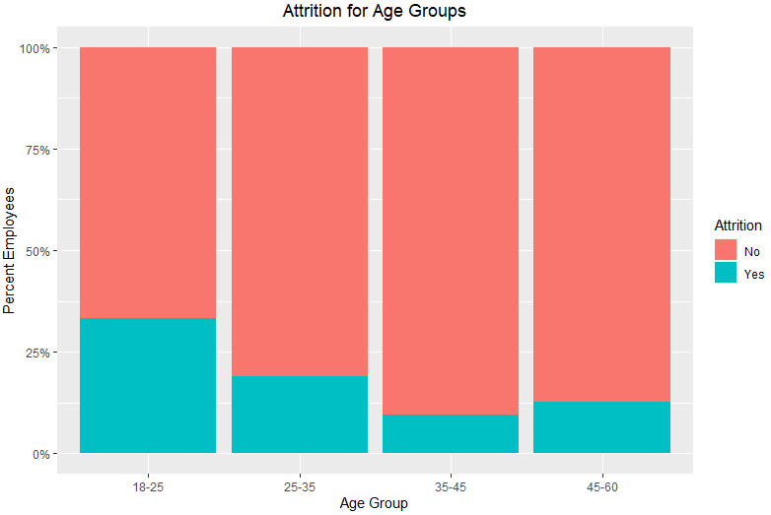
Attrition for Age Groups

