Slide 1

Project 2: Attrition Case Study
Presented by:
Kevin Boyd and Shikha Pandey

Slide 2
Objective and Approach
Approach
Utilize R to study employee dataset.
Objective
Conduct an analysis for DDSAnalytics on its existing employee data to predict employee turnover to help gain a competitive edge over its competition.

Slide 3
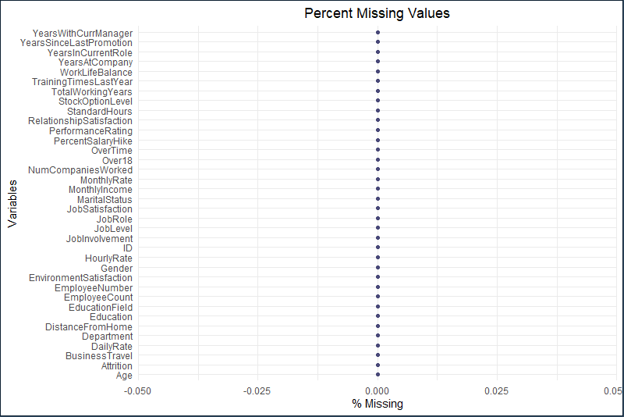
Investigate Missing Values

Slide 4
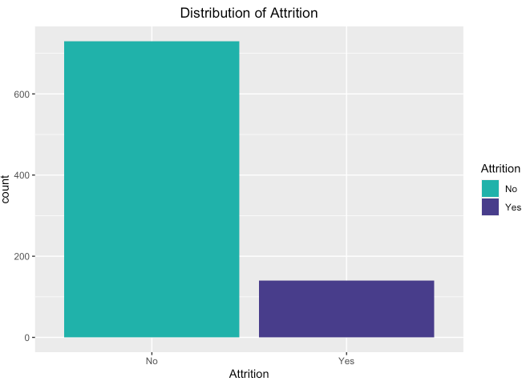
Distribution for Attrition

Slide 5
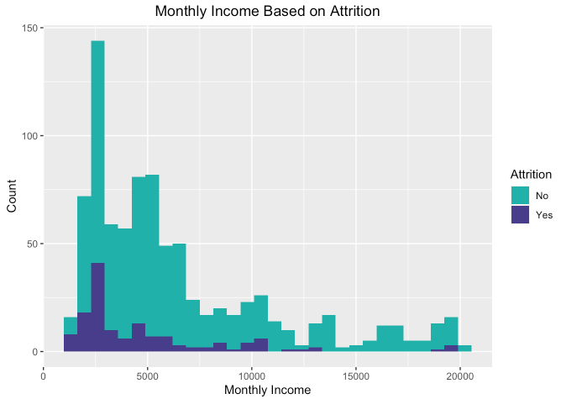
Monthly Income based on Attrition

Slide 6
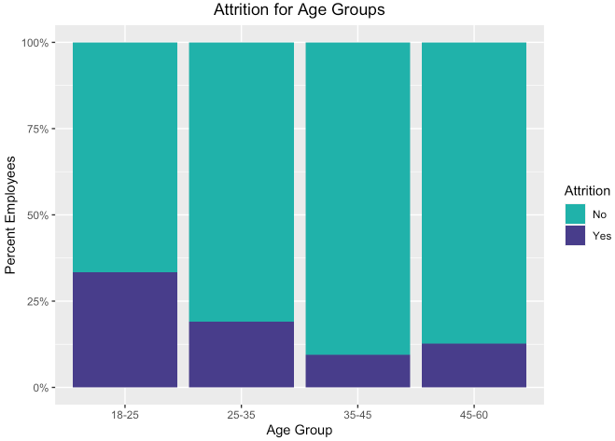
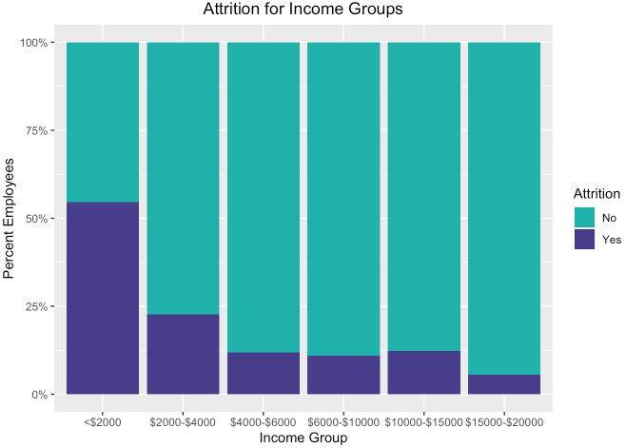
Attrition based on Age & Income Groups

Slide 7
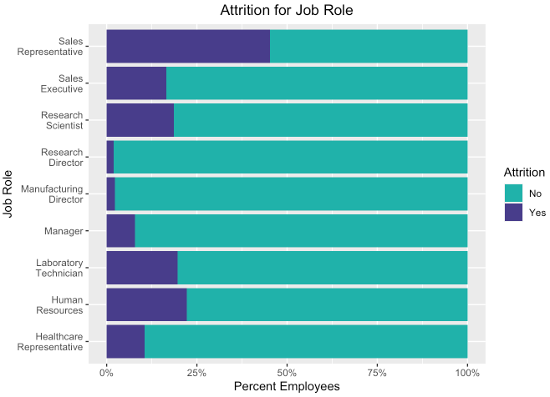
Attrition based on Job Role

Slide 8
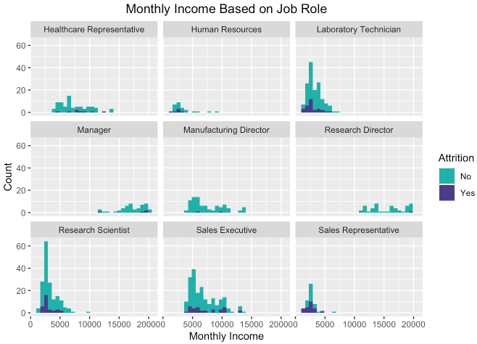


Monthly Income based on Job Role

Slide 9
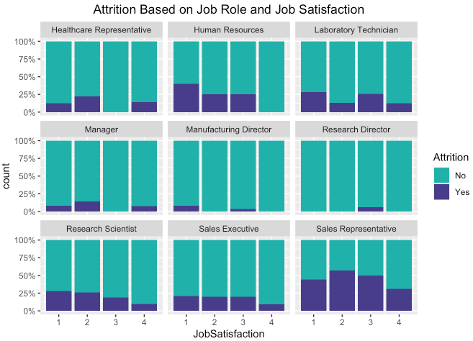
Attrition based on Job Role and Job Satisfaction

Slide 10
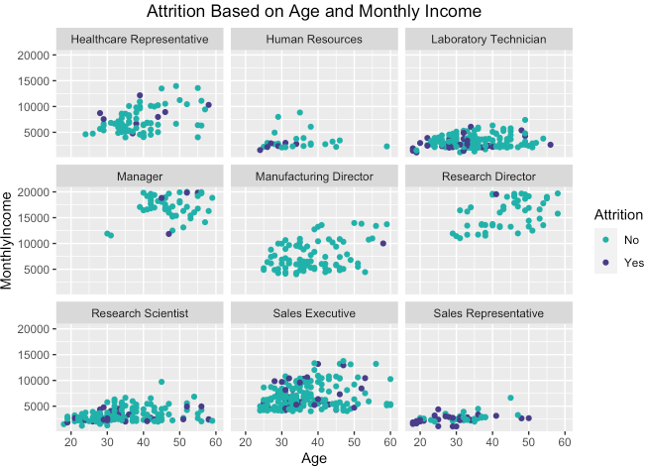
Attrition based on Age and Monthly Income

Slide 11
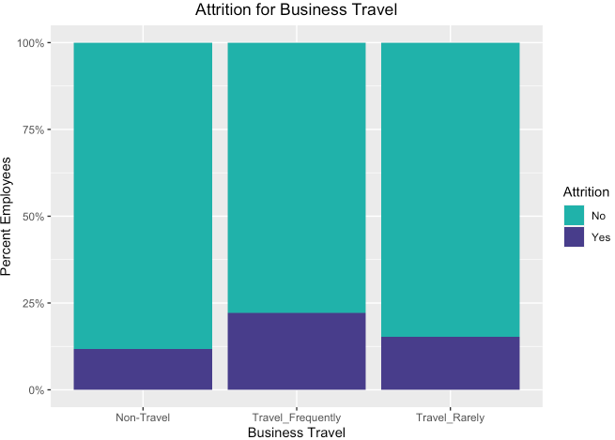
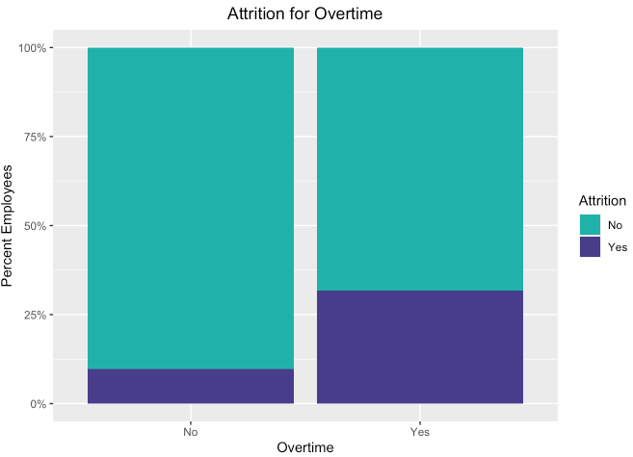
Attrition based on Overtime & Business Travel

Slide 12
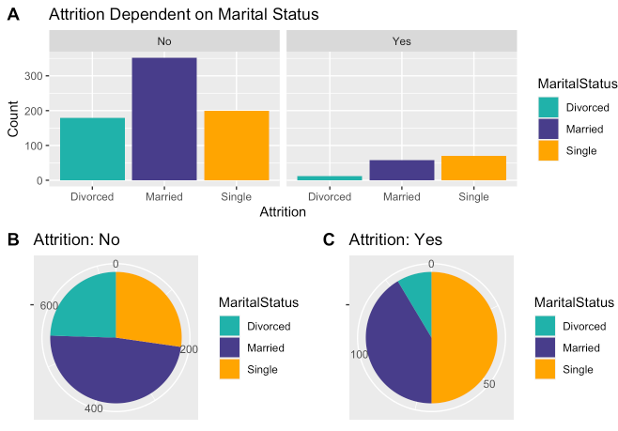
Attrition based on Marital Status

Slide 13
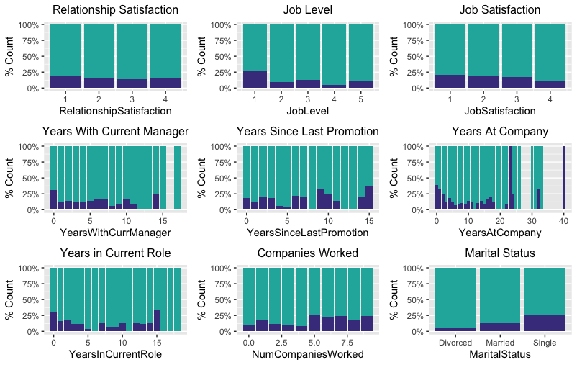
Attrition based on Multiple Variables

Slide 14
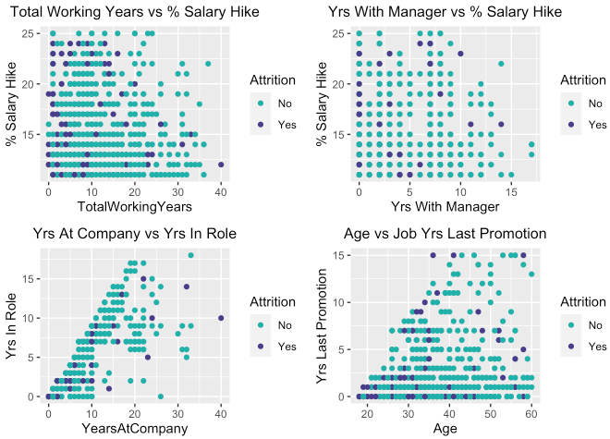
Attrition based on Continuous Variables

Slide 15
Predict Attrition: Naïve Bayes Model
Confusion Matrix
Naïve Bayes | No | Yes
No | 96 | 6
Yes | 10 | 18
Test Metrics
Accuracy | 0.8769
Sensitivity | 0.9057
Specificity | 0.7500
No Information Rate | 0.8154
P-Value | 0.0401

Slide 16
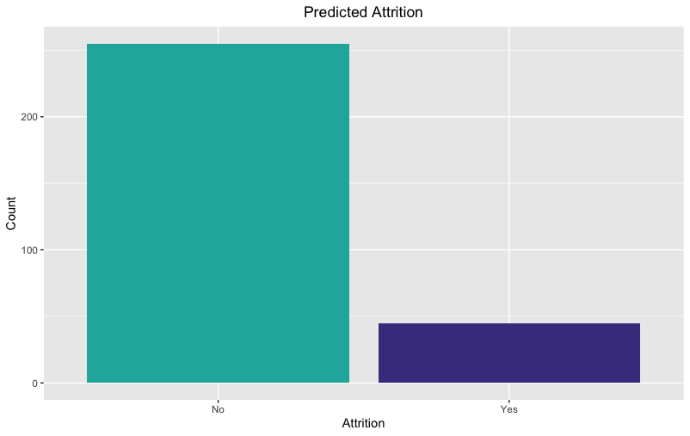
Predicted Attrition

Slide 17
Predict Salary: Linear Regression Model
Coefficients | Pr(>|t|)
(Intercept) | 0.02367*
Age | 0.00386**
Job Level | < 2e-16***
Job Role: Human Resources | 0.20459
Job Role: Laboratory Technician | 0.00219**
Job Role: Manager | < 2e-16***
Job Role: Manufacturing Director | 0.61294
Job Role: Research Director | < 2e-16***
Job Role: Research Scientist | 0.14668
Job Role: Sales Executive | 0.38167
Job Role: Sales Representative | 0.06077
RMSE | 1080
P-Value | < 2.2e-16

Slide 18
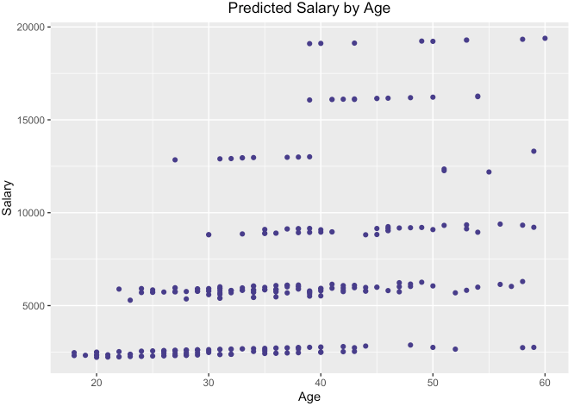
Predicted Salary by Age

Slide 19
Summary

Slide 20
Contact Information

