Slide 1


Project 2: Attrition Case Study
Presented by:
Kevin Boyd and Shikha Pandey
Notes:
Hi, thank you for you time! I am Shikha Pandey along with my partner Kevin Boyd, we are Data Scientists from DDSAnalytics. Today, we are going to discuss our analysis on employee turnover.

Slide 2
Objective and Approach
Approach
Utilize R to study employee dataset.
Objective
Conduct an analysis for Frito Lay on its existing employee data to predict employee turnover to help gain a competitive edge over its competition.
Notes:
We are going to use R to study employee dataset and generate models.
We will identify top factors that lead to attrition and provide you with insight on other trends from the data. And, finally, we will discuss the models we built for you to predict attrition and salary.

Slide 3
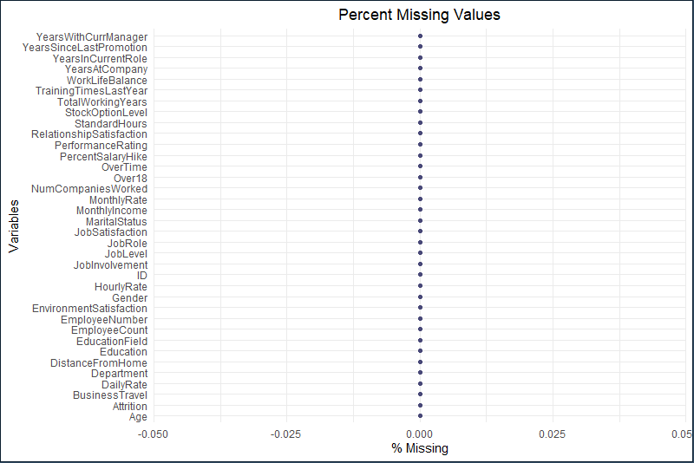
Investigate Missing Values
Notes:
So, let’s start looking at data by investigating the missing values. We are happy to report that there are no missing values found and this a complete dataset to further our analysis.

Slide 4
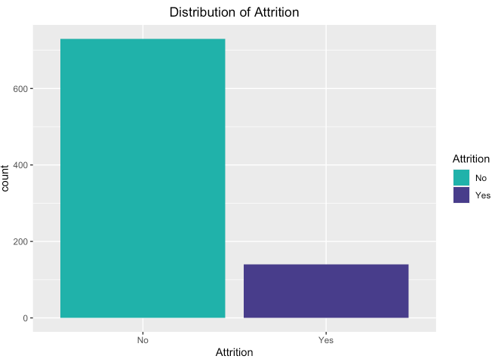
Distribution for Attrition
Notes:
Looking at Distribution for Attrition, we see that data is skewed with much higher number of employees not leaving the company compared to the ones leaving. This is going to play an important role later in our models for predicting attrition and salary.

Slide 5
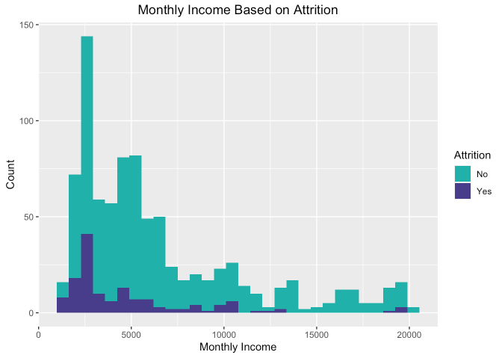
Monthly Income based on Attrition
Notes:
Looing at the histogram here, we see evidence of right skewed distribution for monthly income data. It also tells us that there are more employees and higher attrition for lower income.

Slide 6
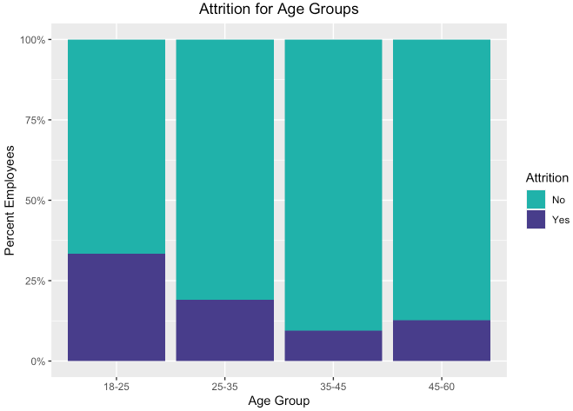
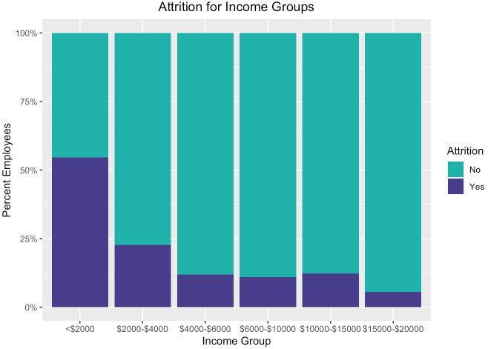
Attrition based on Age & Income Groups
Notes:
We divided age into groups, and we have 4 age groups here. We see that attrition is higher in younger age group and tends to go down for older group.
We divided income in 6 groups and can see a similar trend that attrition is higher for lower income groups and tends to go down as income increases.

Slide 7
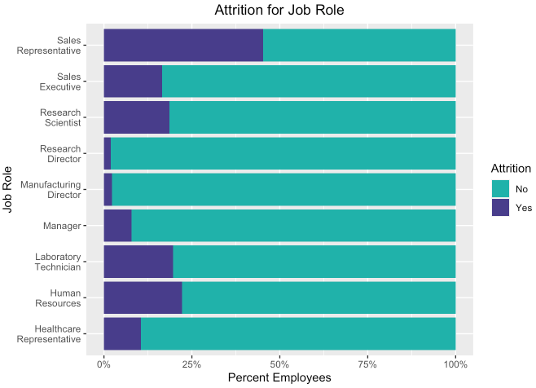
Attrition based on Job Role
Notes:
The plot we have here shows attrition % for the Job roles. We can see highest percentage of attrition with Sales Representative, whereas, Research Director and Manufacturing Director seem to have the lowest percentage of attrition.

Slide 8
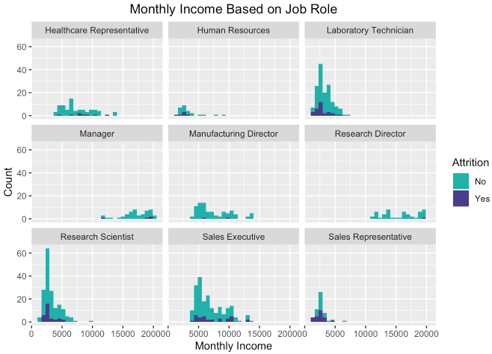


Monthly Income based on Job Role
Notes:
Laboratory Technician, Research Scientist and Sales Representative have lower monthly income and they also have the most employee turnover. On the other hand, Manager, Manufacturing Director and Research Director all have higher monthly income and with least employee turnover.

Slide 9
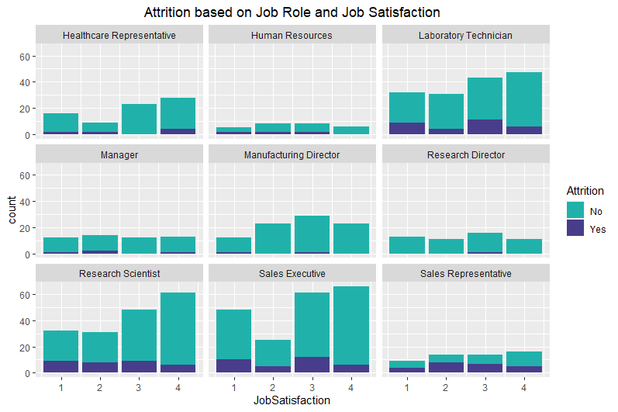
Attrition based on Job Role and Job Satisfaction
Notes:
We see that Laboratory Technician, Research Scientist, Sales Executive and Sales Representative all have consistent attrition across all Job Satisfaction levels, that tells us that Job Satisfaction doesn’t necessarily affect attrition.

Slide 10
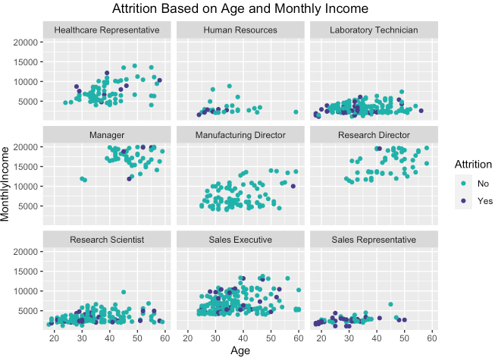
Attrition based on Age and Monthly Income
Notes:
Here we see that Manager, Manufacturing Director and Research Director are older and have higher monthly income but we also do not see attrition in younger employees in these specific job roles. We see attrition at over 45 for Manager, above 55 for Manufacturing Director and above 40 for Research Director.
Human Resources on other side mostly are younger with lower monthly income but higher attrition for younger employees for that specific job role.

Slide 11
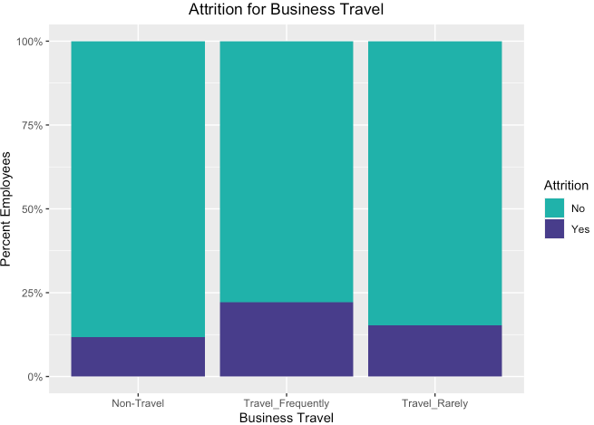
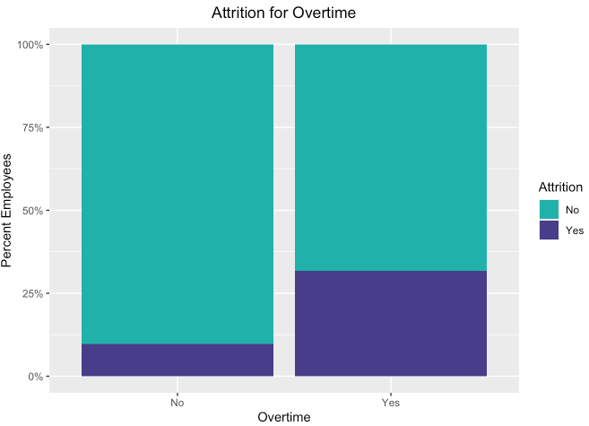
Attrition based on Overtime & Business Travel

Slide 12
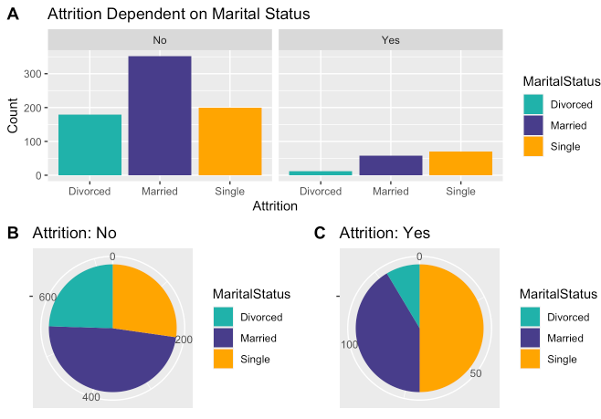
Attrition based on Marital Status

Slide 13
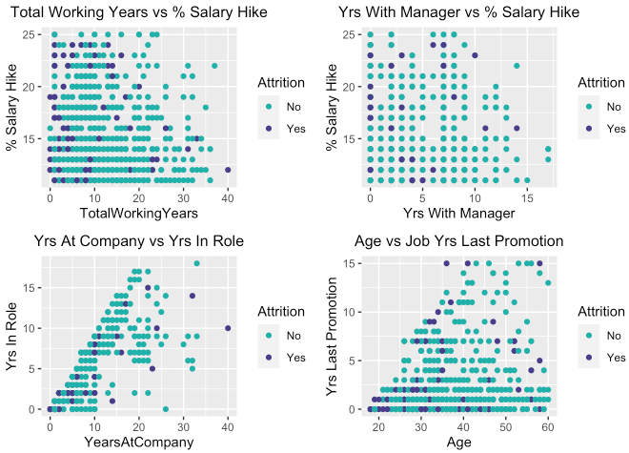
Attrition based on Continuous Variables

Slide 14
Predict Attrition: Naïve Bayes Model
Confusion Matrix
Naïve Bayes | No | Yes
No | 96 | 6
Yes | 10 | 18
Test Metrics
Accuracy | 0.8769
Sensitivity | 0.9057
Specificity | 0.7500
No Information Rate | 0.8154
P-Value | 0.0401

Slide 15
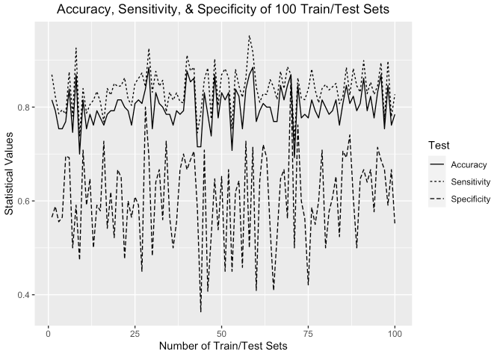
Statistical Values for Multiple Train/Test Sets
Metrics | Mean | Max
Accuracy | 80 | 88
Sensitivity | 84 | 95
Specificity | 60 | 87

Slide 16
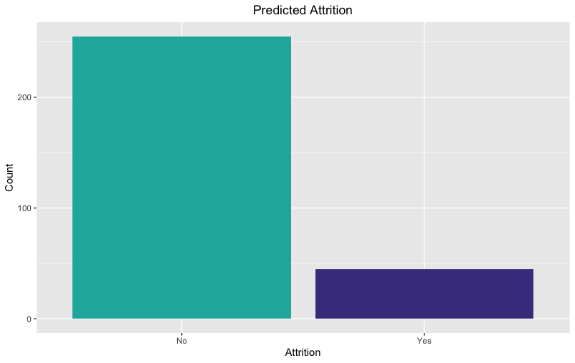
Predicted Attrition
255
45

Slide 17
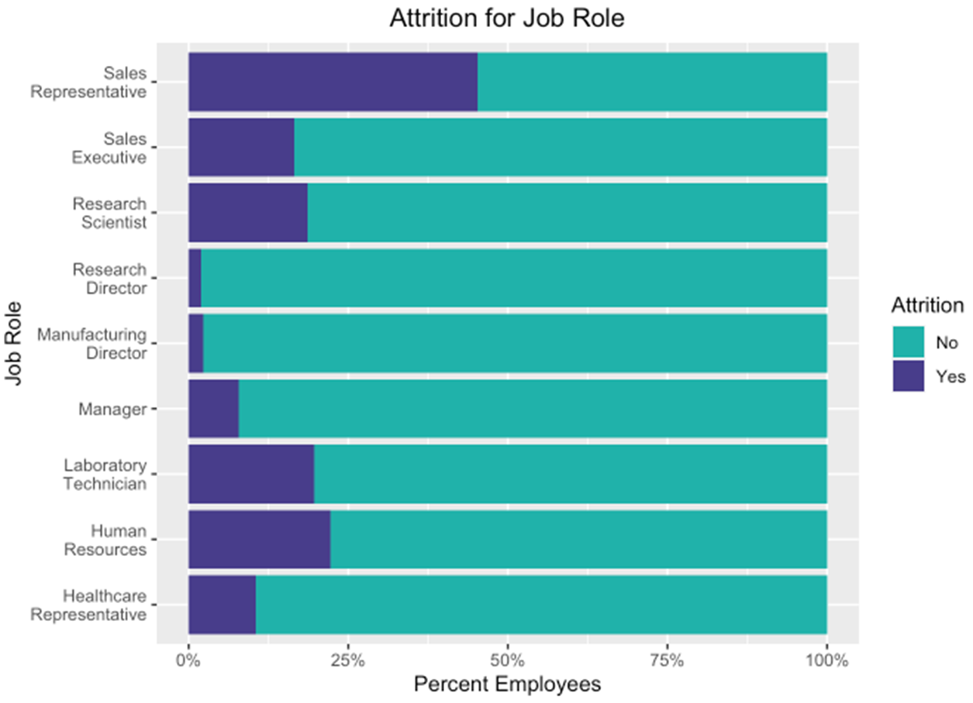
Top 3 Factors for Turnover

Slide 18
Predict Salary: Linear Regression Model
Coefficients | Pr(>|t|)
(Intercept) | 0.02367*
Age | 0.00386**
Job Level | < 2e-16***
Job Role: Human Resources | 0.20459
Job Role: Laboratory Technician | 0.00219**
Job Role: Manager | < 2e-16***
Job Role: Manufacturing Director | 0.61294
Job Role: Research Director | < 2e-16***
Job Role: Research Scientist | 0.14668
Job Role: Sales Executive | 0.38167
Job Role: Sales Representative | 0.06077
RMSE | 1080
P-Value | < 2.2e-16

Slide 19
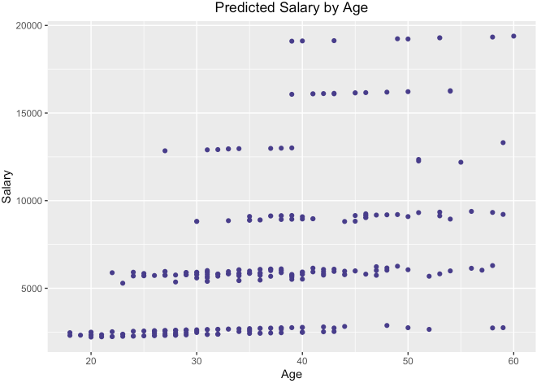
Predicted Salary by Age

Slide 20
Summary
Top 3 factors that contribute to employee turnover are Age, Monthly Income, and Job Role.
Sales Representative have the highest turnover.
Manufacturing Director, Research Director and Managers are the oldest, have most income and have the least amount of turnover.

Slide 21
Summary(Contd.)
We built a model to predict attrition that had an 87% Accuracy, 90% Sensitivity and 75% Specificity.
We built a model to predict salary had an RMSE of 1080 and P-Value of < 2.2e-16.

Slide 22
Thank you!!
Name: Kevin Boyd
Email: kevinboyd@smu.edu
Name: Shikha Pandey
Email: pandeys@smu.edu

