Slide 1
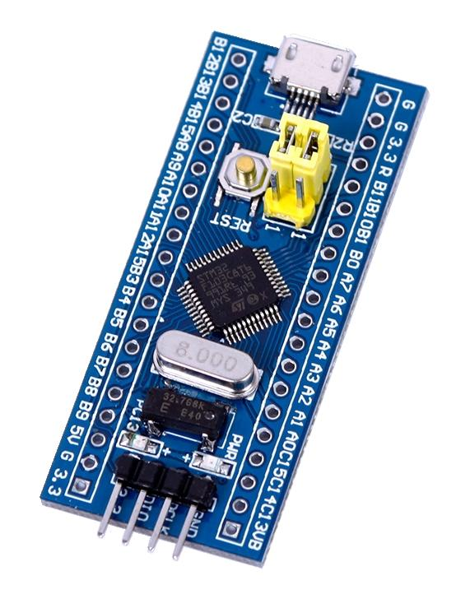
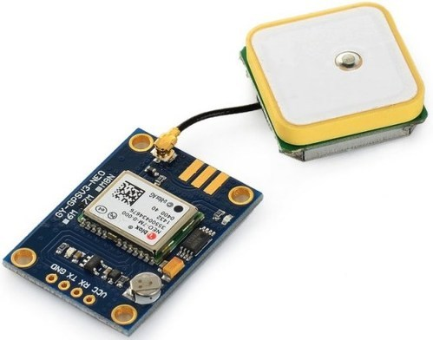
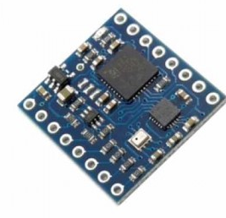
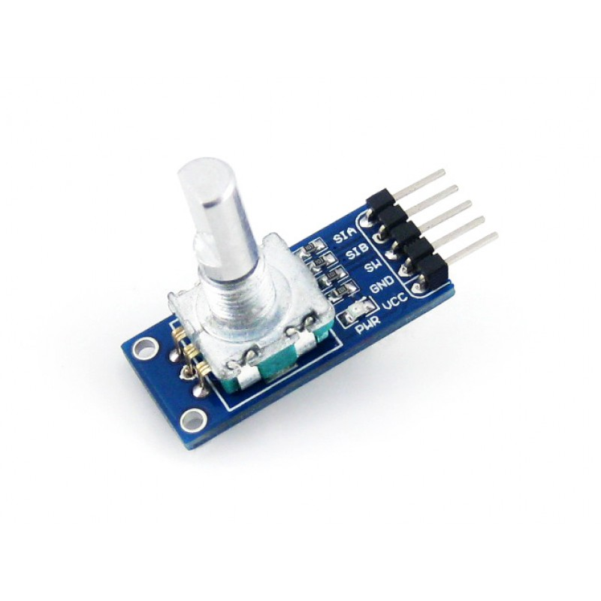
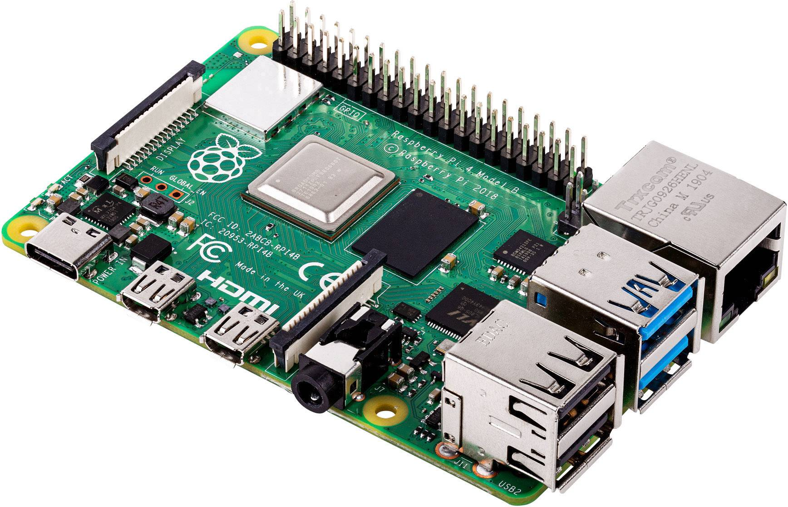
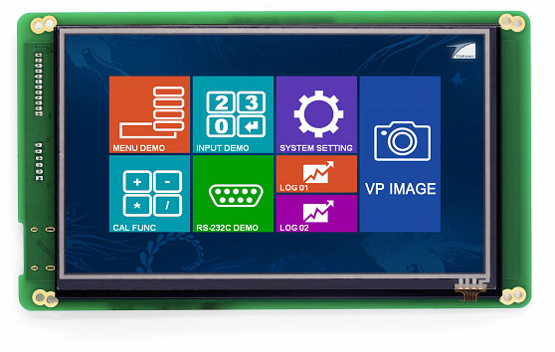

UART
I2C
Bluetooth
Wi-Fi

Slide 2
STM32 Programming:
GPIO (General Purpose I/O Registers)
I2C protocol Interfacing
UART protocol Interfacing
Timer
Interrupts
ADC

Slide 3
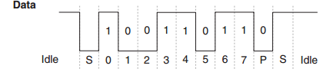
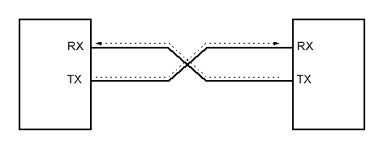
UART protocol Interfacing
UART: Universal asynchronous Receiver/ Transmitter.
It is a protocol for exchanging data between two devices uses two wires (Tx/Rx).

Slide 4
Why UART??
Programmable baud rate generator.
Standard asynchronous communication bits (start, stop, and parity).
Auto generation and stripping of start, stop, and parity bits.

Slide 5
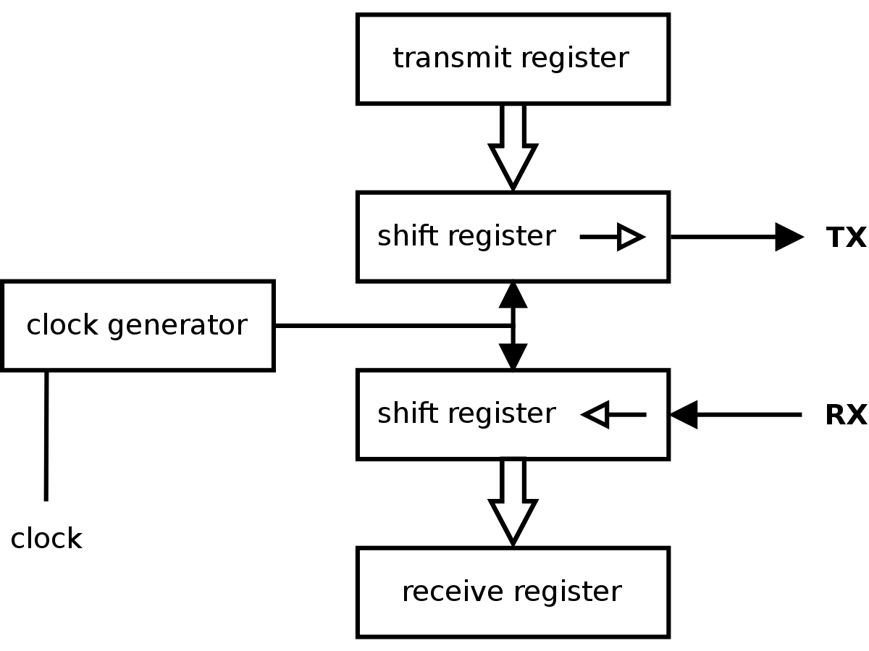
How does it work?

Slide 6
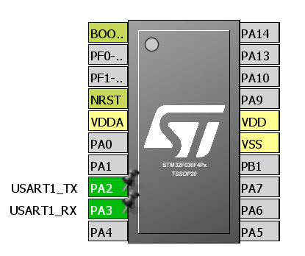
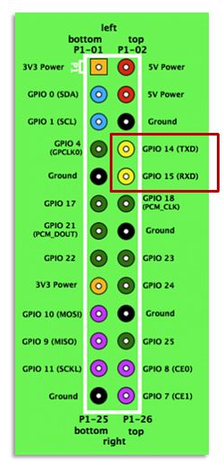

Slide 7
