Slide 1
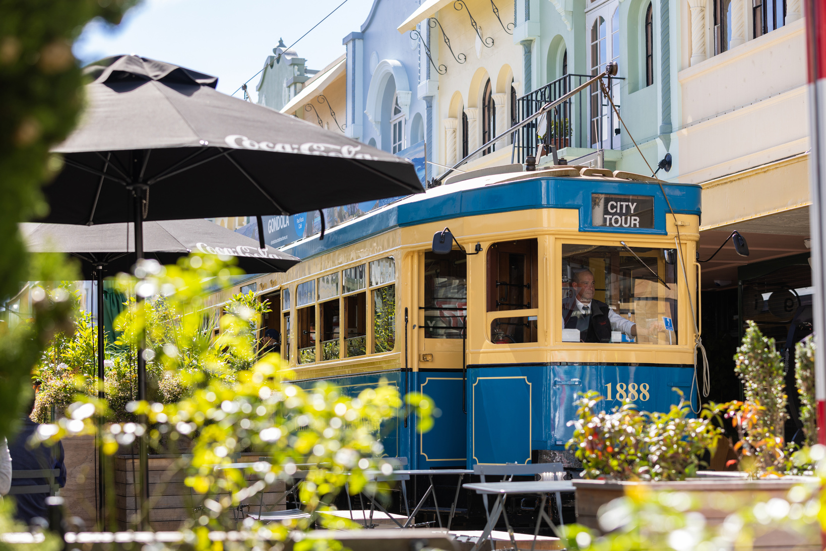
AUSTRALIAN COMMUNICATION THEORY WORKSHOP 2026
Your challenge is to find in and around your table … | Y/N
An analogue communication device
Something that could be used as an antenna
Someone who has published a paper on 6G
A napkin sketch of a wireless network diagram
Business cards from at least two countries
A computing device running a Matlab or Python simulation
Shannon’s capacity theorem written on the back of a conference name badge
A selfie with four people who had never met before the workshop
A toikupu about wireless communications
A drawing of the future of 6G
A watch that is not smart!
Paper boarding pass or luggage tag
Foreign currency (not Au nor NZ)
A drink voucher (bet you didn’t throw out the spares from last night!)
At least 3 colours of ball point pens (or a multicolour pen)
Tiebreaker: A dramatic reenactment of a buffer overflow or packet loss

