Slide 1
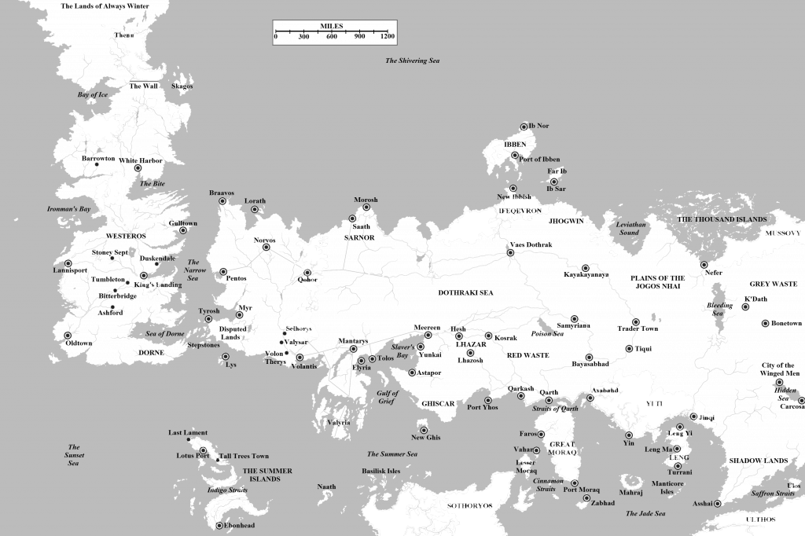
Online-TSP

Slide 2
Online-TSP
TSP
(metric)
Input:
Output:
alg
NP-hard
Approximation algorithms
metric space
places to visit
Shortest tour through all places

Slide 3

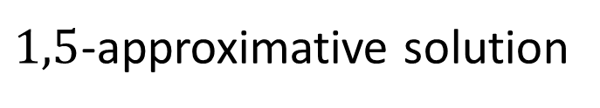


Online-TSP
TSP
(metric)
Christofides Algorithm:
minimal spanning tree
minimum weighted matching of odd vertices
Euler tour
Skip double visited vertices
$$≤1⋅𝒯$$
$$≤\frac{1}{2}⋅𝒯$$
$$≤\frac{3}{2}⋅𝒯$$
$1,5$-approximative solution

Slide 4
Online-TSP
Online-TSP
Input
N-OLTSP vs H-OLTSP
ALG r-competitive ⬄ …

Slide 5
Goals
Find online-algorithms
Find lower bounds
Find polynomial online-algorithms
Bonus: The real line
(superpolynomial)
I. Algorithms
II. Lower Bounds
III. Polynomial Alg.
IV. Real Line

Slide 6


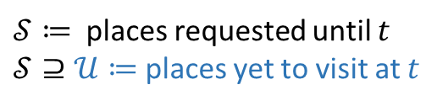
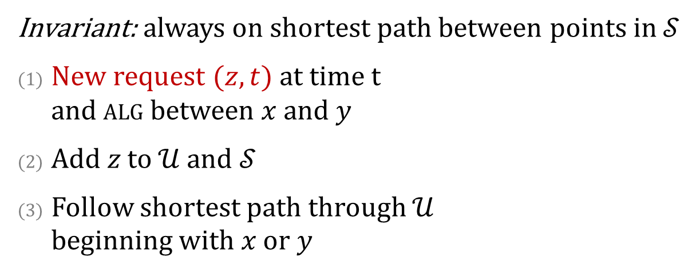



An algorithm for N-OLSTP
Greedily Travelling between Requests (GTR):
Invariant: always on shortest path between points in $𝒮$
New request $(z, t)$at time t and alg between $x$ and $y$
Add $z$ to $𝒰$ and $𝒮$
Follow shortest path through $𝒰$ beginning with $x$ or $y$
$$z$$
$$o$$
$$x$$
$$y$$
$$p(t)$$
$𝒮≔$ places requested until $t$
$𝒮⊇𝒰≔$places yet to visit at $t$

Slide 7
proof

Slide 8
thightness

Slide 9
Lower Bound for N-OLTSP

Slide 10
Lower Bound for H-OLTSP

Slide 11
Plan At Home-Algorithm

Slide 12
proof

Slide 13
Optimal!
Thightness?

Slide 14
Polynomial Algorithm for H-OLTSP

Slide 15
proof

Slide 17
Credits & References
Paper…
Map: http://awoiaf.westeros.org/index.php/File:WorldofIceandFire.png

