Slide 1
SAB Group Project
Graham Farrell x15044726
Neil Fitzgerald x15043606
Alan Gaskin x16130201
Enkhbayar Dashtseren x14118173

Slide 2
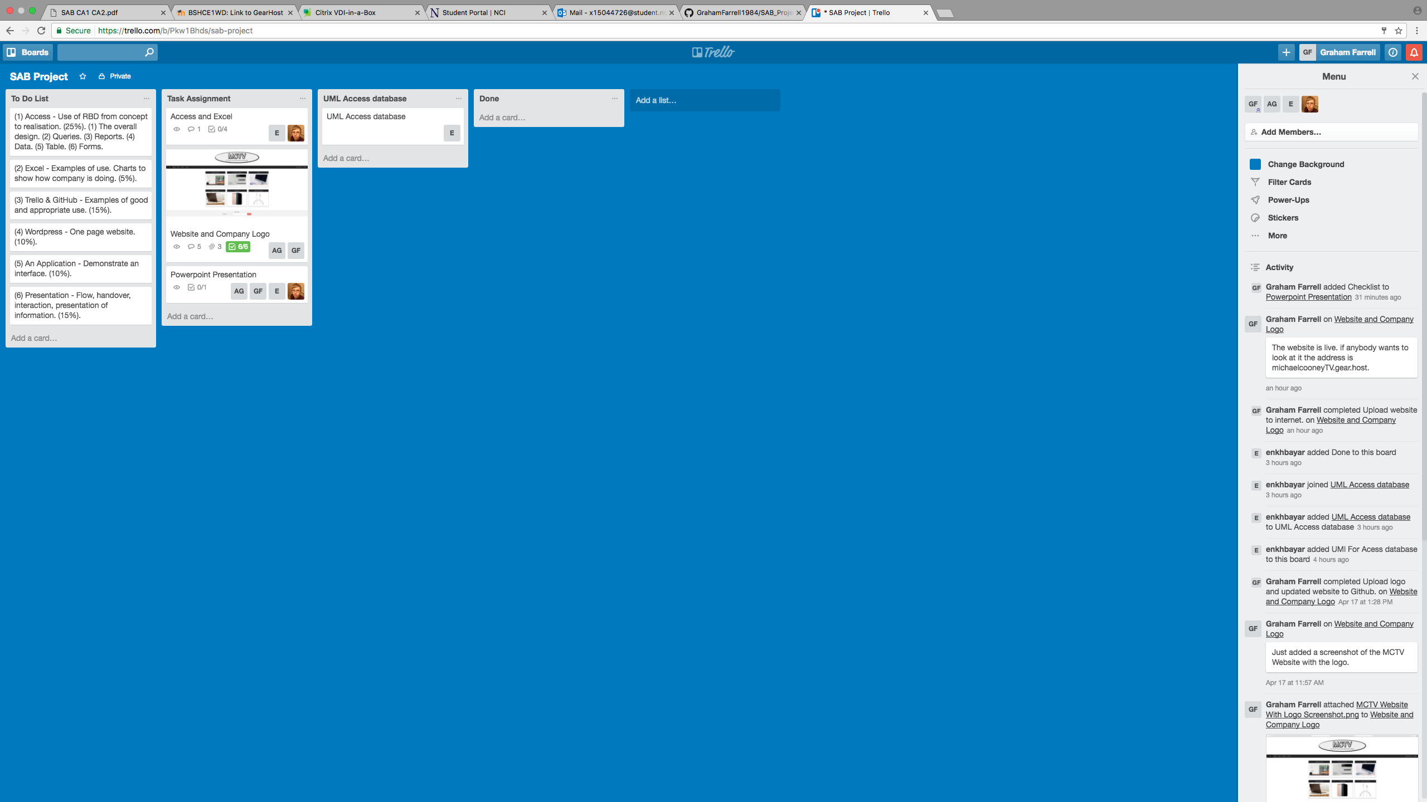
Trello & GitHub
Team collaborated using Trello & GitHub.
Used Trello to delegate tasks to different team members.
Created a to do list and checklists to keep track of completed tasks.

Slide 3
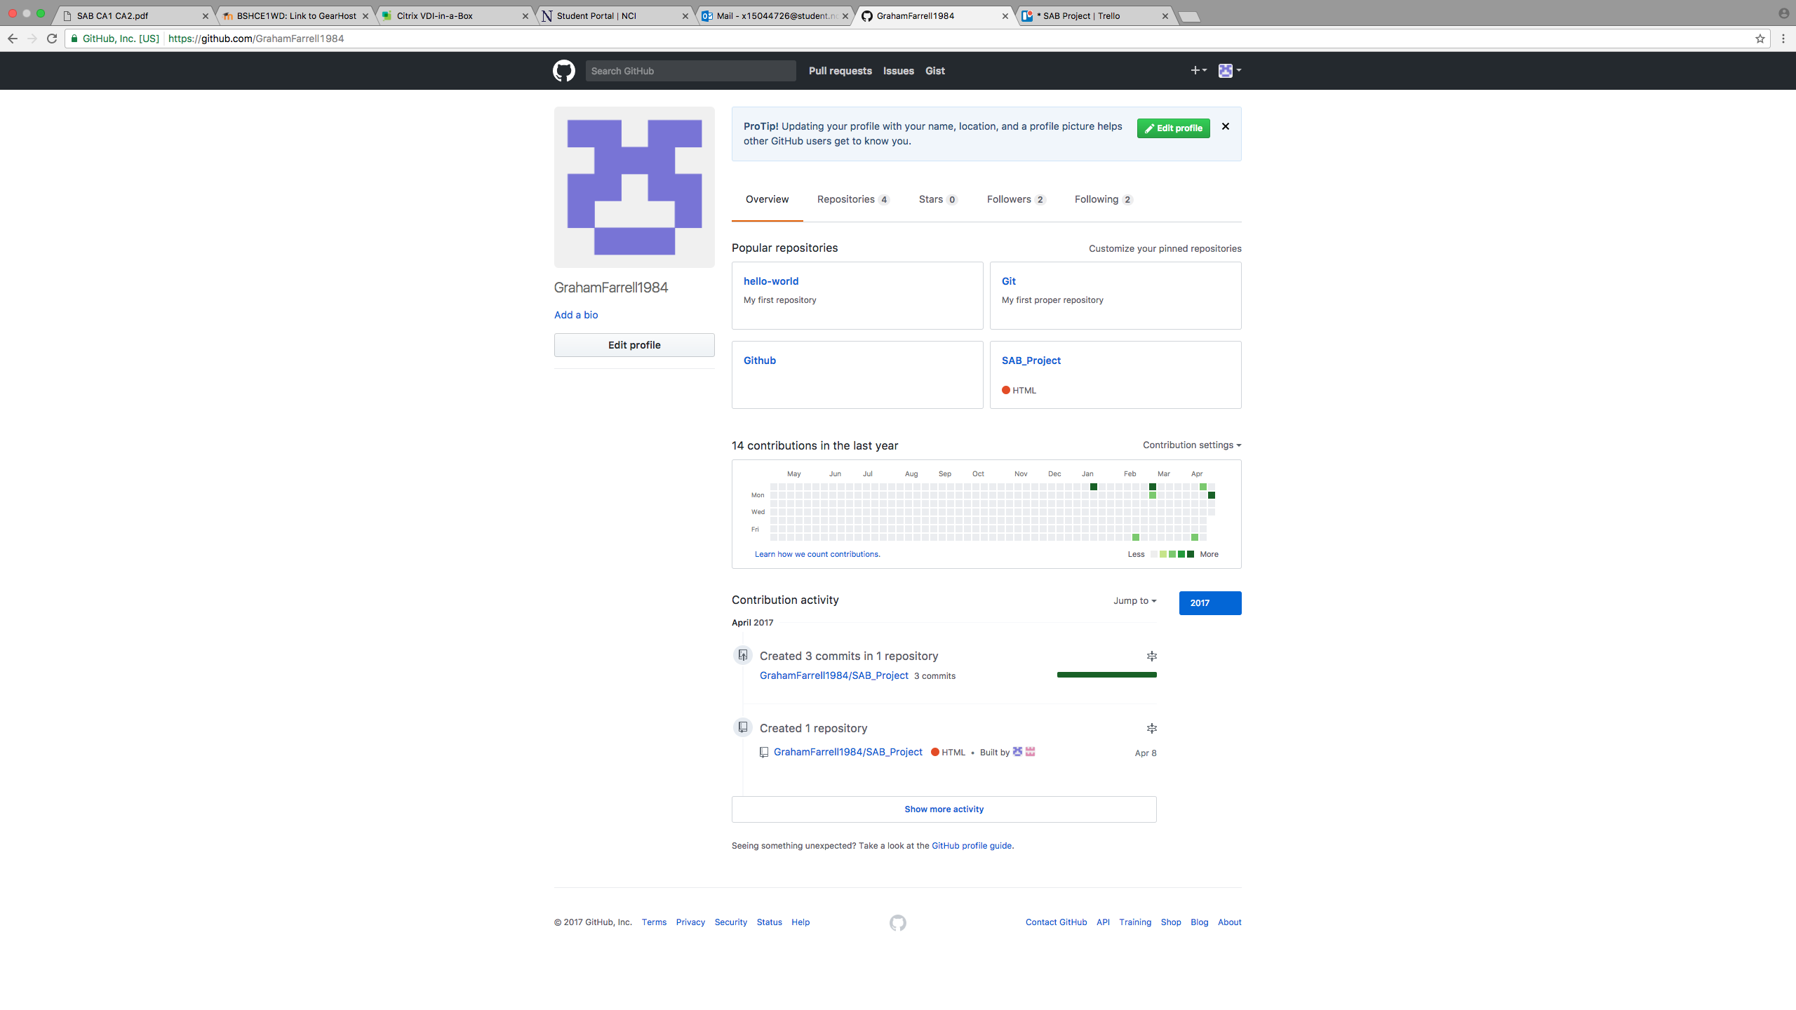
Trello & GitHub
GitHub was used as a second collaboration tool.
Team members were able to access & share files using this.
Used both CLI & GUI to work with Git & GitHub.

Slide 4
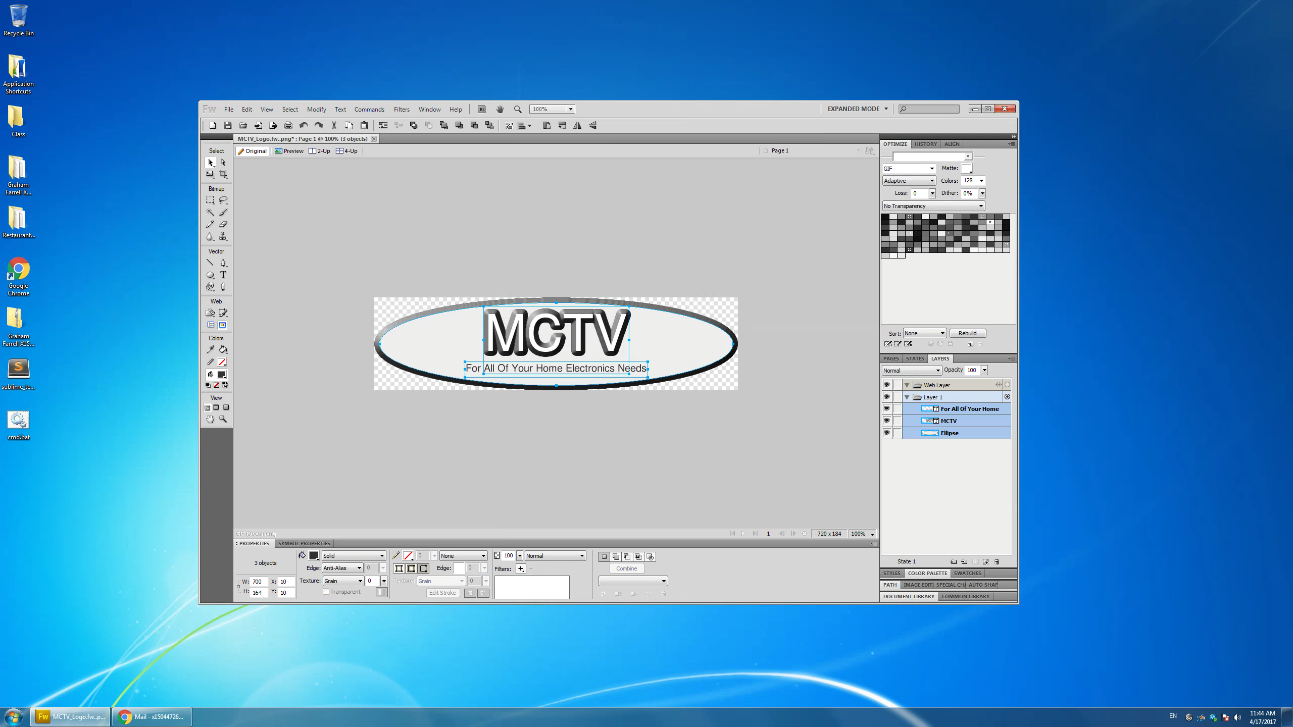
MCTV Logo & Website
Adobe Fireworks was used to create logo for MCTV website.
Colours used for logo were taken from website to keep everything looking uniform.

Slide 5
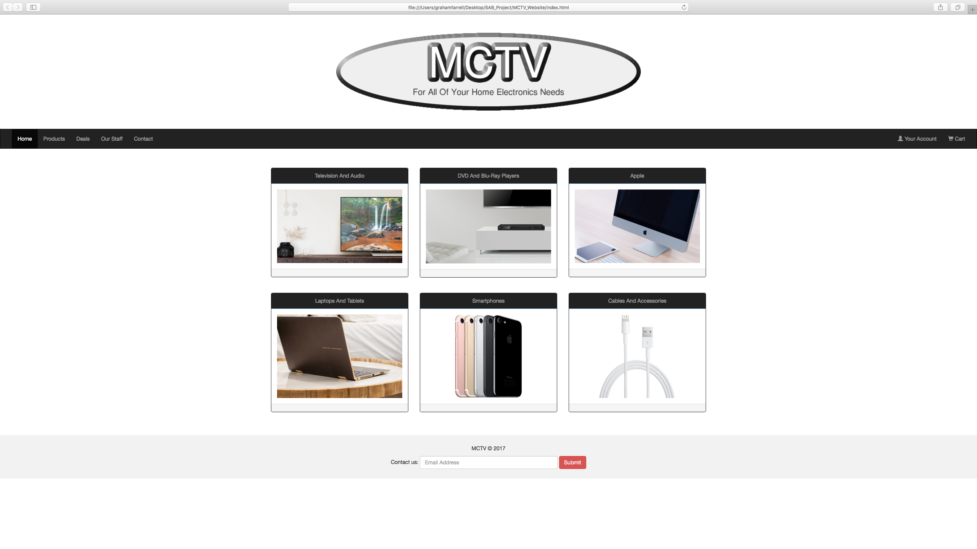
MCTV Logo & Website
Created the home page for the MCTV website integrating the company logo.
Website is responsive as we used CSS for the styling.

Slide 6

Access Database & UML
Microsoft Access was used to build the database for the company.
Created tables, queries, forms & reports in Access.
Used logo created for website in the database too.

Slide 7
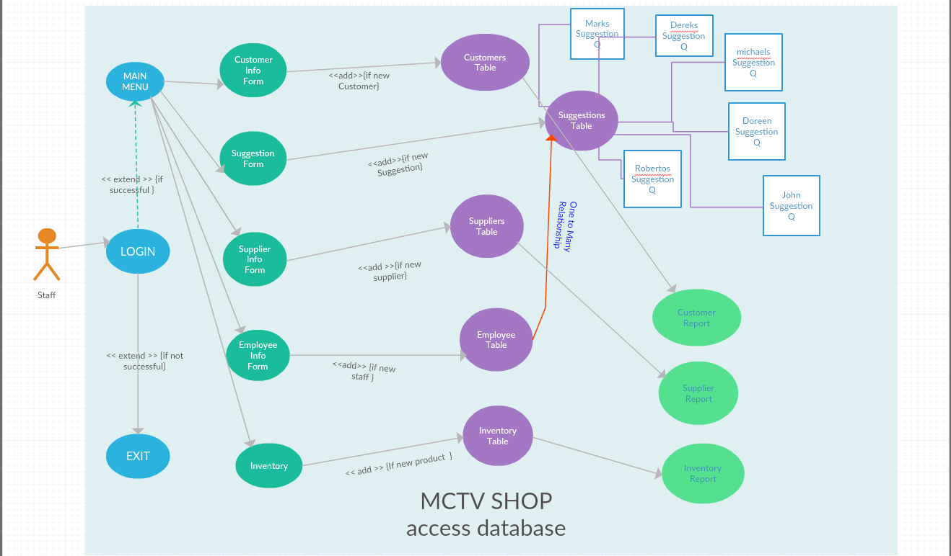
Access Database & UML
Created UML for Access database.
5 tables
5 forms
6 queries
3 reports
1 relationships
Login screen
Main menu

Slide 8
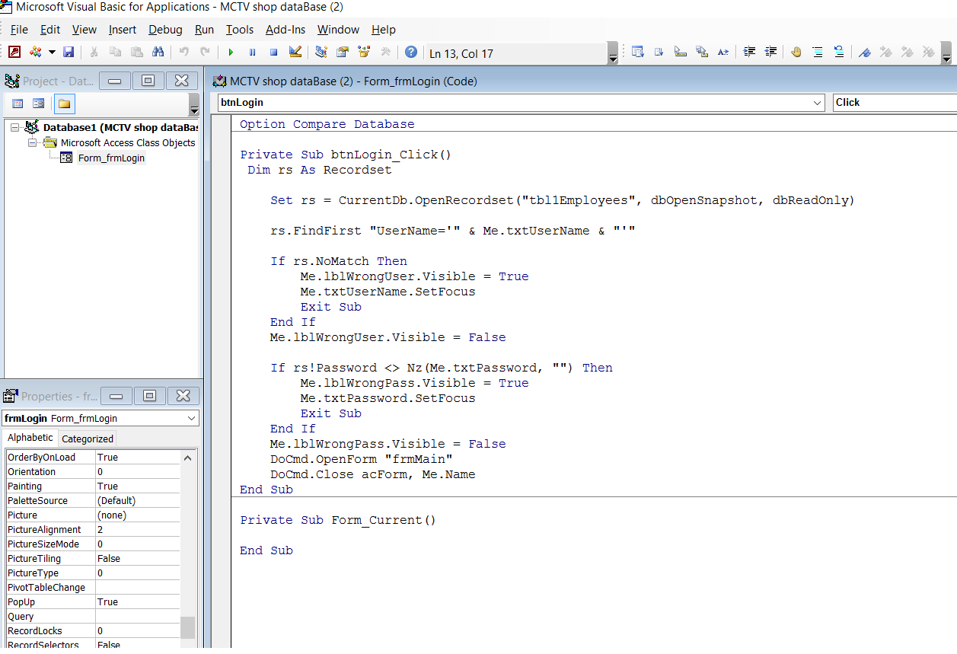
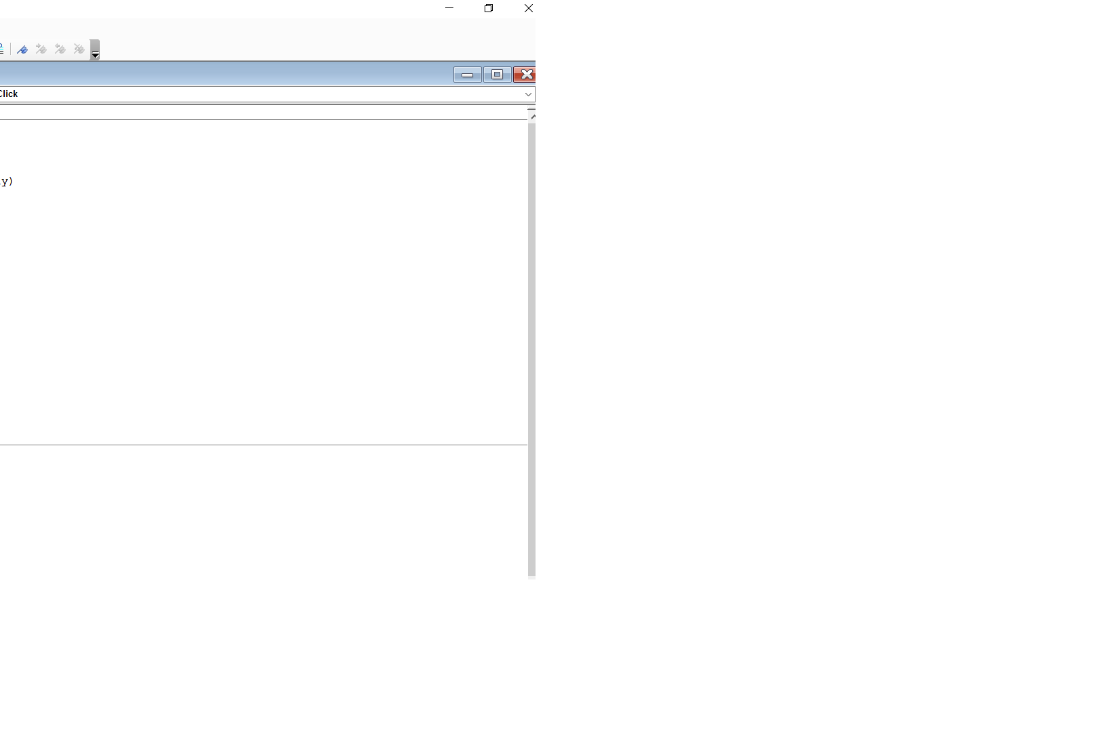
Visual Basic Code
Used Visual Basic Code for Login Form

Slide 9
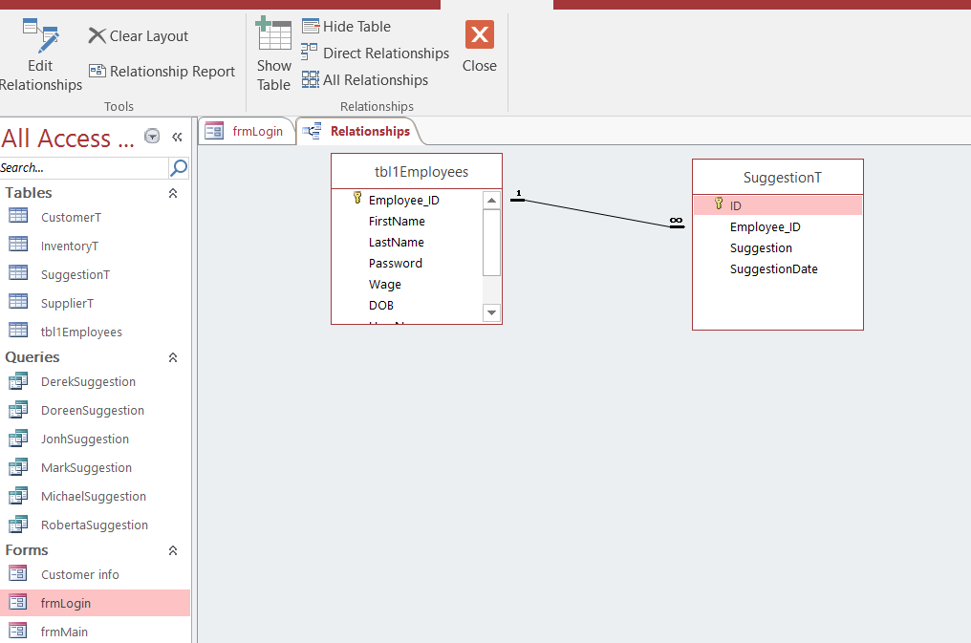
Relationships Between Tables
Used One to Many relationships

Slide 10

Microsoft Excel
Microsoft Excel was used with information from Access to create charts.
.

Slide 11
Microsoft Excel
.
.

Slide 12
SAB Group Project
Thank you for listening.

