Slide 1
SAB Group Project
Graham Farrell x15044726
Alan Gaskin x16130201
Enkhbayar Dashtseren x14118173
Neil Fitzgerald x15043606

Slide 2
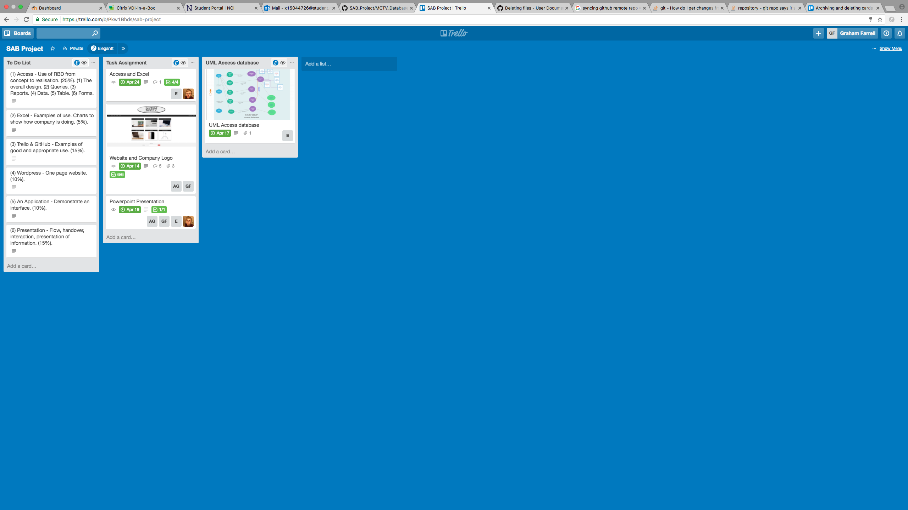
Trello & GitHub
Team collaborated using Trello & GitHub.
Used Trello to delegate tasks to different team members.
Created a to do list and checklists to keep track of completed tasks.

Slide 3
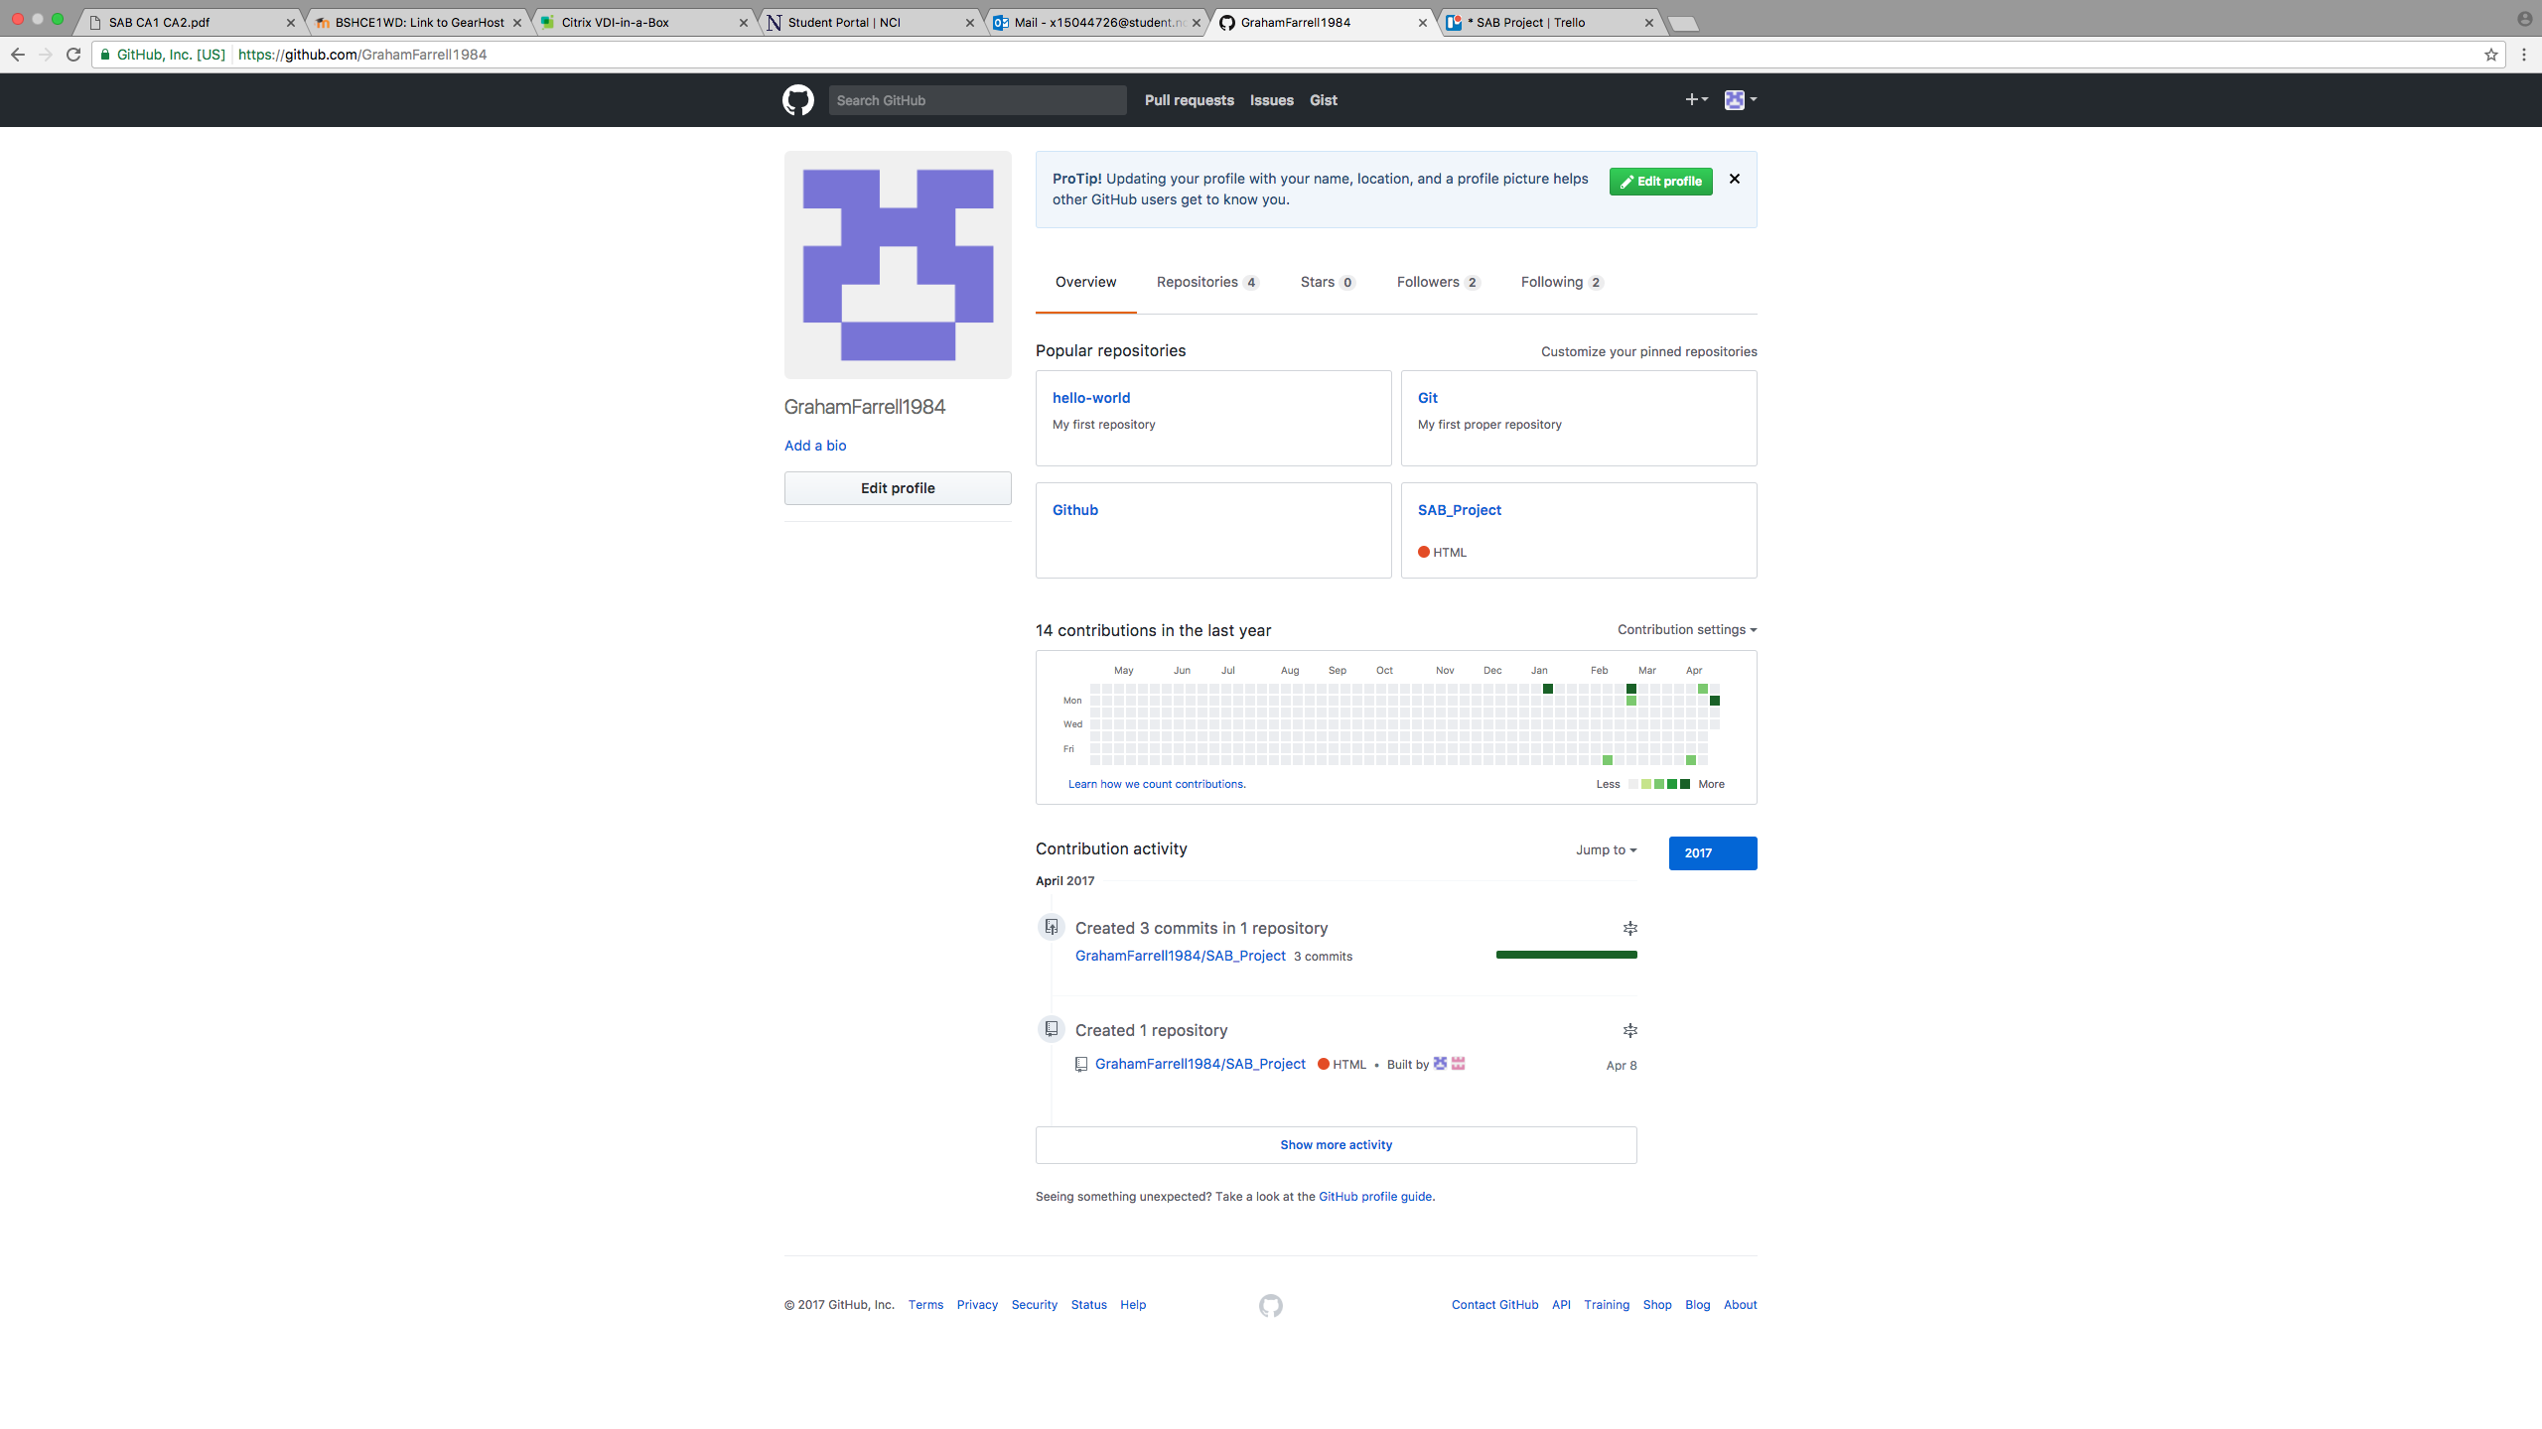
Trello & GitHub
GitHub was used as a second collaboration tool.
Team members were able to access & share files using this.
Used both CLI & GUI to work with Git & GitHub.

Slide 4
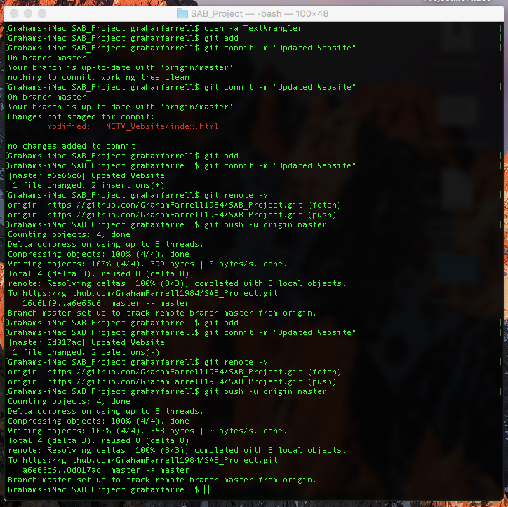
Working With Git & GitHub
Used CLI to update files on GitHub.
Understanding of the basic commands in Git.

Slide 5
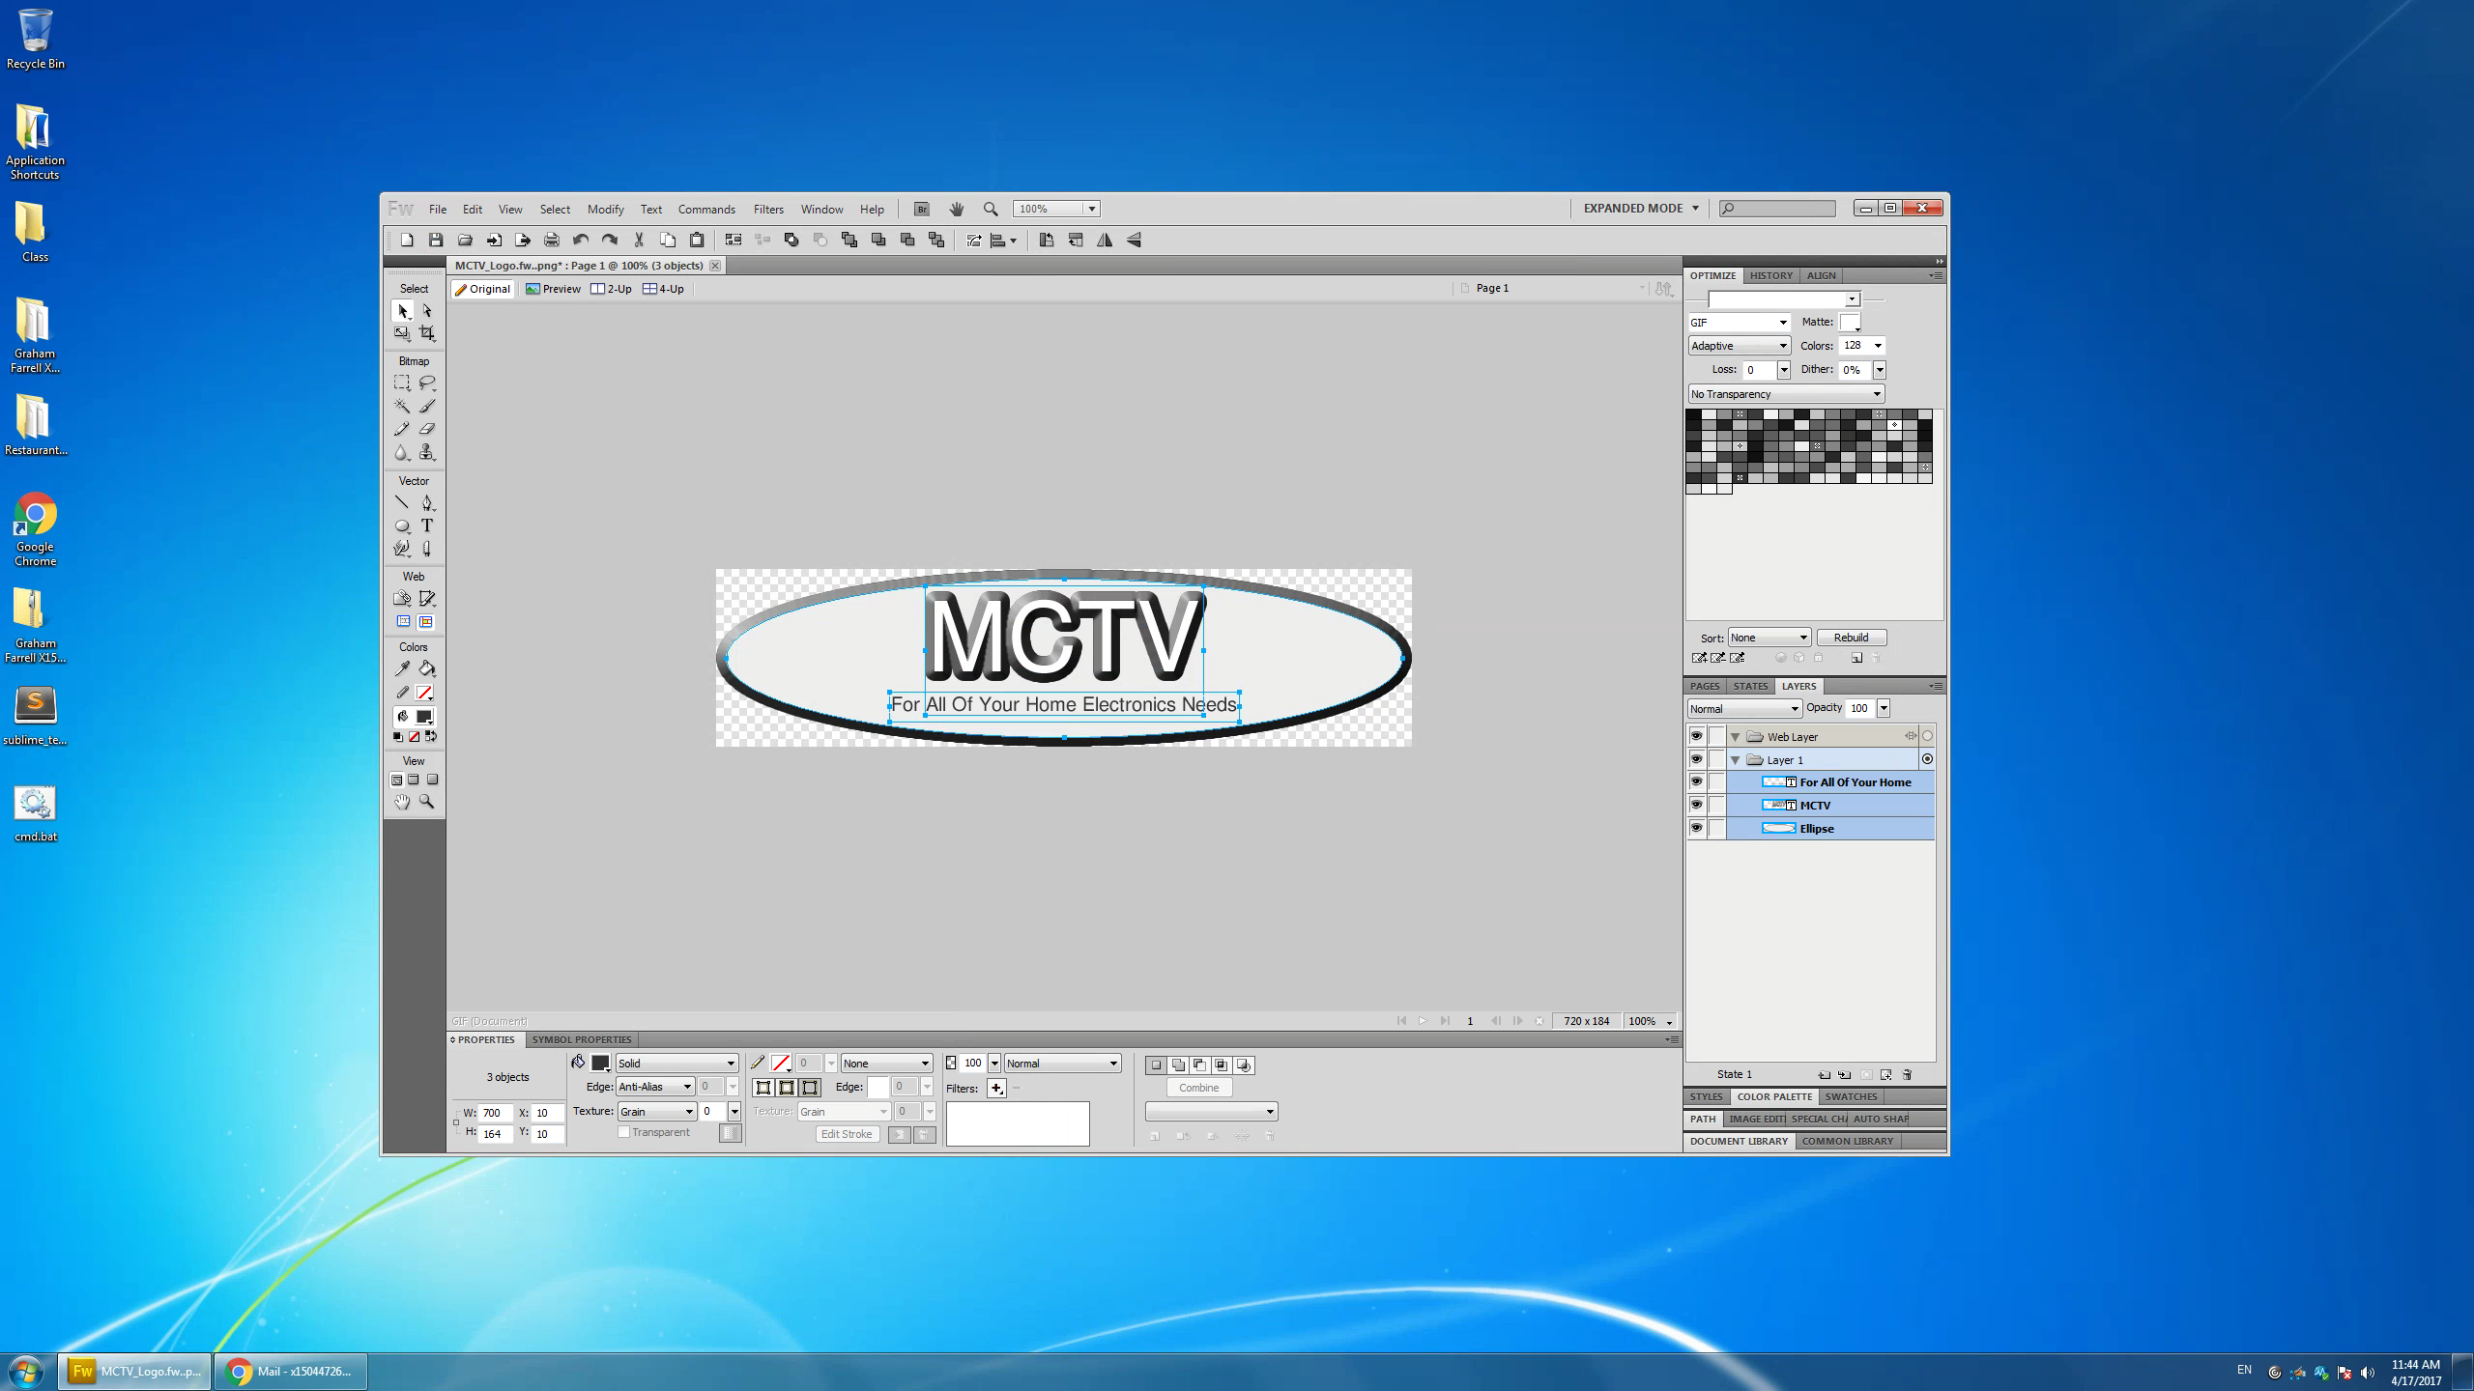
MCTV Logo & Website
Adobe Fireworks was used to create logo for MCTV website.
Colours used for logo were taken from website to keep everything looking uniform.

Slide 6
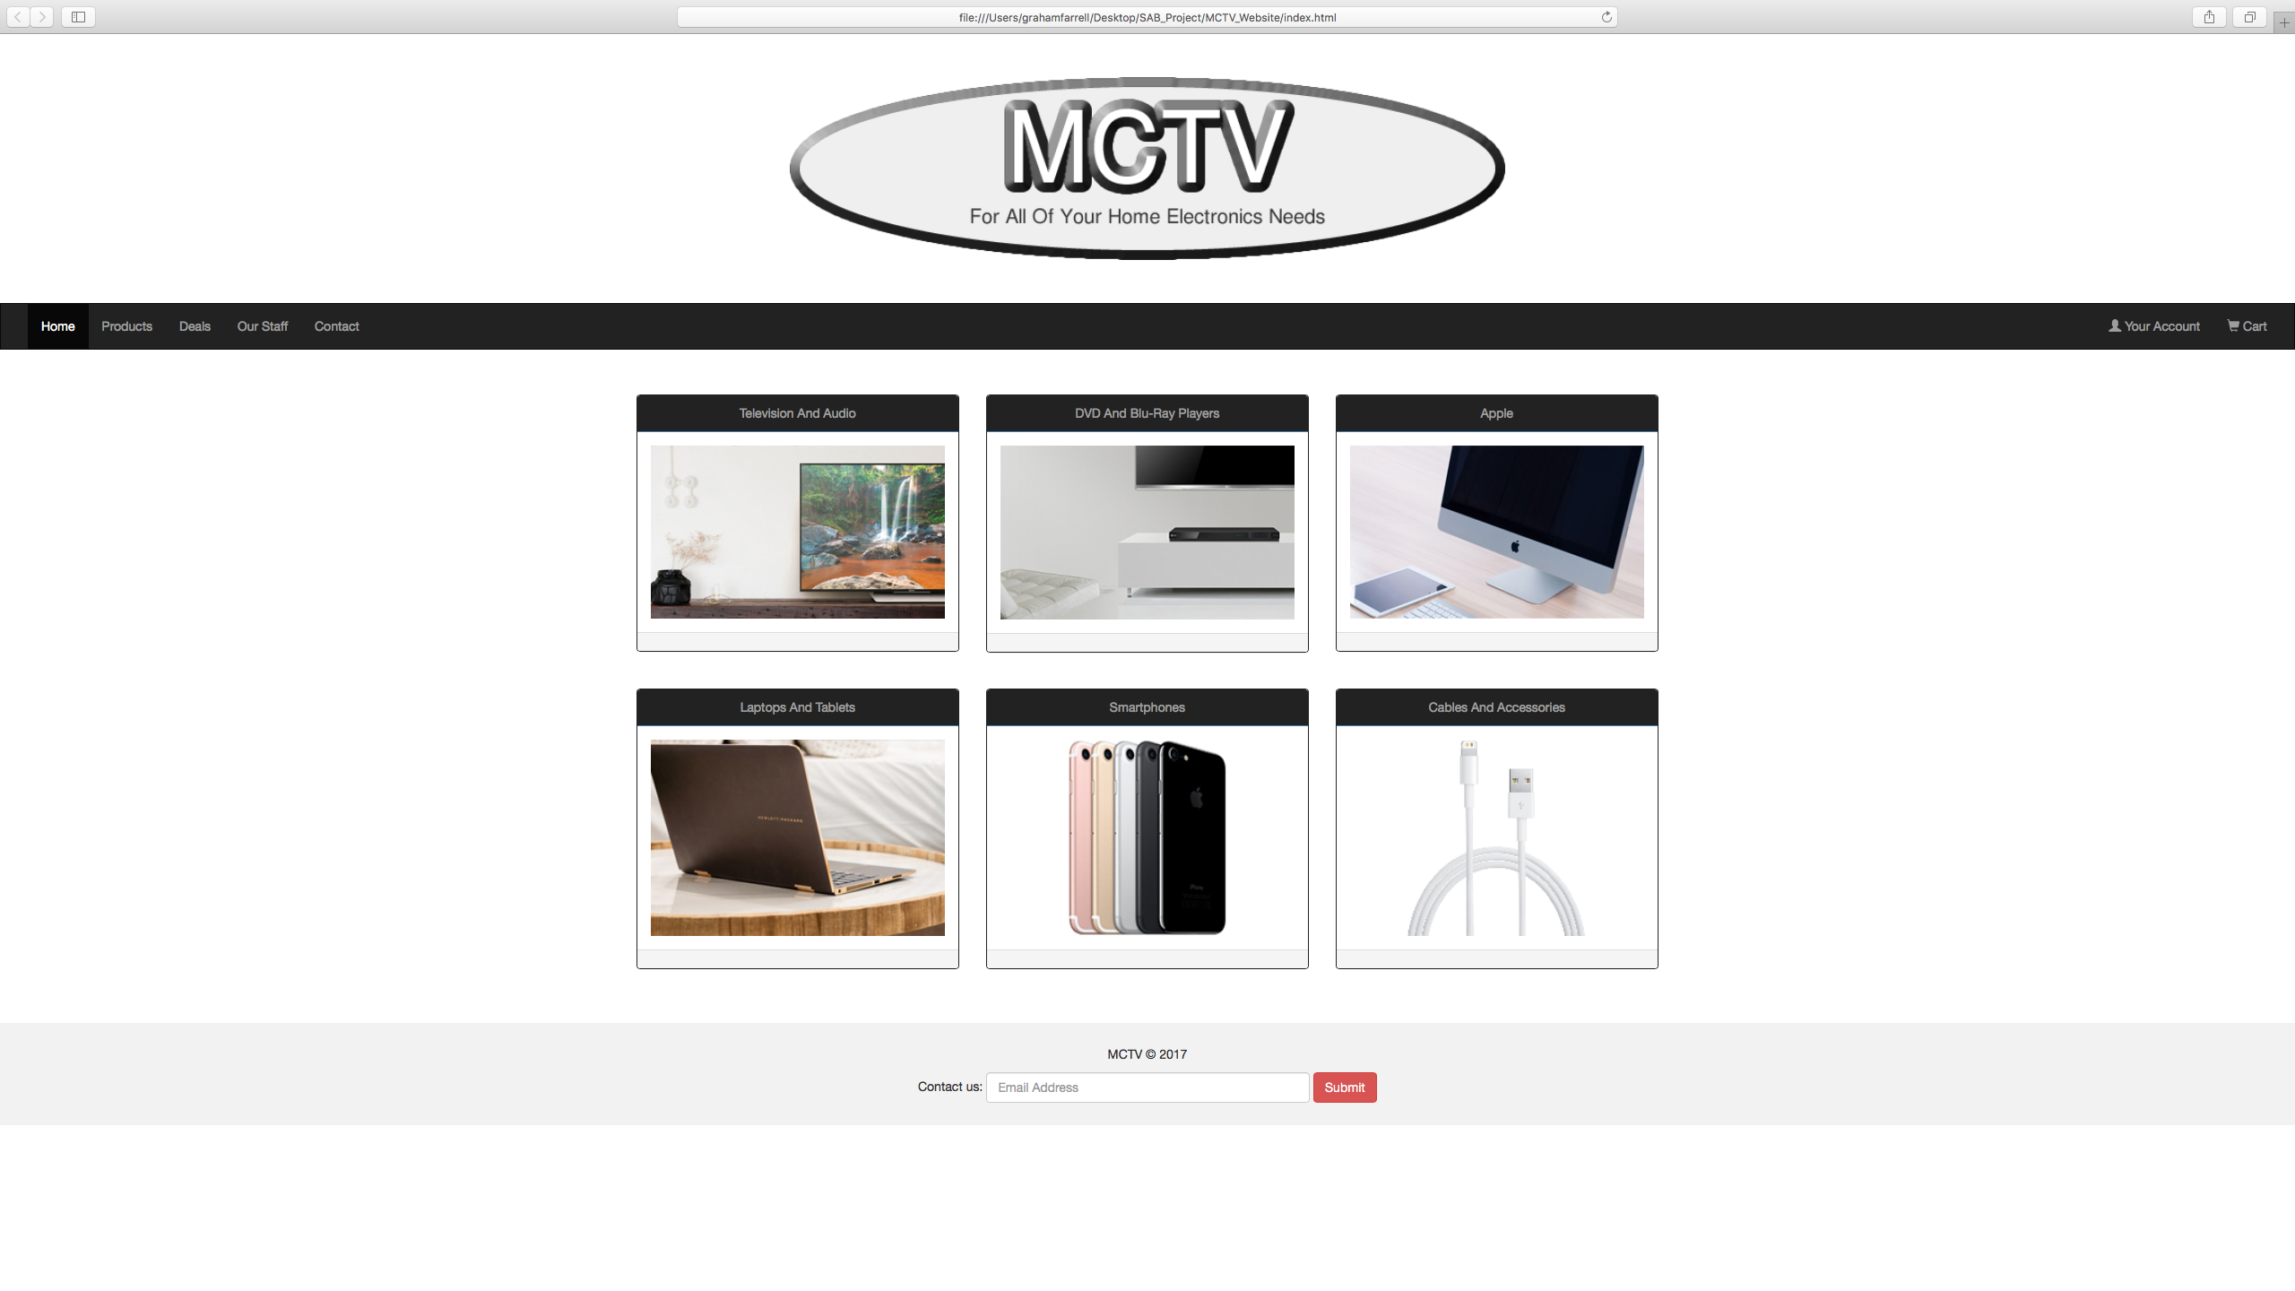
MCTV Logo & Website
Created the home page for the MCTV website integrating the company logo.
Website is responsive as we used CSS for the styling.

Slide 7
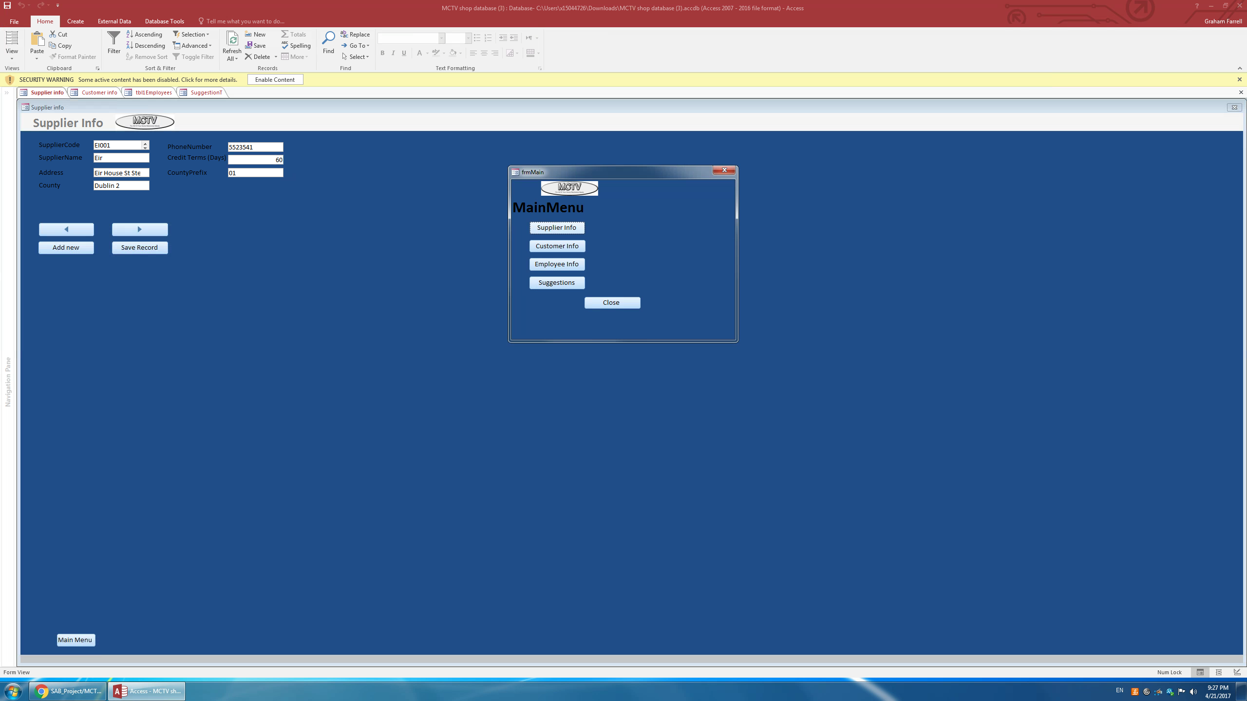
Access Database & UML
Microsoft Access was used to build the database for the company.
Created tables, queries, forms & reports in Access.
Used logo created for website in the database too.

Slide 8
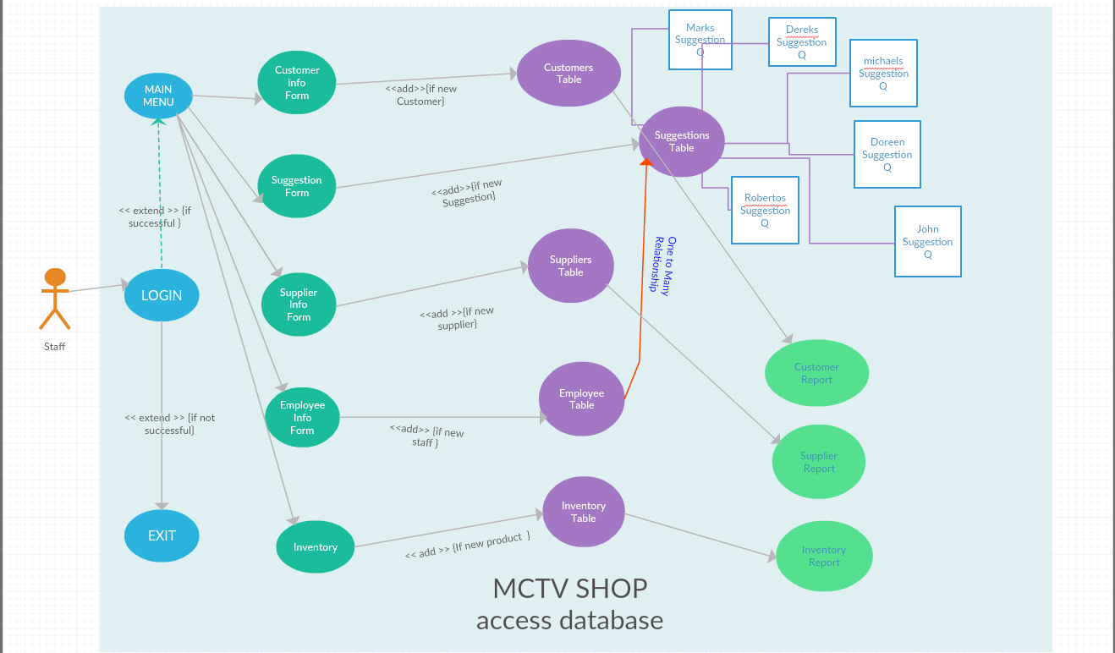

Access Database & UML
Created UML for Access database.
5 tables.
5 forms.
6 queries.
3 reports.
1 relationships.
Login screen.
Main menu.

Slide 9
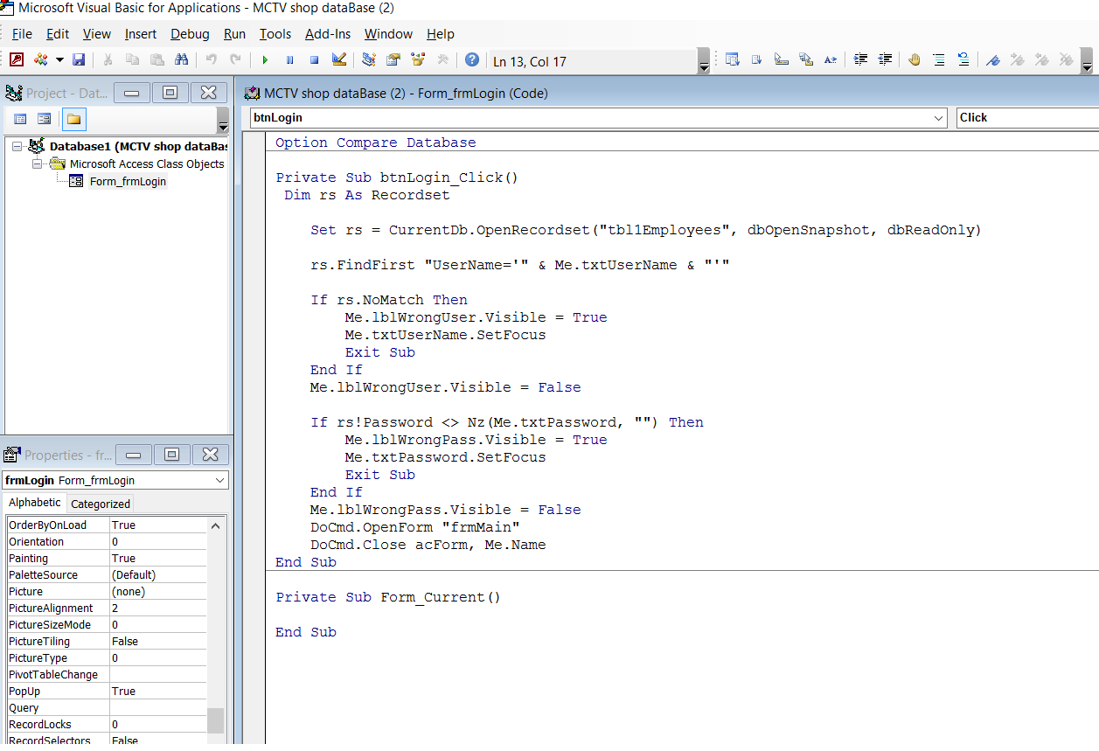
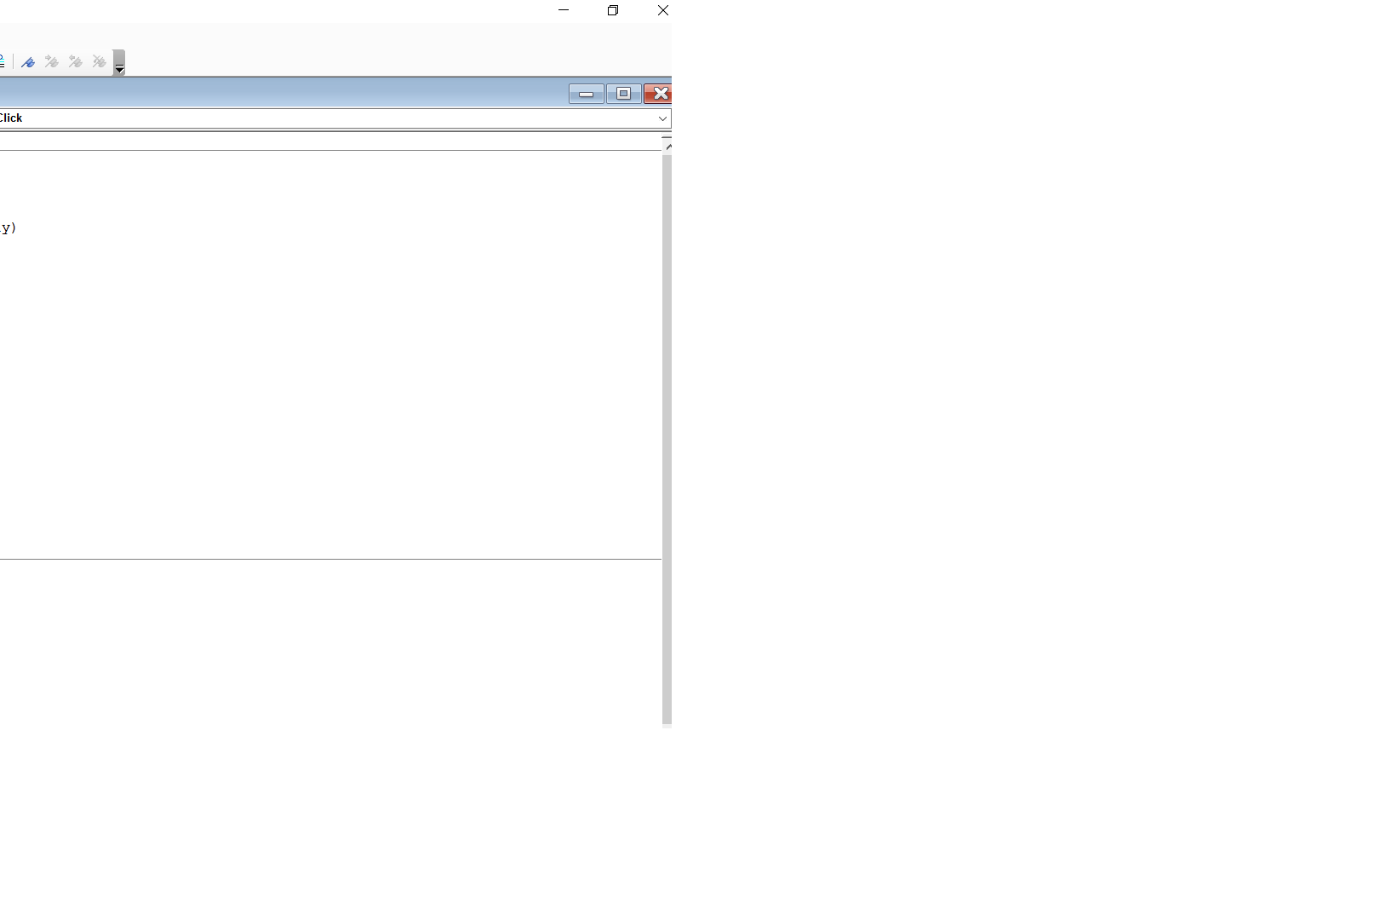
Visual Basic Code
Used Visual Basic Code for Login Form.

Slide 10
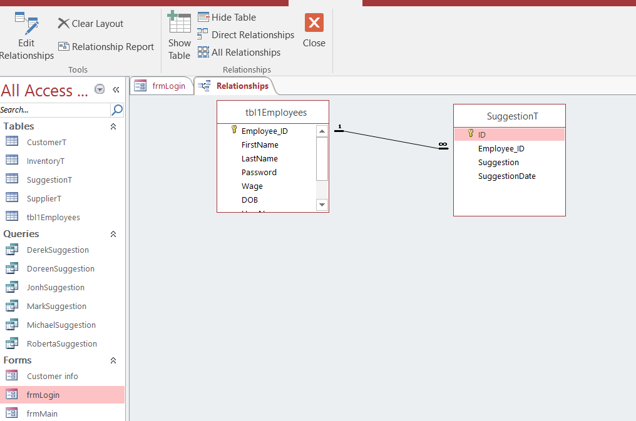
Relationships Between Tables
Used One to Many relationships.

Slide 11
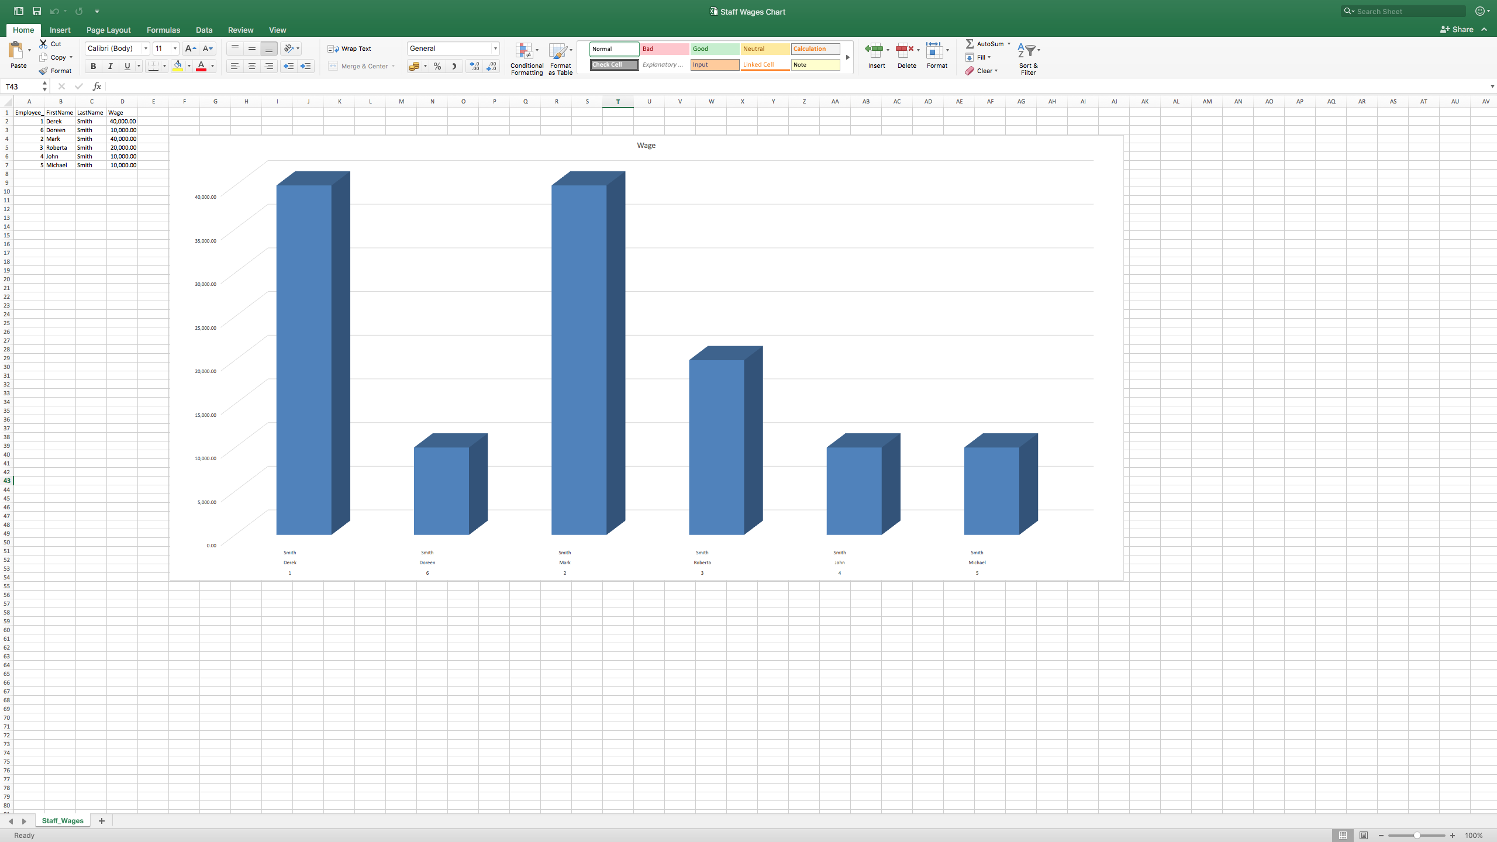
Microsoft Excel
Microsoft Excel was used with information imported from Access to create charts.
Created a chart for staff wages.

Slide 12
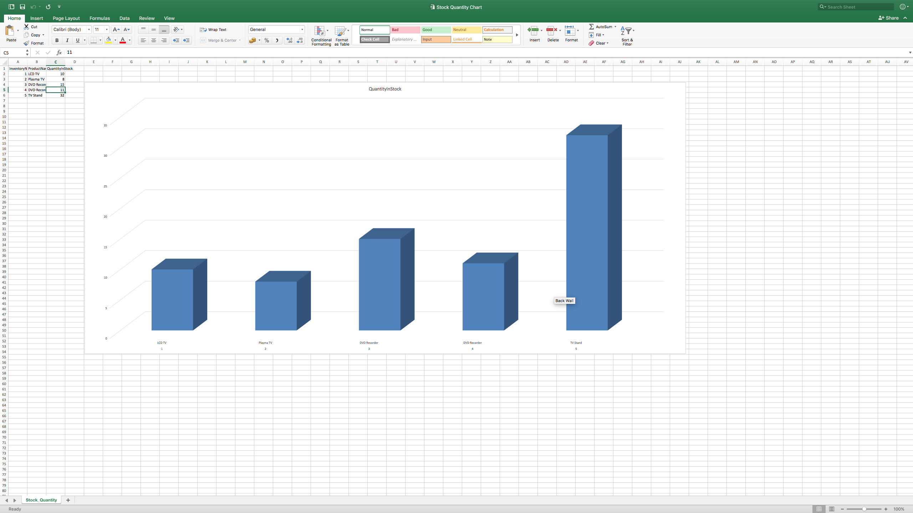
Microsoft Excel
Created another chart for stock quantity.
These charts were simple but effective at showing information.

Slide 13
SAB Group Project
Thank you for listening.

