Slide 1
Functional Analysis
Graham Hamilton

Slide 2
Overview
Loading packages
Loading results from DESeq2
Annotation
Filtering results by fold change and adjusted p value
Gene ontology analysis
Pathway enrichment
Cell marker gene set enrichment
Visualisation

Slide 3
Ingenuity Pathway Analysis
Qiagen Ingenuity Pathway Analysis
Canonical pathways
Upstream analysis
Diseases & functions
Regulator effects
Expensive annual licence

Slide 4
DAVID
Web server
Functional enrichment analysis
Functional annotation
Free to use
Brad T Sherman, Ming Hao, Ju Qiu, Xiaoli Jiao, Michael W Baseler, H Clifford Lane, Tomozumi Imamichi, Weizhong Chang, DAVID: a web server for functional enrichment analysis and functional annotation of gene lists (2021 update), Nucleic Acids Research, Volume 50, Issue W1, 5 July 2022, Pages W216–W221, https://doi.org/10.1093/nar/gkac194

Slide 5
ClusterProfiler
ClusterProfiler is an R package that performs functional enrichment analysis, to aide interpretation of high throughput data like RNASeq.
Over representation analysis
Identify pathways or ontologies annotated be the gene set greater than expected by chance, ORA
Gene set enrichment analysis, GSEA
Similar to ORA but with differing statistical approach
Free to use
https://yulab-smu.top/biomedical-knowledge-mining-book/index.html Wu T, Hu E, Xu S, Chen M, Guo P, Dai Z, et al. clusterProfiler 4.0: A universal enrichment tool for interpreting omics data. Innovation (Camb). 2021;2(3):100141., https://doi.org/10.1016/j.xinn.2021.100141

Slide 6
CRAN packages
Install CRAN packages
cran.packages <- c("tidyverse", "ggrepel", "kableExtra", "ggupset") cran.load <- function(pkg){ new.pkg <- pkg[!(pkg %in% installed.packages()[, "Package"])] if (length(new.pkg)){ install.packages(new.pkg, dependencies = TRUE) } sapply(pkg, require, character.only = TRUE) } cran.load(cran.packages)

Slide 7
Bioconductor Packages
Install Biocondustor packages
bioconductor.packages <- c("org.Hs.eg.db", "biomaRt", "clusterProfiler", "enrichplot", "pathview") bioconductor.load <- function(pkg){ new.pkg <- pkg[!(pkg %in% installed.packages()[, "Package"])] if (length(new.pkg)){ if (!requireNamespace("BiocManager", quietly = TRUE)) install.packages("BiocManager") BiocManager::install(new.pkg) } sapply(pkg, require, character.only = TRUE) } bioconductor.load(bioconductor.packages)

Slide 8
Statistical cut off values
Create the cut off used for filtering results
pvalueCutoff <- 0.05 # P value qvalueCutoff <- 0.1 # Adjusted P value foldchange <- 1 # Fold change, usually fold change is log2

Slide 9
Load Results
Read in the results file from DESeq2 Analysis
de_results <- read_delim("./data/Treatment_vs_Control_results.tsv", delim = "\t")
baseMean - mean of normalized counts for all samples log2FoldChange - log2 fold change (MAP): condition treated vs untreated lfcSE - standard error: condition treated vs untreated stat - Wald statistic: condition treated vs untreated pvalue - Wald test p-value: condition treated vs untreated padj - BH adjusted p-values

Slide 10
Annotations
The DESeq2 results file contains very little information about the genes. Annotations can be added from the GFF3 file or form the Biomart data base. Using the R package biomaRt we can access the data sets
There are 214 organism datasets in Biomart.

Slide 11
Annotations
Here we get annotations from the Ensembl human database at Biomart
database <- "hsapiens_gene_ensembl" mart <- "genes" filt <- "ensembl_gene_id" ensembl <- useEnsembl(biomart = mart, dataset = database) att <- c("ensembl_gene_id","external_gene_name","chromosome_name","start_position","end_position","gene_biotype","entrezgene_id") annotations <- getBM(attributes=att,filter=filt,values=de_results$ensembl_gene_id,mart=ensembl) %>% distinct(ensembl_gene_id, .keep_all = TRUE)

Slide 12
Annotations

Slide 13
Add Annotations
The annotations can be merged with our results file
de_results <- de_results %>% left_join(annotations, by = "ensembl_gene_id")%>% # merge annotations by ensembl gene id arrange(padj) %>% # Sort the dataframe by the p adjusted value ascending replace_na(list(log2FoldChange = 0.001))

Slide 14
Results Directory
Create a results directory for the ClusterProfiler results files
results_directory <- "ClusterProfiler" dir.create(results_directory, showWarnings = FALSE)

Slide 15
Filter
Filter the results table for genes that have a p adjusted value of 0.1 and a log 2 fold change of 1.
NOTE: The use of the absolute value for the log2 fold change.
filtered_de_results <- de_results %>% filter(padj < qvalueCutoff, abs(log2FoldChange) > foldchange) %>% drop_na()
There are 4954 genes remaining after filtering.

Slide 16
Gene Ontology
Ontology is a formal representation of knowledgebase for the functions of genes, computer and human readable
GO split into three domains
Molecular Function
Molecular-level activities performed by gene products e.g. catalysis or transport
Cellular Component
Location relative to cellular structure of gene function e.g. mitochondrian or ribosome
Biological Process
Larger processes accomplished by multiple molecular activities e.g DNA repair or signal transduction
GO does not describe pathways

Slide 17
Over Representation Analysis
Widely used approach to determine whether known biological functions or processes are over-represented in a set of differentially expressed genes
Example - 57 genes were differentially expressed out of a total of 17,980. Among the differentially expressed genes, 28 are annotated to a gene set
d <- data.frame(genes_not_differentially_expressed=c(2613, 15310), genes_differentially_expressed=c(28, 29)) row.names(d) <- c("In_GO_term", "Not_in_GO_term")
f_test <- fisher.test(d)
Test significance using hypergeometric distribution, one-sided Fisher’s exact test. The un-corrected P value 7.879194e-10
Boyle, Elizabeth I, Shuai Weng, Jeremy Gollub, Heng Jin, David Botstein, J Michael Cherry, and Gavin Sherlock. 2004. “GO::TermFinder–open Source Software for Accessing Gene Ontology Information and Finding Significantly Enriched Gene Ontology Terms Associated with a List of Genes.” Bioinformatics (Oxford, England) 20 (18): 3710–15. https://doi.org/10.1093/bioinformatics/bth456.

Slide 18
Gene Set Enrichment Analysis
Over representation analysis find genes where the difference is large but will fail where the difference is small.
Gene Set Enrichment Analysis (GSEA) directly addresses this limitation.
Calculate Enrichment Score (ES)
Estimation of Significance Level of ES
Adjustment for Multiple Hypothesis Testing
Subramanian, Aravind, Pablo Tamayo, Vamsi K. Mootha, Sayan Mukherjee, Benjamin L. Ebert, Michael A. Gillette, Amanda Paulovich, et al. 2005. “Gene Set Enrichment Analysis: A Knowledge-Based Approach for Interpreting Genome-Wide Expression Profiles.” Proceedings of the National Academy of Sciences of the United States of America 102 (43): 15545–50. https://doi.org/10.1073/pnas.0506580102.

Slide 19
Gene Ontology Analysis
Over representation analysis
List of entrez ids for the differentially expressed genes, using the pull() command from dplyr
de_genes <- filtered_de_results %>% pull(entrezgene_id)
[1] 55707 6504 57823 2213 7431 5552

Slide 20
Gene Ontology Analysis
Over representation analysis
go_ora <- enrichGO(gene = de_genes, OrgDb = org.Hs.eg.db, ont = "CC", # Can choose "BP","CC", "MF" or "ALL" pAdjustMethod = "BH", # Can choose "holm", "hochberg", "hommel", "bonferroni", "BH", "BY", "fdr", "none" pvalueCutoff = 0.01, qvalueCutoff = 0.05, readable = TRUE)

Slide 21
Gene Ontology Analysis
Gene set enrichment analysis
Input is a named vector of log fold changes with entrez ids as the names, sorted
gsea_gene_list <- filtered_de_results$log2FoldChange names(gsea_gene_list) <- filtered_de_results$entrezgene_id gsea_gene_list <- sort(gsea_gene_list, decreasing = TRUE)
84824 219970 344658 6439 5596 2327 7.372843 6.883795 6.746818 6.634223 6.440792 6.368684

Slide 22
Gene Ontology Analysis
Gene set enrichment analysis
go_gsea <- gseGO(gene = gsea_gene_list, OrgDb = org.Hs.eg.db, ont = "CC", # Can choose BP,CC, MF or ALL pAdjustMethod = "BH", # Can choose "holm", "hochberg", "hommel", "bonferroni", "BH", "BY", "fdr", "none" minGSSize = 100, maxGSSize = 500, pvalueCutoff = 0.01)

Slide 23
Gene Ontology Analysis
Saving the results to a file
ORA GO analysis
write_delim(as.data.frame(go_ora), file = file.path(results_directory, "go_ora_enriched.tsv"), delim = "\t")
GSEA GO analysis
write_delim(as.data.frame(go_gsea), file = file.path(results_directory, "go_gsea_enriched.tsv"), delim = "\t")

Slide 24
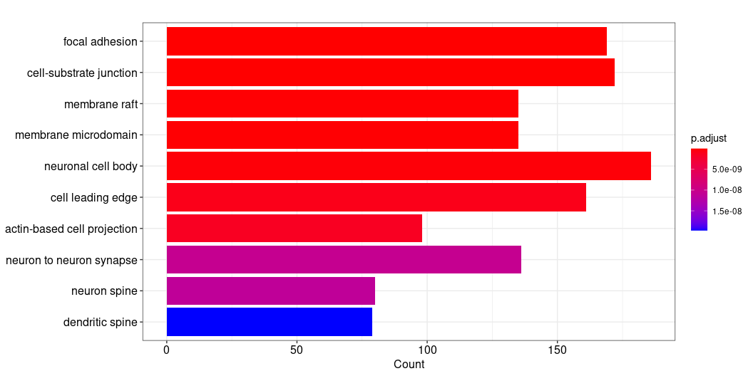
Gene Ontology Analysis
Various options for visualising the results
Barplot
Dotplot
Heatmap
Cnetplot
barplot(go_ora, showCategory=10)
https://yulab-smu.top/biomedical-knowledge-mining-book/index.html

Slide 25
Pathway Analysis
Pathway analysis uses over representation and gene set enrichment analysis. Can use several databases for pathway analysis:
KEGG
WikiPathways
Reactome

Slide 26
Pathway Analysis
WikiPathways
Continuously updated pathway database curated by a community of researchers. Supported organisms:
[1] "Anopheles gambiae" "Arabidopsis thaliana" [3] "Bos taurus" "Caenorhabditis elegans" [5] "Canis familiaris" "Danio rerio" [7] "Drosophila melanogaster" "Equus caballus" [9] "Gallus gallus" "Homo sapiens" [11] "Mus musculus" "Pan troglodytes" [13] "Populus trichocarpa" "Rattus norvegicus" [15] "Saccharomyces cerevisiae" "Solanum lycopersicum" [17] "Sus scrofa" "Zea mays"
https://www.wikipathways.org

Slide 27
Pathway Analysis
Reactome
Reactome is an open-source, open access, manually curated and peer-reviewed pathway database. Only implements over representation analysis. Supported organisms:
[1] "celegans" "fly" "human" "mouse" "rat" "yeast" [7] "zebrafish"
G Yu, QY He*. ReactomePA: an R/Bioconductor package for reactome pathway analysis and visualization. Molecular BioSystems 2016, 12(2):477-479. doi: 10.1039/C5MB00663E

Slide 28
Pathway Analysis
KEGG
Kyoto Encyclopedia of Genes and Genomes.
Implements ORA and GSEA
Supports a large number of organisms 8137.
Search using search_kegg_organism() command:
search_kegg_organism("Mus musculus", by="scientific_name") %>% # Can also search using kegg_code or common_name kbl() %>% kable_styling("condensed")
Full list can be found here: http://www.genome.jp/kegg/catalog/org_list.html

Slide 29
Pathway Analysis
Over representation analysis
Use de genes from the GO over representation analysis
kegg_ora <- enrichKEGG(gene = de_genes, organism = 'hsa', pvalueCutoff = 0.01)

Slide 30
Pathway Analysis
Gene set enrichment analysis.
Use de genes list from the GO gene set enrichment analysis
kegg_gsea <- gseKEGG(geneList = gsea_gene_list, organism = 'hsa', minGSSize = 10, pvalueCutoff = 0.05)

Slide 31
Pathway Analysis
Save the pathway analysis to file
Over representation analysis
kegg_ora %>% as.data.frame() %>% write_delim(file = file.path(results_directory, "ora_pathway.tsv"), delim = "\t")
Gene set enrichment analysis
kegg_gsea %>% as.data.frame() %>% write_delim(file = file.path(results_directory, "gsea_pathway.tsv"), delim = "\t")

Slide 32
Pathway Analysis Visualisation
Pathview is a tool set for pathway based data integration and visualization
Input Kegg pathway id
List of differentially expressed genes
names - entrez ids
values - log fold changes
Luo, Weijun, and Cory Brouwer. 2013. “Pathview: An R/Bioconductor Package for Pathway-Based Data Integration and Visualization.” Bioinformatics 29 (July): 1830–31. https://doi.org/10.1093/bioinformatics/btt285.

Slide 33
Pathway Analysis Visualisation
Create a function to retrieve the KEG pathways
kegg_pathview <- function(kegg_pathway_id){ pathview(gene.data = kegg_gsea, # List of DE gene entrez ids and log fold changes pathway.id = kegg_pathway_id, # KEGG pathway id to download and annotate species = "hsa", # Organism KEGG id gene.idtype = "KEGG", kegg.native = TRUE) } kegg_gsea_list <- kegg_gsea %>% as.data.frame() %>% pull(ID) lapply(kegg_gsea_list, kegg_pathview)
Tidy up the pathway files
results.files <- list.files(path = ".", pattern = "pathview.png") %>% # list all pathview files file.copy(results_directory) # Copy pathway files to results directory # Delete results files remove_files <- list.files(path = ".", pattern = "hsa") %>% # List all files dowloaded from KEGG file.remove() # Delete the files

Slide 34
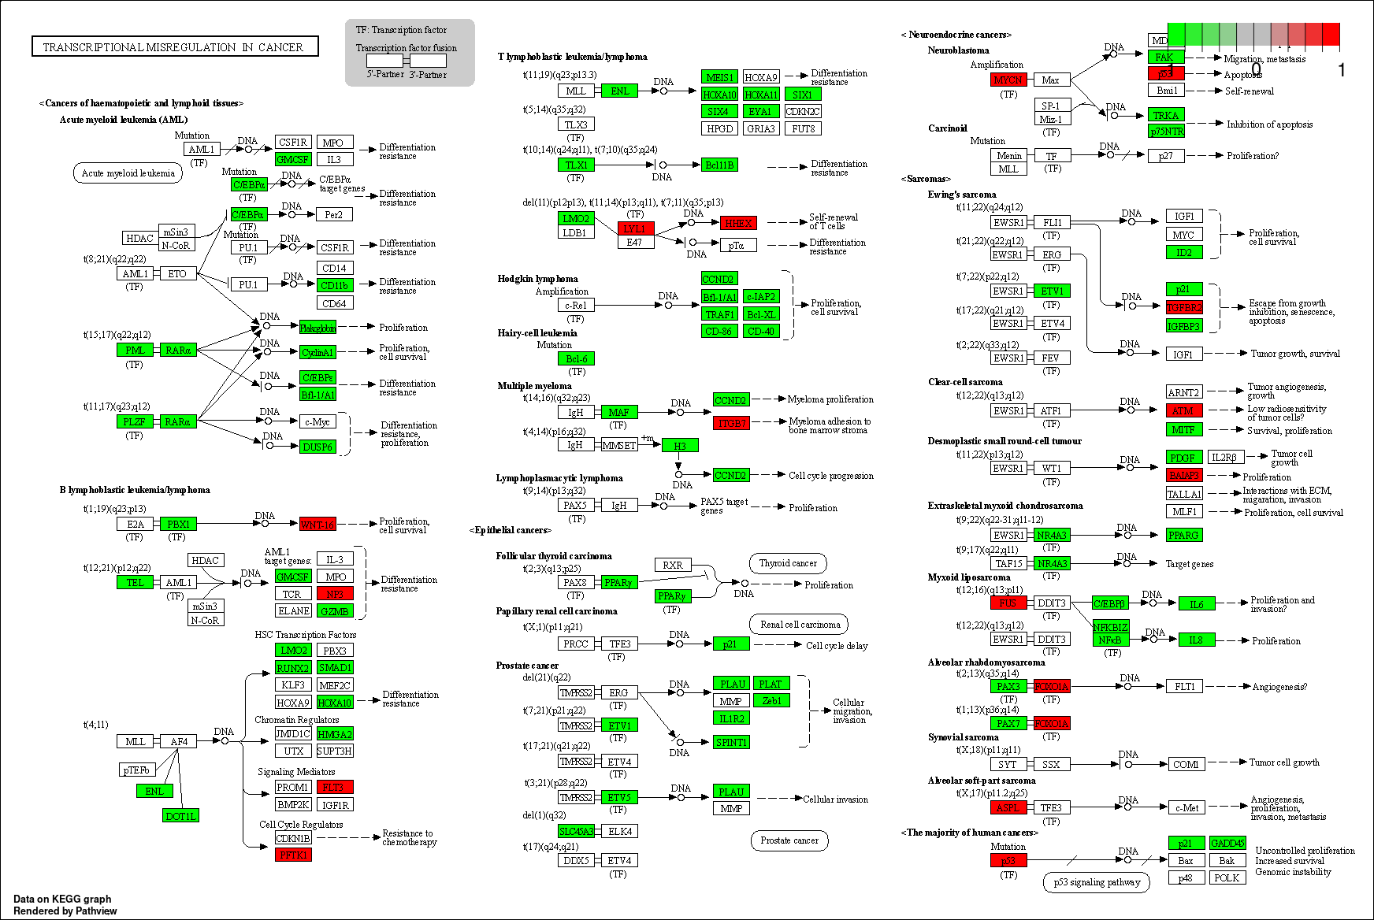
Pathway Analysis Visualisation

Slide 35
Download Course Material
https://github.com/GrahamHamilton/FunctionalAnalysisTeaching

Slide 36
Download Course Material
Select Download ZIP
Unzip the downloaded file
Move the folder to a suitable place on computer
Open RStudio and, using the files pane, navigate to the FunctionalAnalysisTeaching-main folder
Double click on the FunctionalAnalysis.Rproj

