Slide 1



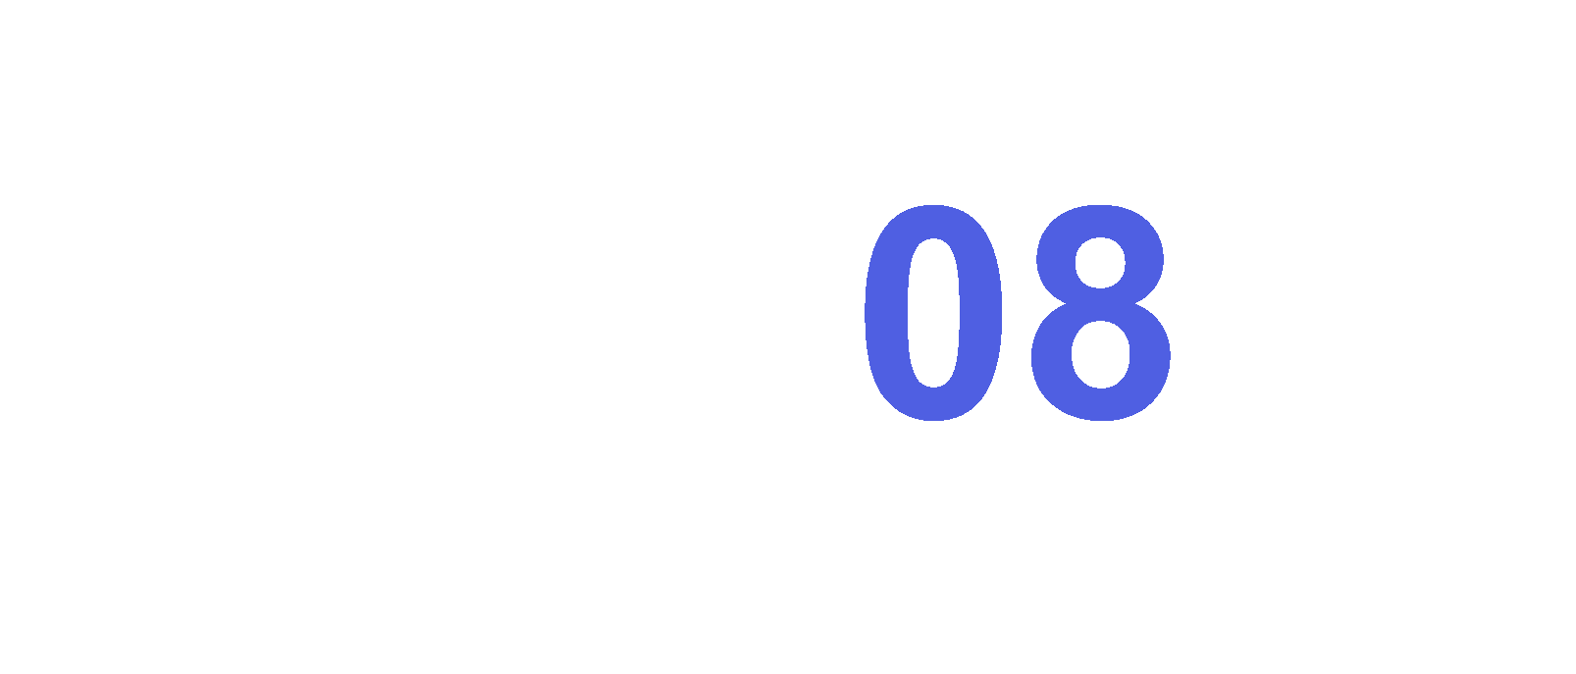


Slide 2
thursday – sunday
26 – 29 june
3 Barnstaple venues:
The Factory
The Inn on the Square
The Platform

Slide 3
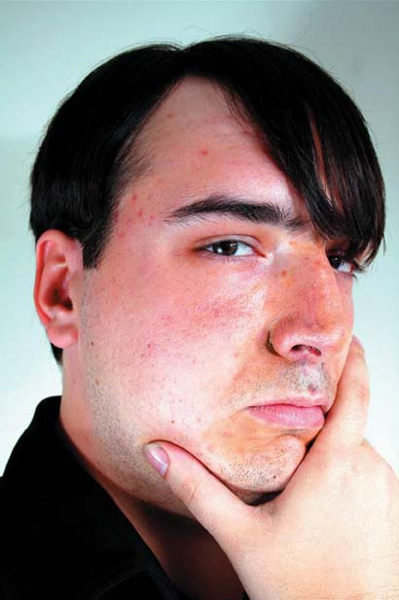
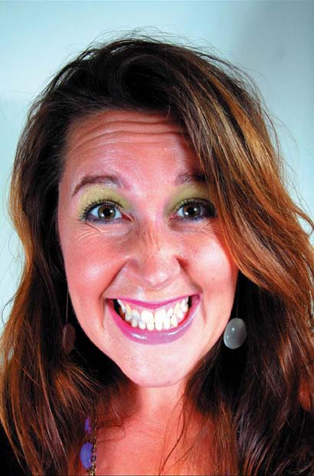
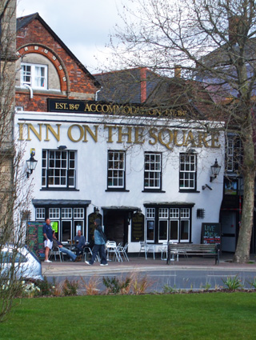
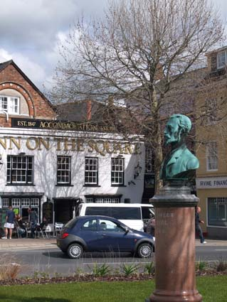
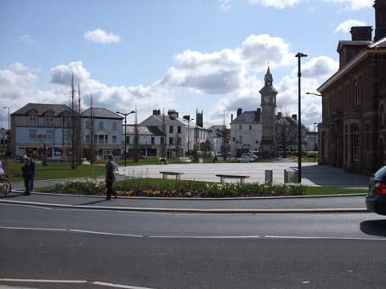
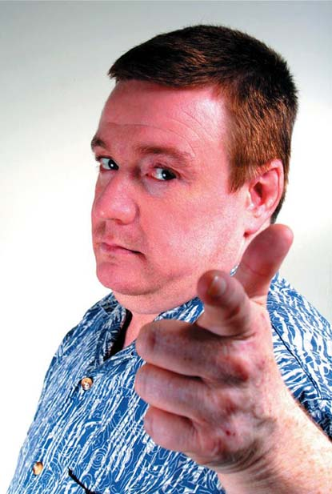
Courtesy of the new management, a studio theatre at the back of the Inn will host a mix of outrageous cabaret and hard-hitting drama.
A central location and refreshment on site!
The Inn on the Square

Slide 4
Barefaced Cheek
presents
KNIGHTS OF THE LONELY HEARTS
comedy sketch show
adult (16+)
@ The Inn on the Square

Slide 5
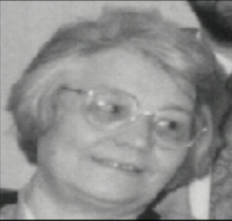
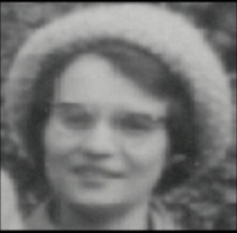
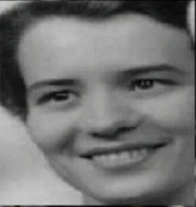
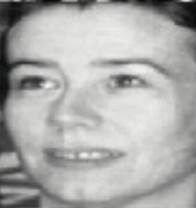
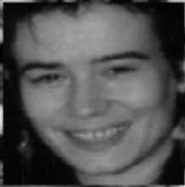
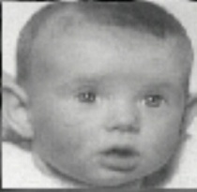
Becoming Mum:
Bootlace Productions
present:
A Cautionary Tale

Slide 6
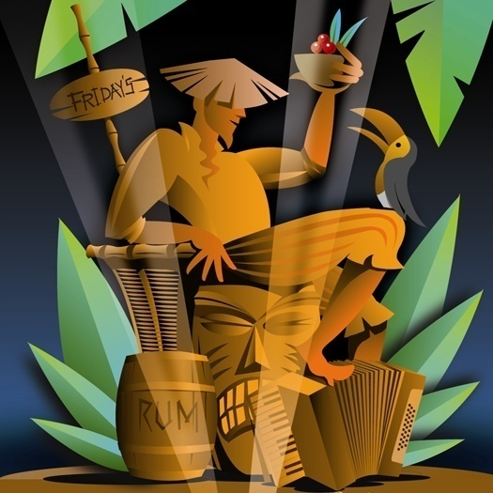
Becoming Mum:
You don't think it's going to happen to you, until one day you look in the mirror and find your mother staring back!
comedy-drama
age recommendation 16+
A Cautionary Tale
@ The Inn on the Square

Slide 7
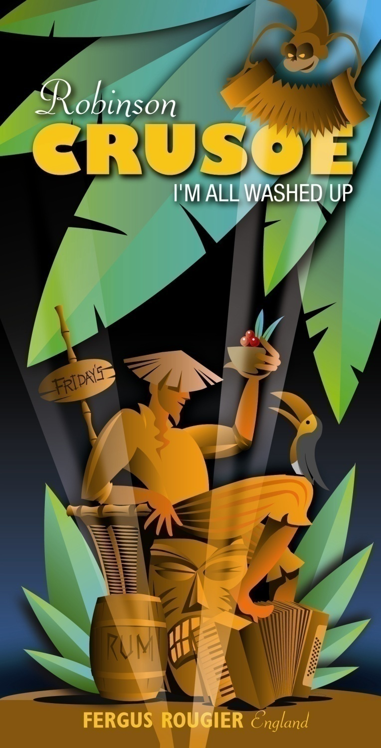
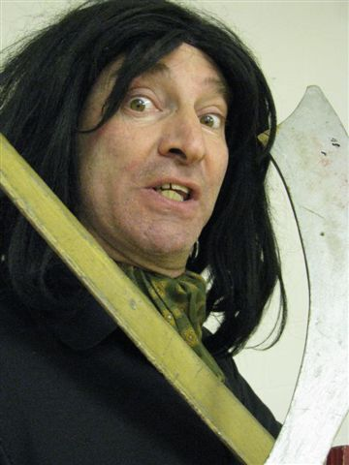
A dramatic retelling of the Daniel Defoe novel about the shipwrecked guy, Man-Friday, cannibals and a parrot called Polly.
Arrant
Knaves
All
A highly unusual mix of singing, instrument playing, physical storytelling and movement.
FERGUS ROUGIER
presents
age 13+
@ The Inn on the Square

Slide 8
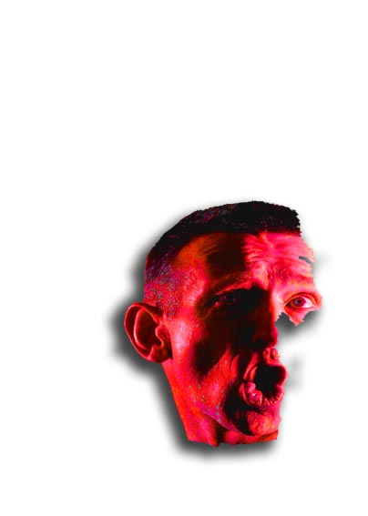
Jackdaw Productions UK
Arrant
Knaves
All
A celebration of some of theatre's most wicked, knavish and dastardly Men and Women.
one person comedy-drama
age 12+
@ The Inn on the Square

Slide 9
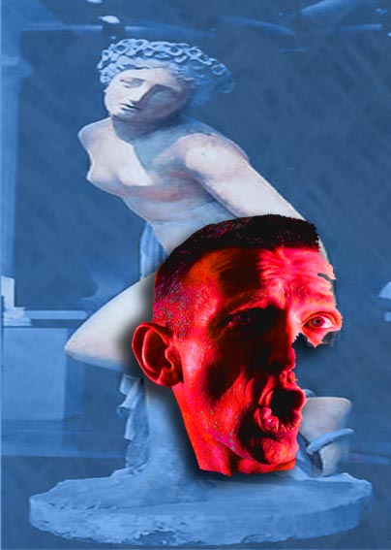

backward glance
A celebrity death triggers the latest invigorating mix of physical action, visual imagery and word-weaving from multi story.
drama
age 15+
@ The Inn on the Square

Slide 10
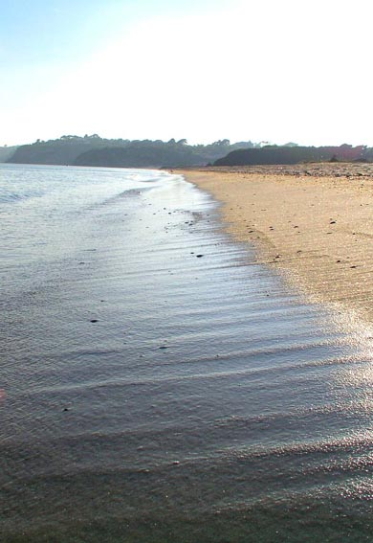
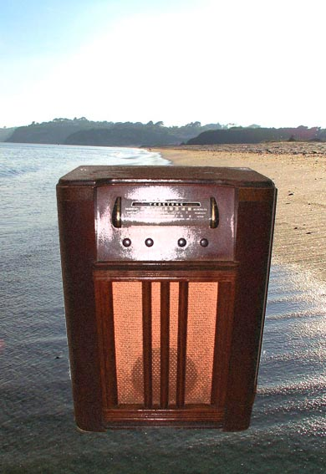
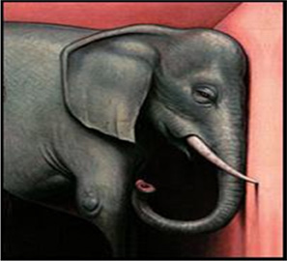
Beach Impediment Episode 2… Halloween
A-up Productions present
Glasshouse Theatre Company
A Room Full
of
Elephants
The long awaited prequel to last summer's Christmas special - an instant cult hit.
comedy thriller
age 14+
@ The Inn on the Square

Slide 11
thursday – sunday
26 – 29 june
Glasshouse Theatre Company
A Room Full
of
Elephants
You check in, you check out.
Room 379, yours for the day - or night
Someone else’s tomorrow.
And yesterday?
Still, as long as the sheets are clean....
Glasshouse is a Manchester based theatre company who spend a lot of time in hotel rooms. We always wish we’d spent more time sleeping. Come and be a fly on the wall... you might just be surprised.
3 Barnstaple venues:
The Factory
drama
age 16+
The Inn on the Square
@ The Inn on the Square
The Platform

Slide 12
thursday – sunday
26 – 29 june
3 Barnstaple venues:
The Factory
The Inn on the Square
The Platform

Slide 13
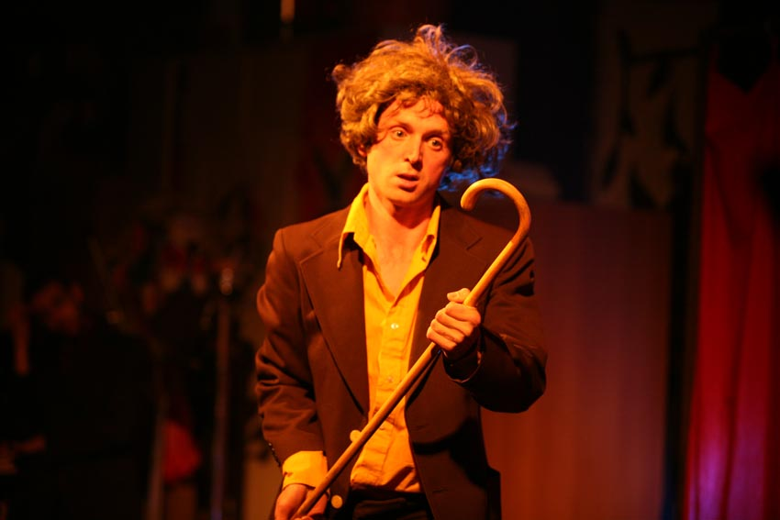

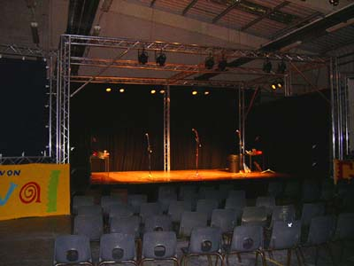
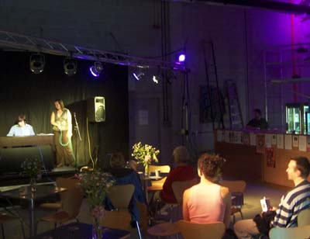
The Factory,
Gratton Way,
Roundswell Industrial Estate, Barnstaple
Just beyond Sainsbury’s, this converted industrial unit that houses North Devon College music performance courses, proved an instant hit as a venue in 2007.
Once again hosting the dance element of the Fringe theatrefest, alongside comedy and drama.
The Factory

Slide 14
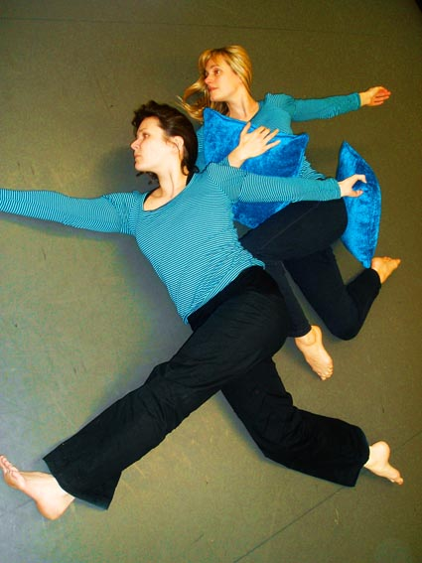
Harry Hair
Cabaret Show
Harry Hair, entertainer extraordinaire, enjoys himself enormously performing in front of his audience.
Unfortunately his shows don't always go quite as planned....
@ The Factory
modern clown comedy
age 3+

Slide 15
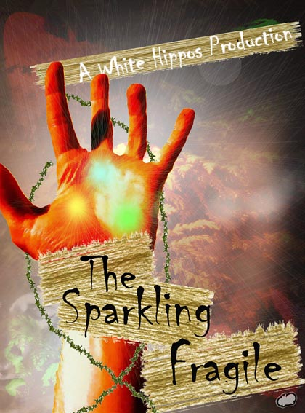
North Devon Dance
present
YoYo Triptych
in
Let Me Rest
YoYo Triptych are back with a
new twist on their latest work,
dancing out both the adrenalin
and the deep heartache that often
go hand in hand with our desire
for status.
@ The Factory
dance
age 10+

Slide 16
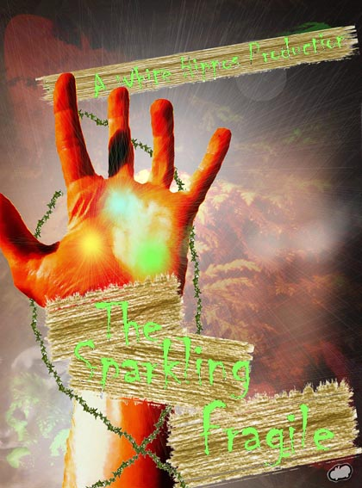

Life, love, loss and everything in between collide as a clock ticks its way to midnight, and the Lord of Fragile Things must decide what survives.
THEATRE WITH TEETH
IN
comedy-drama
age 14+
@ The Factory

Slide 17
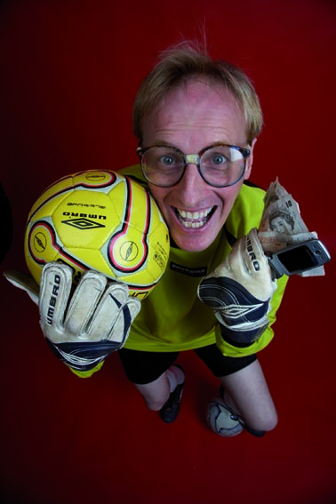

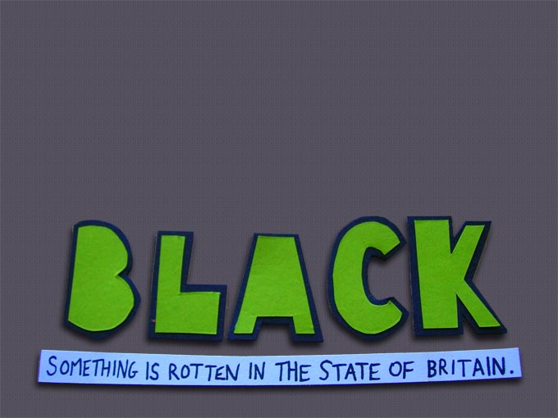
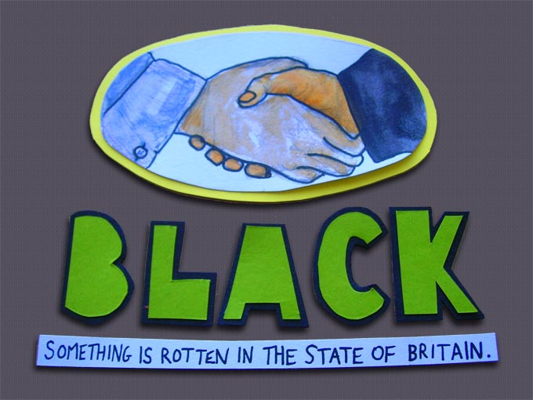

THEATRE WITH TEETH
IN
A political adaptation of “Hamlet” - Britain's current administration explored in the framework of Shakespeare's epic tragedy.
@ The Factory
political satire/new writing
age 12+

Slide 18
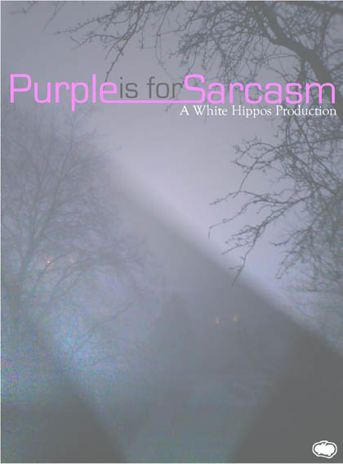
stretch mark productions
in
Dodgy Keeper
This goalie has a dark secret, it's going to cost him everything.
He's even gambled the team's money on a dodgy horse.
As for his family - his wife is seemingly having an affair and his nine-year-old daughter appears to know more about his life than he does...
drama/stand-up
age 13+
@ The Factory

Slide 19
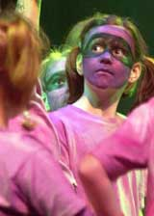
Live from the scene of a near disaster, a news reporter begins to question how reliable the media actually is.
@ The Factory
drama
age 14+

Slide 20
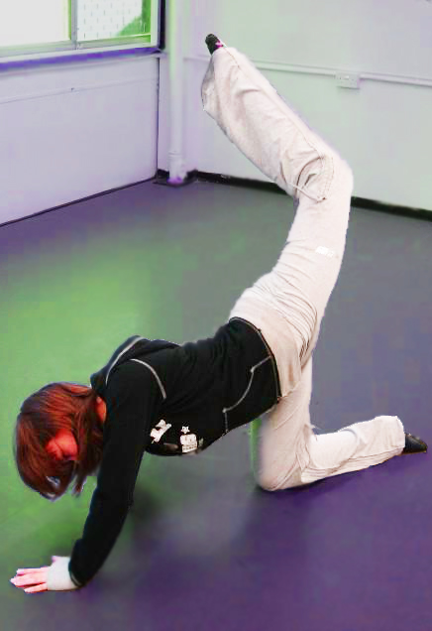
Forches Finest
present
Midsummer Margaret
pre-teenage relationships erupt close to the edge
A group of 10 and 11 year olds from Forches Cross Primary School - have taken ideas from "A Midsummer Night's Dream" and put them in a modern day local setting.
The play is a movement and dance-based drama, incorporating computer imagery.
comedy-drama, dance
age 8+
@ The Factory

Slide 21
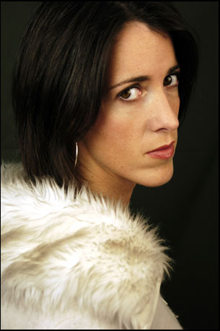
OUT THERE
in
We’re All Human
A stylized look at how we interact with each other from an exciting new dance company.
dance
age 10+
@ The Factory

Slide 22
Sally-Anne Hayward
in
Cyril
A pre-Edinburgh Fringe showing of a brand new comedy from a truly talented comedian.
A modern village life fairytale from the FHM Comedy Award Winner.
‘Fabulous … a quick wit with a warm and edgy charm’ BBC.
WARNING: Contains maypole dancing, murder and damson jam.
comedy
age 16+
@ The Factory

Slide 23
thursday – sunday
26 – 29 june
3 Barnstaple venues:
The Factory
The Inn on the Square
The Platform

Slide 24
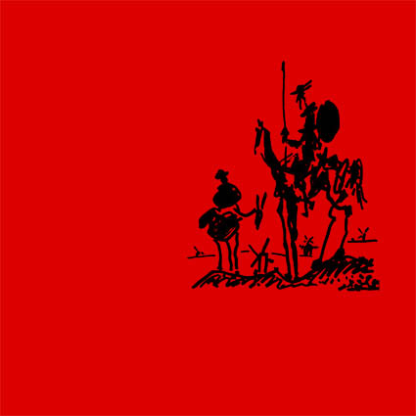
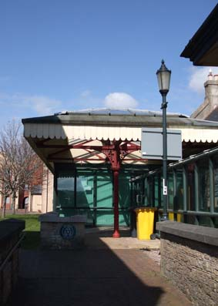
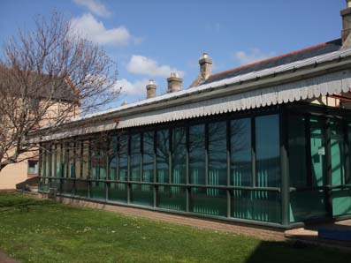
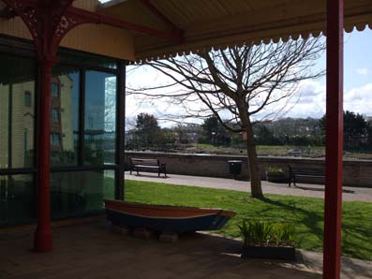
The Platform, The Old Railway Station, The Strand, Barnstaple
An intimate studio space in one of Barnstaple’s historic buildings hosting a range of work including a number of family orientated shows.
Easy access to town-centre parking.
The Platform

Slide 25
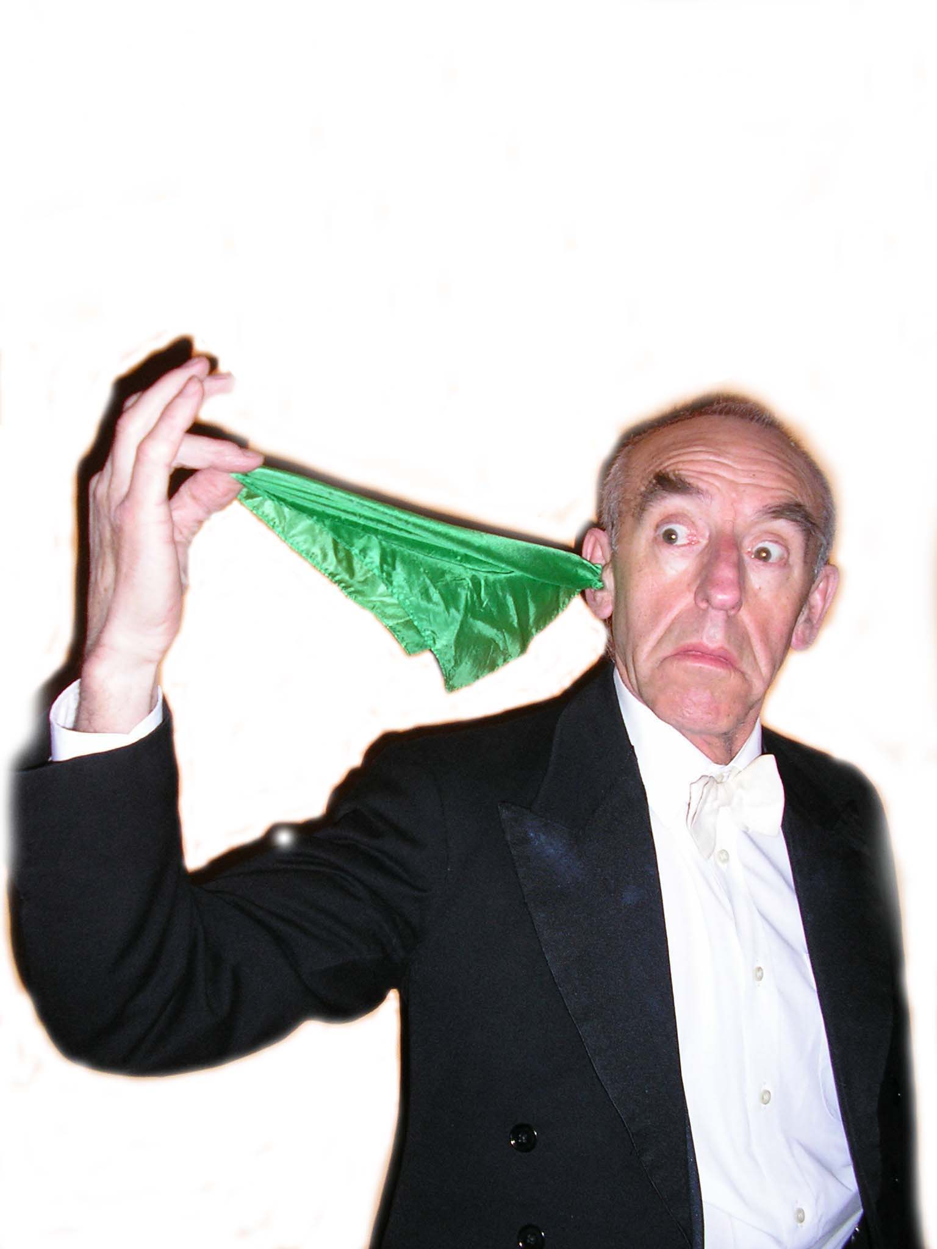
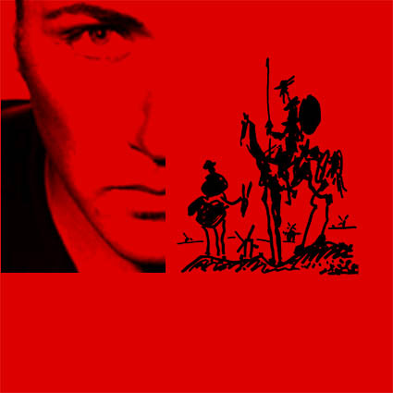
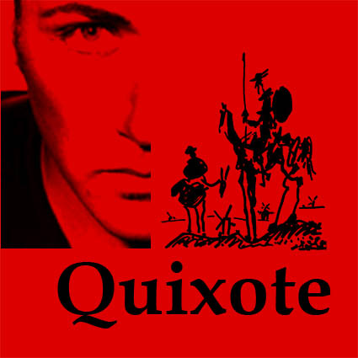
Erik de Waal
presents
“It’s been said before, but it’s worth saying again: Erik de Waal is a master storyteller.”
story theatre
age 14+
@ The Platform

Slide 26
The Great Surmo's Back
A cabaret style show
containing marvellous,
magical moments from the
evergreen, ever popular
man of mystery.
age 7 - 70+
@ The Platform

Slide 27
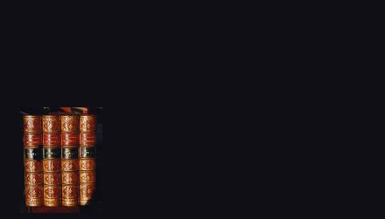
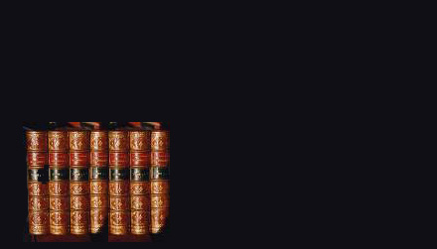
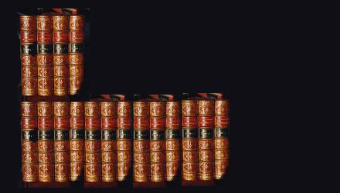
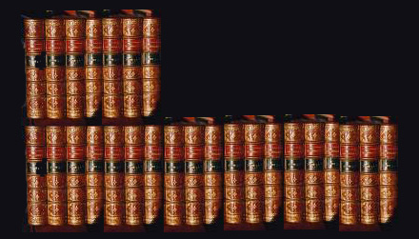
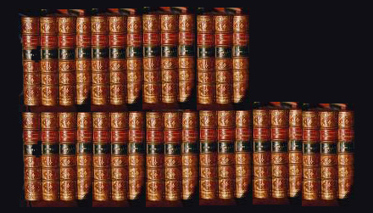
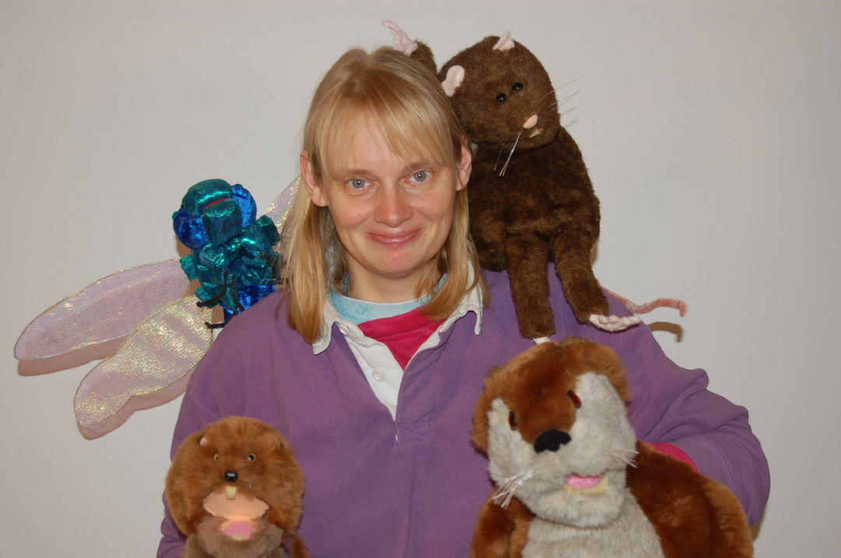
The Torrington Players
15 literary openings in 45 minutes - famous and not-so-well-known.
Guess them right you could be a winner!
First Impressions –
A Novel Entertainment
readings
age 14+
@ The Platform

Slide 28
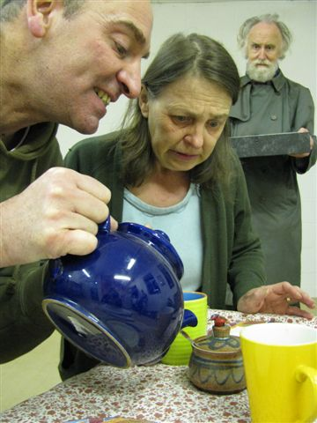
Fat Cat Theatre Company
An Otter's Tale
Jane Leakey brings you the stories of some of the exciting animals who live at Shapwick Nature Reserve and provides a fantastic opportunity to meet the inhabitants "up close and personal".
Featuring beautifully crafted puppets, full of laughter, excitement and adventure.
"Close encounters of the furred kind"
age 5+
@ The Platform

Slide 29
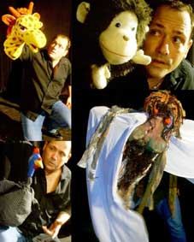
Crediton Actors Workshop
Harold Pinter's dark comedy about the fears and obsessions of life in rural England, powerfully staged by Crediton Actors Workshop.
dark comedy-drama
age adults (13+)
@ The Platform
A Slight Ache

Slide 30
Tales from the Calabash
Traditional stories from the Ekoi, Nguni and Tswana cultures - and from Erik de Waal's imagination.
"Tales from the Calabash finds great charm in its rustic puppets and masks, transporting kids to a land where the animals are different, the words are foreign and melodic, and imagination is the most important ingredient.“
See Magazine
story-telling theatre - including puppetry
age 5+
@ The Platform

Slide 31
www.ndfringe.org

