Slide 1


European Conference on EDGE AI
Technologies and Applications - EEAI
The convergence point of generative intelligence and autonomous action. Edge AI creates, reasons, and acts.
19-21 October 2026, Malta

Slide 2
M.AI.ESTRO: Virtual Reality Skill Guidance Through Edge AI
Graham Pellegrini
University of Malta
Malta

Slide 3

Presentation Outline
Introduction
State-of-the-art
Research Question
Methodology
Design and Implementation
Orbit Demo
Task Demo
Next Steps
Conclusion

Slide 4


Introduction
Malta has high importation of skilled work
National/EU-level push toward Industry 4.0
Traditional Onboarding and Transfer Learning
Shadowing an expert, consuming skilled labour time
Witten documentation, slow and needs to be updated
Formal/classroom training
(TVET courses, apprenticeship programs)

Slide 5



Introduction
M.AI.ESTRO aims to capture the task and convey it as a
Digital Twin
That can be processed offline and inferences with live, using dedicated AI modules, to enable transfer learning under two pilots:
VR Guidance
Robotic Automation

Slide 6

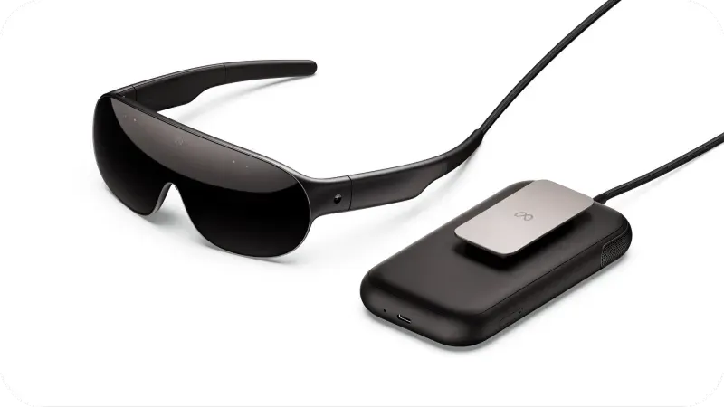
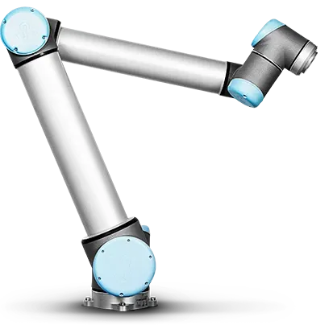
Introduction
VR Headsets/Glasses
Hold processing chip sets (Snapdragon XR2 Gen 2), however limited to rendering application graphics
Neither hold processing power to run heavy AI and Computer Vision pipelines.
Robotic Arms
Have on board controllers (Linux Os) that run real-time servo loops and handle signal processing for movement

Slide 7
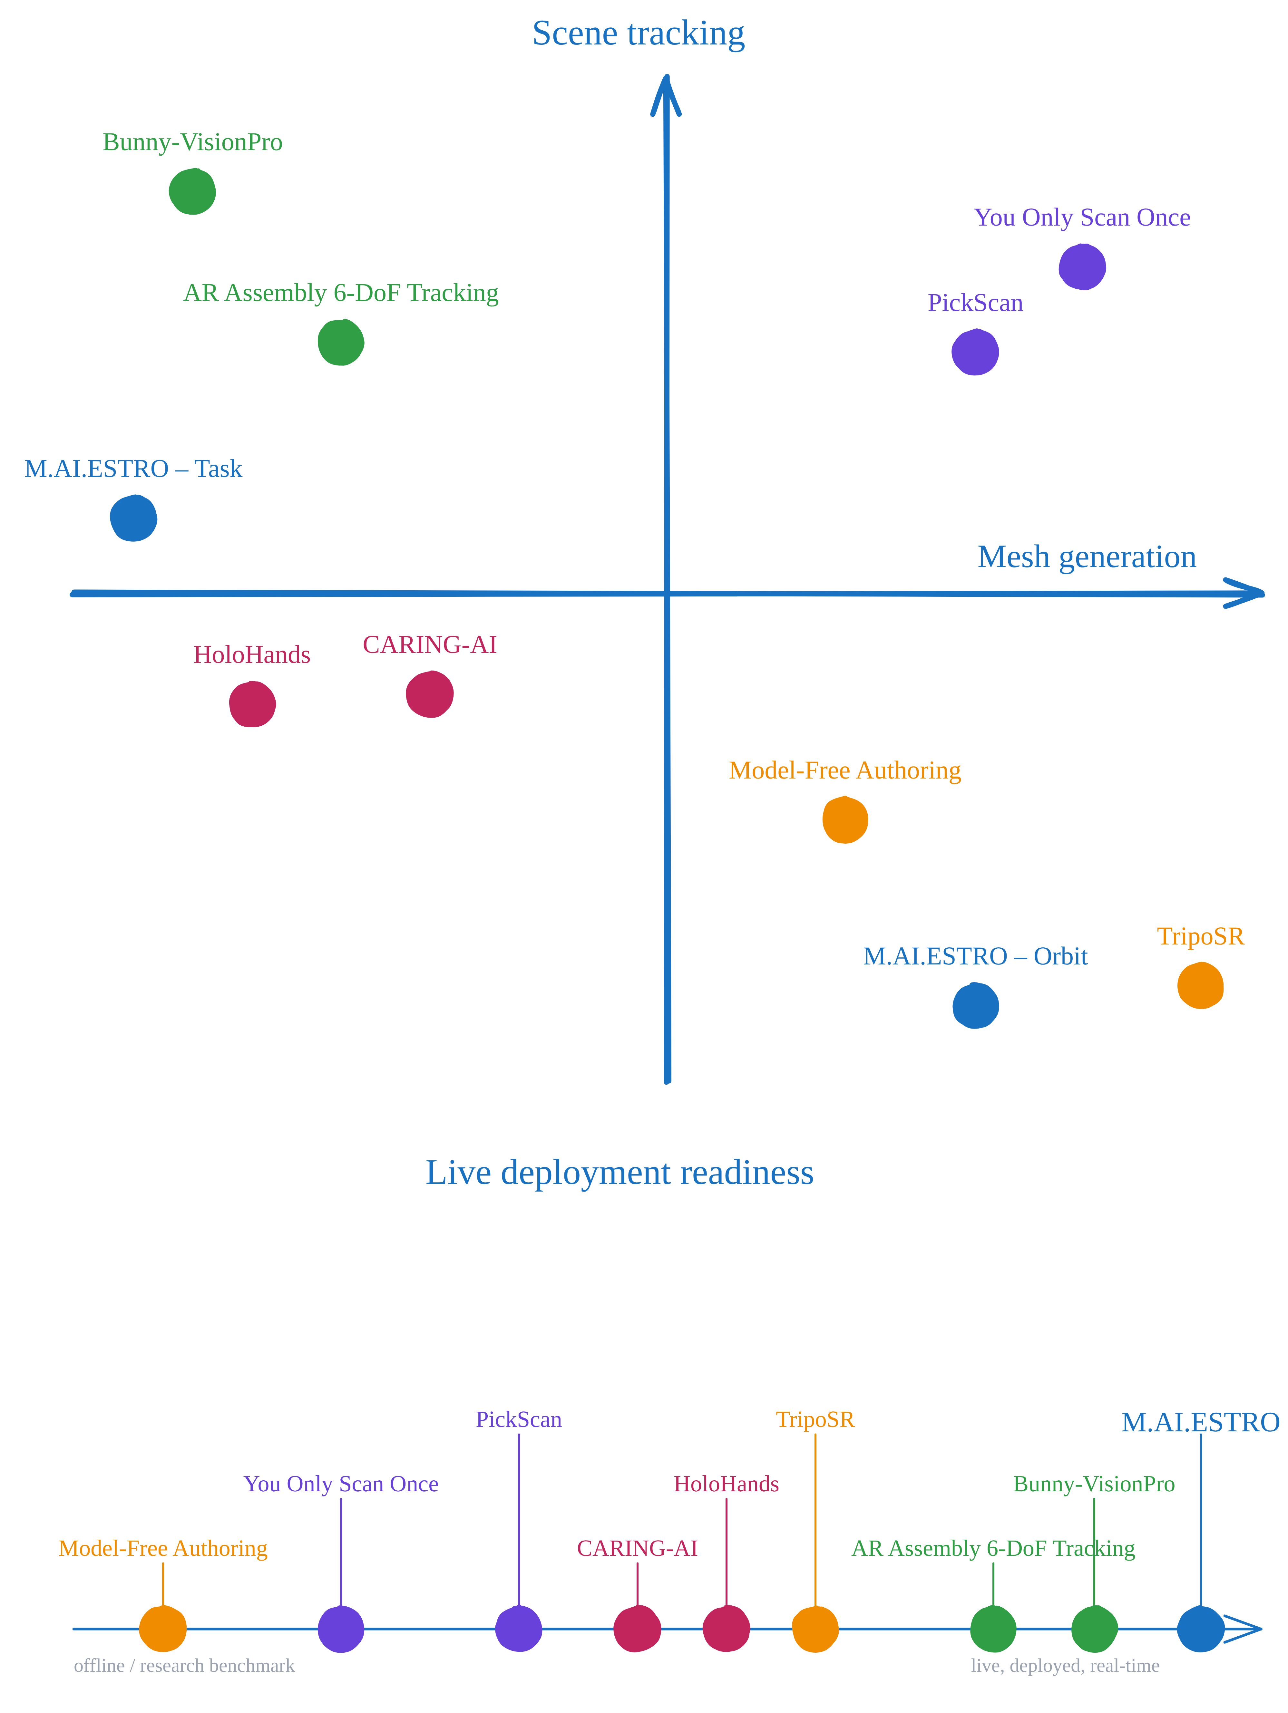
State-of-the-art

Slide 8
Research Question
How plausibly can we capture and utilize expert level skill demonstrations to enable transfer learning to a human/robot ?
Constraints :
The level of autonomy viable given then AI tool set currently available
The on-device hardware and compute needed to run the AI tool set

Slide 9
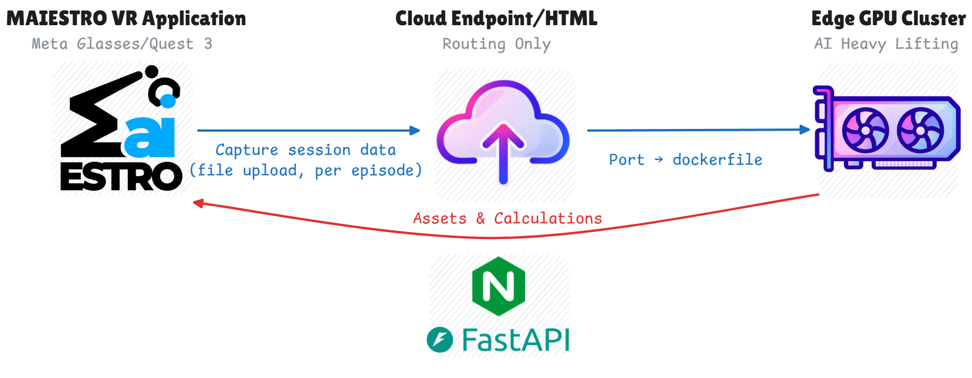
Methodology

Slide 10
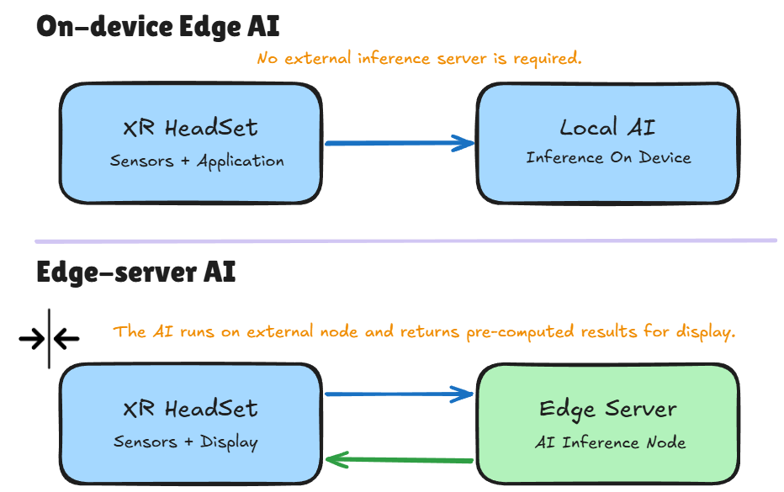
Design and Implementation: Thin Client / Fat Cloud

Slide 11
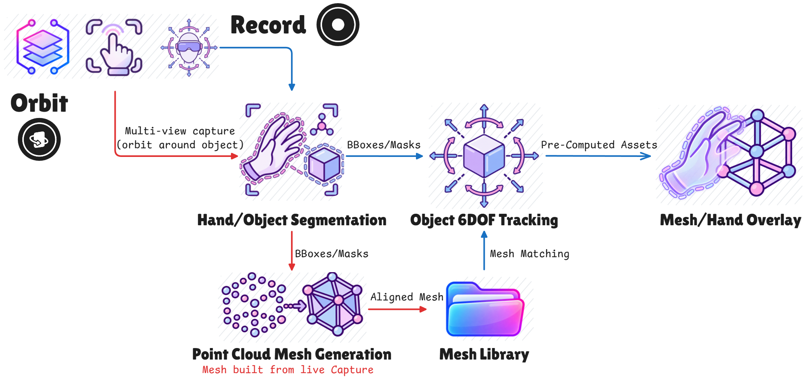
Design and Implementation: Edge-AI Modules

Slide 12
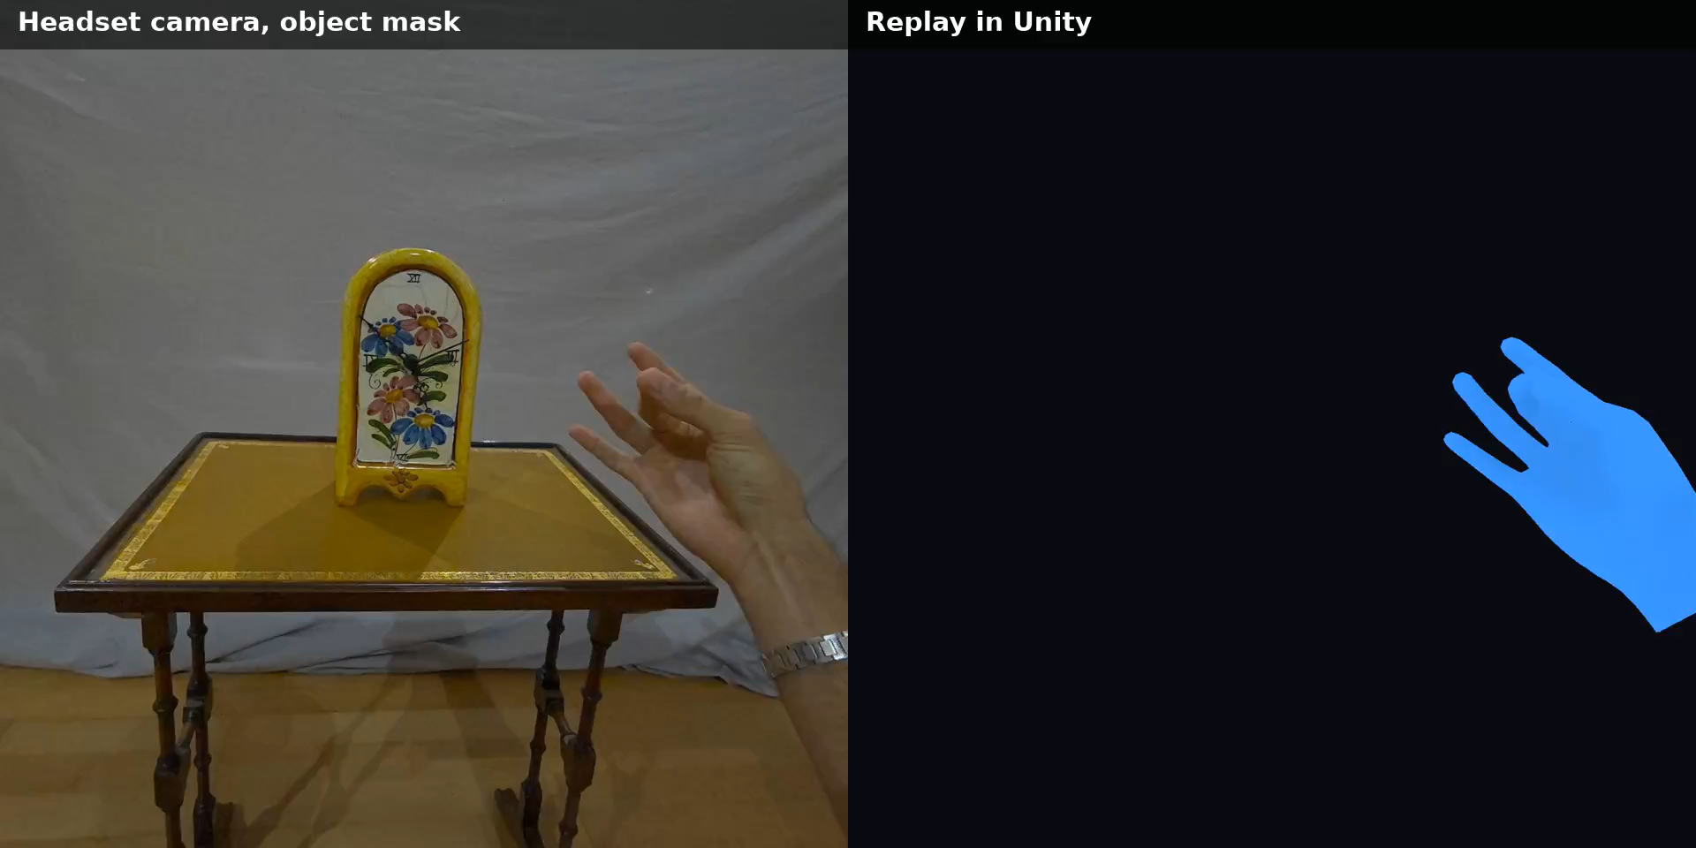
Orbit Demo: Ceramic Flower Clock
RGB/Mask capture (left) vs. Unity ghost/mesh replay (right)

Slide 13
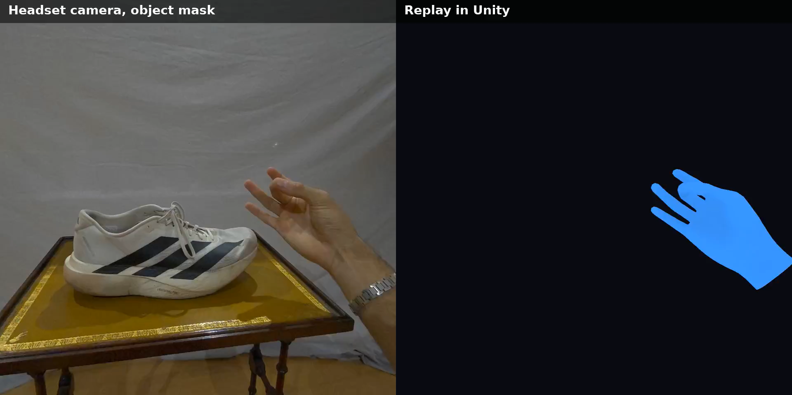
Orbit Demo: Running Shoes
RGB/Mask capture (left) vs. Unity ghost/mesh replay (right)

Slide 14
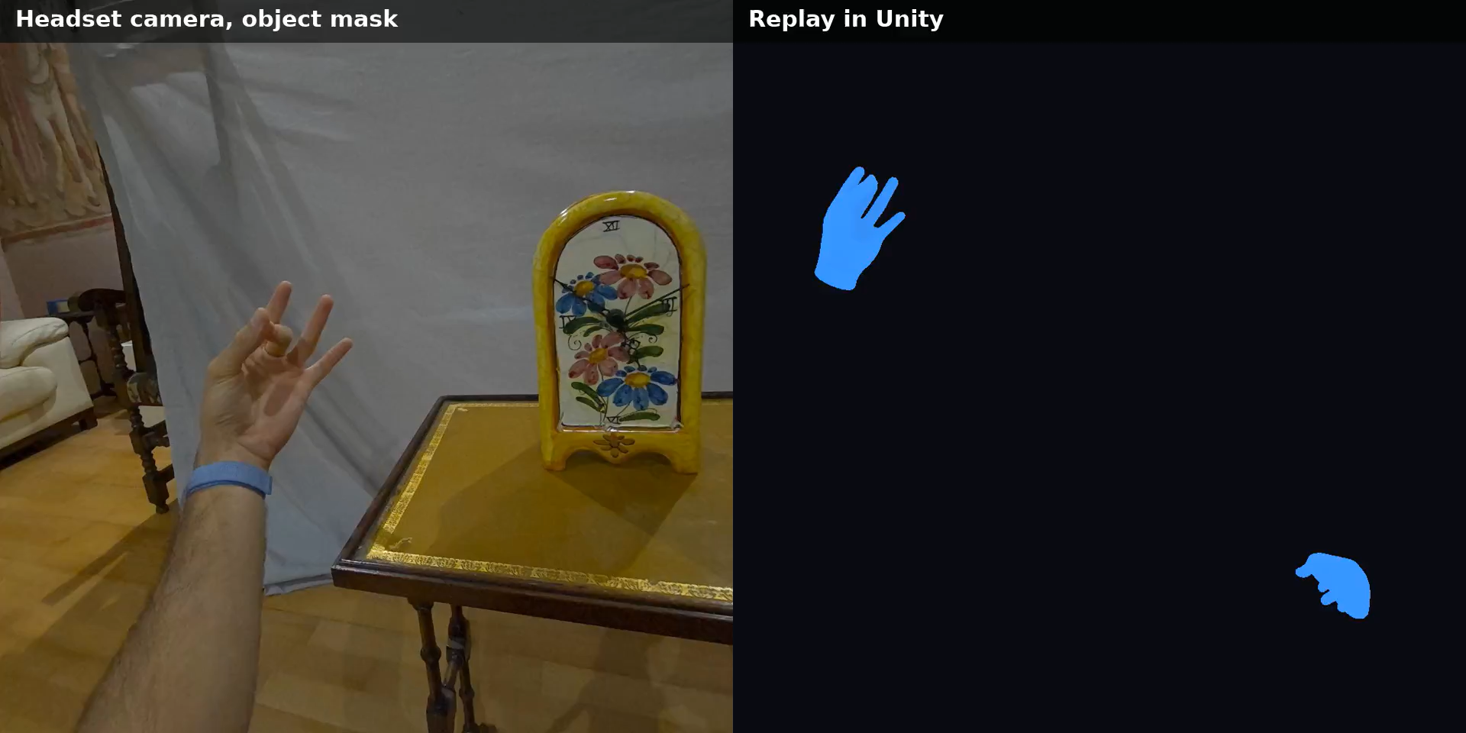
Task Demo: Ceramic Flower Clock
RGB/Mask capture (left) vs. Unity ghost/mesh replay (right)

Slide 15
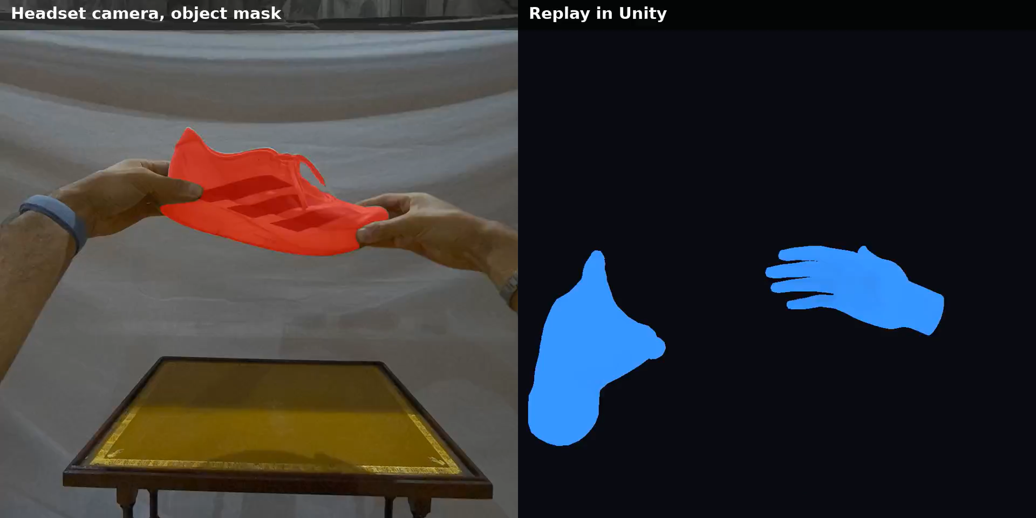
Task Demo: Running Shoes
RGB/Mask capture (left) vs. Unity ghost/mesh replay (right)

Slide 16
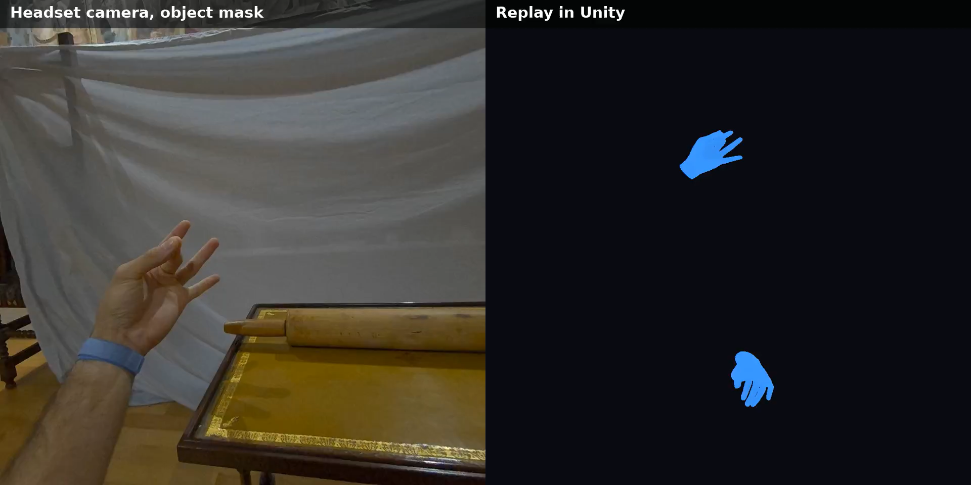
Task Demo: Wooden Rolling Pin
RGB/Mask capture (left) vs. Unity ghost/mesh replay (right)

Slide 17
Next Steps for MAIESTRO
Finalize the capture pipeline to unblock dataset construction.
Establish/train a policy and world model on the resulting dataset, predicting action chunks to guide task completion.
Reuse the same Maestro VR app for the first pilot of human guidance, serving both episode capture and guidance inference.
Translate hand instruction into robotic arm end-effector commands and wire the robotic sensing nodes needed for the second pilot.

Slide 18
Conclusion
A thin client capable of heavy AI work through a leveraged GPU cluster compute node.
Correct construction of scene data to create a digital twin of a task, building toward the two inference pilots.
Live mesh generation is scene-dependent:
- initial object masking is sometimes partial
- sparse matching and point cloud don’t always produce watertight meshes.
Fast movements or off-screen tracking remain an unsolved edge case

Slide 19


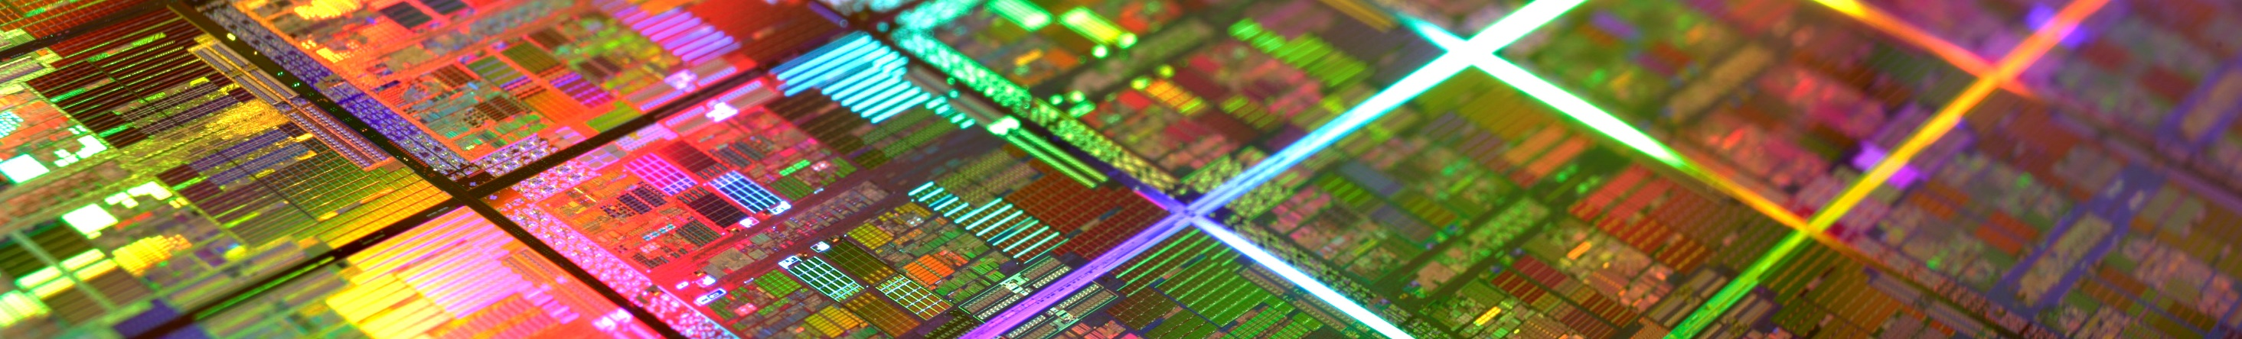
Thank You
For your attention
graham.pellegrini@um.edu.mt
Copyright © 2026

Slide 20





Event Organisers
EdgeAI
NEUROKIT2E
SMARTY
dAIEDGE
EdgeAI (Edge AI Technologies for Optimised Performance Embedded Processing) develops new electronic components and systems, processing architectures, connectivity, software, algorithms, and middleware through the combination of microelectronics, edge AI, embedded systems, and edge computing. www.edge-ai-tech.eu
NEUROKIT2E (Open source deep learning platform dedicated to Embedded hardware and Europe) proposes a Deep Learning Platform for Embedded Hardware around an established European value chain (AI HW/SW). The solutions developed support neural network design, optimisation, and implementation on constrained HW. https://www.neurokit2e.eu/
NEUROKIT2E
SMARTY - Scalable and Quantum Resilient Heterogeneous Edge Computing enabling Trustworthy, focuses on cloud-edge continuum for heterogeneous systems, that protects data-in-transit and data-in-process, employing novel accelerators for quantum resilient communications, confidential computing, and software defined perimeters. https://www.smarty-project.eu/
dAIEDGE is the European Network of Excellence for distributed, trustworthy, efficient, and scalable AI at the Edge and promotes the application, development, and deployment of Artificial Intelligence (AI) on edge computing platforms. https://daiedge.eu/

Slide 21



Event Organisers
SMARTEDGE
TRISTAN
CLEVER
REBECCA
The SmartEdge project aims to achieve dynamic integration of decentralized edge intelligence while prioritizing reliability, security, privacy, and scalability. The SmartEdge solution includes a low-code tool programming environment with three main tools: Continuous Semantic Integration, Dynamic Swarm Network, and Low-code Toolchain for Edge Intelligence. https://www.smart-edge.eu/
TRISTAN aims to expand, mature, and industrialize the European RISC-V ecosystem to compete with commercial options by leveraging the Open-Source community to gain productivity and quality. A European strategy for RISC-V designs will be defined, creating a repository of industrial rate building blocks for SoC designs in various application domains. www.tristan-project.eu
CLEVER (Collaborative edge-cLoud continuum and Embedded AI for a Visionary industry of thE futuRe) proposes innovations in hardware accelerators, design stack, and middleware software that revolutionize the ability of edge computing platforms to operate federated, leveraging sparse resources that are coordinated to create a powerful swarm of resources. www.cleverproject.eu
REBECCA (Reconfigurable Heterogeneous Highly Parallel Processing Platform for safe and secure AI) aims to democratize the development of edge AI systems and create a complete hardware and software stack centered around a RISC-V CPU, which offer higher performance, energy efficiency, safety, and security than existing systems. www.rebecca-chip.eu

Slide 22




Event Organisers
LoLiPoP IoT
EdgeAI-Trust
AIMS5.0
MOSAIC
The objectives of LoLiPoP IoT (Long Life Power Platforms for Internet of Things) are to develop energy harvesting-based innovative Long Life Power Platforms that enable retrofit of wireless sensor network edge devices for asset tracking, condition and performance monitoring. www.lolipop-iot.eu
EdgeAI-Trust addresses an advanced, trustworthy edge AI ecosystem through cutting-edge hardware, software, and tools. The project aims to enhance decentralized EdgeAI operations that are secure, reliable, and sustainable. By integrating AI-based algorithms, devices, and APIs, EdgeAI-Trust fosters interoperability and secure data exchange across diverse platforms. from sensor-actuated devices to cloud systems, all within a dynamic zero trust environment. https://www.edgeai-trust.eu/
AIMS5.0 aims to boost the economy by adopting, extending, and implementing AI-enabled HW and SW components and systems across the entire industrial value chain. New technologies from IoT and based on Semantic Web ontologies, ML and AI help European manufacturers to shift from Industry 4.0 to Industry 5.0, creating human-centric workplace conditions and a climate-friendly production. https://aims50.eu/
The MOSAIC project aims to achieve European technological independence and digital autonomy in Electronic Components and Systems (ECS) for automated systems, aligning with the EU Chips Act. It will develop next-generation, energy-efficient, and robust cognitive ECS, focusing on integrating diverse perception hardware and fostering interoperability to gain a competitive advantage for European manufacturers. https://chips-mosaic.eu/

Slide 23





Supporting Organizations
EU
AENEAS
EPoSS
INSIDE
Chips JU
AENEAS standing for Association for European NanoElectronics ActivitieS, is an industrial Association, established in 2006, providing unparalleled networking opportunities, policy influence & supported access to funding to all types RD&I participants in the field of micro and nanoelectronics enabled components and systems. https://aeneas-office.org/
The European Technology Platform on Smart Systems Integration is an industry-driven policy initiative, defining research, development and innovation needs as well as policy requirements related to Smart Systems Integration and integrated Micro- and Nanosystems. The main objective is to develop a vision and to set up a Strategic Research Agenda. www.smart-systems-integration.org
Inside Industry Association is the European Technology Platform for research, design and innovation on Intelligent Digital Systems and their applications. The Association is a membership organisation for the European research and innovation actors with more than 200 members and associates from all over Europe. www.inside-association.eu
Chips Joint Undertaking supports research, development, innovation, and future manufacturing capacities in the European semiconductor ecosystem. Launched as part of the Chips for Europe Initiative, it confronts semiconductor shortages and strengthens Europe's digital autonomy, engaging a significant EU, national/regional and private industry funding of nearly €11 billion. https://portal.chips-ju.europa.eu/

