Slide 1

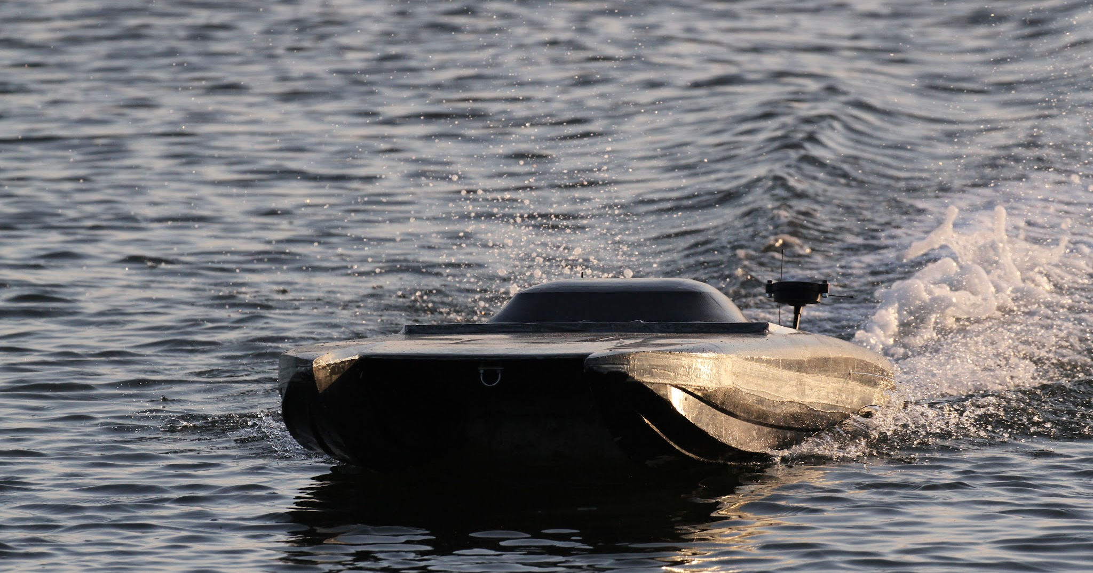
OSPREY
Where the boat is, and what is left
7 FT CATAMARAN
97 LB
30 MPH LOGGED
TWIN ELECTRIC INBOARD
IN-HOUSE CARBON HULL
PEP AUTONOMY DIVISION
Princeton Electric Speedboating · Fall 2026
Notes:
Osprey is the Autonomy-division boat. Built and raced by Aidan Astudillo and Sean Lee for their 2026 senior thesis; they have now graduated. This deck covers where the boat actually is and what is left to do.

Slide 2
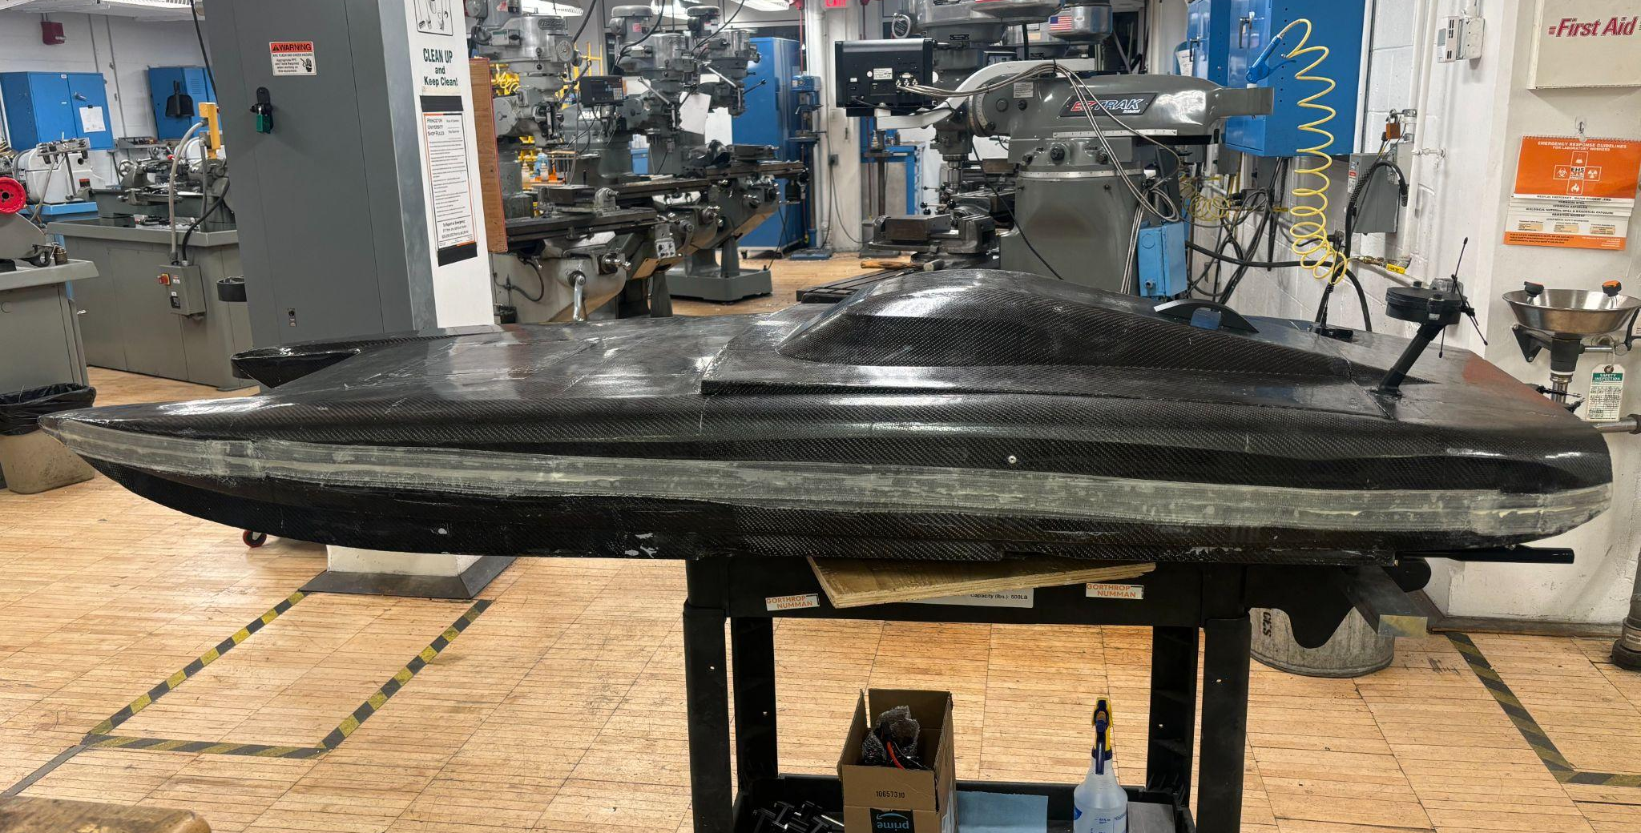
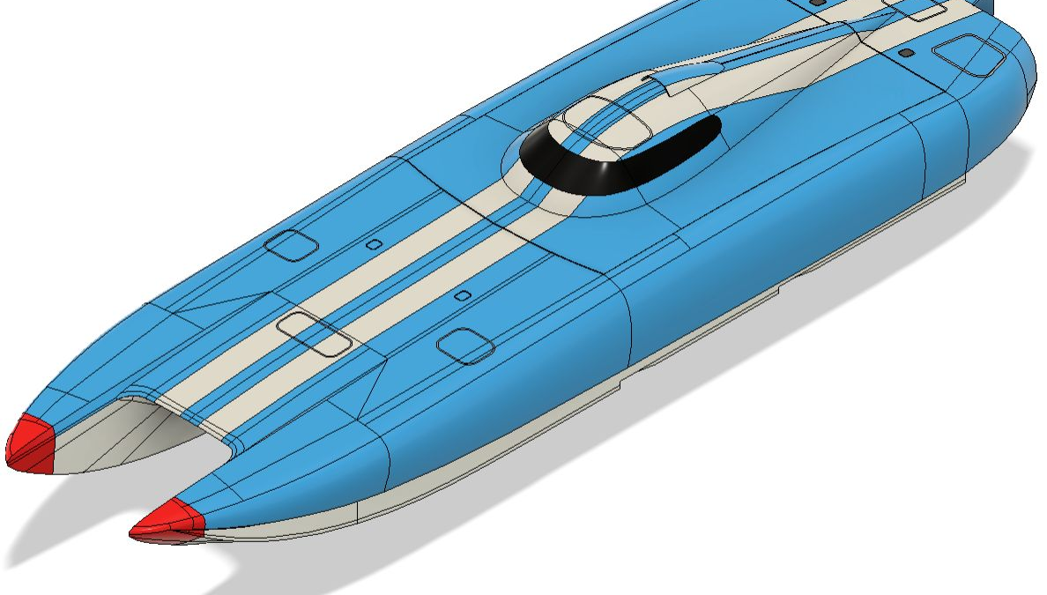
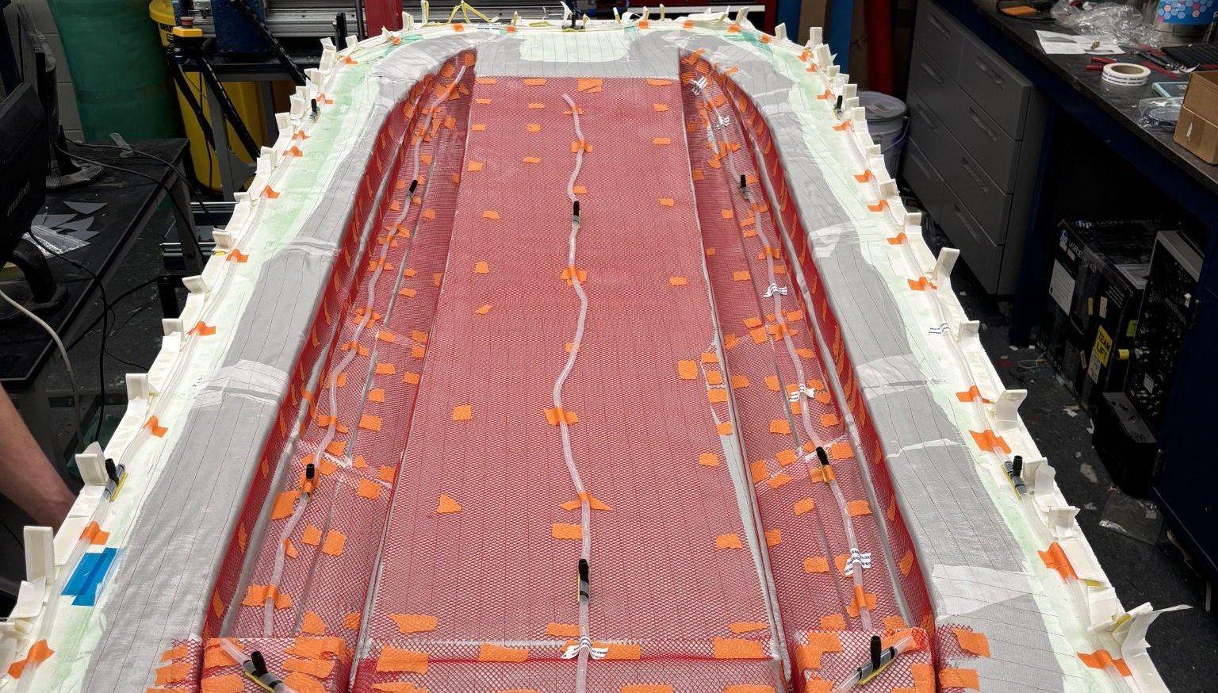


What Osprey Is
The boat:
7 ft LOA, 44 kg (97 lb), tunnel-hull catamaran with stepped sponsons and 21.5° deadrise
Resin-infused carbon hull laid up in-house over 3D-printed molds
Twin Castle 2535 680 Kv motors on Hydra Cobra 5 HV ESCs — 180 A continuous, 9 kW each
8 × Lectron Pro 22.2 V 5200 mAh 100 C packs — 44.4 V, 10.4 Ah, two fully independent HV domains
Design speed 80 mph. Logged 30 mph on the water.
Finished hull, the tunnel-hull CAD, and carbon layup in the mold
Notes:
Design speed was 80 mph; the boat has logged 30. That gap is the story of the next few slides. The hull is resin-infused carbon over 3D-printed molds, laid up in-house at Forrestal.

Slide 3
The Mission: PEP27, Autonomy Division
The two-mark oval
The race:
2-mile oval between two marks a quarter mile apart, run autonomously at Portsmouth City Park, Virginia
Scoring rewards finishing: 10 points per completed half-mile (40 total) against 20 for winning outright
0.98 m/s is the average speed needed to finish inside a 55-minute heat
0.25 mile between marks
Rule 21 — and it is a gate:
The kill switch must engage when navigation data is missing or corrupted, and judges watch it demonstrated
Not implemented anywhere yet — not on the boat, not in the simulation
A number to reconcile:
The course is described as four laps. But marks a quarter mile apart put half a mile of straight into a lap before any turning, so a lap is 0.54–0.58 mile — making 2 miles about 3.5 laps. Confirm which figure ASNE scores.
Notes:
Scoring is the thing to internalise: finishing is worth twice winning. And the lap arithmetic does not close — marks a quarter mile apart put half a mile of straight into a lap before any turning, so a lap is nearer 0.55 mile than 0.5. Confirm with ASNE before it goes in a white paper.

Slide 4
Where the Boat Is Today
Works
Hull: sealed, sound, no major repairs
RC control and telemetry on the water
Planed at 30 mph without payload
Two independent HV domains
Remote kill switch, ~5-mile radius
Broken
Driveline: the shaft escaped the collet mid-race
One ESC failed on the bench and still needs replacing
Cooling: raw water never flowed reliably
Unknown
The autonomous system — 5 lb of hardware, wired in, excluded from the thesis
Has it ever steered the boat? Nobody has told us either way
Battery range was never characterised
The hull was never the problem. What stopped Osprey competing was a driveline failure that ended the race, an ESC failure before it, and a cooling system that never worked.
Notes:
This is the honest status board. The hull is genuinely done. Three systems are not. And the autonomous system is a question mark rather than a blank sheet — it is on the boat, it is wired in, and nobody currently knows what it is.

Slide 5
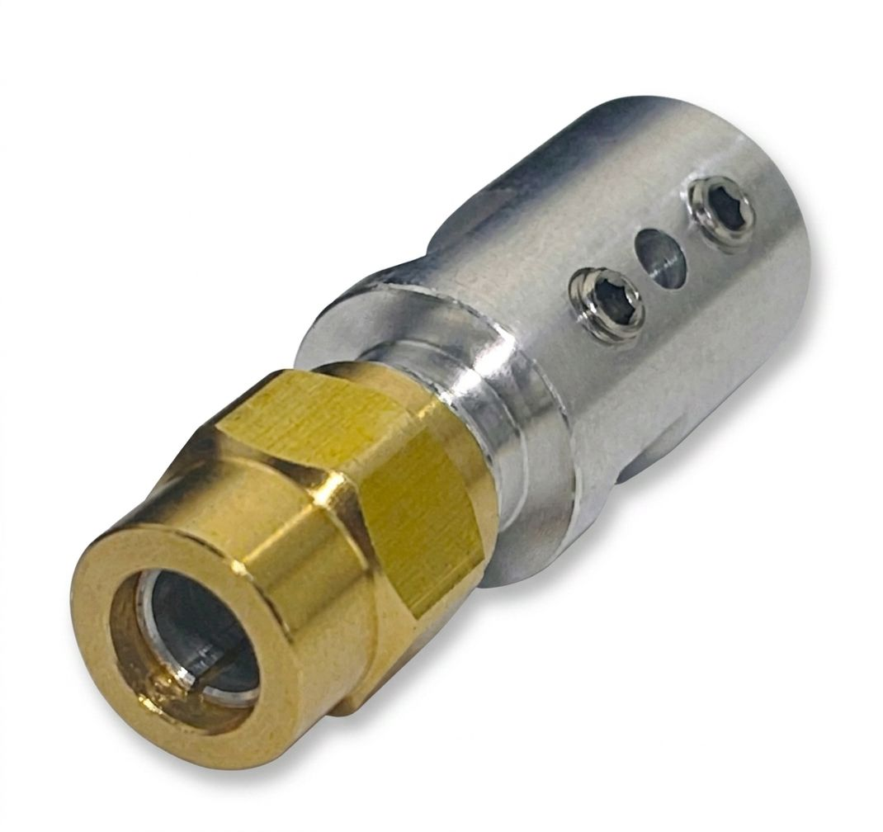
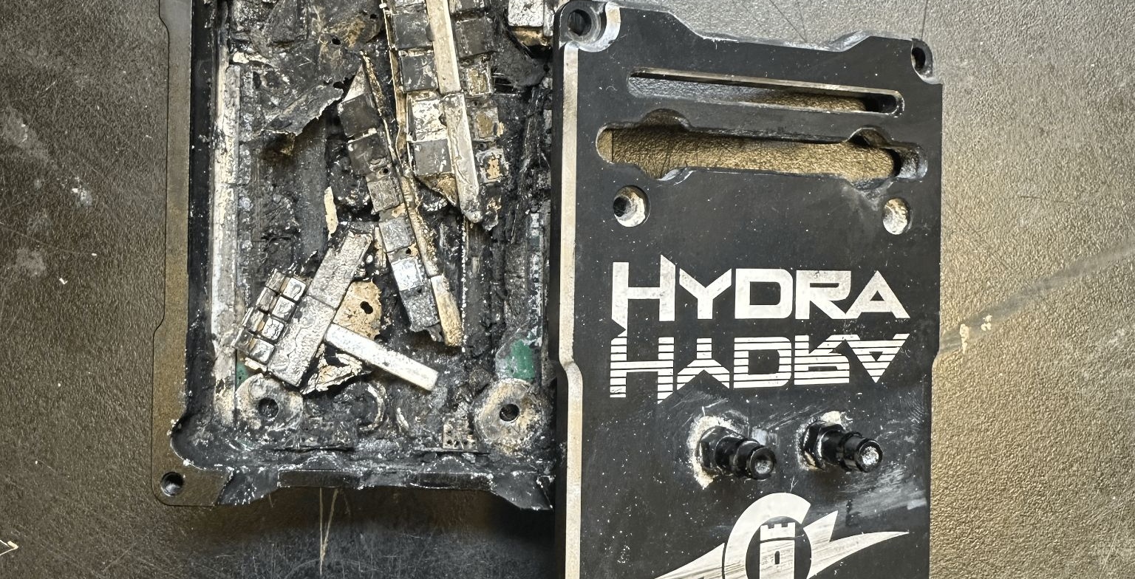
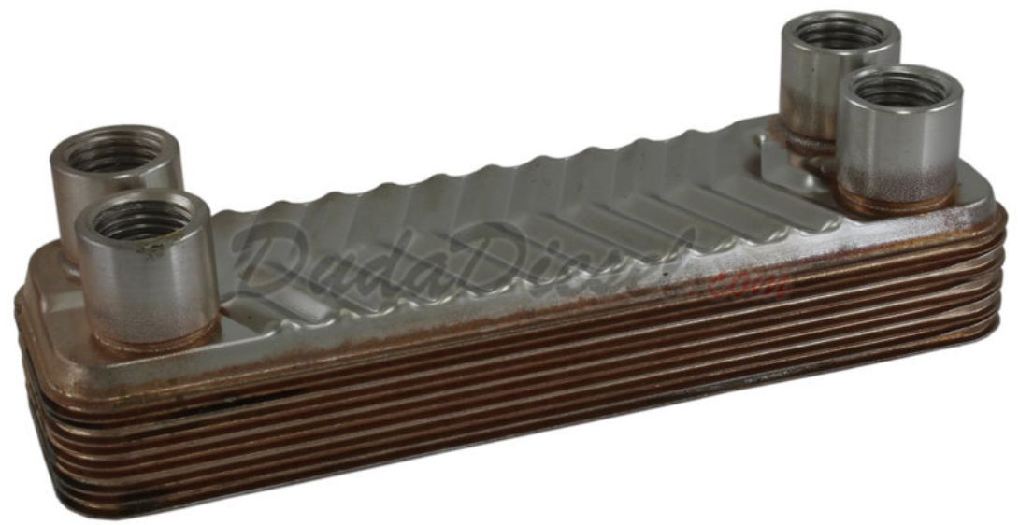
What Ended the Last Campaign
All three root causes are already diagnosed
Driveline
The flex shaft and propeller escaped the collet mid-river; the open stinger flooded the stern
Root cause: wear on the collet's clamping surface. The nut never backed out — the shaft vibrated through it
Motor controller
Voltage ripple reached 27.767 V, about 60% of pack voltage, against a 10% limit
Root cause: 12 C packs against the 50 C the ESCs require. Packs replaced; one ESC still needs replacing
Cooling
The raw-water pickups never consistently flowed water through the heat exchangers
It relies on hydrodynamic pressure at speed. Never fixed, never properly tested
Notes:
All three were diagnosed by the previous team, which is the useful part — we are not starting from a mystery. Note the driveline symptom: one prop lost RPM, so the boat pulled to one side and it presented as a steering fault. Worth remembering when we write fault detection.

Slide 6
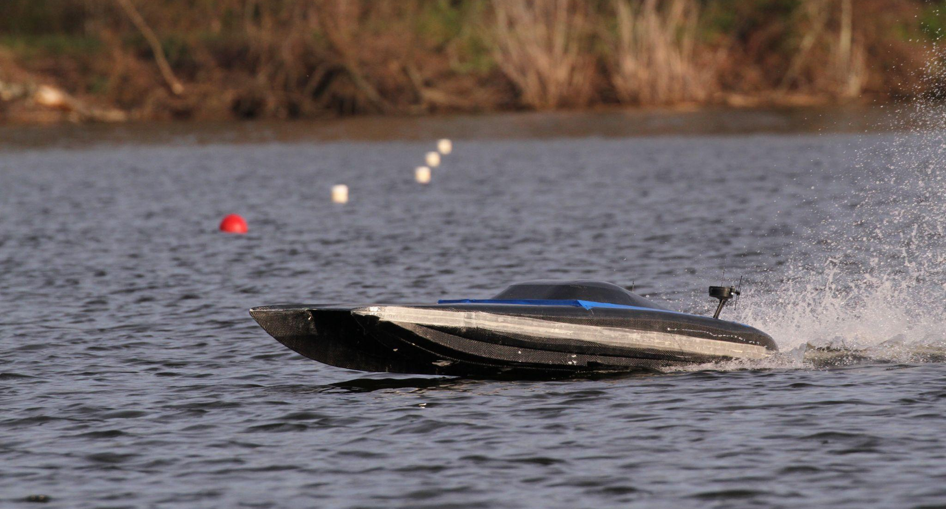
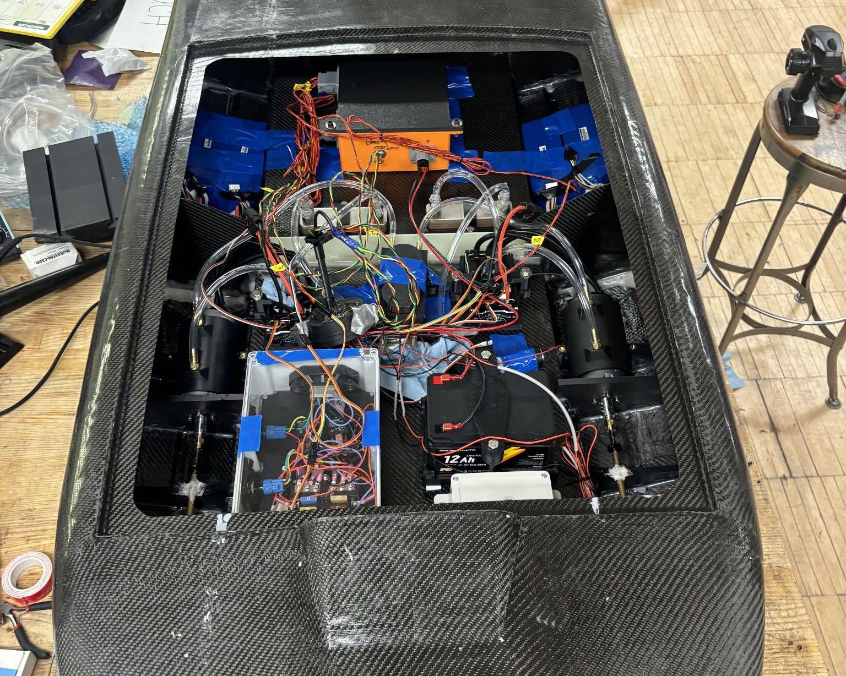
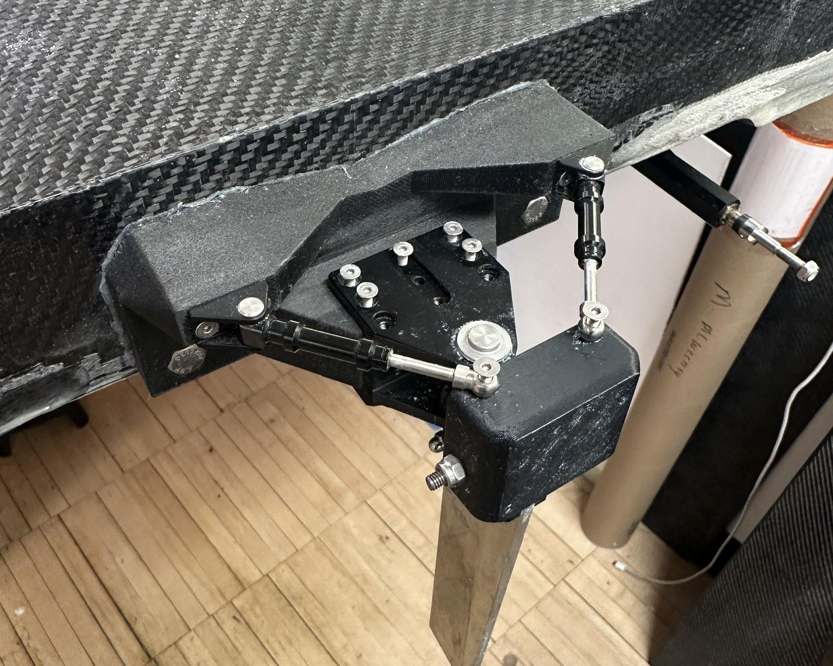
What Has Been Added Since
A manoeuvring simulation and control design:
Python 3-DOF simulation of hull, rudder, props and sensors — 49 checks, all passing
Validated to ~3% against the one logged planing run
ArduPilot Lua autopilot: motors steer below 10 mph, rudder above
Flown at 50 mph from a standing start — never on hardware
Read this before trusting any number:
The hull coefficients are unknown to within ±5×. Every deliverable is built to survive being wrong by that much — and anything that does not survive it is labelled as such.
The logged planing run, and the hardware the model describes
Notes:
Be straight about the caveat. The boat runs at Froude number 2.9 to 7.8; every standard manoeuvring regression is fitted below 0.3. So the hull derivatives are placeholders swept plus or minus five times, and the simulation is built so its conclusions survive that. It cannot tell you what your gains should be.

Slide 7
Four Findings That Change What We Do
1
Size the rudder on span, not area
Authority is area × lift-curve slope. 30× the area at fixed span buys 32% more authority; 3.3× the area via span buys 5.3×. Chosen: 45 mm × 5 in, 2.7× the old blade.
2
At 50 mph, the unknowns decide whether it can turn
The nominal boat finishes with either blade. Across the plausible hull range, 63% of boats with the old blade cannot make the marks, 38% with the new one. Measuring the hull is the critical path.
3
The powertrain is correctly sized. The boat is not using it
80 mph needs about 180 A per motor. The ESC is rated 180 A continuous — it matches almost exactly. What is 4× short is the current actually drawn: 45 A. That is a propeller problem, and no new electronics fixes it.
4
Limit servo travel to ±10°, not ±35°
Past ventilation onset the yaw moment falls as deflection rises — 64.4 down to 38.7 N·m at 13.4 m/s, latched until it unloads. Commanding into that region hands the controller a negative plant gain.
Notes:
Four results that change what we should actually do. The rudder one is the counter-intuitive one: making the blade bigger the obvious way buys almost nothing, because growing the chord collapses the aspect ratio.

Slide 8
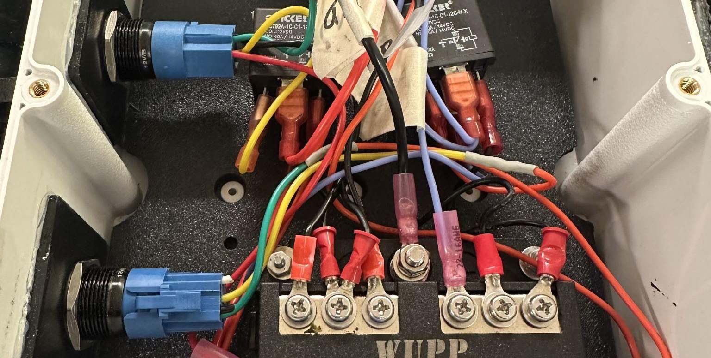
The Biggest Unknown: Autonomy
An autonomous system is already on the boat.
The thesis budgets 5 lb for it and lists it as integrated into the electrical system — then places it “outside the scope of this thesis”
So it exists and it is wired in, and it was documented somewhere we have not found, or not at all
What we need to find out:
Which flight controller, GPS, compass, radio? 5 lb is a lot of hardware — we may already own most of what we need
Has it ever driven the boat? Even a straight line, even one waypoint
Is it wired to the steering servo and throttle now, and what happens on handover?
Two hard software facts:
The autopilot is a Lua script that drives the servo outputs itself, so Rover's steering modes are not needed — but it has never run on ArduPilot
The script does its own gain scheduling, so Rover's lack of it no longer matters
Notes:
This is the single biggest unknown going into the next cycle. It decides whether the autonomy work is 'integrate and tune' or 'build from scratch'. The thesis budgets five pounds for it and then says it is out of scope — so it was documented somewhere else, or not at all.

Slide 9
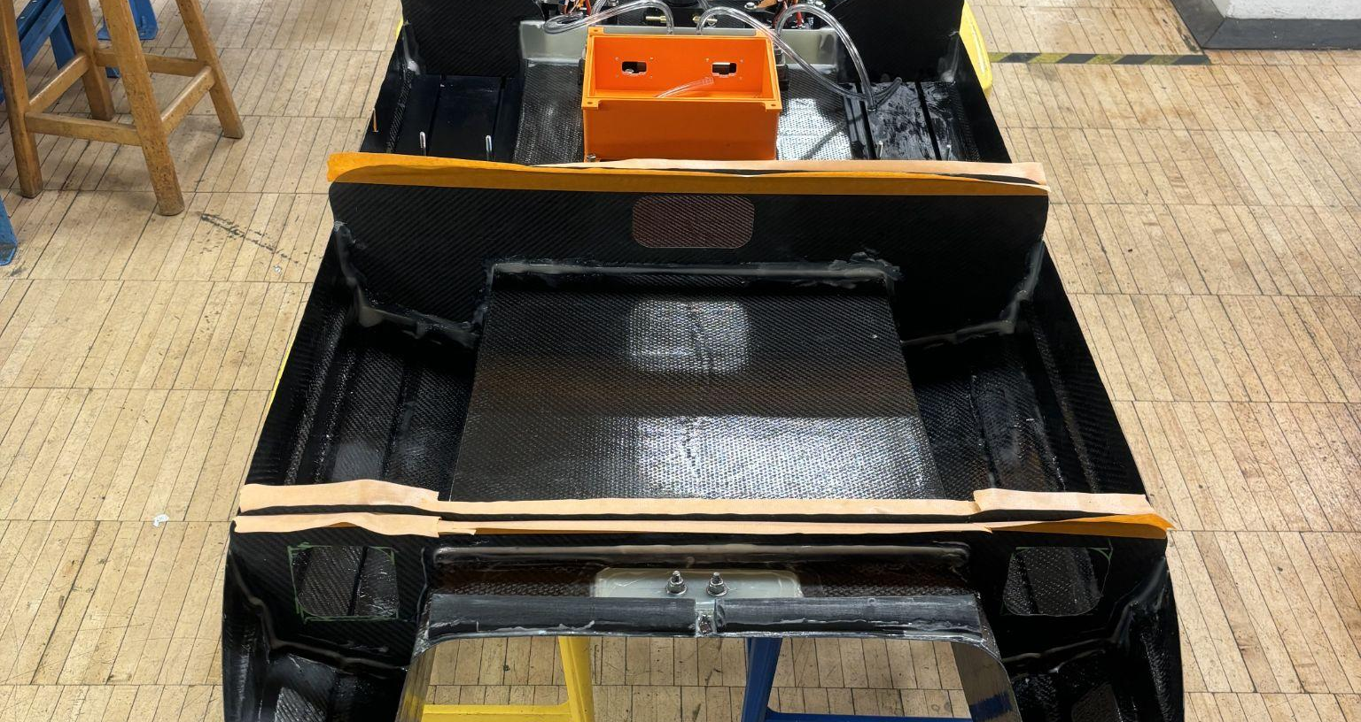
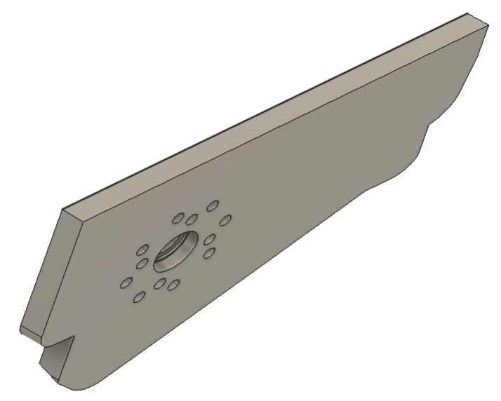
What Is Left — Mechanical
Driveline first: nothing else matters if this repeats
Critical — driveline
Replace both shaft clutch collets — the failure was wear on the clamping surface. Inspect before every run day
Add positive retention so clamping force is not the only thing holding the shaft: a shoulder, a cross-pin or a retaining compound
Build an alignment go/no-go fixture. Motors sit at a 9.5° down angle, set by the motor plates
Seal the stinger. Losing a shaft should not be a flooding failure
High — rudder and manufacturing
New rudder blade 45 mm chord × 5 in submerged, same mount, stock balanced at 20–25% chord
Stuffing tube jigs in ASA, not PLA. Anneal the brass at 85 °C in the jig — PLA warps at that temperature
Assembly, the rudder blade, and the collet that failed
Notes:
Driveline first. Nothing else matters if the shaft comes out again. Note that the clamping nut never loosened — the shaft slipped through it — so the fix is positive retention, not more torque.

Slide 10
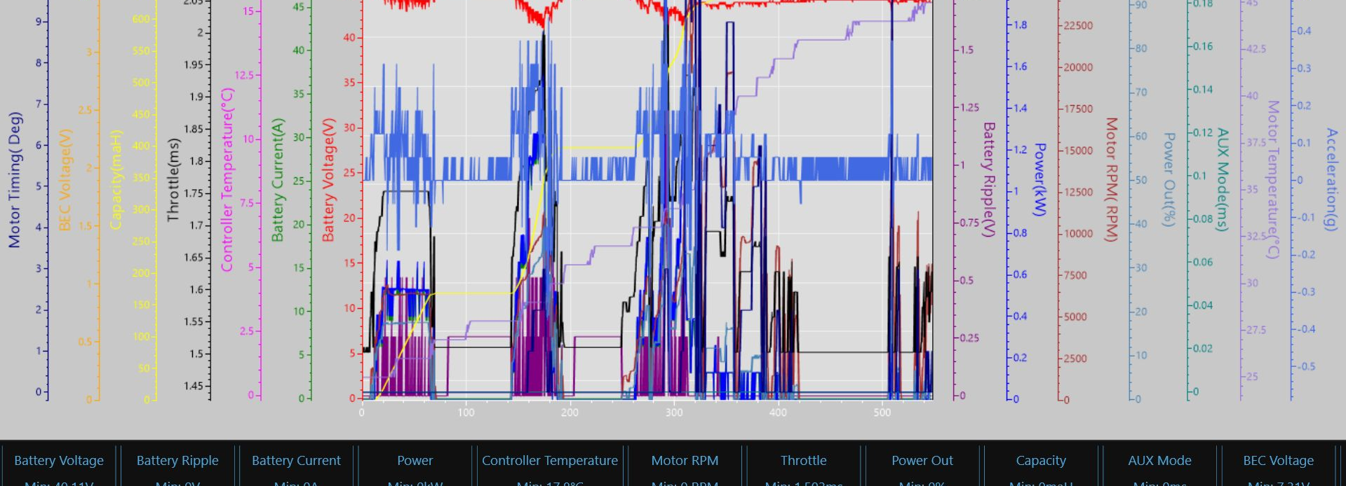
What Is Left — Electrical
Cooling — never actually worked
Fit pumps on the raw-water side rather than relying on hydrodynamic pressure — the previous team's own recommended fix
Instrument and verify flow through the heat exchanger, not just “the pump runs”
Run a sustained thermal test at race duration. This is the test that was never done
Low voltage — re-budget for autonomy
The autopilot, GPS, radio and companion computer are new loads the 10 Ah pack was never sized for
Give the autopilot its own fuse, isolated from the pump circuits
ESC and batteries
Like-for-like replacement is right — the Hydra Cobra 5 HV is correctly sized for the full design point
Check pack C-rating against the ESC requirement on every battery change
Add ripple monitoring to the pre-run checklist
Castle Link log from the 30 mph run — 23,150 RPM at 45 A, where 180 A was available
Notes:
The headline is that we do not need a bigger ESC — it is already rated for the full design point. Fix cooling before chasing current, whichever ESC you buy: 180 A continuous is a rating that assumes the cooling works, and it does not.

Slide 11
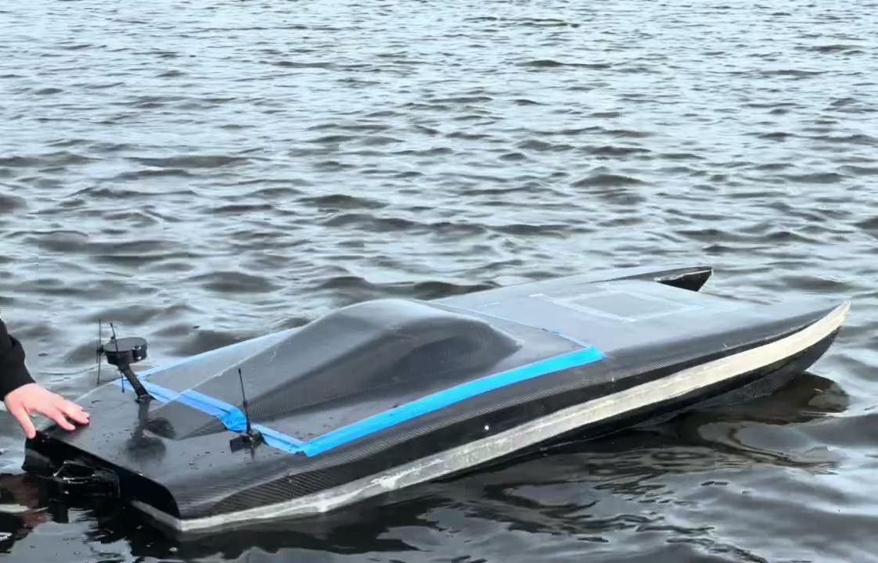
What Is Left — Software & Autonomy
S1
Stand up ArduPilot Rover SITL + Mission Planner
About a day, no hardware. Run the Lua autopilot on it.
S2
Demonstrate the Rule 21 GPS-loss kill
In the script and working in simulation. Judges watch it: prove it on SITL, then the boat.
S3
Control allocation: decided
Differential thrust only below 10 mph, rudder only above, with a 1 mph hysteresis band. Implemented in the Lua script.
Already built:
3-DOF plant model in Python
Gain schedule, derived not grid-searched
Monte Carlo robustness study
Failure-mode analysis
Lua autopilot, Rule 21 kill
S4
Gain schedule: done in the script
The rate loop works in moment units, so one gain serves every speed and both actuators.
S5
Build a steering-fault response mode
Above 10 mph the motors never steer, so a jammed rudder loses the boat. Detect it, slow below 10 mph, steer on the motors.
Notes:
Level 1 SITL is about a day and needs no hardware; the Lua autopilot runs on it directly. Most of the flight-code work lives there, including the Rule 21 kill. It is the best first task for anyone joining the software side.

Slide 12
If Only Three Things Get Done
01
Driveline retention
Collets replaced, positive retention added, alignment checked with a fixture. This is what ended the race.
02
Cooling that works
Pumps on the raw-water side, flow verified through the exchanger, and one sustained thermal test at race duration.
03
The Rule 21 GPS-loss kill
The craft must stop when navigation data is lost or corrupted. Not implemented anywhere. It gates competing at all.
The first two are what ended the last campaign. The third is a gate on competing at all.
Notes:
If the next cycle achieves only three things, these are the three. The first two ended the last campaign. The third is a gate on being allowed to compete at all.

Slide 13
You Can Help on Day One
Measurements that collapse more uncertainty than any amount of further simulation
Rudder stock position
10 min, callipers
Decides whether the servo spec closes at all: ~103 kg·cm at the leading edge against roughly zero if balanced. New blade, 50 mph.
Rudder tiller arm radius
10 min, ruler
Scales the required servo torque linearly. It was never recorded.
Yaw inertia
1 hour, bench
The largest single unknown in the model, swept ±50%. Hang the boat on two lines, twist it, time 20 oscillations.
Submerged rudder span
1 run + a photo
Assumed 3 in. The new blade adds 2 in to whatever this really is — so measure it.
Prop lateral separation
5 min, tape measure
Sets differential-thrust authority, the only steering below 10 mph.
Lateral area above waterline
20 min, CAD
Drives the crosswind disturbance directly. Currently a guess.
The full list, ordered by how much the answer changes, is in docs/HANDOFF.md §9.
Notes:
This is the slide for anyone wondering what a new member could actually do. Several of these are an hour with a ruler or a load cell and they collapse more uncertainty than any amount of further simulation. Items one and two are twenty minutes with callipers and they decide whether the existing servo is adequate.

Slide 14
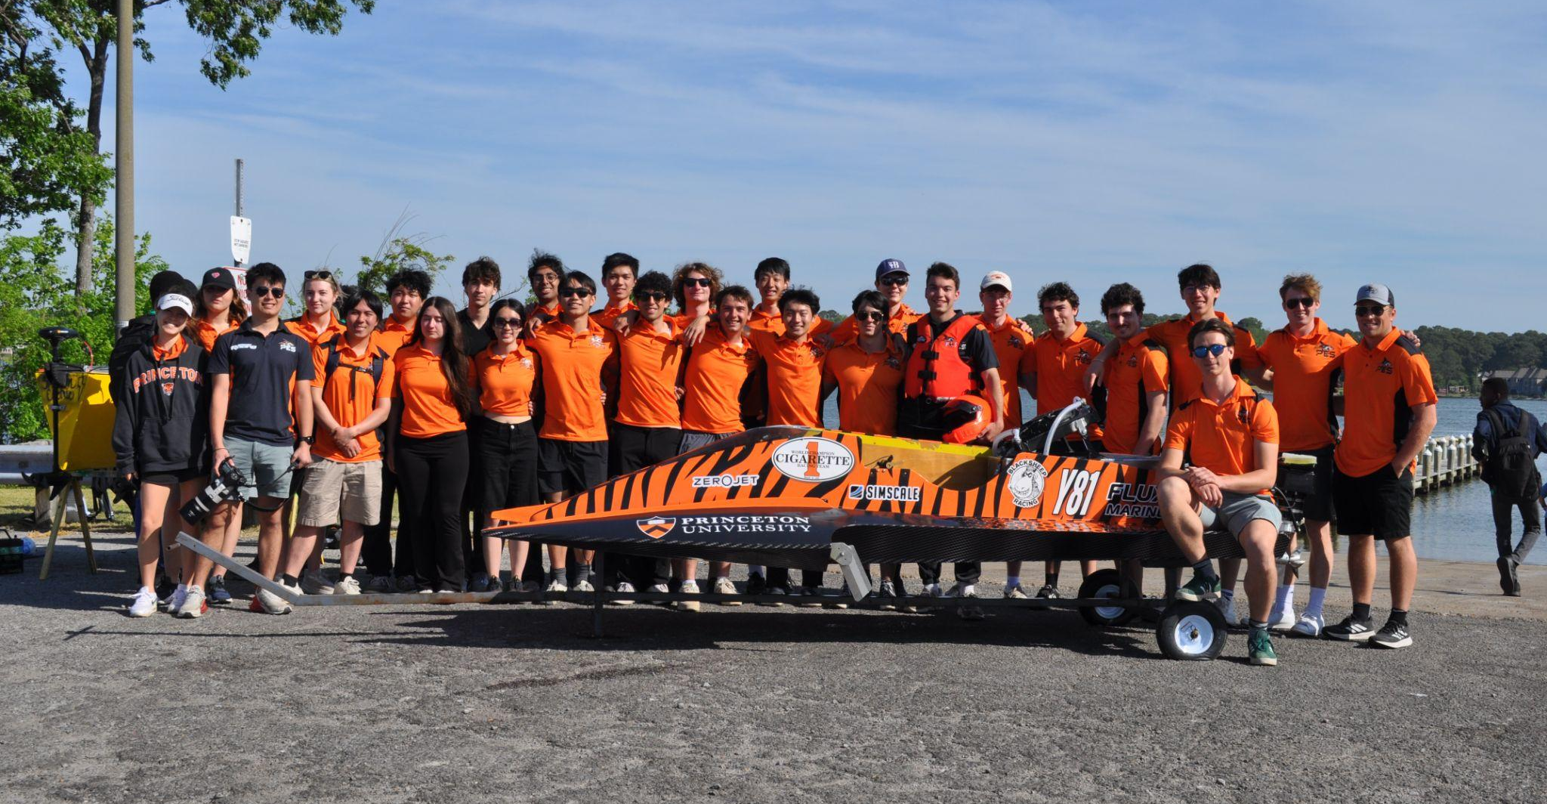
Get Involved
Where to start:
Run the tests. 44 sanity checks. If any fail, stop and fix that first
Read results/summary.md, then ASSUMPTIONS.md — every number driving a conclusion has an entry
Pick up a Tier 1 measurement — twenty minutes with callipers unblocks the servo spec
Or stand up SITL. Half a day, no hardware needed
Osprey subteam leads:
Mech / HV — Raymond Wang, Graham Smith
LV — Nigel Hu, Daniel Amolis
Autonomous — Fengyou Liu, Mihika Tiwari
Everything is in the repo:
github.com/GrahamSmith2/Osprey
README · ASSUMPTIONS.md · docs/HANDOFF.md · docs/WORK_REMAINING.md · results/summary.md
Notes:
Point people at the repo. Run the tests first — if anything fails, stop and fix that before trusting a number. Then read the summary and the assumptions register, then pick up a Tier 1 measurement or stand up SITL.

