Slide 1


B10 – “The Rocket Men”
Control Group
Matthew Gill – 13249157
Graham Whyte - 45688158

Slide 2
RCGs
Requirement
50 ms Instruction time / Rise Time less than 50 ms
Less than 5% overshoot
2-DOF Spherical Wrist
Simulink Model
Real-Time Controller
Constraints
16 MHz CPU clock speed
Budget ($1000 UBCD + $400 CAD)
Goals
Everything on PCBs
Separate Laser Power – No Dangling Wires from Diode
Animation
Optimal Rise – 25 ms
Satisfied
Satisfied
Satisfied

Slide 3
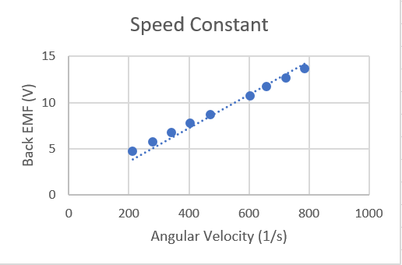


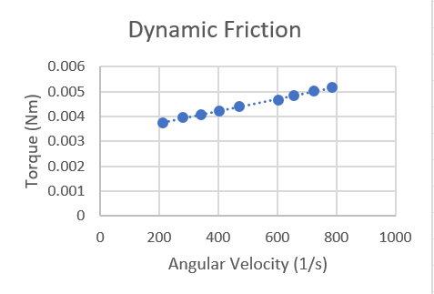

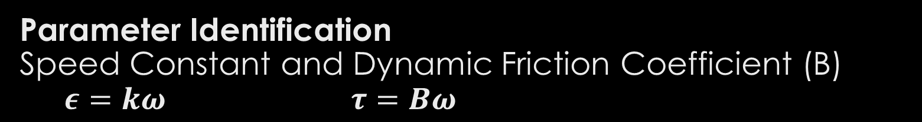
Parameter Identification Speed Constant and Dynamic Friction Coefficient (B) $ε=kω τ=Bω$
Steady State Unloaded Voltage Tests
Current Draw (I) and Angular Velocity ($ω$) Recorded
Back EMF ($ε$) calculated from current & terminal resistance
Terminal Resistance & Inductance measured with RLC meter
Speed Constant (K) as slope of Velocity/Back EMF curve
Friction Coefficient (B) as Slope of Torque / Speed Curve
Torque calculated with: $τ=kI$

Slide 4
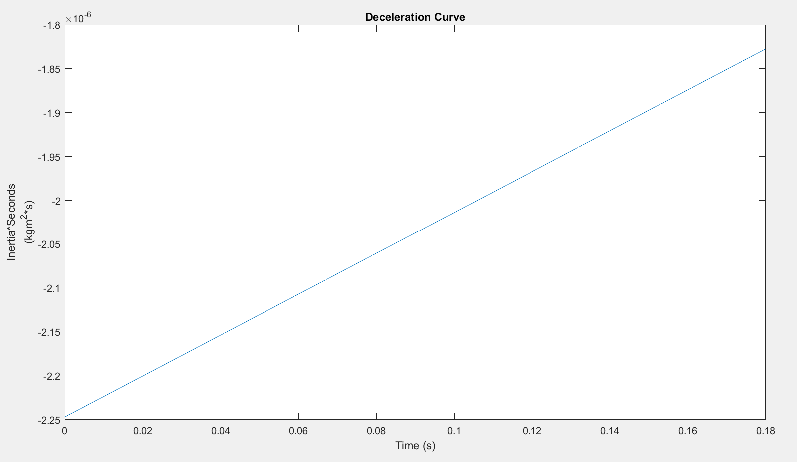


Parameter Identification Rotor Inertia (J) - Deceleration test of unloaded motor
J $=8.30 g{cm}^{2}$
Angular System with no external Torque:
$0=J\dot{ω}+Bω$
then:
$J is Slope of−\frac{B∗ω\left(t\right)}{\dot{ω}(t)} curve$
Power is cut to motor running constant velocity and velocity and acceleration is recorded as motor slows

Slide 5
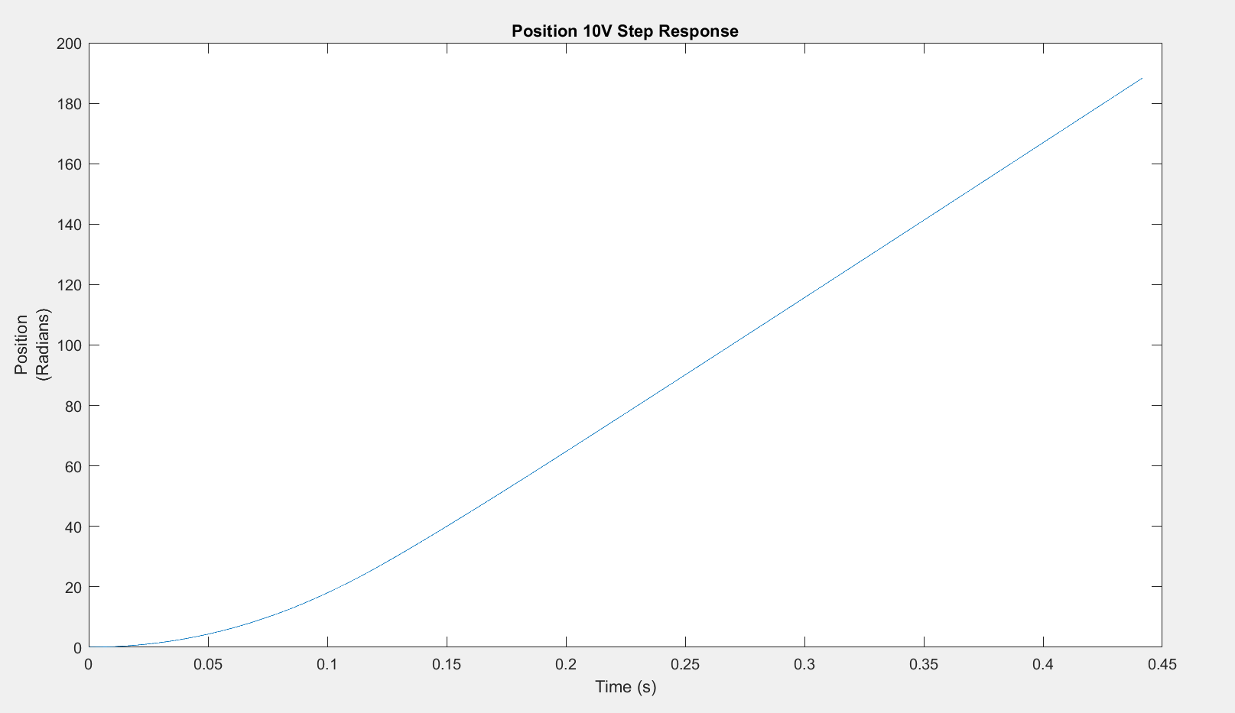
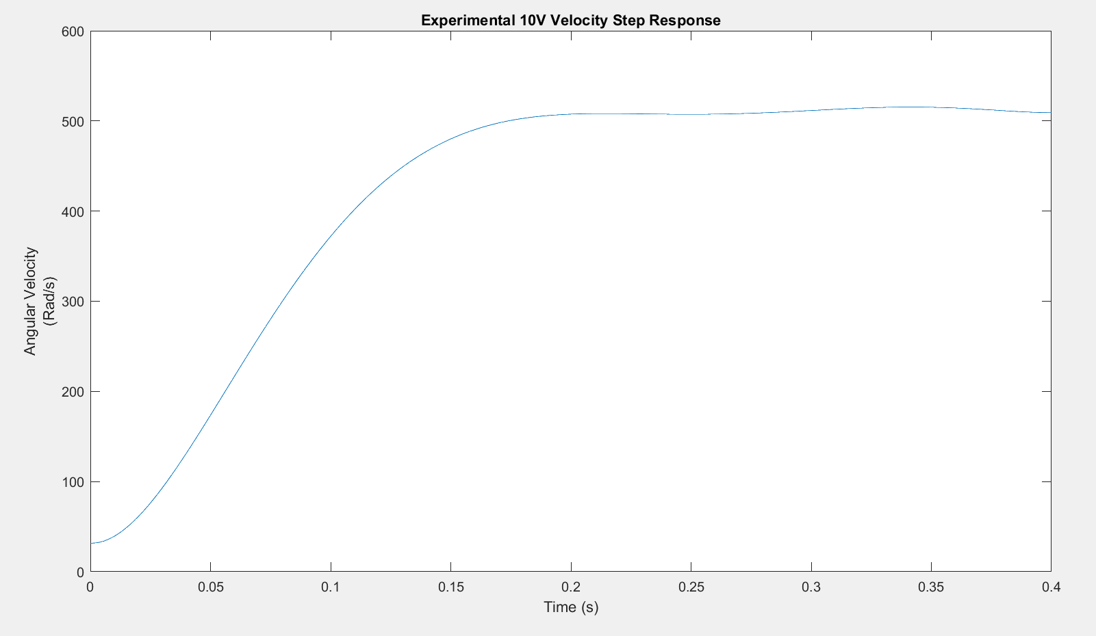

Experimental Step Response Curve Fitting
Step test is conducted by applying a 10V step voltage to motor and recording position of motor
The Velocity Step Response is obtained by differentiating the Position Step Response
Utilizing MATLAB's System Identification toolkit a transfer function can then be fitted to the Velocity Response
Transfer Function from Velocity Step Response
$\frac{ω(s)}{V(s)}\frac{2.702x{10}^{4}}{s^{2}+38.02s+531}$

Slide 6
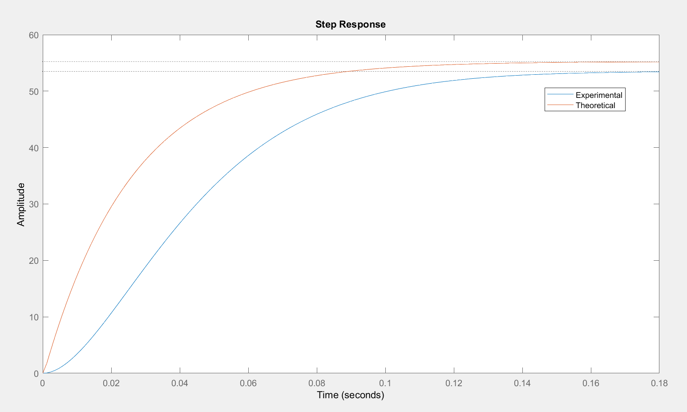
Model Verification – Step Response Comparison
Comparison between Experimental and Modelled Step Responses helps verify model accuracy
Possible Causes of Difference between Responses:
Static Friction is unmodeled
Accounts for initial delay of experimental response
Current Driver is unmodeled
Resistance/Capacitance/Inductance that could effect response

Slide 7
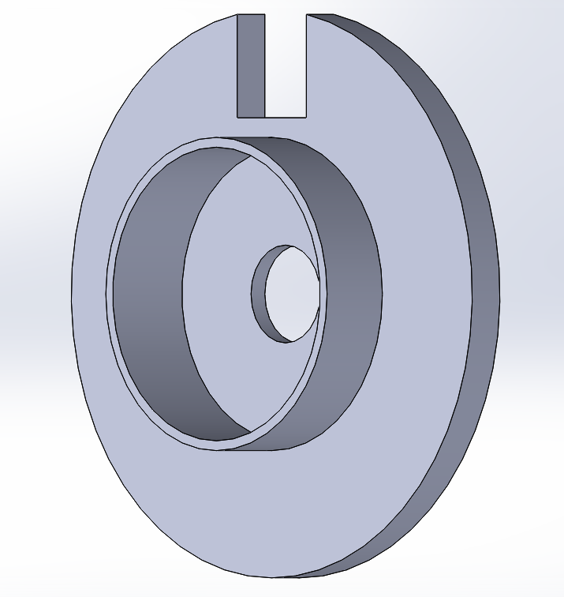
Encoder & Slot Detector Attachment
Fits directly onto face of Jameco Motor.
Slot Detector friction fitted into slot at tope of attachment
Advantages:
Usable with motor oriented vertically and horizontally
Reusable
Adjustable

Slide 8
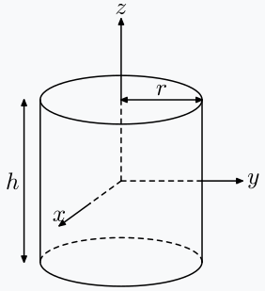
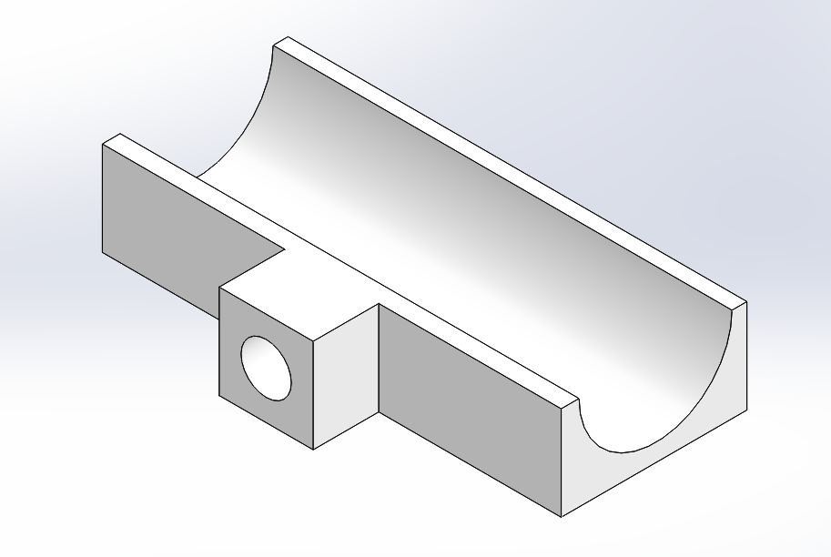

Mechanical System Model
Encoder Disk
Modelled as Cylinder rotating about it’s Z-Axis
Mass (m) calculated from Encoder Dimensions & density of FR4 (1.850 $\frac{g}{{cm}^{3}}$)
$J_{Encoder}= \frac{1}{2}∗mr^{2}=\frac{1}{2}∗\left(5.2719\right){\left(2.4\right)}^{2}=15.18 g{cm}^{2}$
Laser Diode Bracket
Modelled using SolidWorks Mass Analysis & density of PLA (1.25 $\frac{g}{{cm}^{3}}$)
$J_{Bracket}=0. 177g{cm}^{2}$
Laser Diode
Modelled as cylinder rotating its y – axis
Mass Measured at 2.00 grams
$J_{Diode}= \frac{1}{12}m\left(3r^{2}+h^{2}\right)=\frac{1}{12}∗\left(2.00\right){\left(3(0.7\right)}^{2}+{\left(2.1\right)}^{2})=0.98 g{cm}^{2}$

Slide 9
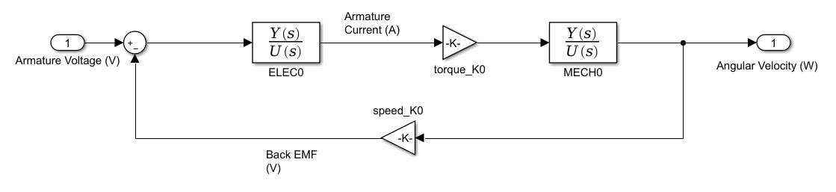
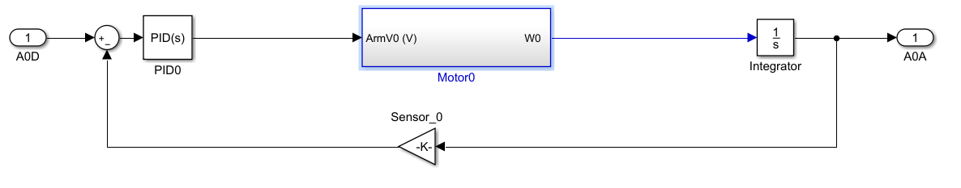

Simulink – Block Diagram + Kinematics
DC Motor Block
Allows for real time simulation of system
Builds transfer function blocks from measured parameters
Parameters in separate MATLAB files to allow for incremental and documented change
Single Degree of Freedom for Laser Diode with Constant $Y_{d}$
$\left(X_{d} , Y_{d}\right) ⇒ θ_{D}$
Inverse
$θ_{D}=atan\frac{X_{D}}{Y_{D}}$
Direct
$X_{A}=tan⁡(θ_{A}$)* $Y_{A}$
PID Control Block + DC Motor

Slide 10
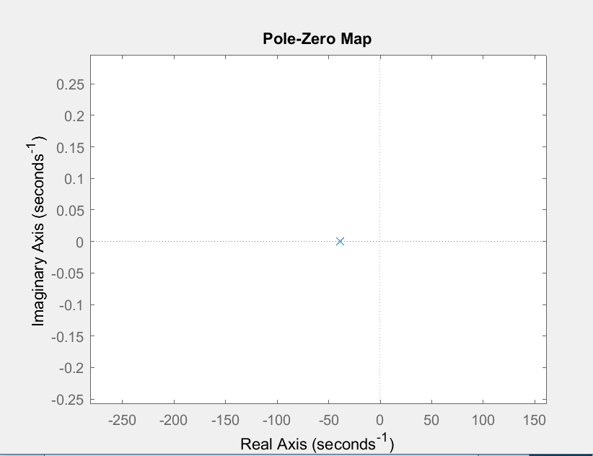
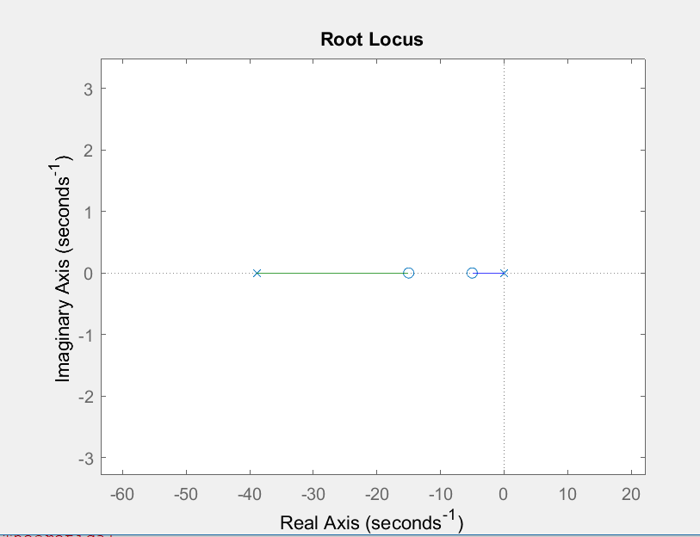

PID – PZ Plot & Zero Placement & Root Locus
PZ Plot
Additional Pole at S = -3000
Assuming contribution is negligible
Starting Zero Placement
(s + 5)(s+15)
Draw Pole at Zero to left for me stability
Draw Pole on the left to right for improved response time
No $K_{U}$
Starting Gains
$K_{D}=$0.0400
$K_{P}=$0.30
$K_{I}=$0.80

Slide 11

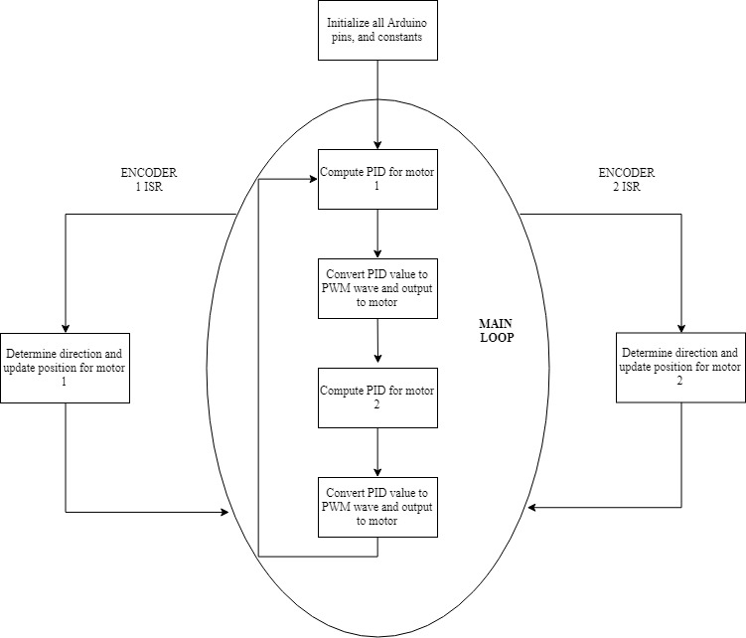



Program Block Diagram

Slide 12
PID Pseudocode
Record current program time
Calculate dt = time – last time
Calculate error = desired position – current position
Calculate de
IF Setpoint has changed since the last reading, de = -current position – last error
ELSE de = error – last error
Calculate total error = total error + error
Calculate output = kp*error + ki*total error + kd*de/dt
Constrain output between ±255 for Arduino
Store time, total error, and desired position for next calculation

Slide 13
Microcontroller Selection
Arduino Uno
Arduino Mega
Interrupt pins: 2
PWM pins: 6
RAM: 2kB
Readily available and easy to build PCB around
Interrupt pins:
PWM pins: 15
RAM: 8kB
Need to order in, challenging to build PCB around

Slide 14
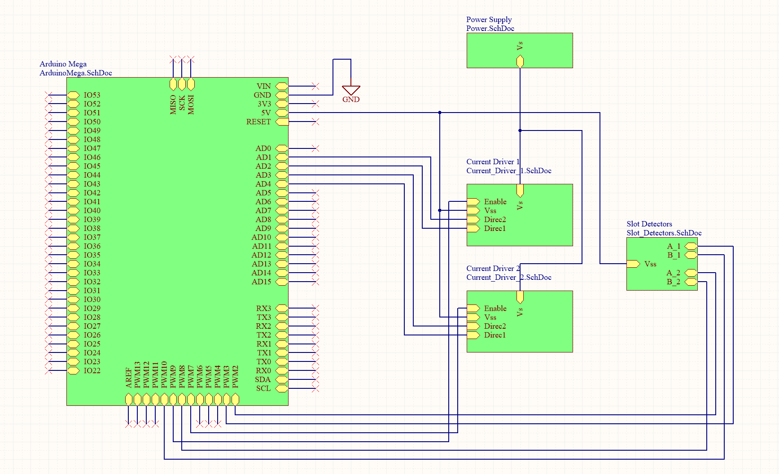
PCB Top Level Design

Slide 15
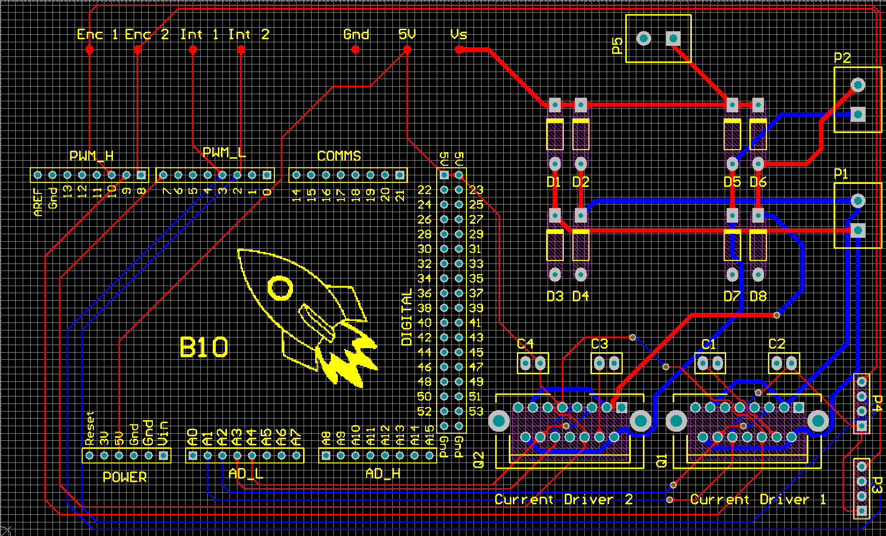
PCB Layout
All ground connections connected to polygon pour

Slide 16
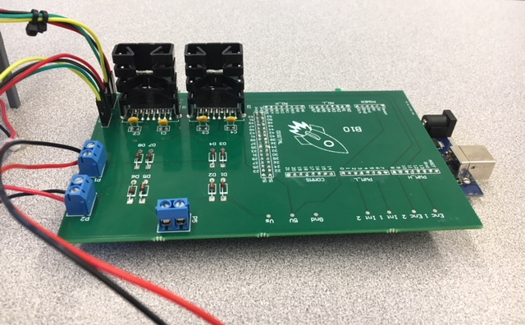
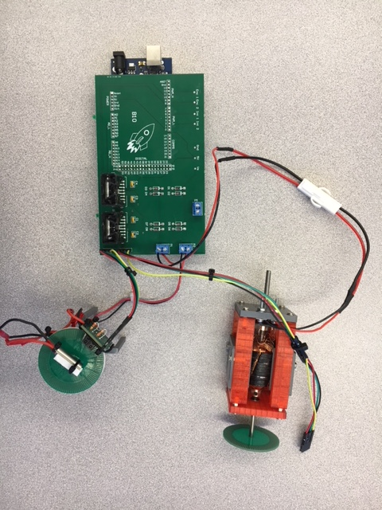
PCBA

Slide 17

Encoder ISR Pseudocode
ISR triggers on falling edge of Slot Detector A
Check state of Slot Detector B
If Slot Detector B is high, direction is forwards
Increment displacement (number of interrupts from initial position)
If Slot Detector B is low, direction is backwards
Decrement displacement
Convert displacement to radians:
$$Displacement_{rad}=Displacement∗\frac{3.6}{180}$$

Slide 18
PCB Future Improvements
Reduce noise from custom motor
Add mechanical cutout between motors
Replace ground plane with multiple small ground planes that don’t come near motors
Add capacitor across motor terminals
Add small inductors in series with motors to prevent large currents in one motor from affecting the other
Reduce size of PCB
Remove Arduino daughter board
Add additional power ports
Banana plugs, barrel connector

Slide 19
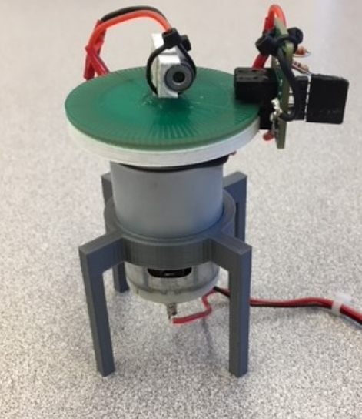
Summary
Currently Have Operational Real-Time Controlled 1-DOF System
Satisfactory Overshoot
Fully operational Parameter Acquisition Procedure
Accurate Model of System
Alpha Version of PCB designed and manufactured

