Slide 1
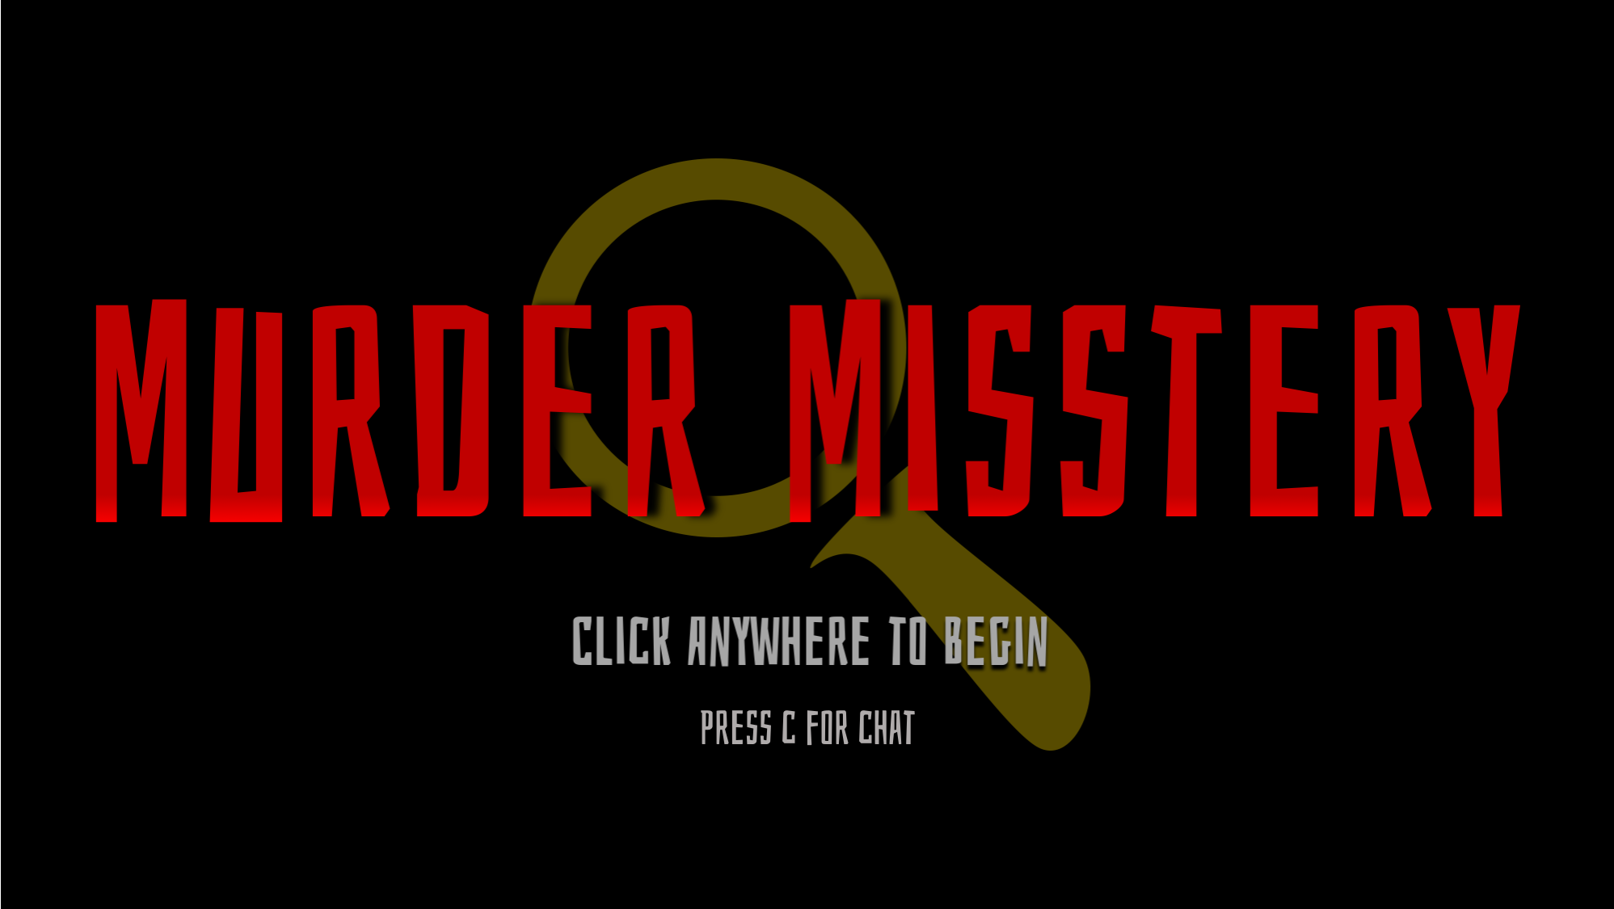
E

Slide 2
PRESS ‘X’ TO INTERACT
PRESS ‘Z’ TO EXIT
PRESS ‘X’ TO INTERACT
HI! I’m a church!

Slide 3
Town Hall
The Factory
The Church
The INN
The Murder Scene

