Slide 1

NOW 2.0 A/B Testing Results
May 2016

Slide 2
Process
3 members of the development team conducted A/B tests with a total of 9 Individuals
Each test participant was asked to pick a number between 1 & 10 in order to determine which design they saw first ( <= 5 – Design A)
Each participant was asked to go through “Get It” testing with each design and answer a few follow up questions afterward (2 Sentence Summary, Valuable for Job Responsibilities & Estimated Usage)

Slide 3
Design A - Observations
Users liked the Updates from your network but felt they didn’t belong there. (more my.ge.com)
Users Don’t Like Pop-ups (Duh)
Users aren’t sure what effect updating a answer will have
Navigation on the Answer page is strange (left/right and up/down)
Information presented is helpful, but hard to digest and the amount is overwhelming
Design doesn’t encourage interaction and commitment - high interaction cost, more like a traditional search. Type and pray
Didn’t like seeing reviews – faster to just check out the site
Users liked being able to personalize the offering
Users liked being able to opt-in and out of chat
Users liked the categories, once they understood them
Most interest was expressed in Best Answer and Expert
Not quite sure why the Best Answer is the Best Answer (Where did this come from?)

Slide 4
Design B - Observations
No Duplicates & No Outdated/Inaccurate Information struck a cord with users
Users ask: “What do the different colors mean when I type?” “How do I use that to build my query?”
Users feel it is a completely different way to search, but they state they are ok with fumbling through it the first couple of times
Users did a pretty good job exploring the different engagement points (why is this so big, help us map, etc)
Users generally liked the idea of being able to help map GE – one even thought it was fun
Liked having other options than Chat, in addition to it
Users liked being able to narrow down to the right answer by answering follow-up questions
Most Users claim they would use the modify assumptions hover boxes
User’s would like a “Don’t Know” Option when answering questions
Users thought the “Why we picked this answer” facts would be valuable in order to have an intelligent conversation with the expert
“Gets you where you need in order to do work” – nice!
Want to see the source of the information being presented
Want to be able to confirm they found the right answer (help more)
Users aren't sure the effect changing assumptions will have (New search? New page?)
Users who skip the web presence are not clear what the offering does

Slide 5
Overall Observations
Users are afraid of the chat disrupting their day
Users are afraid of being the answer
Users liked the additional information in Design A (Alec) but were overwhelmed by it – needs a reorganization or allow users to dig for additional info.
Users have mixed feelings on the chat. Those who do like it don’t want it to be in the browser (lots of tabs, not another tool)
Users also had mixed feelings about seeing chat logs as answers. Cool & Creepy
Users aren’t sure about editing content. They seem to feel like it might not be their place or they don’t have the authority to do so
Users want to see what else a person knows besides what they were the expert in that made them the answer
Users want to see Experts 2nd
AnswerForge (Design B) gave the impression it would get the user to the right answer
Users had higher confidence using it
Users saw a higher potential payoff for their interactions (interaction cost)
Testing showed it will be hard to establish trust that this is the right answer on “first load”
Users like having information presented to them that they would normally have to browse further to see (Search as a Browser)

Slide 6
Issue Learning Curve
Design doesn’t encourage interaction and commitment - high interaction cost, more like a traditional search. Type and pray (Design A)
Users feel it is a completely different way to search, but they state they are ok with fumbling through it the first couple of times (Design B)
Users did a pretty good job exploring the different engagement points (why is this so big, help us map, etc) (Design B)
Users who skip the web presence are not clear what the offering does (Design B)

Slide 7
Issue Information Architecture
Information presented is helpful, but hard to digest and the amount is overwhelming (Design A)
Users liked the categories, once they understood them (Design A)
Most interest was expressed in Best Answer and Expert (Design A)
Not quite sure why the Best Answer is the Best Answer (Where did this come from?) (Design A)
Didn’t like seeing reviews – faster to just check out the site (Design A)
Users ask: “What do the different colors mean when I type?” “How do I use that to build my query?” (Design B)
Want to see the source of the information being presented (Both Designs)
Users thought the “Why we picked this answer” facts would be valuable in order to have an intelligent conversation with the expert (Design B)
Users liked the additional information in Design A (Alec) but were overwhelmed by it – needs a reorganization or allow users to dig for additional info.
Users want to see what else a person knows besides what they were the expert in that made them the answer
Users want to see Experts 2nd
Users like having information presented to them that they would normally have to browse further to see (Search as a Browser)

Slide 8
Issue Community Driven
Users aren’t sure what effect updating a answer will have (Both Designs)
Users liked being able to personalize the offering (Both Designs)
Users liked being able to opt-in and out of chat (Both Designs)
No Duplicates & No Outdated/Inaccurate Information struck a cord with users (Design B)
Users generally liked the idea of being able to help map GE – one even thought it was fun (Design B)
Users aren't sure the effect changing assumptions will have (New search? New page?) (Design B)
Users have mixed feelings on the chat. Those who do like it don’t want it to be in the browser (lots of tabs, not another tool)
Users also had mixed feelings about seeing chat logs as answers. Cool & Creepy

Slide 9
Issue Getting Information From Users
Users Don’t Like Pop-ups (Duh)
Users liked being able to narrow down to the right answer by answering follow-up questions
Most Users claim they would use the modify assumptions hover boxes
User’s would like a “Don’t Know” Option when answering questions
Want to be able to confirm they found the right answer (help more)
Users aren't sure the effect changing assumptions will have (New search? New page?)
Users aren’t sure about editing content. They seem to feel like it might not be their place or they don’t have the authority to do so

Slide 10
Issue Trust, Fear and the NOW Way
Users are afraid of the chat disrupting their day (Both Designs)
Users are afraid of being the answer (Both Designs)
Testing showed it will be hard to establish trust that this is the right answer on “first load”

Slide 11
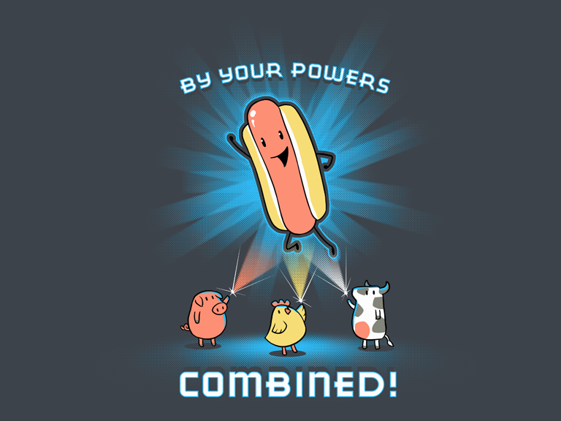
Results Sketching Workshop (Remote Edition)

Slide 12
Questions From Design Assessment Results
Users are afraid of being the answer. How can we address/positively spin and mitigate the fear of increased commination?
Users like the “Search as a Browser” approach. Can we leverage this more?
Users liked the updates from their network feature, but felt it doesn’t belong in this offering. What do we do?
Popups are out (duh) How can we make answering questions more engaging?
Tell me how many questions I would have gotten
Tell me how many conversations have been avoided because I am awesome
Continue to push the “Community Driven” persona
Users like the idea of Community Driven Information because they believe it will help their main concern (outdated/inaccurate information) but no one wants to do the updating because:
Not my place or I don’t have the authority
Who is to say I actually have the Best Right Answer or mine is better that what is already there
Not sure what effect my update will have (where does it go?)
Users like being able to choose between the best “thing” and the best “person”. How does this influence our design/process?
Users who found the personalization settings trusted/were more comfortable with the solution. How can we make everyone feel that way?

Slide 13
Questions From Design Assessment Results
Users want to help make GE better. How can we use that to help make NOW better? How to we leverage that driver?
NLP is cool, Modifying Assumptions is cool, Traverse Answer Structure by Q&A is cool, Searching by Knowledge Dump is cool. All are different than traditional search and there is a learning curve. How can we decrease that learning curve?
Users liked the in depth information of Alec, but found it overwhelming and hard to digest. How can we improve?
Trust that we have presented the right answer to the user is hard to establish. How can we improve trust our offering is sending the user in the right direction from the very first search they conduct?
Users liked being able to modify assumptions, but the users aren’t able to predict what effect that modification will have.
Users who skip the AnswerForge web presence have a hard time determining what the system does. How can we improve this?

Slide 14
Design A - Max
Design B - Craig
Drill Down Questions – with graphical related information links
Hey Did You Know – Lower Importance
Edit In Place (Crowd Source)
Low important on Expert, More on Answer
Show Reviews (Included as Related Information)
Community Driven (Action Based)
Offset Fear: Response Score – Drive traffic to the people who actually want to answer
Real-Time “Did you mean” syntax highlighting (Learning Curve Reduction)
Mapping information and Previous search quality information through - Chat-Driven Search
Established Trust in Answer
Same Aesthetics – (White background answer page. Primary Color: Green, Secondary: Blue, Third: Grey. Homepage Solid Primary Color)
Just Drill Down Questions
Hey Did you know – Higher Importance
Submit Improvement
Answer & Expert – Equal Weight
No Reviews
Community Driven (Theme)
Offset Fear: Show Benefits and give user control to stop questions
Real-Time Syntax Highlighting with on-click modifications (Feedback Capture)
Current AnswerForge Approach to Mapping Information, In-app approach for previous search quality – ONLY if I can make it very different from chat
Established Trust in Answer
Same Aesthetics – (White background answer page. Primary Color: Green, Secondary: Blue, Third: Grey. Homepage Solid Primary Color)

Slide 15
Test Scenarios
Searching for a person who has recently changed jobs (Max Scenario)
General Person Search
Previous Search (Asking how it went)
Not A Person – How do I migrate an application to AWS at GE?
Answer is CoreTech Public Cloud Services
Answer is totally wrong/Inaccurate/outdated – Holiday Schedule for last year
Does the user: Improve/Edit Answer/Review
Answer is incomplete – The Badging example (we know your site, but not others)
Does the user: Improve/Edit/Review

