Slide 1
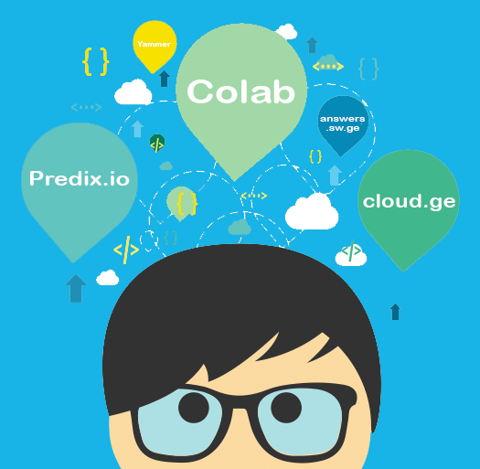
GE DC Personas
Craig Graham
UX/UI Engineer

Slide 2
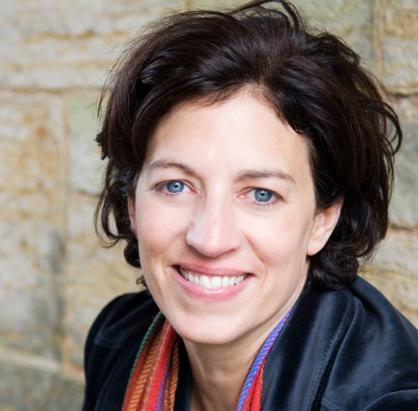
About Joanna:
Joanna is a manager of well-size, focused and highly dedicated group of software engineers working on the next iteration of internal, supplier & customer portals for Aviation. As a result she has to be able to keep up with an ever changing landscape of requirements, new technologies and regulations in order to effectively lead and advocate for her team. With her busy schedule it is hard to find time to do a lot of independent research and frustrating to have to put everything she reads “in the context of GE” when does have a free moment.
Joanna Johnson
Behavioral Considerations:
Age: 34
Location: Charlottesville, NC
Tech Exp: Moderate
Position: Aviation Strategic Innovations Leader
Joanna cares about her success and the success of her direct reports, so finding the resources necessary for her team’s success is critical
While technical, Joanna is also very business knowledgeable and benefits from training materials which balance the two
Joanna is proud of her teams accomplishments to date
Goals:
“I want to keep my team successful and establish them as technical leaders in the ever-changing GE Software Landscape”
Wants to be able to get her team connected with the information & contacts the will need in order to be successful in the ever-changing GE Software landscape
Wants to promote the good learning’s of her team within GE
Tasks:
Identify resources that can help guide the overall, high-level direction of her team’s efforts
Frustrations:
Annoyed when she cannot get her team what they need in order to be successful
Frustrated when information is not clearly accessible, doesn’t like to “play a game” to get critical information

Slide 3

About Marty:
Marty is a fresh Computer Science graduate at his first full time job as a Software Engineer. He is a wiz in his area of expertise, but now has the challenge of translating and applying that knowledge within the scope of his responsibilities here at GE. He has been brought on a mostly business-centered team and works heavily with GE Contractors.
Behavioral Considerations:
Marty Marne
Marty is motivated to succeed at GE
Marty has little experience navigating the GE Environment
Marty is an “isolated developer” working on a mostly business-specific team and at a remote facility.
Marty is experienced with Non-GE approaches to learning and exploring new technology and has the expectation he will have similar experiences here.
Age: 23
Location: Bucyrus, OH
Tech Exp: Moderate/High
Position: Software Engineer
Goals:
“ Where is the GE Software Developer Quick-Start Readme file?”
To become familiar with the GE Software Development Landscape as quick as possible
Make valuable connections which actually result in beneficial interactions with more experienced coworkers outside his geographical area.
Learn how he can take advantage of the best GE has to offer within the scope of his own responsibilities.
Tasks:
Find the information he needs in order to get started developing custom applications at GE
Frustrations:
Annoyed by the Sunday/Monday Line
Frustrated when information is available that seems like it logically should be

Slide 4
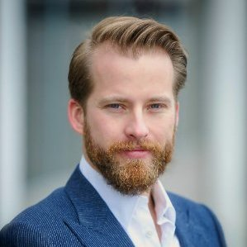
About Curtis:
Curtis is a long-time GE employee with a wealth of contacts within GE Digital, especially at his site. Over his tenure, Curtis has shown that he is able to quickly adapt to new initiatives and technologies as they are adopted by GE. He is the go-to-guy for software development questions within his circle of influence, a title he is proud to carry. In his spare time he works on one of several personal technology projects related to what he does at GE.
Curtis Crim
Behavioral Considerations:
Very committed to technology and works hard to understand the benefits of each new technology he encounters
Extremely technical and personable – likes to be the expert others turn to
Knows where to go in order to get the information he needs in order to be successful.
Age: 36
Location: ISTC, VA
Tech Exp: High
Position: Systems Engineer
Goals:
“There is a lot of knowledge and useful tools at GE, but no effective way of connecting them all”
Continue to establish himself as an expert in his realm of expertise
Share his findings with others who might not have the opportunities to connect he enjoys at a GE Tech Center
Continue to learn how GE is taking advantage of the new offerings they are implementing
Tasks:
Publish training material based on learning's which are important to him
Connect with individuals who could provide valuable information
Frustrations:
When the reasoning for using a particular offering is not made clear or does not make sense based on what he knows of the GE Landscape

Slide 5
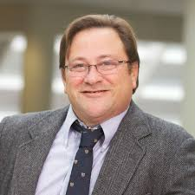
About Leonard:
Leonard has been a software developer for over 20 years, 15 of which he has spent at GE. He now develops on several high visibility projects in Corporate where he is considered a “Pillar of Knowledge”. Leonard is not thrilled about being forced into using a particular methodology or offering in order to fulfill his job responsibilities. He is very knowledgeable, but he is not the type you nominate for an Intern’s AL
Leonard Scotts
Behavioral Considerations:
Likes to get right to the point, dive into the code and work independently
Does not tolerate mistakes
Struggles to explain technical achievements in business terms
Would much rather do thank explain or teach
Age: 44
Location: Governor Hill
Tech Exp: High
Position: Sr. System Architect
Goals:
Obtain the minimum amount of information/knowledge necessary in order to complete his minimum job requirements
Get to “the code” as fast as possible
“Lets just get this over with, it will change in 3 months anyway”
Tasks:
Same as goals – who has time for this!
Frustrations:
Having to jump though hoops to get the job done
Being forced to do something that might not (at first glance) seem that different from what we are doing before
Not seeing the benefits to new approaches and being told to do them without specific direction and adequate resources.

