Slide 1

MyApps UX Study
Craig Graham
UX/UI Engineer

Slide 2

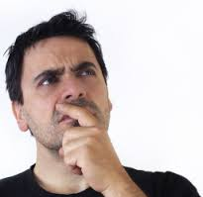

Why Conduct a UX Study?
Adoption of MyApps has Plateaued
MyApps has a Branding/Brand Image Problem
No single factor has led to the plateau

Slide 3
What Do We Want to Find Out?
Could we raise adoption of MyApps by developing additional functionality?
What are the most used/demanded remote access features at GE which MyApps doesn’t have today?
Are there GE users whose needs would be completely met by MyApps, but they have not adopted MyApps?
Branding Problem?
Uniformed Users?
User Reach?
Have the requirements for remote access tools at GE changed?

Slide 4

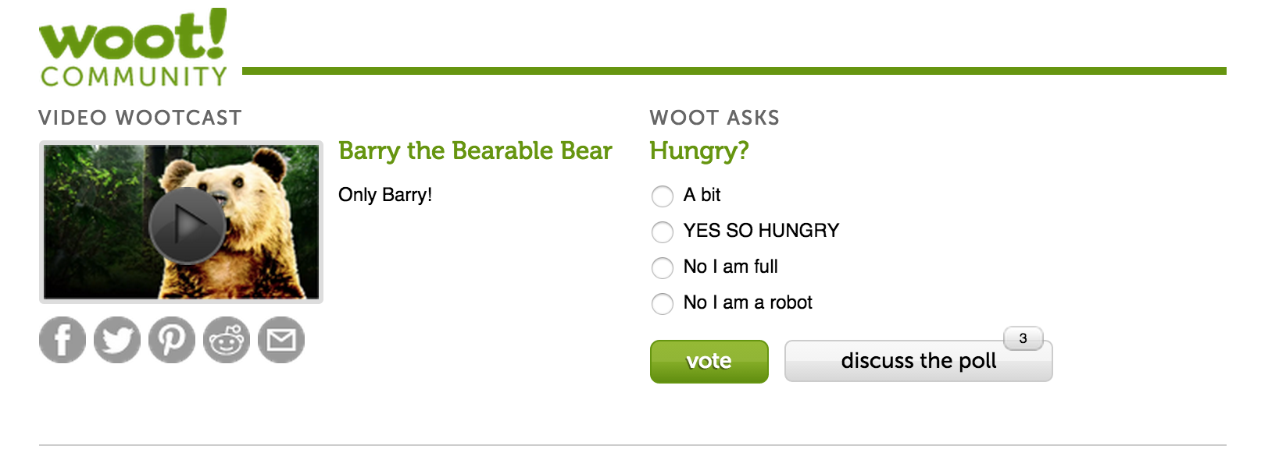
How Do We Find the Answers?
Redesign MyApps Web Presence
Re-evaluate Branding
Improve user access to information
Improve information data architecture
Increase feelings of legitimacy
Drive Excitement through re-launch
Think any Apple product ending in ‘s’
Use Design Assessments to drive feature discussion
Suggested Improvements
URL Compatibility Checker
Collect analytics
Increase User Awareness
Incentivize Application Owners
System Requirements Checker
Single Poll Question
MyApps 2.0s
URL is MyApps Compatible!!

Slide 5
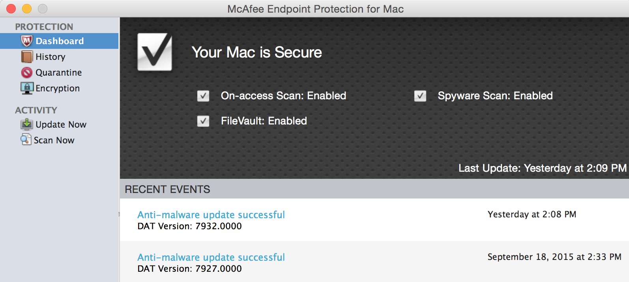
How Do We Find the Answers?
Create Desktop Dashboard
Improve Visibility to MyApps Functionality
Increase Legitimacy
Increase Customer Reservoir of Goodwill
Increase Customer Awareness to MyApps System Status
Reduce/Remove unfair blame
Suggested Features
System Status and Applicable Metadata
Speed, Traffic, Applications Running on MyApps, MyApps Idle (on GE Network), etc
Error Conditions
Infrastructure failures, others?
FAQ’s, About US, Contact Us, Help Ticket
MyApps Is Currently Awesome

Slide 6
How Do We Find the Answers?
Conduct Community Outreach
Deploy Interviews
Talk with users who have never installed and used MyApps
Talk with users who installed MyApps and stopped using it
Talk with users who currently use MyApps
Questions to ask
How long have you worked for GE?
Have you heard of MyApps?
When you Downloaded MyApps What Was Your Perception of MyApps Functionality?
Missing Functionality?
Perception of MyApps Brand?
Intended usage of MyApps?
After work email/All day GE Network Access(WFH)
What Sites would you like to see supported by MyApps?
Use MyApps for Global Tier Applications or Business Specific Apps?
When something goes wrong with MyApps, what do you wish you could do in order to resolve the issue?
Do you know which sites are supported by MyApps or how to find that information if you wanted to?
What is your Job Function? (IT, Services, Sales, HR, etc…)

Slide 7
How Do We Find the Answers?
Splunk & SiSense Analytics Data
Can we develop useful reports on:
What are users requesting that we aren’t providing?
Is there a category of applications/websites users want access to most that we should be providing?
How much time are users on MyApps?
Is the primary usecase just checking your email at home after work or carrying out a full days work via MyApps?
What Services/Applications are MyApps users accessing the most?
Help build out our understanding of the primary usecase for MyApps
What Services/Applications are GE Internal users accessing the most?
Comparing to MyApps Most used would identify MyApps shortcomings
Who is using MyApps?
This will help identify which users MyApps is yet to reach and define our primary user
How Many Users Have Uninstalled MyApps?
Help us determine if retention is an issue?

Slide 8
Want to Help? – Great!
Volunteer your time to complete quick design assessments of mockup interfaces
Help Collect Data where possible
Identify Potential Design Assessment Participants
Help Answer: “Is this functionality reasonable?” questions
Ex: “Can we detect which applications on a computer are currently using MyApps?”

Slide 9
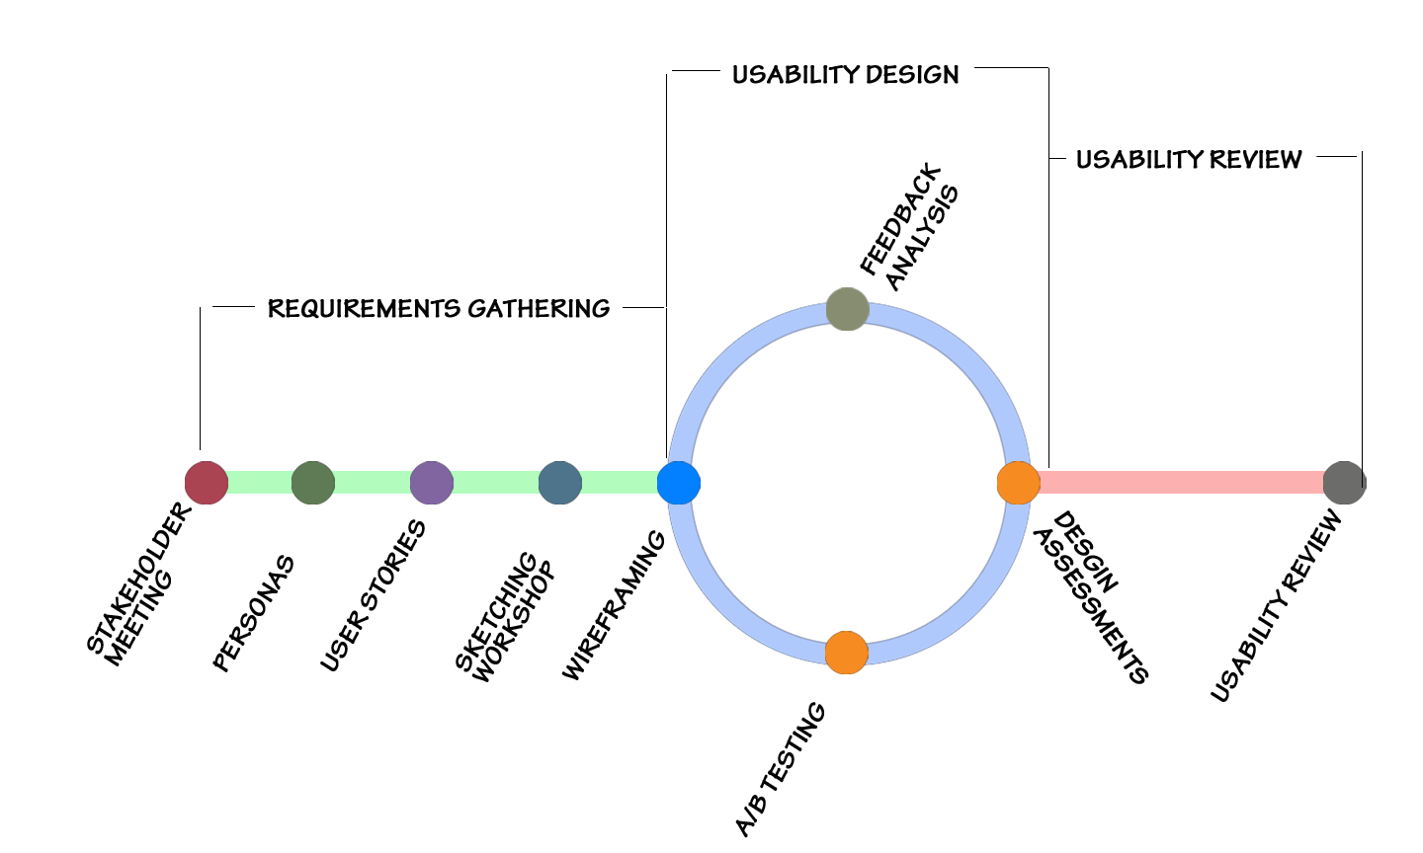
Our Common Approach

