Slide 1
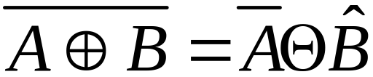
Homework 7 (Due:4/28 )
Show that

